Slide 1
The necessity of a basic materials research community for the accelerated development of SRF materials.
Shreyas Balachandran¹ , Peter J. Lee¹ , Wenura Withanage¹ , Lance D. Cooley¹ , Thomas R. Bieler²
1 ¹Applied Superconductivity Center, National High Magnetic Field Lab, Tallahassee, FL 32309
²Chemical Engineering and Material Science, East Lansing, MI 48824-1226.

Slide 2
Basic materials research is important for High Q and High Gradient Frontiers- Nb and beyond.
High Q Frontier
High Gradient Frontier
General Accelerator R&D RF Research Roadmap Workshop Report
https://www.osti.gov/servlets/purl/1631119/
2/17/2021- Snowmass AF-7- Subgroup RF

Slide 3
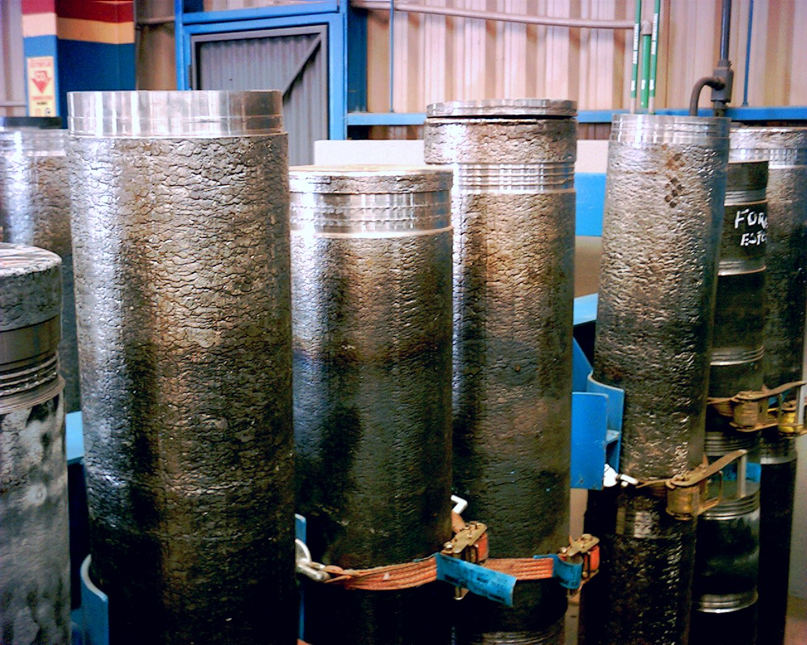
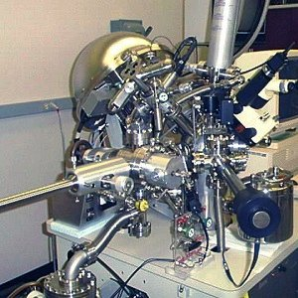
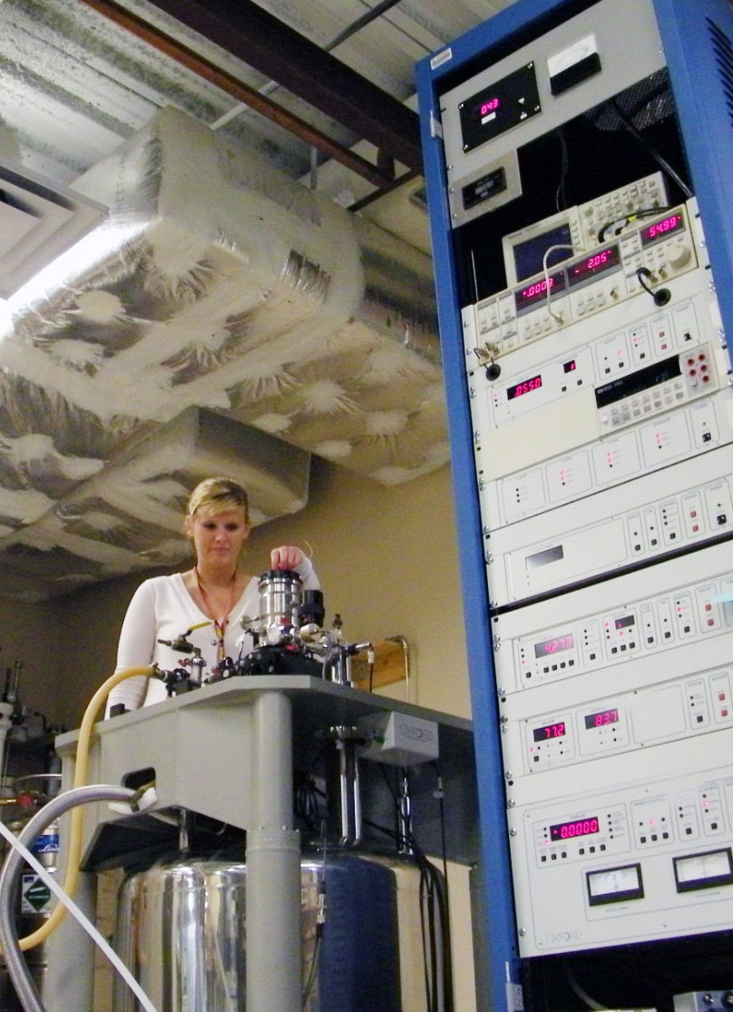
Improving SRF cavity performance requires expertise in a wide variety of materials issues
Materials Science
Billet fabrication
Metal forming
Microstructure
Microchemistry
Surface science
Surface chemistry
Surface topology
Thin films
Superconducting properties
2/17/2021- Snowmass AF-7- Subgroup RF

Slide 4
Coupon sample testing and their relevance to the GARD RF Research Roadmap.
2/17/2021- Snowmass AF-7- Subgroup RF

Slide 5
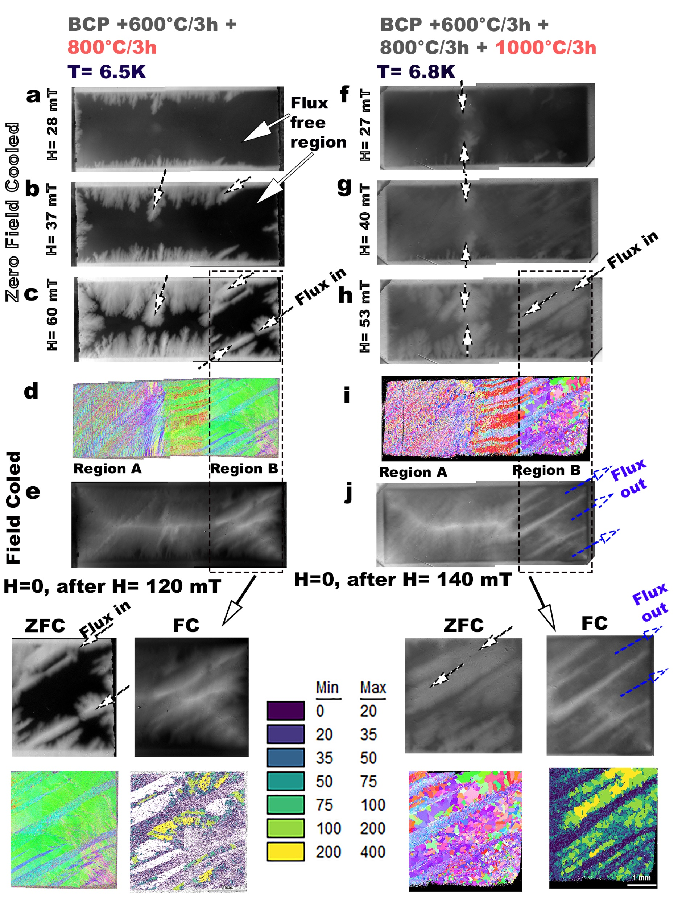
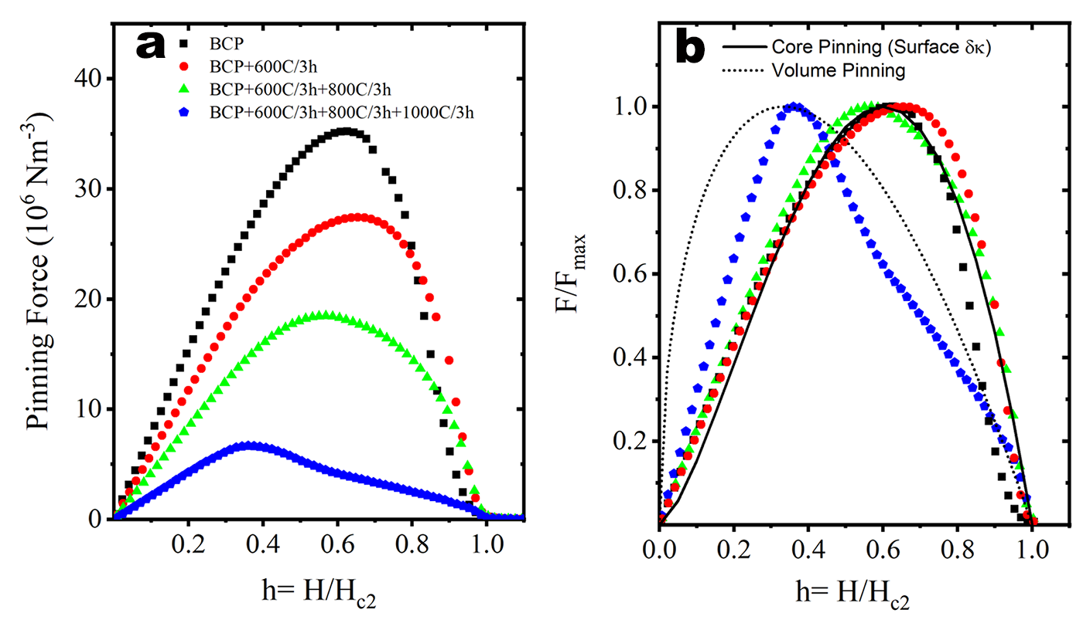
Understanding of bulk and surface structures of Nb applicable to High Q Frontier- Flux trapping and expulsion.
Shift
Reduction
DC magnetization measurements on Nb coupon samples with different heat treatments. Pinning density decreases with increase in heat treatment temperature, pinning mechanism also changes.
Paying attention to Recrystallization and Annealing processes in Nb are necessary to reduce flux trapping and improve expulsion.
S. Balachandran et al, accepted for publication in Sci. Reports
2/17/2021- Snowmass AF-7- Subgroup RF

Slide 6
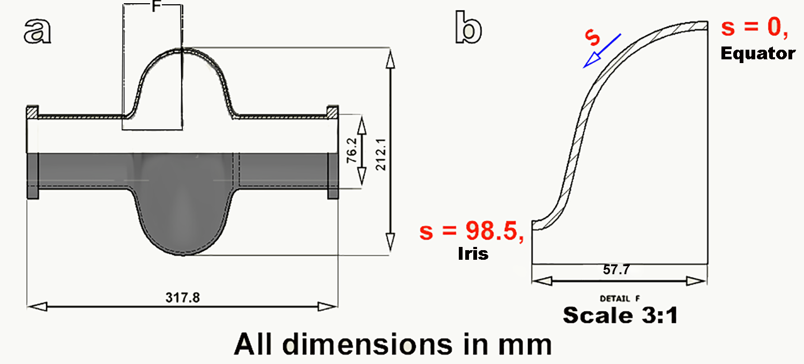
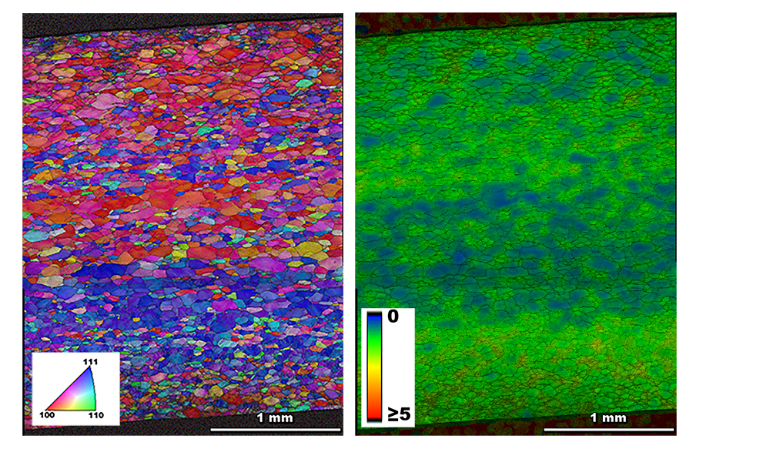
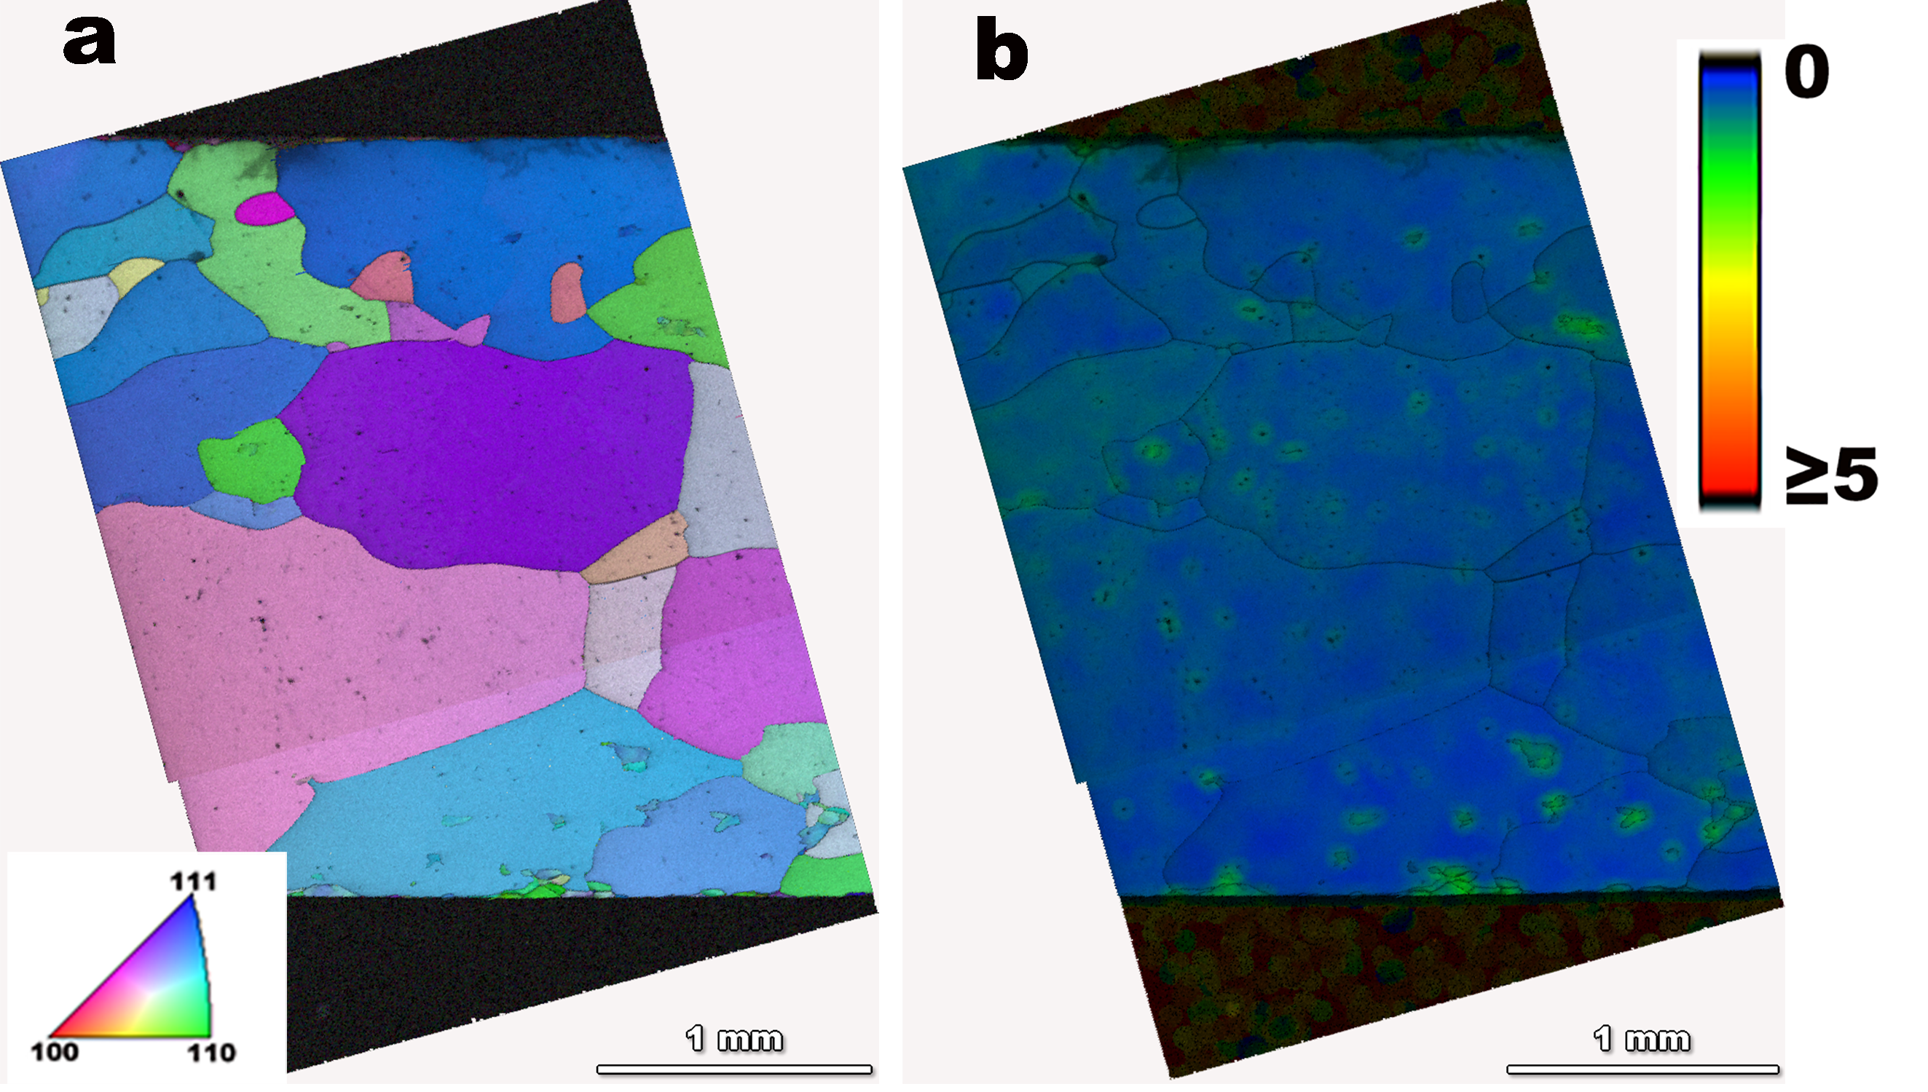
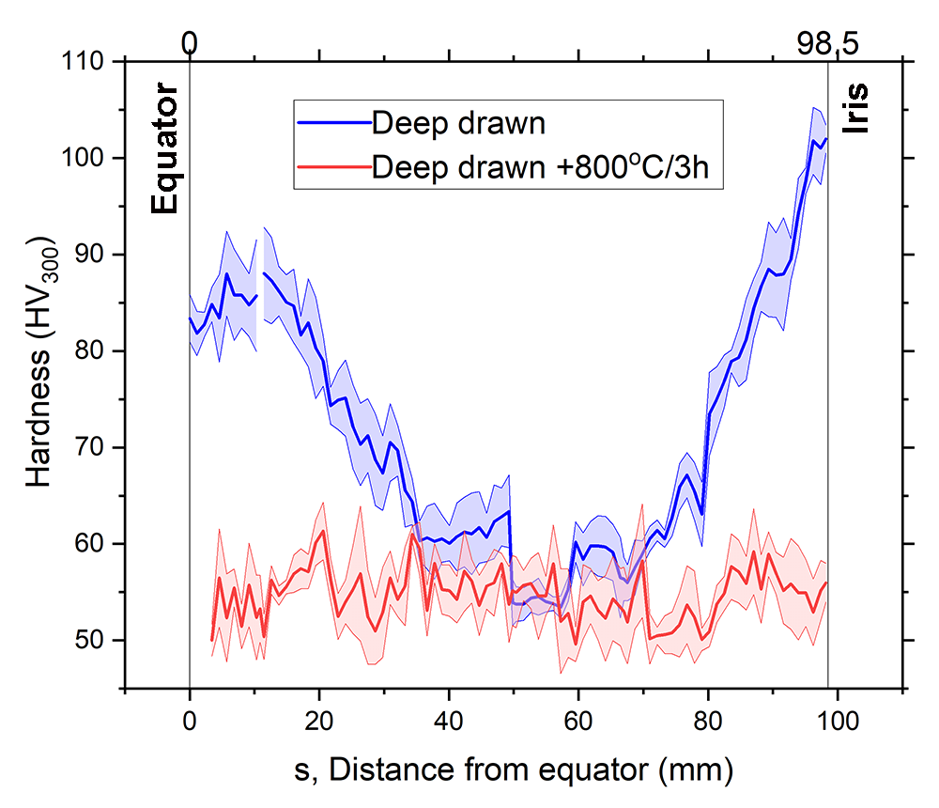
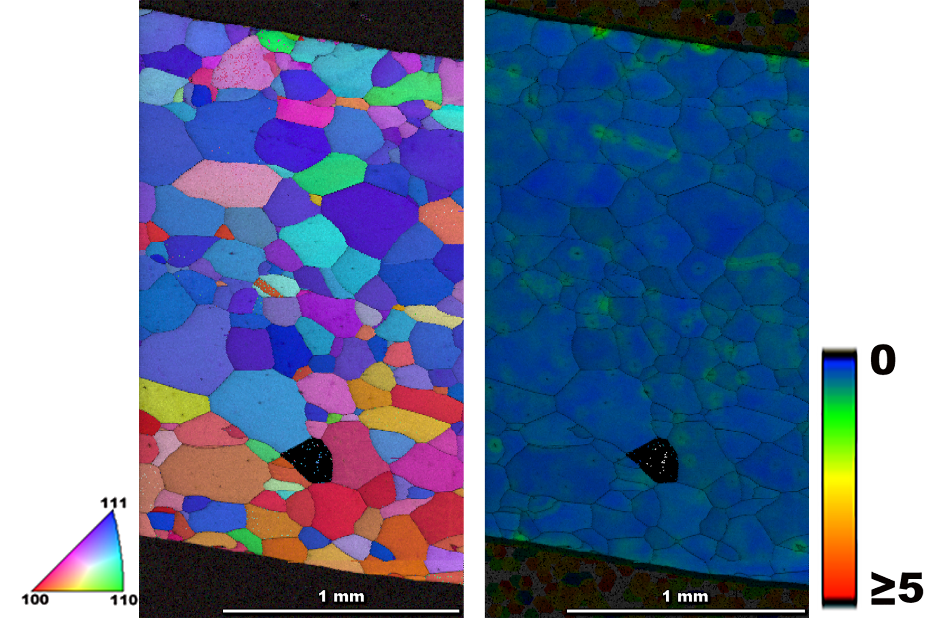
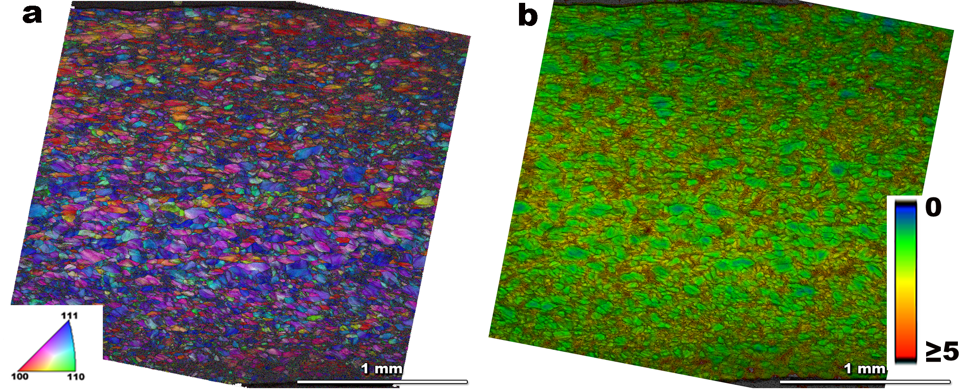
Microstructure of SRF Nb after cavity deformation and annealing depends on location after heat treatments.
Equator After deformation
After deformation + 800°C/3h
Hardness along the half cell cross-section indicates Nb is strained differently along the cavity profile during manufacture.
After deformation + 800°C/3h
Iris After deformation
Unpublished. Manuscript in preparation
2/17/2021- Snowmass AF-7- Subgroup RF

Slide 7
Microstructure of bulk SRF Nb to eliminate flux trapping- R&D need for next five years
Tuning the microstructure of the as received sheet by working with vendors on up stream processes are needed.
Access to intermediate sheet material from cavity vendors.
R&D on intermediate sheets that can lead to cavity fabrication and testing
Specify necessary changes to specifications of sheet material beyond current specification.
There are possibilities to have a higher strength material which expels flux easily.
2/17/2021- Snowmass AF-7- Subgroup RF

Slide 8
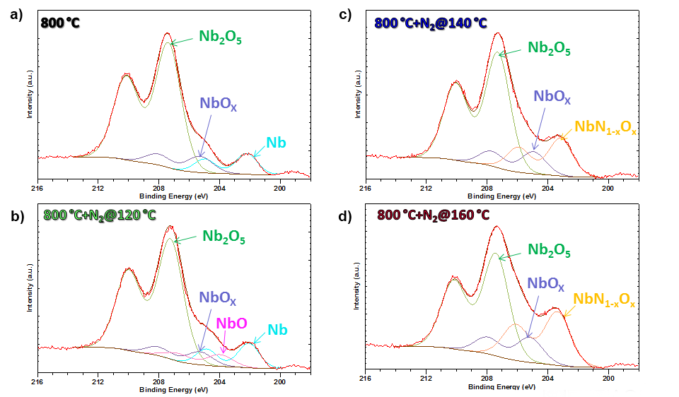
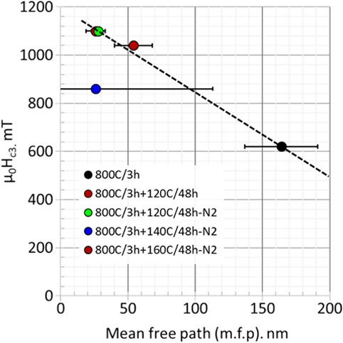
Surface studies without altering the SRF layers
Angle resolved XPS
Dhakal, P., Chetri, S., Balachandran, S., Lee, P.J. and Ciovati, G., 2018. Effect of low temperature baking in nitrogen on the performance of a niobium superconducting radio frequency cavity. Physical Review Accelerators and Beams, 21(3), p.032001.
Push towards increasing infrastructure and capacity of X-ray analysis for the community in next 5 years. Explore surface spectroscopy techniques beyond X-rays in long term. IR spectroscopy?
Comparison of surface critical field H_{c3} measured on cylindrical coupon samples versus m.f.p calculated from R_{s} fit to the Q versus E curve from TJAF cavity RDL-02 indicates a linear trend.
2/17/2021- Snowmass AF-7- Subgroup RF

Slide 9
ECCI imaging developed for Nb by MSU for SRF applications ( $ρ$~ ${10}^{12} to {10}^{13}$ $m^{−2}$ )- A TEM alternative, applicable to other SRF materials?
This is a lower bound of dislocation density estimation since:
Not all dislocations are visible in a single ECCI image due to invisibility criteria
Dislocation lines that are not perpendicular lead to underestimate of dislocation density
Mingmin Wang, MSU (now at SLAC)
MS&T 2018
grain 9
g=(-200)
grain 9
g=(-200)
grain 9
g=(-200)
grain 10
20 μm
5 μm
5 μm
Dislocation density:
$$ρ=2×{10}^{13}$$
$$ρ=4×{10}^{12} m^{−2}$$

Slide 10
Beyond Nb… Nb₃Sn, V₃Si, Iron pnictides, surface structures?
2/17/2021- Snowmass AF-7- Subgroup RF

Slide 11
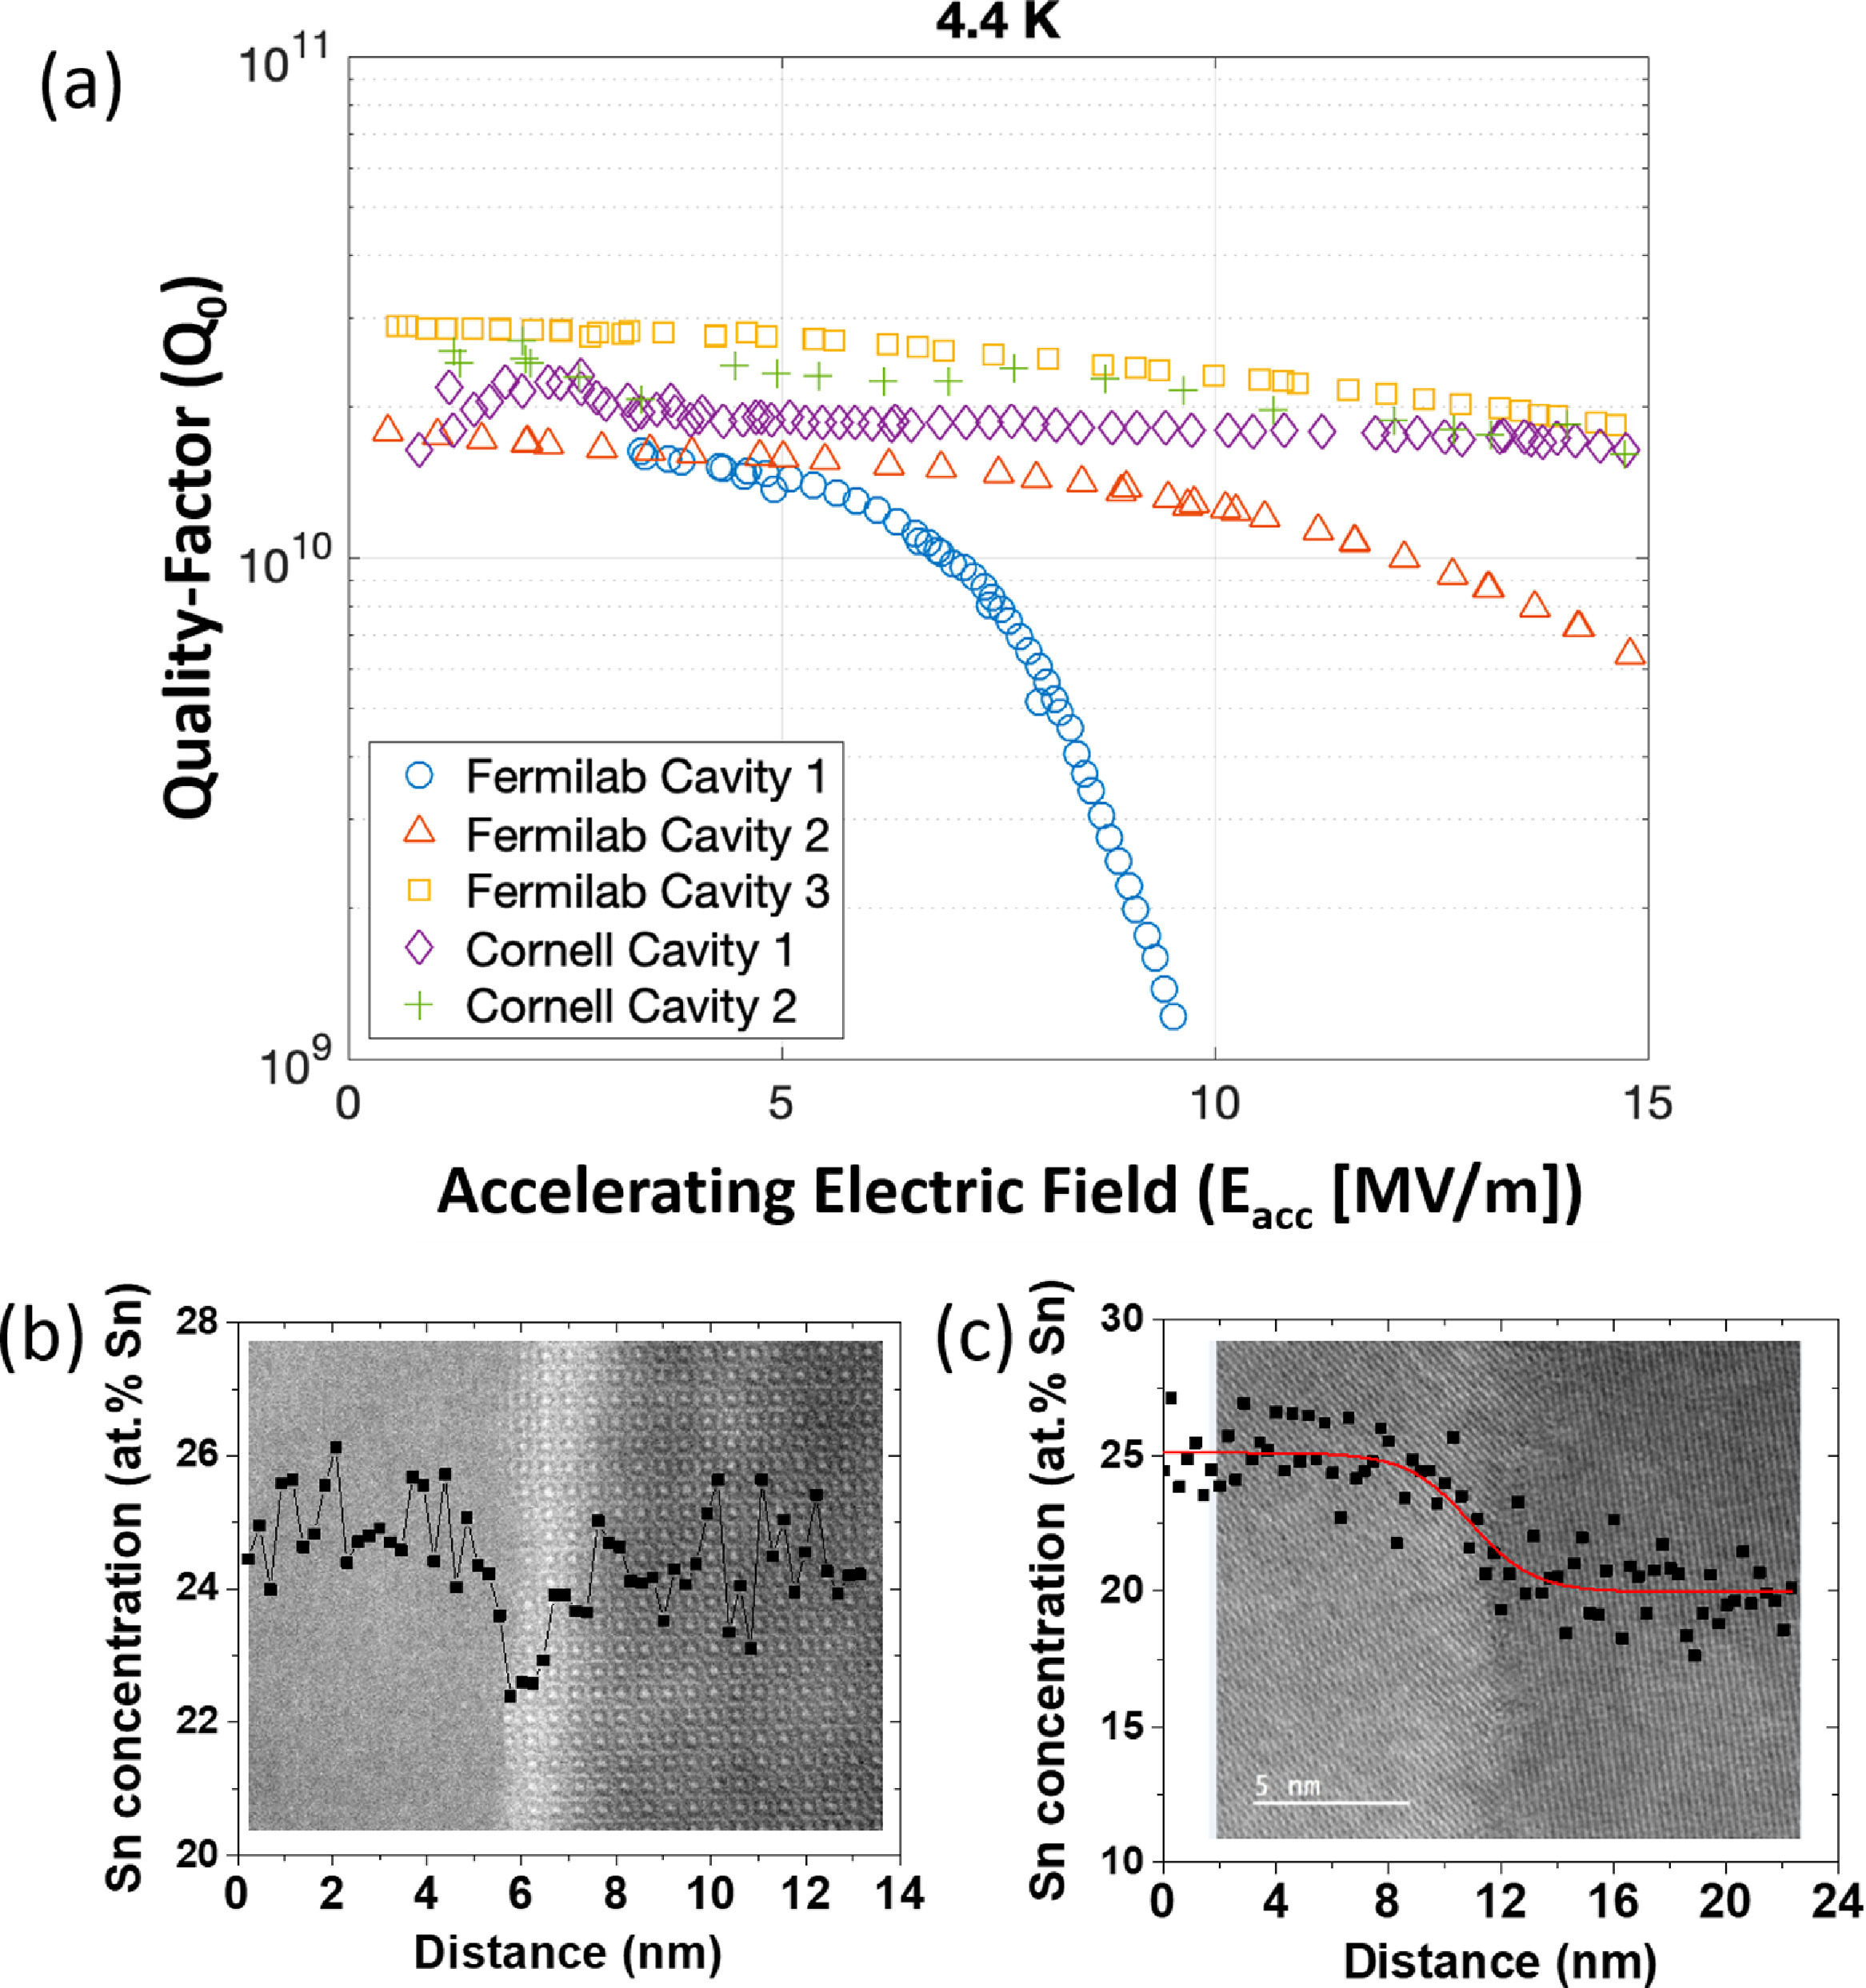
Nb₃Sn on Nb cavities are on track to reach high gradients.
The best cavities have lower segregation!
Fig. 10 from Lee, J., Mao, Z., He, K., Spina, T., Baik, S. I., Hall, D. L., ... & Posen, S. (2020). Grain-boundary structure and segregation in Nb3Sn coatings on Nb for high-performance superconducting radiofrequency cavity applications. Acta Materialia, 188, 155-165.
2/17/2021- Snowmass AF-7- Subgroup RF

Slide 12
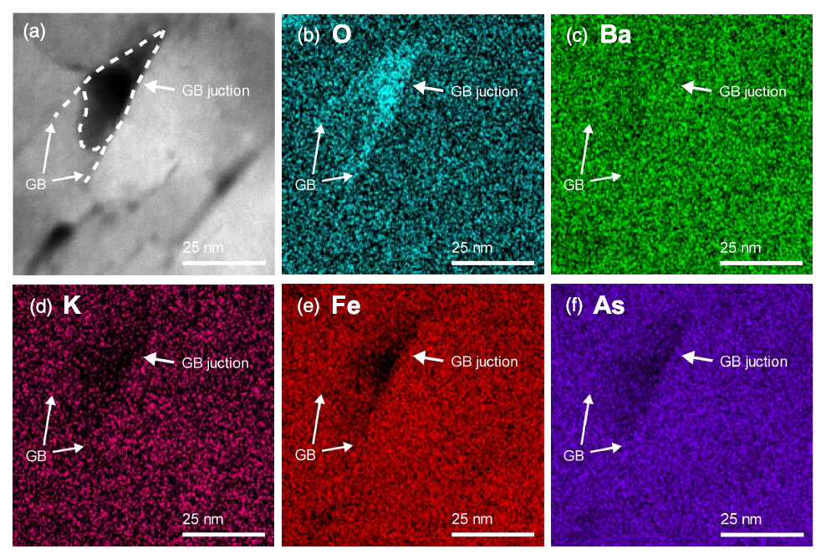
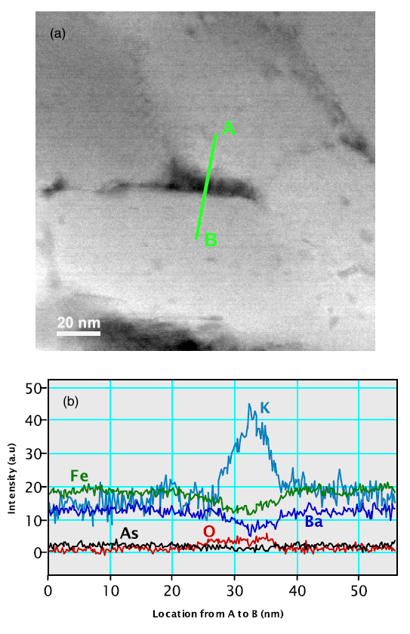
Fundamental Long term R&D need- Beyond Nb, Alternative SRF materials are all compounds- Chemistry, grain boundaries and interfaces are issues.
For example, in Ba_{0.6}K_{0.4}Fe₂As₂ (K-Ba122, iron pnictide), there are intrinsic issues with segregation and high angle GB’s.
When oxygen and water levels are in the range of 0.05ppm, K segregation is an issue.
In the presence of tens of ppm of oxygen and water, Oxide segregation is an issue
Long term Systematic material science and material engineering is needed for next generation SRF materials.
Synergies are possible with magnet development programs
Kametani, F., Su, Y. F., Collantes, Y., Pak, C., Tarantini, C., Larbalestier, D., & Hellstrom, E. (2020). Chemically degraded grain boundaries in fine-grain Ba0. 6K0. 4Fe2As2 polycrystalline bulks. Applied Physics Express, 13(11), 113002.
2/17/2021- Snowmass AF-7- Subgroup RF

Slide 13
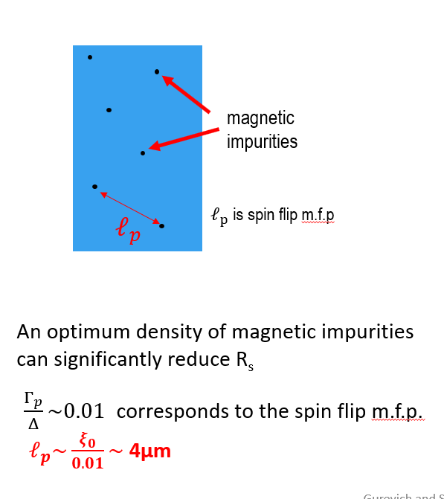
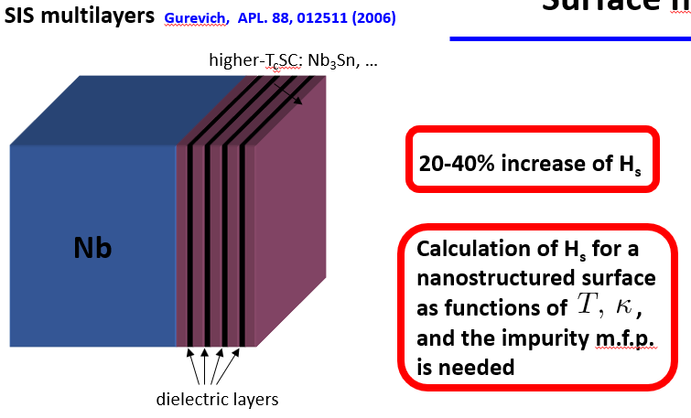
Developing newer cavity surfaces for high Q, and high G.
For high throughput and optimization, there is a need to develop coupon based (~25-50mm) microwave property measurements for sustained innovation.
Examples from this meeting:
Fabrication of SIS structures is challenging, and needs significant R&D in next 5 years.
Gurevich and Sauls, SNOWMASS-AF7-RF, 2/16/2021
2/17/2021- Snowmass AF-7- Subgroup RF

Slide 14
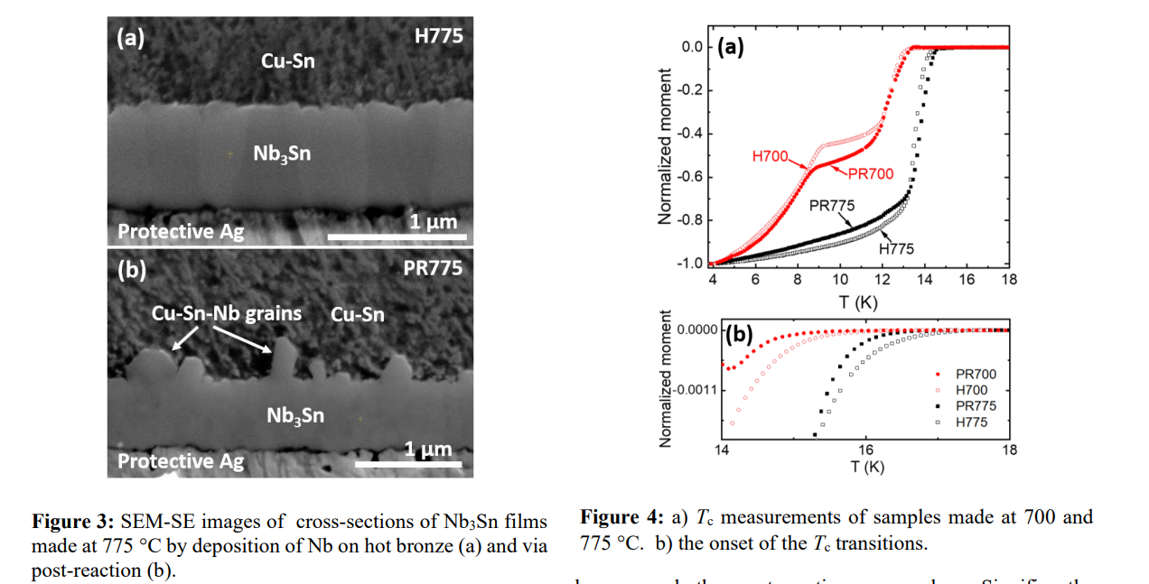
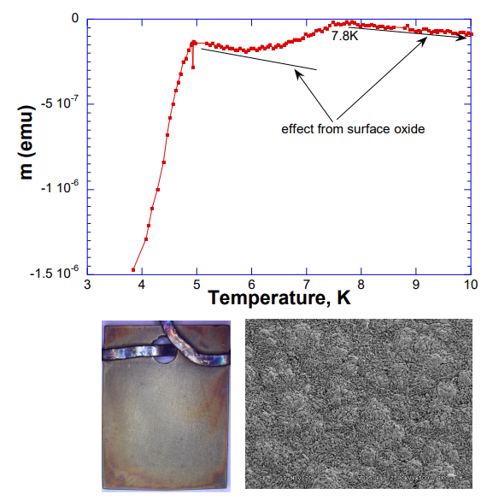
New coating strategies can be developed further, however not under current GARD thrust areas of High Q, High G.
Thin Nb plated on Au/bronze
Thin Nb electro-plated on Au/bronze, Courtesy: Choong-un Kim and Geng Ni,
University of Texas at Arlington (expertise in interconnects for semi-conductor industry).
Nb electroplating is difficult but promising results suggest designs for multi-layers maybe possible.
Wenura Withanage, Andre Juliao, Lance D. Cooley,
Rapid Nb3Sn film growth on hot bronze via Volmer-Weber mechanism . Paper submitted and under review.
Bronze route is a well developed technique for Nb₃Sn superconductor wires
Possibilities need to be explored for synergies
2/17/2021- Snowmass AF-7- Subgroup RF

Slide 15
Takeaways
Fundamental medium-term R&D needs to be supported for current Nb material to produce consistent high Q cavities.
Up stream process variables for current high RRR Nb can be tuned.
Coupon samples are efficient in tuning metallurgical variables.
Specification of material would likely change.
Long term support from GARD University Grants for materials research is essential
Accelerator Stewardship has contributed additional support, and synergies between ARDAP and GARD should be exploited.
Possibilities exist for material research synergies with the magnet development program for new SRF materials
Approaches to evaluate microwave properties on coupon (20-50mm) samples needs development.
Engage academic research for long term sustainability
Provides man-power for future projects.
Also forms a broad base to draw from during mission critical emergencies.
Possibilities exist for couplings between different areas of expertise when focused on long term R&D.
Engaging subject experts from outside the SRF community has been and will continue to be valuable
2/17/2021- Snowmass AF-7- Subgroup RF

