Slide 1
Update on NOvA Feldman-Cousins Analyses for sterile neutrinos
Tarak Thakore
January 20, 2021

Slide 2
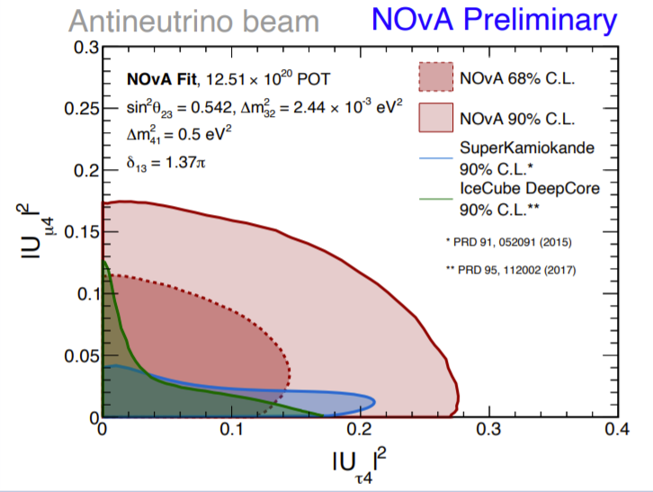
FC for NOvA sterile neutrino analyses - 1
Neutral current (NC) RHC sterile analysis
Follow up from Jacob Todd’s work
Constrains parameters (ϴ₂₄- ϴ₃₄ ) in the (3+1) model
The draft of the NOvA paper for this analysis is under review. Following it, we will run an FC analysis with updated systematics list if needed and generate 1D and 2D parameter limits.
The FC code and the docker image built by Jacob in 2019 is still working fine. We are testing it on novagpvms, and probably run it on the Fermigrid, as it runs fast enough.
“Sterile Neutrino Search via Neutral-Current Disappearance with Antineutrinos in NOvA”,
M. Wallbank, Neutrino-2020 poster

Slide 3
FC for NOvA sterile neutrino analyses - 2
The first 2-detector (ND and FD) NOvA sterile analysis with both CC and NC event samples.
This analysis will provide limits on parameters in the (3+1) flavor model : ϴ₂₄-Δm²₄₁, ϴ₃₄- Δm²₄₁,ϴ₂₄- ϴ₃₄ for NH and IH.
The NuX group in NOvA is developing two parallel analyses:
(1) Poisson likelihood covariance matrix fit – based on the CAFAna framework, developed at the University of Cincinnati (UC)
A new FC package has been created based on the 2020 3-flavor FC package and includes recent CAFAna framework updates for the UC group’s analysis. Implementation of the analysis code into this package is underway.
It will be ready for testing and benchmarking on the novagpvm machines in a few days.
A new SL7-based DIY docker image will be needed to test it on NERSC.
(2) Covariance Matrix Fit – based on the FNEX framework, developed at the University of Wisconsin (UW)
It will take some more effort to build a docker image with a different framework than CAFAna. So far, there was one meeting and some slack conversations with the UW group to discuss what’s needed to make it work. In contact with them for the follow ups.
The final FC runs will be performed either for one or both of the analyses, depending on available computing hours and robustness of the analysis, to be decided by the NuX conveners.

