Slide 1
Present CHG0 and requirements
C.Y. Tan
CHG0 Detector Review
25 Jan 2021

Slide 2
Contributors to this talk
K. Triplett
C. Bhat
A lot of this talk comes from Kent’s talk at the following link:
https://beamdocs.fnal.gov/AD-public/DocDB/ShowDocument?docid=8579
Kent and Jeff do a lot of work to maintain the CHG0 devices. This is a home made device that have served us well but the components are long obsolete.
Link to NPCT specifications:
https://beamdocs.fnal.gov/AD-public/DocDB/ShowDocument?docid=8675

Slide 3
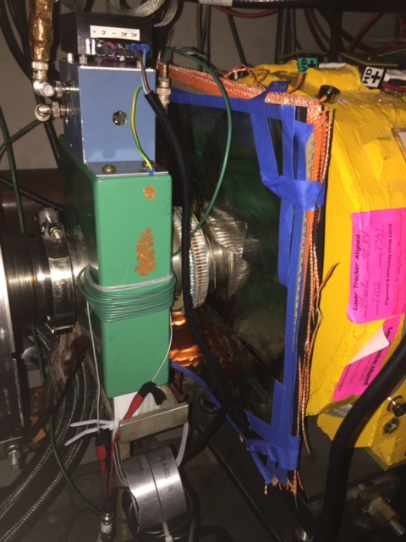
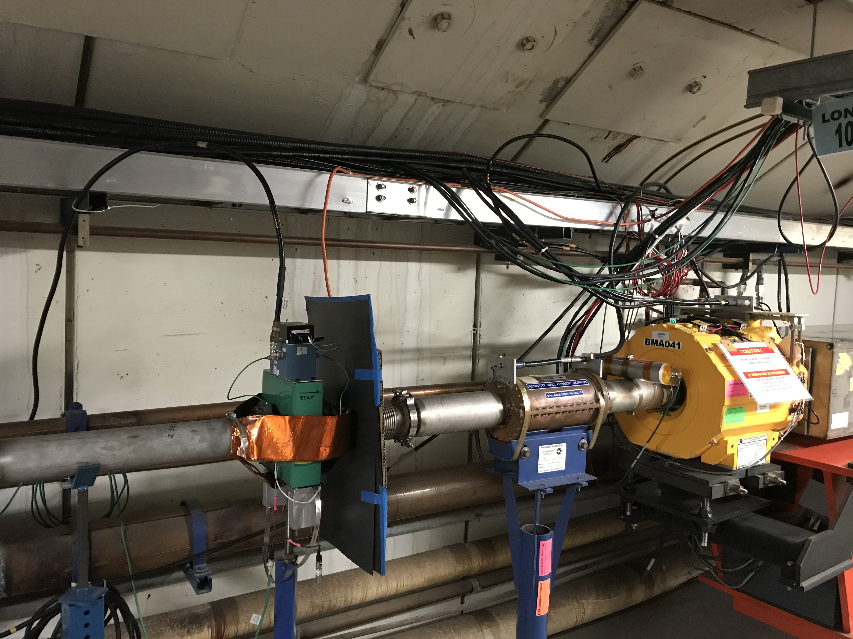
The present CHG0 (L20)
Upstairs NIM
Amplifier Module
L20
Pearson E3100 Current Transformer with external winding and
tunnel amplifier box
L10
Normalizer boxes is used to convert current to particles
NIM Normalizer Module
(ED-282121)
Notice the shielding between the CHG0 and the magnet.

Slide 4
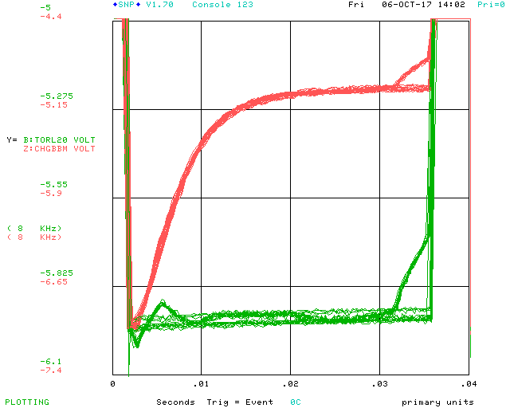
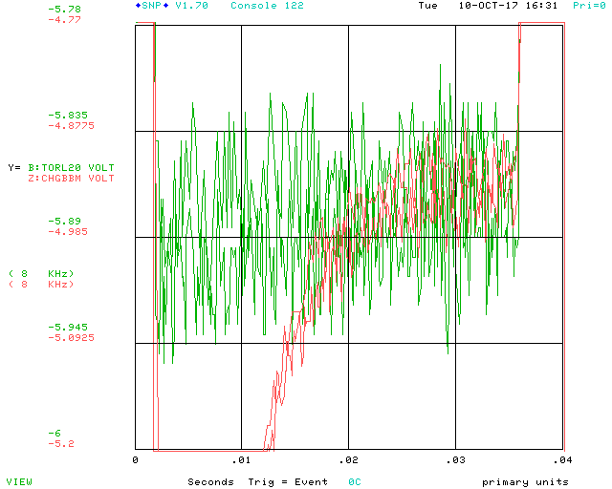
Affected by BMA ramps and BMA bulk supply 80 kHz noise
Normalizer signal
CHG0
CHG0 L20 Close up comparing corrector ramp and no ramp conditions.
We found the two dipoles at L20 are primarily responsible for the interference.
L20 with standoffs, Shielding is in place (on upstream side of ceramic). Bulk is ON, Scale Factors are set to zero, Offsets are set to zero. The spread in signal is increased. The magnetic shielding doesn’t help this.

Slide 5
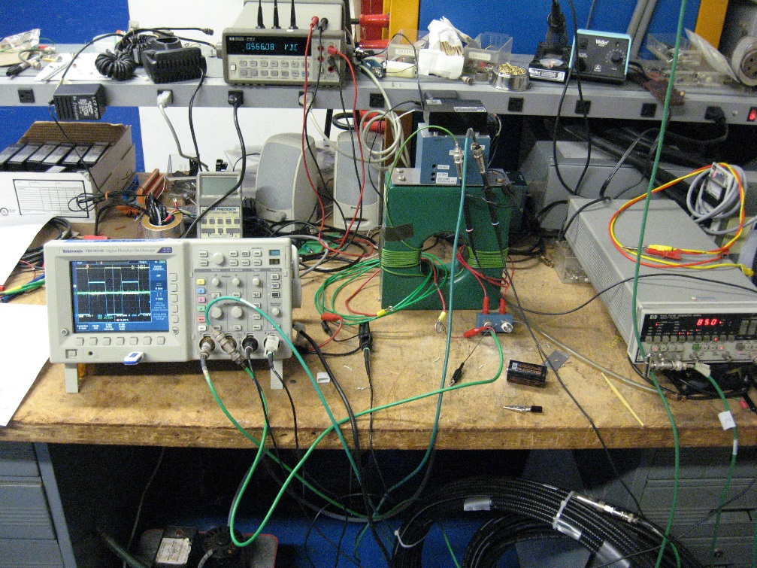
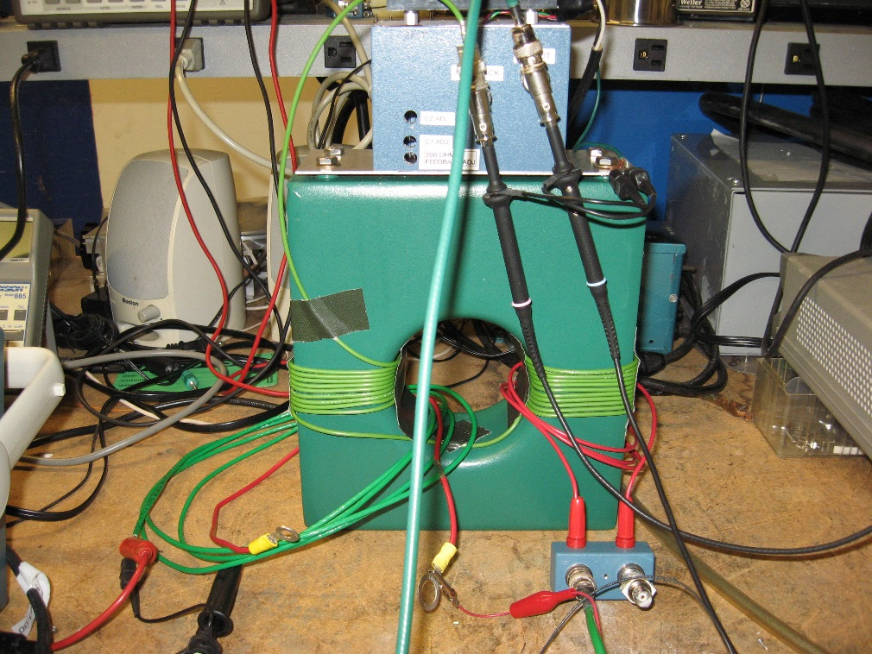
Calibrating CHG0
Tunnel Box Gain, Offset, & Compensation Adjustments are via the holes in the box cover.
For operational systems, if any of these parameters need adjustment, a tunnel access is required.

Slide 6
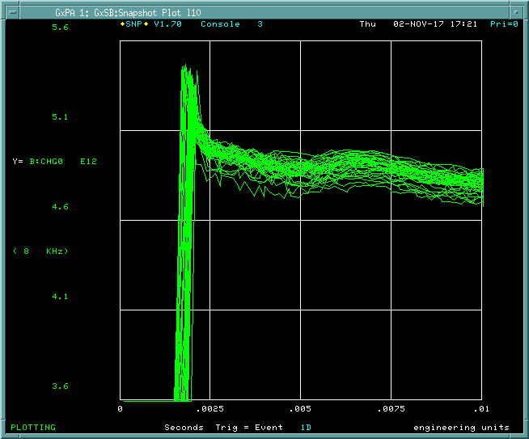
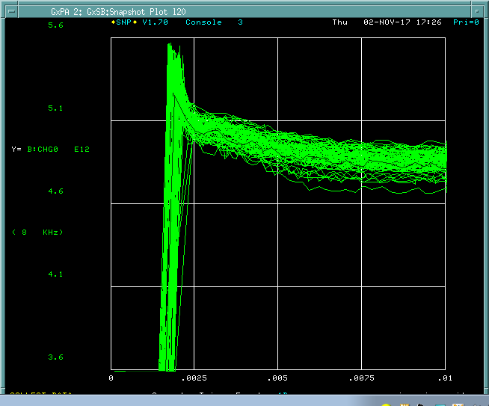
Bunch structure affects CHG0 even after calibration
Electronics? Cable lengths?
L10 Tor with spare box 2
L20 Tor with original box
Calibration alone is not sufficient to guarantee good CHG0 measurements

Slide 7
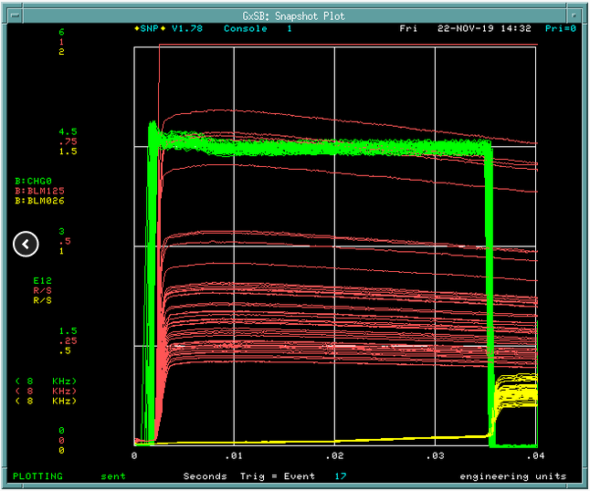
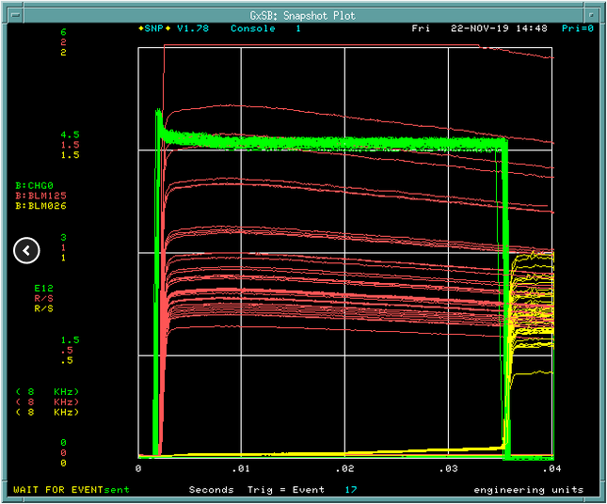
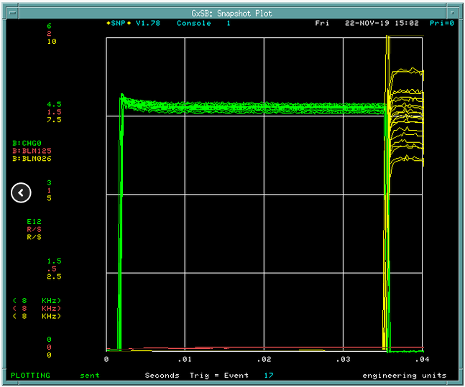
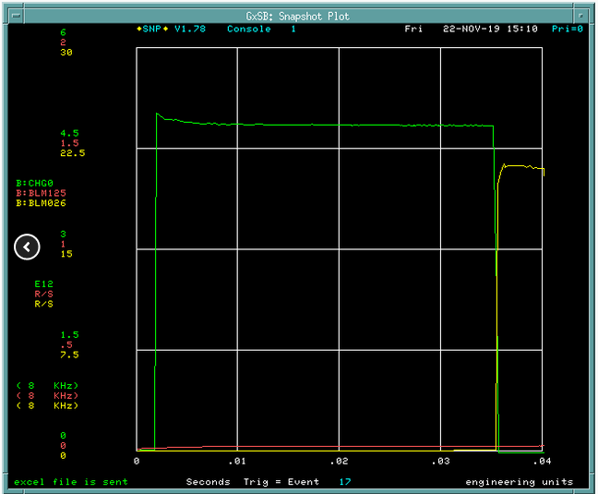
Notching affects CHG0
Laser Notch ON Booster Notch ON
Laser Notch OFF Booster Notch ON
Booster notching at about 2 ms (very early in these plots)
Laser Notch ON Booster Notch OFF
Laser Notch OFF Booster Notch OFF

Slide 8
Requirements
The requirements for the NPCT are stringent because the losses in the Booster have to be carefully controlled. The transfer efficiency from injection to extraction is expected to be in the 98% range during the PIPII era and so the beam current measurement accuracy will have to better than 0.1% for the entire Booster ramp.
Parameter | PIP | PIPII | Units
Injection current for tuning per pulse | 36 (~2 to 3 turns, 0.5 e12 protons) | 36 (~18 turns, 0.5 e12 protons) | mA
Maximum current at extraction per pulse | 700 (7e12 protons) | 800 (8e12 protons) | mA
Typical number of turns | 2 – 17 | 1 – 300
Ramp rate | 15 | 20 | Hz
Harmonic number | 84 | 84
Extraction notch size | 3 | 3 | Booster buckets
Injection frequency | 37.8 | 44.7 | MHz
Injection revolution frequency | 450.0 | 532.1 | kHz
Extraction frequency | 52.8 | 52.8 | MHz
Extraction revolution frequency | 628.6 | 628.6 | kHz
Injection kinetic energy | 400 | 800 | MeV
Extraction energy | 8 | 8 | GeV
Bunch structure | See section 2.2 | See section 2.2
NPCT must work in PIP and PIPII intensities and low current for tuning.
Accurate measurement of current at 0.1% at HEP intensities.
It is important that
the NPCT not to see the notch and be affected by bunch structure.
Not saturate at PIPII beam currents.

Slide 9
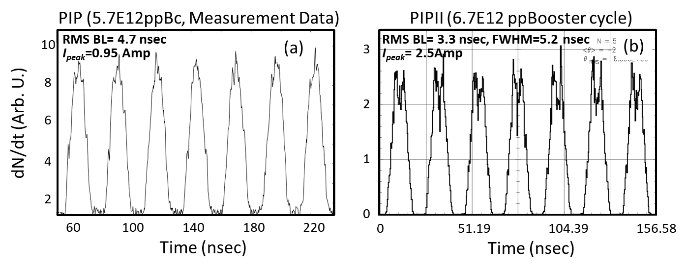
Requirements (cont’d)
Important that NPCT can withstand 20 A of peak current in PIPII going through transition.
Measured PIP @ 400 MeV
Simulated PIPII @ 800 MeV
PIP: measured Booster cycle beam data for 5.7e12 protons
 | Revolution period (μs) | RMS bunch length (nsec) | Full bunch length (nsec) | Number of protons per bunch | $I_{\text{peak}}$ (A$)$
Injection (400 MeV) | 2.217 | 4.73 | 20.2 | 7e10 | 0.95
Transition (5.16 GeV) | 1.608 | 0.56 | 3.2 | 7e10 | 8
PIPII: simulated Booster beam data for 6.7e12 protons
Injection (800 MeV) | 1.879 | 3.3 | 16 | 8.27e10 | 2.5*
Transition (5.16 GeV) | 1.608 | 0.3-0.6 | 2.2-3.2 | 8.27e10 | 18.9

Slide 10
Conclusion
CHG0 works but requires a lot of expertise, calibration and tuning of electronics to get it to ~0.5% accuracy (w.r.t. TOR800 accuracy improves as beam current increases)
Calibrations can be improved by correlating with BLM losses. (see Shiltsev talk: https://beamdocs.fnal.gov/AD-public/DocDB/ShowDocument?docid=8043)
For the NPCT it is required that the device work:
For both PIP and PIPII intensities at HEP
Independent of bunch structure, i.e. notching.
Accuracy at 0.1% for HEP intensities > 4e12 (for PIP and PIPII)

Slide 11
Backup slides

Slide 12
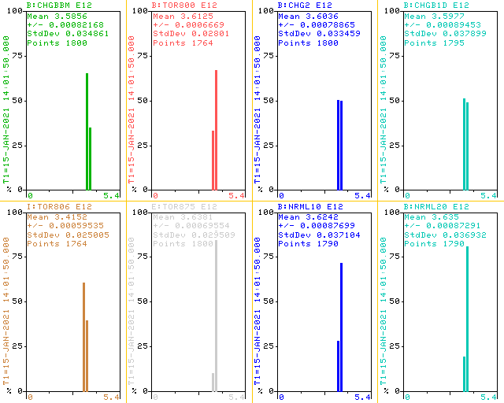
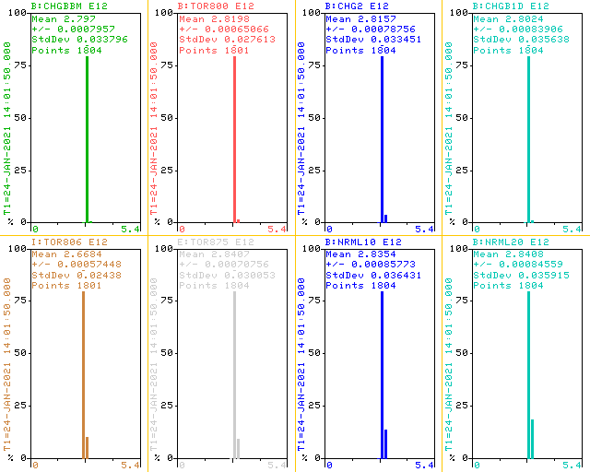
Comparisons to other toroids (K. Triplett)
Date | CHGBBM* | TOR800 | CHG2* | CHGB1D* | TOR806 | TOR875 | NRML10* | NRML20*
01/15/21 | 0.74% LOW | @3.6125E12 | 0.5% HI | 0.41% LOW | 5.46% LOW | 0.71% HI | 0.32% HI | 0.62% HI
01/24/21 | 0.80% LOW | @2.8198E12 | 0.1% LOW | 0.6% LOW | 5.37% LOW | 1.02% HI | 0.5% HI | 0.74% HI
*: using CHG0 electronics

Slide 13
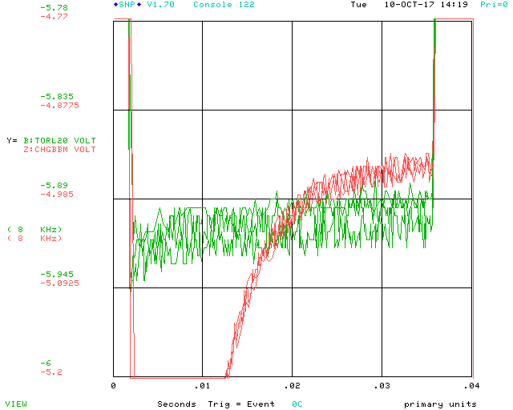
L20 Tunnel Electronics also see the bulk supply switching frequency of 80Khz from BMA (K. Triplett)
↑CHG0 L20 with standoffs, shielding is removed, bulk is OFF. This is the first time we realize a difference between scale factors = 0 and the bulk being OFF!
↑L20 with standoffs, Shielding is in place (on upstream side of ceramic). Bulk is ON, Scale Factors are set to zero, Offsets are set to zero. The spread in signal is increased. The magnetic shielding doesn’t help this.
↑CHG0 L20 with standoffs, shielding is removed, bulk is ON but the 6 scale factors are all set to 0.

