Slide 1
Booster NPCT System
M.A. Ibrahim
1/25/2021

Slide 2
Booster NPCT System Block Diagram
RF

Slide 3
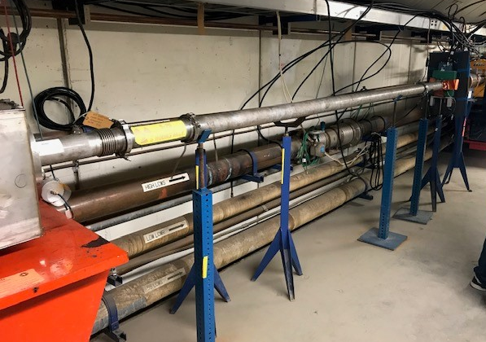
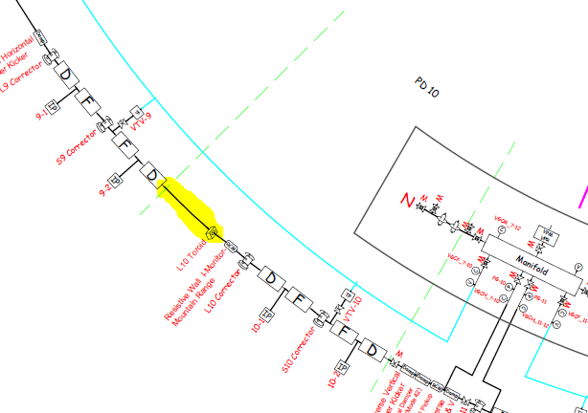
Proposed Installation Location
Install in Long 10 (proposed)

Slide 4
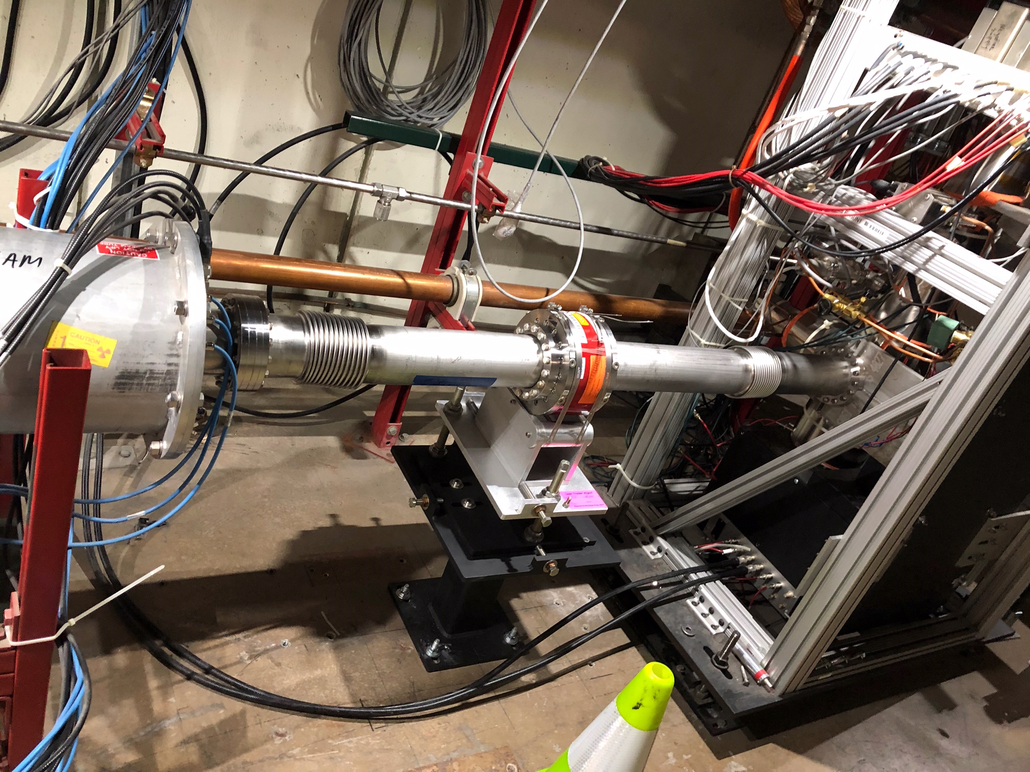
Mechanical Work for Mounting Fixtures
Use current stand design from Main Injector and adjust height to interface with Booster beamline
Make up new spool pieces
Adapt to Booster Beam pipe (smooth transition or hard transmission dictated by beam physicists)
3.25” Beam pipe size in Booster
Additional bellows likely needed
Current NPCT Stand in Main Injector. It was installed during the 2020 shutdown

Slide 5
NPCT Stand Reference Drawing
Notes:
Drawings used for MI NPCT, installed 2020 Shutdown

Slide 6
Toroid Stand Reference Drawing
Modify existing B:CHG0 stand design to incorporate standard toroid mounting fixture
Notes:
Need to compare NPCT system with current CHG0 for commissioning/initial studies
Use opportunity (already vacuum/alignment) to incorporate standard toroid stand to improve CHG0 fixture

Slide 7
Mechanical Specifications
 | Requirement | NPCT-CF6"-96.0-120-UHV-VHR-316LN-H
Beam pipe outer diameter | 3.25” | 4” (ID: 3.78”)
Flange-to-Flange physical length | <1m | 6.38” (DN100 NW100CF Mating Flange)
Vacuum | < 1e-7 Torr | UHV compatible to 7.6e-10 torr (1e-9mbar) Bergoz provides vacuum certificate, showing leak rate with He
Other |  | AISI 316LN steel for better rust prevention Radiation-resistant sensor 200ft cable with PP polypropylene dielectric; pre-terminated with DB15 connectors
Notes:
Toroid cores of the parametric transformer are made out of high permeability amorphous alloy thin ribbons. Bergoz developed a special manufacturing process to improve the magnetic characteristic stability of the parametric current transformer cores. In addition, these cores require a very careful packaging and a sophisticated annealing treatment, both thermal and magnetic, using a longitudinal field and a transverse field. A multilayer magnetic shield using amorphous alloys provides a good shielding factor from external magnetic fields.

Slide 8
Electrical Specifications
NPCT is meant to provide an average beam current.
Operations does not need turn-by-turn
10kHz bandwidth (53turns PIP2 // 45turns BSTR)
Rise time = 35us, typically (10%-90%)
NPCT core material will be able to handle expected peak currents.
Sensor can handle >100mC
NPCT can achieve 0.1% resolution into order to track 1-2% changes.
RMS noise of output is constant, and noise density depended on output bandwidth
With higher currents, expect better SNR and need less time to reach desired resolution
At injection (2mA , 2.5e10 ), expect 2-3% error. However, as increase current to 8e12, achieves 0.1% resolution after 25 turns during PIP2
 | SPECIFICATION
Amplifier settling time | <50 us
Bandwidth | 10 kHz
Resolution (VHR) | < 0.5 $μ\text{A}/\sqrt{\text{Hz}}$
Linearity error | < 0.1 %
Output Accuracy | 0.1%
Temperature Drift | Sensor: 5µA/K Electronics: 0.05uA/K
Magnetic Sensitivity | 10uA/mT (axial) 1mA/mT (radial)
Sensor Saturation Flux | 10mT (axial) 2mT (radial)
Notes:
Per discussion with Bergoz
( Tom Delaviere delaviere@bergoz.com
Hervé Bayle bayle@bergoz.com )

