Slide 1
Energy Frontier
Pushpa Bhat, Anadi Canepa, Paddy Fox, Sergo Jindariani, Sergei Nagaitsev
SAC Meeting
Feb 1, 2021

Slide 2
Energy Frontier: Goals
Secure strong continued support from P5 on the US-HL-LHC program, including experiment operations and research program.
Develop plans for Fermilab’s participation in post-LHC collider projects being planned abroad (ILC, FCC, Muon Collider), in collaboration with university community where pertinent. This would include participation in accelerator/detector design, physics performance studies and R&D.
Coordinate activities across the Lab that could lead to the development of a roadmap for a potential future collider facility to be hosted at Fermilab in the post-LBNF/DUNE era. The goal towards Snowmass 2022 would be to develop a proposal for focused studies and R&D in this context.
------------
Capabilities: Fermilab was home of the most powerful hadron collider not too long ago! The USLHC and USCMS engagements have kept many of the Lab’s capabilities at the Energy Frontier in-tact. These include detector technology and R&D (with focus on silicon detectors, ASIC, trigger systems), expertise in data analysis and collider phenomenology, accelerator physics and technology (magnets, cavities).
P. Bhat, A.Canepa, P.Fox, S. Jindariani, S. Nagaitsev

Slide 3
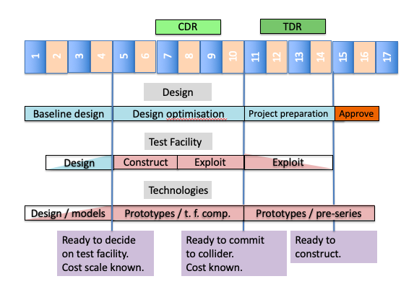
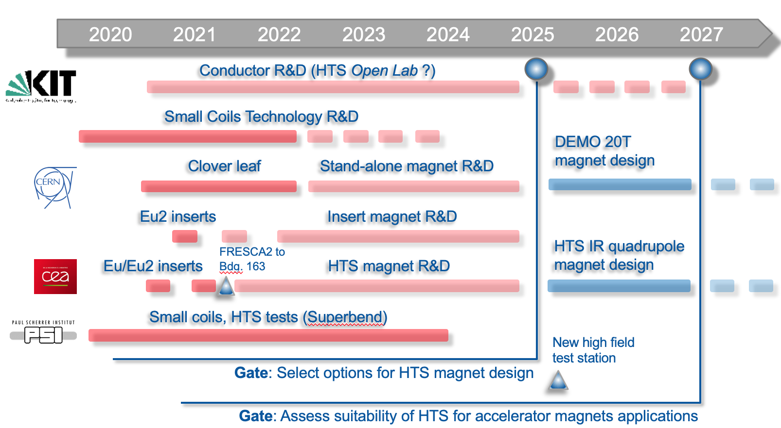
Some Timelines
Muon Collider (CERN)
ILC250
HL-LHC and FCC (ee,hh):
2020
2030
2035
High Field Magnet R&D for pp collider
Can envision three different colliders – ILC, FCC and Muon Collider in the
three major world regions ← Japan/Asia, Europe, US

