Slide 1
News
Brendan Casey
4/30/20

Slide 2
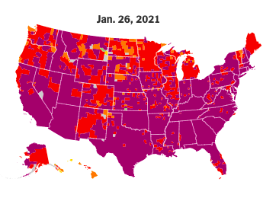
Covid News
We are now in Tier 1 of Illinois rules
No real change for any muon work happening on site
There are changes in quarantine and mask policies coming soon. We expect an all-hands email.
This is still a dangerous situation. Please do not let your guard down.
All of us have been affected by this and some of us have been hit very close to home.
Cabin fever is setting in at some level for everyone.
Please take a moment often and reach out to someone. It’s good for you and it’s good for them.
When in doubt about regulations/contacts/etc. contact Raymond and Katie
They are very responsive
If you ever have questions about lab resources, contact Ilene.
She is also very responsive
NYT map of the risk of getting Covid-19 by county
We are all either in very high-risk or extremely high-risk counties
rhlewis@fnal.gov
kswanson@fnal.gov
iwinston@fnal.gov

Slide 3
People news
Vivian O’Dell has taken a position as ICE-CUBE upgrade project manager at Wisconsin
Wish her well and wish her warmth when she travels to the South Pole
Mike Crisler has joined the department to work on Mu2e
Help welcome him

Slide 4
Journal Club
From Manolis’ email:
The first journal club will be led by Pasha and Mete, and they have selected to read the Nature paper "Phosphine gas in the cloud decks of Venus", which was widely reported in the news: https://www.nature.com/articles/s41550-020-1174-4 The first journal club will be held next week. If you are interested please designate your preference among the times that are good for Mete and Pasha in the poll below. https://doodle.com/poll/88cnq5a5puzr2d69?utm_source=poll&utm_medium=link

Slide 5
Organization
We’ve have a lot of turn over in the department organization
The department has also grown significantly in scope since we originally set it up
Originally two small groups piggy backing off two large projects
Now two large research groups, two large operations tasks, still a large project, and proto-projects starting to form
We’ve spent the last several months looking at different models and understanding our needs and evaluating where we are doing well and where we can do better and have a new model for the department structure
Main changes:
Department Head and Deputy Department Head will no longer be group leaders.
Scope of work is now beyond 2 people
Making a separate group for the RAs
Allows that group leader to focus on RA supervision and RA mentoring.
Making a separate management position for operations
This is in lieu of making an operations group which doesn’t fit well in the current matrixed PPD organization

Slide 6
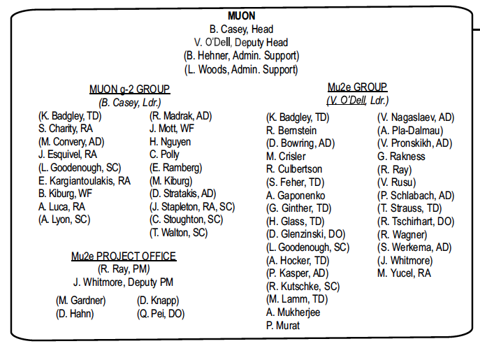
Current Organization

Slide 7
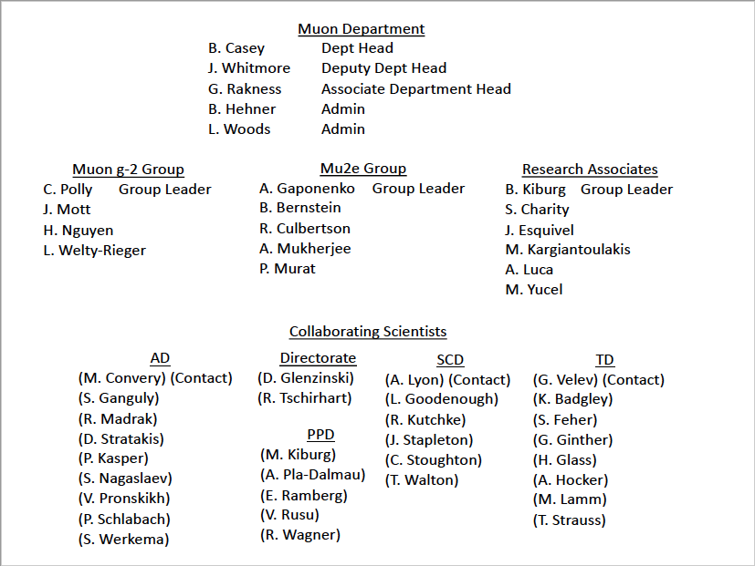
Proposed New Organization

Slide 8
New Organization
This is open for comment
We plan on implementing this March 1

Slide 9
Summer programs
One of our action items from the Department Self Assessment was:
6) Increase participation in existing public engagement and intern programs
Goal: get more people involved in engagement and help make the lab’s engagement efforts successful
Step 1: Invite Sandra Charles to a future department meeting to discuss current engagement programs and let us know where she needs volunteers the most
Step 2: make sure everyone participating has quality training. This is a place where we could easily do more harm then good.
We are doing Step 1 today and will have a presentation next by Jimmy Mcleod focusing on the summer programs.

