Slide 1
EDI @ Fermilab
Jimmy McLeod & Jeomar Montelon
Friday, February 19, 2021

Slide 2
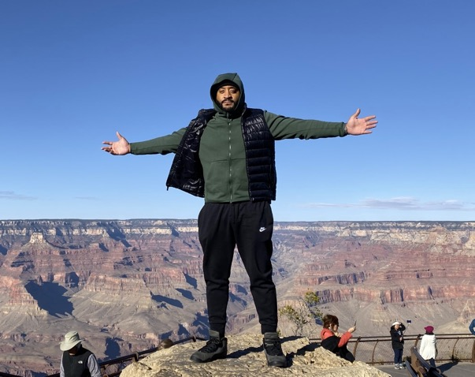
Who Is Jimmy?
From Cleveland, OH
Has lived in Cincinnati, Dallas, and Denver
Former higher education and corporate D&I professional
Multicultural Affairs, Fraternity & Sorority Life, Career Development, Leadership Development
Learning and Development
Avid fan of NBA basketball, festivals, movies, and concerts
Responsible for establishing external relationships throughout Chicagoland for a more diverse and prepared pipeline/workforce.

Slide 3
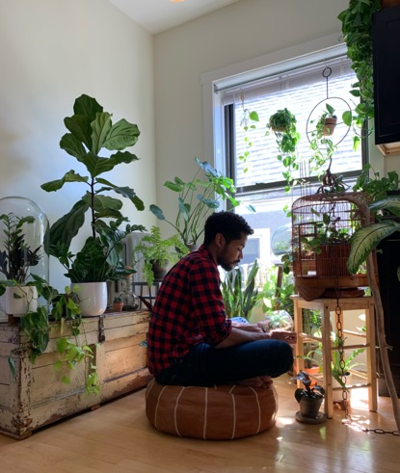
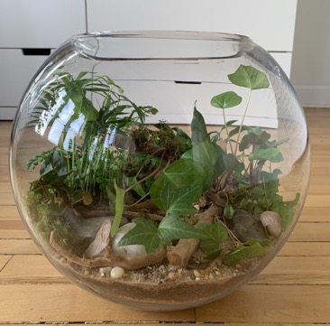
Who is Jeomar?
From Queens, NYC
Also lived in Spain, France, Uganda, India, Morocco
Experience in international education, community development, HR (recruitment/diversity & inclusion)
Fan of running, learning French, 'plant art' - terrariums
Primary role at lab:
internal engagement
external outreach (TARGET)

Slide 4
What is EDI?
Fermilab continues to work towards a culture of equity, diversity, and inclusion through a collaborative, multilateral, cohesive environment to positively impact lab culture and climate. EDI is embedded into all aspects of lab culture/operations and affects the Fermilab community.
How are we moving the needle:
Intentional outreach and partnerships
Internal curiosity, engagement, and momentum
Where does it show up at Fermilab?
Directorate
LRGs
Postings/Hiring
External opportunities/Internships
Attending conferences and job fairs
Chicagoland

Slide 5
Summer Programs for 2021
DOE Programs
Summer Undergraduate Laboratory Internships (SULI)
Community College Internships (CCI)
Fermilab Programs
Summer Internships in Science and Tech (SIST)
TRAC
June 7 – August 13, 2021
June 7- August 13, 2021
6 credit hours in STEM
Other programs
UChicago
Visiting Faculty Program (VFP)
11 submissions
Applications under review
Applications under review
Applications under review
May 24 – August 13, 2021
12 weeks
No 2021 offerings
Not much value in the virtual experience
TARGET
Different format for 2021
Applications under review
Graduate Fellowships in Engineering and Science (GEM)
May 24 – August 13, 2021
Three students
Applications under review
10 weeks
Undergraduate sophomores and up
10 weeks
Metcalf, Odyssey, Provost and Innovation Scholars Program
10 weeks
Rising juniors and seniors
Two students
VetTech
June 7 – August 13, 2021
10 weeks
Applications window closes March 2
EDI @ Fermilab

Slide 6
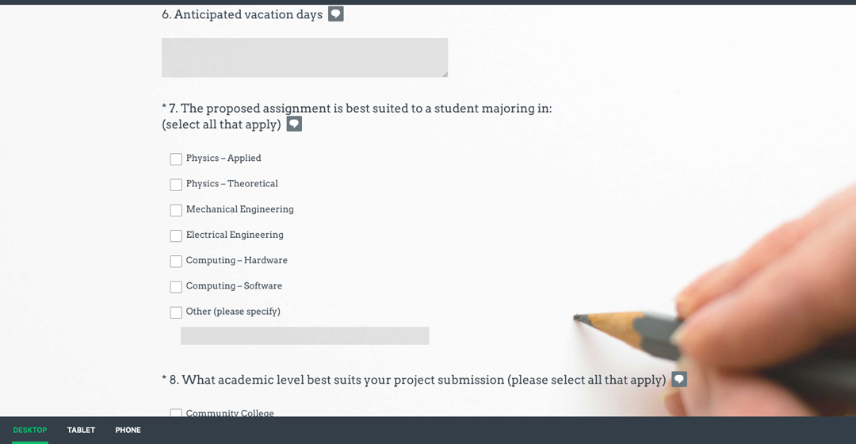
Internship Job Submission Site
Please submit a job that aligns with a skillset, not a specific program.
https://www.surveymonkey.com/r/9JKLZYH
Notes:
Currently open
Add link
If you want to host student
https://www.surveymonkey.com/r/9JKLZYH

Slide 7
Inclusion Matters 2021
Empowerment, Gratitude, and Inclusion
Gratitude is defined as being thankful and exhibiting a readiness to show appreciation. We want to acknowledge and appreciate the diversity of lab employees and users while promoting individual contributions to advancing the lab's EDI efforts.
Empowerment encourages users, employees and leaders to exist as their full selves while fulfilling the mission of Fermilab. It promotes seeking access to skills and opportunities that not only advance the efforts of the lab, but also encourages the accumulation of skills for members of the Fermilab community.
Inclusion ensures a feeling of belonging and connectedness throughout all aspects of Fermilab. Maximizing talent expression and self-awareness to provide a safe and innovative space is of the highest priority of Fermilab.
Registration for each event or workshop is available through Zoom, and registrants will receive reminders and updates about the upcoming workshop or event: https://diversity.fnal.gov/inclusion-matters-2021/

Slide 8
First workshop
Inclusive Communication with Gratitude on February 25th, 2021
EDI @ Fermilab

Slide 9
LRG Updates, Events
LRG representation on EDI Task Force
High school STEM Conference: Saturday, April24th
Next meeting March 18
Women's Initiative Tea Talk (March):
https://www.sankofatravelher.com/
Speaker suggestions: wiboard@fnal.gov
Postdoctoral Research Associates and Fellowships Webinar: February 23rd 12:00 - 1:00pm
Volunteers needed!
Mike Kirby, kirby@fnal.gov
Minerba Betancourt -Hispanic/Latino LRG (betan009@fnal.gov)
Entrepreneur & storyteller Tammy Gibson talk with Black & African American LRG

Slide 10
How to Get Involved
Postdoc / Fellowship webinar with Mike Kirby:
Feb 23rd 12 – 1pm:
kirby@fnal.gov
Act-SO Mentoring
act-so@listserv.fnal.gov
Host and mentor an intern
Class Presentations
We are always looking for assistance with Info Sessions, Career Fairs, Meet n Greets
LRG engagement
https://diversity.fnal.gov/resource-groups/
PartiSUPPORT (Participate + Support)
Inclusion Matters series: https://diversity.fnal.gov/inclusion-matters-2021

Slide 11
Thank you!
jmcleod@fnal.gov
montelon@fnal.gov
Q&A

