Slide 1
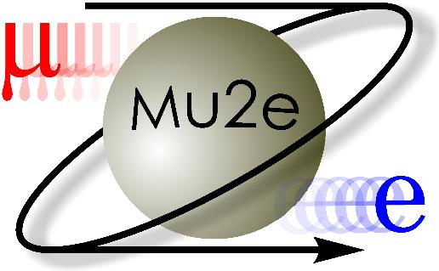
Mu2e Cryogenic System
Mike White
Fermilab Engineering Retreat
February 24, 2021

Slide 2
Overview
What is Mu2e?
  Scientific Objective
  Brief Description of Superconducting Solenoids
Cryogenic System Overview
Overview of key components of Mu2e Cryogenic System
  Helium refrigerators
  Outdoor transfer line
  Distribution Box
  Feedboxes
  Power leads
  Indoor transfer line
Engineering Challenges
  Mu2e is an ambitious project with many challenges
  Given limited time the primary focus will be on welding related challenges, which is of general interest to engineering community

Slide 3
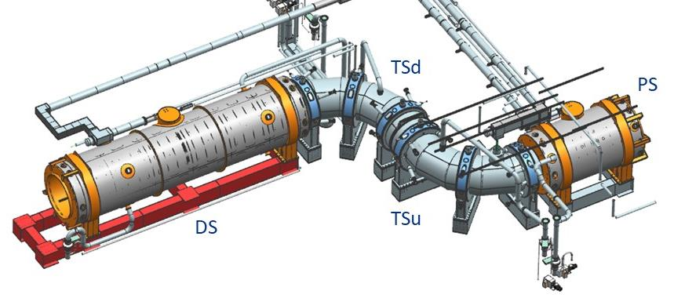
What is Mu2e?
The muon-to-electron conversion (Mu2e) experiment at Fermilab will search for the charged lepton flavor-violating conversion of muons to electrons in the field of an atomic nucleus
Key components of this experiment are the 4 superconducting solenoid magnets operated at liquid helium temperatures

Slide 4
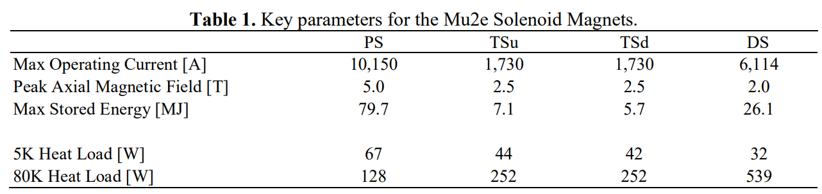
What is Mu2e?
In the beam direction
  The first solenoid is the Production Solenoid (PS), which is a 1.8 m aperture axially graded solenoid with a peak field of 5 T used to focus secondary pions and muons from a production target located in the solenoid aperture
  Next are upstream and downstream transport solenoids (TSu and TSd), which sign/momentum-select and transport the subsequent muons towards a stopping target
  The beam then enters the Detector Solenoid, which is an axially graded solenoid where the electrons from the decays of muons that were transported to the aluminum stopping target, located at the DS entrance, are measured in a spectrometer located within the DS volume

Slide 5
Mu2e Solenoid Cooldown Times
 | PS | TSu | TSd | DS
Cooling scheme | Thermosiphon | Forced Flow | Forced Flow | Thermosiphon
Cold mass (tonnes) | 10.9 | 13 | 13 | 10
300 K to 80 K He mass flow (g/s) | 30 | 30 | 30 | 90
80 K to 4 K He mass flow (g/s) | 4 | 4-6 | 4-6 | 4
Cooldown time 300 K to 80 K with 30 g/s GHe and 20 kW LN2-GHe HX (hrs) | 72 | 52 | 52 | 240
Cooldown time 80 K to 4.7 K with 4 g/s 5 K GHe mixed with RT gas (hrs) | 42 | 16 | 16 | 48
Total cool down time (hrs) | 114 | 68 | 68 | 288
Total cool down time (days) | 4.8 | 2.8 | 2.8 | 12.0
Total cool down time (weeks) | 0.68 | 0.40 | 0.40 | 1.71
Notes:
The times shown here are based on cooldown FEA analysis which considers thermal stress constraints.
The times are the fastest its possible to cooldown a solenoid with a perfectly tuned cryogenic support system

Slide 6
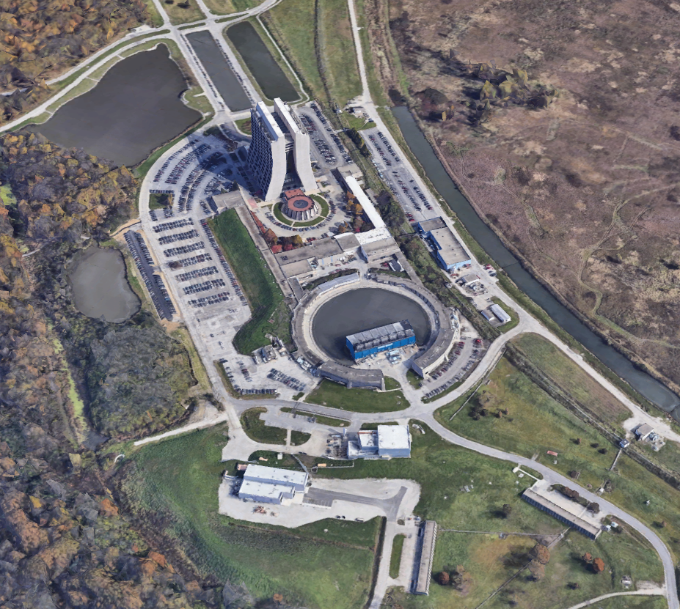
Where is Mu2e?
Mu2e Building

Slide 7
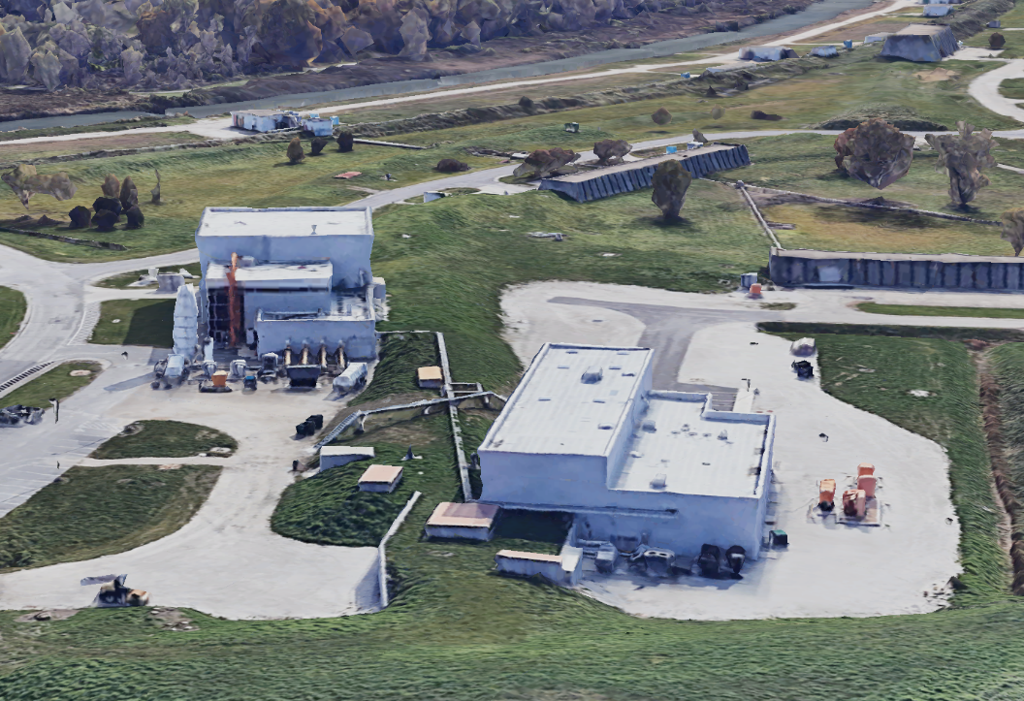
Muon Campus
M4 Beamline Berm
G-2 Experiment Building
MC-1 Refrigerator and LN2 Dewar
Mu2e Detector Hall & Hi-Bay
Cryogenic transfer line
Mu2e Solenoid Power Room

Slide 8
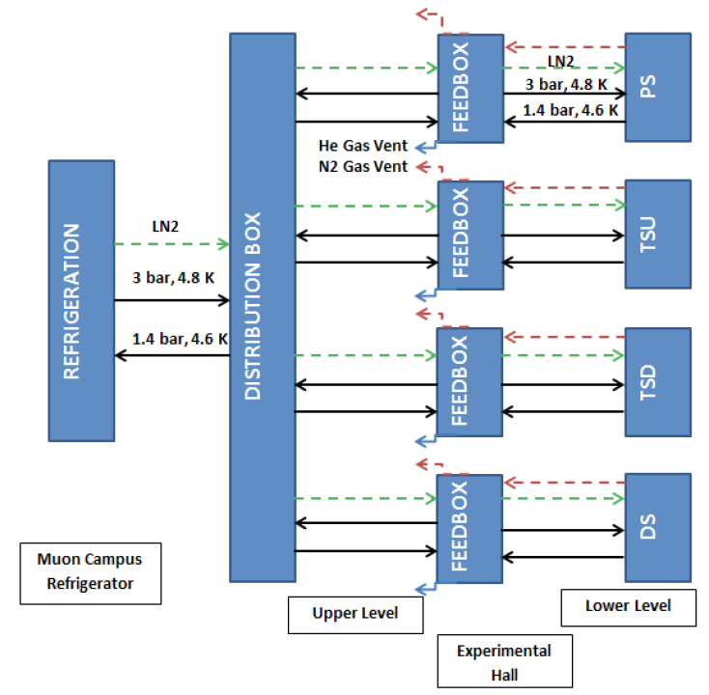
Cryogenic System Process Flow Diagram

Slide 9
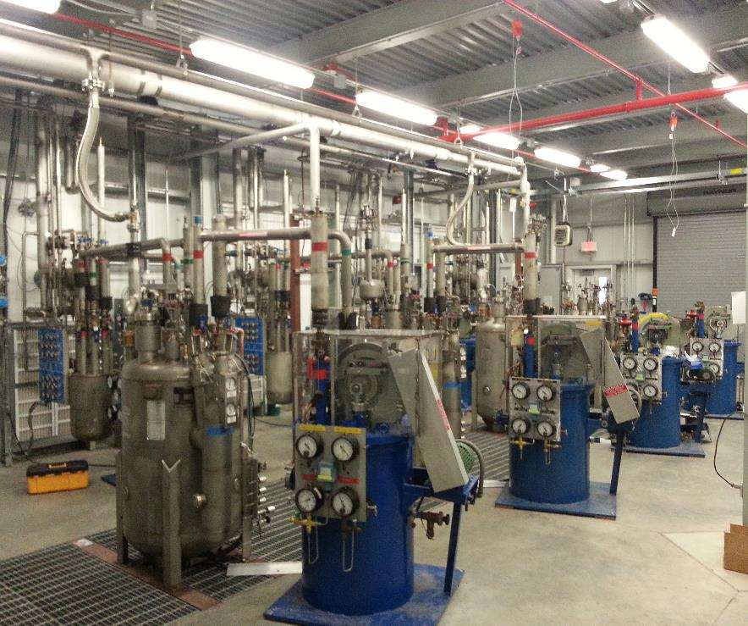
Helium Refrigeration
4 repurposed Tevatron satellite-style refrigerators were relocated to the Muon g-2 experiment building at Fermilab.
  Helium refrigeration for the Mu2e solenoids will be supplied by 2 of the refrigerators
  G-2 already using the other 2 helium refrigerators
Each refrigerator has a capacity of 600 W at 4.5 K.
Piping was extended from the Tevatron A0 compressor building to the Muon campus so that the existing set of four Mycom 2016C compressor skids could be re-used.

Slide 10
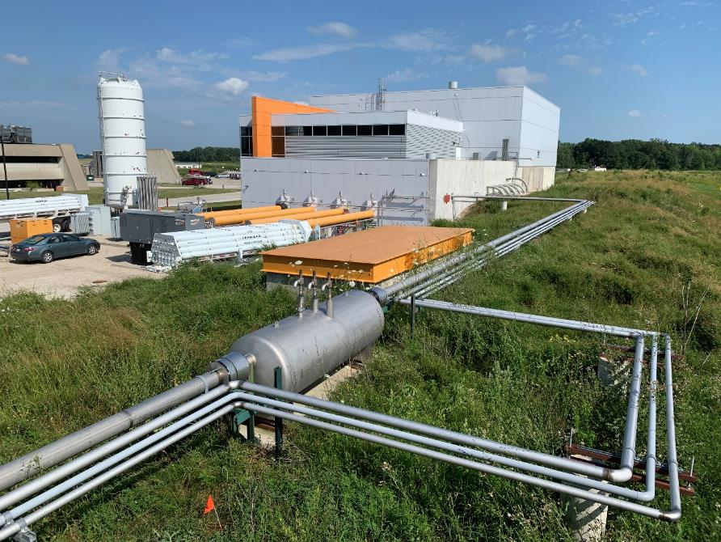
Refrigeration & Supply to Mu2e
The large vertical tank on the left is the 60,000 L (15,000 gal) LN2 storage tank.
Shown in the foreground is the middle expansion box on the refrigerator transfer line.
The helium supply is concentric with the helium return to function as a long counter-flow heat exchanger.
The transfer line to the Mu2e building is approximately 150 m (500 ft) long.

Slide 11
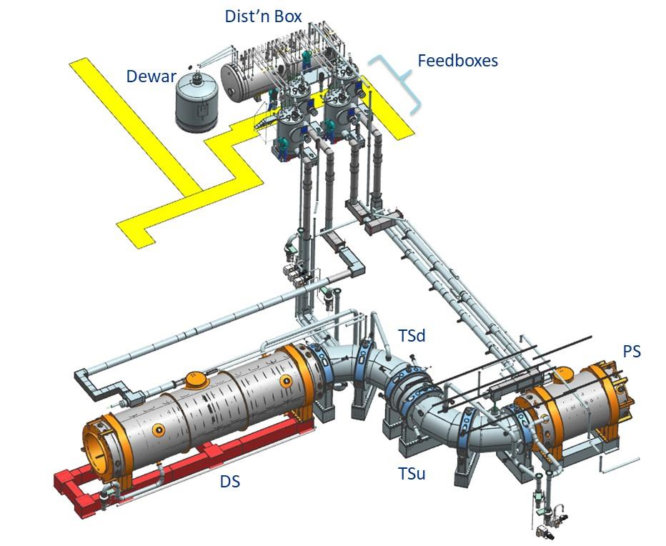
3-D Model of Cryogenic System
The cryogenic distribution system is in the Solenoid Power Room, located on the ground level.
The solenoid magnets are located in the lower detector hall
Teamcenter Person
(Mr. Clean)

Slide 12
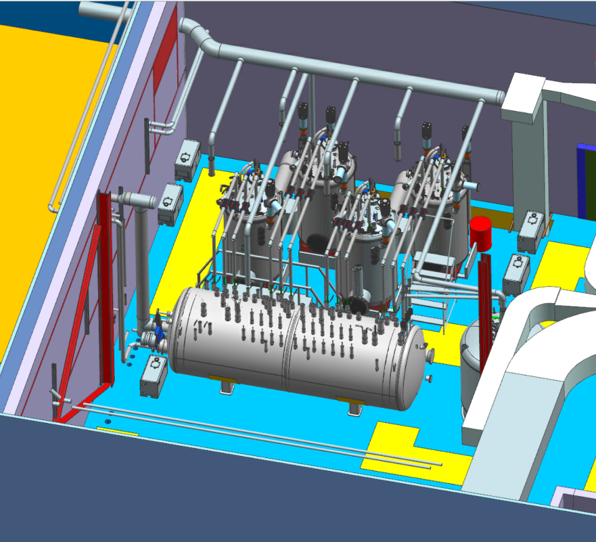
Mu2e Solenoid Power Room
PS Feedbox
TSu Feedbox
DS Feedbox
Outdoor Transfer Line Connection
TSd Feedbox
Distribution Box
3000L Dewar

Slide 13
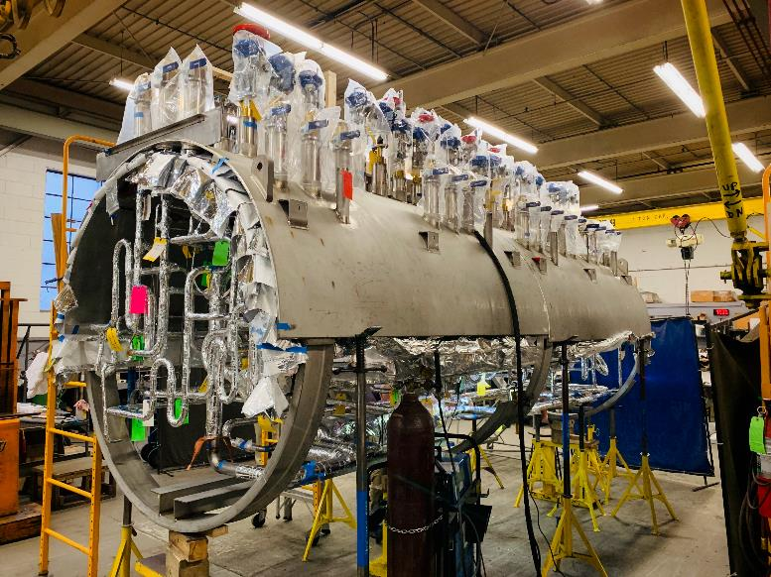
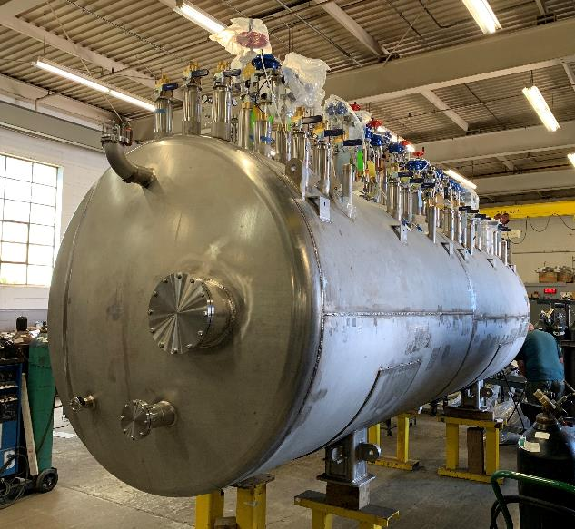
Distribution Box
Distribution Box Fabrication Photos

Slide 14
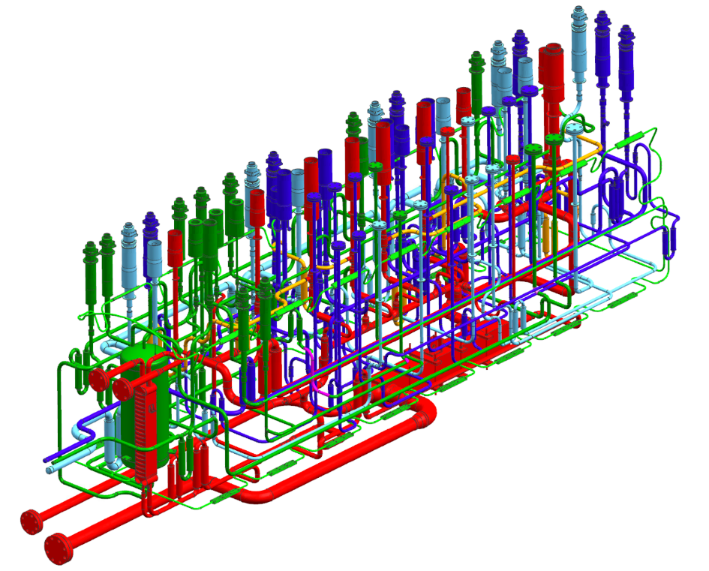
Distribution Box Internal Piping
The nitrogen supply and return are dark green and light green respectively.
The helium supply and return are dark blue and light blue respectively.
The piping for cooldown and warmup is shown in red.
The nitrogen phase separator vessel is located in the bottom left corner.

Slide 15
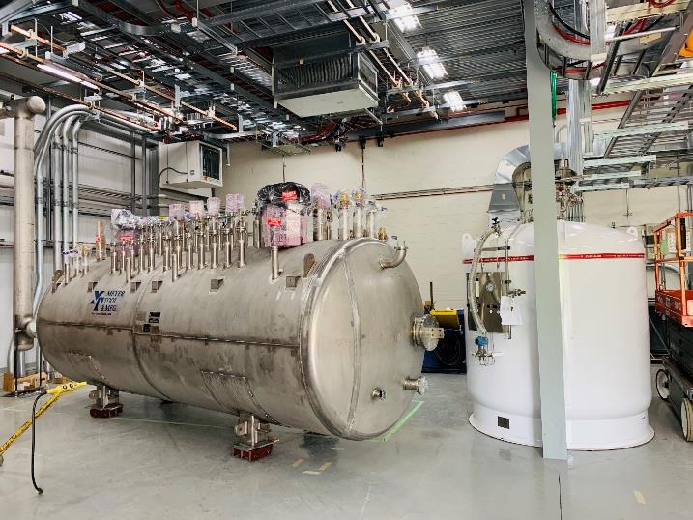
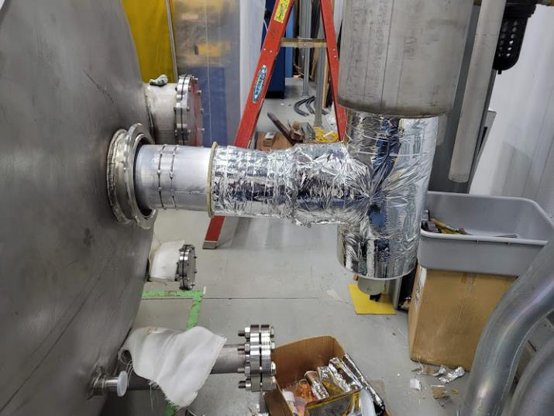
Distribution Box
The transfer connection to the Distribution Box is almost complete
Objective is to cooldown the outdoor transfer line and Distribution Box in Summer 2021
DB and 3000L LHe Dewar as Delivered to Fermilab
DB connection to Outdoor Transfer Line as of last week

Slide 16
Distribution Box to Outdoor Transfer Line Connection
Two welds which had been made several years ago showed evidence of inadequate purging.
Use of oxygen monitor to measure oxygen content in purge gas is a best practice.
Engineer should specify the maximum oxygen content in purge gas

Slide 17
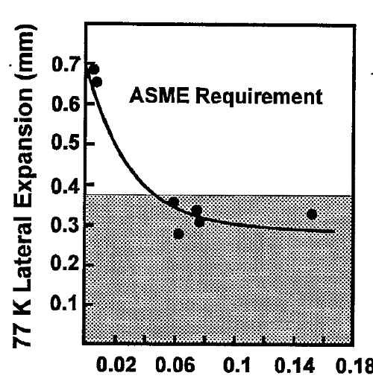
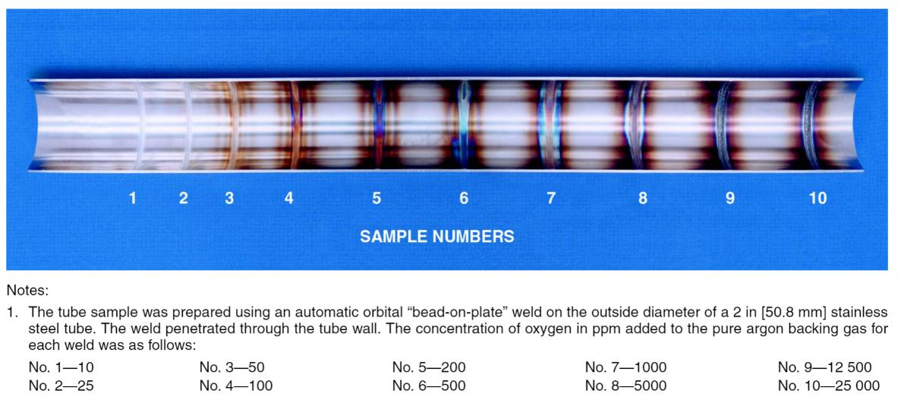
Oxygen and Stainless Steel
ASME requires lateral expansion on Charpy impact test specimen to be 0.53 mm if we want to impact test at 77K instead of 5K for 308L and 316L filler metal
In paper from Brookhaven & NIST only weld metal with less than 50 ppm oxygen content passed impact testing requirements
Good shielding and purging practices make weld cleaning easier and improve low temperature toughness
% Oxygen in Weld Metal

Slide 18
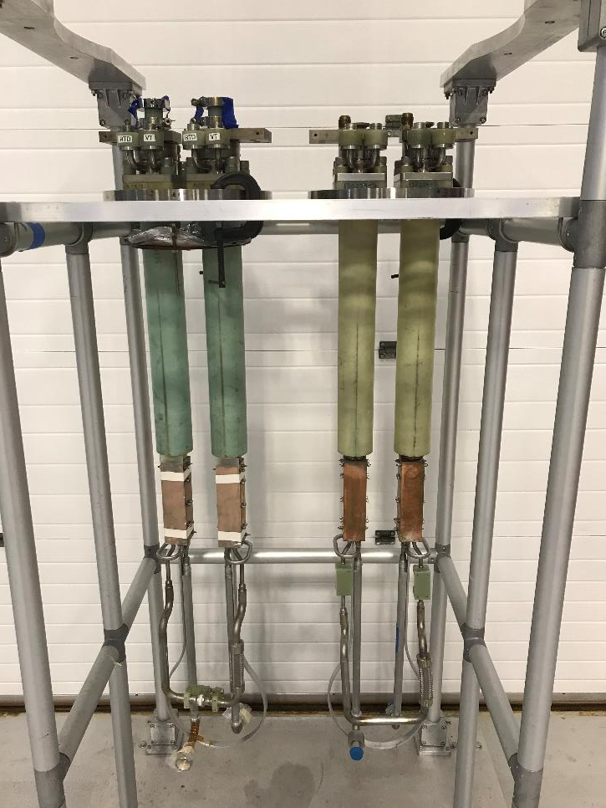
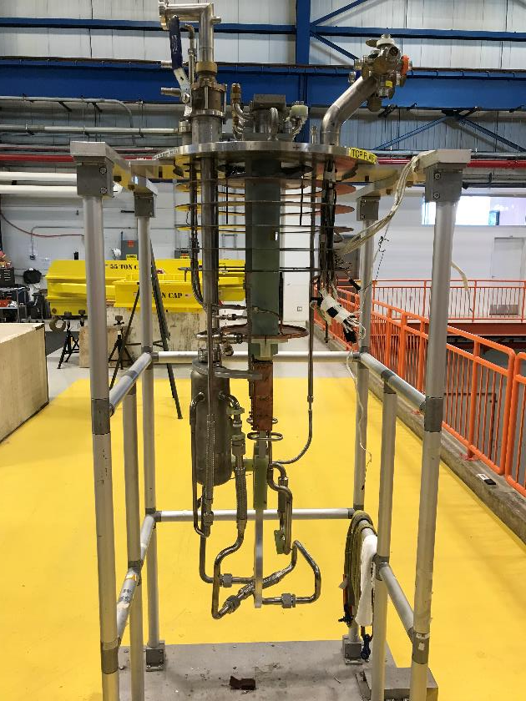
ASC Leads at HAB

Slide 19
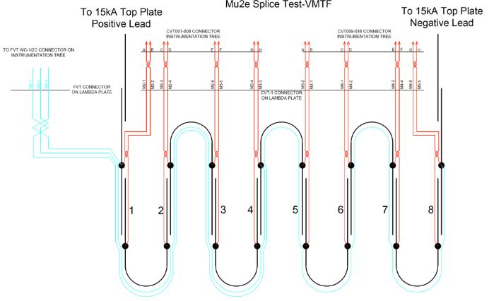
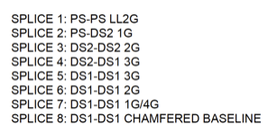
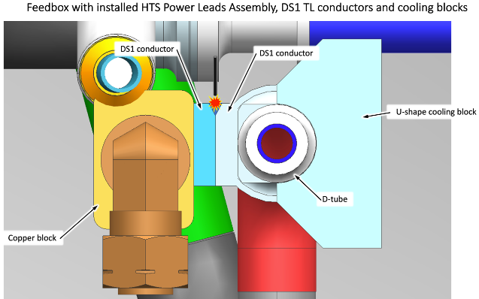
Power Lead Splice Lead Qualification Testing

Slide 20
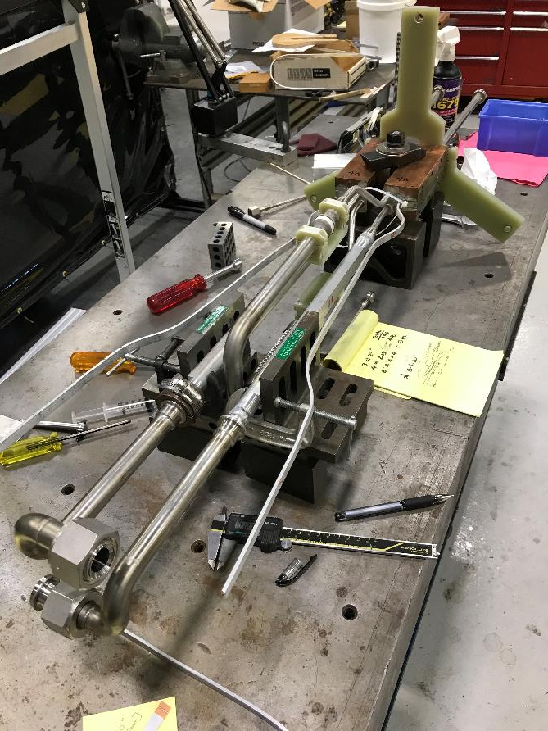
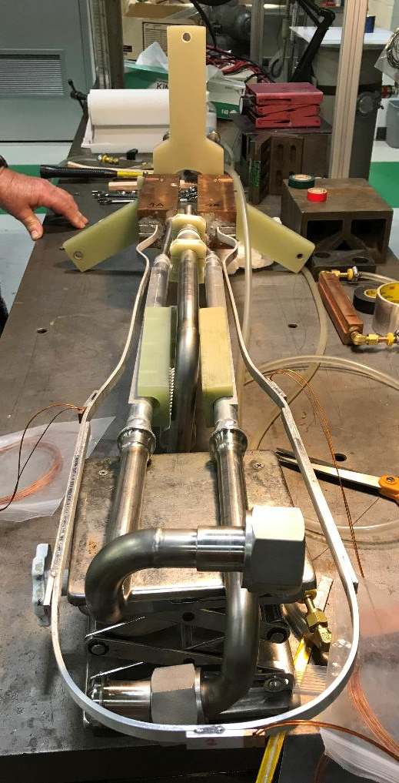
HINS (trim) leads for TSu/TSd

Slide 21
Feedboxes
There is one Feedbox for each of the Solenoids
  Each Feedbox, Indoor Transfer Line, and Solenoid has one common insulating vacuum
  This is important consideration for the ODH analysis and Paschen effect
There are two different “flavors” of Feedboxes
  Tsu/TSd Feedboxes
    Incorporates ASC and HINS power leads
    Forced flow cooling of Solenoids
  PS/DS Feedboxes
    Uses only ASC power leads
    Thermosiphon flow cooling of Solenoids
One of the biggest engineering challenges is that the Feedboxes were manufactured by an outside vendor, but then approximately half of the vacuum jacket and thermal shield must be removed to install the power leads
  There is a lot of installation work to perform within a crowded area inside the Feedboxes to make up the power lead connections
  The Feedboxes are designed to be cut open three times. Additionally, a large flange is included in the hope that any necessary repairs can be made without removing the power leads

Slide 22
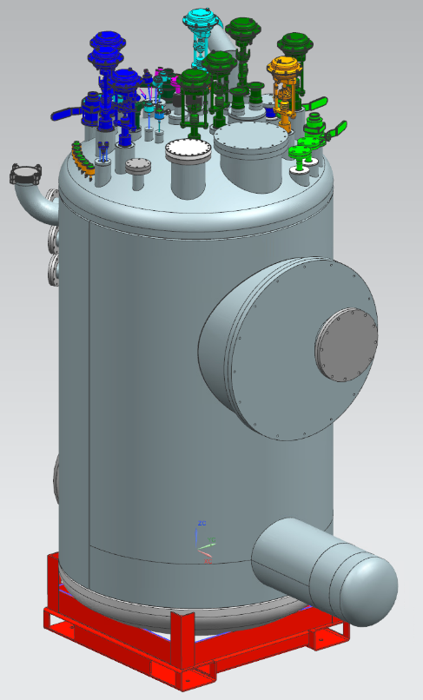
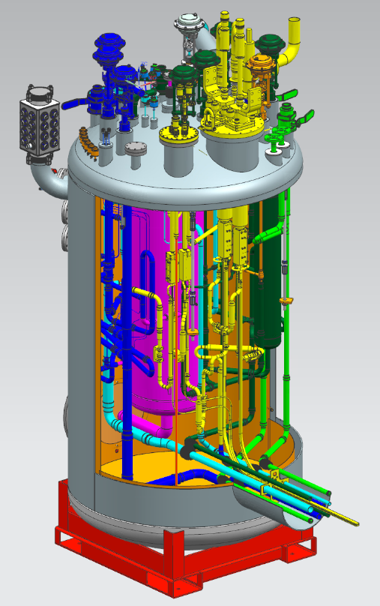
Feedboxes
Tsu/TSd Feedbox Conceptual Model

Slide 23
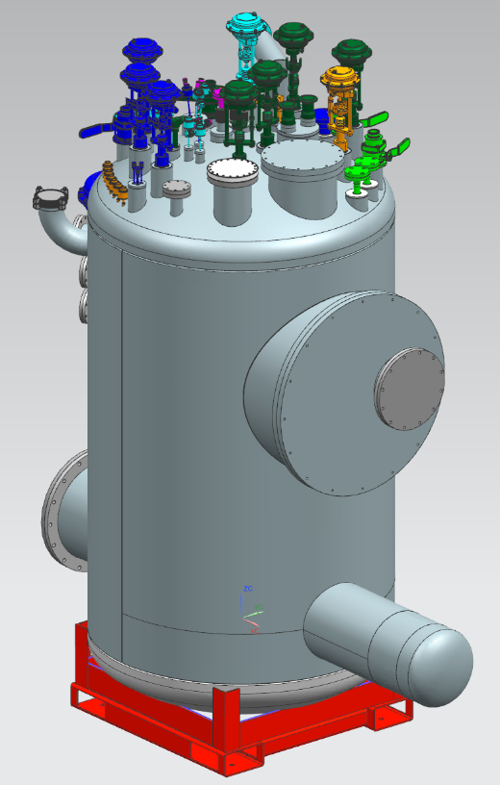
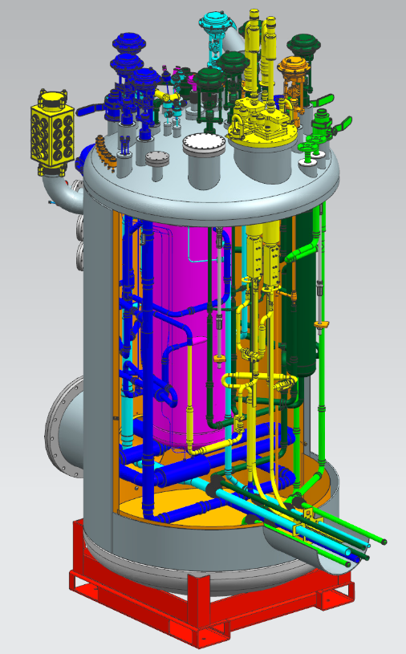
Feedboxes
PS/DS Feedbox Conceptual Model

Slide 24
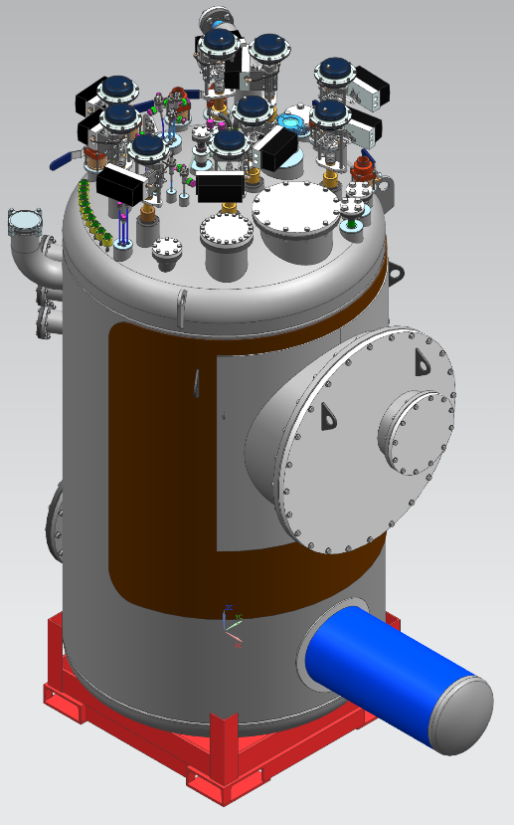
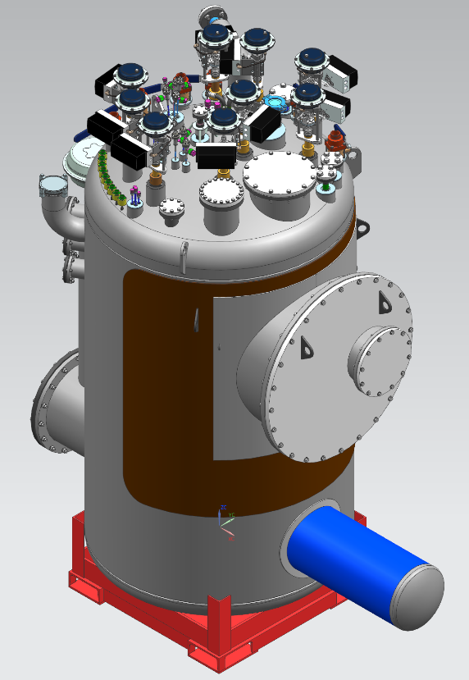
Final Design of Feedboxes
TSu/TSd Feedbox
PS/DS Feedbox

Slide 25
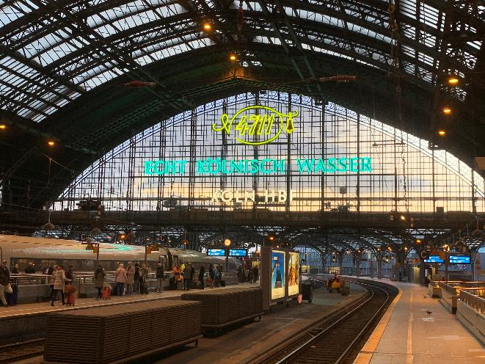
Feedbox Challenges
There are only a handful of manufacturers of custom cryogenic vessel and piping systems in the world.
  We want to get both American and European vendors to bid on large cryogenic procurements to get maximum number of qualified vendors to bid
  Time zones, time/cost of travel, and English as 2nd (or 3rd) language require an increased effort on ensuring frequent and effective communication
In-person visits are essential to success despite the time/cost and all the (mis)adventures of international travel.
Be prepared to get to know the local train station well.

Slide 26
Feedbox Challenges
EN13445 and EN1348 piping codes
  Everything is the same but different
  Expect everything in the EN codes to be in a different order with different variable names and slightly different rules than ASME
  For most piping and all vacuum vessels there is no role of the Notified Body. The FNAL engineer is the Owner’s Inspector similar to ASME B31.3 piping or a vacuum vessel per ASME BPVC VIII.
  Be prepared to spend a significant amount of time learning European codes even if you are an expert with ASME codes
Materials
  Material certifications for Feedbox materials typically included certifications to both ISO/EN standards and ASTM standards.
    This is helpful for when we mix codes. Work at Fermilab done per ASME
  Comparison of low temperature requirements
    ASME places higher emphasis on impact testing
    EN13445 places higher emphasis on using only a few carefully selected materials
  Equivalent of 308L filler metal was used for MDMT > 77K and above
    Small amount of ferrite in weld metal
  Equivalent of 317L filler was used for 5K piping welds
    Fully austenitic weld metal

Slide 27
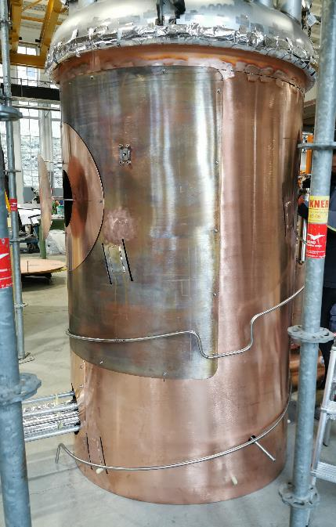
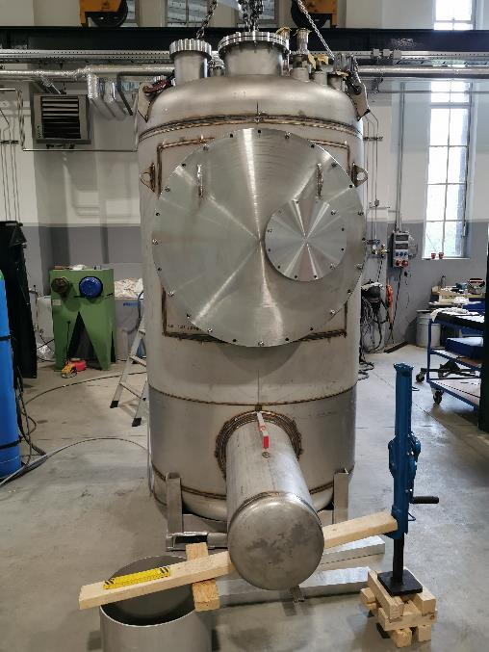
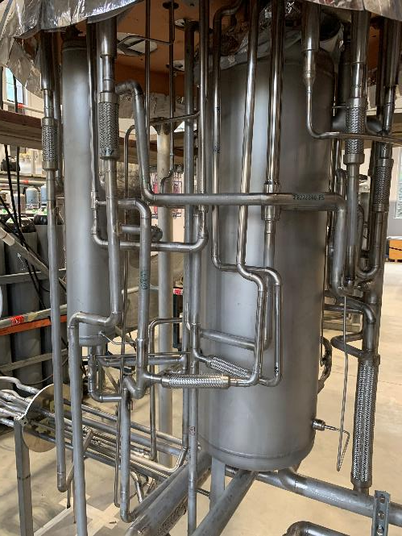
Feedboxes
Feedbox piping, thermal shield, and vacuum vessel fabrication

Slide 28
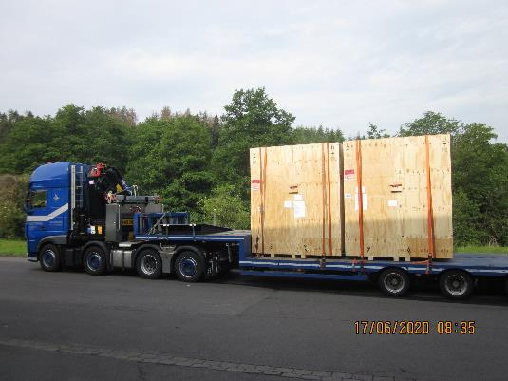
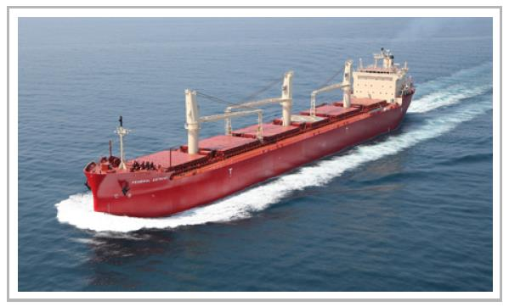
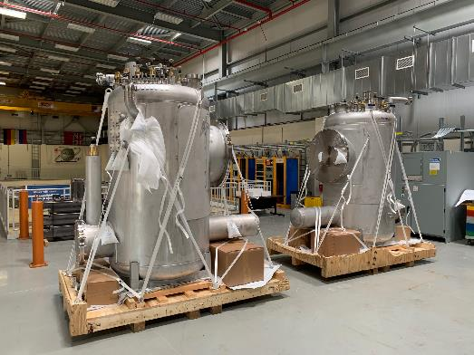
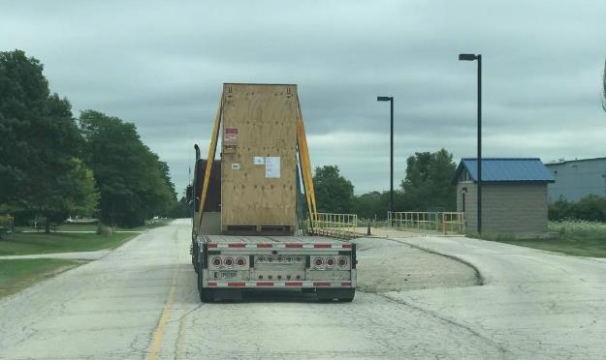
Transport

Slide 29
Delivery Acceptance Testing
Objective is to repeat all factory acceptance tests (FAT)
  In non-pandemic times FNAL would have sent witness for FAT
  Vendor has extensive experience, detailed test procedures and detailed test records
  The Feedboxes were almost certainly leak tight when they left the vendor
Requirement for leak tightness
  Subsystem must pass 1x10⁻⁹ torr-L/s helium leak check
Delivery Acceptance Results
  Vacuum vessel leak check
    3/4 vacuum vessels passed at full vacuum
    Large leak (>>10⁻⁷) in PS Feedbox liquid level port bellows
  Internal piping and vessels leak check
    4/4 helium circuits passed at full design pressure
    4/4 nitrogen circuits passed at full design pressure
  All internal temperature sensors passed electrical checkout

Slide 30
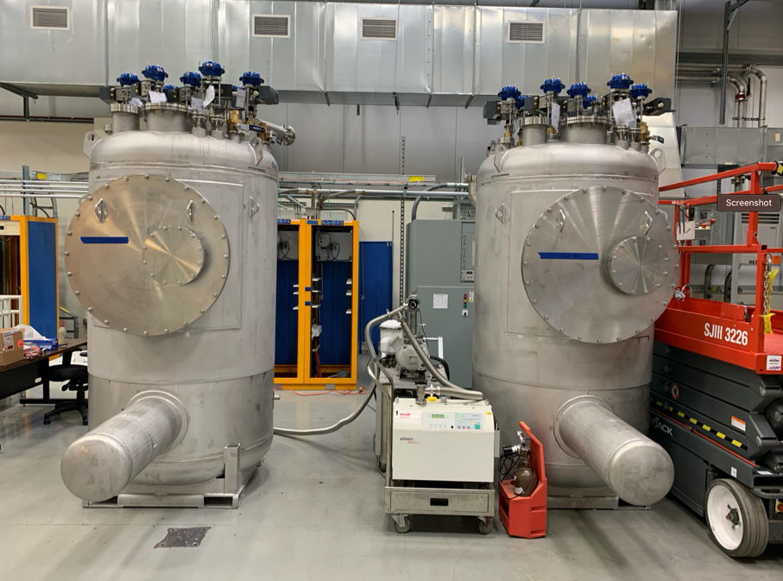
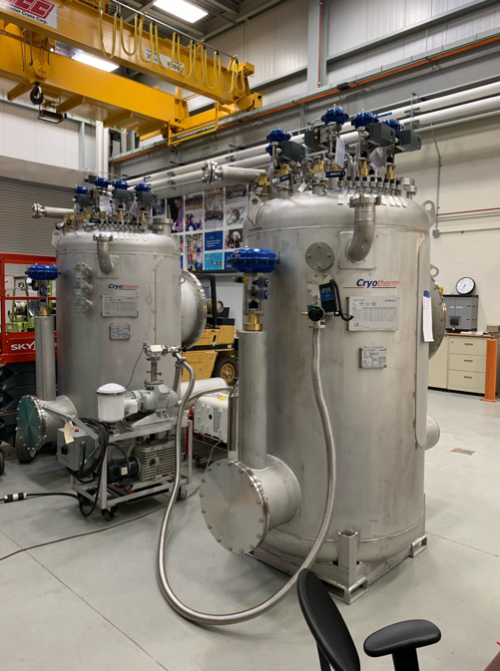
Delivery Acceptance Testing
PS Feedbox
DS Feedbox

Slide 31
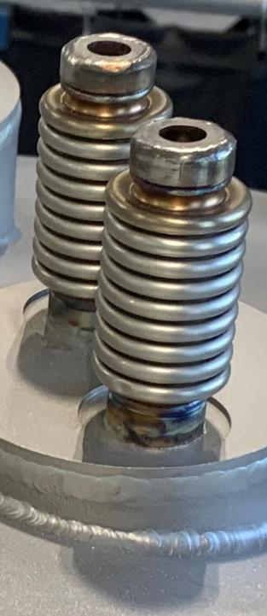
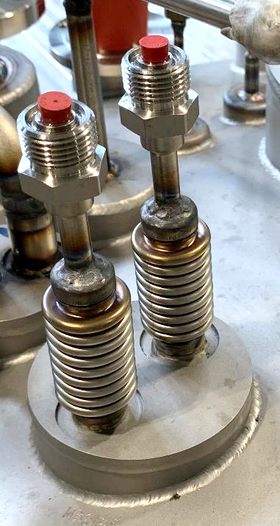
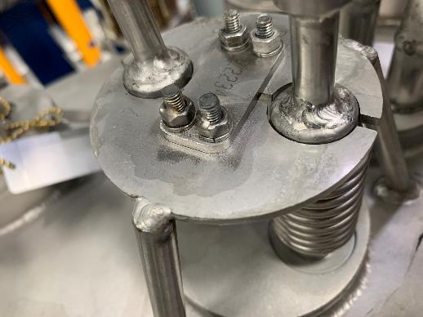
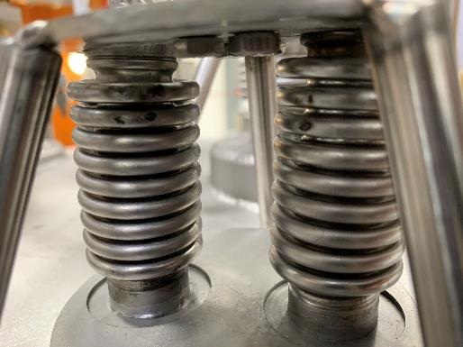
Delivery Acceptance Testing
Prohibit vendors from using pickling paste!
Heat tint should be easily removable with stainless steel wire brush or fine grit sandpaper. If it’s not, then improve welding process (better shielding, less heat, etc.)

Slide 32
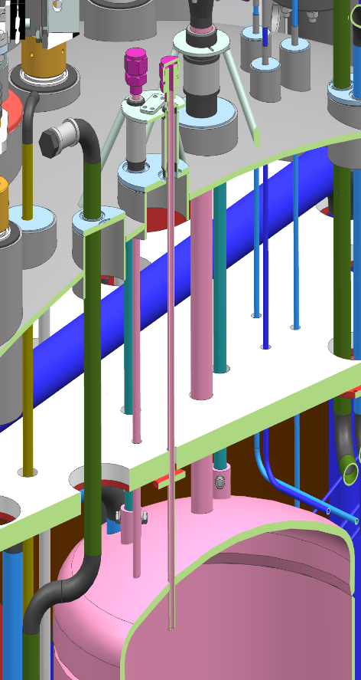
Stainless Steel Internal Weld Protrusion
The liquid level probe has an OD of 0.25”. In 2 out of 4 Feedboxes we cannot get a 0.25” tube into the helium vessel
New smaller diameter level probes will need to ordered
Internal weld protrusion here from fillet weld connect thin wall tubing to a much thicker dished head

Slide 33
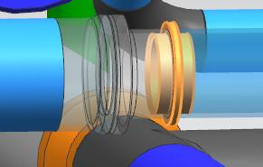
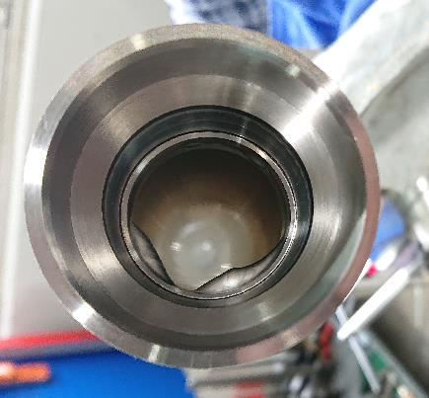
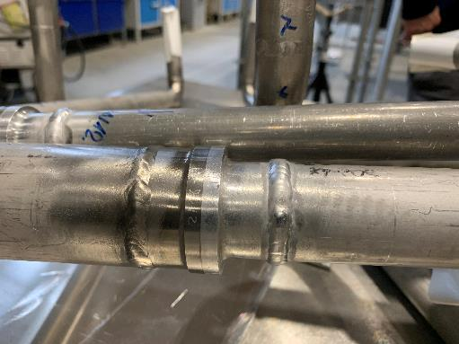
Feedbox Aluminum Welding
Explosion bond bimetallic transition joint
Adapter specifically designed for two small fillets welds to limit welding heat input near the bimetallic fitting and to limit internal protrusion.
Stainless Steel
6061-T6 Aluminum
It turned into one large butt weld with internal protrusion

Slide 34
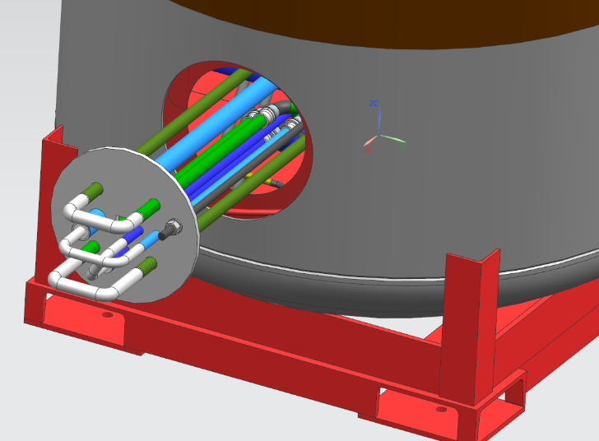
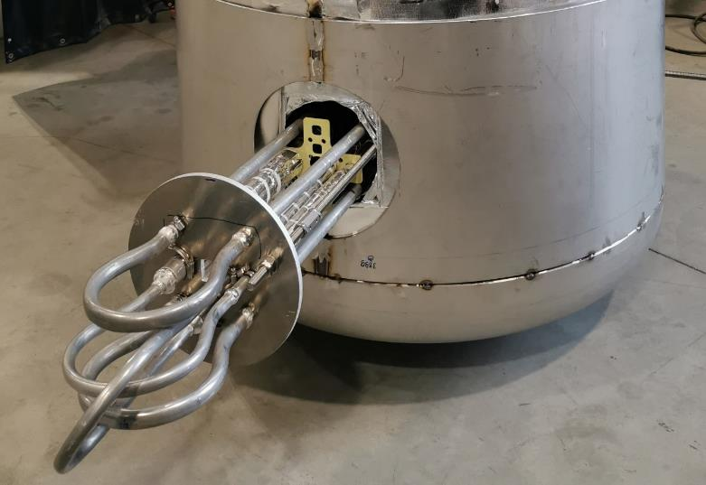
Feedbox Aluminum Welding
Design
Reality
Vendor had difficult time getting the turnaround aluminum tubing welds to seal helium leak tightness
Highly skilled welders qualified per EN/ISO standards have the same struggles as ASME qualified welders with aluminum piping welds (more on that shortly….)
Solution was to replace pipe elbows with aluminum tubing bent into a ‘lyra’ shape to minimize the number of welds

Slide 35

Transfer Line Piping
Red: LN2 Supply
Green: LN2 Return
Yellow: Conductor LHe Supply & Return
Purple: Solenoid LHe Supply
Orange: Solenoid LHe Return
Aluminum piping was chosen so that thermal contraction of piping and power leads would be equal

Slide 36





TSu Solenoid Welds

Slide 37

Transfer Line Aluminum Welding
Transfer Line Objectives
  Minimize potential for internal leaks
  Minimize potential for internal weld protrusion
Background
  Small leaks could lead to electrical arcing (Paschen effect)
  ASME B31.3 allowable internal protrusion for aluminum welds would result in a 34% reduction in thermosiphon flow rate
Actions
  No flexhoses or bellow used
  Specially bent elbows with long straight lengths on each end
  Coupling with two fillets welds used rather and butt weld to limit internal protrusion
  Couplings spaced apart to provide best access for welder
  Even highly skilled experienced welders should practice on test pieces that can be easily examined for internal protrusion before making real weld.

Slide 38

Paschen Effect
Paschen's law is an equation that gives the breakdown voltage, that is, the voltage necessary to start a discharge or electric arc, between two electrodes in a gas as a function of pressure and gap length
Paschen breakdown during a solenoid quench is a low-probability high-risk concern with respect to the superconducting power leads.
A helium leak into the common insulating vacuum could cause a solenoid to quench.
During a quench voltages as high as 600 V can be generated as the stored energy in the solenoid is extracted through dump resistors.
If the helium pressure in the insulating vacuum space is in the Paschen regime the conductor could arc to other parts of the transfer line which are at ground potential and cause significant damage.
Quench voltage
Paschen's law - Wikipedia

Slide 39


Power Lead Insulation
50% overlap Kapton tape of 0.025 mm thickness wrapped around of the aluminum stabilized NbTi superconductor
On top of the Kapton tape Von Roll 7031 varnish is sprayed to provide a secondary layer of protection.
Lead wrapping machine developed for the Mu2e conductors

Slide 40


Power Lead Cooling Clamp
Power lead cooling clamp assembly tested in cryocooler test stand.
TS conductor splice clamps

Slide 41
Questions

