Slide 1
Cryocooler conduction-cooled SRF accelerator cavities
Ram C. Dhuley
Fermilab Engineers’ Retreat, 25 February 2021

Slide 2
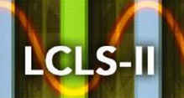
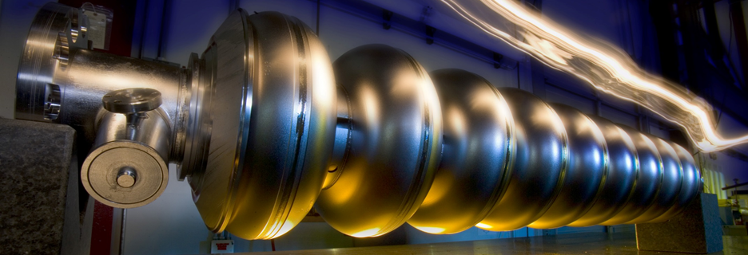
Expanding the application space of SRF technology
From basic science…
to industry…
Electron beam radiation processing applications
Water/sludge/medical waste
decontamination
Flue gas cleanup
Medical device sterilization
Strengthening of asphalt pavements
Radiation processing requires:
Beam energy: 0.5-10 MeV
Beam power: >>100 kW
Industrial settings demand:
Low capital and operating expense
Robust, reliable, turnkey operation
http://accelconf.web.cern.ch/AccelConf/napac2016/talks/thb3io02_talk.pdf

Slide 3
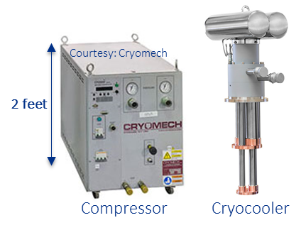
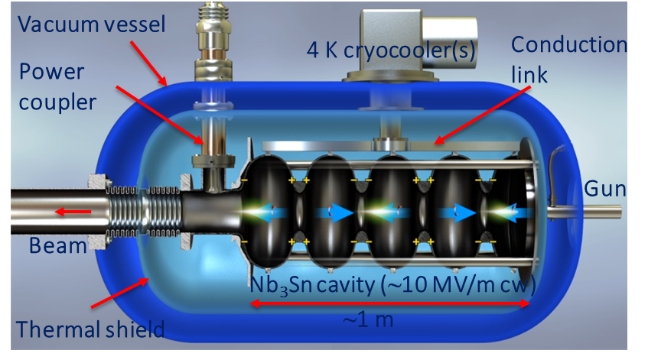
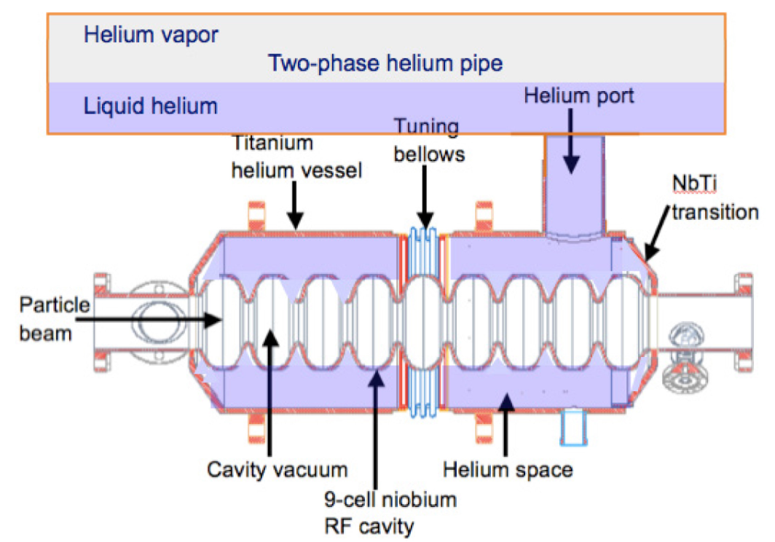
Simplifying SRF cryogenics for industrial settings
R.D. Kephart, SRF2015. https://accelconf.web.cern.ch/srf2015/papers/frba03.pdf
Patents: US10390419B2, US10070509B2, US9642239B2, 63/023,811

Slide 4
Outline – cryogen free SRF
Research and development at Fermilab
Development of cavities and practical cw gradient demonstration
Design and development of a cryogen free SRF accelerator
Activities outside Fermilab and opportunities
Conduction cooling at other labs
An example of SRF research enabled by conduction cooling
Private industry ventures

Slide 5
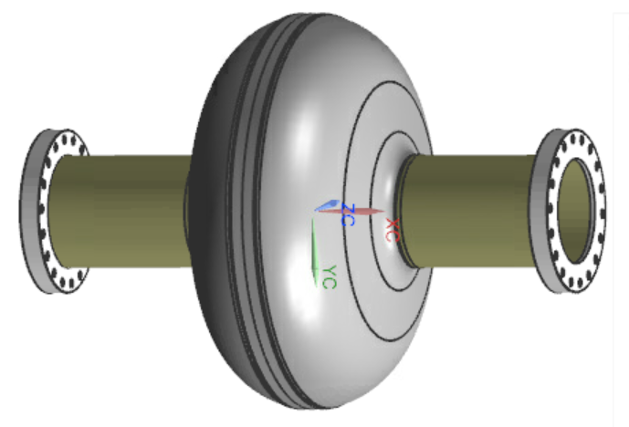
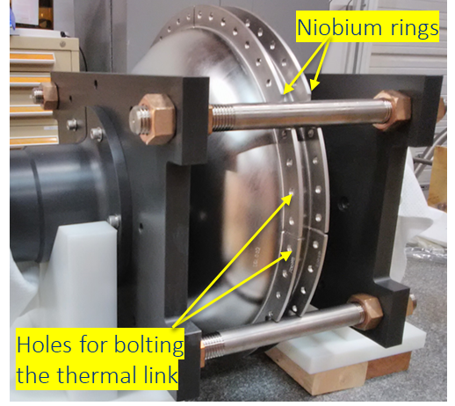
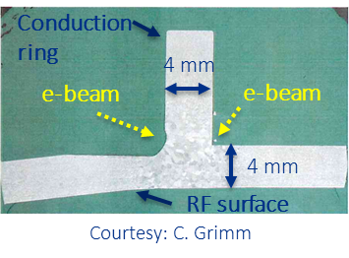
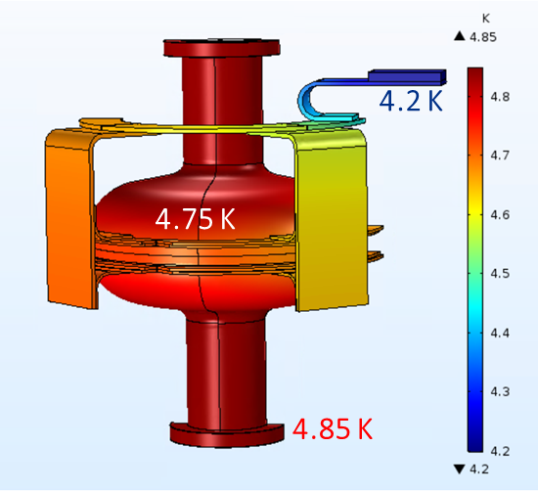
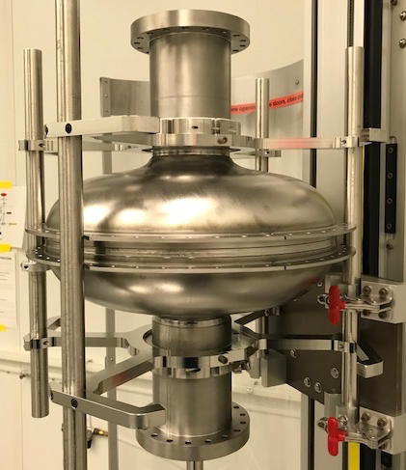
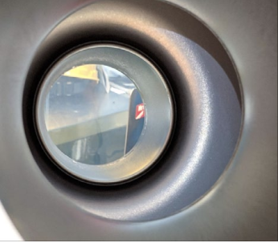
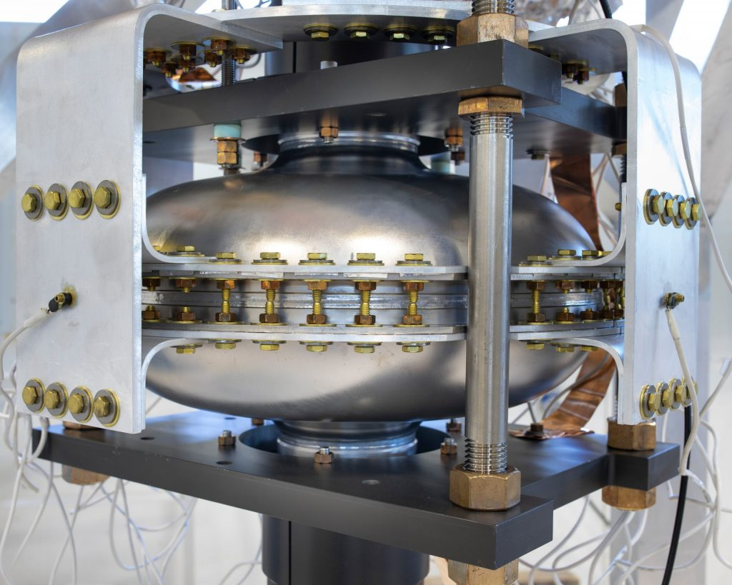
Development of conduction cooled SRF cavities at Fermilab
(supported by Fermilab LDRD 2016-19)
650 MHz Nb single cell
Welding of conduction rings: e-beam parameter development
Fabricate cavity with Nb conduction rings
Design and FEA verification of thermal conduction linkages
RF surface processing, Nb₃Sn coating, and cavity-link assembly
HPR, EP, 800 ⁰C furnace
Nb₃Sn coating
Assembly with thermal links
5N aluminum
links bolted to
Nb conduction rings
R.C. Dhuley et al. (2018) https://doi.org/10.1016/j.cryogenics.2018.06.003
R.C. Dhuley et al. (2019) https://doi.org/10.1109/TASC.2019.2901252

Slide 6
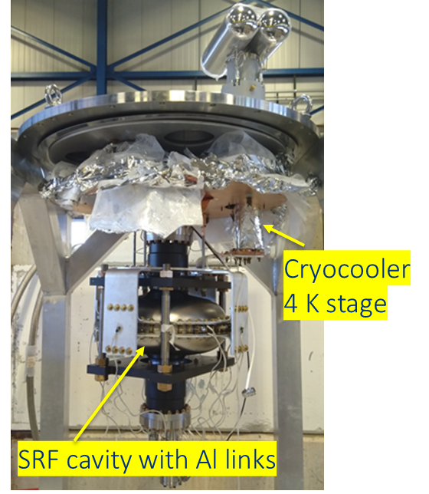
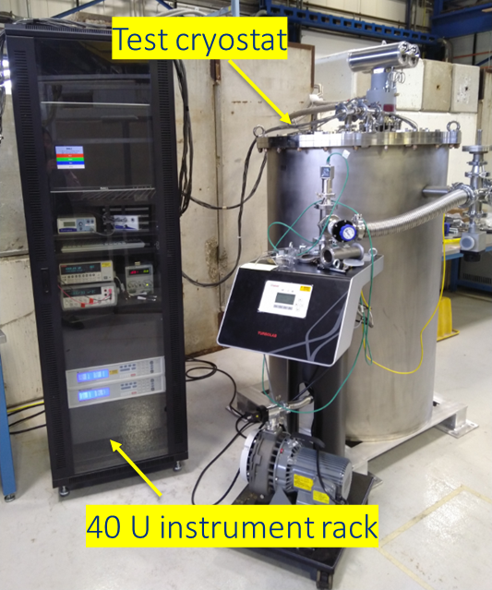
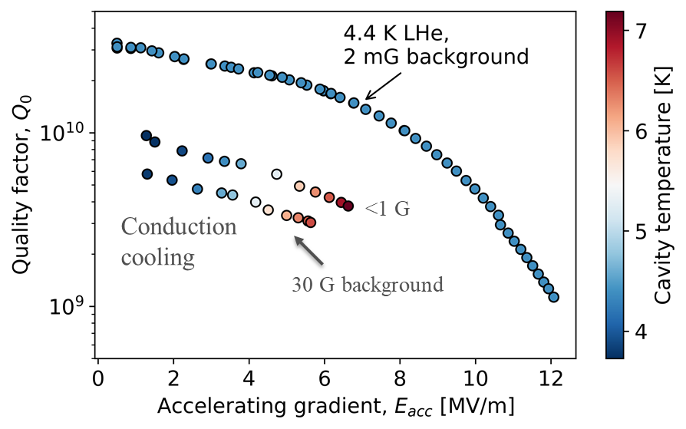
Progress with cavity performance characterization
(supported by Fermilab LDRD 2016-19, DOE HEP Accelerator Stewardship 2019-21)
Development of a conduction cooled SRF (CCSRF) cavity test stand at Fermilab-IARC
Globally first demonstration of practical cw accelerating gradients on an SRF cavity without using liquid cryogens
R. Dhuley et al., (2020) https://doi.org/10.1088/1361-6668/ab82f0
R. Dhuley, S. Posen, et al. (2020) https://doi.org/10.1088/1361-6668/ab82f0
Work in progress to push E_{acc} to 10 MV/m cw

Slide 7
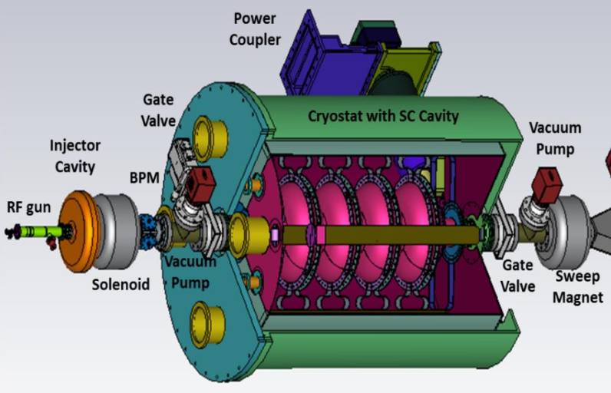
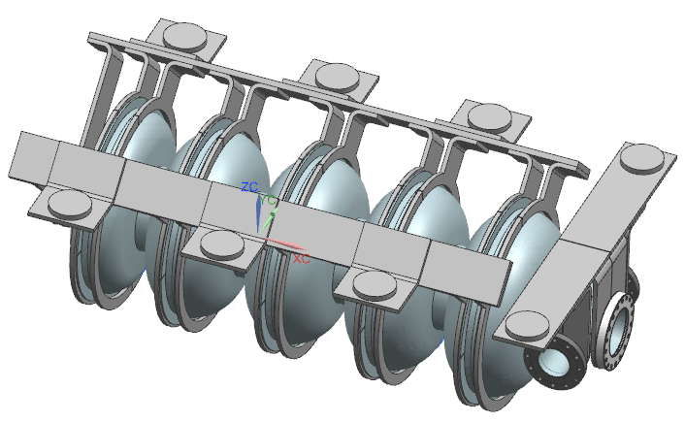
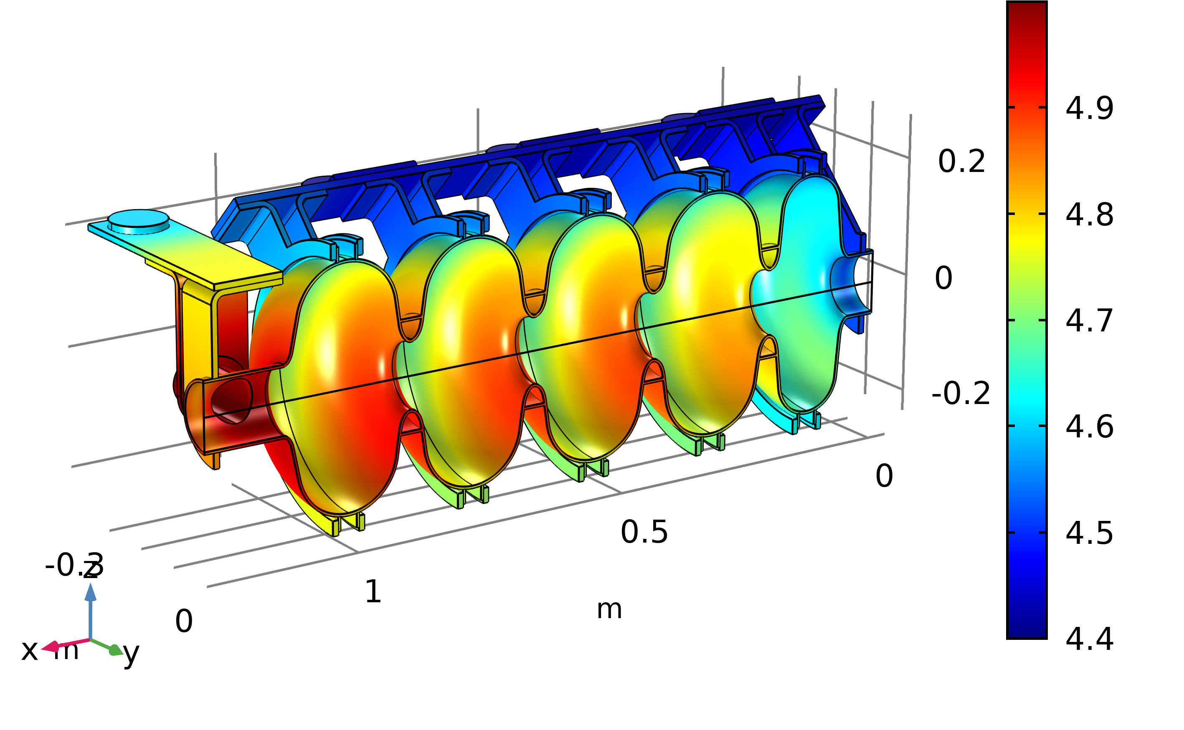
Design of a 10 MeV, 1000 kW (100 mA) module at Fermilab
(supported by DOE HEP Accelerator Stewardship 2019-21)
RF design of a 5-cell 650 MHz cavity
Beam transport simulations
(external injection 300 keV --> 10 MeV)
Estimation of 4 K heat load, cryocooler selection
Design and thermal simulations of conduction link
Cryostat design and integration (thermal and magnetic shield, vacuum vessel, couplers)
Cost assessment
Courtesy : I. Gonin (Fermilab)
8 x PT420 mounting pads
Courtesy : R. Kostin (Euclid Techlabs)

Slide 8
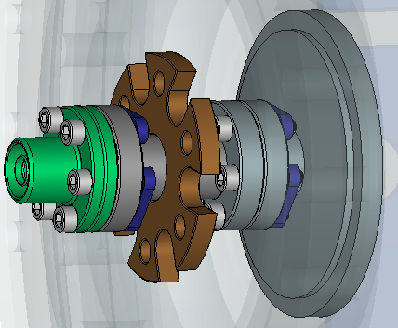
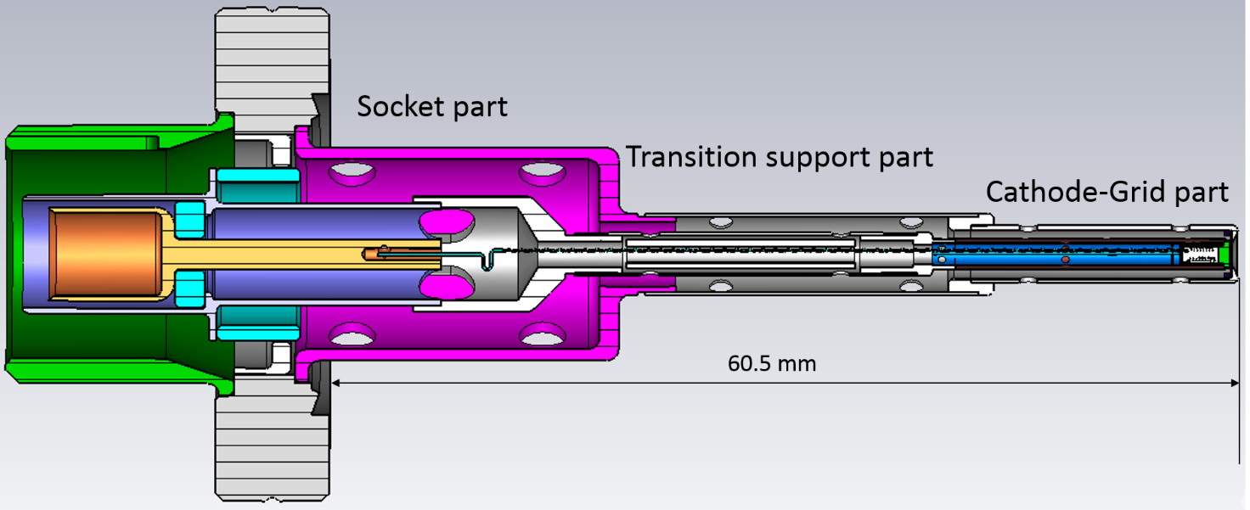
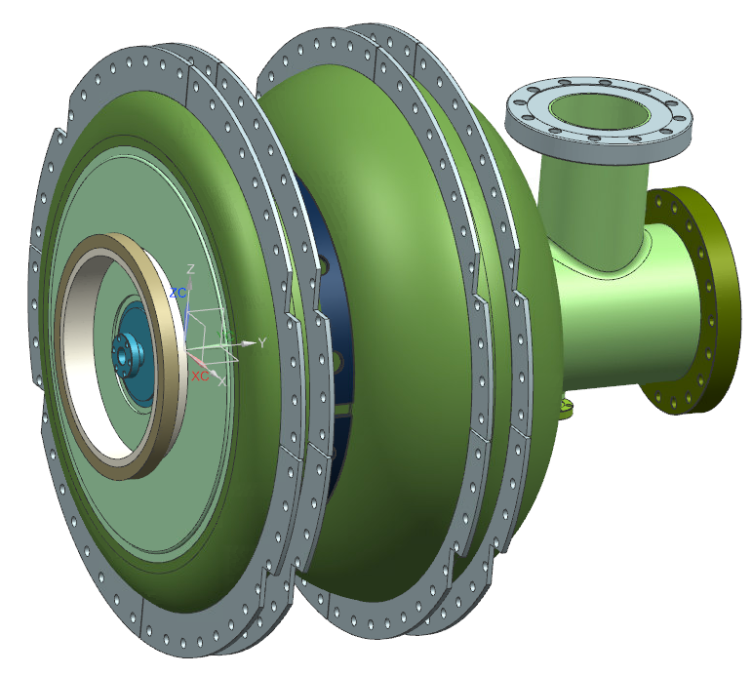
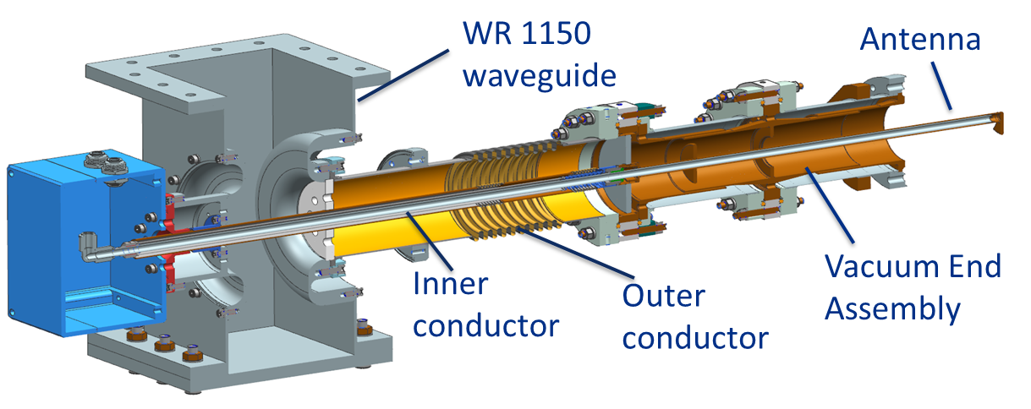
Cryogen-free SRF electron accelerator development at Fermilab
(supported by US Army Corps of Engineers/ERDC; National Nuclear Security Administration)
Goal: Component production, integration, and demo of a 1.6 MeV, 20 kW accelerator
Cavity with integrated e-gun
(design in progress)
Thermionic
cathode
(to be tested)
“1.5-cell” 650 MHz Nb₃Sn cavity
Courtesy : I. Gonin, V. Yakovlev (Fermilab)
Low heat leak
coupler
(to be tested)
Courtesy : S. Kazakov (Fermilab)

Slide 9
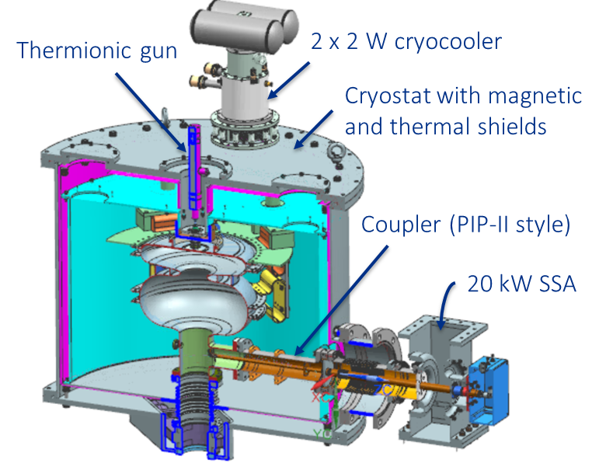
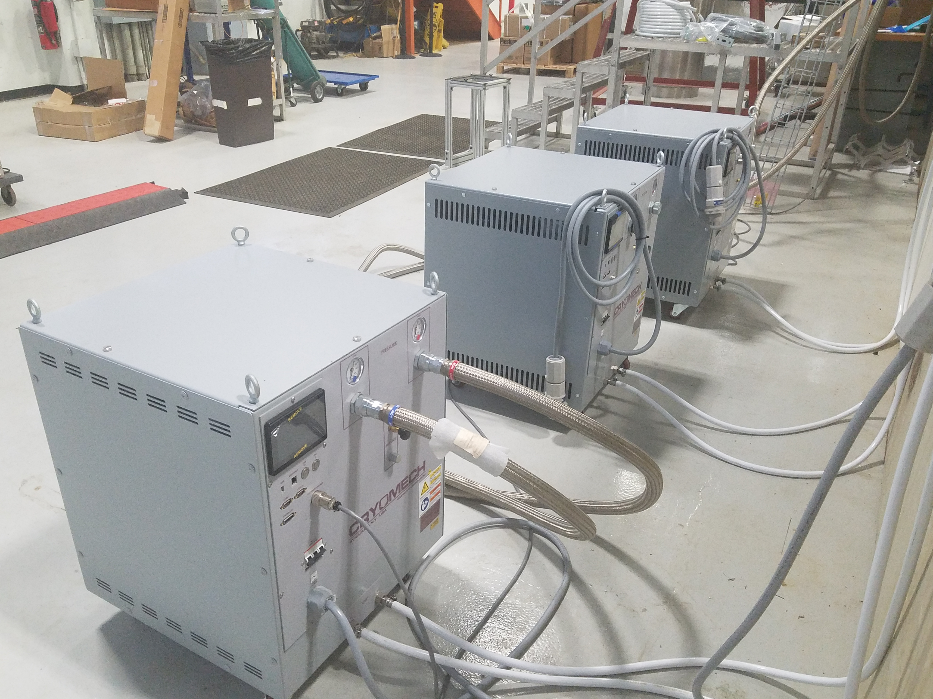
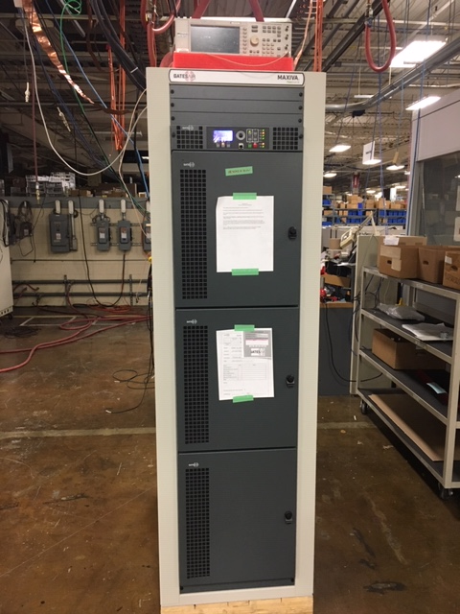
Cryogen-free SRF electron accelerator development at Fermilab
(supported by US Army Corps of Engineers/ERDC; National Nuclear Security Administration)
Cryostat (design in progress)
20 kW SSA (to be installed
and commissioned)
Cryomech PT420 coolers
(to be commissioned)
Courtesy : M.I. Geelhoed (Fermilab)

Slide 10
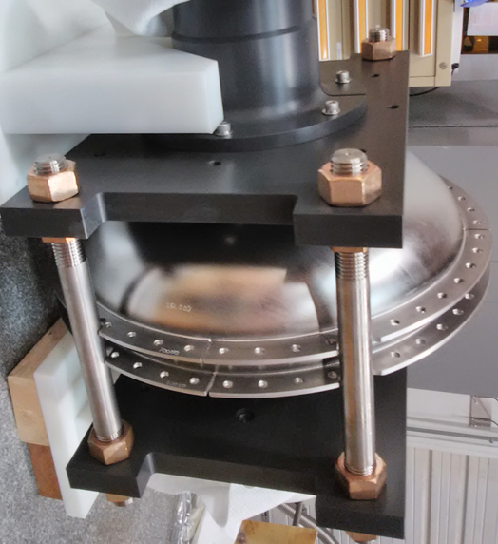
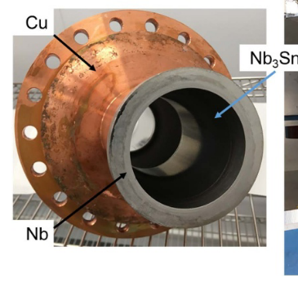
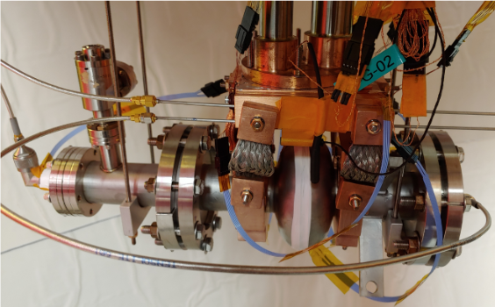
Fermilab is not alone!
Fermilab
Jefferson Lab
Cornell University
https://doi.org/10.1088/1757-899X/755/1/012136
https://arxiv.org/abs/2002.11755
1.5 GHz
Cold sprayed +
electrodeposited copper
2.6 GHz
Copper clamps
650 MHz
welded niobium rings

Slide 11
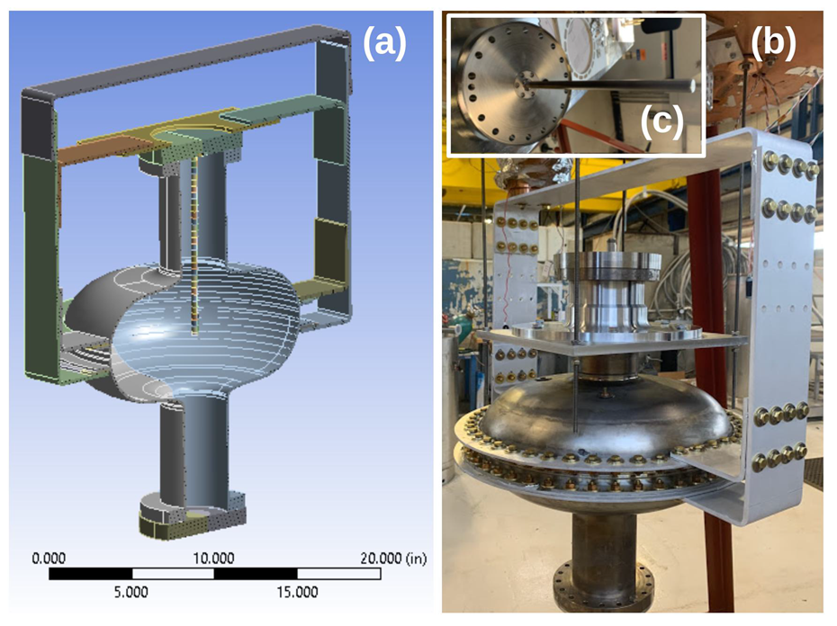
Enabler for academia: SRF R&D without needing full
stack helium cryogenic systems
Osama Mohsen completed PhD research in 2020 using conduction cooled SRF apparatus at IARC@FNAL (https://arxiv.org/abs/2012.13388v1)
High repetition rate field emission source using a conduction cooled SRF cavity
More opportunities:
Study of Nb₃Sn layer degradation due to electron bombardment from a cavity-integrated electron source
Cryocooler cuts down cooldown/warmup cycle time - enable fast turnaround experiments on new thin film coating techniques and material science for SRF

Slide 12
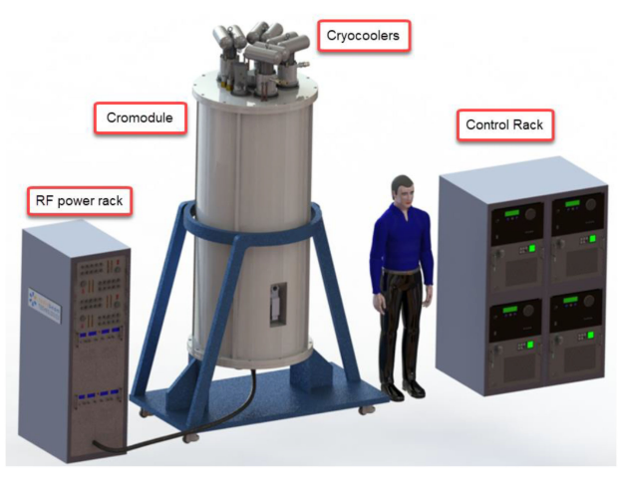
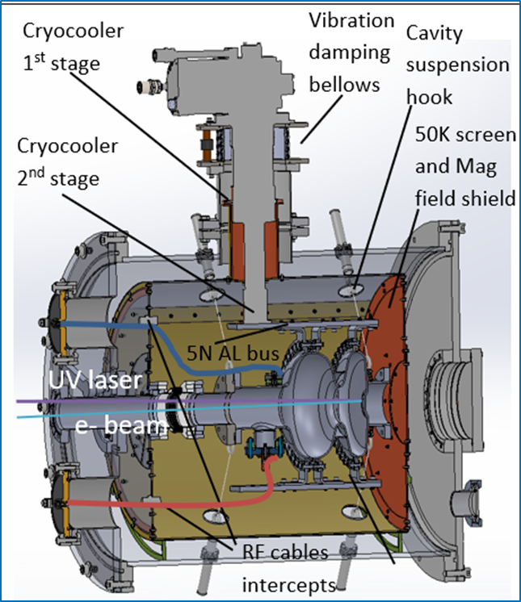
Enabler for industry: Private ventures
Standalone cryomodule for QW resonators
S. Kutsaev et al. (2020),
https://ieeexplore.ieee.org/document/9119112/
SRF photogun for UEM/UED applications
R. Kostin et al. (2020),
https://indico.classe.cornell.edu/event/1806/contributions/1460/

Slide 13
Acknowledgement
This presentation has been authored by Fermi Research Alliance, LLC under Contract No. DE-AC02-07CH11359 with the U.S. Department of Energy, Office of Science, Office of High Energy Physics.
Conduction-cooled SRF demonstration: J.C.T. Thangaraj, Fermilab LDRD
Accelerator design studies: R.C. Dhuley DOE HEP Accelerator Stewardship Award
Compact SRF accelerator development: T. Kroc, R.C. Dhuley NNSA and R.D. Kephart, US Army Corps of Engineers (ERDC)
Nb₃Sn SRF R&D: S. Posen, Fermilab LDRD and DOE Early Career Award

Slide 14
Thanks! Questions?

Slide 15
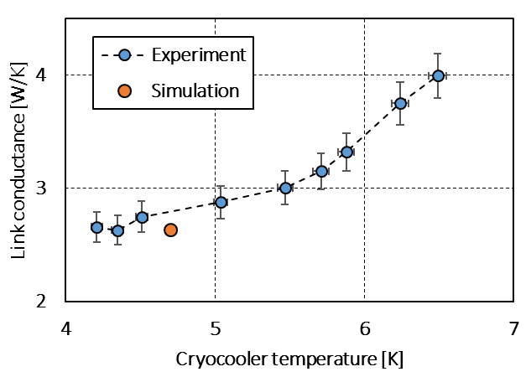
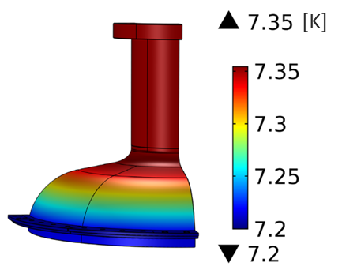
Extra: Conduction link performance, cavity thermal stability
Comparison of measured and simulated
link thermal conductance
Computed cavity surface temperature at steady state with 6.6 MV/m cw
Ring temperature = 7.2 K (boundary condition)
RF dissipation = 4 W (boundary condition)
Increasing P_{diss} with E_{acc}
ΔT_{spatial} <0.15 K
T_{max} < 9 K
Good match!
Courtesy : R. Kostin (Euclid Techlabs)

Slide 16
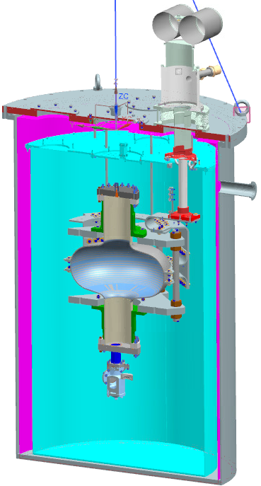
Extra: IARC CCSRF test stand
Two-stage cryocooler
55 W @ 45 K
2 W @ 4.2 K
Euclid Techlabs
RF system
- 10 W cw @ 650 MHz, 1.3 GHz
- Resonance locking
- P_{f}, P_{r}, P_{t}, τ_{L} measurements
Thermal shield
(cooled by the 45 K stage)
Magnetic shield
(~15 mG)
SRF cavity with Al link
(cooled by the 4 K stage)
Vacuum vessel
0.8 m

