Slide 1
Near Site Conventional Facilities (NSCF)
Kate Sienkiewicz and Kennedy Hartsfield
Near Site Integration Workshop
16 March 2021

Slide 2
Outline
Introduction to NSCF
NSCF Design
Near Detector Complex

Slide 3
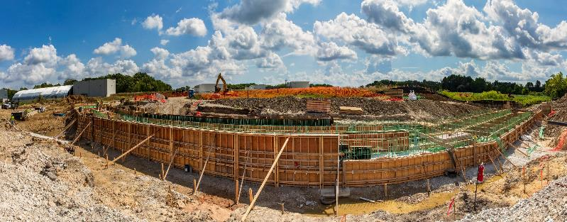
NSCF Technical Design Status
In last phase of Final Design
Near Detector requirements under configuration control
NSCF design up to date in the Near Site integrated 3D model
60% Final Design deliverable due next week (March 26th)
Last chance to review design for facility and interface issues so we have time to resolve with you
Space claims within Near Detector cavern, shaft, and ND Service Building
Electrical and mechanical design meets your requirements
Access and laydown areas meet your requirements
Changes after NSCF design completion or during construction typically increase cost impact
60% Final Design Review period March 29 – April 16
Page turns with stakeholders the first two weeks of April
Comments due no later than Friday, April 16th
Construction note: Near Detector Complex AUP planned for July 8, 2026
NSCF Site Prep Construction – Summer 2020

Slide 4
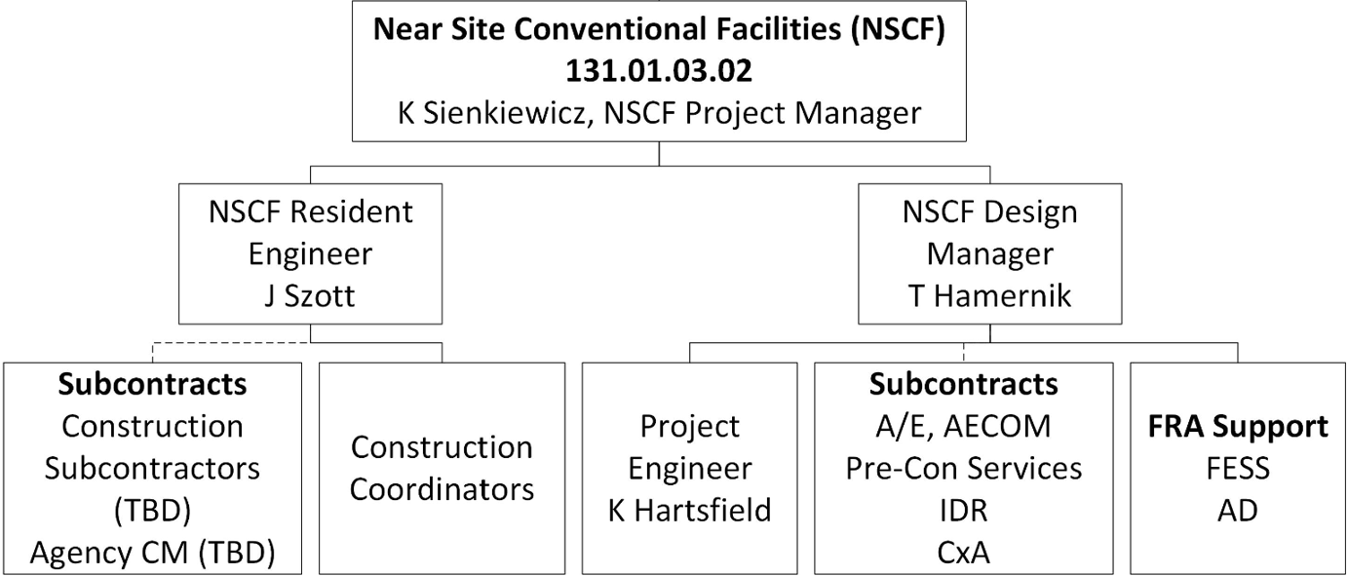
NSCF Team and Communication Lines
NSCF team members
Fabrice is our main point of contact for NSI and ND
Work through him for changes and issues
Near Site integrated 3D model resource for interface discussions and clash detection
Ad hoc technical breakouts with NSI and ND stakeholders
Recently discussed electrical load and equipment, grounding, controls, equipment coordination, mezzanine, roof hatch, ODH air flows
Page turns for 60% Final Design Review opportunity to discuss with NSCF team how the NSCF technical design meets the ND requirements

Slide 5
NSCF Design
What does NSCF scope include?
All the “civil” or “house” needs for the Near Detector Complex
Building Code Design and Compliance
Construction staging planning
Environmental Permitting – Wetlands!

Slide 6
Site Works
Parking
Contractor Laydown
Wetlands
Existing and New Site Utilities
Site Boundaries
Exterior Infrastructure (Cryo Foundations)

Slide 7
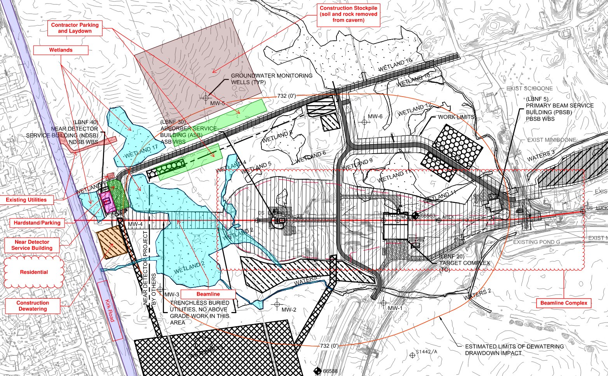
Site Works

Slide 8
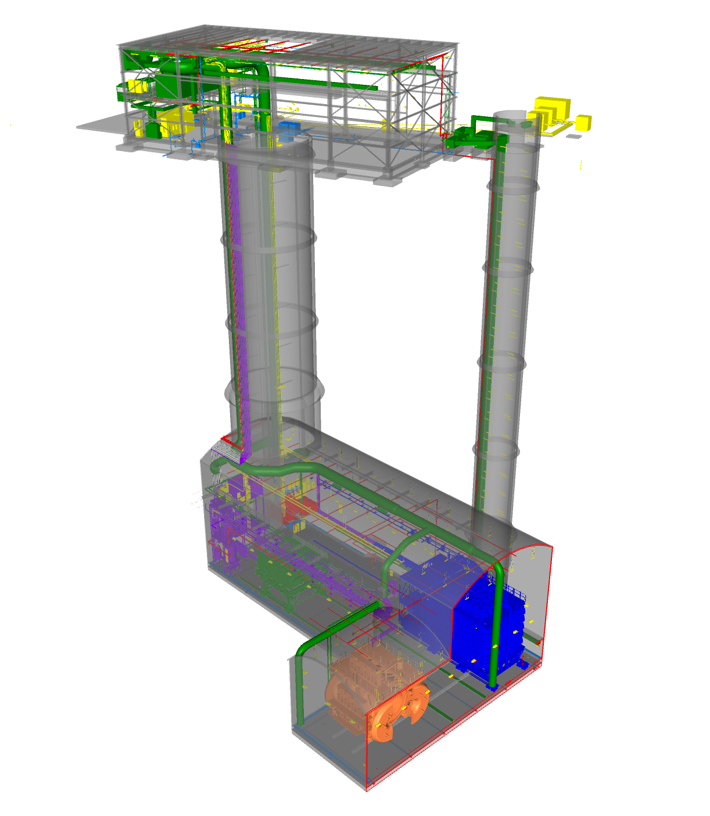
Near Detector Complex (NDC)
Near Detector Service Building (NDSB -Above Ground)
Near Detector Hall (NDH - Underground)

Slide 9
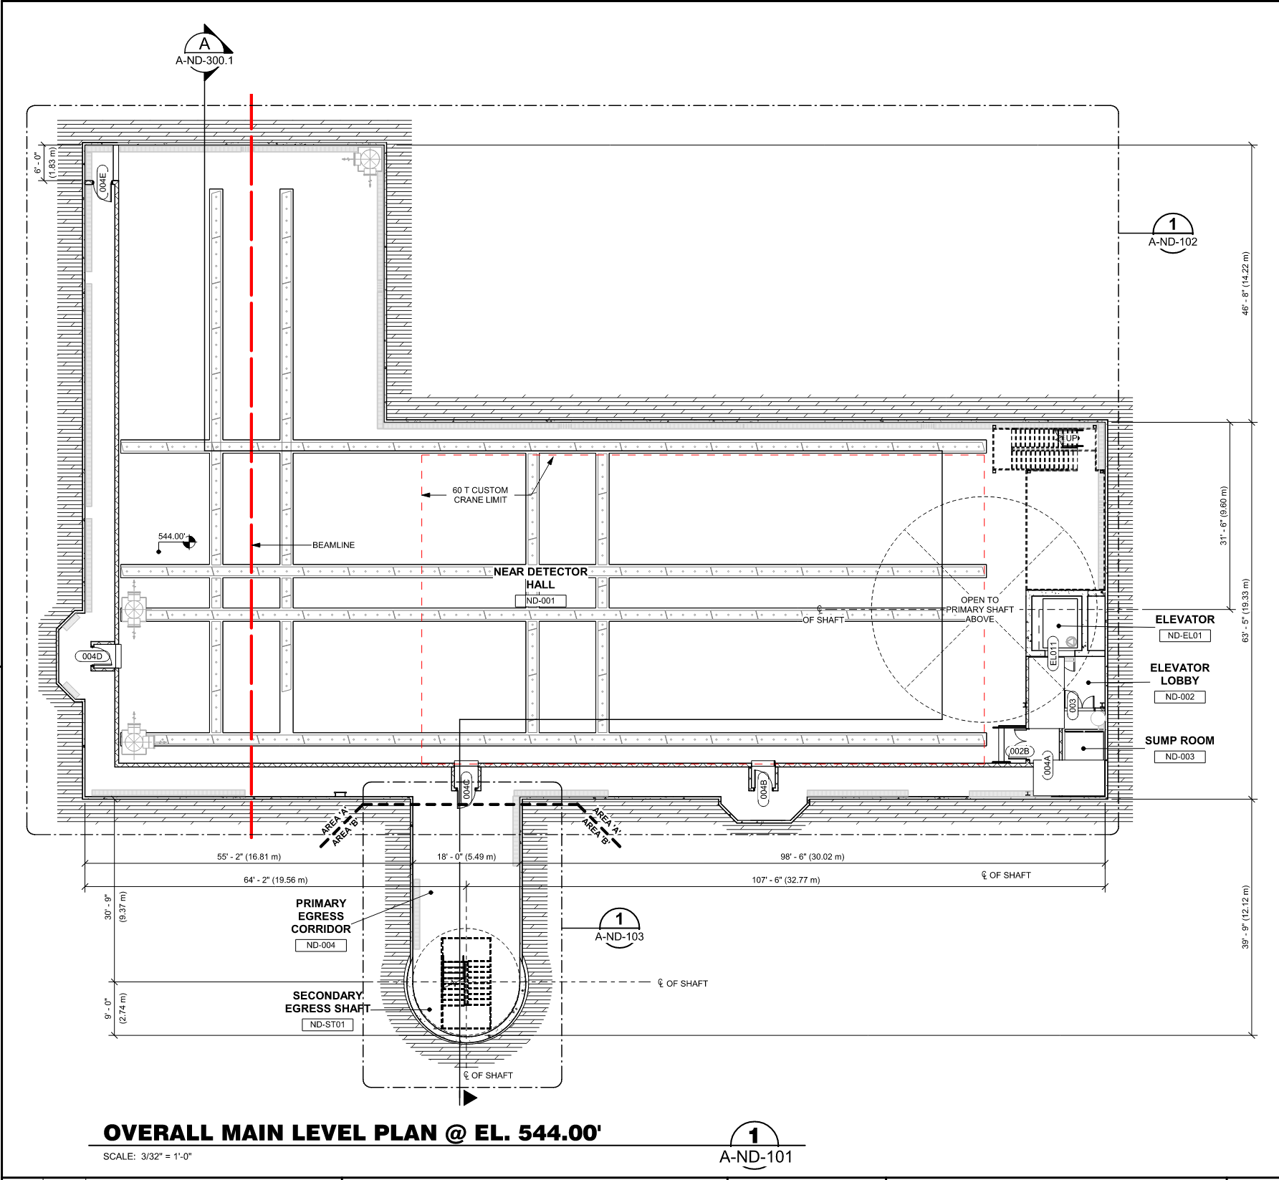
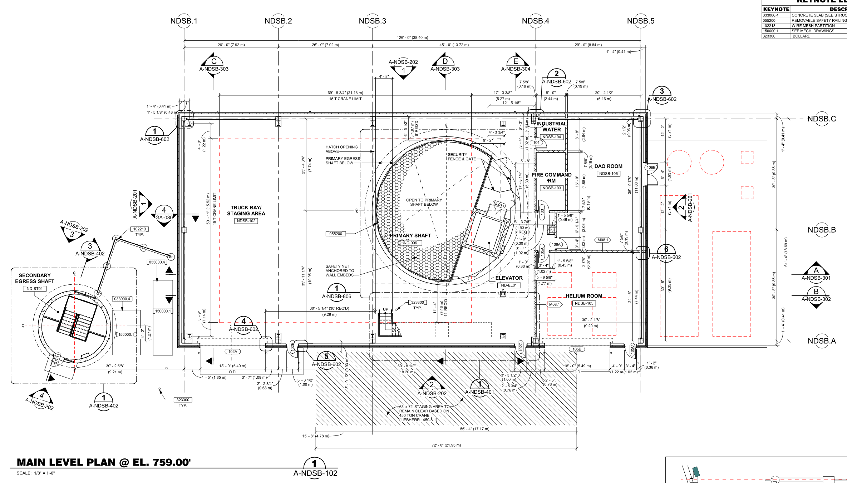
Near Detector Complex
~172 ft
~50 ft
~126 ft
~46 ft
38 ft
~63 ft
~92 ft
Near Detector Hall (NDH)
Near Detector Service Building (NDSB)

Slide 10
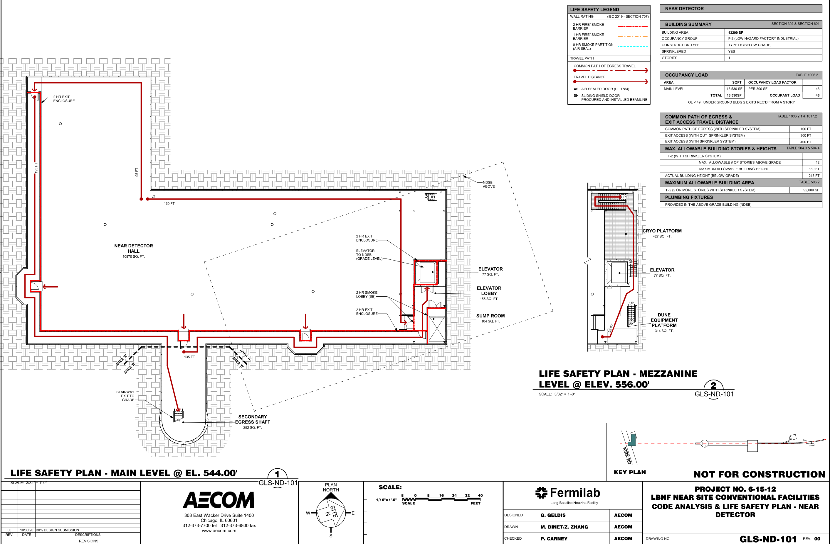
Life Safety / Architectural
Emergency Egress, Lighting, Ventilation, & coordination with ODH
Building Code Analysis
Occupancy Underground =
46 People Maximum
Did you know Fermilab has our own Fire Department on site? A security department as well!

Slide 11
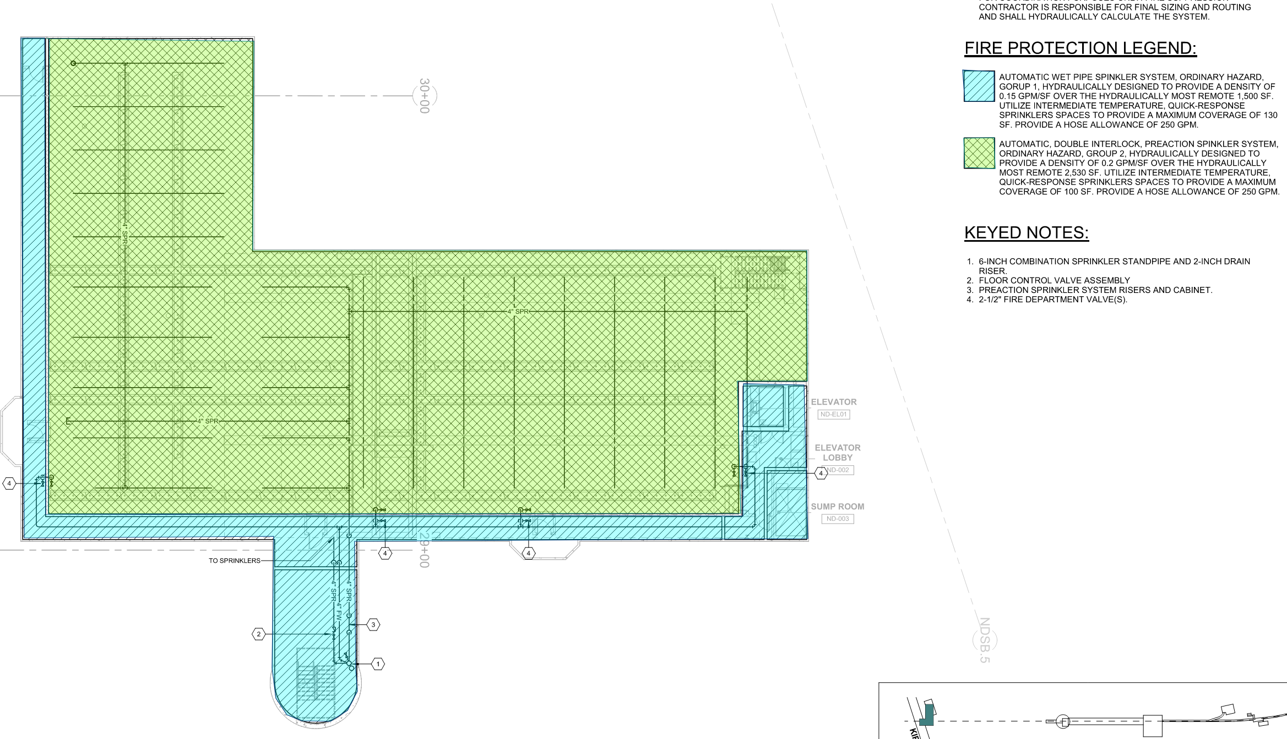
Life Safety / Architectural
Double Interlock Fire Sprinklers over the detectors and
cryo mezzanine
Fire Protection in NDH and NDSB
Automatic wet pipe sprinkler system in non-detector spaces

Slide 12
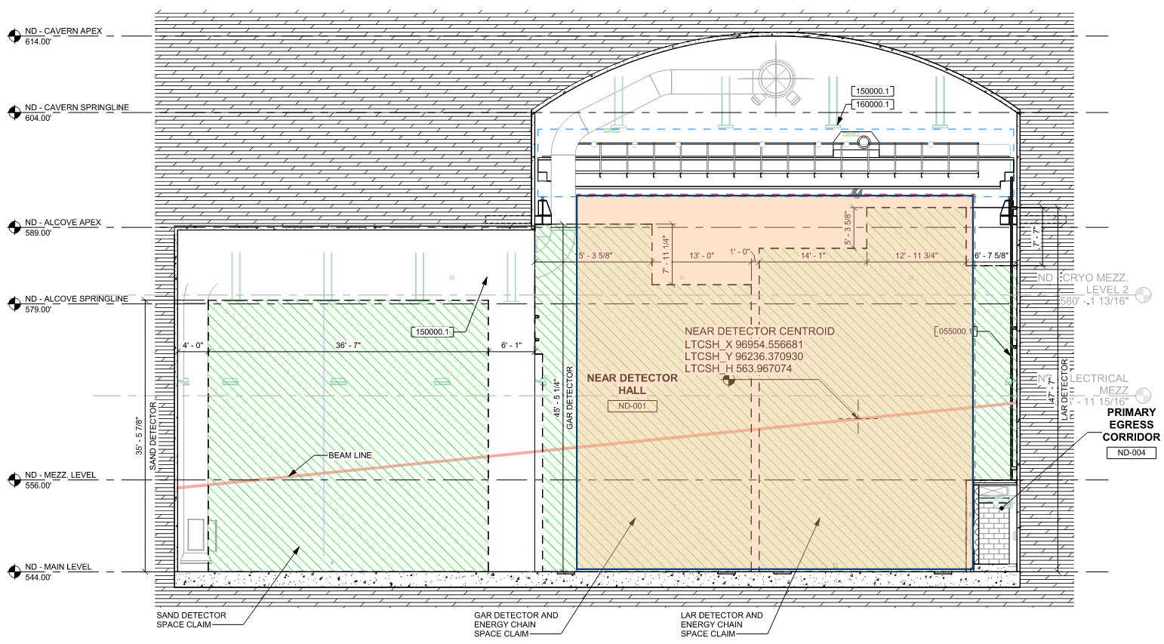
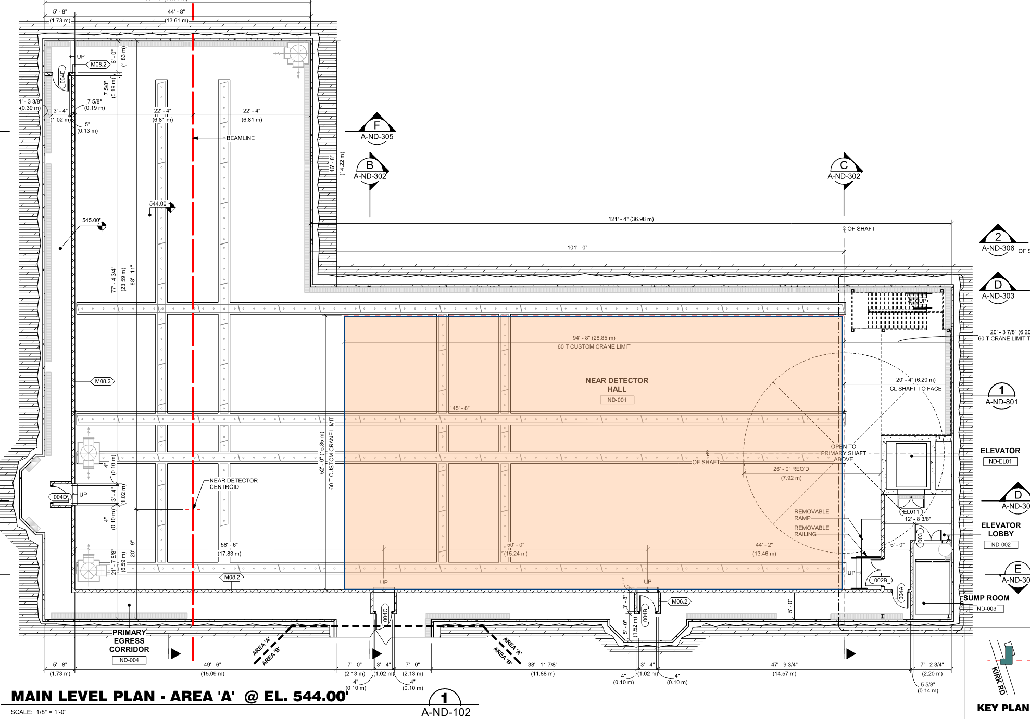
Overhead Bridge Cranes
NDH Crane – 60 US short Tons
“Green Box” is space claim reservation for detectors. This is the “Envelope” provided for the detectors in which to live
Crane Hook Coverage

Slide 13
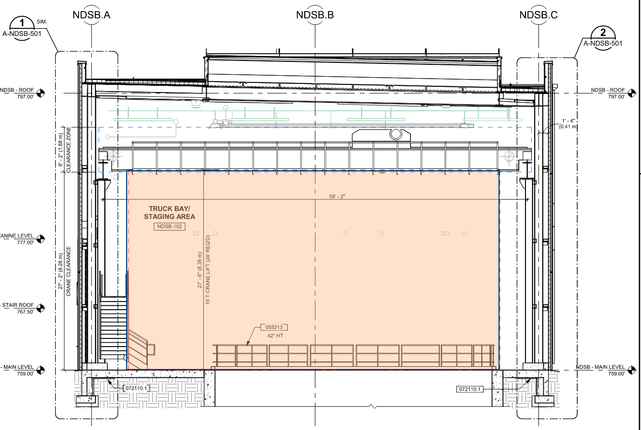
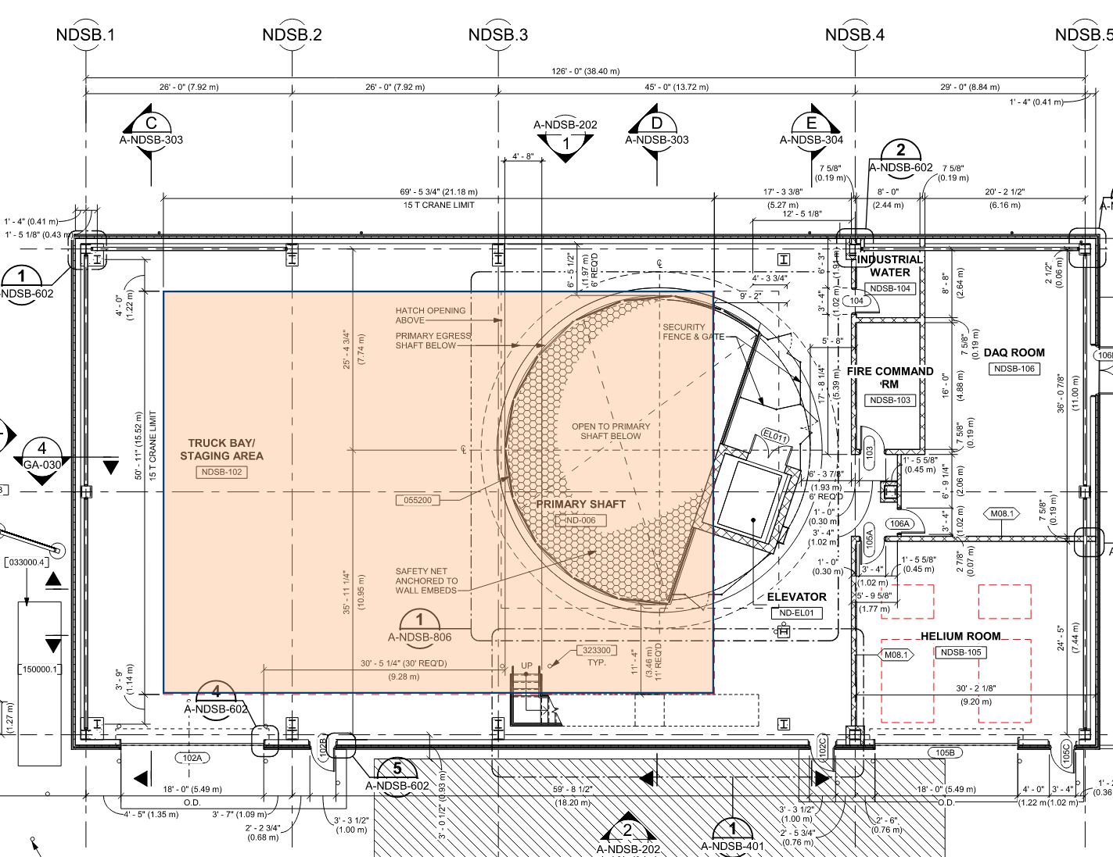
Overhead Bridge Cranes
NDSB Crane – 15 US short Tons
Crane Hook Coverage

Slide 14
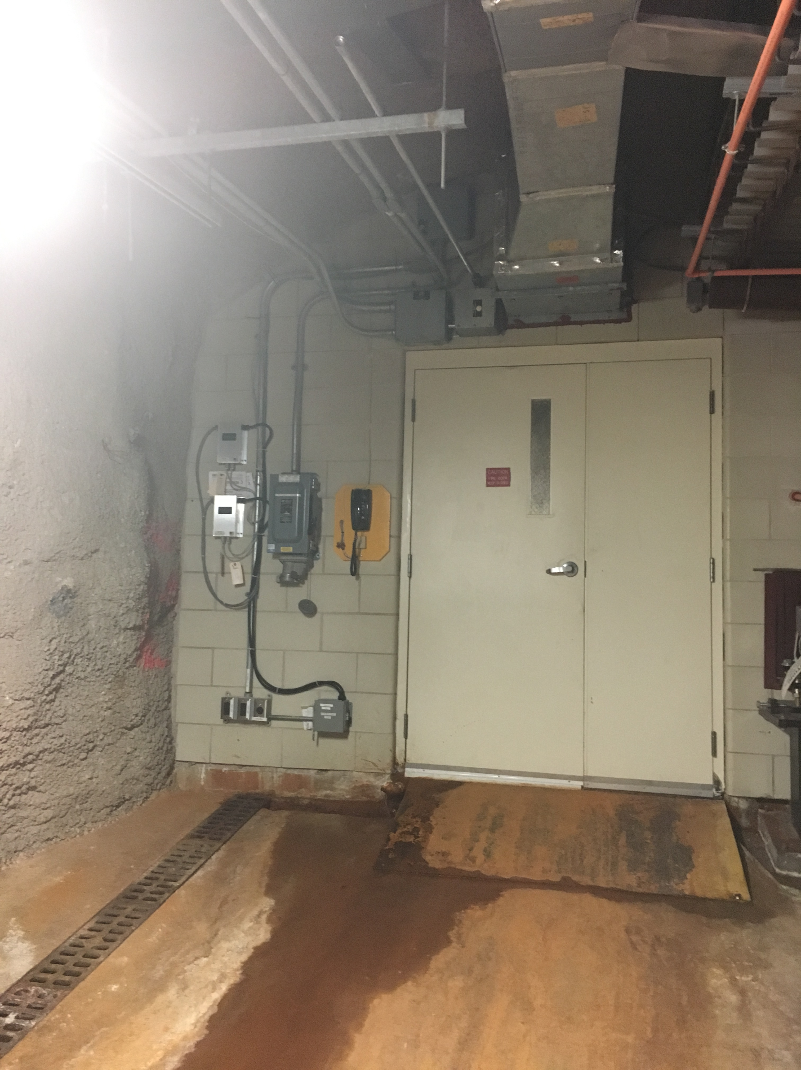
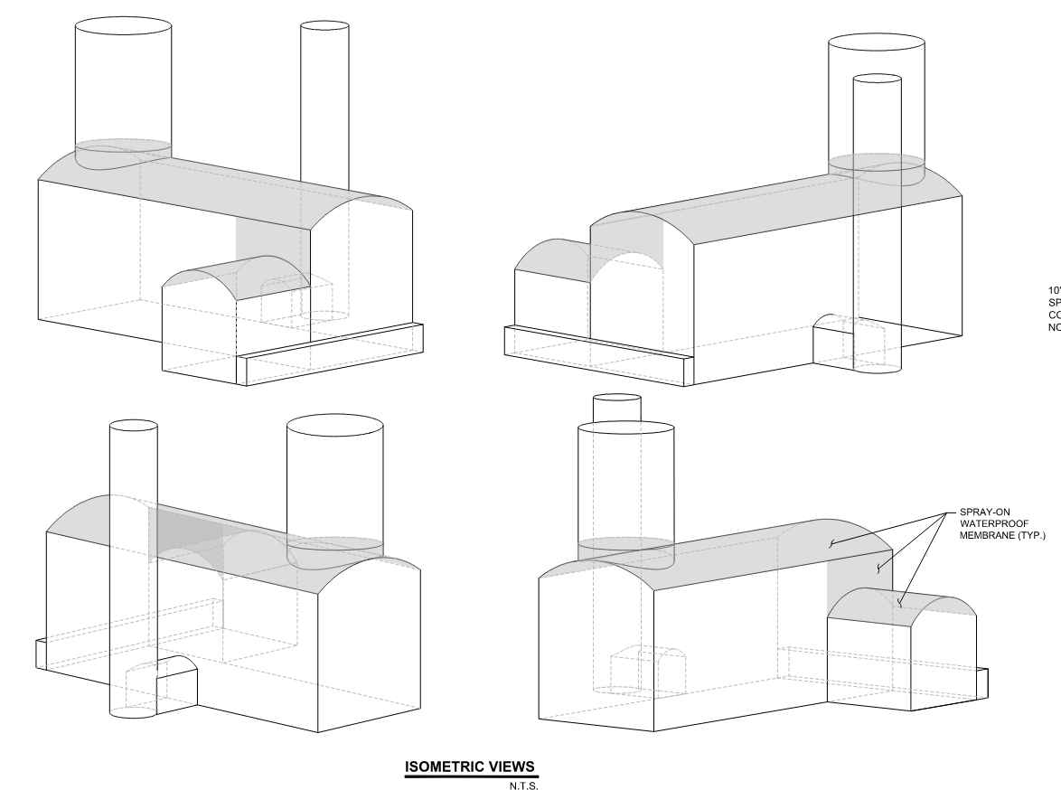
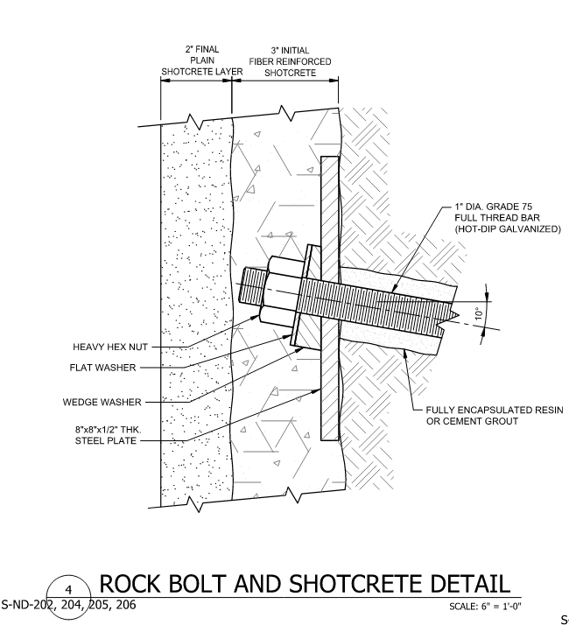
Structural Cavern Support
Dimensions to walls are given clear to face of final shotcrete
Spray Applied waterproofing to ceiling protects equipment and detectors from ceiling drips
“Gun Shot” finish
Clear
Dimension
Waterproof Membrane

Slide 15
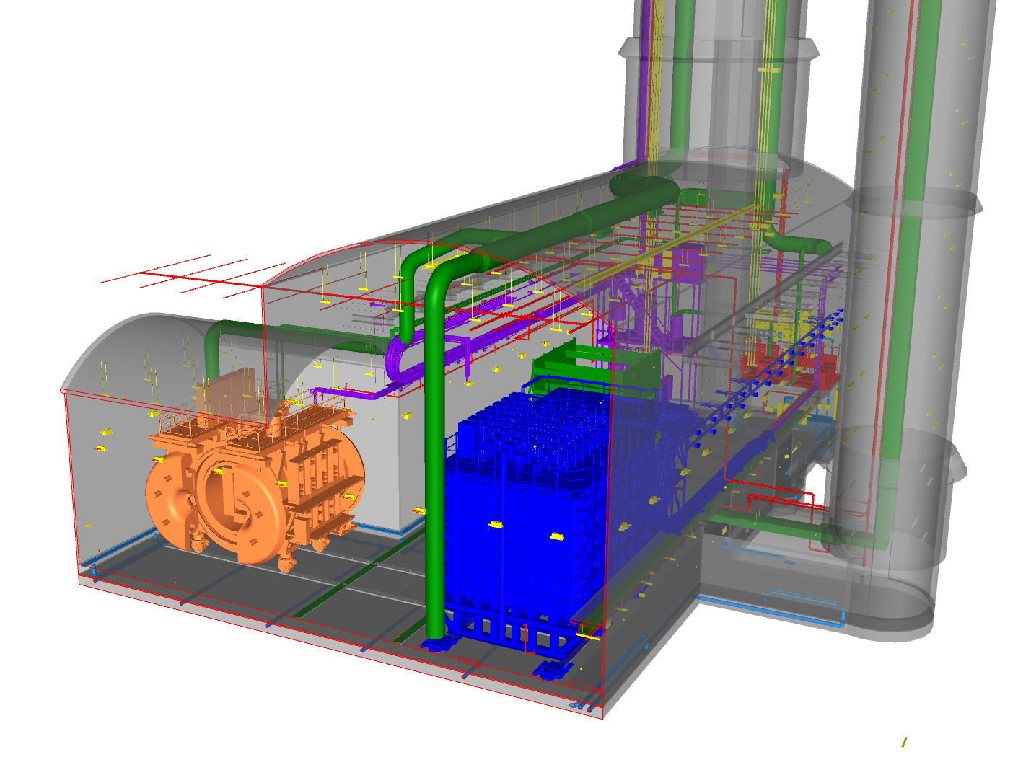
Mechanical HVAC
Control temperature, humidity, and air flow based on NSI and building code requirements
Coordinate location of ductwork with NSI/DUNE equipment – still ongoing

Slide 16
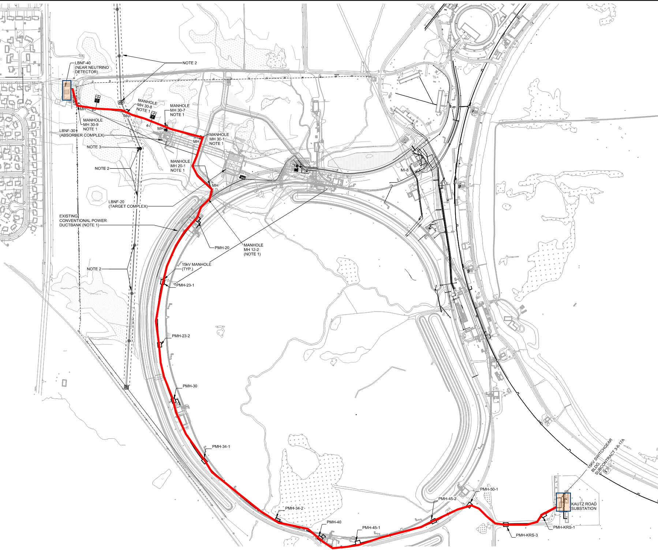
Electrical Distribution & Grounding
NDC
NSCF provides power distribution from Kautz Road (KRS) to NDC
Coordinating with NSI for loads and distribution details within NDC
Standby Generator provided for life safety and other critical loads (sump pumps, cryo controls etc)
Building and detector ground requirements are being coordinated with NSI
Main Ring
KRS
13.8kV Power Route
Main Injector

Slide 17
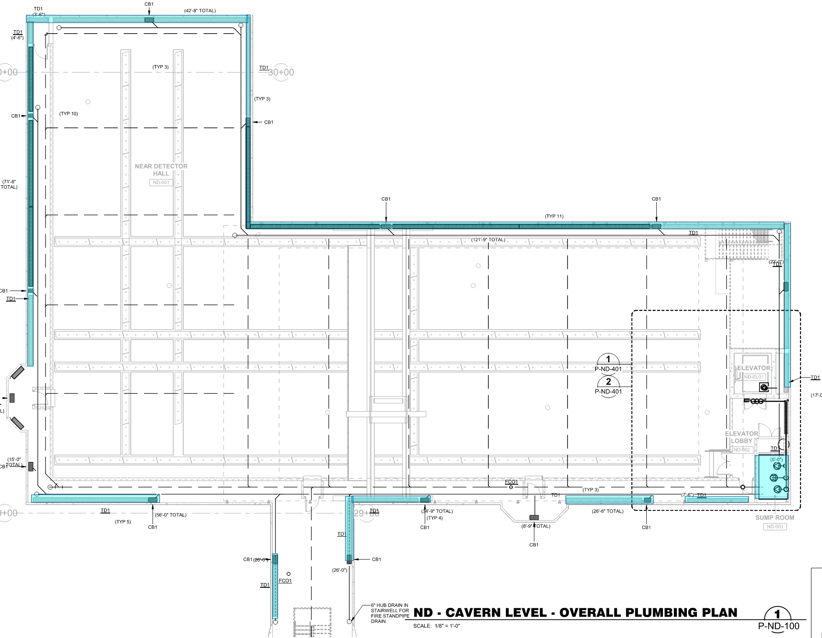
Plumbing & Dewatering
NDH is actively dewatered and pumped to surface
Drainage strips provided behind shotcrete to collect water
Backup pumps and standby generator provided
Trench Drains around perimeter collect seepage water
Waterproof membrane provided over equipment and detectors
Trench Drains
Sump Room

Slide 18
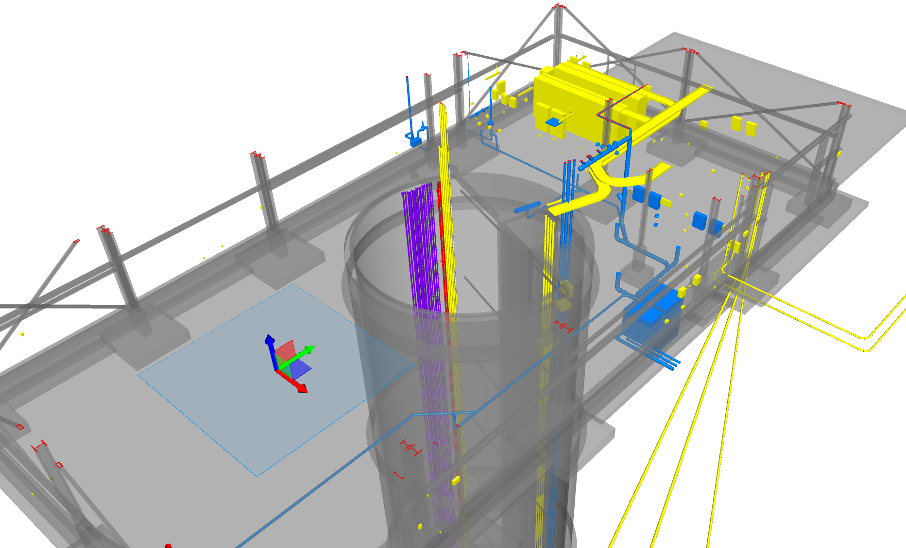
Site and NDC Communications
DAQ Room
NSCF provides fiber optic backbone for site communications.
NSCF coordinates with FNAL Computing Division for installation of phones and network
NSCF provides cable tray routing and is coordinating on communications needs with NSI within NDC
NSCF provides space, power, and cooling for DAQ room
Cable Tray Routing

Slide 19
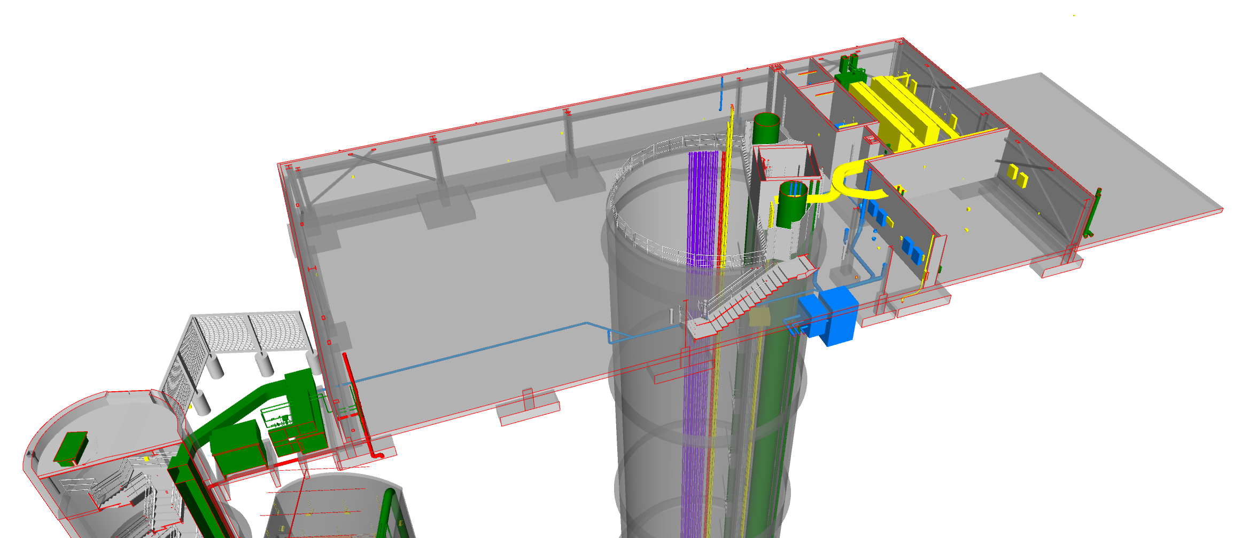
NDSB Layout
DAQ Room
Elevator
Cryo Foundation
High Bay Assembly Area
Secondary Egress Shaft
Helium Room
Mechanical/Electrical Mezzanine Upstairs
Main Access Shaft

Slide 20
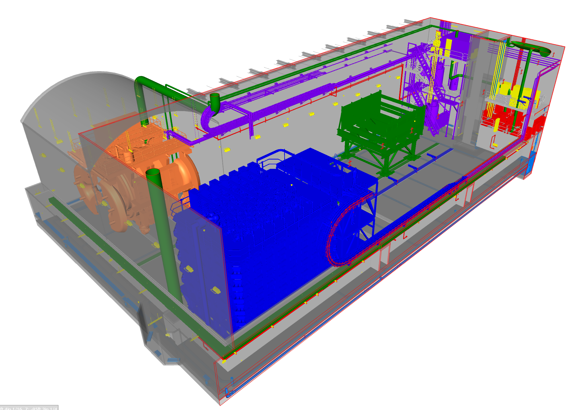
NDH Layout
Mezzanine
Elevator
Mezzanine
SAND Alcove
Sump Room
Egress Passageway
To Secondary Egress Shaft (Not shown for clarity)

Slide 21
Summary
Communicate through Fabrice, our point of contact for NSI and ND
60% Final Design Review comments due no later than Friday, April 16th
Near Detector Complex AUP July 2026

