Slide 1
Grounding & Shielding Expectations for PDR
Terri Shaw
NS Integration Workshop
March 16, 2021

Slide 2
Content
Detector Grounding
Cables and Shielding
Electronics (commercial and custom) and Documentation
ORC Requirements and Process
Electrical PDR documentation

Slide 3
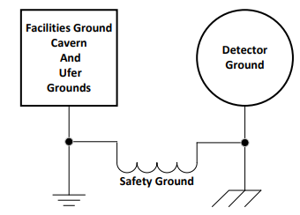
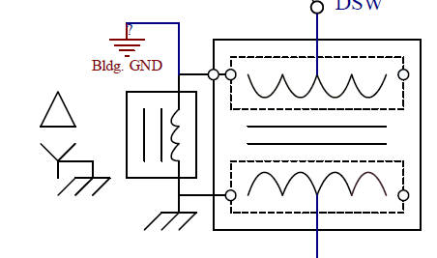
Detector Grounding
Grounding strategy provides each detector with independent low noise ground which will minimize any environmental noise that can couple into detector either conductively or through emitted noise.
We create “quiet” detector ground through use of special double shielded transformer. Inductor is used to create a safety ground which is low impedance for DC and high impedance for AC “noise”.
https://edms.cern.ch/document/2464842/1
Building
Ground
Detector
Ground

Slide 4
Detector Grounding
Requirements on each detector
Detectors should be electrically isolated from Building Ground.
Low noise detector power will be provided to each detector as shown on previous page.
No copper connections (other than AC power provided) shall be used going/coming from “off” detector. Fiber Optic cables should be used for data transmission, slow controls and timing distribution.

Slide 5
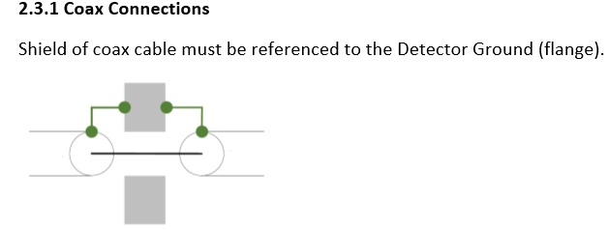
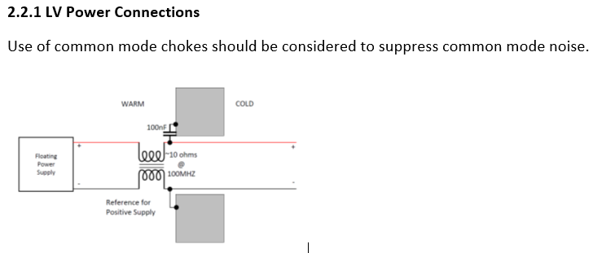
On Detector Cabling and Shielding
Cable and Shield document for the Far Detector also applies to the Near detector and can be found at https://edms.cern.ch/document/2095958/1
This document treats detectors as Faraday cages and has specific requirements and examples for shield connections at penetration points.
We can set up meetings to discuss specific detector applications. (tshaw@fnal.gov)

Slide 6
Electronics (commercial and custom) and Documentation
Documentation required for:
Commercial and Custom Equipment
Cables and Cable Construction
System level Cabling/Wiring
Power Path Ampacity Analysis (don’t have 5 amps going through 2 amp wire!)
Documentation will be used in the PDR and Operational Readiness Clearance (ORC); must successfully pass an ORC prior to operations
ORC info: https://esh-docdb.fnal.gov/cgi-bin/ShowDocument?docid=3311
Defines a lab-wide process for ORCs applicable to experiments, tests, R&D and other activities required by D/S management that have the potential to cause harm to personnel, property or the environment

Slide 7
Operational Readiness Clearance (ORC)
Fermilab Environment, Safety and Health Manual (FESHM) documents procedures to be followed and design standards to be met for work at the lab. It also documents the ORC process. https://eshq.fnal.gov/manuals/feshm/
Of particular interest during electrical ORC review
Is commercial equipment stamped with National Recognized Testing Laboratory (NRTL) approval?
All custom electronics must be documented and reviewed
Printed Circuit Boards designed for use by experiment
Chassis assembled for experiment
Any modified equipment
Any cabling designed and implemented by experiment
Other hazards such as Class 3b or Class 4 Lasers.
Helpful guidance can be found in Electrical Design Standards for Electronics in Experimental Apparatus: ESHQ DocDB #2781

Slide 8
Electrical PDR documentation
Grounding & Shielding Plan
Electrical Schematics & Board Layouts
Including Bill of Materials
Specification/Drawings of Electrical Cabling and Wiring Connections
Documentation Links for Commercial and Off-the-Shelf Powered Components
Documentation on all Electrical Interfaces

Slide 9
Conclusion
We are here to help – contact me with any questions/concerns at tshaw@fnal.gov
Designs can be and should be reviewed early in the design process to ensure that standards are being met.

