Slide 1
DUNE Near Site Integration ESH
Michael Andrews/Duane Newhart
Near Site Integration Workshop
16 March 2021

Slide 2
Outline
Near Site ESH Plan
ESH Support
General Site Access
ESH Training

Slide 3
Near Site Integration ESH Plan
The plan will identify safe workplace requirements for users, that require personnel to perform installation activities at Near Site, to assure compliance with FNAL, DOE orders, federal and state regulations. Will also establish Stop Work Authority for all personnel.
  Site & facility access
  Emergency management
  Fire protection, life safety, & ODH
  ESH Training
  Personnel protective equipment
  Work planning & controls
    Hazard Analysis
  Material handling
    Lift Plans
  Installation & operational readiness

Slide 4
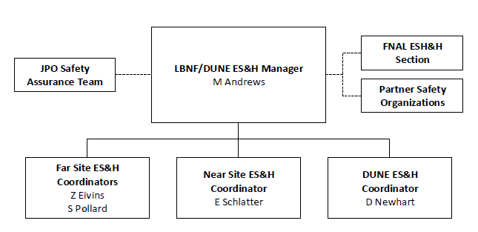
Joint Project Office ESH Staffing
LBNF/DUNE ESH Manager
  ESH program management
  Fire & life safety discussions with Fermilab AHJ & Systems Integration Manager
  Coordination with the JPO Assurance team
    Regulatory compliance - Code equivalency
DUNE ESH Coordinator
  Support for the consortia leads
  ESH POC production factories
  Provide supplemental field support
Near Site ESH Coordinator
  Daily ESH field support/oversight

Slide 5
ESH Program Integration & Documentation
Project ESH documentation – Update to incorporate pandemic hazard
  LBNF/DUNE Integrated Environment, Safety and Health Management Plan
  LBNF/DUNE Hazard Analysis Report
  LBNF/DUNE Security Vulnerability Assessment Report
Integration through project management meetings all levels
Near Site ODH
  Preliminary ODH analysis in development, ODH mitigation strategies identified
  Led by Joaquim Prats - Engaged with LBNF Cryogenic Safety panel
Interfaces with major stakeholder organizations
  Partner Laboratories and institutions ESH Organizations
  Near Site Stakeholders
    Fermilab ESH Section – Neutrino Division - FESS-OPS
  DOE-Fermilab Site Office

Slide 6
Fermilab General Site Access & Training
Site access requirements
  User Registration (Visa holders may more)
    FNAL User training
      Site ESH Requirements
      Emergency Response
  On-line FNAL ID process
  Individual Training Needs Assessment (ITNA)
    Supervisor completes the training needs analysis for individual
      Work planning & Controls (HA’s)
      Fall protection
      Aerial lift operation
      Confined space
      DUNE Detector Hall Underground Access training
        Badging in and out on board
        Total occupancy underground (Maximum Limit 46 personnel)

Slide 7
Summary
Questions???

