Slide 1
PIP-II Project Status
Lia Merminga – Project Director
CD-3A IPR of PIP-II
17 February 2021

Slide 2
A few words about me
PIP-II Project Director
“Card-carrying” Accelerator Physicist
Worked at Jefferson Lab, TRIUMF, SLAC, FNAL
Experience in accelerator R&D, operations, projects
  More than 25 yrs experience in SRF linacs
  ARIEL e-Linac was built as a collaboration with VECC, Kolkata
Accelerator division head at TRIUMF
Associate lab director for Accelerators at SLAC

Slide 3
Bottom Line Up Front – PIP-II Status
Performance baseline approved by DOE in Dec 2020:
  TPC $978M (+$310M IKC), CD-4 Dec 2028
  PIP-II is blazing a new trail in major accelerator projects in the US (international partners)
Construction of cryoplant building is advancing
Beam has been accelerated in the first two PIP-II cryomodules to 17 MeV
International partner engagement strong, contributions enable beam test
Focus on securing resources, ensuring stability of requirements and interfaces, and streamlining processes for execution

Slide 4
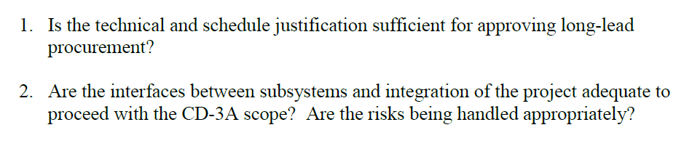
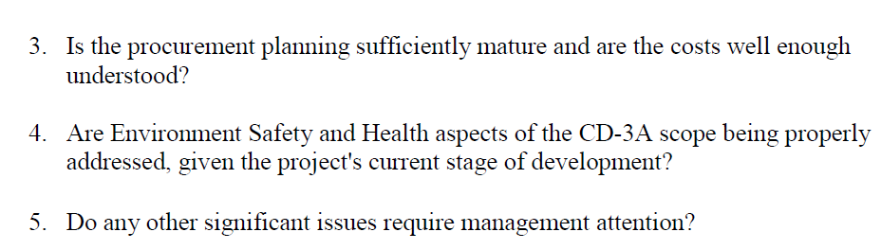
Outline
Kaducak
Boffo
Klebaner
Kourbanis
PIP-II Mission, Scope, KPPs, Team
Technical Systems Progress
PIP-II Schedule and Funding Profile
Summary

Slide 5

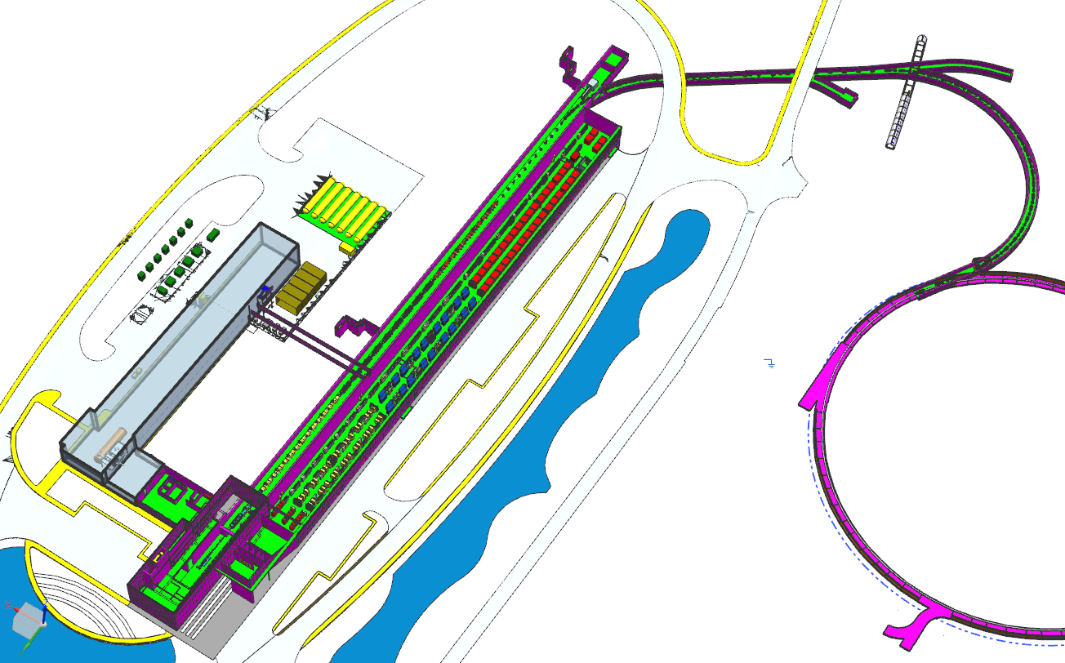
PIP-II Mission
PIP-II will enable the world’s most intense beam of neutrinos to the international LBNF/DUNE project, and a broad physics research program, powering new discoveries for decades to come.
PIP-II linac capabilities
Beam Power
1.2 MW proton beam
Upgradeable to multi-MW
Flexibility and multi-user capability
Compatible w/ CW-operations
Customized beams
Multi-user delivery
Reliability
PIP-II Scope
800 MeV H− linac
  Warm Front End & SRF section
Linac-to-Booster transfer line
  3-way beam split
Upgraded Booster
  20 Hz, 800 MeV injection
  New injection area
Upgraded Recycler, Main Injector
  RF in both rings
Conventional facilities, incl.
  Site preparation
  Cryoplant Building
  Linac Complex
  Booster Connection
The PIP-II scope enables the accelerator complex to reach 1.2 MW proton beam on LBNF target.

Slide 6
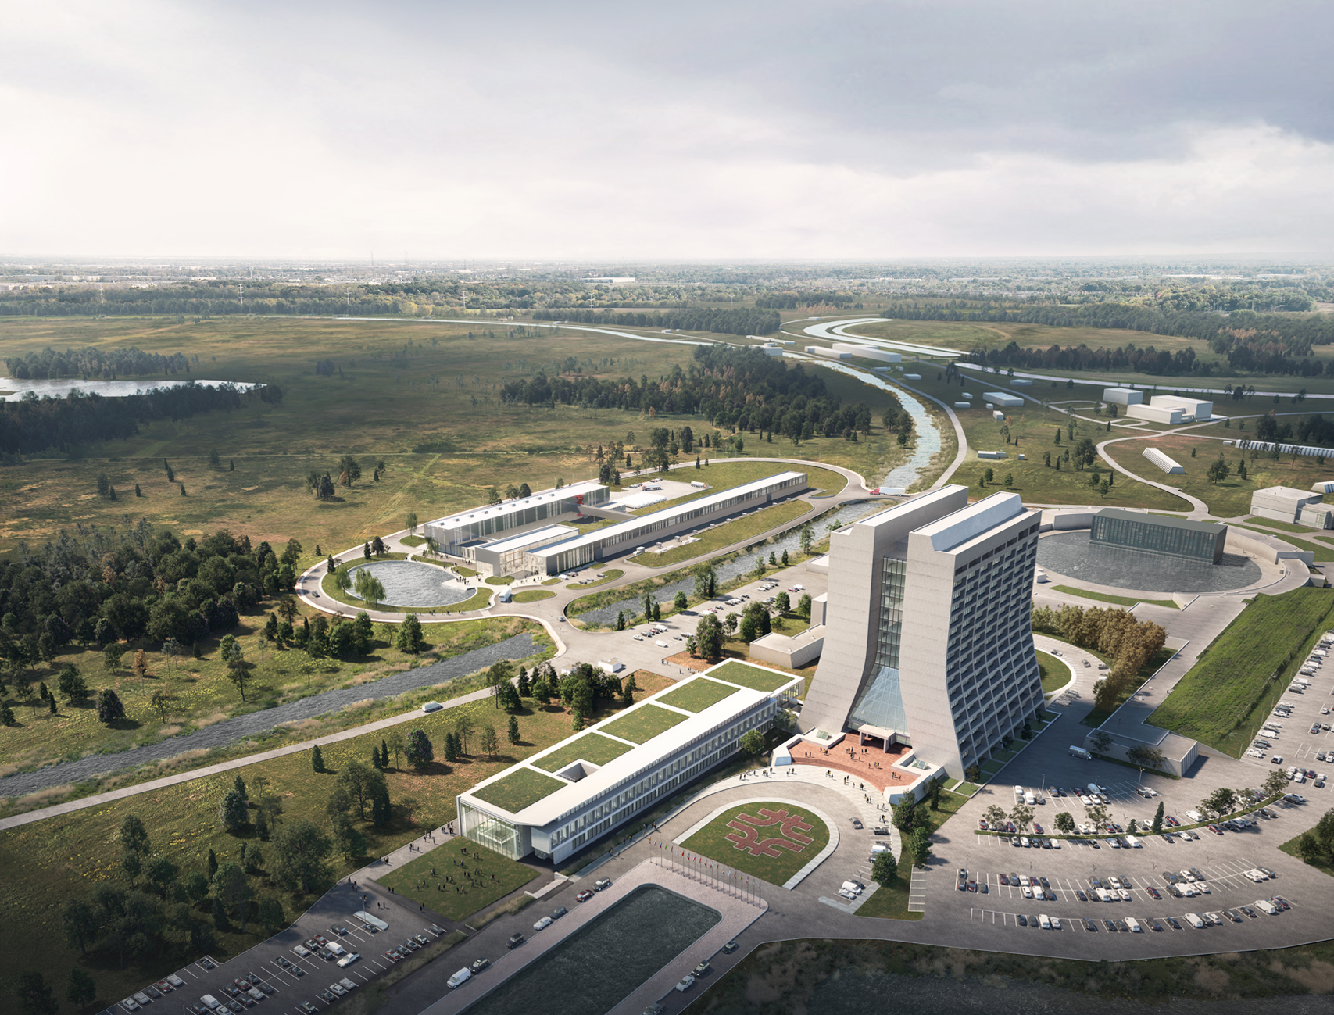






Main Injector
Transfer Line
PIP-II
SRF Linac
Booster

Slide 7
CD-4 Key Performance Parameters in PEP
Demonstrated at Project Completion
# | Scope | Threshold KPPs | Objective KPPs
1 | Linac Beam Energy | Accelerate H- beam to 600 MeV | Accelerate H- beam to 700 MeV Linac systems required to accelerate beam to 800 MeV installed and tested
2 | Linac Beam Intensity | Beam delivered to Beam Dump at the end of Linac | Beam with intensity of 1.3E12 particles per pulse (H-) at 20 Hz delivered to Beam Line Dump
3 | Booster/ Recycler/ Main Injector upgrades | Booster, Recycler, and Main Injector Upgrades to support operations with beam power of 1.2 MW on the LBNF target are installed and tested without beam | Linac beam injected and circulated in Booster
Objective KPPs are aligned with the baseline project scope and assure that the accelerator facility, as constructed, is capable of meeting the scientific needs of the Fermilab program (Project Execution Plan, PIP-II DocDB #3036)

Slide 8
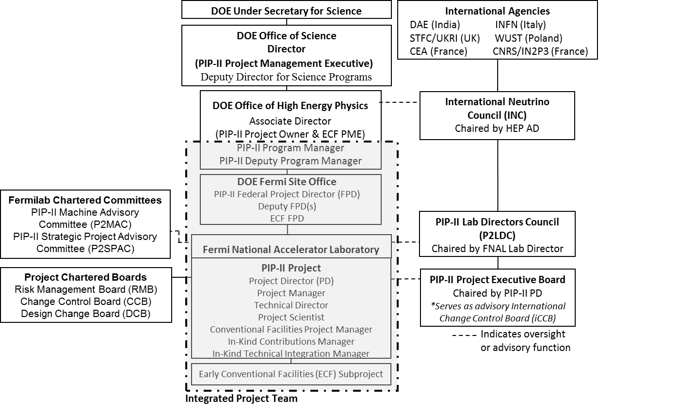
PIP-II Top Level Management & Governance
Strong, effective, highly engaged IPT. Smooth transition to new FPD.
PIP-II International Partners are engaged at the top level.

Slide 9
PIP-II Project Management and Level 2 Systems/Managers
ADVISORY COMMITTEES
PIP-II Machine Advisory Committee H. Weise
PIP-II Project Management Group D. Glenzinski
PIP-II Strategic Project Advisory Committee J. Yeck
PIP-II Project
L. Merminga
PROJECT DIRECTOR
US TECHNICAL COORDINATOR
PROJECT MANAGER M. Kaducak
TECHNICAL DIRECTOR A. Klebaner
PROJECT SCIENTIST E. Pozdeyev
IN-KIND CONTRIBUTIONS MANAGER L. Lari
ENVIRONMENTAL, SAFETY & HEALTH J. Anderson Jr.
SPECIAL ADVISOR S. Holmes
INTERNATIONAL COORDINATION
Technical Coordinators
DAE-BARC S. Krishnagopal
DAE-RRCAT P. Shrivastava
UK-UKRI P. McIntosh
ITALY-INFN C. Pagani
FRANCE-CEA O. Napoly
FRANCE-CNRS/IN2P3 D. Longuevergne
POLAND-WUST M. Chorowski
FNAL SUPPORT
ACCELERATOR DIV M. Lindgren
APS-TD A. Romanenko
CFO OFFICE V. Peoples
WDRS T. Turner (acting)
CSO OFFICE A. Kenney
COO OFFICE K. Gregory
CPO OFFICE D. Glenzinski
PROJECT OFFICE
Project Manager - M. Kaducak
PROJECT CONTROLS MANAGER D. Leeb
Project Controls Specialists M. Bossert
C. Jackson
J. Randall
A. Tomori
L. Wolfe
OPSS Consultant D. Hoffer
FINANCIAL MANAGER T. Casillas
PROCUREMENT MANAGER S. Gaugel
Procurement Administrators C. Blanchard
S. Cozzens
J. Eddy
RISK MANAGER L. Taylor
LOGISTICS MANAGER TBD
DOCUMENT SYSTEM MANAGER T. Langford
EXECUTIVE ADMINISTRATION T. Langford
Administrative Support K. Hannapel
TECHNICAL INTEGRATION
Technical Director - A. Klebaner
PROJECT ENGINEER L. Kokoska
IN-KIND TECHNICAL INTEGRATION A. Rowe
INTEGRATION COORDINATOR A. Martinez
ELECTRICAL SYSTEMS COORD R. Crawford
SRF COORDINATOR J. Holzbauer
QUALITY ASSURANCE MGR J. Adetunji
Quality Engineer T. DiGrazia
Quality Engineer (SRF/CRYO) M. Luedke
WBS 121.01
PROJECT MANAGEMENT
M. Kaducak
System Manager
WBS 121.02
SRF & CRYO SYSTEMS
G. Wu
System Manager
C. Boffo, Deputy Mgr.
WBS 121.03
ACCELERATOR SYSTEMS
E. Harms
System Manager
WBS 121.04
LINAC INSTALLATION & COMMISSIONING
J. Leibfritz
System Manager
A. Soha, Deputy Mgr.
WBS 121.05
ACCELERATOR COMPLEX UPGRADES
I. Kourbanis
System Manager
WBS 121.06
CONVENTIONAL FACILITIES
S. Dixon
System Manager
Experienced, highly motivated team; all key positions filled;
stable management structure

Slide 10
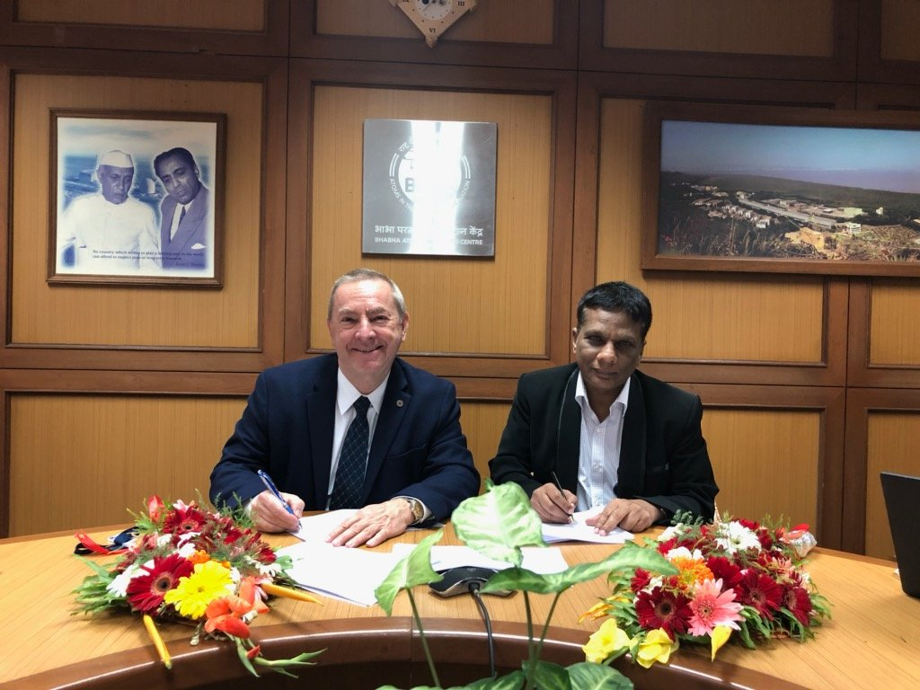
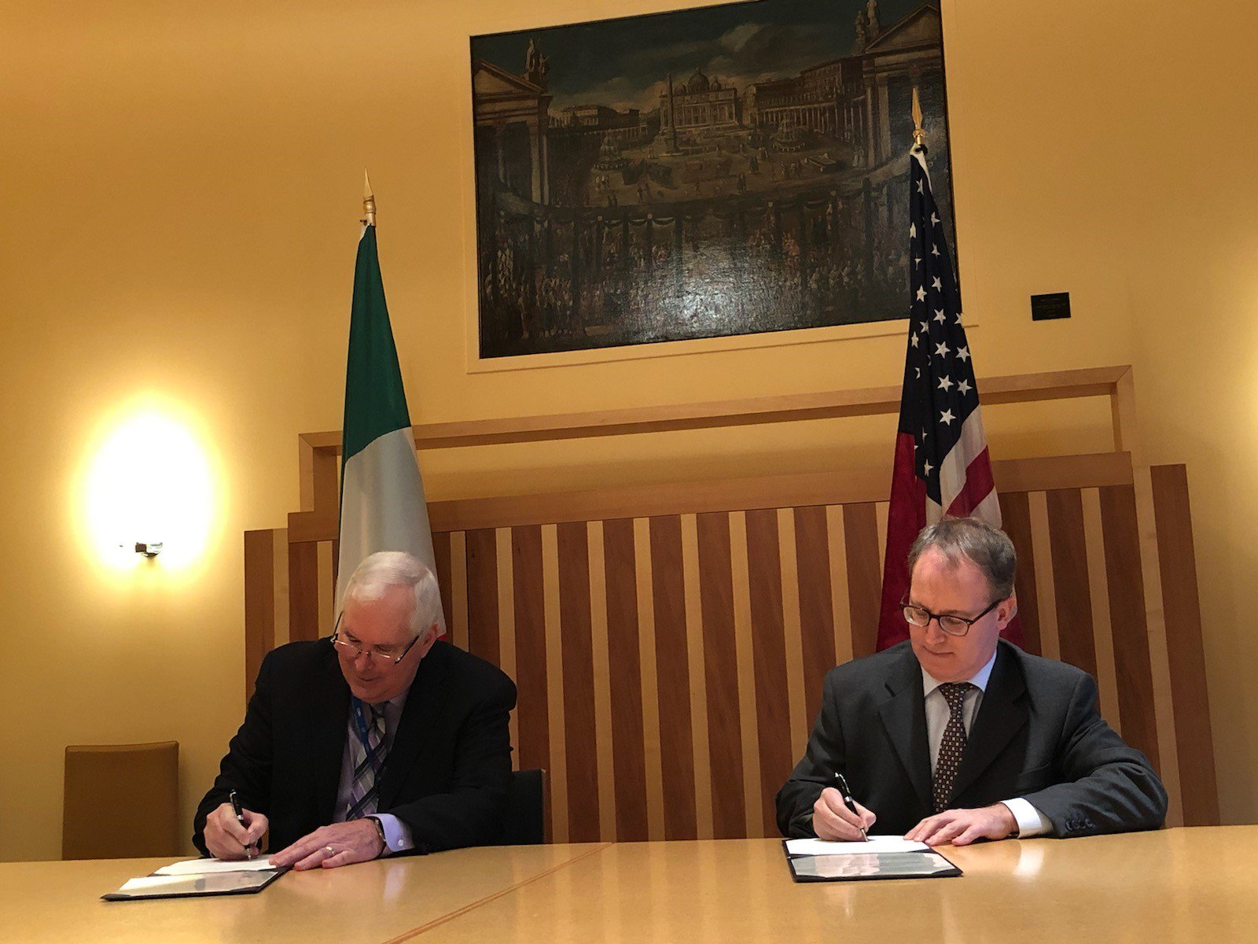
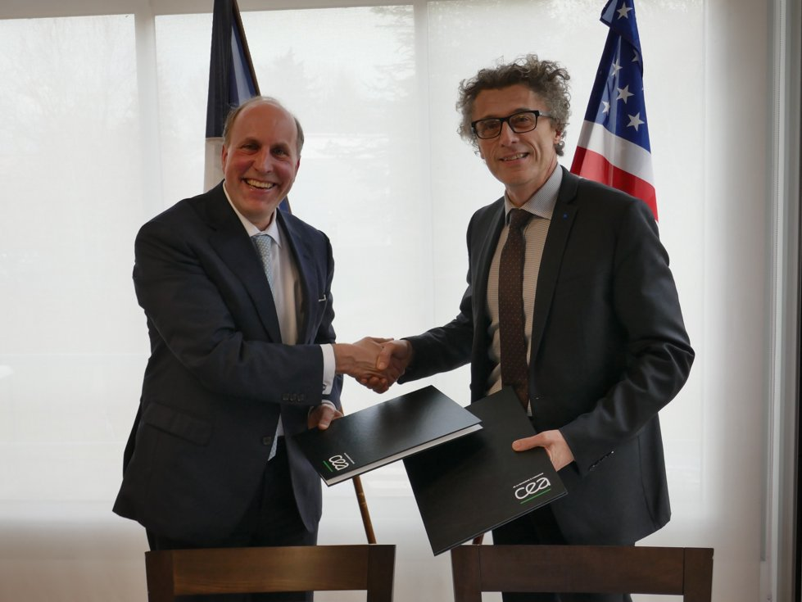
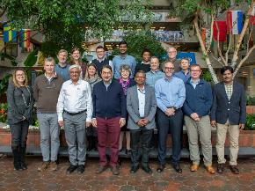
PIP-II International Partners, Expertise and Capabilities
India, Department of Atomic Energy (DAE) (started 2009)
BARC, RRCAT, VECC; also IUAC
    Substantial engineering / manufacturing experience; Superconducting magnets for LHC; 2 GeV synch light source
Italy, INFN (started 2016)
  Internationally recognized leader in superconducting RF technologies
  SRF cavity and cryomodule fabrication for XFEL; SRF cavities for ESS
UK, STFC UKRI (started 2017)
  Substantial engineering and manufacturing experience; Construction, operation of synch light & neutron sources SRF cavity processing and testing for ESS
France, CEA, CNRS/IN2P3 (started 2017)
  Internationally recognized leader in large-scale CM assembly
  CM assembly for European XFEL and ESS; SSR2 cavities and couplers for ESS
Poland, WUST, WUT, TUL (started 2018)
  Substantial engineering / manufacturing experience; CDS, LLRF, QC for XFEL, ESS
PIP-II Project benefits from world-leading expertise, facilities.
“Timing is perfect”

Slide 11







L3 Systems/Managers and International Partners
WBS 121.01
PROJECT MANAGEMENT
M. Kaducak
System Manager
WBS 121.02
SRF & CRYO SYSTEMS
G. Wu
System Manager
C. Boffo
Deputy System Mgr.
WBS 121.03
ACCELERATOR SYSTEMS
E. Harms
System Manager
WBS 121.04
LINAC INSTALLATION & COMMISSIONING
J. Leibfritz
System Manager
A. Soha
Deputy System Mgr.
WBS 121.05
ACCELERATOR COMPLEX UPGRADES
I. Kourbanis
System Manager
WBS 121.06
CONVENTIONAL
FACILITIES
S. Dixon
System Manager
WBS 121.03.01
Project Management
E. Harms
WBS 121.04.01
Project Management
J. Leibfritz
WBS 121.05.01
Project Management
I. Kourbanis
WBS 121.06.01
Project Management
S. Dixon
WBS 121.02.01
Project Management
G. Wu
WBS 121.03.02
MPS
A. Warner
WBS 121.04.02
WFE
L. Prost
WBS 121.05.02
Transfer Line/Beam absorber
M. Xiao
WBS 121.06.02
Site Preparation
R. Wielgos
WBS 121.02.02
Half-wave Cryomodule
J. Ozelis
WBS 121.03.03
HPRF, RF distribution
J. Steimel
V. Grzelak-Deputy
WBS 121.06.03
Cryoplant Building
S. Dixon
WBS 121.04.03
Test Infrastructure
J. Leibfritz
WBS 121.05.03
Beam Transfer Line Installation
D. Morris
WBS 121.02.03
SSR Cryomodules
D. Passarelli
C. Boffo - CAM
WBS 121.03.04
LLRF
B. Chase
C. Hovater - CAM
WBS 121.04.04
Building Infrastructure
M. Ball
WBS 121.06.04
Utility Plant
E. Alcaraz
WBS 121.05.04
Booster
D. Johnson
WBS 121.02.04
650 MHz Cryomodules
F. Furuta
S. Chandrasekaran - CAM
WBS 121.03.05
Magnets/PS
B. Hanna
WBS 121.06.05
Linac Complex
E. Alcaraz
WBS 121.04.05
Linac Installation
C. Baffes
WBS 121.05.05
MI/RR
J. Dey
WBS 121.06.06
Booster Connection
E. Alcaraz
WBS 121.02.05
Cryogenic Plant
B. Hansen
WBS 121.03.06
Vacuum
R. Campos
WBS 121.04.06
Beam Commissioning
E. Pozdeyev
D. Crawford - CAM
WBS 121.03.07
Controls
J. Patrick
B. Drendel - CAM
WBS 121.04.07
Accelerator Physics
E. Pozdeyev
D. Crawford - CAM
WBS 121.02.06
Cryogenic Distribution
A. Dalesandro
WBS 121.03.08
Safety Systems
R. Zifko
WBS 121.03.09
Instrumentation
V. Scarpine
B. Drendel - CAM
PIP-II Partners are embedded in organization at multiple levels

Slide 12
Approved Tailoring Strategy
CD-ECF–2/3 – 17 Jul 2020
  Scope: Site preparation (beyond site clearing); cryoplant building construction; $36M
CD-2 – 14 Dec 2020
CD-3A – Q2FY21
  Scope: SSR1 Nb and cavities; Cryogenic system improvements; Main Injector power amplifiers and vacuum tubes; beam current monitor; total request ~$12.5M
  Drivers: Request capitalizes on investments from foreign partners, mitigates impacts related to COVID-19, supports approved baseline schedule, reduces schedule risk
CD-3 – Q1FY22
  Scope: Remaining construction
  Driver: Linac Complex final design complete. Maintain overall progress.
Kaducak
ECF: Early Conventional Facilities

Slide 13
Scope of CD-3A – Approval for Long-lead Procurement
Kaducak
Boffo
Klebaner
Scope and cost
  SSR1 Niobium procurement for SSR1 cavities ($1.9M)
    1st Nb award needed June 2021 to minimize risk of facilities and personnel conflicts
  SSR1 jacketed cavities for SSR1 CM ($3.0M)
    Award needed December 2021 to minimize risk of facilities and personnel conflicts
  Equipment for Cryogenic System Improvement ($3.5M)
    Funding needed July 2021 to mitigate cryogenic capacity risk, maintain alignment with DAE schedule, and maintain the project schedule
  Main Injector power amplifiers and vacuum tubes ($3.9M)
    1st Power Amplifier award July 2021, vacuum tubes Sept 2021. Vacuum tube vendor has limited capacity of 16 tubes per year and the project needs 40
  Booster Beam Current Monitor ($0.22M)
    Award in April 2021 for installation in 2021 summer shutdown
Total request anticipated to be ~$12.5M
Kourbanis

Slide 14
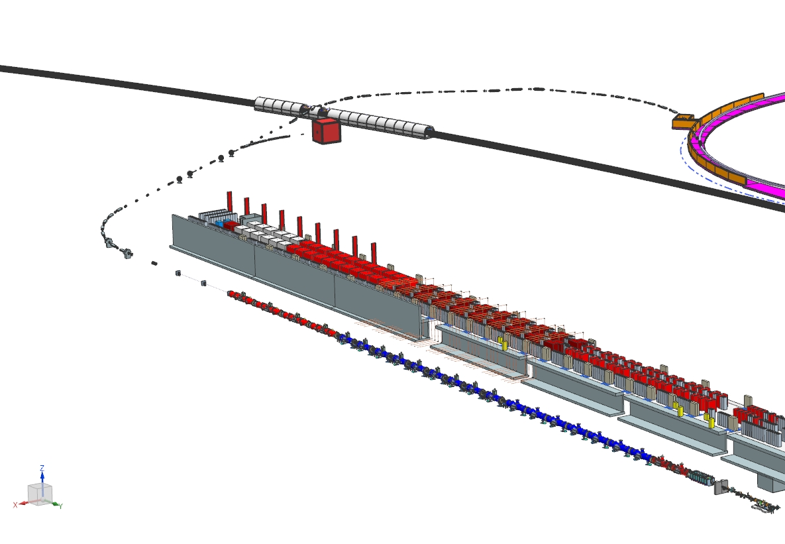
Technical Systems Progress
Technical design under configuration control since March 2019

Slide 15

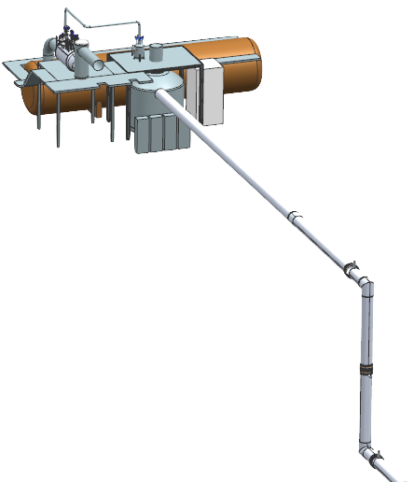
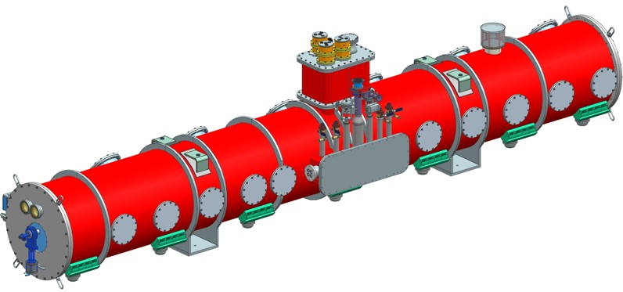
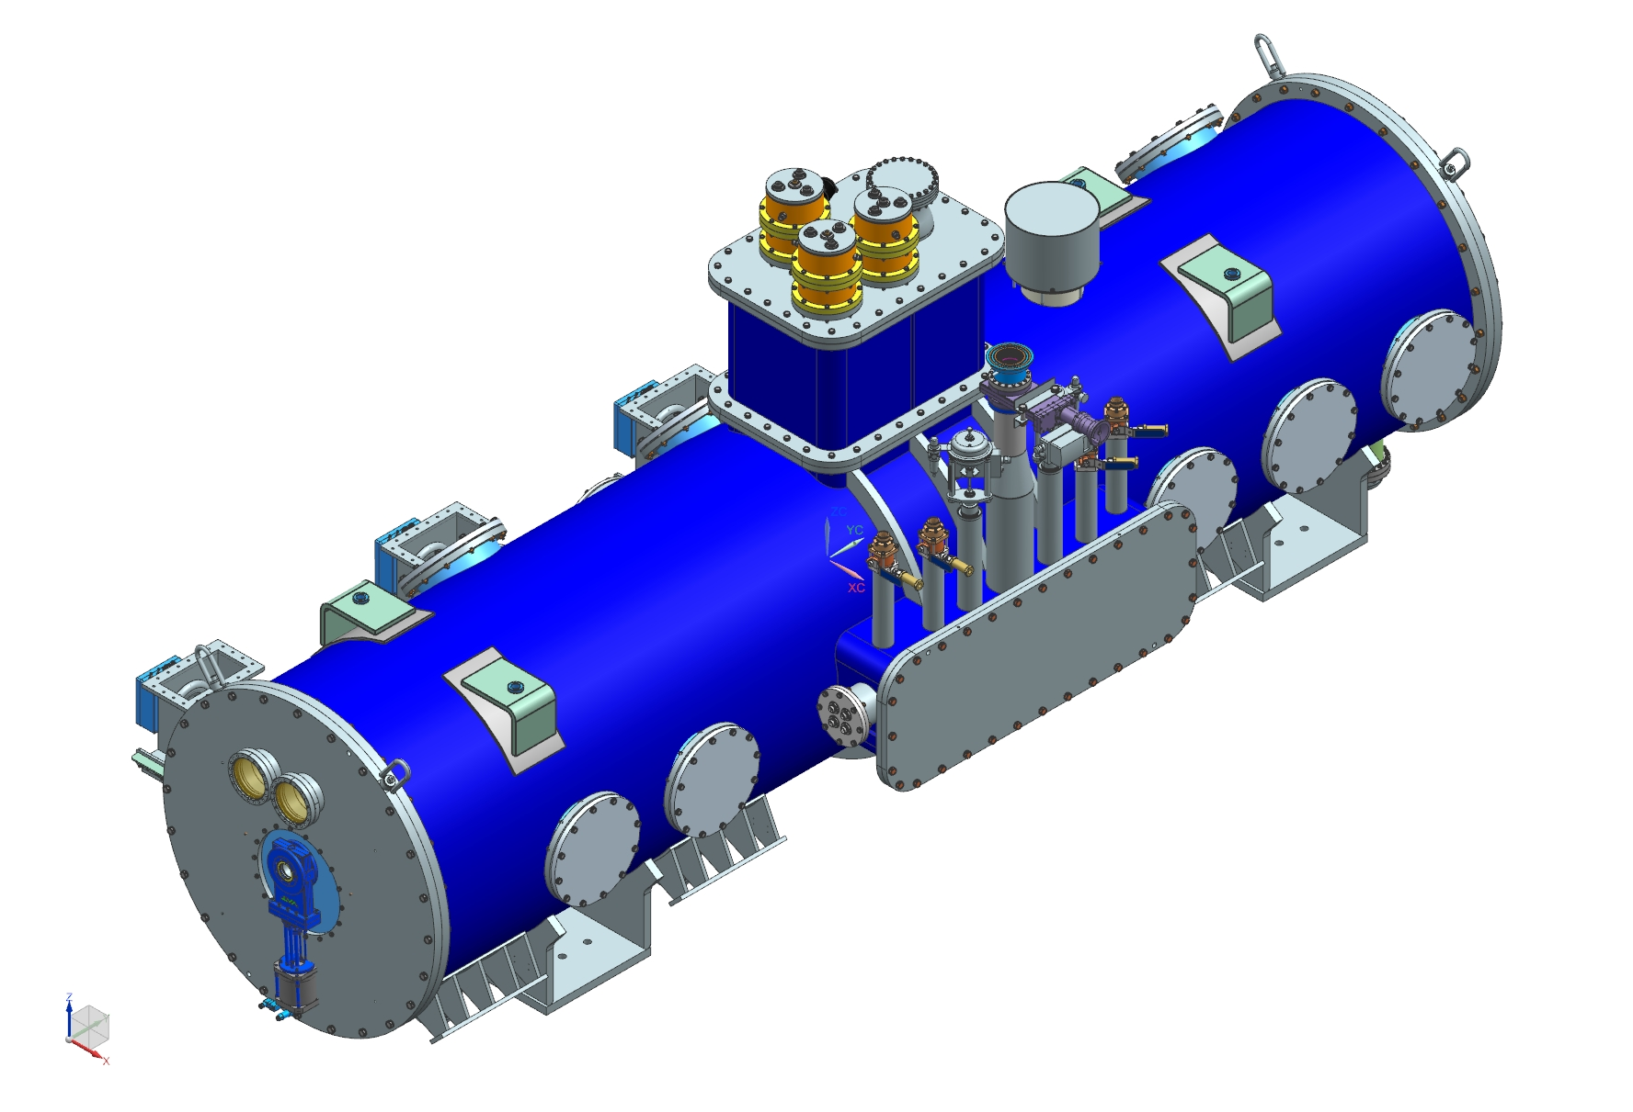

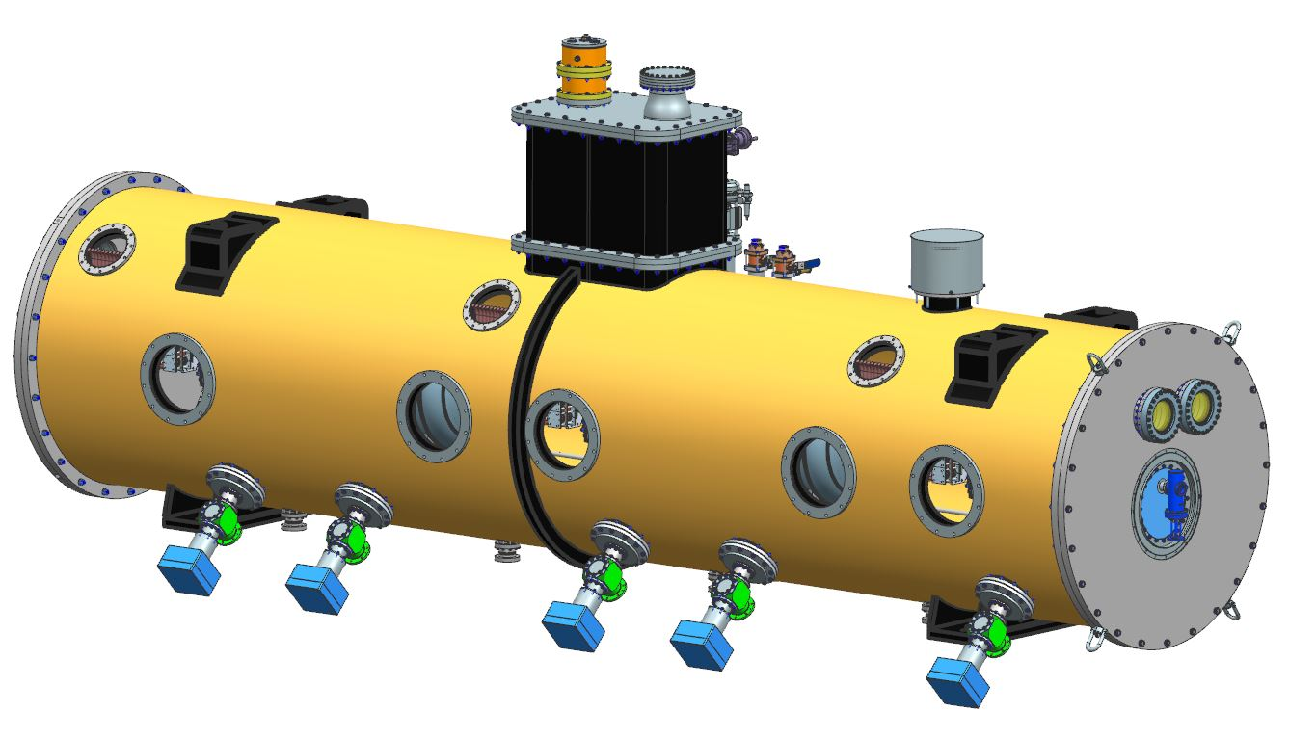
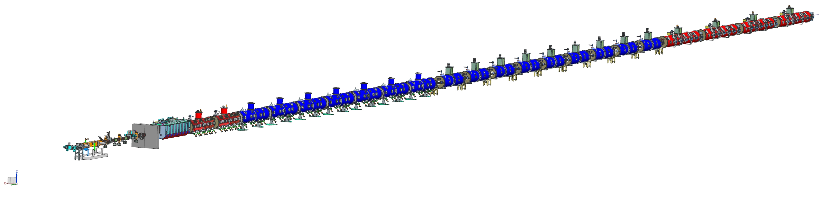
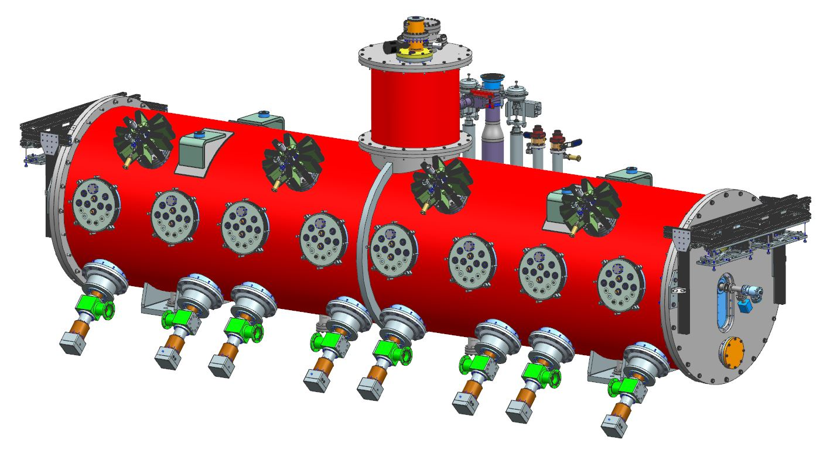
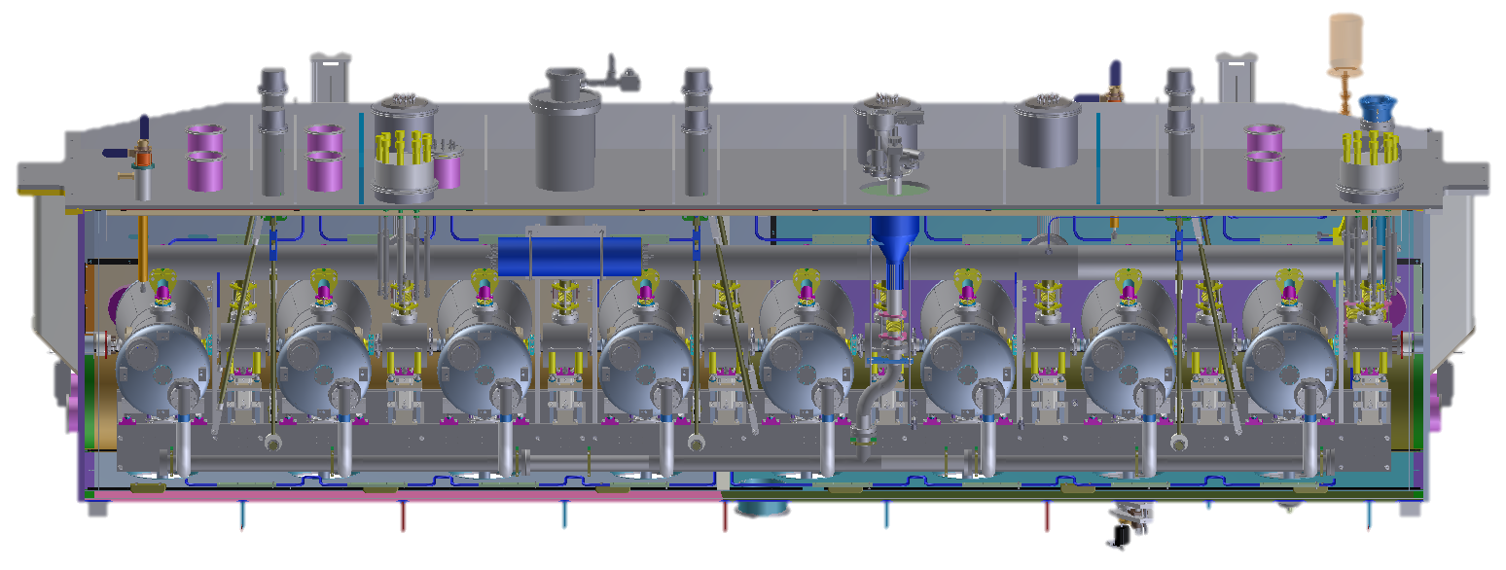
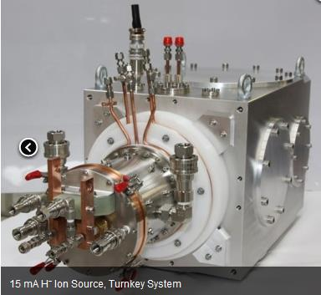
PIP-II Superconducting RF CW Linac, 800 MeV Consists of
Five Types of Cryomodules
Elliptical
HB650 X 4
24 Cavities
650 MHz
Cryoplant
Elliptical
LB650 X 9
36 Cavities
650 MHz
Single Spoke
SSR2 X 7
35 Cavities
325 MHz
Single Spoke
SSR1 X 2
16 Cavities
325 MHz
HWR
8 Cavities
162.5 MHz
CDS
833 MeV
H- Ion source
516 MeV
177 MeV
Superconducting
RFQ
32 MeV
10 MeV
PIP-II Linac is technically complex, state of the art superconducting RF accelerator
2.1 MeV
Room Temperature
PIP-II is the world’s highest energy and power CW proton linac, and the U.S. first accelerator project to be built with major international contributions

Slide 16


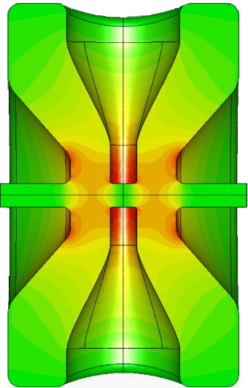
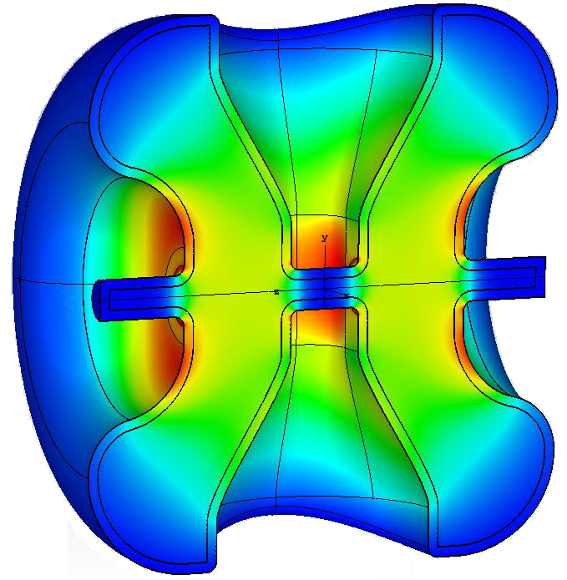
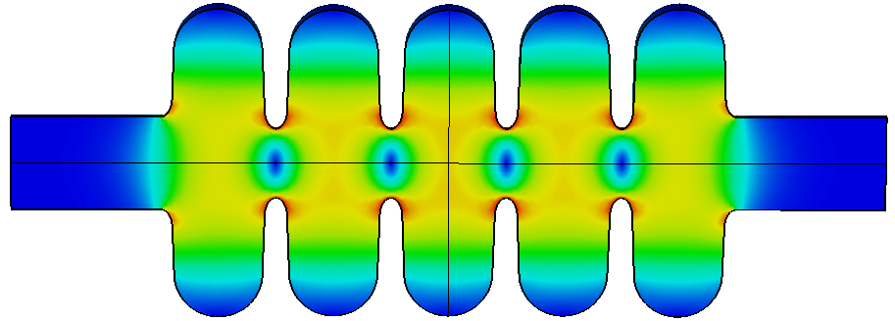
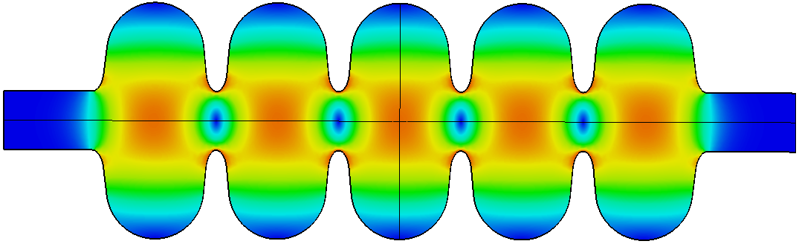
The state-of-the-art PIP-II Superconducting RF Systems
2023
2023
2021-22
5.9 m
5.3 m
5.5 m
9.9 m
6.5 m
2022
Single Spoke
SSR1
β=0.22 Q₀ =0.82x10¹⁰
Single Spoke
SSR2
β=0.47 *Q₀ =0.82x10¹⁰
Half Wave Resonator
β=0.11 Q₀ =0.85x10¹⁰
Elliptical
LB650
β=0.61 *Q₀ =2.4x10¹⁰
Elliptical
HB650
β=0.92 *Q₀ =3.3x10¹⁰
Performance validated
Testing in progress
Dates: component built
*state-of-the-art performance requirement

Slide 17
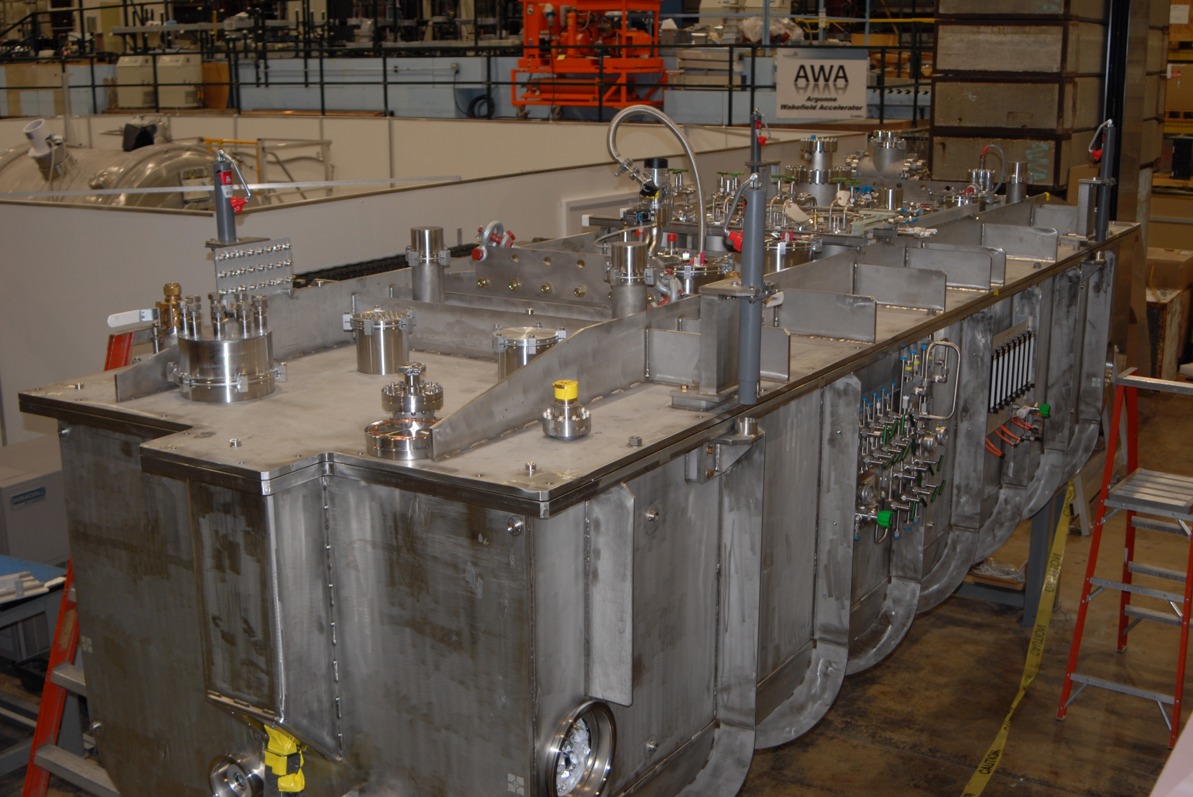


Half-Wave Resonator (HWR) Fabrication by
HWR cryomodule at 2K, RF tests complete,
accelerated beam
HWR cryomodule installed at PIP2IT;
2K RF tests complete, accelerated beam

Slide 18
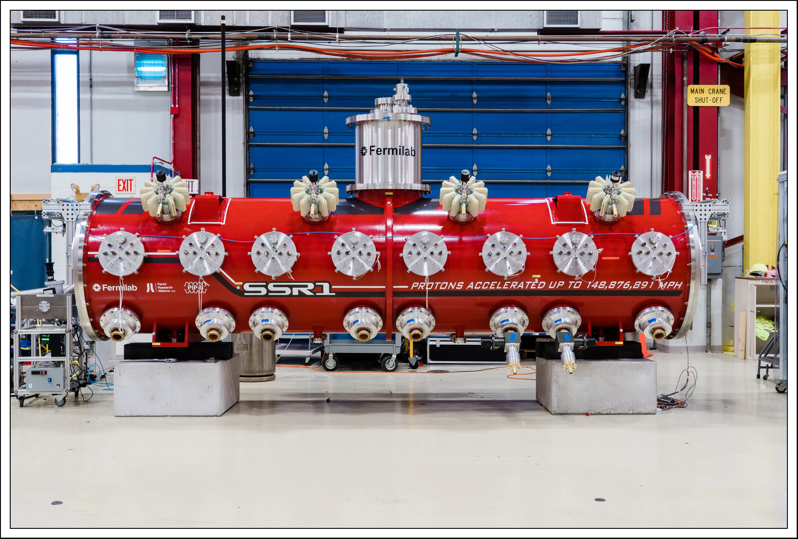
Single Spoke prototype cryomodule fabricated by Fermilab; installed at PIP2IT; 2K RF tests complete; successfully accelerated beam

Slide 19

SSR1 Prototype Cryomodule Tests: Phase 1 Gradients achieved
  All eight SSR1 cavity gradients measured, exceed Phase 1 requirements. Phase 2 test, Qo meas’t in March.
  CD-3A scope: SSR1 Nb and jacketed cavities for SSR1 production cryomodule #1
    Fully integrated, performance validated with beam.
Boffo
Cavity Position | Cavity Serial # | Phase 1 gradient required (MV/m) | Phase 2 gradient required (MV/m) | Cavity gradient measured (MV/m) | Notes
CAV1 | S1H-NR-106 | 4.88 | 10.00 | 11.5 | Phase 2 admin limit, FE onset 10.5 MV/m.
CAV2 | S1H-NR-110 | 4.63 | 8.78 | 5.3 | Phase 1 admin limit
CAV3 | S1H-NR-112 | 4.78 | 8.05 | 5.5 | Phase 1 admin limit
CAV4 | S1H-NR-109 | 7.32 | 10.00 | 8.4 | Phase 1 admin limit, FE onset 5.5 MV/m
CAV5 | S1H-NR-114 | 7.80 | 9.76 | 9.0 | Phase 1 admin limit
CAV6 | S1F-IU-104 | 7.56 | 10.00 | 8.7 | Phase 1 admin limit
CAV7 | S1H-NR-113 | 7.32 | 8.54 | 8.4 | Phase 1 admin limit
CAV8 | S1H-NR-111 | 10.00 | 10.00 | 11.0 | Phase 1 admin limit, FE onset 10.5 MV/m.
Phase 1: first SSR1 slot; Phase 2: second SSR1 slot

Slide 20



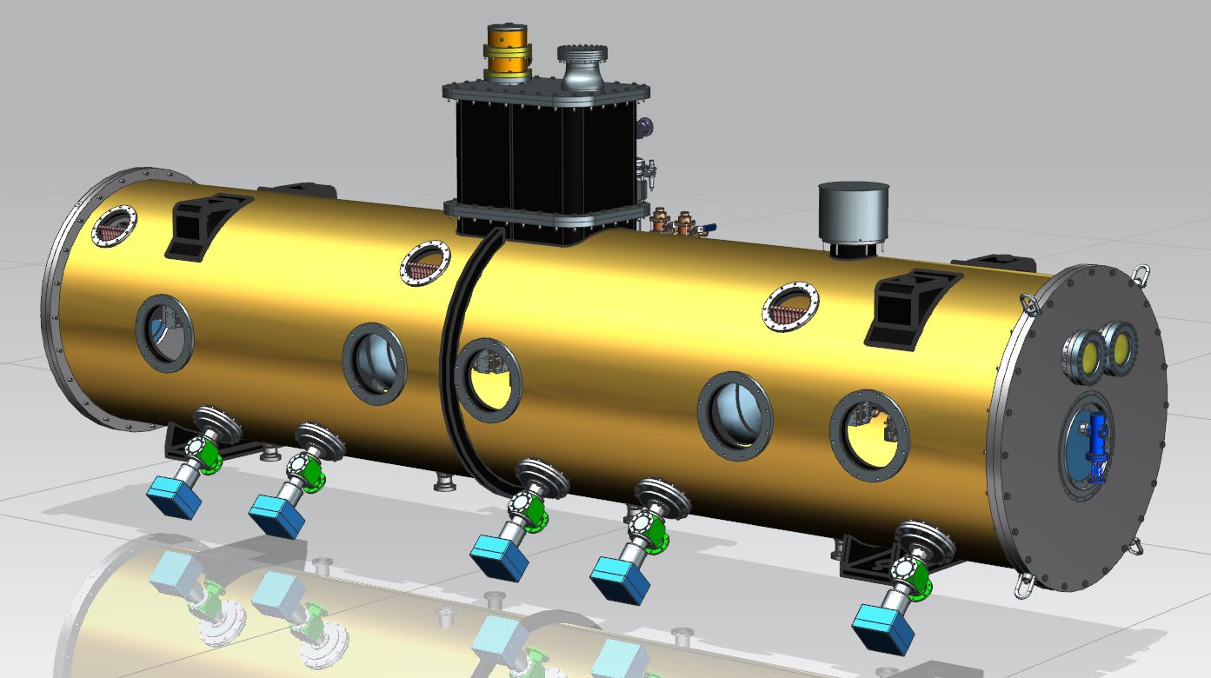
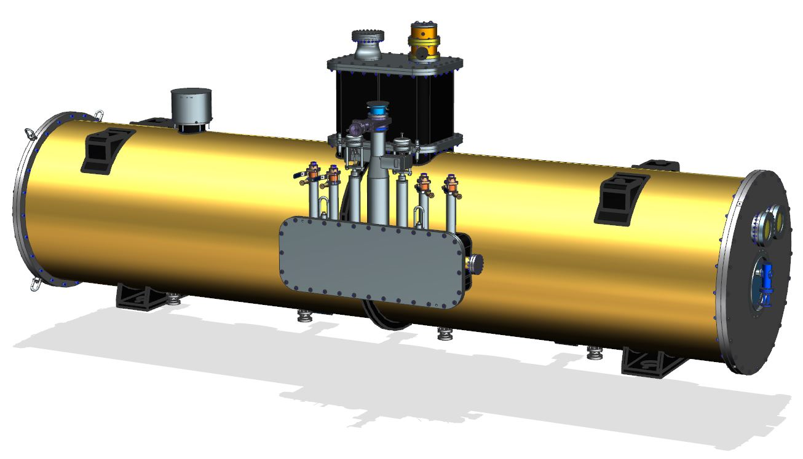
SSR2 Cavities, Pre-Production Cryomodule
Cavity
Integrated design team: Fermilab, IN2P3 and DAE
Niobium production at vendor completed
Prototype jacketed cavity procurement in progress
Coupler procurement in progress
Cryomodule
Design in progress by Fermilab, DAE
Parameters | SSR2 v 3.1
Optimal beta β_{opt} | 0.472
Aperture [mm] | 40
Frequency [MHz] | 325
Effective length 2β_{opt}λ/2 [m] | 0.436
E_{peak}/E_{acc} | 3.51
B_{peak}/E_{acc} [mT/(MV/m)] | 6.75
G [Ohm] | 115
R/Q [Ohm] | 305.2
E_{peak} [MV/m] @ 5 MeV | 40.2
B_{peak} [mT] @ 5 MeV | 77.4
Max energy gain [MeV] | 5.0
Max gradient [MV/m] | 11.47

Slide 21


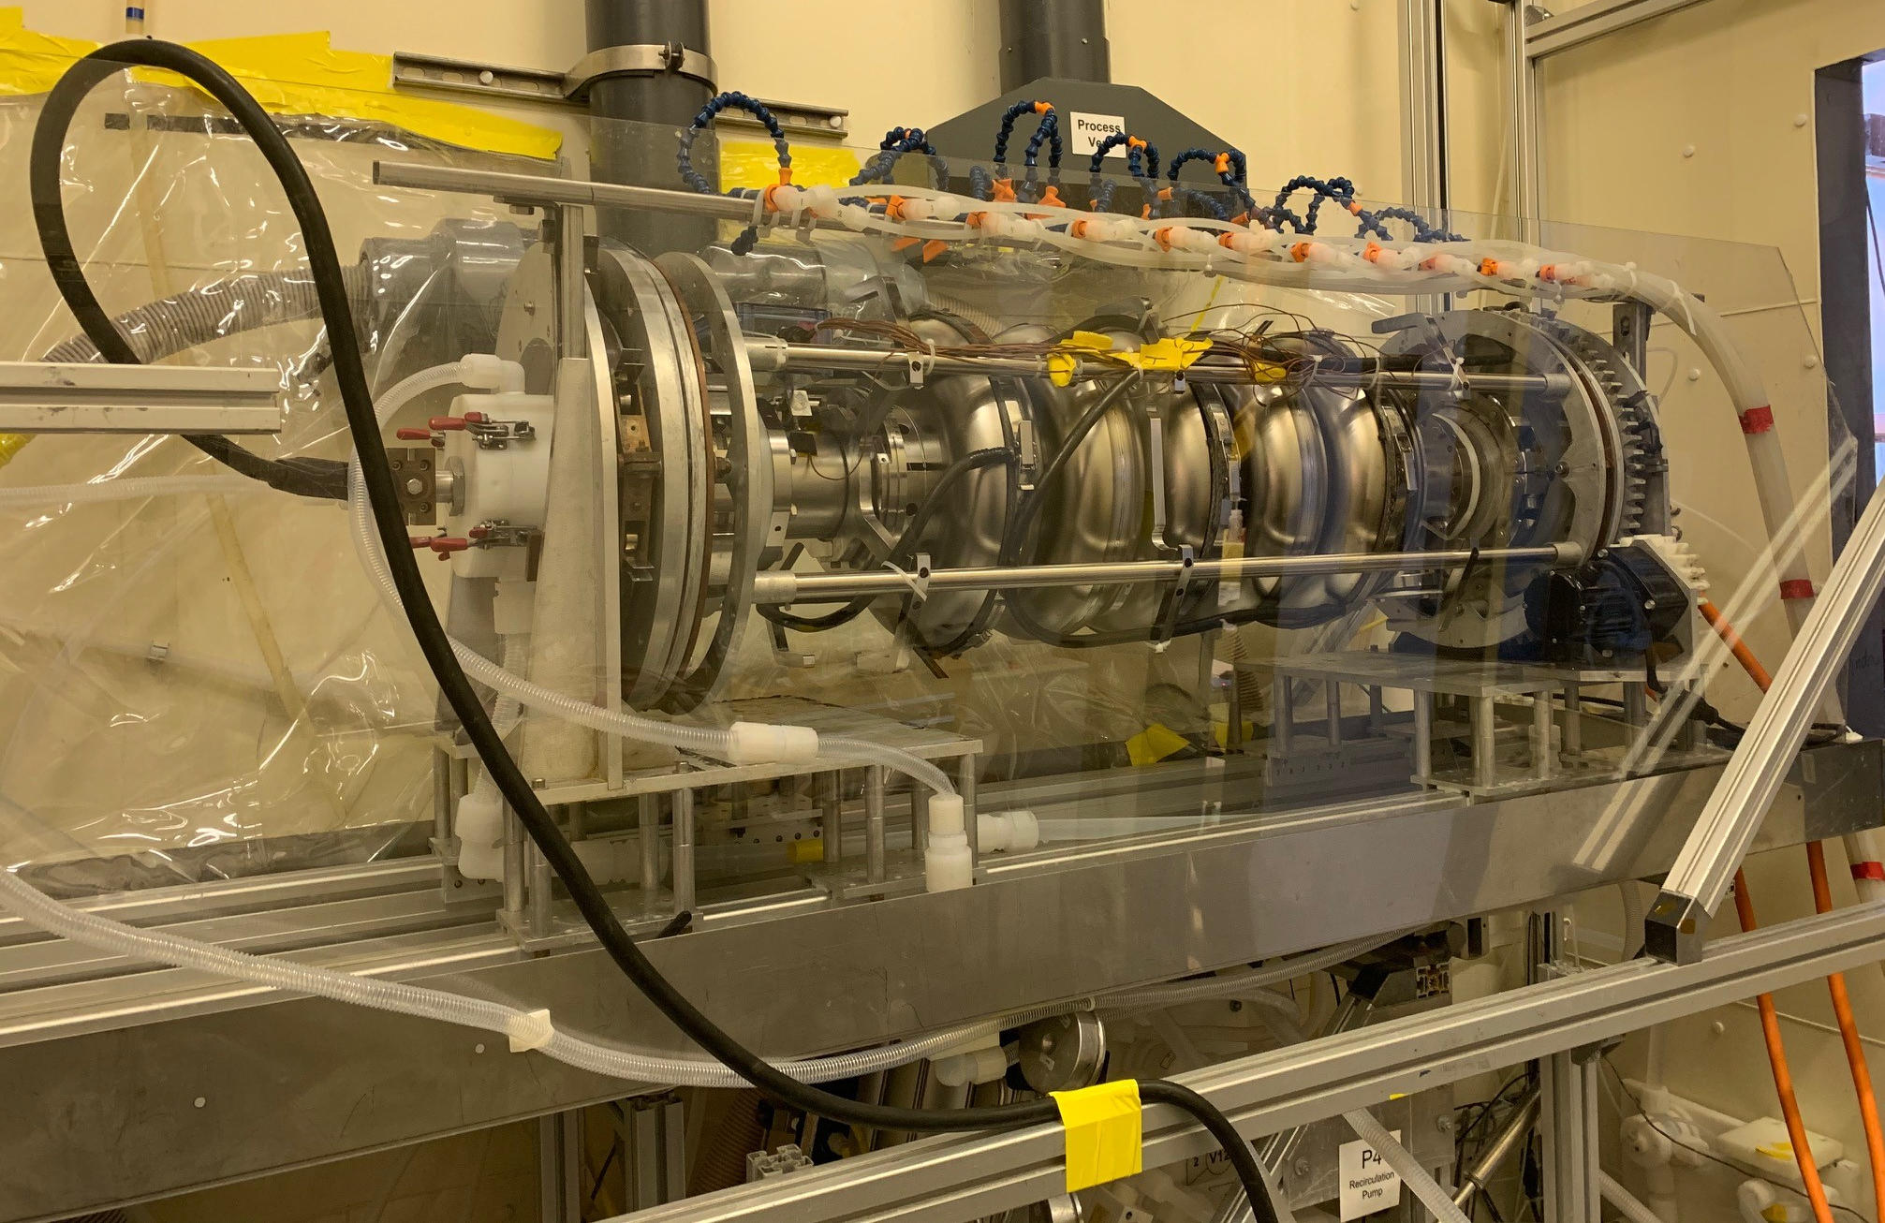
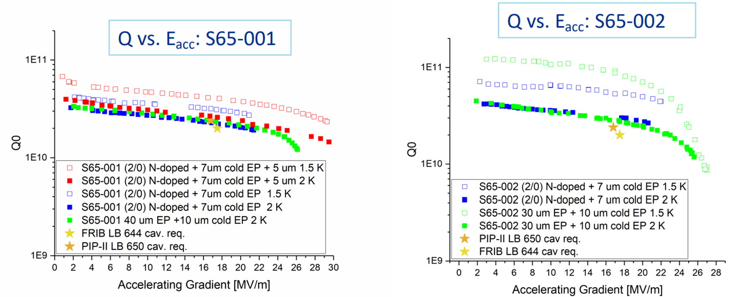
LB650 Cavities
Q₀, Gradient → 2.4 x10¹⁰ and 16.8 MV/m
Cavity RF design completed led by INFN
  First prototype bare cavity INFN contribution arrived in May 2020
  RF testing in progress
MSU 644 MHz cavities tested, meet PIP-II Q₀, gradient specs
B61-EZ-001 on ANL EP stand
MSU cavities are directly scaled from PIP-II LB650 cavity design.
Courtesy: Martina Martinello

Slide 22


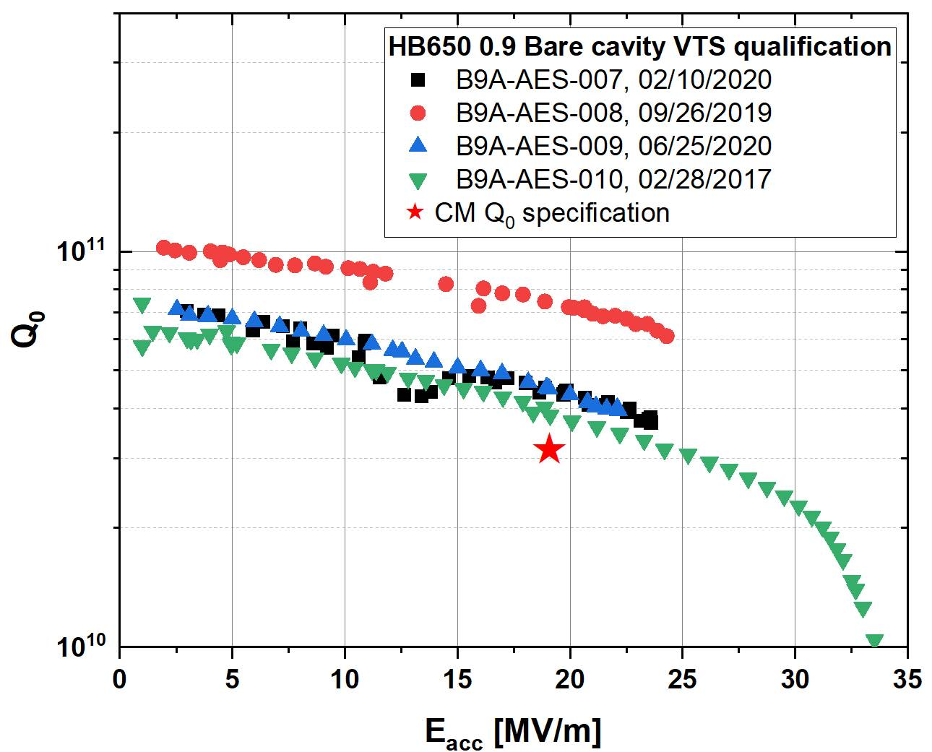
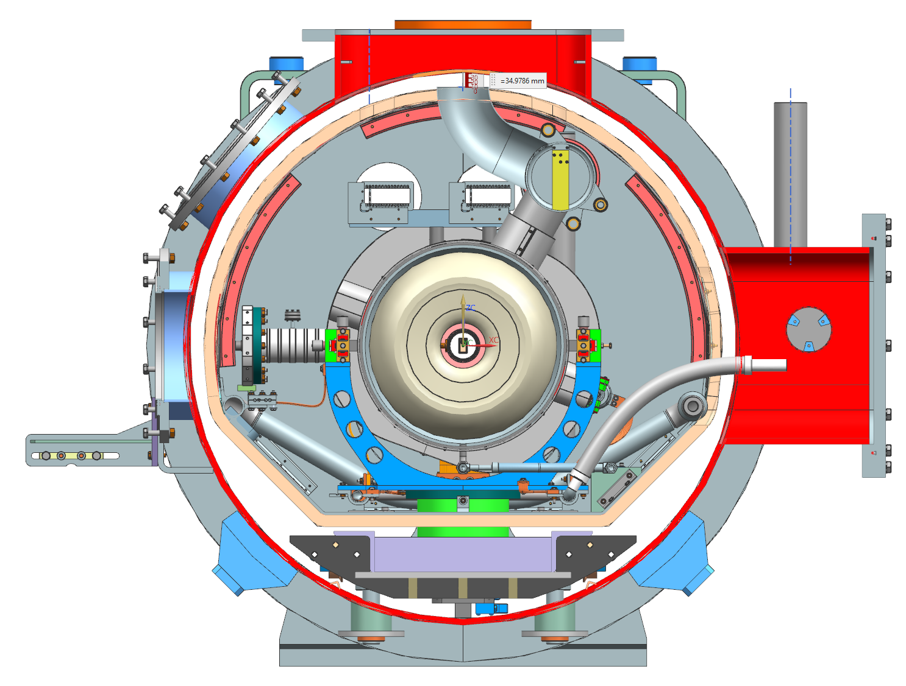
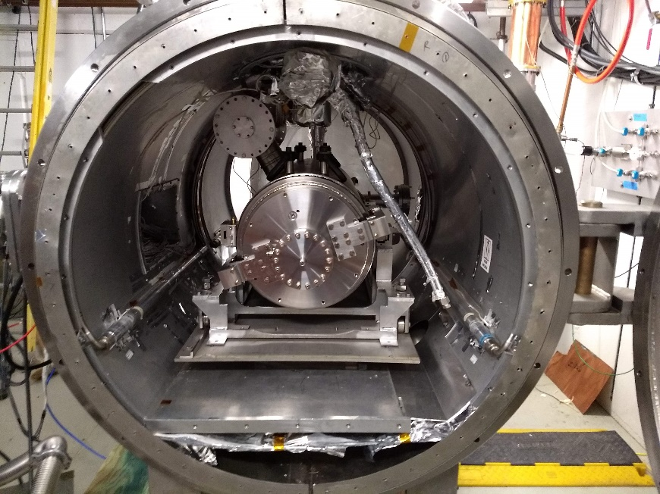
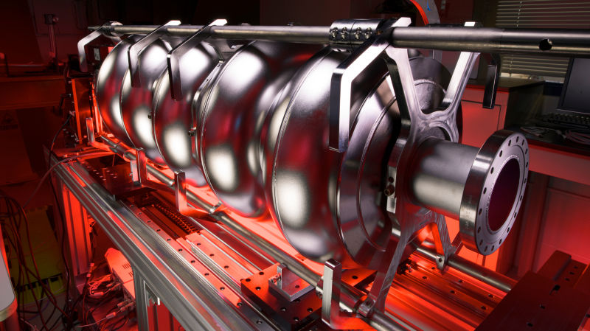
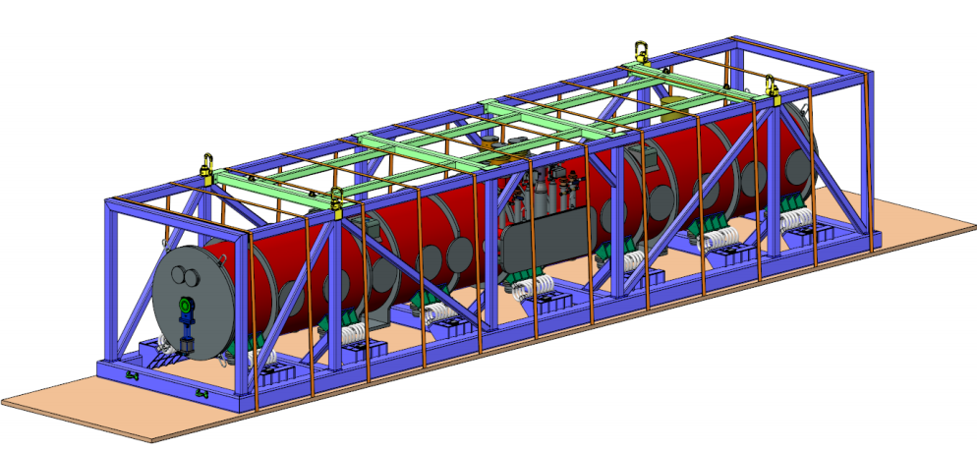
HB650 Prototype Cryomodule
Cavity
Q₀, Gradient → 3.3 x10¹⁰ and 18.7 MV/m
  N-doping optimization & fast cool down required
All four HB650 Fermilab cavities exceeded cryomodule Q₀ spec
RRCAT cavity reached max gradient 29 MV/m, met PIP-II specs
Cavity, coupler procurement awarded
Cryomodule
FDR was successfully completed in 7/29-31/2020
Successful HB650 Transportation FDR on 9/22/2020 led by UKRI
HB650 Transportation Tooling
Bare HB650 Cavity
Jacketed HB650 Cavity in STC
HB650 proto cryomodule

Slide 23
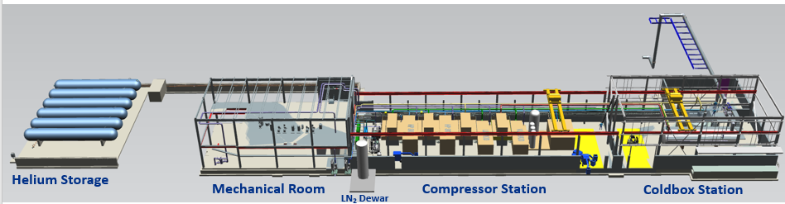

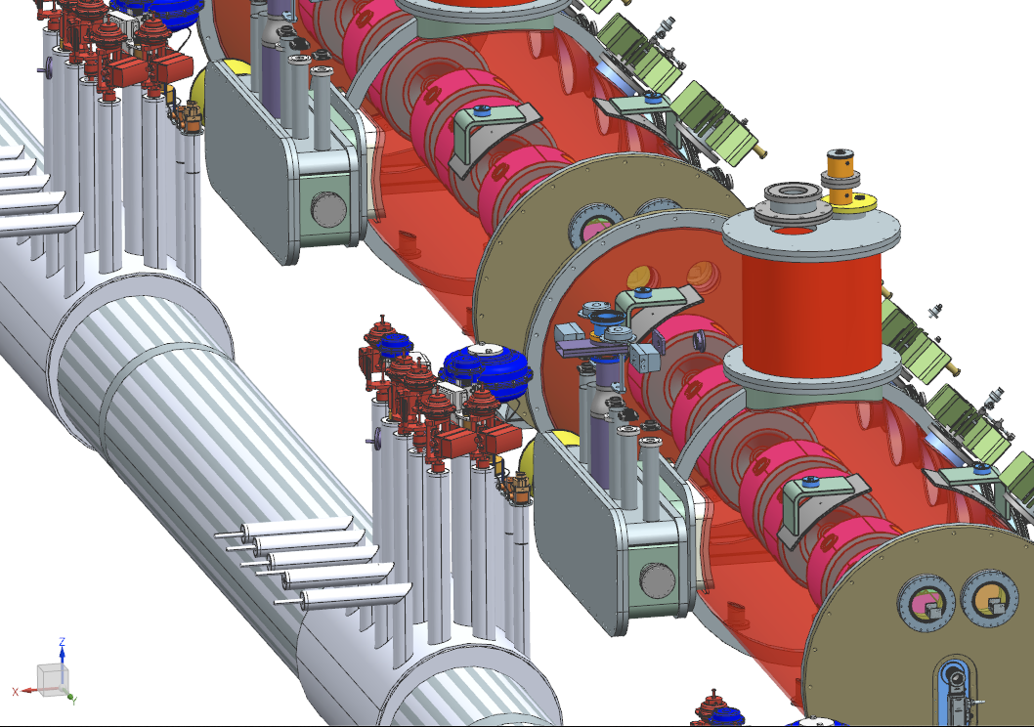
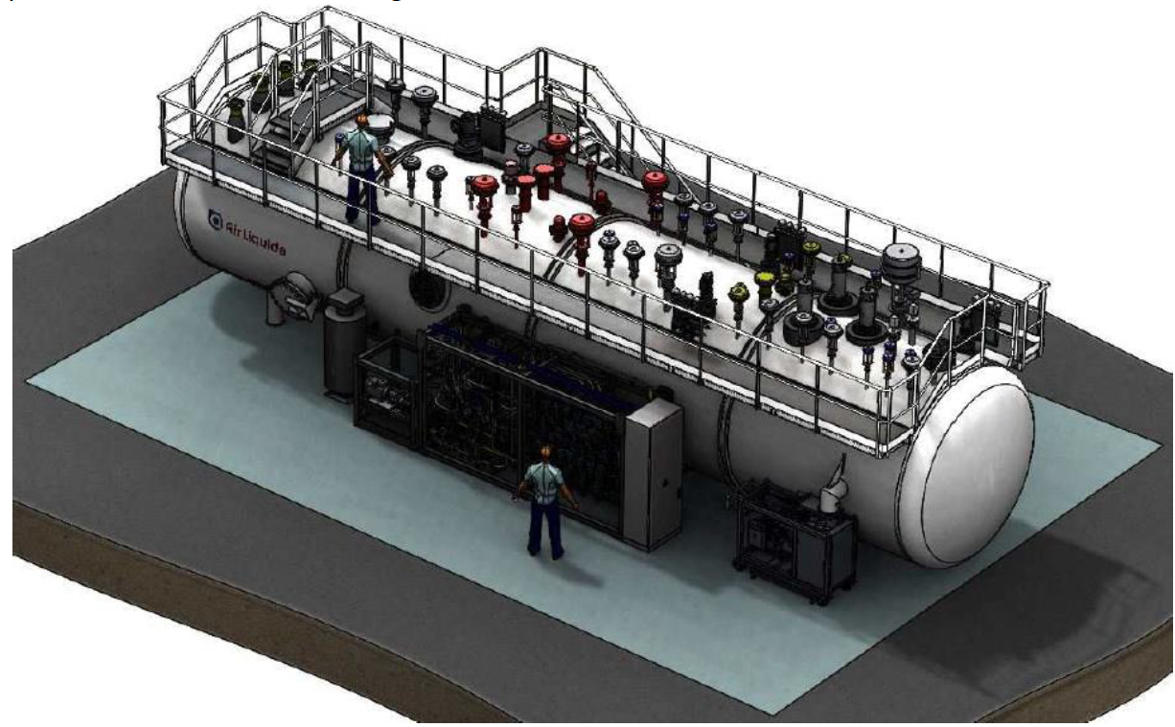
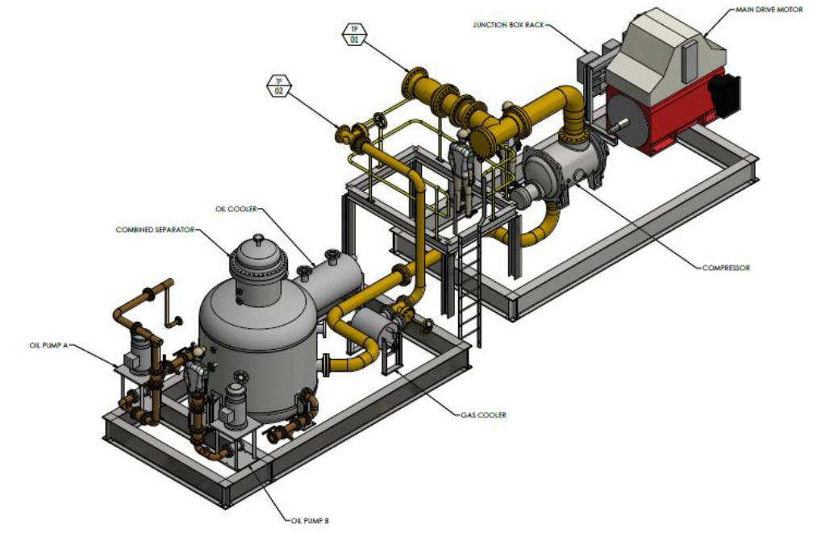
Cryoplant & Cryogenic Distribution System (CDS)
Jointly developed cryoplant specification between DAE and Fermilab
DAE issued purchase order for cryoplant
CD-3A scope: Cryogenic System Improvement
  Fully integrated with DAE scope
Designed in collaboration with Fermilab and Wroclaw University of Science and Technology
Final Design completed
3D Models completed
  Interconnect Transfer Line (ITL)
  Tunnel Distribution Line (TDL)
Klebaner

Slide 24



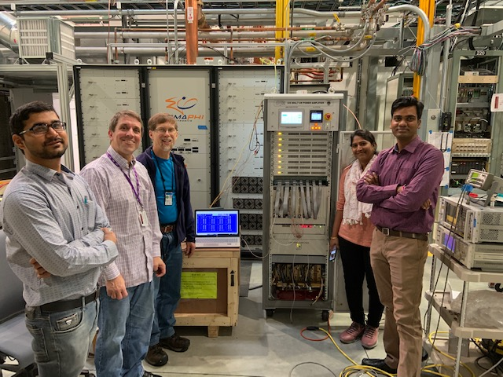
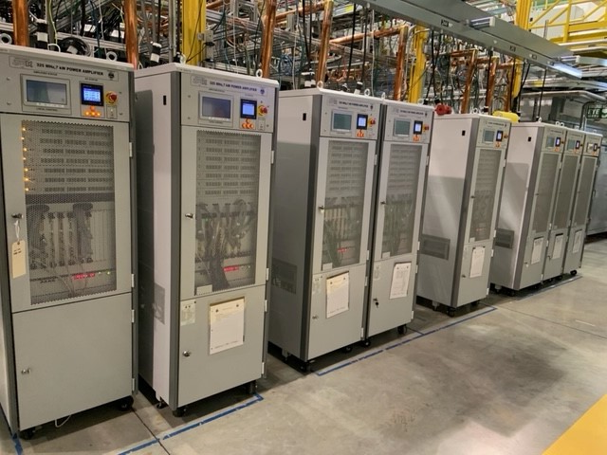
Accelerator Systems
Design, procurement, fabrication, and testing of various accelerator system hardware and software including:
  Machine Protection Systems, High Power RF & RF distribution, Low Level RF, Magnets & Power Supplies; Vacuum; Controls; Safety Systems; Beam Instrumentation
Focus:
  PIP2IT support for beam operation and SRF testing
  Maturing PIP-II technical designs
Highlights:
  Eight ECIL/BARC 325 MHz 7 kW amplifiers power SSR1 cavities, support beam tests
  LLRF/RFPI with resonance control operational in HWR, SSR1
  Laser profile monitor installation complete, first profile measured
  MPS focus on increasing beam pulse length up to 550 µs
    Low energy loss detector (diamond detector) installed
First ECIL/BARC 325 MHz, 7 kW RF amplifier at Fermilab – Feb 2020
ECIL/BARC 325 MHz, 7 kW RF amplifiers

Slide 25
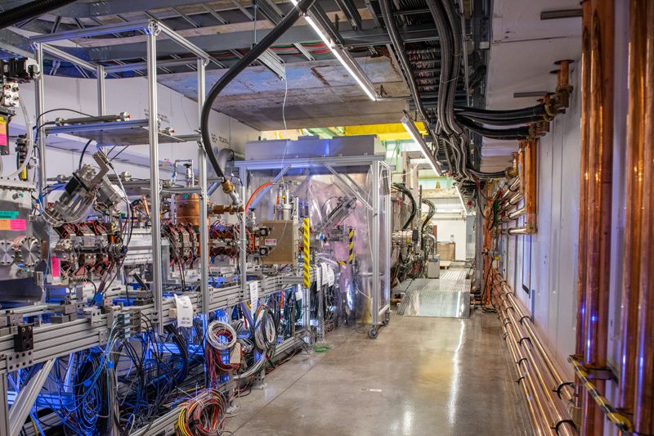

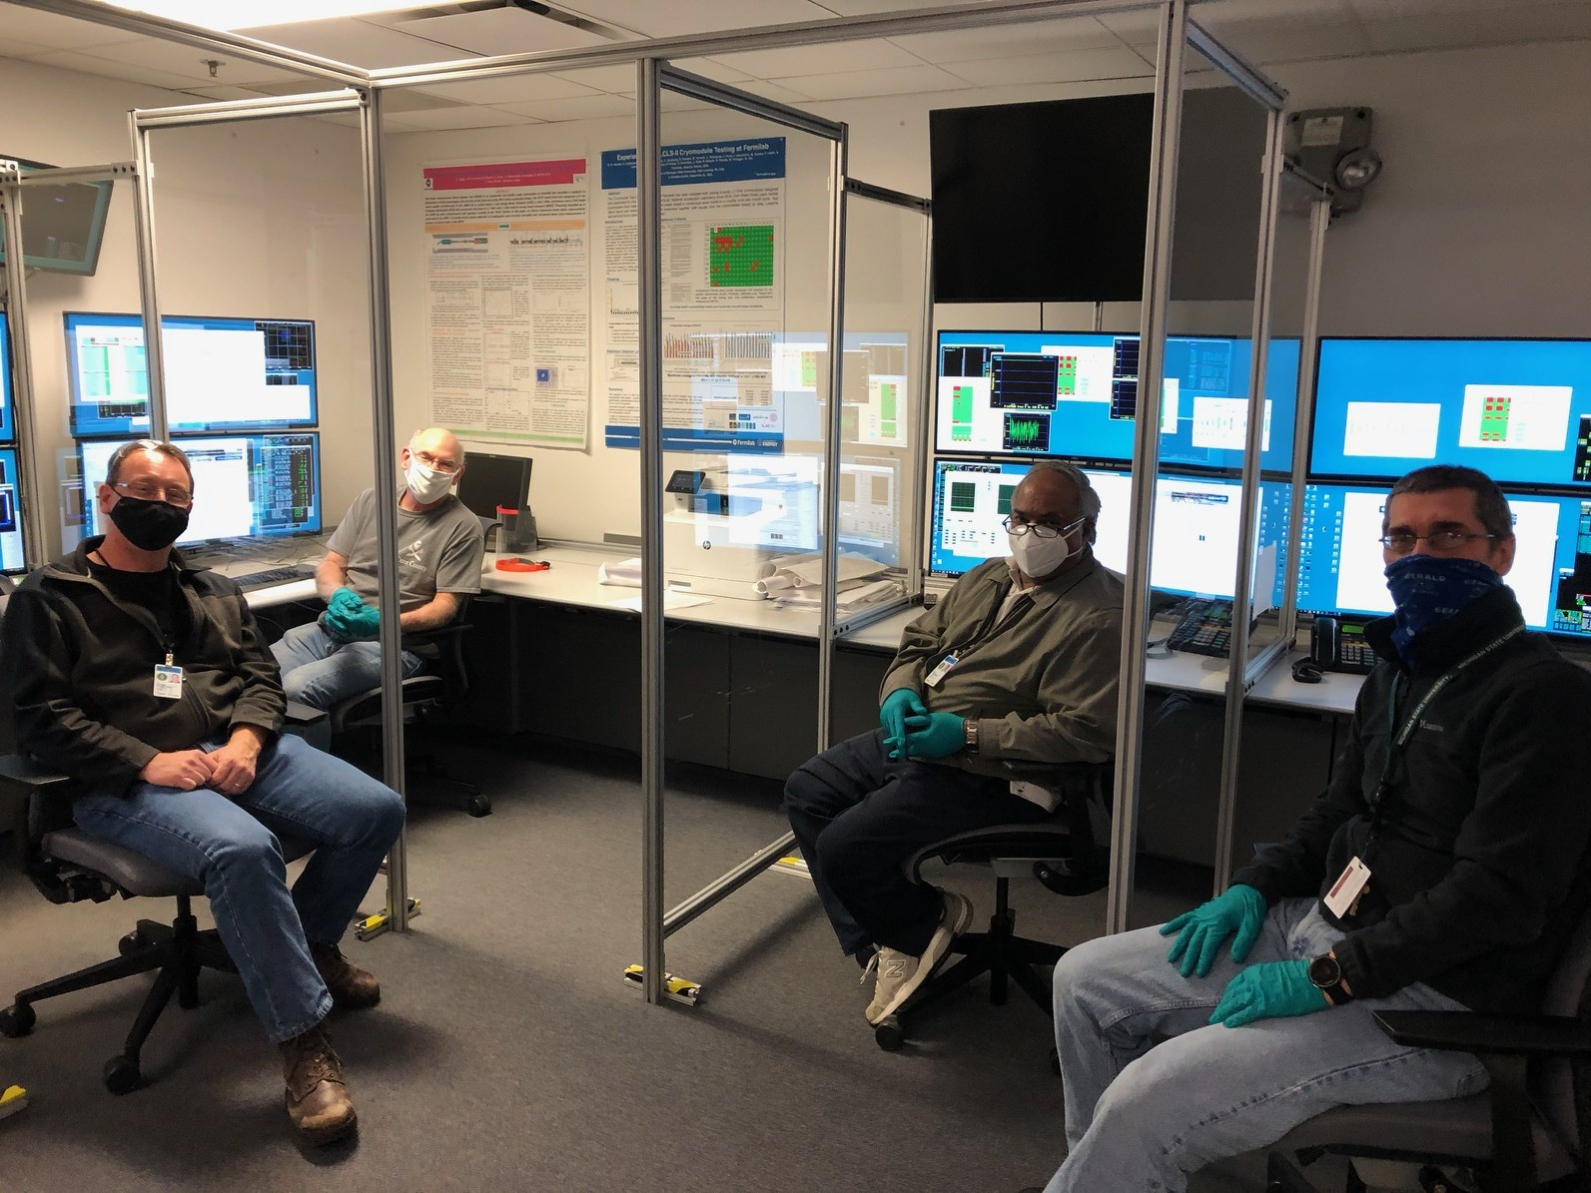
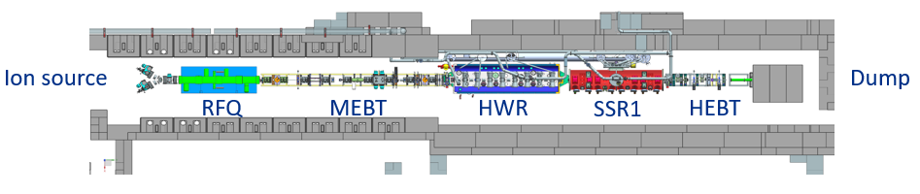
PIP-II Cryomodules accelerate beam to 17 MeV!
17.2 MeV
achieved
Beam energy evolution with 5 HWR and 8 SSR1 cavities
PIP2IT to be converted to PIP-II Cryomodule Test Facility
Significant Milestone: SRF cryomodules and battery of accelerator systems demonstrate solid performance; design requirements are being validated; international partners’ deliverables seamlessly integrated.
New era of SRF proton acceleration at Fermilab

Slide 26
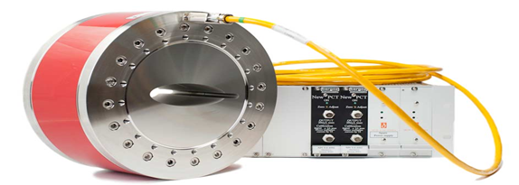
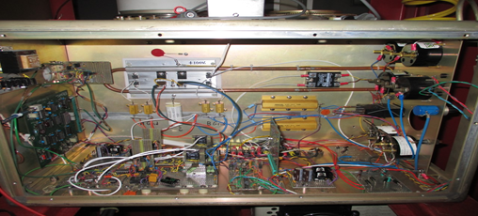
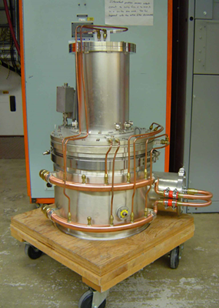
Accelerator Complex Upgrades
Beam Transfer/Absorber Line
  Finalized design of Beam Absorber at the 177 MeV location
  Finished thermal and shielding calculations of the 25 KW Beam Absorber
Booster
  Completed testing of Booster Longitudinal Dampers Boards
    Preparing for PDR review of Booster Longitudinal Dampers
  Refurbished a spare Booster Girder for 20 Hz testing
  CD-3A scope: Booster beam current monitor
    Replaces existing detector
    Finalizing purchase order
MI/RR/Booster RF
  Completed testing of the new Booster cavity
  Testing of the new MI RF modulator in progress
  CD-3A scope: MI power amplifiers and vacuum tubes
    Design and integration of MI PAs validated in upgraded MI RF station #5 (in operation since 2019)
    Finalizing procurement plan
Kourbanis
Booster Current Monitor
Kourbanis
New MI Modulator deck MI 200 kW PA

Slide 27
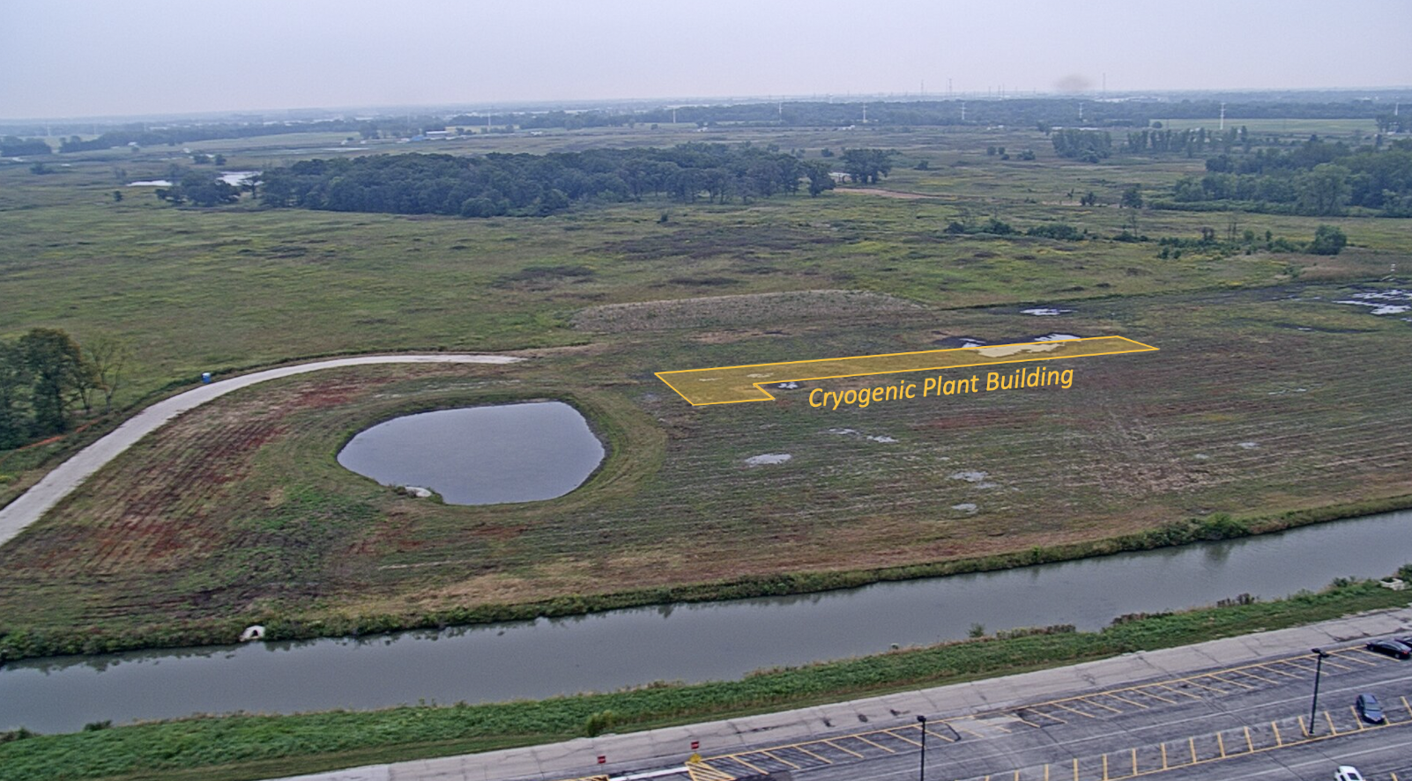
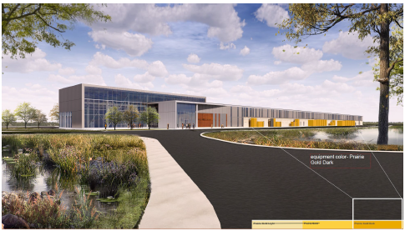
Conventional Facilities
Cryoplant Building Construction underway
  Structural steel erection ongoing until end of February 2021
  Precast concrete wall panels installation scheduled for mid-February 2021
  Completion in December 2021
Site Work
  - Proposal docs underway; DOE review Mar 2021
Linac Complex Design integrated with technical systems
  Final design underway
    90% review in progress
    On track for 100% in April 2021
Booster Connection
  Design to start in April 2021

Slide 28
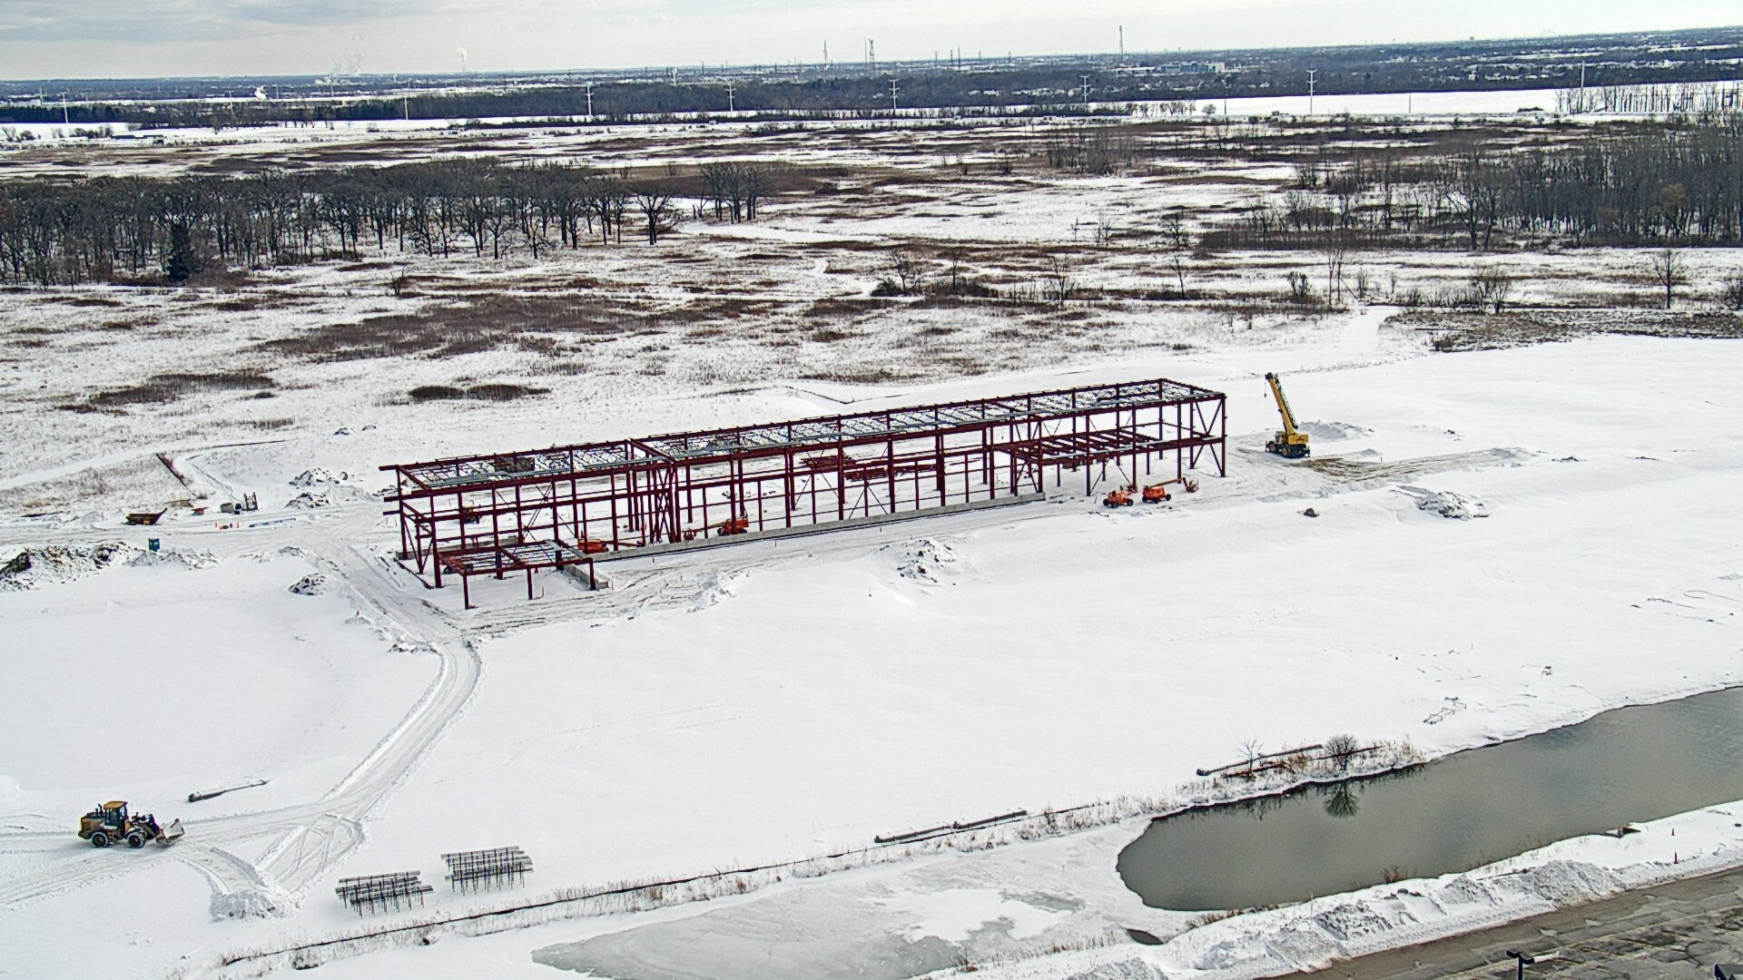
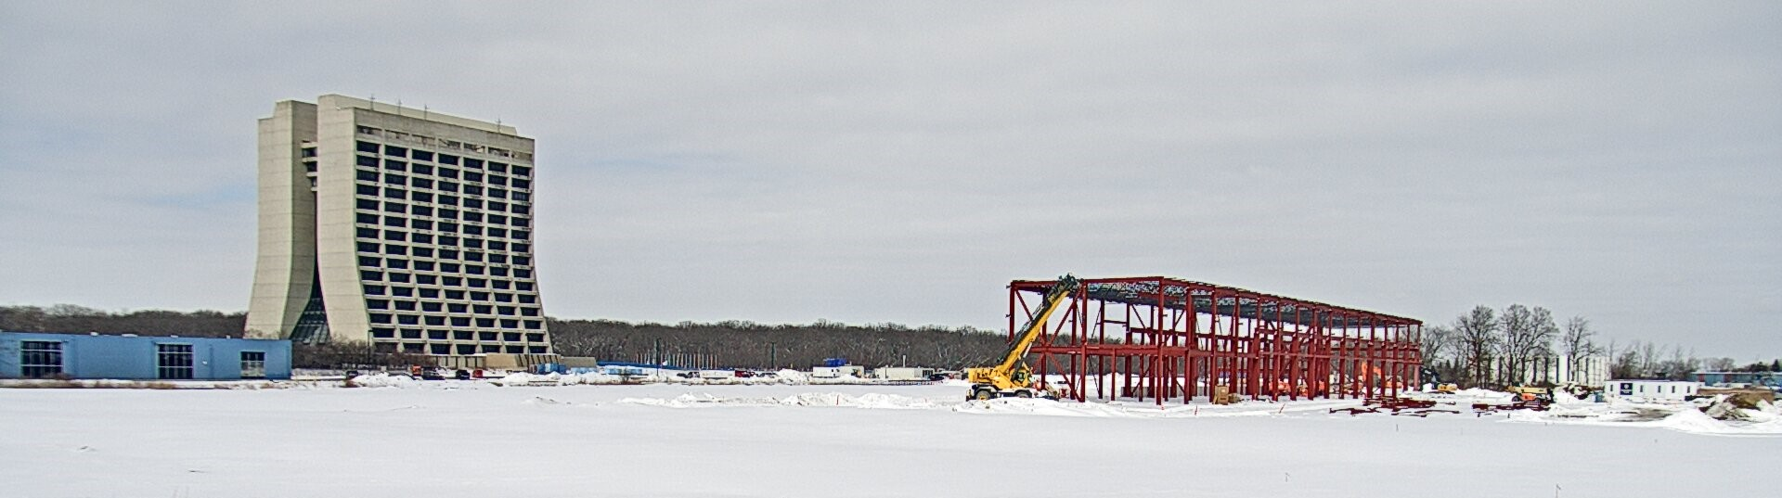
PIP-II Site on 16 February 2021
https://app.truelook.com/?u=fc1599677013#tl_live
https://app.truelook.com/?m=16002500832205565503647
https://app.truelook.com/?u=fc1599677013#tl_live

Slide 29
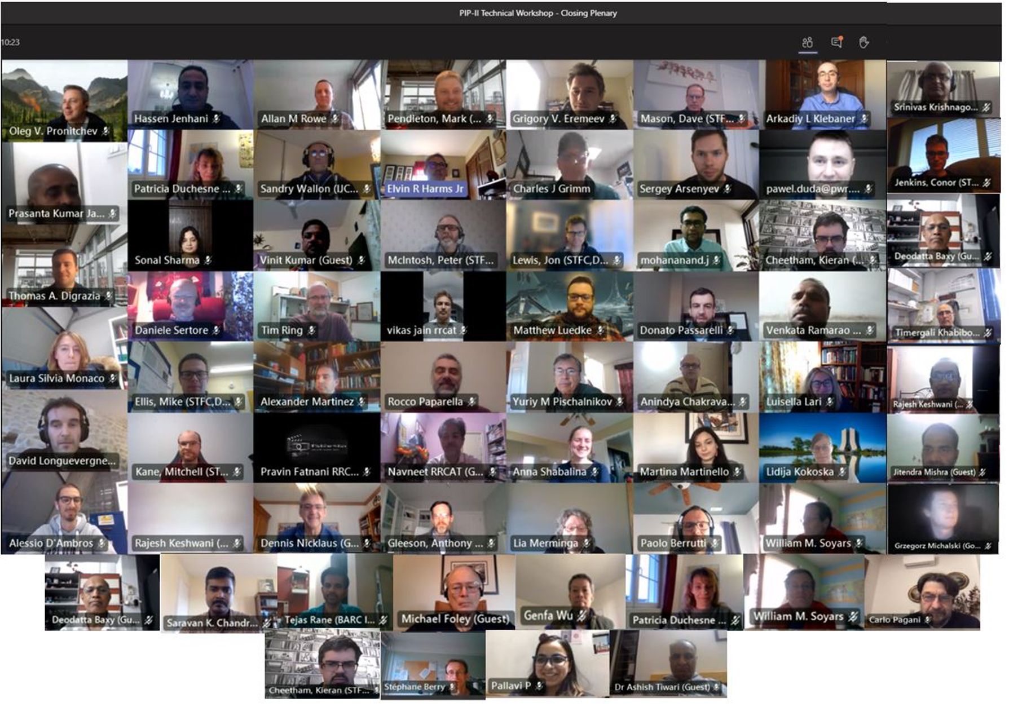
Inaugural PIP-II Technical Workshop held in December 2020
Working Groups
RF Power Couplers
SRF Cavity Design & Analysis
SRF Cavity Processing & Testing
SRF Cavity Manufacturing
Cryomodule Production
SRF Facilities
Controls
Cryogenic Systems
Requirements and Interfaces

Slide 30
ESH and Quality
ES&H documents approved with strong ties between Safety and Quality
Robust multi-tiered construction safety oversight program in place
PIP-II COVID-19 Recovery Plan and Laboratory established protective measures are working
ESH Integrated into and supporting all aspects of the PIP-II Project
PIP-II Quality Assurance (QA) Plan is established
  Each L2M has developed system level QA plans in alignment with the PIP-II QA Plan
    L3Ms create and maintain Subsystem-level/L3 QC Plans
  Partners submit a detailed QA plan in accordance with the PIP-II QA Plan

Slide 31

PIP-II Baseline
Schedule

Slide 32

TPC $978M
Contingency 39%
on work-to-go
PIP-II Obligations and Funding Profile
Funding profile agreed with HEP, supports performance baseline

Slide 33
PIP-II 2021 Major Milestones
Receive CD-3A approval for long lead procurements
Complete beam tests at PIP2IT through HWR and SSR1
Advance HB650 proto cryomodule integration
Complete CD-3 DOE IPR - Start of Construction/Execution
Complete Cryoplant Building Construction

Slide 34
Summary
Excellent, experienced project team and strongly committed international partners ensure continued technical progress despite pandemic challenges
  PIP-II performance baseline approved
  Construction of cryoplant building is advancing
  Beam accelerated in first two PIP-II cryomodules
Project is focused on execution
  Project baseline established at end of January 2021
  Key management positions are filled, processes are streamlined
  Stability of requirements and interfaces is ensured
Approved tailoring strategy includes a CD-3A request for long-lead procurements
  Well motivated: systems needed to maintain baseline schedule and reduce risk
  Scope is technically ready
  Procurement plans are in place
PIP-II is ready for CD-3A approval
Kaducak
Boffo
Klebaner
Kourbanis

Slide 35
Thank you!

