Slide 1

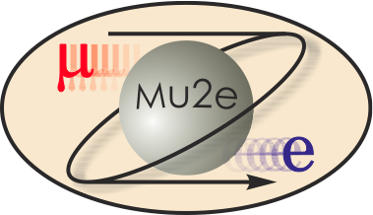
-II
Mu2e-II Workshop (vii) - Introduction
Frank Porter
March 3, 2021
DocDB-37229
This meeting will be recorded

Slide 2
Mu2e-II workshops
Workshop dates | Links to recordings
Thursday, June 18 https://mu2e-docdb.fnal.gov/cgi-bin/sso/DisplayMeeting?conferenceid=9755 | AM: https://caltech.box.com/s/b67edbgtxofaujuooorafm4kfq9owhjd PM: https://caltech.box.com/s/vnsm9nh7qroznt3n6q5n3sn4ut1bswo5
Wednesday, July 29 https://indico.fnal.gov/event/44541/ | https://caltech.box.com/s/k45jik5i7uztq2letmaxb93fq3arl0kf
Wednesday, August 26 https://indico.fnal.gov/event/44997/ | https://caltech.box.com/s/ws8hkzmjo96xlnile8q27yphb87nlpjp
Wednesday, September 23 https://indico.fnal.gov/event/45632/ | https://caltech.zoom.us/rec/play/_xbOzK448M0VhhDArf9UE8AjiOKdshh4et0tYOOhtViPn3qveG95CkQUOHQ0_SzeJ8pxVzw5M0PoIvjD.I-zdhaNXvu3i5Sll?autoplay=true&startTime=1600873315000
Wednesday, October 28 https://indico.fnal.gov/event/45937/ | https://caltech.zoom.us/rec/share/zCGxa2uJwAKwONXm7pyiqrrLPJvIxTaNHkY2cxHRDjtmb_mWOYqraV8D9ynUMATk.JNeSkLhSj4-Hfcof
Wednesday, December 9 https://indico.fnal.gov/event/46433/ | https://caltech.zoom.us/rec/share/xXVV4YURBMeRsnF0GLQSgAPv-FJ466HNnTGze3VeiAoooyUcRSU7cP16QBwlvNPv.XvSqSC_JVmuSKVA9
Wednesday, March 3 https://indico.fnal.gov/event/47787/

Slide 3
Mu2e-II Working Groups
Mu2e-II working groups | Convenors
Theory mu2eii-theory@fnal.gov | Lorenzo Calibbi Julian Heeck
Accelerator (including PS, production target, extinction) mu2e-ii-accelerator@fnal.gov | Karie Badgley David Neuffer Eric Prebys
Radiation mitigation (includes radiation simulation) mu2eii-radiation@fnal.gov | Michael MacKenzie Stefan Mueller Vitaly Pronskikh
Tracker mu2eii-tracker@fnal.gov | Daniel Ambrose Giovanni Tassielli
Calorimeter (and STM?) mu2eii-calorimeter@listserv.fnal.gov | David Hitlin Luca Morescalchi Ivano Sarra
CRV mu2eii-crv@listserv.fnal.gov | Craig Dukes Yuri Oksuzian
Sensitivity estimate (includes simulation, stopping target) mu2e-ii-sensitivity@listserv.fnal.gov | Lisa Goodenough Sophie Middleton Yuri Oksuzian
Trigger and DAQ mu2eii-tdaq@listserv.fnal.gov | Antonio Gioiosa Giani Pezzullo

Slide 4
Accelerator
Karie Badgley, Convenor, FNAL
David Neuffer, Convenor, FNAL
Eric Prebys, Convenor, UCD
Mary Anne Cummings, Muons, Inc.
Keegan Harrig, UCD
Andrei Gaponenko, FNAL
Vadim Kashikhin, FNAL
Kevin Lynch, CUNY
James Popp, CUNY
Diktys Stratakis, FNAL
TBD, 2021 (10-12 CT): AF2/AF5/AF7/RP/NP target workshop (contact: Eric Prebys) https://indico.fnal.gov/event/46752/

Slide 5
Radiation simulation and mitigation
Michael MacKenzie, Convenor, Northwestern
Stefan Mueller, Convenor, HZDR
Vitaly Pronskikh, Convenor, FNAL
Anna Ferrari, Reuven Rachamin, HZDR
Vadim Kashikhin, FNAL
James Popp, CUNY
David Pushka, FNAL
Yuri Oksuzian – CRV
Sophie Middleton – Sensitivity
Giani Pezzullo - TDAQ

Slide 6
Theory
Lorenzo Calibbi, Convenor, Nankai U
Julian Heeck, Convenor, UVa
Robert Szafron, CERN
Yuichi Uesaka, Kyushu Sangyo University

Slide 7
Tracker
Daniel Ambrose, Convenor, UMinn
Giovanni Tassielli, Convenor, INFN Lecce
David Brown, LBNL
Brendan Casey, FNAL
Manolis Kargiantoulakis, FNAL
James Popp, CUNY
Mete Yucel, FNAL
Tracker meetings every two weeks on Tuesdays 11:15AM CT
Next meeting Tuesday, March 16

Slide 8
Calorimeter
David Hitlin, Convenor, Caltech
Luca Morescalchi, Convenor, INFN Pisa
Ivano Sarra, Convenor, LNF
Leo Borrell, Bertrand Echenard, Dexu Lin, Sophie Middleton, James Oyang, Frank Porter, Liyuan Zhang, Renyuan Zhu, Caltech
Eleonora Diociaiuti, Raffaella Donghia, Simona Giovannella, Fabio Happacher, Stefano Miscetti, LNF
Stefano Di Falco, Simone Donati, Antonio Gioiosa, Elena Pedreschi, Franco Spinella, INFN Pisa

Slide 9
Cosmic Ray Veto
Craig Dukes, Convenor, Uva
Yuri Oksuzian, Convenor, ANL
Karen Byrum, Simon Corrodi, Peter Winter, Lei Xia, ANL
Raymond Culbertson, Gary Drake, Anna Pla-Dalmau, Greg Rakness, FNAL
Akram Artikov, Yuri Davydov, JINR, Dubna
Timothy Bolton, Glenn Horton-Smith, Yurii Maravin, Kres Neely, KSU
Gerald Blazey, Kurt Francis, Sergey Uzunyan, Vishnu Zutshi, NIU
Merrill Jenkins, U South Alabama
Steven Boi, Ralf Ehrlich, Stephen Goadhouse, Craig Group, UVa

Slide 10
Trigger/DAQ
Antonio Gioiosa, Convenor, INFN Pisa
Gianantonio Pezzullo, Convenor, Yale
Richard Bonventre, LBNL
Rebecca Chislett, UCL, Tracker
Raffaella Donghia, LNF
Bertrand Echenard, Caltech
Ryan Rivera, FNAL
Franco Spinella, INFN Pisa – Calorimeter
Craig Dukes, UVa - CRV

Slide 11
Sensitivity estimates
Lisa Goodenough, Convenor, FNAL
Sophie Middleton, Convenor, Caltech
Yuri Oksuzian, Convenor, ANL
Rebecca Chislett, UCL
Michael Hedges, Purdue
Cole Kampa, Northwestern
Manolis Kargiantoulakis, FNAL
Michael MacKenzie, Northwestern

Slide 12
Snowmass 22 Planning – “covid pause”
January Snowmass newsletter:
https://indico.fnal.gov/event/47394/attachments/139229/175180/Snowmass_Newsletter_Jan.2021.pdf
https://snowmass21.org/announcements
• High-level activities on hold until the end of June 2021
  Includes Frontier-level and Topical Group-level workshops, All-conveners meetings, Advisory Group meetings and Newsletters.
• Other Topical Group and cross-frontier activities paused or reduced to a significantly lower level, proceeding only as necessary to ensure:
  scientific continuity
  meet essential programmatic needs
  maintain collaborative work with other units and communities
o No critical decisions will be made during the hiatus
o No individuals obligated to participate in these activities
• Individual, collaborative and self-organized work can continue at the discretion of the individuals involved

Slide 13
Snowmass 22 - Endgame Schedule
White Paper submission to arXiv: no later than March 15, 2022
  Late submissions and updates unlikely to be incorporated in the working group reports
• Preliminary reports by the Topical Groups due: no later than May 31, 2022
• Preliminary reports by the Frontiers due: no later than June 30, 2022
• Snowmass Community Summer Study (CSS): July 2022 at UW-Seattle
• Final reports by Frontiers due: no later than September 30, 2022
Snowmass Book and on-line archive documents due: October 31, 2022

Slide 14
Snowmass 22 RP Frontier Schedule
Rare Processes & Precision Measurements Frontier
The rare processes and precision measurements frontier plans to pause activities until the end of August
Will be about three “heartbeat” status meetings among the topical group conveners in that time but no workshops
  CLFV coffee hour
    First one was Feb 25, 2021
    Watch Snowmass CLFV email; I’ll post future ones on the Mu2e-II calendar
Community members should pursue their individual physics interests as they wish
At the end of August, will resume activities again with a schedule to be determined
Plan to postpone Frontier meeting by one year to around May 2022.

Slide 15
Mu2e-II Snowmass Schedule
Main new information for us is the March 15, 2022 deadline for submission of Mu2e-II contribution to arXiv
This will serve as the input to the Topical Group Convenors
  Their deadline for preliminary reports is May 31, 2022
Mu2e-II aims for a “good first draft: by February 1, 2022
  Not so long from now!
  Outline and framework on Overleaf (read link):
    https://www.overleaf.com/read/mrbgttkmfgvq
  Let me know if you would like the Edit link

Slide 16
Mu2e-II talks
Discussion with Kevin Lynch, Mu2e Speakers Bureau Chair
“Mu2e-II” talks for CPAD (Mar 18-22), APS (Apr 17-20), IPAC21 (May 24-28)
  Extinction monitor (?)
  Calorimeter (David Hitlin – SiPMs, Renyuan Zhu – crystals)
  Tracker (Dan Ambrose)
  Production target (Vitaly Pronskikh)
  TDAQ (Richie Bonventre)

Slide 17
Speakers Bureau
Purpose of a speakers bureau:
Spread public talks among deserving speakers
  Junior speakers
  Diversity
  Career advancement
Quality control
  Review of material to be presented
  Suggestions for improvements in presentation

Slide 18
Mu2e-II talks - approaches
Some possible ways to handle Mu2e-II talks, from Kevin Lynch (edited)
1) Keep it wild west for now
2) Give the Mu2e Speakers Committee "jurisdiction" at some level of formality
3) Give Mu2e-II committee jurisdiction
4) Hybrid of 2 and 3 where one or more Mu2e-II committee members "join" the Mu2e Speakers Committee for Mu2e-II talk issues
5) Delegate to 2 or 3 case-by-case
6) Some other idea?
Some presentations today serve as “practice talks”

Slide 19
Mu2e-II talks
If you plan to submit an abstract or give a Mu2e-II talk, or are invited to give such a talk, please
  Email Kevin Lynch and Frank Porter
  If you have an invitation, please email us even if you do not wish to accept – we may be able to suggest someone else
Fermilab requirements – writeups
  Acknowledgment should usually include:
    This document was prepared by members of the Mu2e-II Collaboration using the resources of the Fermi National Accelerator Laboratory (Fermilab), a U.S. Department of Energy, Office of Science, HEP User Facility. Fermilab is managed by Fermi Research Alliance, LLC (FRA), acting under Contract No. DE-AC02-07CH11359.
  Fermilab preprint number
    https://mu2e-docdb.fnal.gov/cgi-bin/private/ShowDocument?docid=4083
Propose with byline:
  “For the Mu2e-II Collaboration”
  Optionally as applicable; “For the <appropriate group name> working group of the Mu2e-II Collaboration”

Slide 20
Mu2e-II Collaboration (author list)
So far, closest things to a collaboration list we have in Mu2e-II is
  LOI author list
  Mu2e-II mailing list
  Mu2e-II working group participant lists
It would be convenient to have a standing author list
  Probably not just the Snowmass white paper
  Cumbersome to ask for authors every time
    Likely to miss people under principle that people have to explicitly sign
    A lot of tedious work
For some people, useful to have a formal connection
  I.e., membership in ‘’Mu2e-II collaboration’’
  If we have a standing author list, that can define the collaboration
Plan to create a standing “Mu2e-II Collaboration List”
  Identical with the standing author list
  A subset of the Mu2e-II email list
  Publications announced to email list; default is authorship, individuals may remove themselves

Slide 21
Mu2e-II Communication
  Public wiki page: https://mu2eiiwiki.fnal.gov
    Please email Lisa or Frank if you wish to have write access
Private wiki page:
    https://mu2eii-internal-wiki.fnal.gov/wiki/Main_Page
  SSO log-on
  Need to contact Lisa or Frank to request access
  This page has the Mu2e-II calendar with links to zoom, indico, etc.
Mu2e-II mailing list: mu2eii@listserv.fnal.gov
Mu2e-II Slack channel invite link:
  https://join.slack.com/t/caltech-tka1525/shared_invite/zt-glsr3405-OondWg0KCpBoUJwIr2uyJw

Slide 22
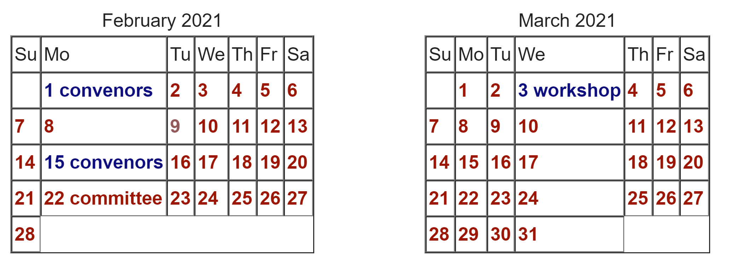
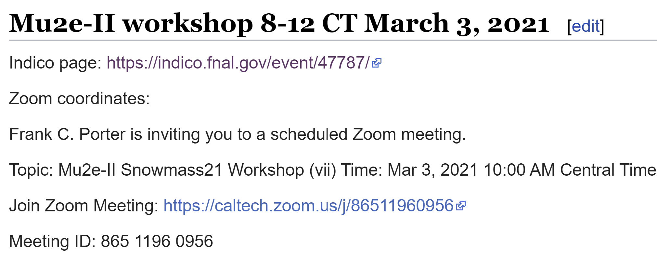
Mu2e-II Calendar
On main page of private Wiki
    https://mu2eii-internal-wiki.fnal.gov/wiki/Main_Page
Clicking on date provides details

Slide 23
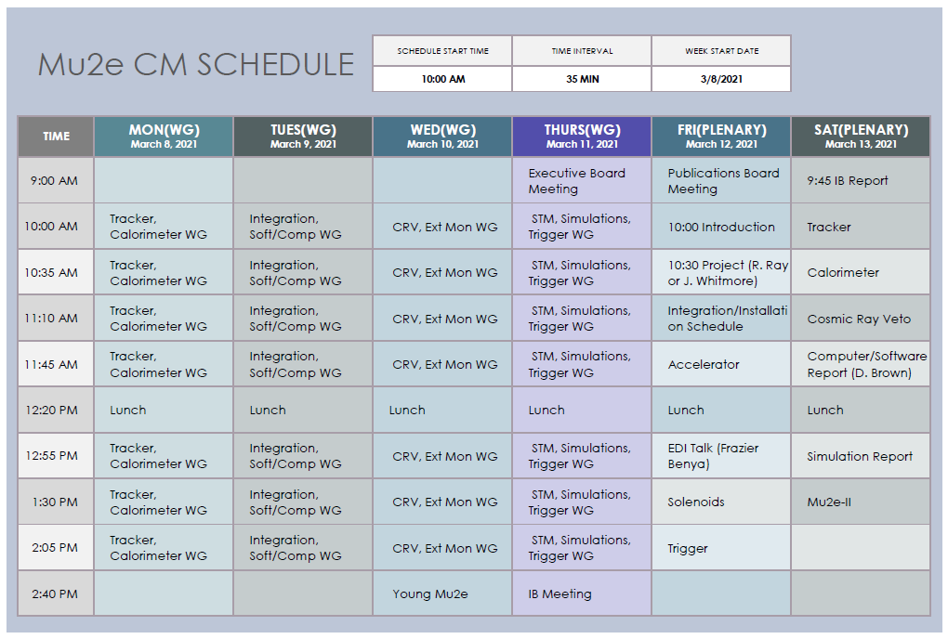

Mu2e-II at Mu2e Collaboration Meeting
Sophie Middleton will give Mu2e-II summary at Mu2e collaboration meeting
Saturday, March 13 at 1:30PM (CT)

Slide 24
March 3 Mu2e-II workshop agenda
Indico timetable at: https://indico.fnal.gov/event/47787/
When (CT) | Who | What
10:00-10:20 | Frank Porter | Introduction
10:20-10:45 | Yuri Oksuzian | CRV - report from Dec 11 workshop
10:45-11:10 | Vitaly Pronskikh | Production target – (APS/IPAC)
11:10-11:30 | David Hitlin | Calorimeter Readout (CPAD)
11:30-11:55 | Renyuan Zhu | Calorimeter Crystals (CPAD)
12:00-12:30 | All | Break
12:30-12:55 | Dan Ambrose | Tracker (CPAD)
12:55-13:20 | Sophie Middleton | Sensitivity – stopping targets
12:20-13:30 | Stefan Mueller | Radiation studies – brief report
13:30-13:40 | Eric/Karie/David | Accelerator - brief report
13:40-13:50 | Julian Heeck | Theory – brief report
13:50-14:00 | Antonio/Giani | TDAQ – brief report
14:00 | All | End

Slide 25
Next Mu2e-II workshop:
Late April or Early May?
PIP-II presentation planned
Production Solenoid – Karie Badgley

Slide 26
Additional Material

Slide 27
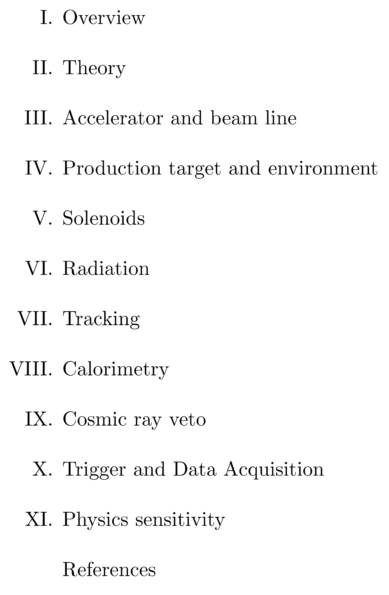
Contributed Paper – Proposed Top Level Outline

Slide 28
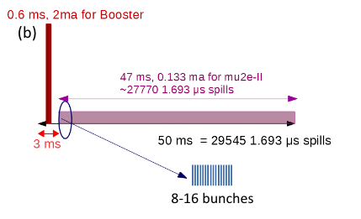
Proposed Mu2e-II beam nomenclature
Follow accelerator group usage
Beam delivery is different than Mu2e
Quantity | Name
Beam in one PIP-II RF bucket (162.5 MHz) | Bunch
PIP-II pulse (20 Hz/0.55 ms) | Pulse (but see below)*
Mu2e-II repetition (e.g., 1693 ns) | Spill (also pulse, but see above)**
Set of bunches in one spill (e.g., 8) | Burst (also pulse, but see above)**
*One PIP-II pulse is about 27770 Mu2e-II spills; suggest saying “PIP-II pulse”
to avoid confusion.
**”Pulse” may be used when distinction is not important
Eric Prebys https://indico.fnal.gov/event/44997/
David Neuffer, DocDB 33896

Slide 29
Mu2e-II Snowmass21 Committee
Name | Institution | Email
Dan Ambrose | U Minn | ambrose0028@gmail.com
Rebecca Chislett | UC London | rebecca.chislett@ucl.ac.uk
Lisa Goodenough | FNAL | goodenou@fnal.gov
Julian Heeck | U Virginia | julian.heeck@gmail.com
David Neuffer | FNAL | neuffer@fnal.gov
Yuri Oksuzian | ANL | yoksuzian@anl.gov
Frank Porter (chair) | Caltech | fcp@caltech.edu
Giovanni Tassielli | INFN-Lecce | giovani.tassielli@le.infn.it
Robert Bernstein (ex officio) | FNAL | rhbob@fnal.gov
Jim Miller (ex officio) | Boston U | miller@bu.edu

Slide 30
Calendar
Wiki already has a calendar of Mu2e-II workshops:
https://mu2eiiwiki.fnal.gov/wiki/Calendar_of_Workshops
Also, Rare frontier has a calendar:
https://snowmass21.org/rare/start#calendar_of_meetings
Proposing to provide an editable Mu2e-II calendar on the private Wiki page
Working group meetings and workshops
Ad hoc working meetings
Convenor meetings
Committee meetings
Related Snowmass21 events
Include links to Zoom, agendas

