Slide 1
Quantum Luminosity
Pisin Chen
Department of Physics and Grad. Inst. Astrophysics National Taiwan University (NTU)
Leung Center for Cosmology and Particle Astrophysics (LeCosPA) National Taiwan University (NTU)
Kavli Institute for Particle Astrophysics and Cosmology (KIPAC) SLAC and Stanford University

Slide 2
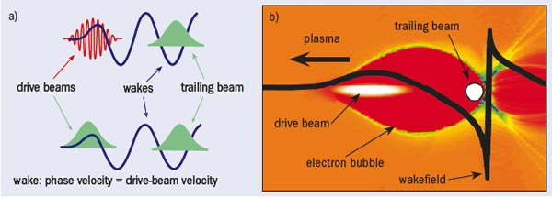
Plasma Wakefield Acceleration Tajima-Dawson (1979) (LWFA) Chen-Huff-Dawson (1984), Chen-Dawson-Huff-Katsouleas (1985) (PWFA)
SLAC & LBL- Acceleration of O(100) GeV/m observed!
AWAKE- A new experiment at CERN

Slide 3
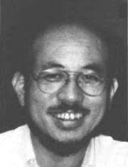
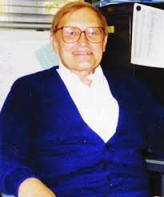
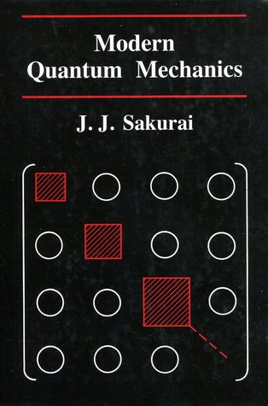
John Dawson Connection
“The Future of High Energy Physics”, Science (1983):
“Tajima and Dawson recently proposed laser acceleration...
…hope of future high energy physics.”
JJ Sakurai (1934-1983)
John M Dawson (1930-2001)
Toshi Tajima, postdoc of John Dawson: 1978-1980
Pisin Chen, postdoc of John Dawson: 1984-1986

Slide 4
Pros and cons of LWFA & PWFA
LWFA and PWFA each has its own pros and cons.
LWFA:
Pro: Thanks to the Nobel-winning invention of chirp pulse. amplification (CPA) scheme, ultra-intense lasers are compact and more readily available.
Con: Short Raleigh length Acceleration sections short; Staging is a challenge.
PWFA:
Pro: Particle beams less diverging (emittance low) Acceleration sections longer.
Con: Massive infrastructure, few facilities in the world

Slide 5
Recent whitepapers, roadmaps
Walker et al., “Horizon 2020 EuPRAXIA design study” (2017).
Hidding et al., “Plasma Wakefield Accelerator Research 2019–2040- A community-driven UK roadmap compiled by the Plasma Wakefield Accelerator Steering Committee (PWASC)” (2019).
Assmann, “EuPraxia Conceptual Design Report” (2020).
Albert, “2020 Roadmap on Plasma Accelerators” (2020).
Joshi, Caldwell, Muggli, “Outlook for the Future- Plasma Accelerators” (2020).
A common theme shared by most points to the direction of a hybrid LWFA-PWFA approach that takes the advantages of both scheme.

Slide 6
Hybrid LWFA-PWFA
Hidding et al., PRL (2010).

Slide 7
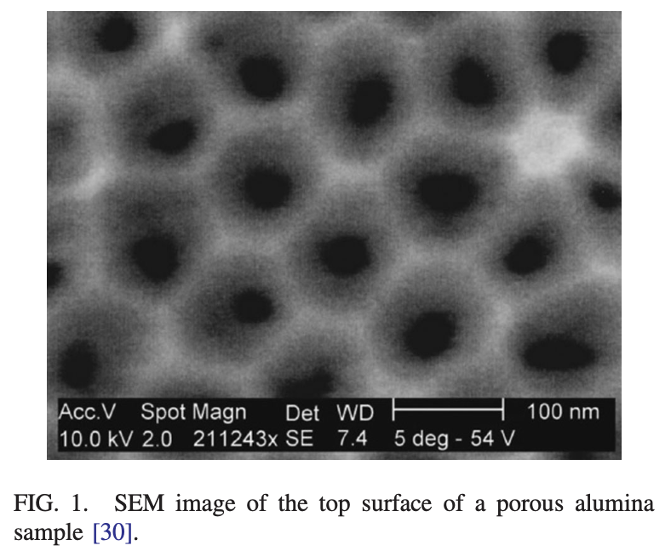
PWFA in Crystals and Nanotubes Chen, Noble, “A Solid State Accelerator” (1987) Chen, Nobel, “Channeled Particle Acceleration by Plasma Waves in Metals” (1987), Tajima, Cavenago, “Crystal x-ray accelerator” (1987) Zhang, Tajima et al., “PIC simulations…” (2016)
Highest possible acceleration gradient, $\sim$TeV/cm.
Microscopic, compact

Slide 8
Absolute Damping in Channels Huang, Chen, Ruth, “Radiation reaction in continuous focusing channels”, PRL (1994).
Consider an electrostatic focusing channel that provides a transverse continuous potential, ,
This is a good approximation of the Lindhard potential
for planar crystal channeling.
The channeling particle, e.g., a positron, had relativistic energy and momenta as , , and
Defining we can approx. the total energy as
where is the transverse energy.

Slide 9
The motion of the particle is now decoupled into two parts, a free long. motion and a harmonic trans. oscillation with an effective mass
Work on crystal channeling showed that the spin degree of freedom plays negligible effect. So one can invoke Klein-Gordon equation,
In the absence of radiation, we let and look the energy levels and the stationary states
where length of the channel, and

Slide 10
Coupling between the channeled particle and the radiation field leads to spontaneous emission of photon. Under Coulomb gauge and ignoring term, we obtain
Moving to the interaction representation, we write
Identifying and
neglecting in expansion of , we get
Using Fermi golden rule, we have

Slide 11
Therefore
Integral over gives rise to i.e., conservation of longitudinal momentum,
.
For the longitudinal energy
must decrease by an amount
Therefore

Slide 12
It follows that
For a small change in
Substituting. for we obtain (finally) an inequality
which is always positive definite.
We therefore conclude that both the transverse energy and transverse quantum number always decrease after a photon emission at all angles.

Slide 13
In the undulator regime where the transition rate is nonzero only if and so
Thus
So the rate of change of the quantum level is
damps exponentially w. const.

Slide 14
The transverse action also damps exponentially, since
and therefore
Because of the lack of recoil and excitation in the transverse dimension, the action damps exponentially to its ground state which is stable against further radiation.
The normalized emittance is related to this minimum action as
where is the Compton wavelength. This is
the minimum emittance limited by uncertainty principle.

Slide 15
Examples: crystals & nanotubes
Crystals
Channeling strength for typical crystal
so
Typical crystal channeling potential is . So for a particle with initial energy barely captured by the channel, the initial quantum level is about So it would take to damp to the ground state.
Nanotubes
Instead of parabolic, the focusing potential is more like a square-well for nanotubes, with

Slide 16
Classical Luminosity Analogy: Collison of two galaxy clusters

Slide 17
Quantum Luminosity Chen, Huang, Ruth, “Channeling acceleration: A path to ultrahigh energy colliders”, (1995). Chen, Noble, “Crystal channel collider: Ultra-high energy and luminosity in the next century”, (1998).
All the channeling radiation damping results are not affected by adiabatic acceleration, provided that it satisfies the condition,
The acceleration gradient is in metals and in semiconductors. In comparison, for for a channeled particle with an initial energy of Thus once the particle is damped to its transverse ground state, it will remain there during adiabatic acceleration.

Slide 18
Idea 1: Acceleration and collision within the same
crystal channels.
Ideal 2: As a final focusing system for conventional
colliders
Let there be particles captured in every channel
during each injection. Since there is no depth-of-focus,
all Particles within each channel will pass through
particles from the opposite side.
The luminosity for each channel is, therefore,
where and is the probability
density of the colliding particles in their transverse
ground state:

Slide 19
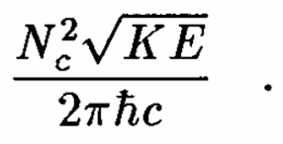
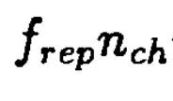
where is the longitudinal distribution of particles.
Carrying out the integration, we find the luminosity per channel:
Let there be. channels in the crystal lattice. Then the total quantum luminosity is

Slide 20
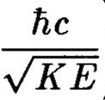
The number of particles in a channel, , is determined by two factors, the number of bunches in a train, , and the number of particles in a bunch, The crystal lattice would disrupt in about or or about 100 plasma oscillations, which imposes a limit,
The number of particles in each plasma oscillation bucket is limited by beam loading, which yields
Note that these limitations are associated with Idea-1 only. If we follow Idea-2, then they can be removed.
The cross sectional area of a particle at transverse ground state is
$\sim {10}^{−16 }\sqrt{\frac{100MeV}{E}}$ ${cm}^{2}$.
$\sim {10}^{−16 }√\frac{100 MeV}{E}$ ${cm}^{2}$.

Slide 21
The luminosity is therefore
To use a proton collider to discover new physics at center-of-mass energy may require a luminosity
This implies at and
at The former can be easily attained.
The average beam powers at these energies are
and respectively.
$$\sqrt{\frac{E}{100 MeV}}$$
$${10}^{8}$$
$${\sim 10}^{14}$$

Slide 22
Discussion
Channeling acceleration inside crystals or nanotubes may provide the ultimate acceleration gradient through plasma wakefields.
Channeling radiation results in an absolute damping of transverse emittance limited only by uncertainty principle.
One surprising bonus is that it also provides the ultimate luminosity, the quantum luminosity, associated with the overlapping wave-functions of colliding particles in their ground states.
We assumed ideal channels and did not discuss about excitations due to scatterings in channels, misalignments, etc. which have been investigated in Chen-Huang-Ruth (1995) and Chen-Noble (1998).

