Slide 1
Neutrino Factory Front End (IDS) and Variations-Status
David Neuffer
C. Rogers, G. Prior, P. Snopok, C. Yoshikawa, A. Alekou …
September 2011

Slide 2
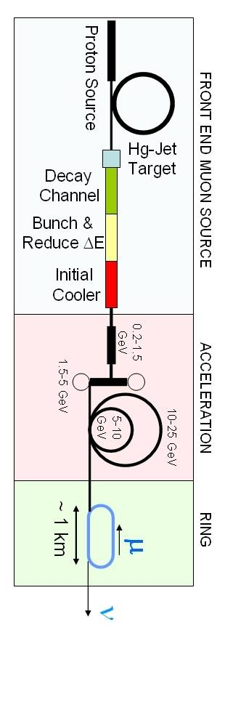
Outline
Front End for the IDS Neutrino Factory
  Basis for engineering/costs
    Rf, requirements
    Engineering required
  Losses – control
    Chicane, proton absorber
    rematching OK
rf gradient/ B concerns
  alternatives
    gas-filled rf/insulated rf/low-B/bucked coil
    experimental concerns
μ⁺-μ⁻ Collider Front End
  Shorter bunch train
  Rebuncher
    Time reverse front-end

Slide 3
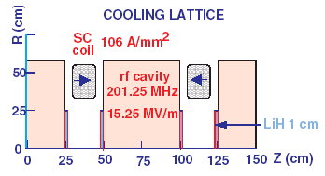
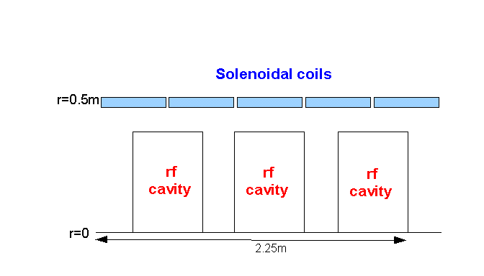
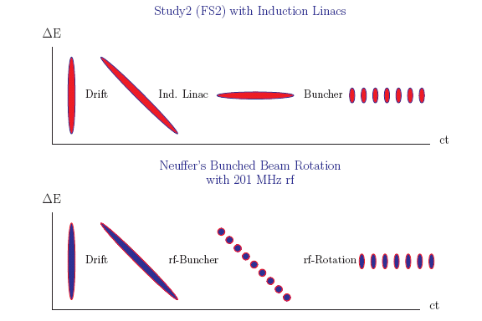
IDS Baseline Buncher and φ-E Rotator
Drift (π→μ)
“Adiabatically” bunch beam first (weak 320 to 232 MHz rf)
Φ-E rotate bunches – align bunches to ~equal energies
  232 to 202 MHz, 12MV/m
Cool beam 201.25MHz
p
π→μ
FE Target
Solenoid
Drift
Buncher
Rotator
Cooler
18.9 m
~60.7 m
~33m
42 m
~80 m

Slide 4
Parameters of IDR baseline
Initial drift from target to buncher is 79.6m
  18.9m (adiabatic ~20T to ~1.5T solenoid)
  60.7m (1.5T solenoid)
Buncher rf – 33m
  320 → 232 MHz
  0 → 9 MV/m (2/3 occupancy)
  B=1.5T
Rotator rf -42m
  232 → 202 MHz
  12 MV/m (2/3 occupancy)
  B=1.5T
Cooler (50 to 90m)
  ASOL lattice, P₀ = 232MeV/c,
  Baseline has 15MV/m, 2 1.1 cm LiH absorbers /cell

Slide 5
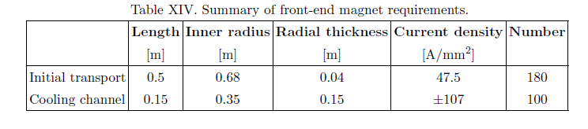
IDS : hardware specification
Specify front end in specific rf cavities, frequencies
Buncher – 13 rf frequencies
  319.63, 305.56, 293.93, 285.46, 278.59, 272.05, 265.80, 259.83, 254.13, 248.67, 243.44, 238.42, 233.61 (13 f)
  ~100MV total
    Keep V’ < ~7.5MV/m
Rotator – 15 rf frequencies
  230.19, 226.13, 222.59, 219.48, 216.76, 214.37,212.28, 210.46,208.64, 206.90, 205.49,204.25, 203.26, 202.63,202.33 (15 f)
  336MV total, 56 rf cavities
    12MV/m at 2/3 occupancy
Cooler
  201.25MHz –up to 75m ~750MV
    ~15 MV/m, 100 rf cavities
Magnet Requirements:

Slide 6
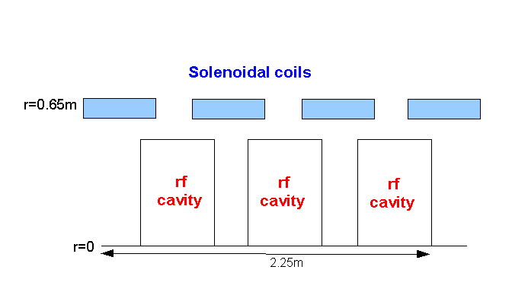
Rf Buncher/Rotator/Cooler requirements
Buncher
  37 cavities (13 frequencies)
  13 power supplies (~1—3MW)
RF Rotator
  56 cavities (15 frequencies)
  12 MV/m, 0.5m
  ~2.5MW (peak power) per cavity
Cooling System – 201.25 MHz
  100 0.5m cavities (75m cooler), 15MV/m
  ~4MW /cavity
Front End section | Length | #rf cavities | frequencies | # of freq. | rf gradient | rf peak power requirements
Buncher | 33m | 37 | 319.6 to 233.6 | 13 | 4 to 7.5 | ~1 to 3.5 MW/freq.
Rotator | 42m | 56 | 230.2 to 202.3 | 15 | 12 | ~2.5MW/cavity
Cooler | 75m | 100 | 201.25MHz | 1 | 15 MV/m | ~4MW/cavity
Total drift) | ~240m | 193 |  | 29 | ~1000MV | ~550MW

Slide 7
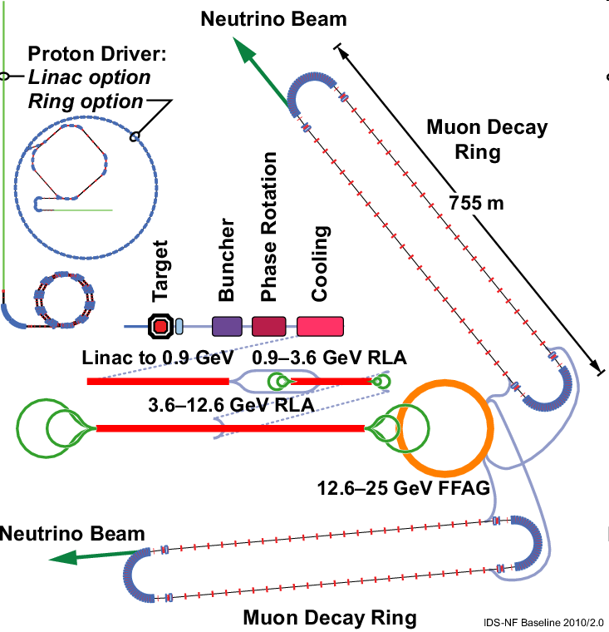
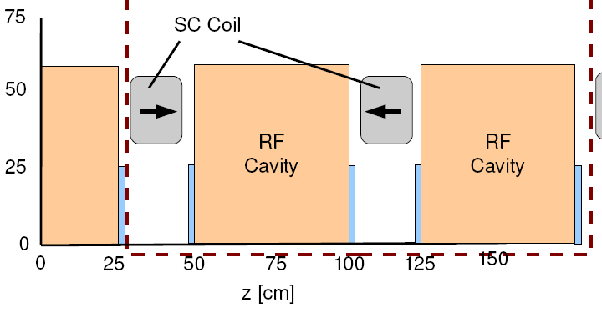
RDR – developing cost model
Spreadsheets for components
Engineering may shift design parameters
  cavity, coils, absorbers constrained
  Be windows/ LiH absorbers
Next IDS meeting
  Arlington VA
  Oct. 17 - 19

Slide 8
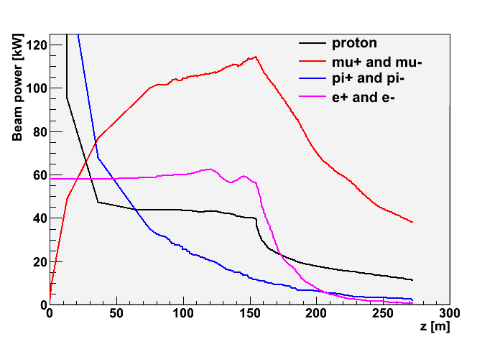
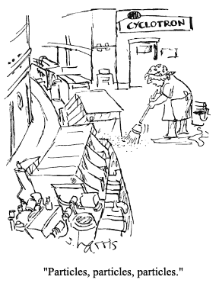
Problem: Beam losses along Front End
Start with 4MW protons
  End with ~50kW μ⁺ + μ⁻
    plus p, e, π, …
    ~20W/m μ-decay
  ~0.5MW losses along transport
    >0.1MW at z>50m
Want “Hands-on” maintenance
  hadronic losses < 1W/m
  Booster, PSR criteria
  Simulation has >~100W/m
    With no collimation, shielding, absorber strategy
Drift
Cool

Slide 9
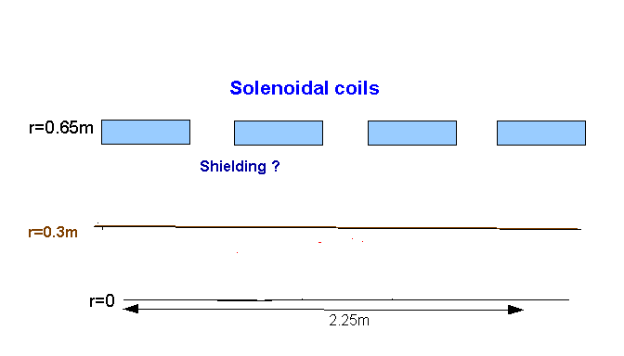
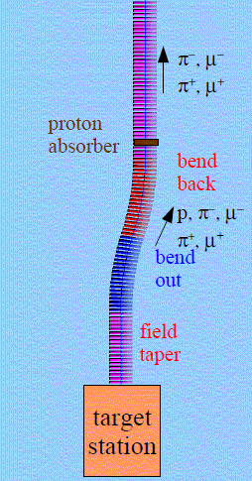
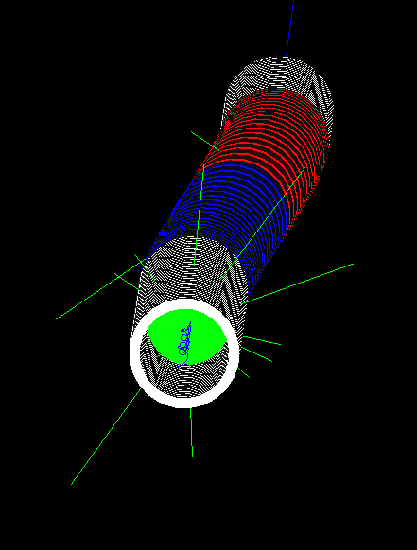
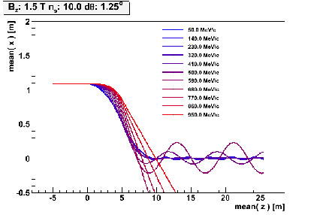
Control of Front End Losses
Add shielding
  Resulting losses ?
Chicane and proton absorber to localize losses (C. Rogers)
  Removes most protons
  Most desired μ’s survive
  Greatly reduces downstream activation problem
p
π→μ
FE Target
Solenoid
Drift
Buncher
Rotator
Cooler
12.7 m
~60.0 m
~33m
42 m
~90 m
Shielding ?

Slide 10
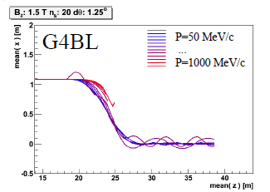
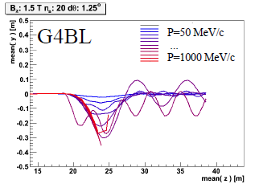
Chicane + absorber
Chicane effect:
  P > ~500MeV/c are lost
  P < ~500MeV pass through
    displaced by ~1.1m
  Nominal Path length increased by only 8cm
    orbits perturbed
absorber effect
  removes low energy particles
    designed to remove protons
  distorts energy distribution
    energy phase-rotation distorted; must be rematched

Slide 11
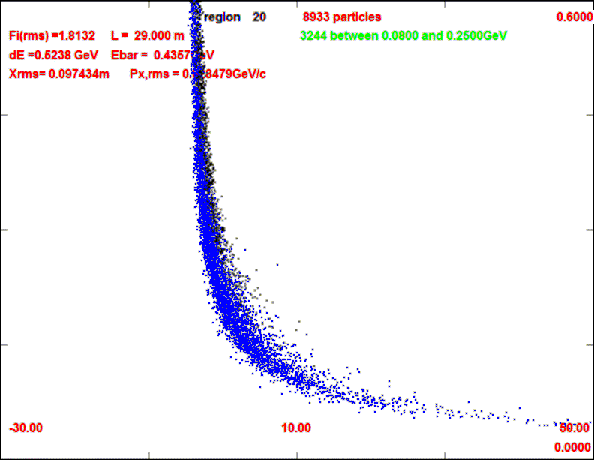
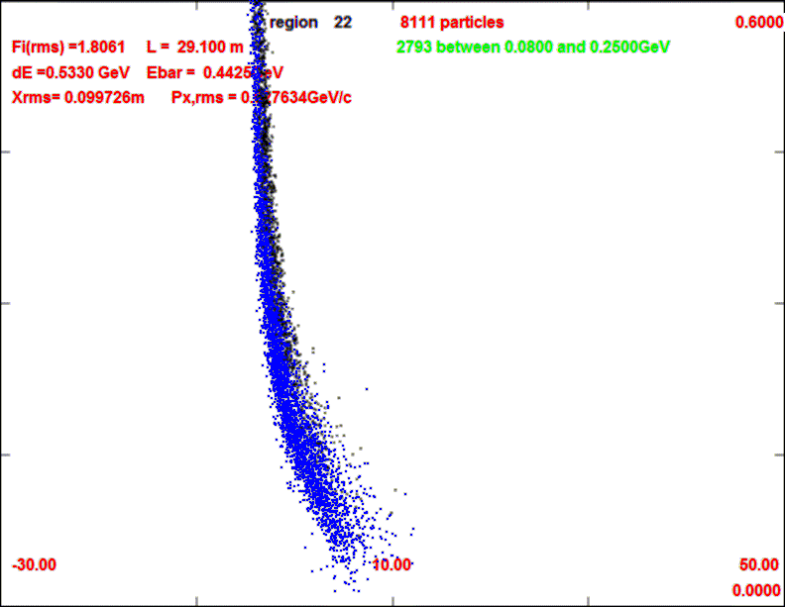
Front End with Absorber
p
π →μ
FE Target
Solenoid
Drift
Buncher
Rotator
Cooler
18.9 m
10.1 m
0.1 m Be
~39.5m
~33m
42 m
~80 m
with absorber
    particle 1-270 MeV/c
    particle 2-185 MeV/c
  absorber at 29m
    10cm Be
    particle 1-237 MeV/c
    particle 2-144 MeV/c
  Bunch N=10
  Rotate N=10.04
  Cool -201.25MHz
    p_{ref}=230 MeV/c
29m
29.1m

Slide 12
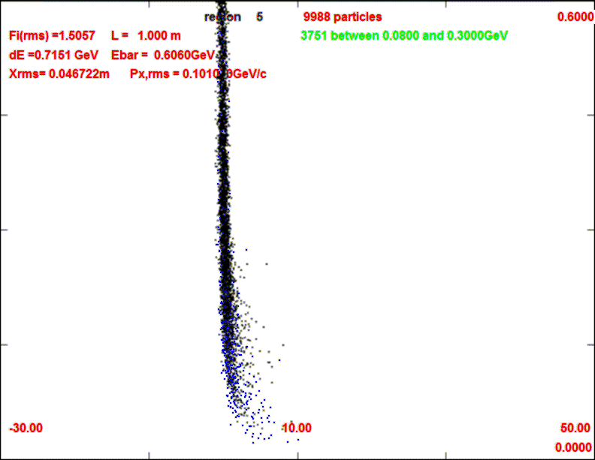
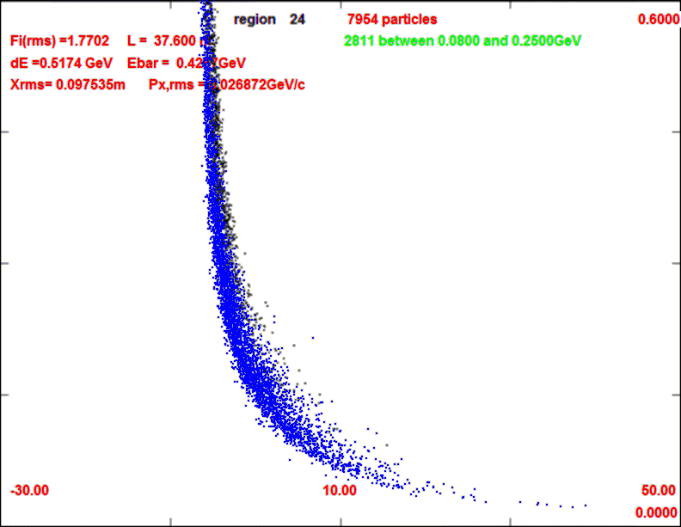
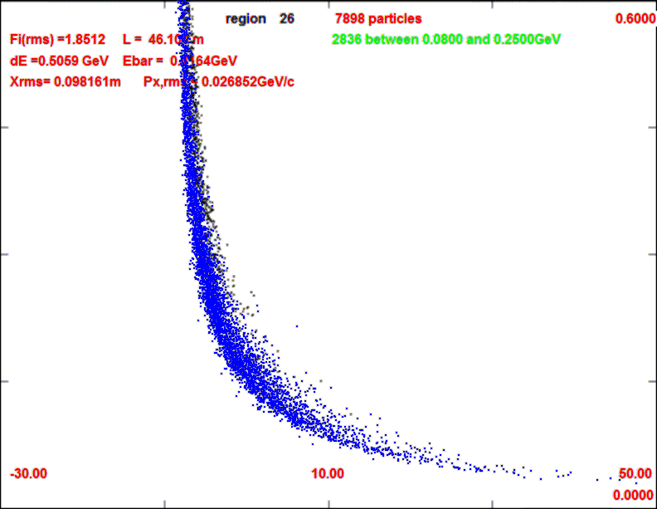
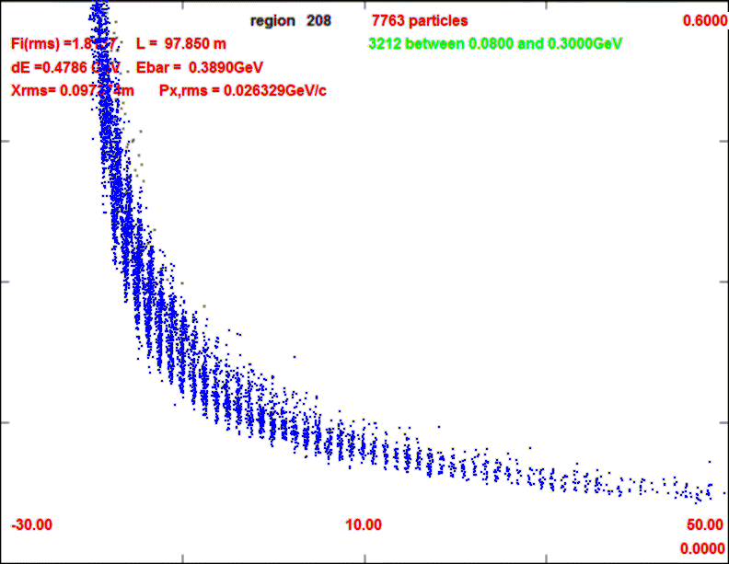
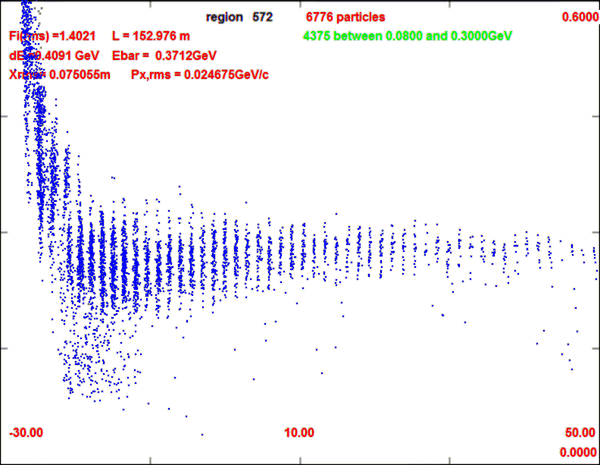
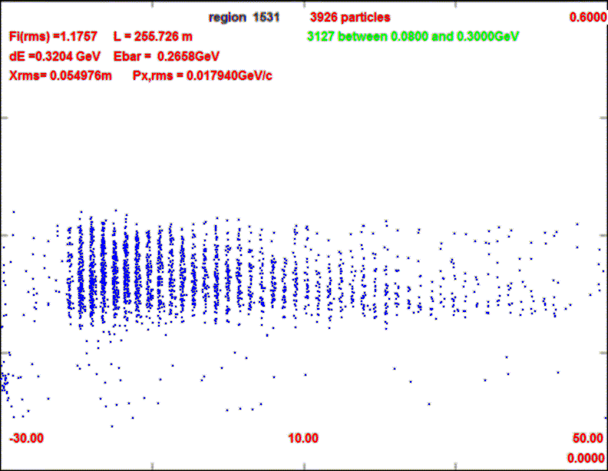
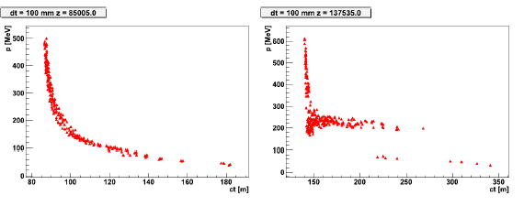
Longitudinal beam through system
ICOOL
0.1m Be absorber
29m
38m
1m
29.1m
46m
98m
152m
252m
G4BL

Slide 13
ICOOL Simulation results
Similar to without absorber
  ~10m shorter drift
  ~10% fewer μ’s within acceptance
  drop of ~20% intensity at absorber
  but longitudinal emittance also reduced
    surviving μ’s are stretched in longitudinal phase space
To do
  include chicane + absorber
  establish beam loss improvement – μ loss level
  decide optimal configuration
0.2
μ⁻/p (all)
0.1
μ⁻/p
(ε_{L}<0.2, ε_{t}<0.03)
0
ε_{L}/10
ε_{t}

Slide 14
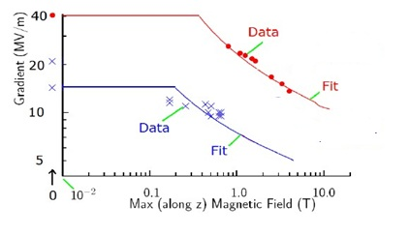
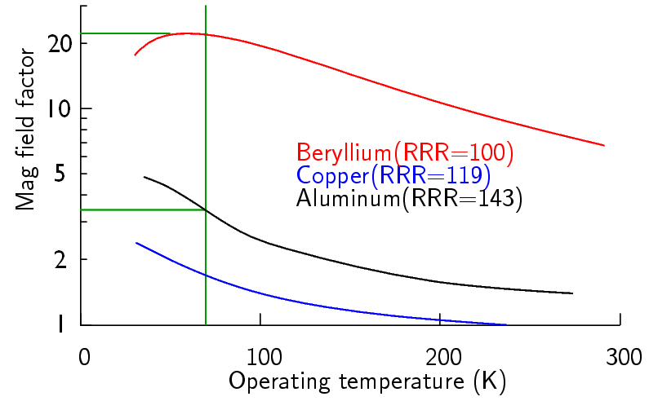
Possible rf cavity limitations
V’_{rf} may be limited in B-fields
  800 MHz pillbox cavity
  200 MHz pillbox test (different B)
NF needs up to ~1.5T, 12 MV/m
    More for cooling
Potential strategies:
Use Be Cavities (Palmer)
Use lower fields (V’, B)
  <10MV/m at 1.5T?
  Need variant for cooling ?
Cooling channel variants
  Use gas-filled rf cavities
  Insulated rf cavities
  Bucked coils (Alekou)
  Magnetic shielding
805MHz
201MHz
Need More Experiments !
at ~200MHz
with B ~B_{frontend}

Slide 15
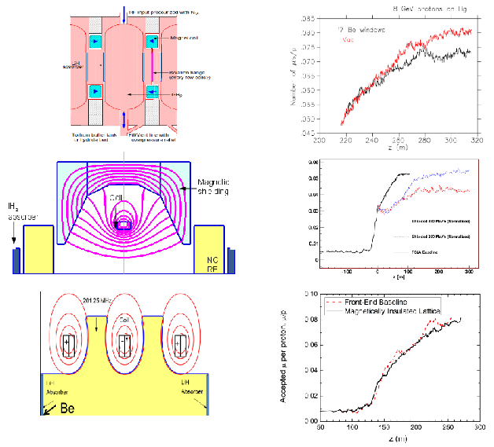
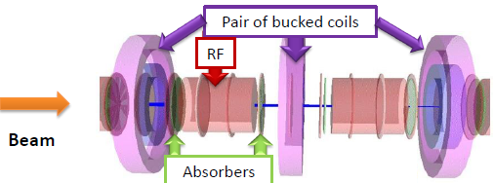
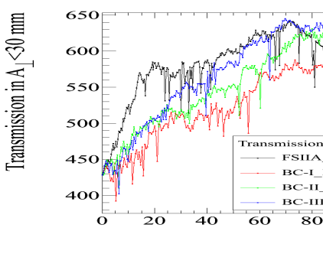
Cooling Lattice variations
Gas-filled rf
  With LiH absorbers
    Zisman, et al.
Magnetically shielded
  Small B at rf
  worse than baseline
Magnetically Insulated
  B ǁ rf surface
  ~open-cell cavities
      Stratakis
Bucked Coil
  Reduced B in rf
  Alekou, Pasternak, Rogers

Slide 16
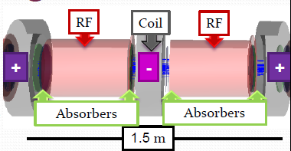
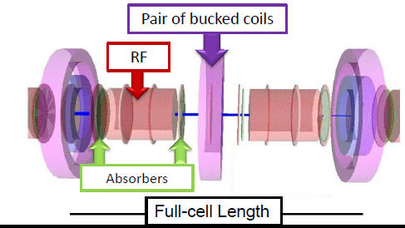
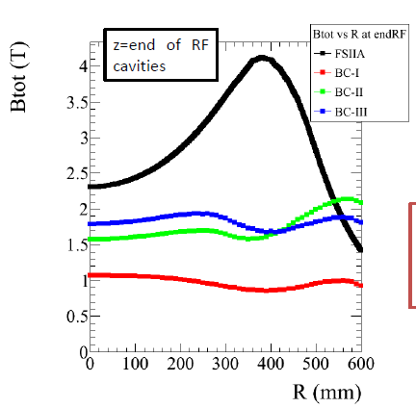
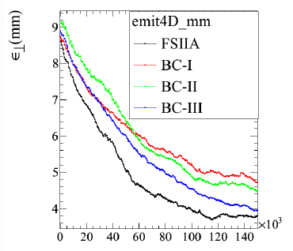
Bucked Coil Variant
Alekou, Pasternak, Roger
Each coil has opposite-current coil outside it
Reduces peak field on rf cavity from ~4T to 1—2 T
Cooling is similar to baseline IDS version
Study2A

Slide 17
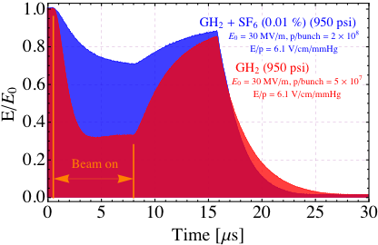
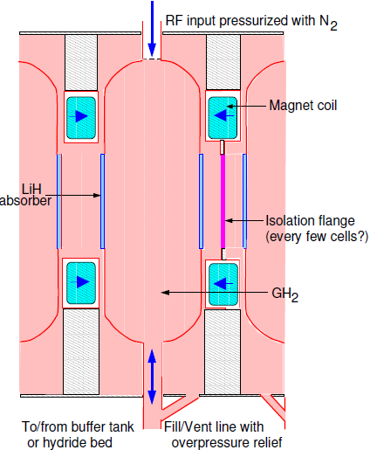
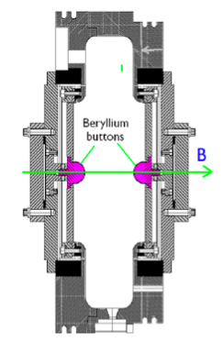
Comments on Experiments
Gas-filled cavity with beam
  beam loading but no breakdown
    bunch train is 100ns
  operation may need to adjust for beam loading
  could use electronegative gas
Gas-filled rf cavity possible for cooling channel
Be button measurements
  verify if Be surface has higher threshold within B-fields

Slide 18
Front End for Muon Collider
MC front end is similar to NF
  must capture μ⁺ and μ⁻
  shorter bunch trains
    Bunches are recombined …
  Use higher gradient, B ?
    NF will debug gradient limits
  Need much more cooling
Recombine Bunches
    After cooling to small bunches
  Front end splits 1 huge emittance bunch into string of smaller ε –bunches
    Can we time reverse to combine cooled bunched to single bunches ?

Slide 19
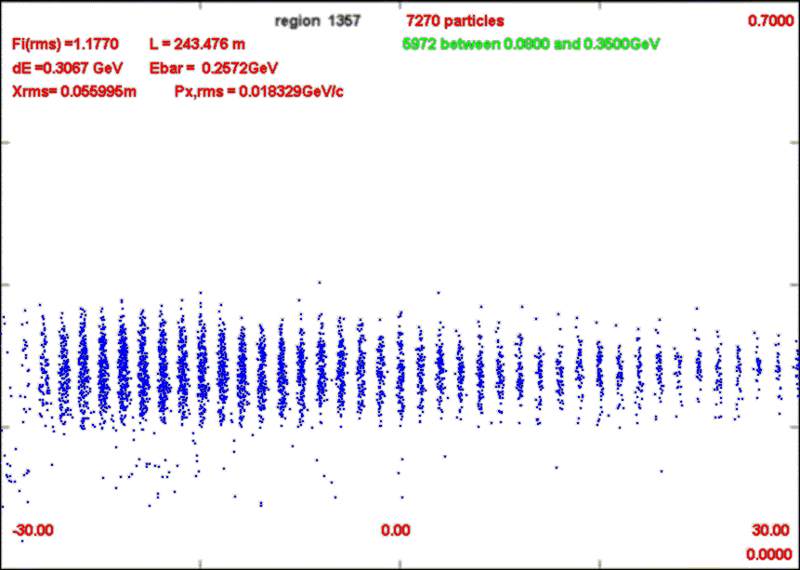
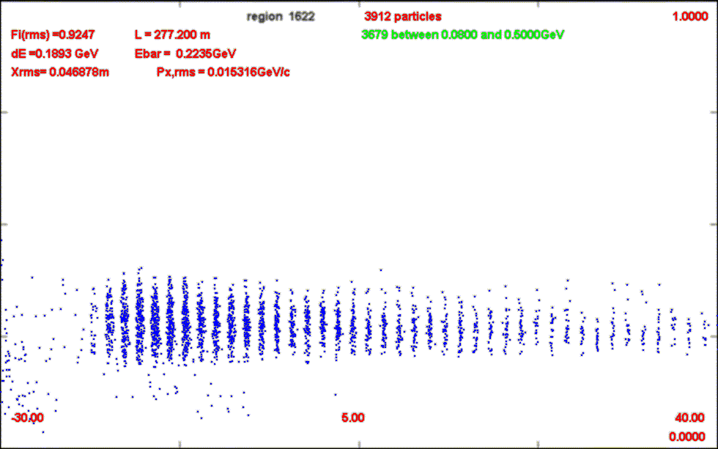
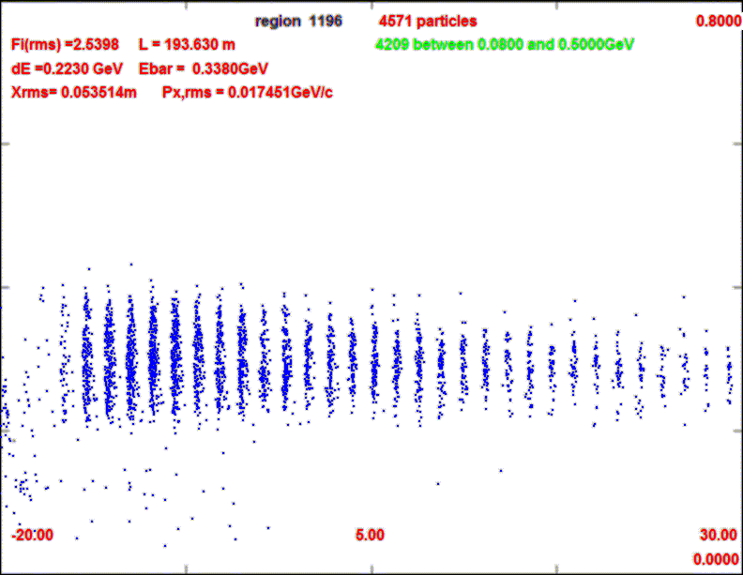
Variant front ends for muon collider
Table 1: Comparison of muon source front end systems.
Front end Scenario | Drift, Buncher, Rotator Length | Rf Voltages | Full length (w 75m cooling) | μ⁺/p (ε_{t}<0.03, ε_{L}<0.3m) | μ⁻/p (ε_{t}<0.03, ε_{L}<0.3m) | Core bunches, N_{B,} all μ⁻/p
IDS/NF | 80.6, 33, 42m | 0→9, 12, 15 | 230m | 0.086 | 0.116 | 20/0.107
N=10 | 55.3, 31.5, 33 | 0→12, 15, 18 | 205 | 0.106 | 0.143 | 16/0.141
N=8 | 47.8, 35.5, 27 m | 0→15, 18, 20 | 180 | 0.102 | 0.136 | 13/0.123

Slide 20
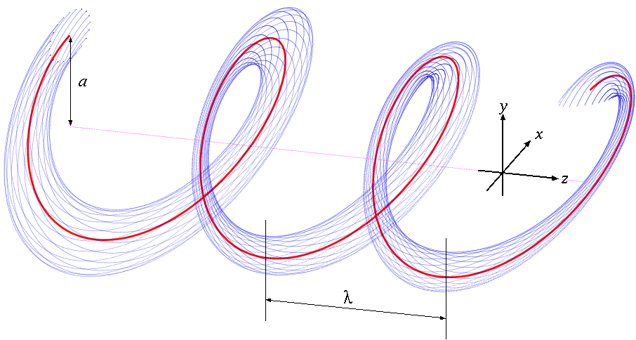
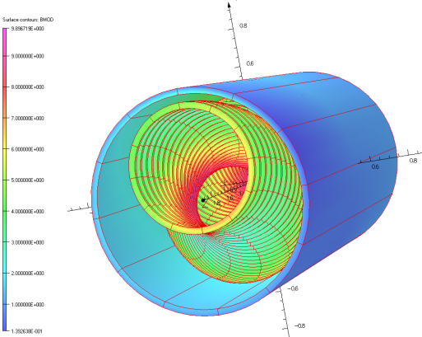
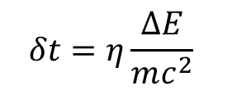
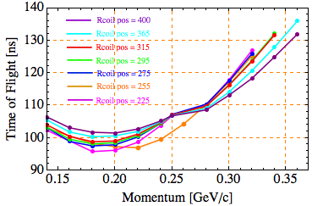
Bunch Recombination: Helical Channel
Would like a large linear dependence of path length on energy
Helical channel naturally has that
  Linear dependence is best …
η=0.43 looks possible
  HC – B= 4.2T b_{d}=0.75, b_{q}=0.4
  κ=1, λ=1.6m, P₀=290MeV/c
  Dˆ=1.7, D=0.44m
    “γ_{t}”=1.085

Slide 21
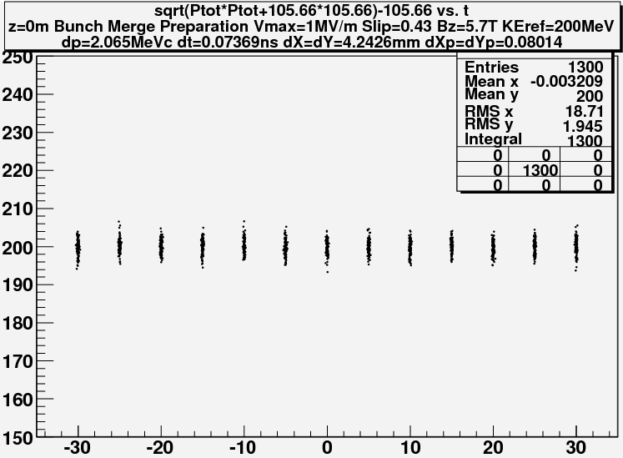
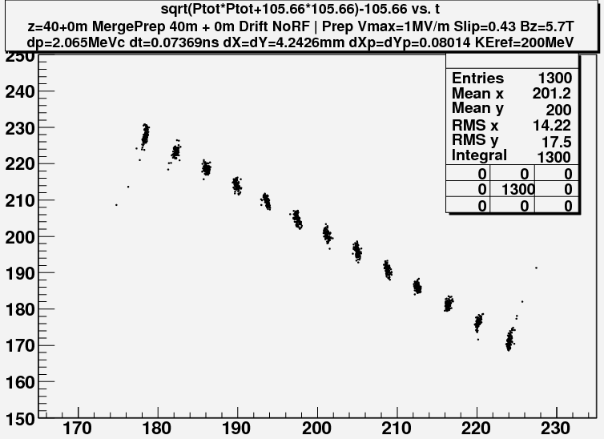
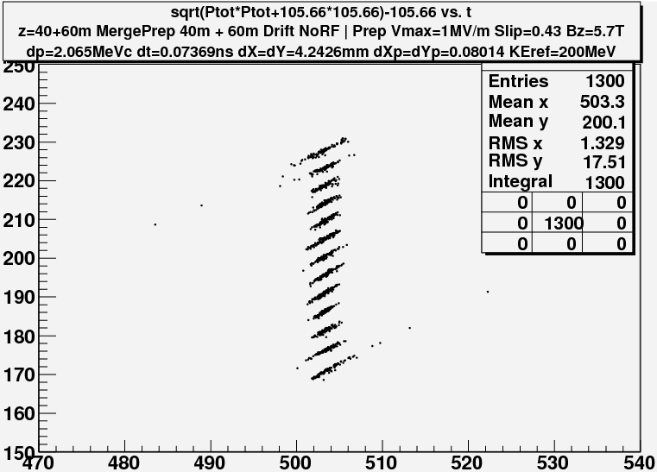
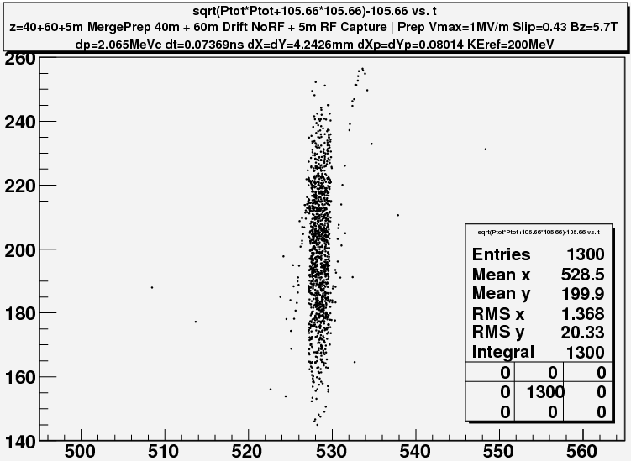
Simulate in 3-D- G4BL
–C Yoshikawa
z = 0 m
Obtain beam from end of 3-stage HCC channel - K. Yonehara
  13 bunches, ε_{L} =0.0011m
  η=0.43 transport (λ=1m)
40m 1MV/m rf
  204 → 270 MHz
    (+45° to -45° ) (N=12.25)
    η=0.43
60m drift
200MHz rf -10MV/m
  >95% capture
  ε_{L} = ~0.040
Have done more discrete rf version
  Need to integrate into cooling scenario –SBIR proposal
60ns
z = 40 m
60MeV
z = 100 m
z = 105m

Slide 22
Summary
Neutrino Factory Front End:
  International Design Report is being developed
    engineering + cost content
  Chicane and absorber to control losses
    need to quantify benefits and losses
  rf in magnetic field
    options discussed, adapt to rf measurements
Adaptation to Muon Collider
  bunch recombiner
  need to integrate into cooling scenario(s)

Slide 23
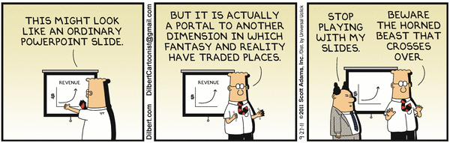
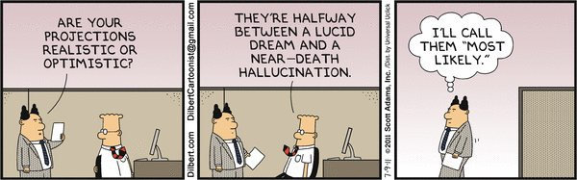
Questions?

