Slide 1
FAST RunCo Summary
Edstrom
2/19/2021

Slide 2
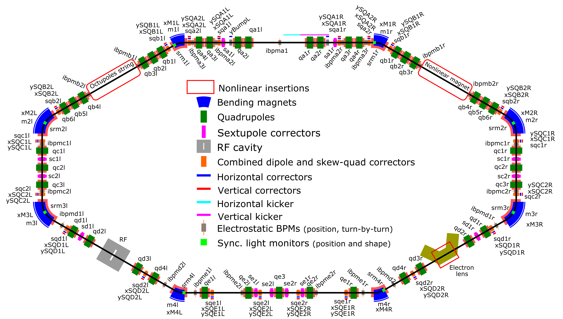
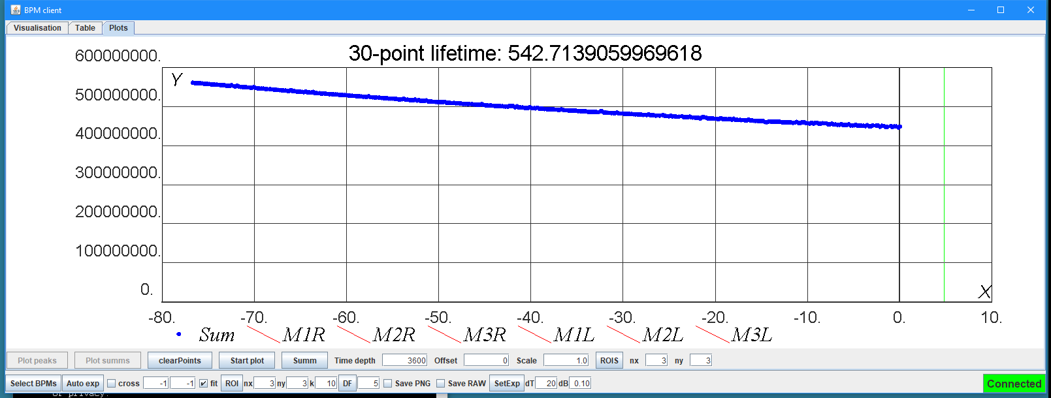
Summary
Controlled Accesses
Most mornings for various jobs
Electron Injector
Beam Delivered for IOTA Injection studies
LRW/SRW Studies continued
IOTA: Circulating beam achieved later in the day last Friday
Reasonable lifetime, and improved throughout the week.
Significant work remains on establishing a good lattice for Optical Stochastic Cooling (E-straight)
New IOTA LCW RTD PLC monitoring implemented (Mon-Tues)
Cryo
Nominal 2K operation, no problems
Some work remains for OSC Run
Kicker timing jitter
Dark box electronics shakedown
Note:
Jamie Santucci is away until 3/01
Chip Edstrom is standing in for FAST RunCo

Slide 3
From the 09:00
Boiler Work Today @ NML (as per Greg Gilbert)
One of the boilers is leaky and needs a new flow switch
Plan to come up on the repaired boiler
No loss of heat expected
New Record Beam Power (main accelerator chain)
775 kW / 1 hr avg
Shared Link for the All (Star) Engineer’s retreat
https://news.fnal.gov/2021/02/registration-open-for-the-2021-all-engineers-retreat/

Slide 4
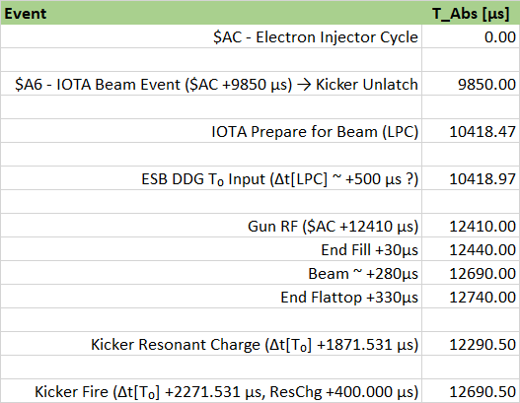
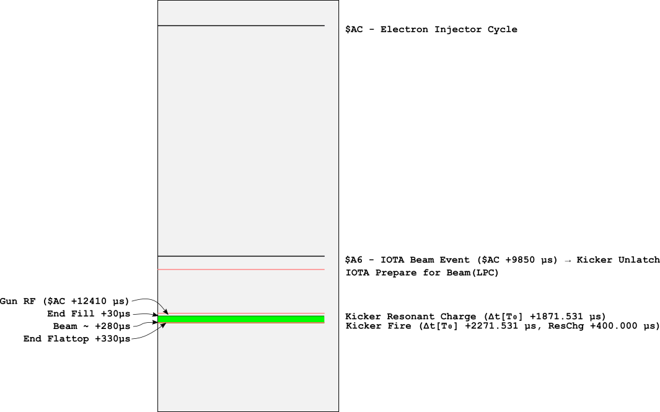
Timing Jitter
Arden Warner & Jin-Yuan Wu are discussing…

