Slide 1
Collimator simulation plan discussion
2 Nov 1947
1974
Phil Adamson
22nd February 2021
1947

Slide 2
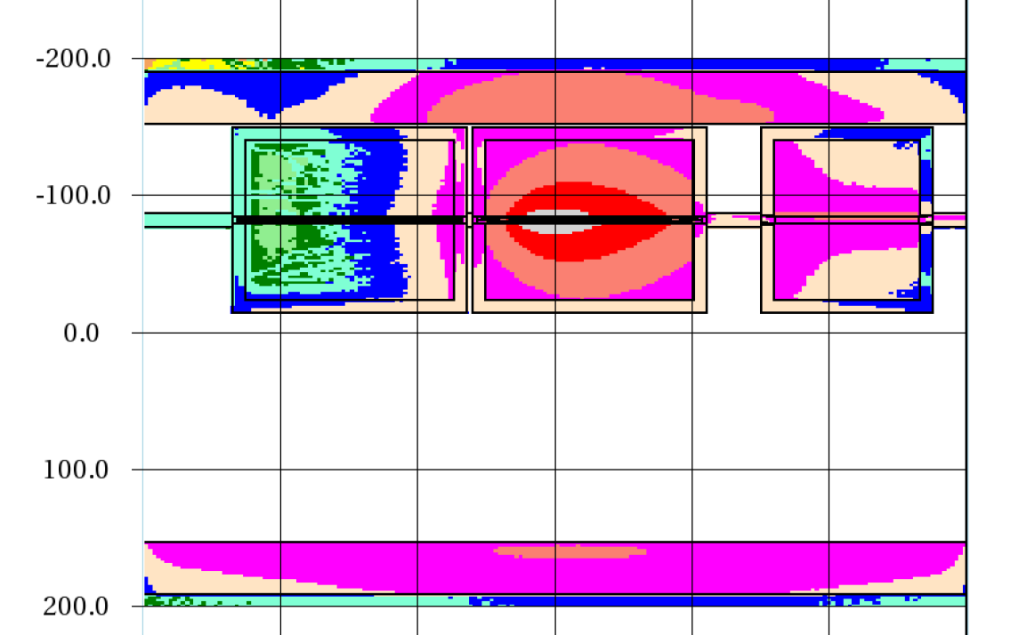
Pencil Beam striking second collimator (M. Vincent)
Two recycler-size collimators, similar width, but shorter mask
Collimator/mask apertures not optimized
Pencil beam, not realistic distribution
See leakage between 2nd collimator and mask – argues for either longer collimator, or mask closer to collimator
Length of mask needs real simulation to study (depends on outscatters)
Getting collimators close together will be necessary and needs engineer input

Slide 3
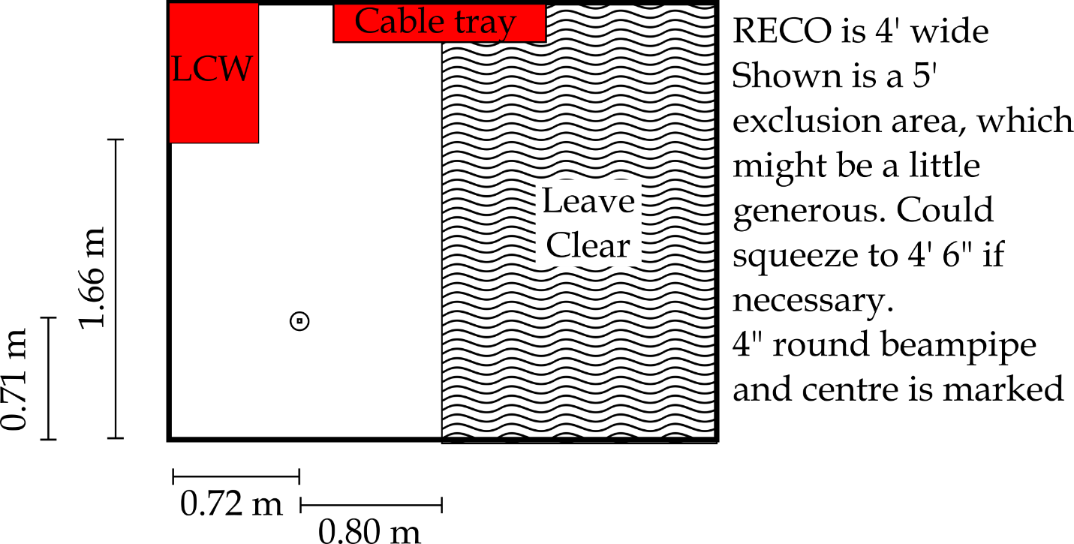
What design decisions need to be resolved soon?
Width of collimators
Don’t think there’s a decision here – make the collimator as wide as we can. Put 10cm of marble on aisle side, on top, and on ends. Don’t put marble underneath or on wall side – steel extends to (close to) wall & floor.
So let’s say steel extends 8-cm from beam centre, then there’s another 10cm of marble. That leaves about 4’ 8” of aisle space.

Slide 4
Length of Collimators
We have 5m of space between magnets, and want to basically fill that space with two collimators and a mask. So we can trade collimator length for mask length.
Needing a gap between two collimators (for bellows to accommodate motion, and big enough for a person to get in and make up vacuum connections) tends to drive us towards long-ish collimators
But mask needs to be long enough to contain shower from protons that outscatter from collimator.
Needs vaguely-sensible beam tail distribution (doesn’t have to be better than vaguely-sensible, but pencil probably isn’t OK)
Magic screen in simulation to log particle 4-vectors?

Slide 5
Engineering Questions
How much space do you have to leave between the two collimators, and between the second collimator and the mask. This has to accommodate the bellows and conflats (and how much space do you need on the collimator side of the conflat for access to bolts / nuts / whatever), and also allow access for someone's arm to install / fix.
That said conflats, but quick connects with the good diamond seals might be better. Comments?
(This is probably a simulation input – want to put a realistic gap in, will also see whether it looks worth pursuing a “plug”)

Slide 6
Size of collimator aperture
Want aperture in collimators to be as small as possible, to minimize outscatter.
But want to be able to “open up” collimators to move them out of the beam
This can come late – it only affects the design of the central core box, and not the rest of the collimator
I suspect we want to do something like set the collimator aperture at 10 sigma for a matched 20-pi beam. I think that’s conservative enough without being too loose.
This is probably also the aperture we want in the mask.

