Slide 1
TMS
ND-GAr-Lite
Eldwan Brianne, Jen Raaf,
Alan Bross, Alfons Weber
DUNE EB, 25-Feb-2021

Slide 2
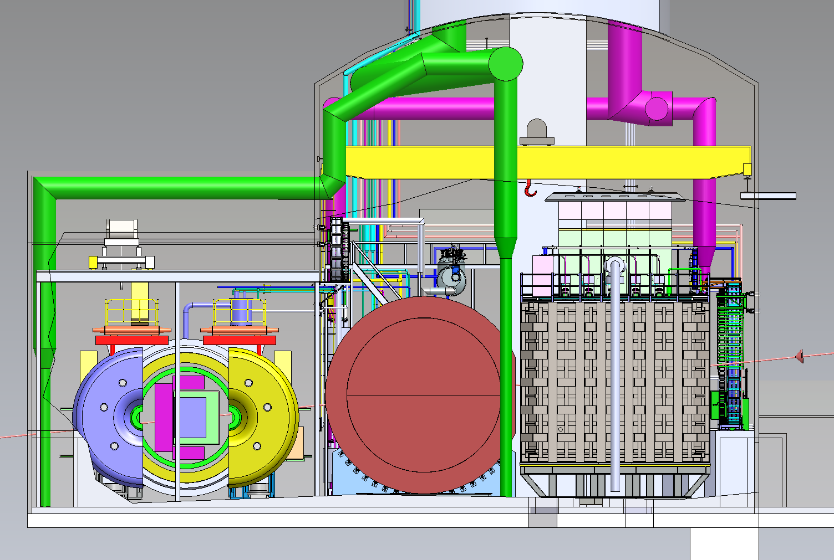
Near Detector Complex
Four main components
  Liquid argon detector
  (ND-LAr)
  Downstream tracker with gaseous argon target
  (ND-GAr)
  ND-LAr and ND-GAr systems can move to off-axis fluxes
  (PRISM concept)
  System for on-Axis
  Neutrino Detection (SAND)
High statistics constrains
  Cross section & neutrino flux
SAND ND-GAr ND-LAr

Slide 3
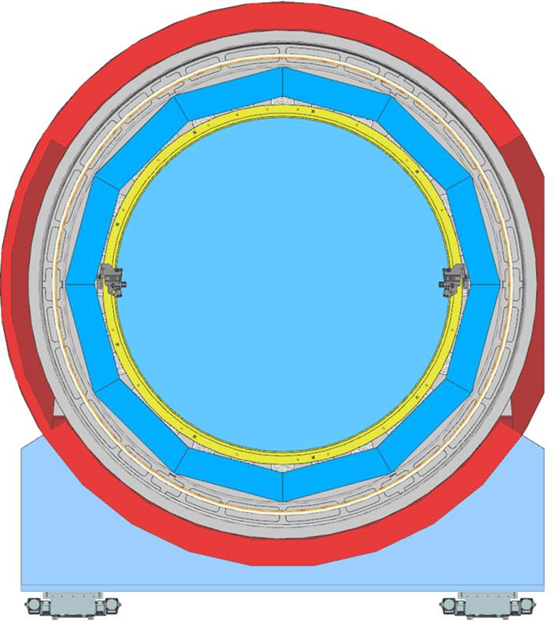
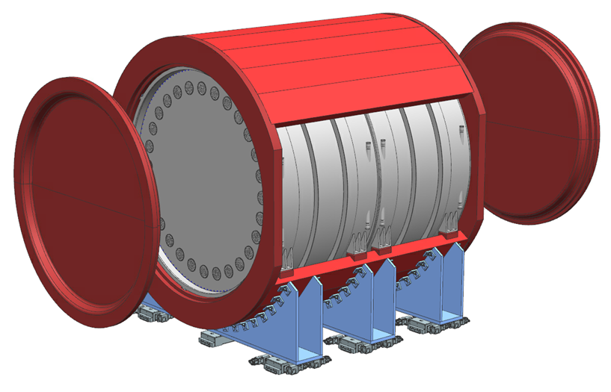
Full ND-GAr design
Partial Return Yoke
Magnet (4 coils)
Yoke + Magnet/Cryostat
act as the pressure vessel
Cryostat end seals

Slide 4
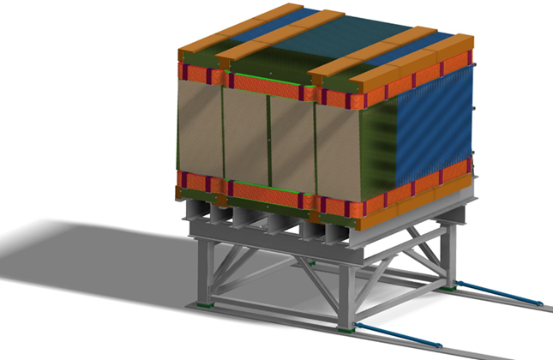
Day-1 Detector: TMS
The resources for ND-GAr are not available yet
Need alternative Day-1 Detector to measure ND-LAr muons
  Temporary Muon Spectrometer (TMS)
DOE DUNE Project
  Sign Selecting Range Instrument (SSRI)
  SSRI as an affordable alternative
  ($9M TPC) within US project
  Implement as late as possible
  to allow ND-GAr, if funding is found

Slide 5
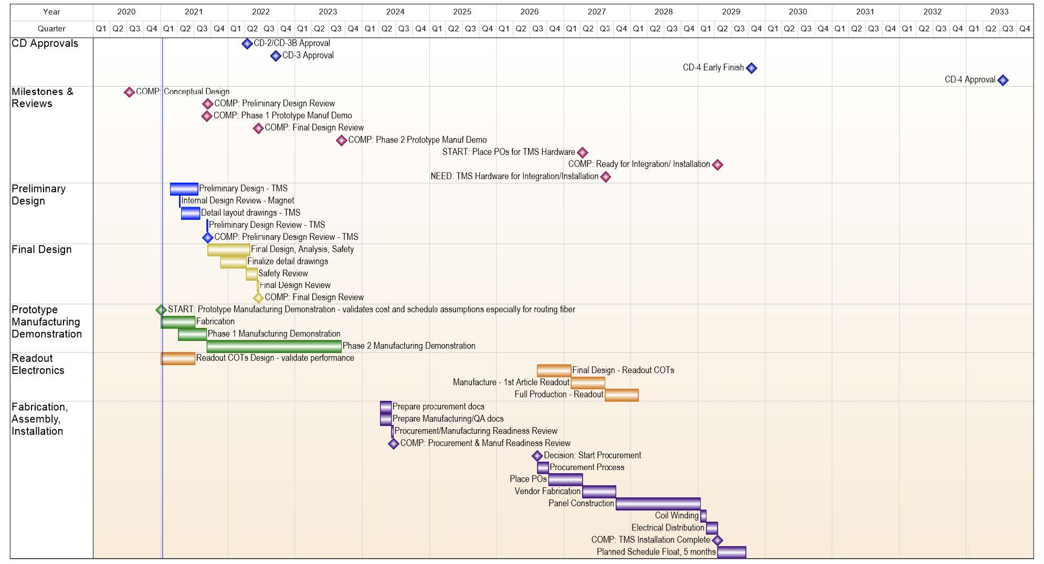
TMS: SSRI Schedule
There are 36 months between a technically-limited schedule and start of panel production

Slide 6
TMS: SSRI
Advantages
  Inexpensive and well known technology
  Can be built and will do the job for the first few years
  Cost fits within US project and schedule understood
Disadvantages
  Not good enough for DUNE to achieve P5 physics goals
  Needs an additional O($10M) on top of eventual ND-GAr
  No easy upgrade path to ND-GAr
    Downtime to remove TMS, then install ND-GAr magnet and detectors

Slide 7
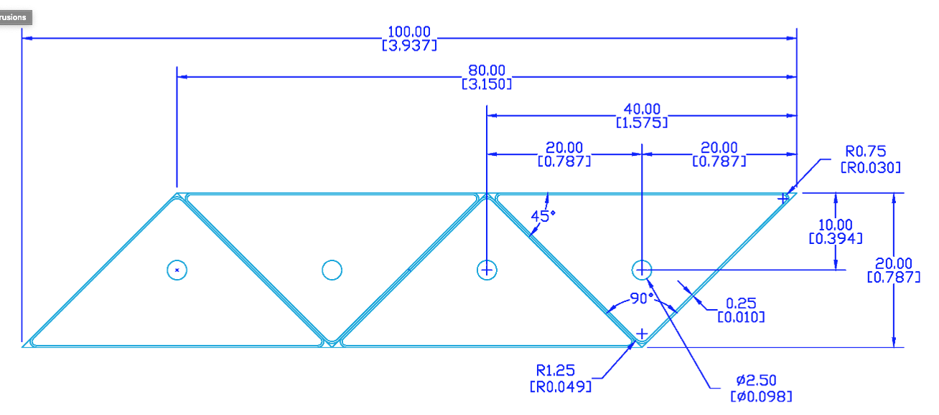
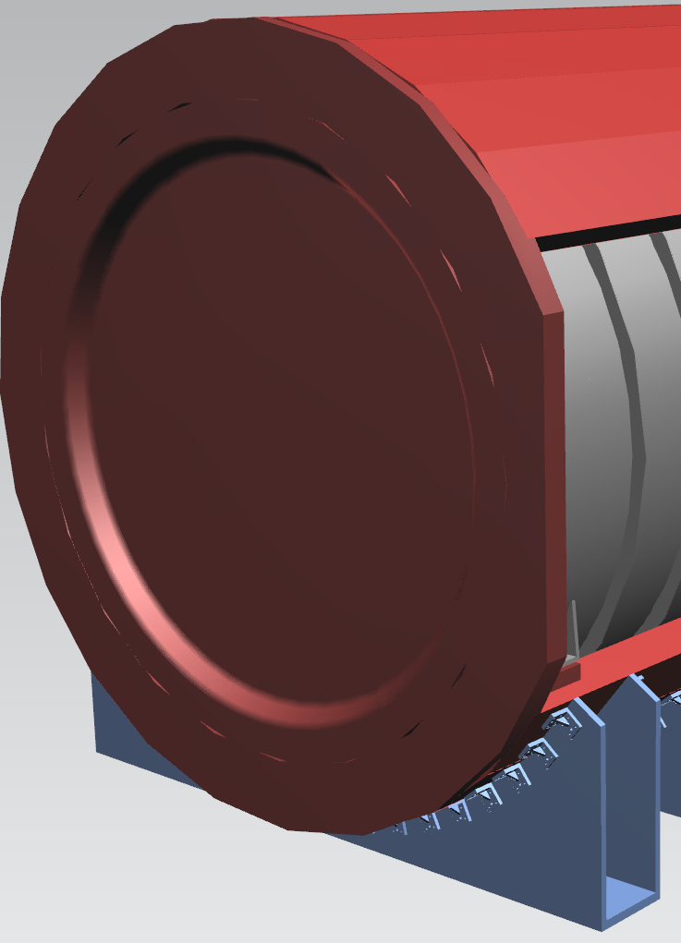
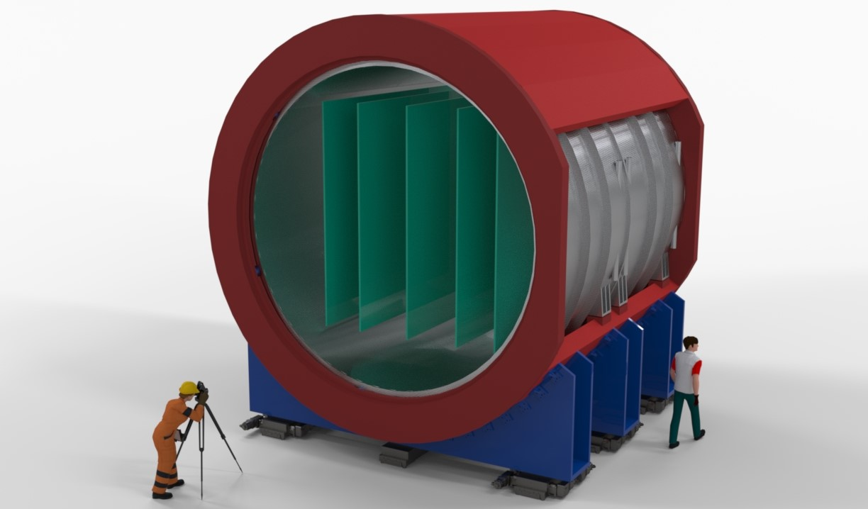
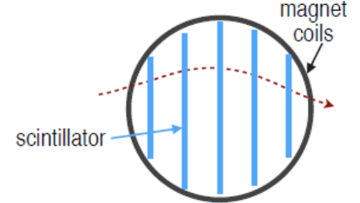
Alternative TMS: ND-GAr-Lite
ND-GAr-Lite
  SC Magnet including partial return-yoke
  Scintillator tracking planes
    Update of MINERvA
    Similar electronics as SSRI
  ECAL modules could be added (but may degrade performance)

Slide 8
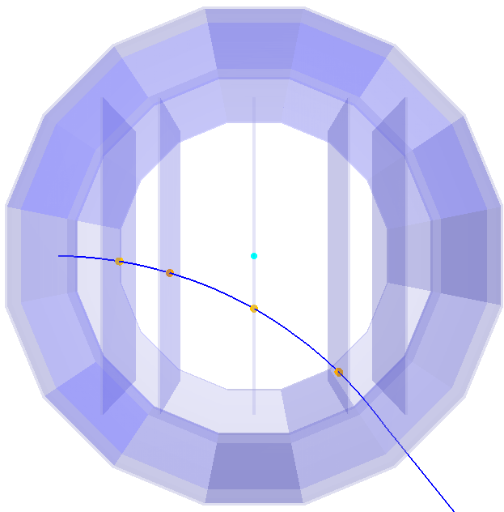
TMS: ND-GAr-Lite Nominal Design
Simple reconstruction
  Require 3 hit scintillator planes
  planes at
  z = {-240, -150, 0, 150, 240} cm
Not optimised for low-p muons
  will bend to not hit third plane
Larger cross section for muons than ND-GAr
Optimisation needed
  Geometry
  Tracking reconstruction

Slide 9
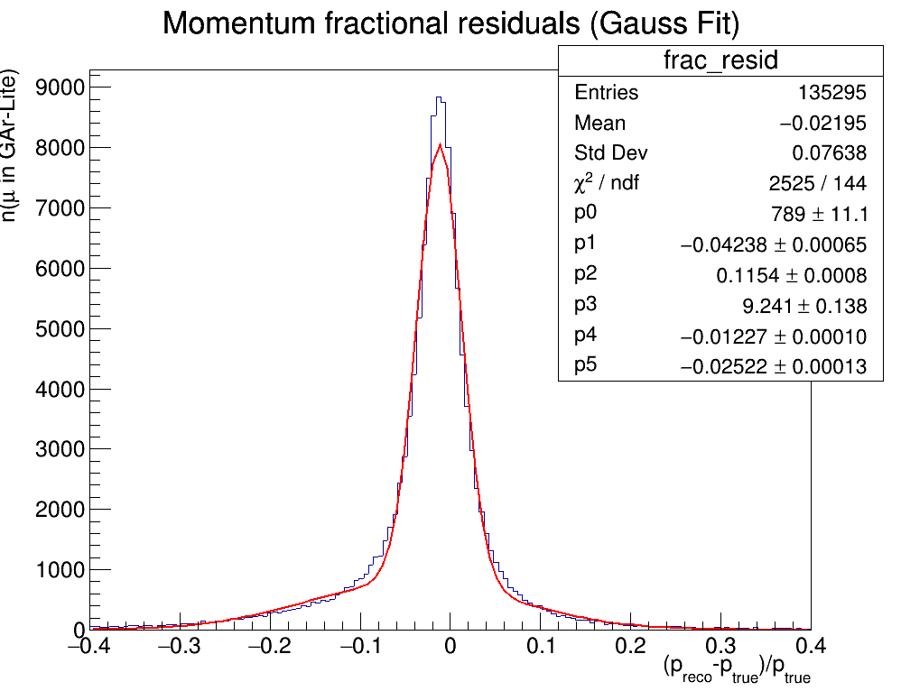
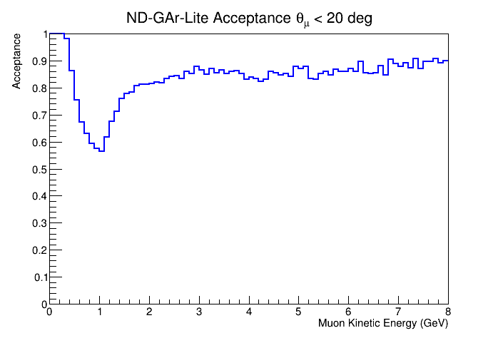
Performance: Acceptance and Momentum Resolution
Muons from neutrino interactions in ND-LAr
Includes ND-LAr-contained muons
ND-GAr-Lite muons crossing first plane
2.5% resolution, with tails due to misassigned hits
Better fit and hit selection quality cuts will improve tails
GEANT4 simulation plus simplified realistic reconstruction

Slide 10
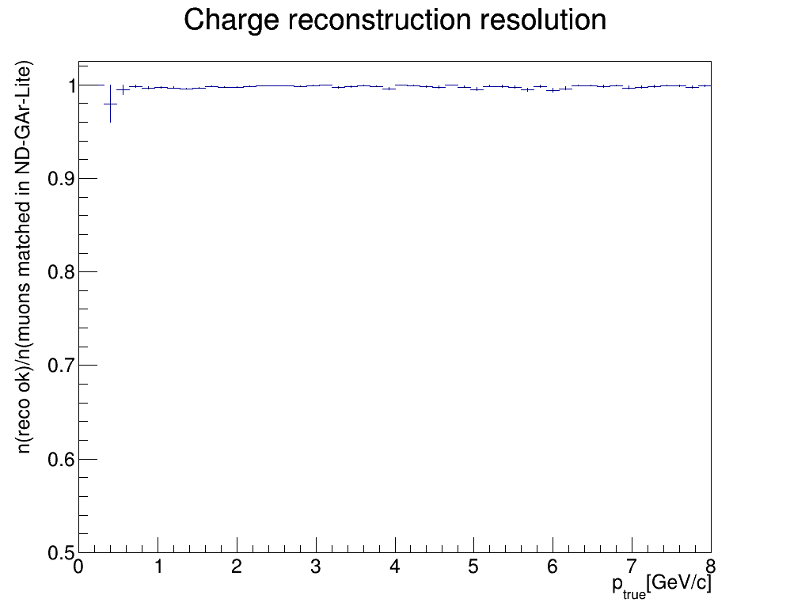
Performance: Charge-sign Determination
excellent capability to determine charge sign

Slide 11
TMS: ND-GAr-Lite
Advantages
  First step towards essential ND component
  Performance might be better than SSRI
  (not important as SSRI is good enough for day 1)
  Allows easier (faster) upgrade to full ND-GAr
  Cheaper than ND-GAr
  Minimizes additional resources for temporary solution
  Allows gradual increase of international contributions
Disadvantages
  Initially more expensive than SSRI (overall less expensive)
  Needs substantial international contributions
  Not yet fully optimised

Slide 12
Optimisation
Increase efficiency/acceptance for low momentum muons by adjusting the scintillator plane spacing -- closer planes at the upstream end.
Adjusting the plane spacing will affect the momentum resolution, primarily by changing the lever arm available for measuring a track.
Some spacing configurations can make the efficiency or resolution better/worse for particular momentum ranges.

Slide 13
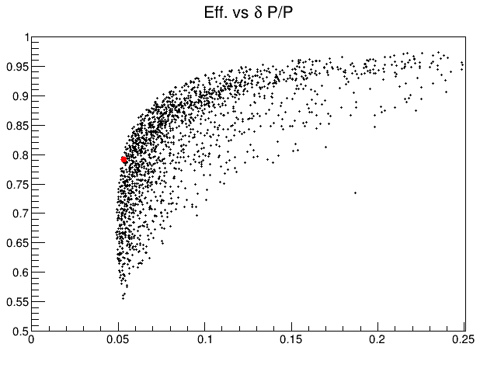
Optimisation
Results from 2000 scintillator plane arrangements
Efficiency and average momentum resolution for all “reconstructed” tracks.
Metrics are not ideal:
Give a useful look at overall behavior of the plane spacing
Nominal

Slide 14
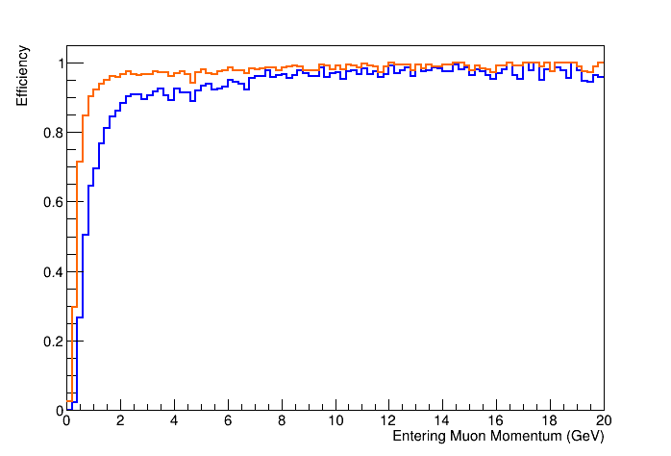
Optimisation
Nominal
Random
Work in progress!
Aim for improved efficiency with minimal degradation in momentum resolution

Slide 15
To-Do
Develop schedule to understand latest decision point
  Will probably be before 2026 (SSRI latest go-date)
Improved cost estimate
Optimise tracker performance
Secure international contributions

Slide 16
Backup

Slide 17
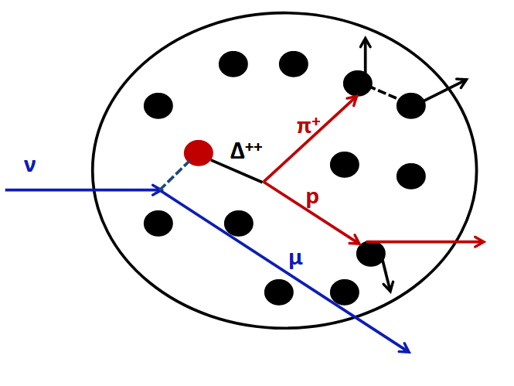
Why ND-GAr?
π⁰ → γγ
Charged and neutral particles
  p from curvature in B-field
  E from range
  Calorimetric energy for γ
  β from ToF of neutron (recoil)
Highlights
  Lower detection thresholds
  Better particle ID
  Neutrons from argon interactions
ND-LAr muon spectrometer
n
Tricky Problem
  Neutrino energy unknown
  Nuclear recoil not measurable
  Nucleus will absorb some energy

Slide 18
TMS: SSRI vs full ND-GAr

Slide 19
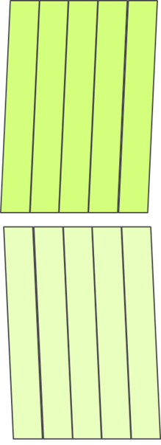
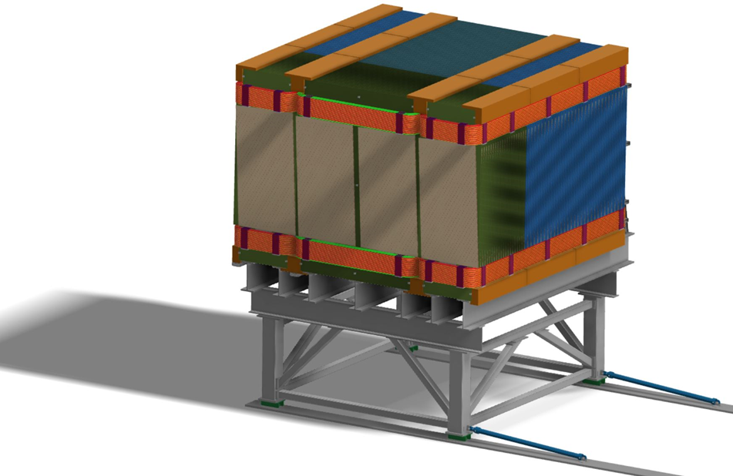
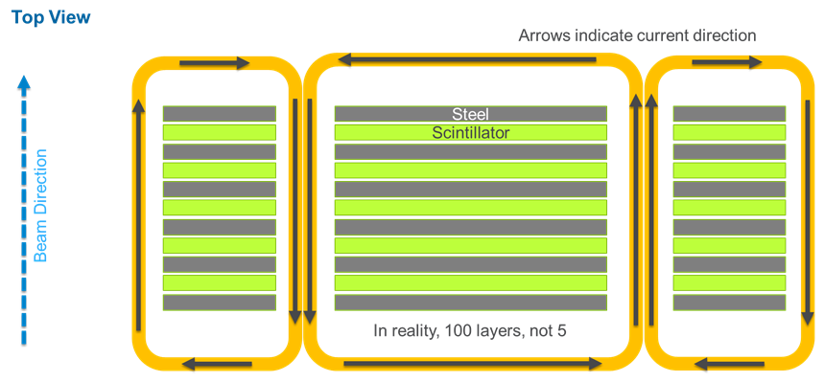
Sign Selecting Range Instrument
A magnetized range stack (100 layers)
  Same area as the ND-LArTPC face
  192 scintillator slats (3.5 cm wide) per plane
  Steel
    15 mm (front 40 layers)
    40 mm (back 60 layers)
Designed to support early physics
  Intended to operate
  up until the ND-GAr is delivered
  Only, if ND-GAr is not achievable on day 1
  Can be build (~$6M) on schedule
  sufficient for initial physics
Was presented at IPR
  cost and schedule estimates
  Can support day one physics

Slide 20
Optimisation
Using the true trajectory information for a sample of muons that reach ND-GAr from ND-LAr.
For each MC trial, estimate the efficiency and momentum resolution for a proposed plane spacing using the muon sample.
The proposed plane spacing fixes the first plane and places the other four planes randomly within ND-GAr-Lite.
Efficiency is estimated by how many tracks “hit” three or more scintillator planes.
Momentum resolution is estimated using the Gluckstern formula.
Repeat many times and build an efficiency vs. resolution graph.

