Slide 1
Initial Thoughts on the Lower CRP Assembly Steps
Bo Yu
Feb. 20, 2021

Slide 2
Assumptions
Assembly site is provided with:
Fully bonded and bridged Anode 1 & 2 PCBs at the half CRP size;
CRP support plates with all anode mounting hardware;
CE adapter boards fully assembled with RC components and input/output connectors;
CE modules with either full set of on-CRP cables and patch panel, or a set of cables to be reused throughout the tests.
WIE /miniDAQ supporting from single CE to multiple (4-5) CRPs.
Assembly site provides the necessary assembly/handling tooling:
A gantry crane with a 3m+ span and CRU lifting fixture with fine positioning capability in 3 axes.
CRP or CRU cold test storage cart, anode PCB cold test cart
Anode PCB carrier frames to facilitate PCB movement and flipping
Various connector positioning guides
CRU temporary support frames
Faraday cage for warm CRU test
A cold box that can hold at least 4 CRPs (1+m high) in horizontal position.

Slide 3
Cold test all anode PCBs
Verify the mechanical bond between segments, and the electrically contacts along the bridged strips. Electrical continuity must be verified in the cold.
Do we need to do the cold test with the boards in a more stressed state (i.e. having the boards slightly bowed by forcing the middle of the board at a different height from the ends?
Place as many pieces into the cold box as practical
For electrical continuity check, need to mount test fixtures on the edges and the middle of the PCB to form one or more serpentine circuits to minimize the channels to monitor.
Special tools: a cart with individual horizontal shelves or vertical slots for the PCBs in the cold box. Strip interconnect fixtures.
Task duration: 1 day per 20(?) boards.
If failure rate is very low, can be superseded by the CRP cold test.

Slide 4
Cold test all the adapter boards
The assembly of the adapter boards is assumed to be performed by a different team/commercial shop.
If assembled by commercial shop, it is assumed that cold test is not performed.
This test can be done in a much smaller setup / different site. The boards are less than 0.9m x 0.3m in size.
Verify the capacitors on the boards have leakage current <0.5nA each at nominal bias in the cold.
Since the leakage currents on each capacitor is typically very small, one could connect a number of caps in parallel to get a quick reading.

Slide 5
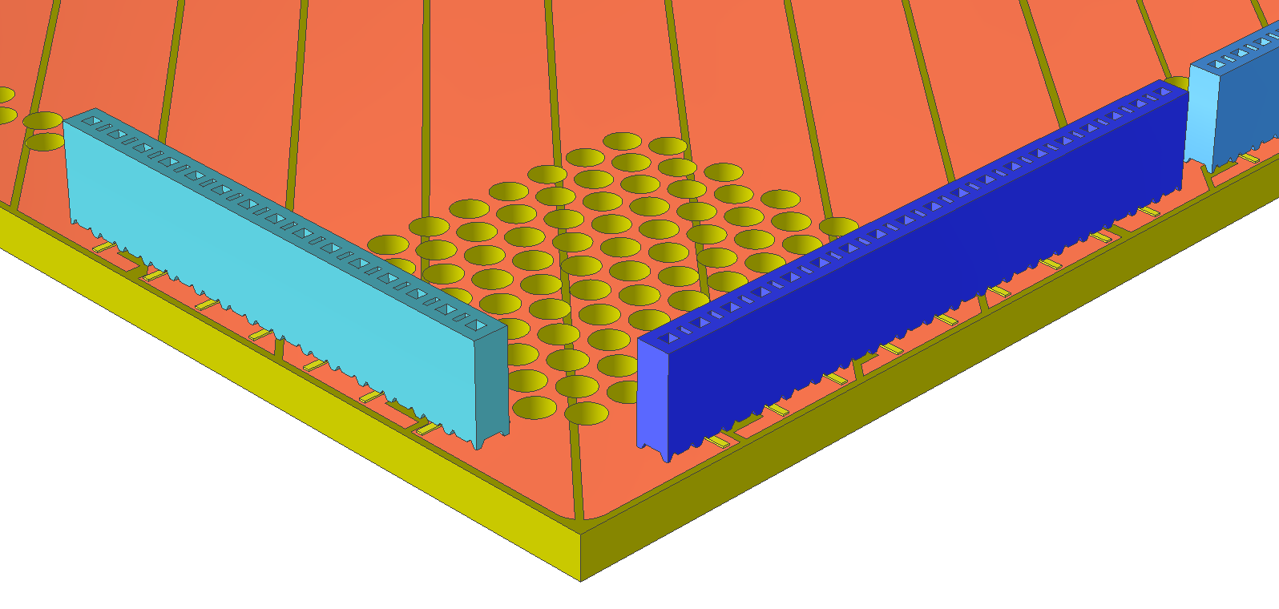
Solder connectors on Anode 1 PCB
Transfer the PCB from the storage pile to an assembly table
Solder all SMT sockets on to the diagonal strips side of the PCB along two edges of the PCB.
Check continuity of the sockets and strips
Clean the edges of the boards
Special tools needed: SMT connector alignment fixtures to ensure accurate placement and orientation of the connectors
Task duration: 2p 3hrs; O(1000) solder joints @ 10s each.

Slide 6
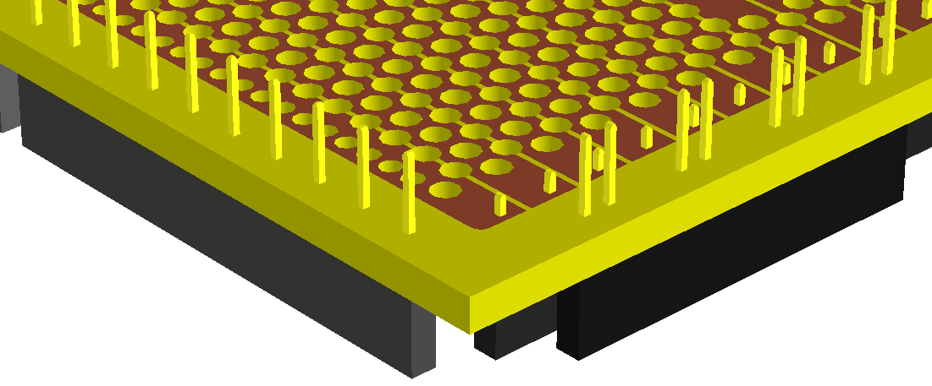
Solder connectors on Anode 2 PCB
Transfer the PCB from the storage pile to an assembly table with the induction strips side up. Elevate the board up 5cm from the tabletop so the connectors can be inserted from below.
Solder all through-hole sockets on to the induction strips side of the PCB along three edges of the PCB.
Check continuity between the pins and strips
Clean the edges of the boards
Special tools needed: connector alignment fixtures to ensure accurate orientation of the connectors
Task duration: 2p 3hrs; O(1200) solder joints

Slide 7
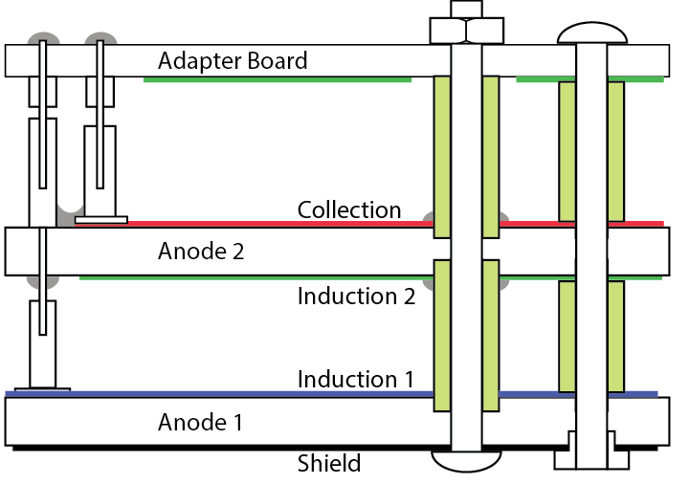
Glue spacers onto Anode 2 PCB
If stainless steel screws are chosen for the anode support, we might need to glue in spacers on both sides of the anode 2 PCB to avoid arcing between screws and strips.
Special tools needed: guiding plates to ensure positions of the spacers, carrier plate to help flipping the PCB side.
Place the PCB on the carrier plate over an assembly table.
Glue spacers onto the top of the PCB. Place the alignment guiding plate over the spacers to lock their positions.
Flip the PCB on the other side.
Glue the spacers on this side of the PCB. Install guiding plate on this side and lock with the guiding plate on the other side.
Wait for the glue to cure.
Task duration: 3p 1h O(100) spacers.

Slide 8
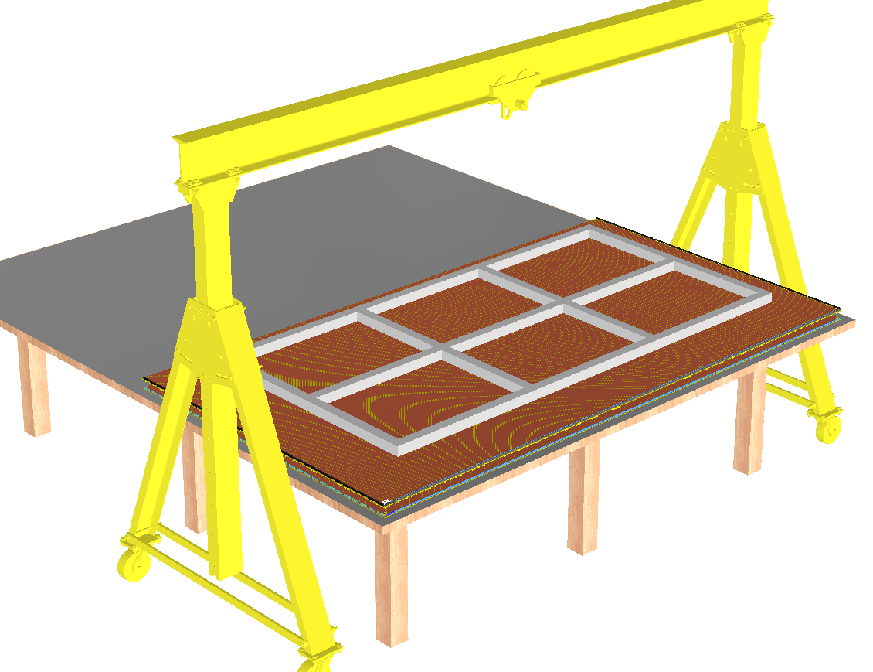
Assemble the Anode PCB Stack (CRU)
Place Anode 1 on an assembly table, induction side up.
Place spacers on Anode 1 (if not already glued onto Anode 2 from previous step)
Raise Anode 2 using a lifting fixture suspended onto a gantry crane (moving on floor or tabletop)
Slowly lower Anode 2 onto Anode 1 using external guiding blocks, with a very small tilt such that connectors near one corner of the boards engage first.
Once all pins are engaged along 3 edges of the boards, lower Anode 2 in small steps while squeezing along the board edges until the nominal stack height has reached.
Install the spacers below the adapter boards on Anode 2
Install the adapter boards onto Anode 2
Special tools: anode PCB lifting fixture, gantry crane
Task duration: 3p, 2hr

Slide 9
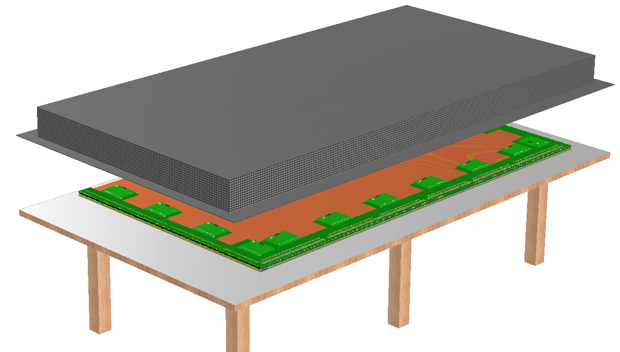
Install and warm test CE
Install the CE modules onto the adapter boards.
Attach the temporary CRU support frame above the anode assembly
Insert all power and data cables into the CE modules. Strain relieve cables onto the CRU support frame.
Move the CRU using the gantry crane on top of the faraday cage base. Enclose the CRU with the faraday cage top. Connect cables to feedthroughs.
Run warm test scripts to verify electrical connections up to CE.
Special tools: CRU support frame, gantry crane, faraday cage, miniDAQ
Task duration: 2p, 2hr

Slide 10
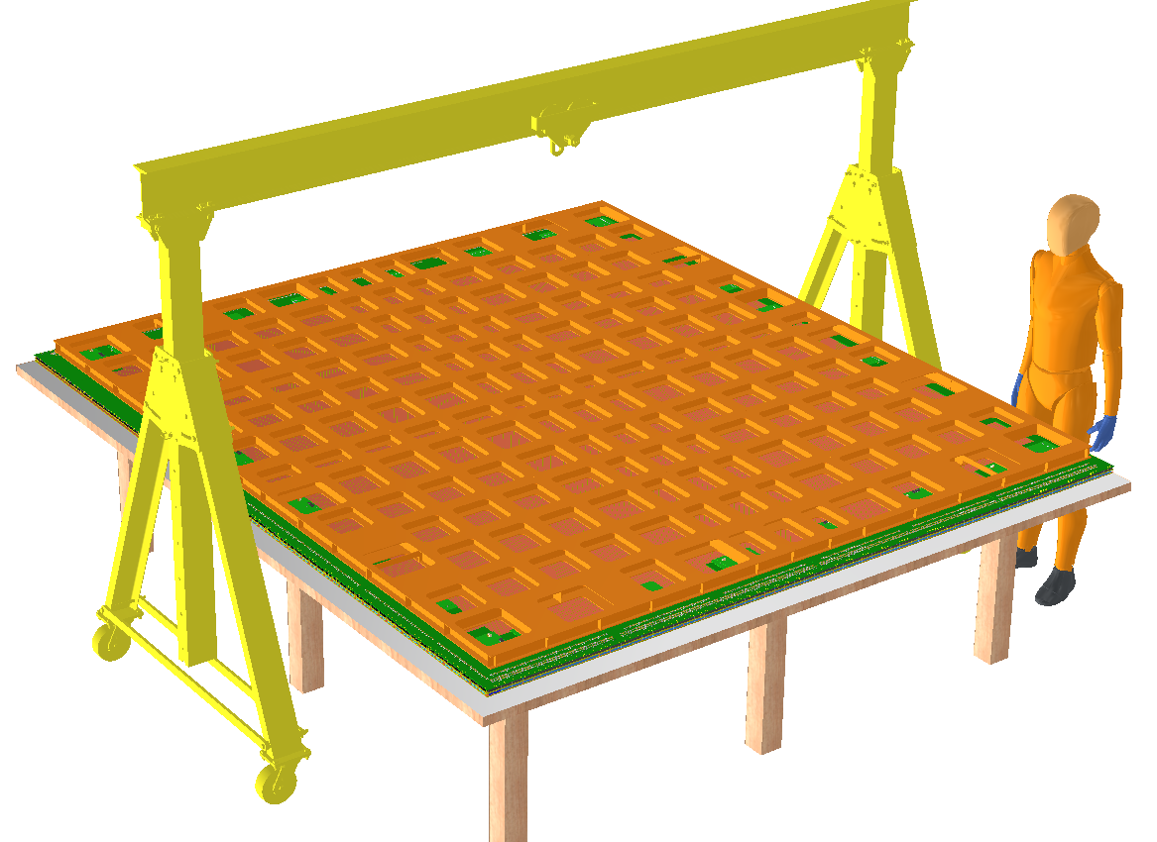
Assemble the CRP
Place two CRUs side by side on the CRP assembly table using the gantry crane
Remove the temporary CRU support frames. Disconnect(?) CE cables.
Lower the CRP support plate onto the two CRUs using the gantry crane.
Install and tighten all interconnect spacers and screws between the CRUs and the CRP support plate. Install cold test stacking frame.
Install CE cables and patch panel. Check communication between CE and miniDAQ.
Flip the CRP and install onto the cold test cart.
Task duration: 4p, 2hr

Slide 11
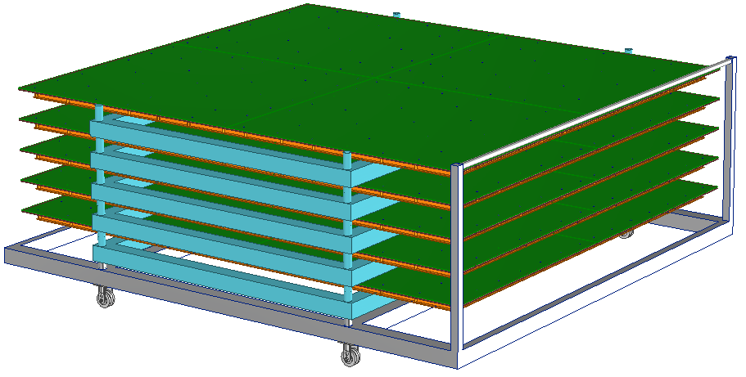
Cold test the CRPs
After accumulated a stack of 4-5 CRPs on the cold test cart, roll the cart into the cold box. Connect the patch panels to the cables inside the cold box. Close the cold box.
Cool down the cold box, while taking data on the miniDAQ.
Warm up the cold box using heating elements on the floor of the cold box.
Open the cold box, remove the CRPs.
Task duration: 3p 3hrs active. 1d total.

Slide 12
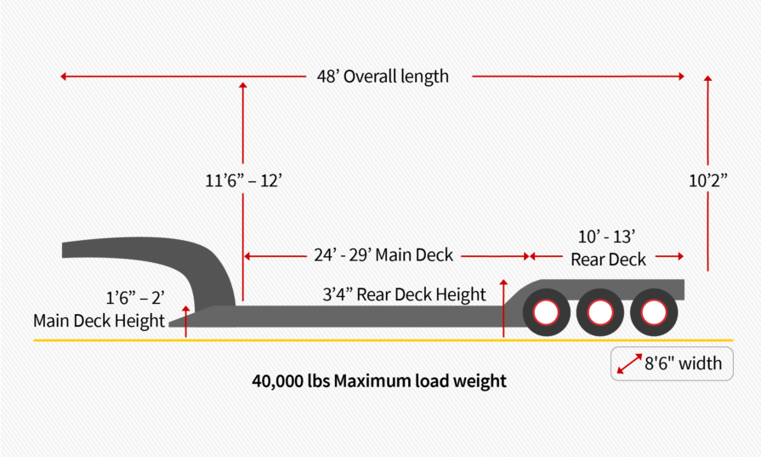
Packing the CRP for shipment
The 3m x 3.4m size of the CRP might be a problem for ground transportation. If transported horizontally, we need to have special permit, and might need pilot/escort vehicles. This seems to be a lot hassle and cost, especially if we cannot pack them densely. Height limit on US highways is about 4m so shipping CRP vertically on lowboy trailers in custom crates does not need special permission.
However, if we can assembly the CRP from 2 CRUs quickly (2-3hrs), and perform a cold test in a day with multiple CRPs, this might be an attractive option to carry out in the underground cleanroom. A single cold box running daily cycles (for all top and bottom CRPs) is not the limiting factor to the TPC installation speed.
Transporting CRUs in a reasonably dense packages that can be loaded into regular container trucks and Ross cage horizontally has the lowest risk of sustaining damages. It would also make it easier for the CRP assembly sites to build smaller cold boxes.
The CRP sized anode support plates can be packed densely and shipping to either CRP assembly sites or SURF in vertical shipping crates on lowboy trailers.
Another possibility: can we skip the CRP step entirely, and install CRUs directly onto the ceiling/floor of the cryostat?

Slide 13
Summary
With a team of 2-3 people, the PCBs (2x2) can be assembled in 2 days.
Two CRUs can be assembled in a day, and warm tested in another day.
Day 5 is to assemble the CRP (4 people).
This gives a basic one per week CRP assembly rate from a team of 3-4 people performing tasks serially.
If we test the CRP in a group of 4, we have a production rate of 4 CRP/month.
It would take 20 months from a single site to supply all bottom CRPs.
Building special transportation fixtures for the CRPs could be expensive and risky. It might be safer and more economical to transport CRUs instead.
If we transport CRUs to the UG cleanroom, should we simply install them directly into the cryostat without forming the CRP modules?

