Slide 1
MI8 Collimators Project Update
Kyle J. Hazelwood
Main Injector Department Meeting
February 24, 2021

Slide 2
February 22 Meeting Notes
Indico link
https://indico.fnal.gov/event/48008/
Preliminary design, plans for simulations (Phil)
Pencil beam simulation may be sufficient to determine length of collimators
A realistic beam distribution is needed to determine mask length
Both the collimator and mask transverse size will be the maximum width we can put there without blocking aisle. Simulations will determine steel/marble percentages
Nikolai believes a full simulation, including downstream MI8 permanent magnets, is needed to determine mask
Both Nikolai and Mike Vincent say they are occupied with PIPII for the next few weeks
They estimated they could get started on MI8 collimator simulations by mid March
Vladimir (and 18.25” markings on the MI8 collimator floor) suggest ~0.5m/20” is needed as a gap between collimators to accommodate bellows movement and repairs
Nikolai suggested having a dedicated collimator simulations meeting in a couple weeks to get everyone on the same page
Nikolai and Mike Vincent both thought it would take 2-3 weeks to run simulations sufficient enough to determine sizing of collimators and mask
This is expected to be done mid April, at which time we will give these numbers to Beth to begin design process
When fabricating the Recycler collimators, we sent out the design for fabrication in January and received items at the start of the shutdown (~July)
This was too close for comfort
The MI8 collimators will have more items to fabricate
October/November 2021 still looks like the desired final design deadline
Next steps
Phil will investigate a 4 location collimation system and make a determination in the next couple weeks as to its viability
We will proceed under the assumption that a 2 location system is to be built
Phil will draft a list of parameters he would like simulated, he will get this list to Nikolai and Mike Vincent
Kyle will schedule a dedicated simulations meetings for a few weeks from now

Slide 3
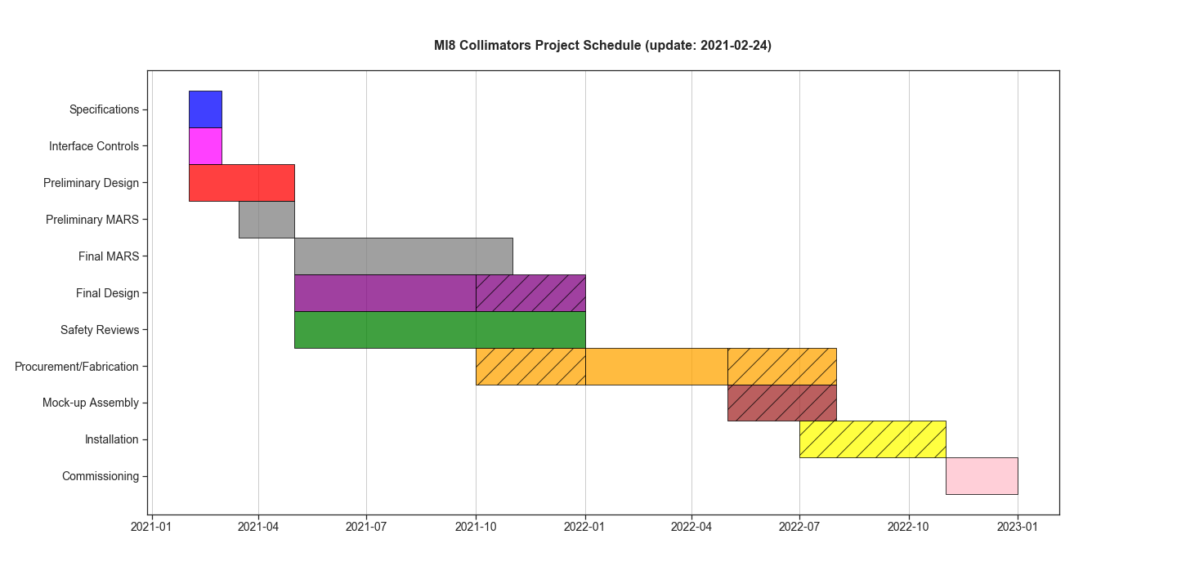
Timeline

Slide 4
Links
Project Document Repository
https://beamdocs.fnal.gov/AD-private/DocDB/ShowDocument?docid=8965
Original MI8 Collimation Design
https://beamdocs.fnal.gov/AD-public/DocDB//ShowDocument?docid=1977
https://beamdocs.fnal.gov/AD-public/DocDB//ShowDocument?docid=1926

