Slide 1
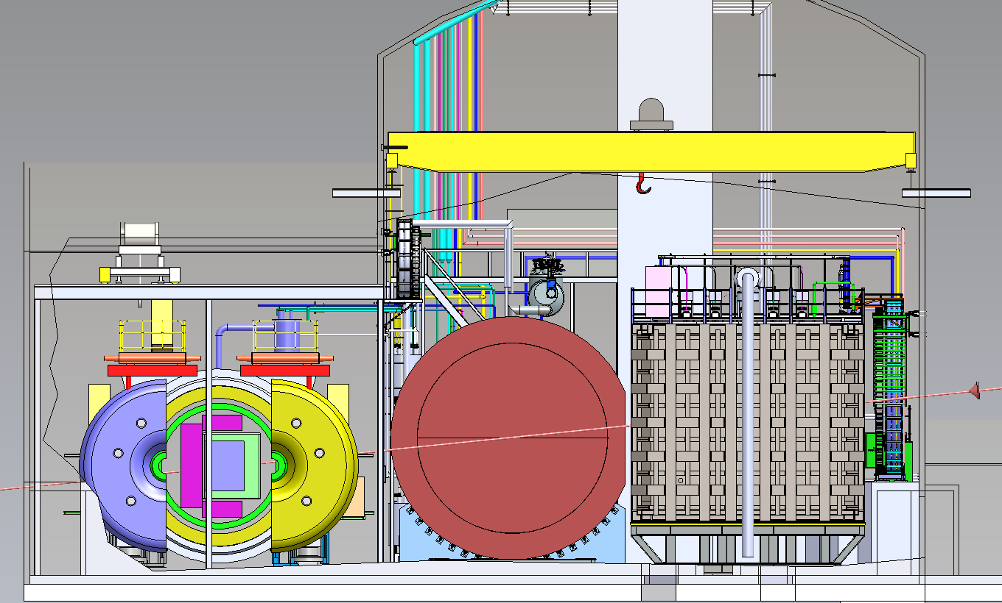
ND-GAr Update
LBNC
March 4th, 2021
ND-GAr

Slide 2
Near Detector Requirements
Motivation for ND-GAr

Slide 3
Overarching ND Requirements & ND-GAr
Unchanged from last presentation
MPD contributes
MPD meets requirement

Slide 4
ND-GAr design status

Slide 5
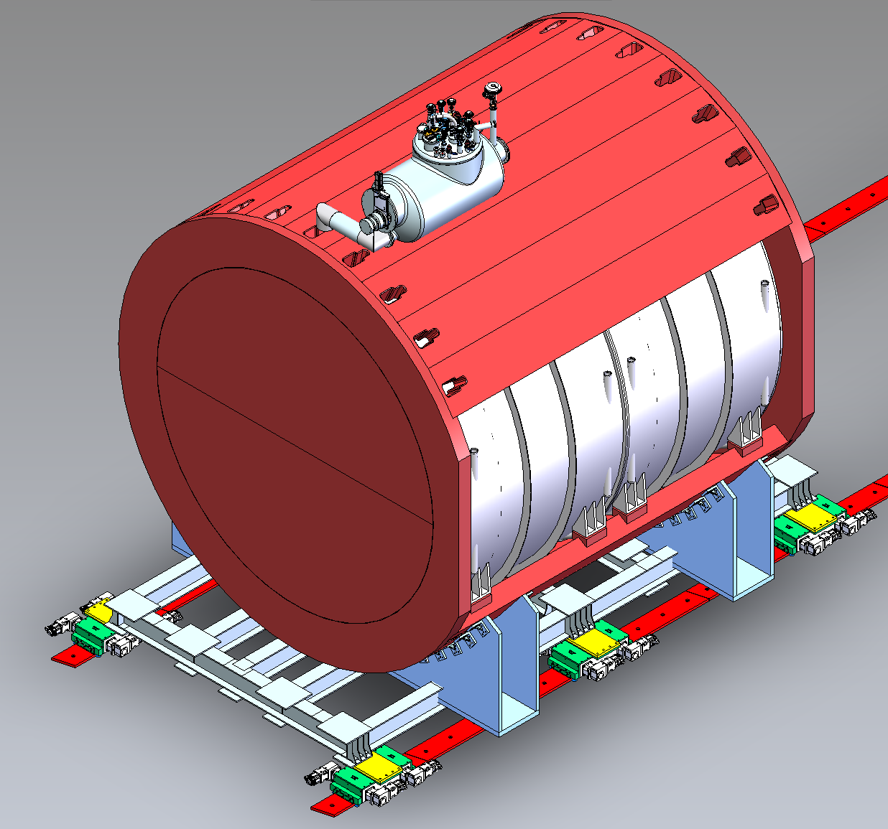
ND-GAr design update
Magnetized volume including high-pressure (10 atm) gaseous argon TPC + ECAL. Plus external muon tagger
Copy of ALICE TPC (5m in diameter X 5m long active)
1t fiducial target mass
Magnet: Solenoid with Partial Return Yoke (SPY)
0.5T field
Acts as pressure vessel for HPgTPC
HPgTPC surrounded by high-performance ECAL
Optimization study underway
Muon tagger
Outside return Fe
Scintillator, RPCs or MicroMegas (tbd)

Slide 6
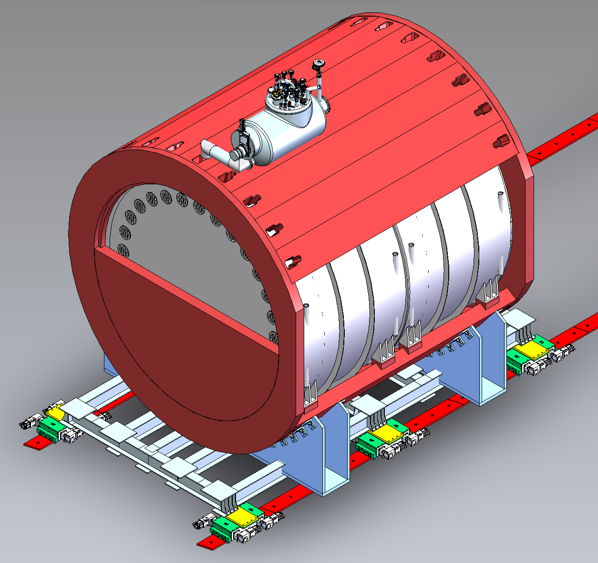
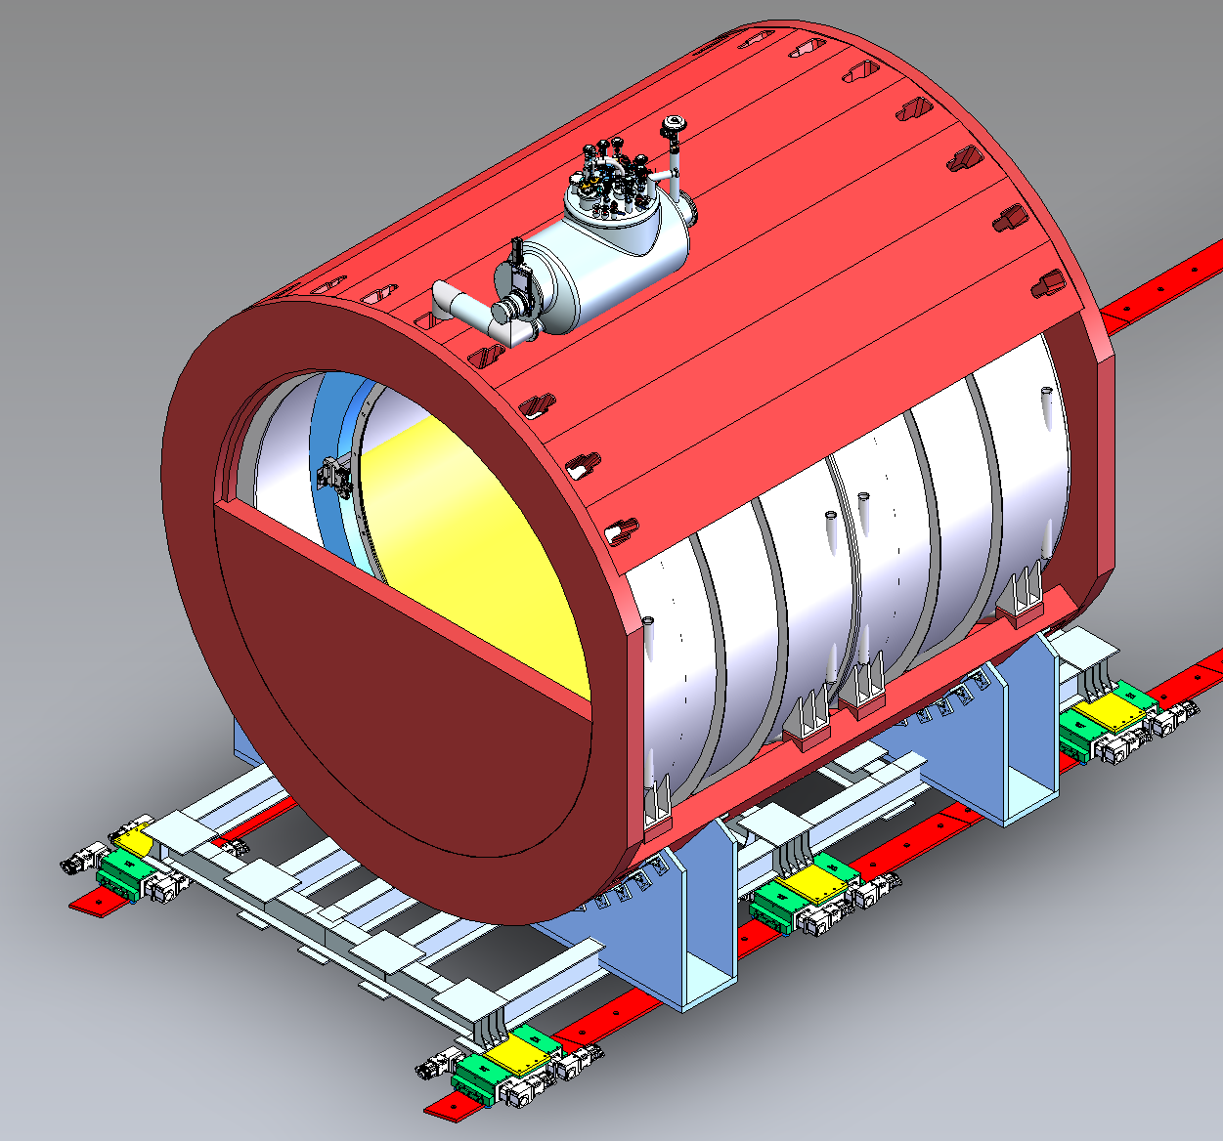
ND-GAr
Yoke
ECAL
HPgTPC
Pressure end seal
Magnet

Slide 7
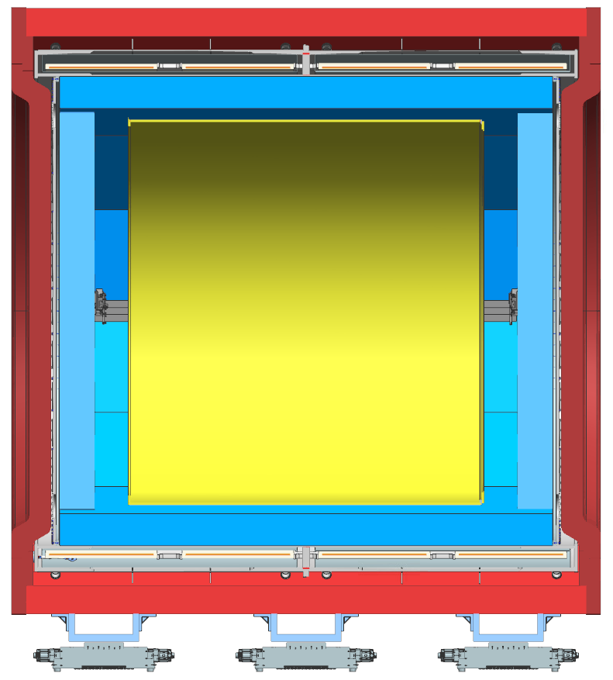
ND-GAr cut-away
Yoke
Magnet
HPgTPC
ECAL

Slide 8
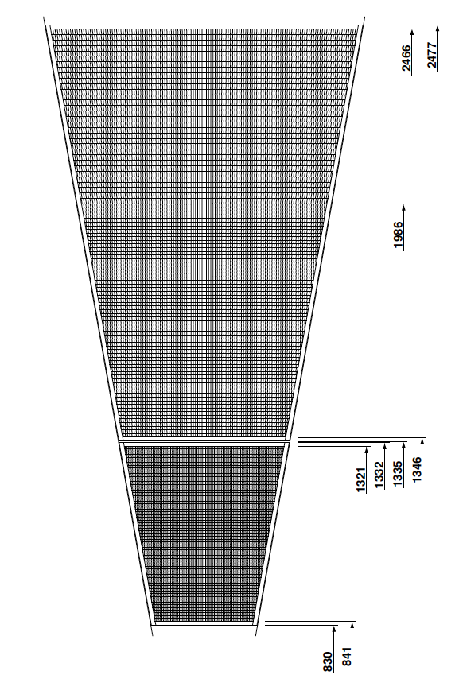
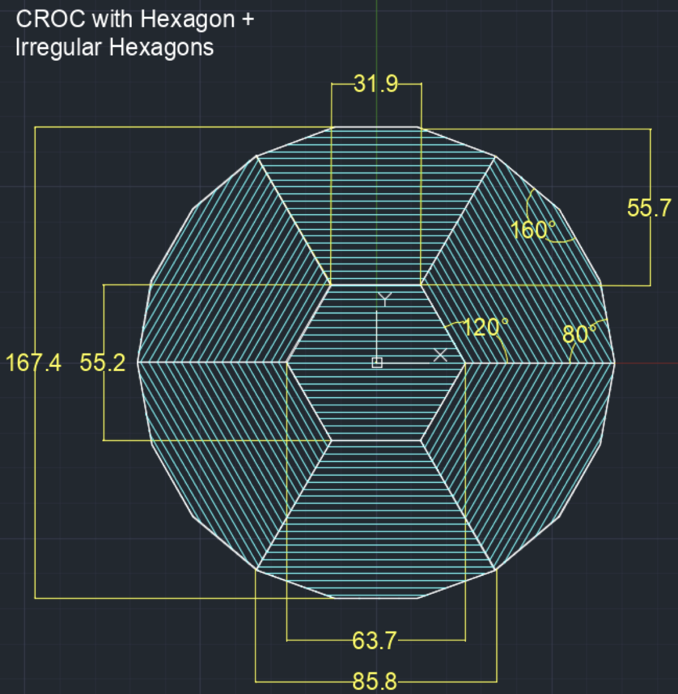
HPgTPC details
Pad readout ONLY. True 3D. No Wires
Readout Pads (ALICE)
Inner chambers (36)
4X7.5 mm² (5504/chamber)
Outer (36)
Inner rows: 6X10 mm² (5952/chamber)
Outer rows: 6X15 mm² (4032/chamber)
Total pads: ~554k
Readout Pads (Central)
Still under study
Starting with 6X6 mm² pads as reference
~125k
Total channels: ~680k
Typical voxel occupancy/spill ~ 0.03%
Readout Electronics
Front-end: Modification of LArPix (GArFastPix)
Back-end: same
ALICE (18-fold symmetry)
Central readout chambers (2, new design)

Slide 9
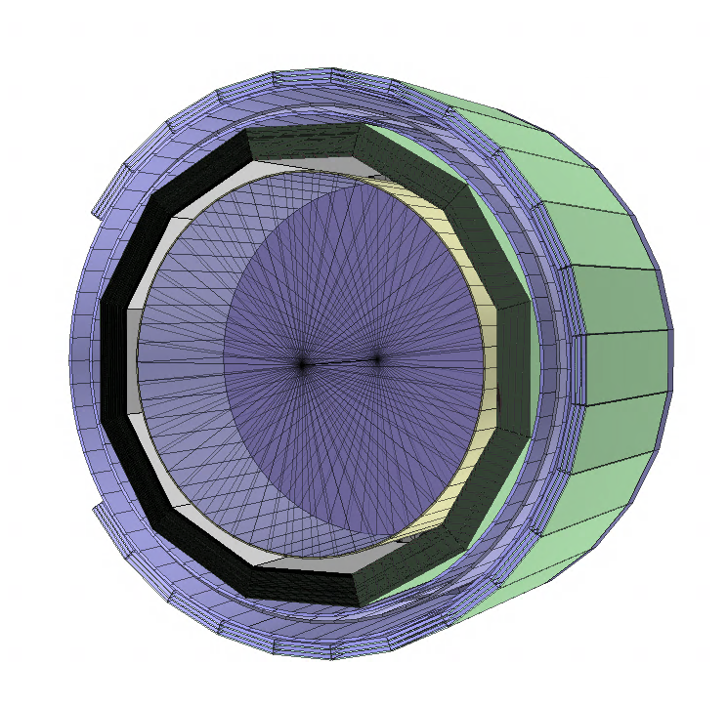
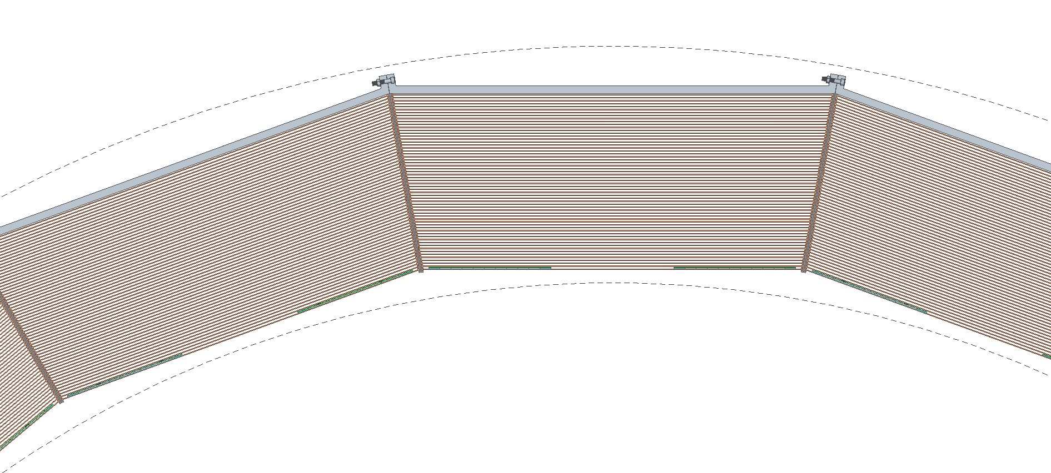
ECAL Baseline Design
Eldwan Brianne
Marco Oriunno
12-sided geometry
Key design features
High granular layers based on CALICE R&D (AHCAL SiPM-on-tile design)
2 mm Copper / 5 mm plastic scintillator tiles of 2.5x2.5 cm²
Cross-striped layers in the back based on Mu2e
4 cm width spanning the full module width/length (~few m)
SiPM readout
Estimated number of channels: ~1- 3M
Based on simulation studies
Energy resolution ~ 6%/Sqrt(E) + 4%
Angular resolution ~ 8º/Sqrt(E) + 4º
Neutron detection eff. ~ 40%

Slide 10
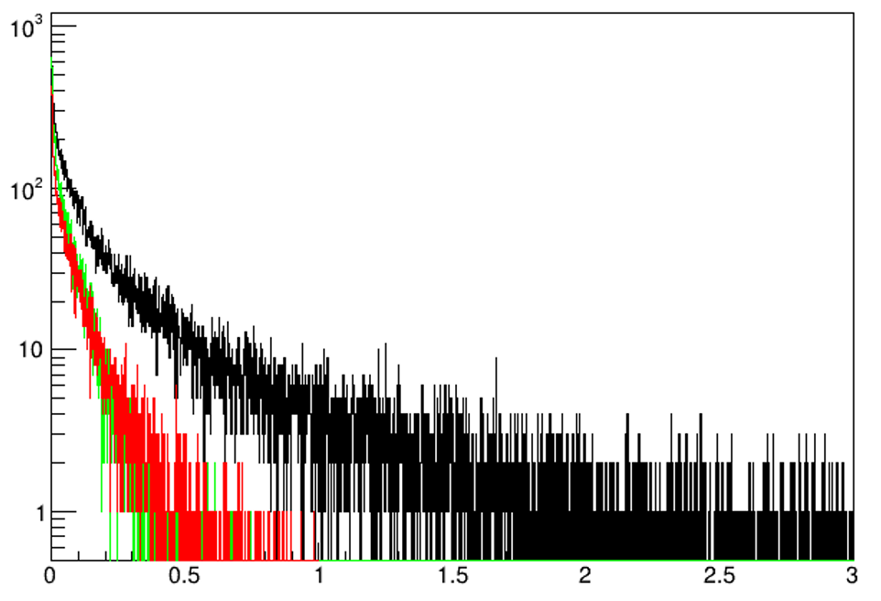
ECAL Optimization
Vivek Jain
Baseline is uniform in θ, φ
Is this needed?
Truth energy flow analysis in regions (US barrel, DS barrel, end caps for ν_{μ}CC evts.
Just neutrals here, n and γ. KE plotted
Downstream barrel (34.3K entries)
Upstream barrel (12.4K entries)
Endcap (9.6K entries)
ν

Slide 11
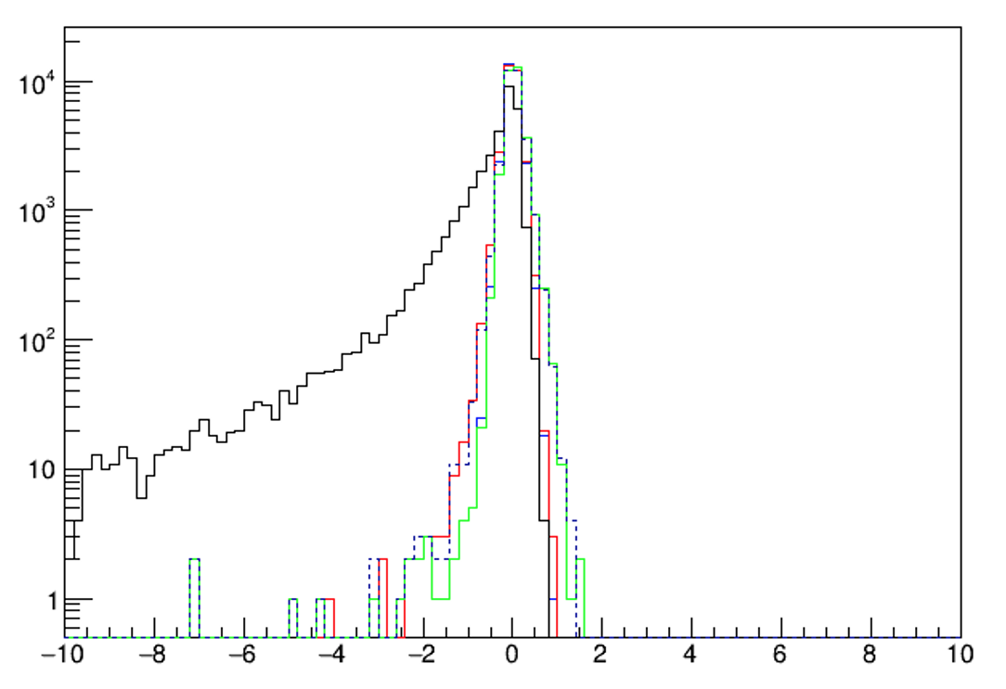
ECAL Optimization
Baseline is uniform in θ, φ
Is this needed?
Truth energy flow analysis in regions for ν_{μ}CC evts.
Barrel upstream (US), Barrel downstream (DS) and end caps
∑ (P'_{true}- P_{true})
All secondaries
Excluding n & γ
Stopping in end cap ECAL
Excluding n & γ
Stopping in US barrel ECAL
Under consideration
Excluding n & γ Stopping in
US barrel or end cap ECAL
Excluding n & γ Stopping in
DS barrel ECAL
ΔP (GeV)
Assumption: all charged secondaries measured in
HPgTPC

Slide 12
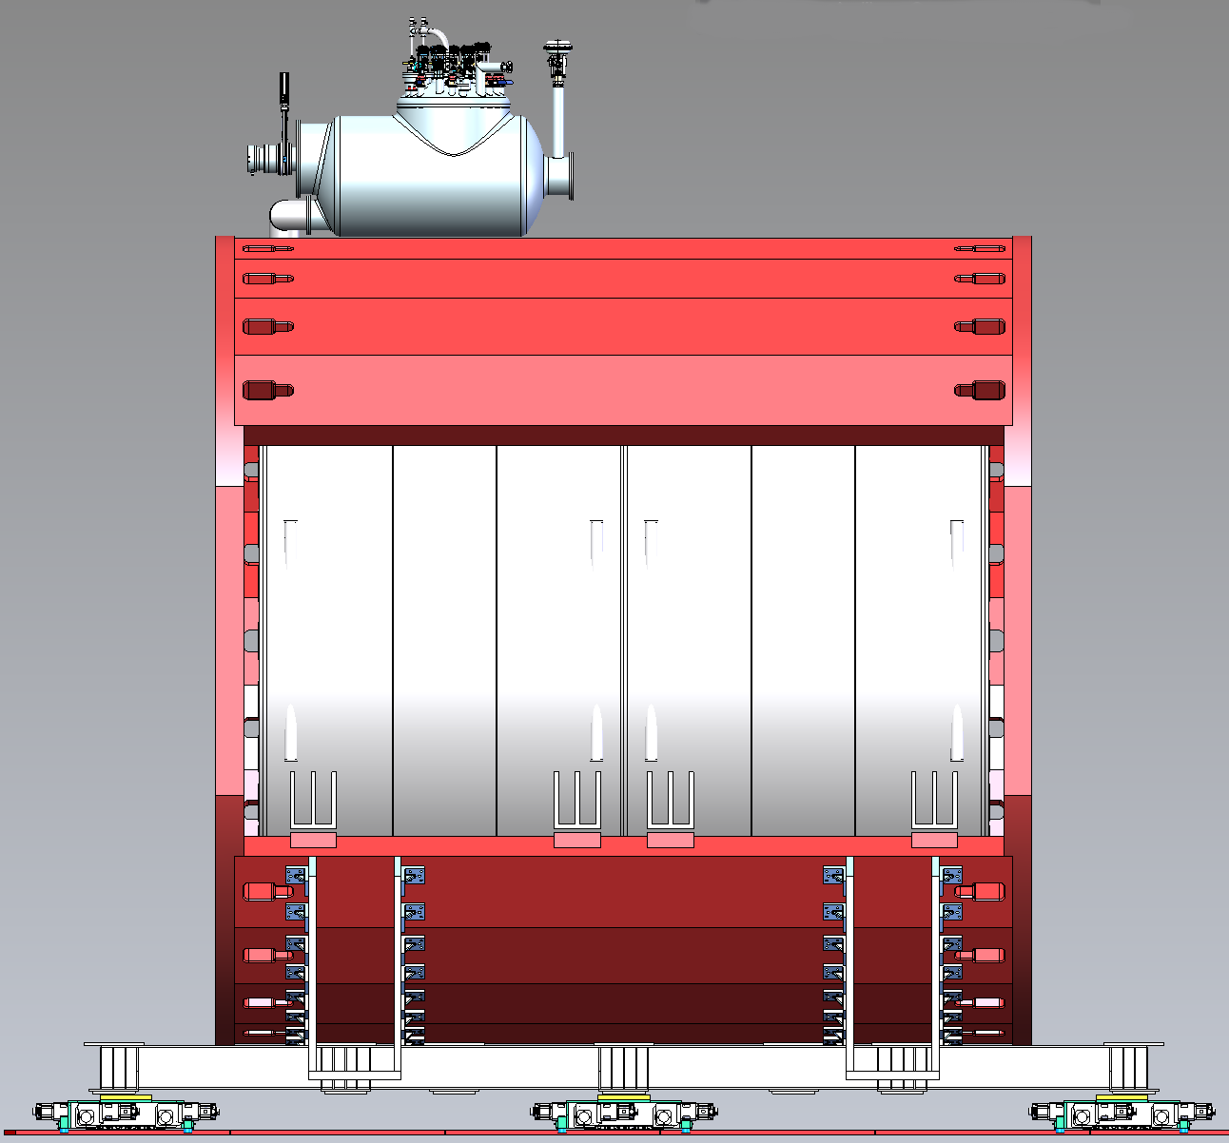
Solenoid with Partial return Yoke (SPY)
Andrea Bersani, Don Mitchell, Colin Narug
Team at INFN, Genoa has been taking design forward
Interacting with ASG Superconductor
Strengths over Helmholtz coil design
~ 1/3 stored energy (Cost ↓)
C($) ∝ E_{s}^{0.7}
Better central field uniformity
Now ~ ± 2%
Less stray field
More natural incorporation of steel for muon tagging system
Existing TDR
75% scale model exists

Slide 13
Software development: Analysis Framework proposal
Chris Hilgenberg
New repository, Garana
Condensed versions of GarSoft products
Tools for reading class-based or flat trees
Tools for class-based → flat tree conversion, consistency checking
Standalone, lightweight event display
Backtracking
Support for C++ or Python analysis with ROOT
Make GarSoft depend on Garana
Extensions for garana products to facilitate construction from nusimdata objects
Class-based trees produced by new analyzer module, StructuredTree_module.cc
Garana takes care of the rest

Slide 14
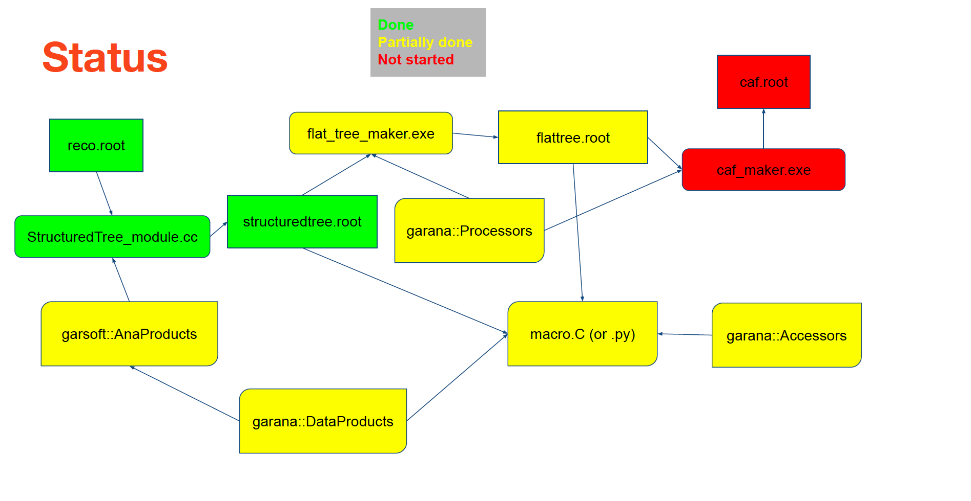
Framework status

Slide 15
GarSoft: Custom Magnetic Field
Due to the ND-GAr magnet, we need to use a custom magnetic field to simulate non-uniformities and see the impact on tracking performance (also may be good to understand the impact of the fringe field on the ND-LAr)
Andrew Cudd nicely implemented this in
edep-sim (see PR: https://github.com/ClarkMcGrew/edep-sim/pull/10)
GArSoft as a standalone art service (MPDMagneticField_service.cc)
He demonstrated that it works perfectly with edep-sim
GArSoft is currently in code-review (branch bfield)
Eldwan Brianne

Slide 16
HPgTPC Workshop
Workshop held January 11th - 13th
~ 80 registered for the meeting
Focus was on the HPgTPC, but included ECAL
Three working groups, but included cross-cutting discussion sessions
Physics/simulation
GArSoft
ND-GAr lite
Single drift
dE/dx resolution
μ catcher
Calibration & concept of Fluorescence tagging
Mechanical
Plans for scintillation light studies
Temps and gas properties
ECAL calibration
TPC calibration thoughts
perhaps for a ND-GAr calibration task force soon?
Muon system
Electrical
Requirements
Interfaces
System design
Digitiser ASIC options
Aggregator
Timing

Slide 17
R&D Plan
HPgTPC (DOE Research Consortium Proposal)
Gas Mixture studies
Electronics and DAQ
Central Readout chamber design
Mechanical engineering
Field cage and HV
Gas & Cooling system
Calibration and slow controls
Light collection
Test stands
ECAL
Starting with CALICE engineering
Detailed design and optimization will come with TDR
Initial engineering resources are now coming from SLAC
Magnet (coils & yoke)
Preliminary design being developed in Genoa with engineering support from FNAL
In consultation with ASG
Muon detector
TBD ➛ Technology choice and then mostly development.

Slide 18
ND Configuration at beginning of ops
TMS as ND-GAr lite

Slide 19
Day 1 Configuration currently imposed by resource constraints

Slide 20
TMS: ND-GAr lite

Slide 21
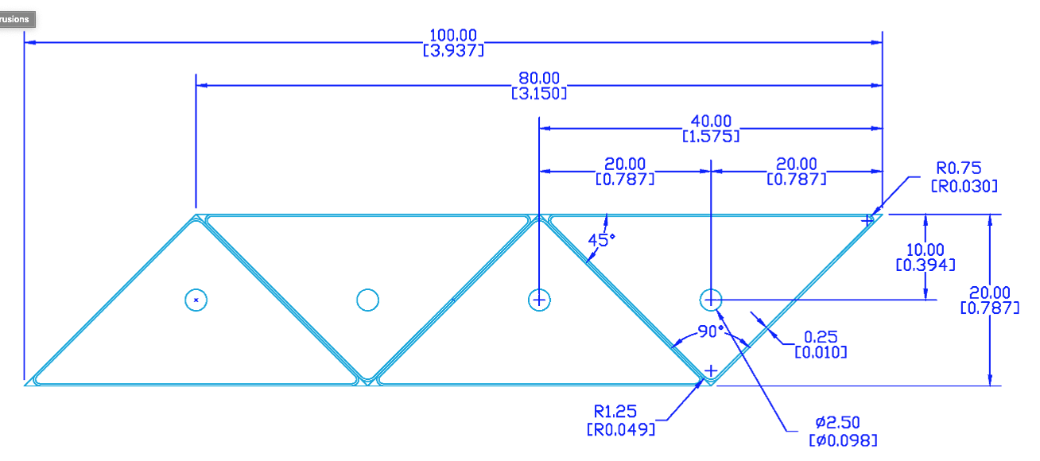
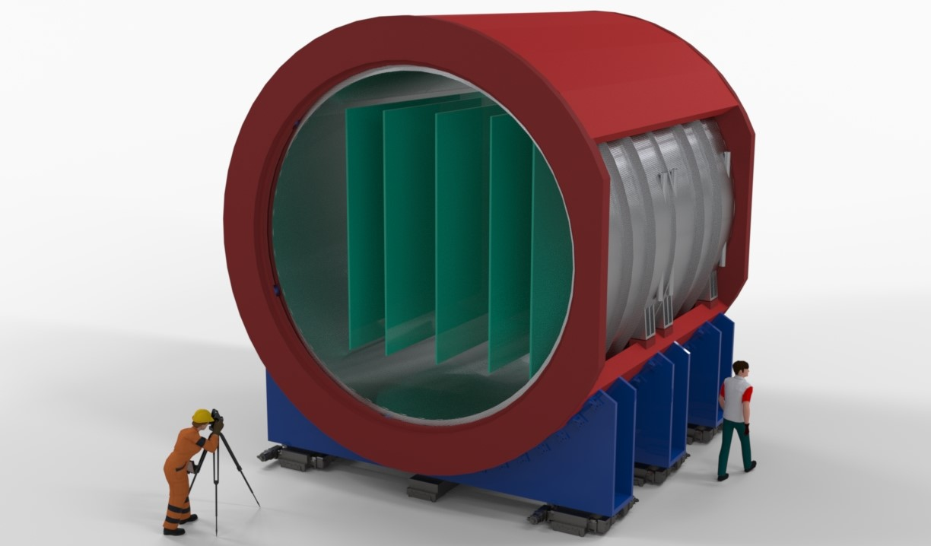
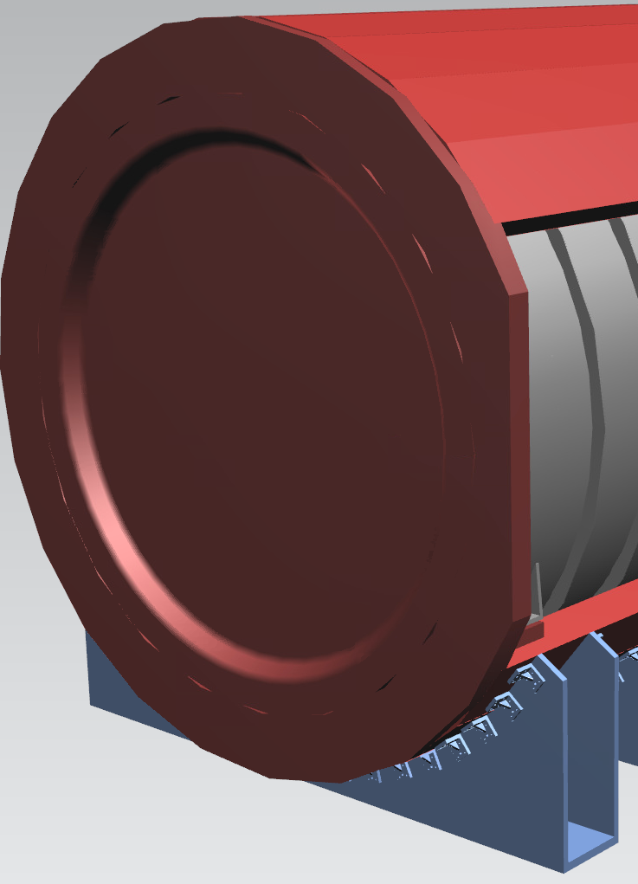
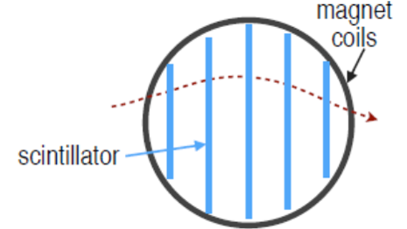
Alternative TMS: ND-GAr-Lite
ND-GAr-Lite
SC Magnet including partial return-yoke
Scintillator tracking planes
Update of MINERvA
Similar electronics as SSRI
ECAL modules could be added (but may degrade performance)

Slide 22
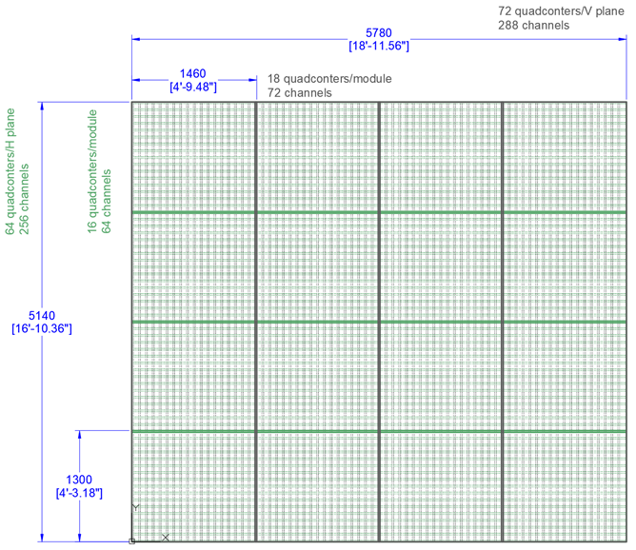
Tracker plane concept

Slide 23
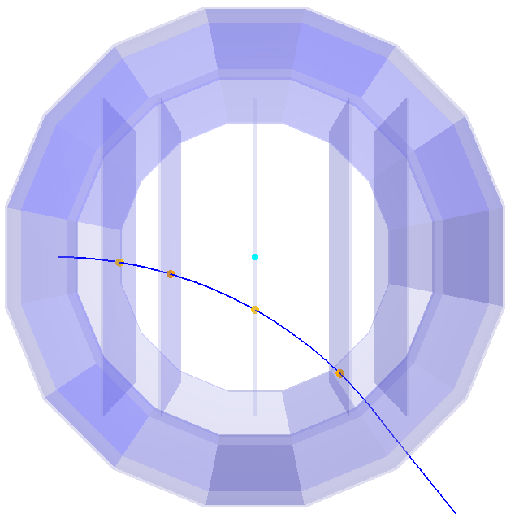
TMS: ND-GAr-Lite Nominal Design
Simple reconstruction
Require 3 hit scintillator planes
planes at z = {-240, -150, 0, 150, 240} cm
Not optimised for low-p muons
will bend to not hit third plane
Larger cross section for muons than ND-GAr
Optimisation needed
Geometry
Tracking reconstruction

Slide 24
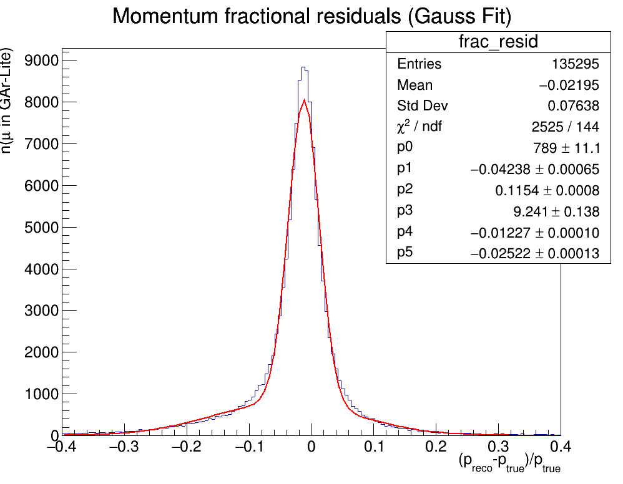
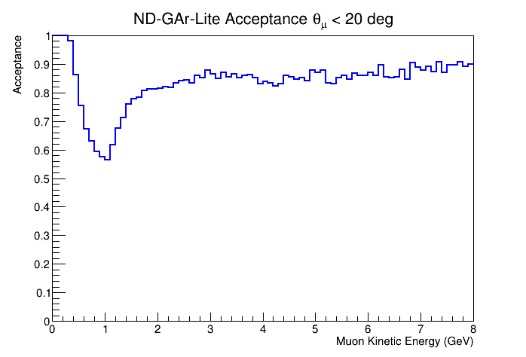
Performance: Acceptance and Momentum Resolution
2.5% resolution, with tails due to misassigned hits
Better fit and hit selection quality cuts will improve tails
GEANT4 simulation plus simplified realistic reconstruction
Muons from neutrino interactions in ND-LAr
Includes ND-LAr-contained muons
ND-GAr-Lite muons crossing first plane

Slide 25
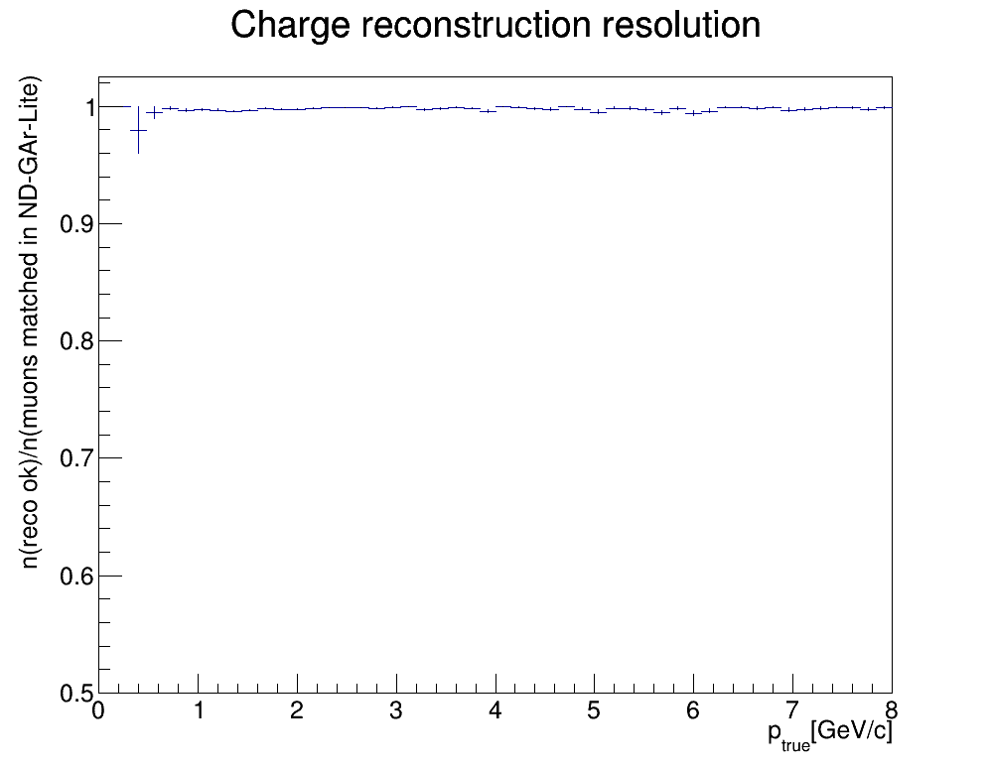
Performance: Charge-sign Determination
excellent capability to determine charge sign

Slide 26
Optimisation
Andrew Cudd
Increase efficiency/acceptance for low momentum muons by adjusting the scintillator plane spacing -- closer planes at the upstream end.
Adjusting the plane spacing will affect the momentum resolution, primarily by changing the lever arm available for measuring a track.
Some spacing configurations can make the efficiency or resolution better/worse for particular momentum ranges.

Slide 27
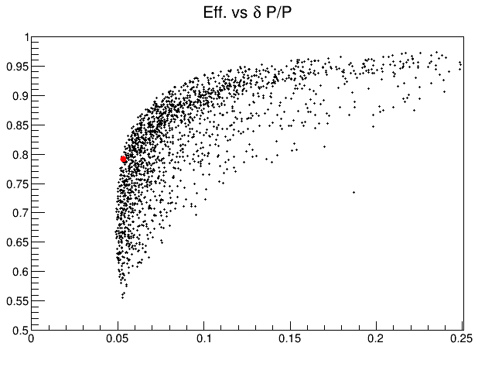
Optimisation
Results from 2000 scintillator plane arrangements
Efficiency and average momentum resolution for all “reconstructed” tracks.
Metrics are not ideal:
Give a useful look at overall behavior of the plane spacing
Nominal

Slide 28
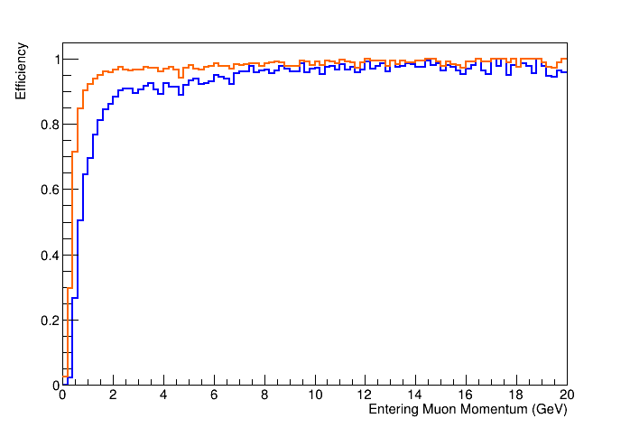
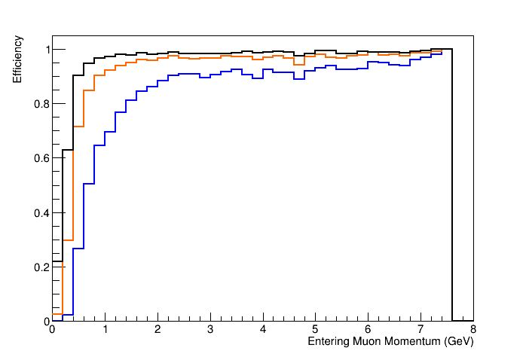
Optimisation
Work in progress!
Aim for improved efficiency with minimal degradation in momentum resolution
Nominal (5 planes)
Random (5 planes)
Random (6 planes)
Nominal
Random

Slide 29
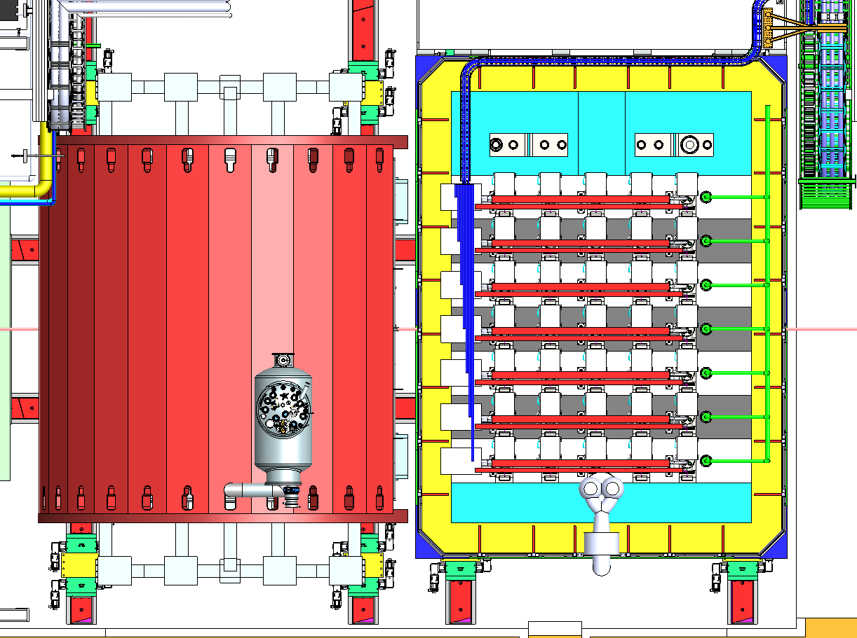
ND-GAr lite & ND-LAr
Additional instrumented
plane?

Slide 30
Preliminary schedule
Technically limited estimate but does include detailed schedule input from external projects that have similar components
Magnet system
Genoa group (Bersani, Fabbricatore) met with ASG management:
Sergio Frattini – Managing Director
Antonio Pellecchia - Commercial Manager Magnets & Systems unit
Giovanni Grasso - Business Development Manager, MgB₂ wire unit
Daniele Magrassi - Engineering and R&D Manager, Columbus MgB2 unit
Input based on completed magnet for MPD experiment at NICA heavy-ion accelerator at JINR
Tracking system
Obtained “as-built” estimates from Craig Dukes (Mu2e Cosmic-ray Veto L2 manager)

Slide 31
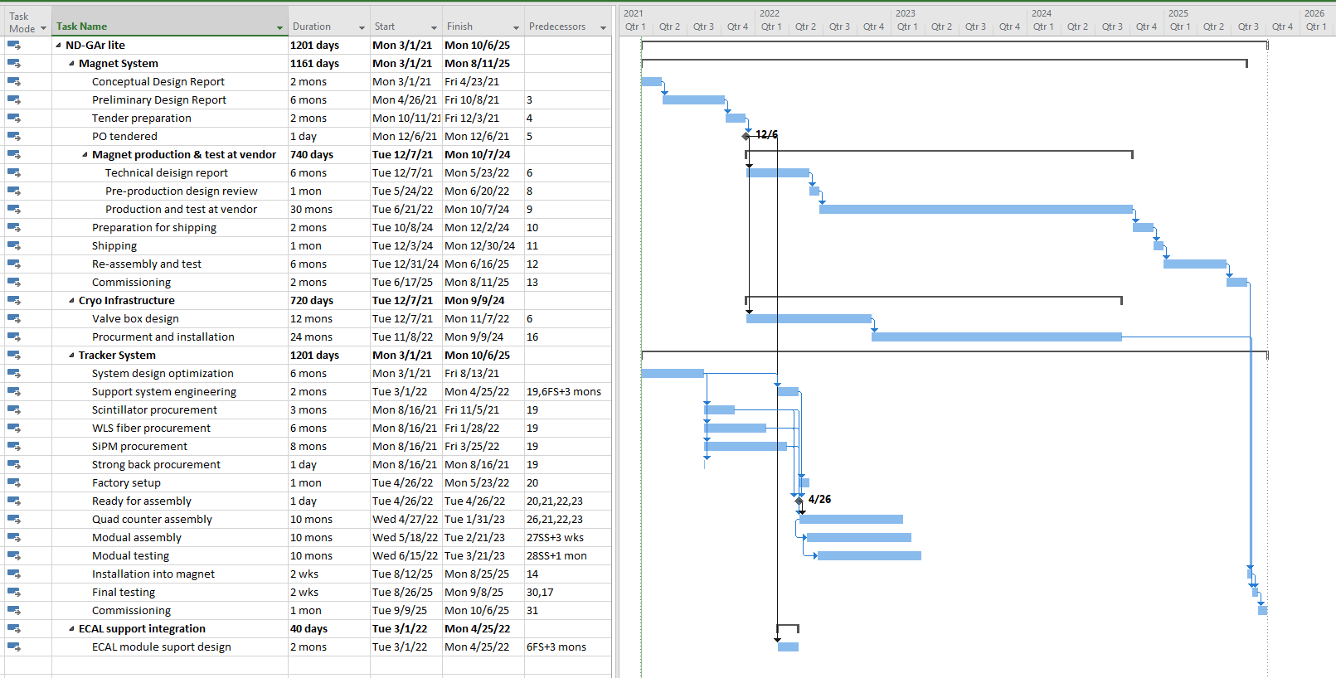
ND-GAr lite schedule
Preliminary, technically limited

Slide 32
Participating Institutions
Georgia
The Georgian Technical University
Germany
DESY
University of Mainz
MPI, Munich
RWTH-Aachen
India
Bhabha Atomic Research Center
Tata Institute for Fundament Research
University team forming
Italy
INFN, University of Genoa
Poland
University of Warsaw
Spain
Santiago
Valencia
UK
STFC
Imperial College
Queen Mary
Royal Holloway
University College London
University of Oxford
University of Edinburgh
University of London
US (next page)

Slide 33
US Institutions
Abilene Christian Univ.
ANL
Univ. of CA, Santa Barbara
Univ. of Colorado
Fermilab
Indiana Univ.
Univ. of Iowa
LBNL
Univ. of Minnesota
Univ. of Mississippi
Univ. of Pittsburgh
Univ. of Rochester
Rutgers Univ.
SLAC
Univ. of Texas, Arlington
Univ. of Wisconsin, Madison
Wichita State
William and Mary

Slide 34
Conclusions

Slide 35
QUESTIONS?

Slide 36
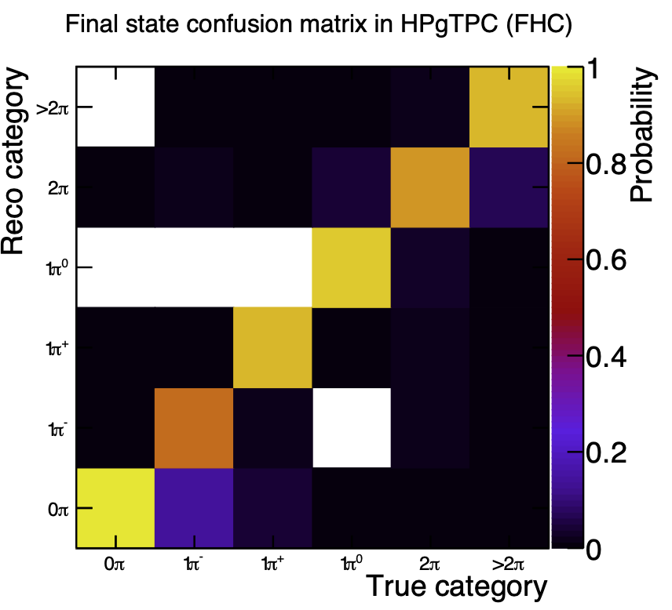
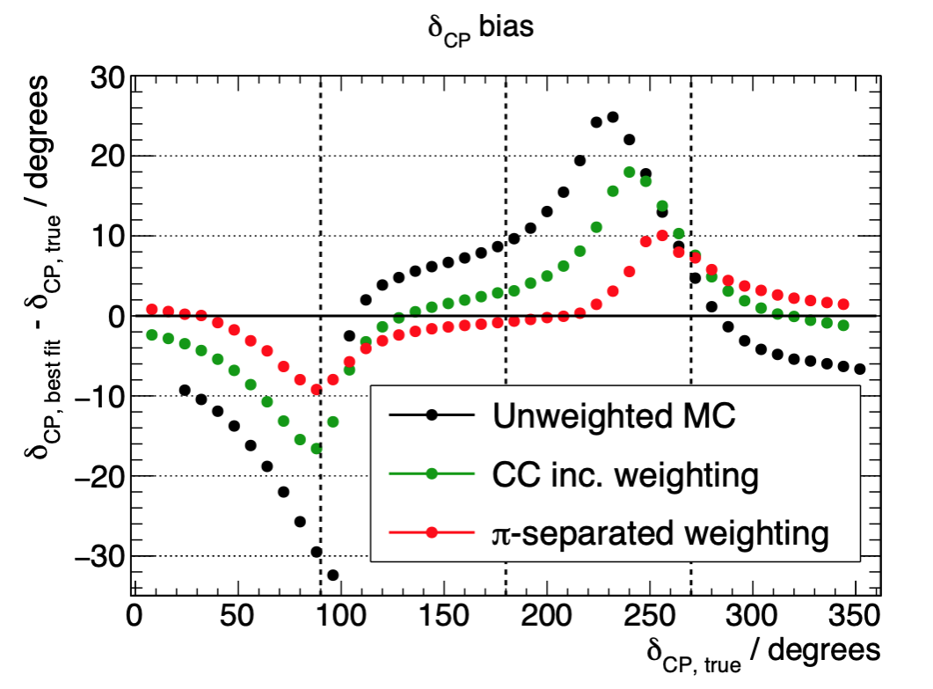
ND-GAr’s strengths: An example
Seb Jones
Case study: Genie, NuWRO differ greatly in pion production channels
Genie model fit to NuWRO “fake” data leads to enormous biases in extracting δ_{CP}. Case study of unknown, unknowns.
ND-LAr will to some extent be able to measure/correct such a discrepancy inclusively in accordance with capabilities at FD. Issues:
Secondary interaction effects and thresholds
Non-trivial acceptance corrections
ND-GAr can perform detailed channel decomposition and correction with cleanly separate the channels
The precision tracking capability of the HPgTPC allows ND-GAr to accurately identify and separate final states in neutrino interactions. Measuring various kinematic distributions for these exclusive final states allows deficiencies with the interaction model to be identified and fixed.
102. I am puzzled by this whole procedure. What is this intended to show? If you just wanted to show that GENIE and NuWro
give different results, you wouldn't need to reweight one to look like the other, would you?

Slide 37
Muons from ν_{μ}CC events in gas (LBNF beam)
Tom Junk
Correct hits assigned to track
Pattern reco in development
No noise
Full pad response
Drift/Diffusion simulated
Point resolution needs optimization
Kalman fit
Needs optimization
Track stitching across cathode

Slide 38
Funding sources/opportunities
INFN is committed to support the MPD magnet coil design using current funding.
US groups have submitted a R&D Consortium Proposal to the DOE that will focus on the development of the HPgTPC and will produce a technical design report.
3 years and $1.7M.
Currently under review.
UK groups are preparing a ND DAQ proposal
German groups are preparing a targeted R&D proposal for the ECAL.
To be submitted in November.
Indian groups are looking for funding for the partial-return yoke and muon tagging detectors
Not needed at Day 1 for μ spectrometer

Slide 39
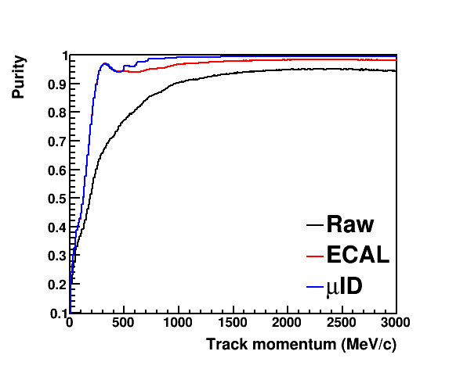
Muon catcher -- Requirements
Design is obviously coupled to that of ECAL and magnet
Preliminary study with 20 cm Fe. Some conclusions
Muons and pions stopping in ECAL can be separated by range with nearly 100% efficiency
μID is required to get right-sign CC purity above 95%
20cm iron μID gets ~100% purity for high-momentum tracks
Backward μID is not needed if there is a backward ECAL
Increasing the number of ECAL layers would improve the purity in the 400-500 MeV/c momentum range
Detailed design is in progress.
Chris Marshall
FHC ν_{μ}CC purity (μ⁻/π⁻)
Note: Raw ≡ Select highest P track
from μs and πs

Slide 40
μ purity vs. Fe thickness
For each case, the
steel was segmented
into 3 sections:
3.3, 6.6, 10 cm

