Slide 1
FAST RunCo Summary
Edstrom
2/26/2021

Slide 2
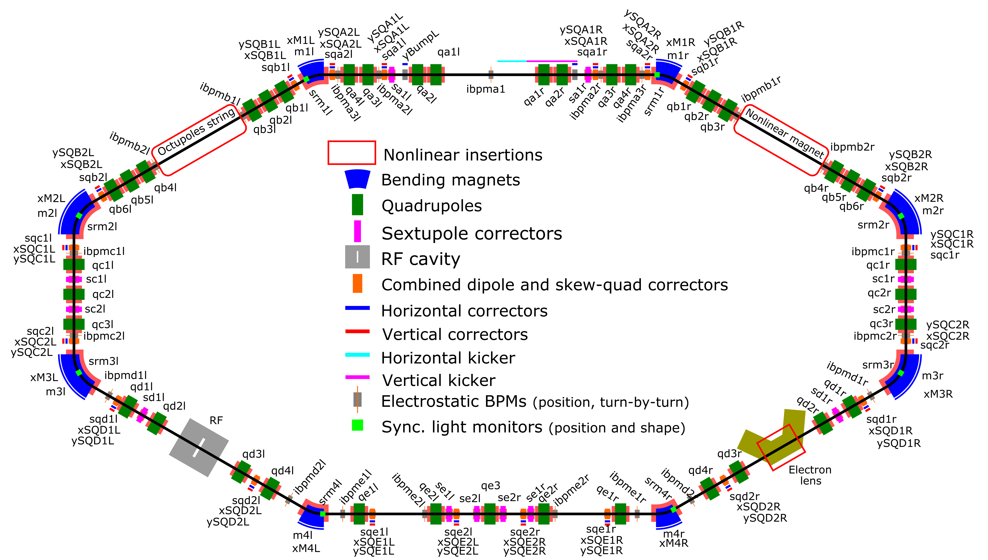
Summary
Controlled Accesses
Most mornings for various jobs
Alignment Wed/Thurs for OSC elements (E-Straight) / Swapped in OSC Sextupoles in time for alignment
Electron Injector
Beam Delivered for IOTA Injection studies
Trouble with Toroid front-ends
Cryo
Scheduled PM for Tuesday next week (3/2) will require 4K warm-up into Wednesday
For now, nominal 2K operation, no problems
IOTA Issues
Swapped noisy 16-Chan 2A Supply Chassis
Toroid Work
Kicker timing jitter
Longitudinal Beam Instability
Implement OSC Lattice
Note:
Jamie Santucci is away until 3/01
Chip Edstrom is standing in for FAST RunCo

Slide 3
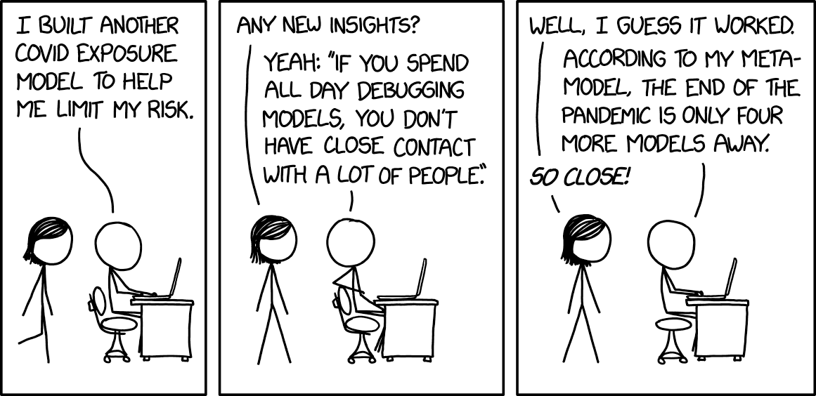
Notes from the 0900 & Internal
FESS reports that the boiler flow switch was replaced (as scheduled)
We have a back-up again
AC Technicians at NML Thursday
Findings?

Slide 4
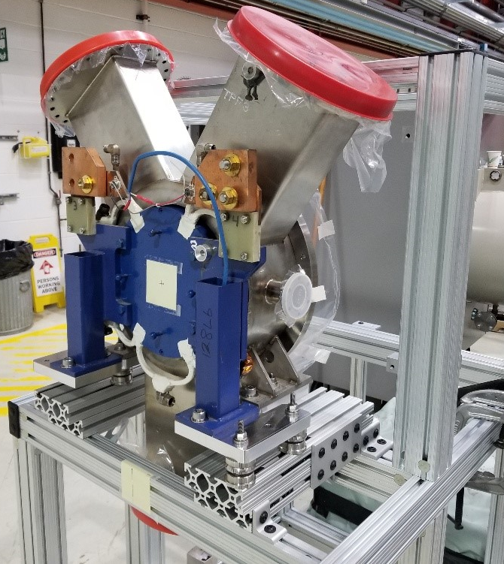
IOTA Proton Injector Beamline
The Y-Chamber and LEBT Solenoid #1 are mounted
Need the upstream LEBT spool
Leak check progress?
Next steps:
Assemble the source
Leak Check the full assembly
Complete HV cabinet**
Coat and activate another cathode
Plug it in and turn it on…
EPICS interface for BPM & LLRF systems
Need final beamsheet for MEBT stand design

Slide 5
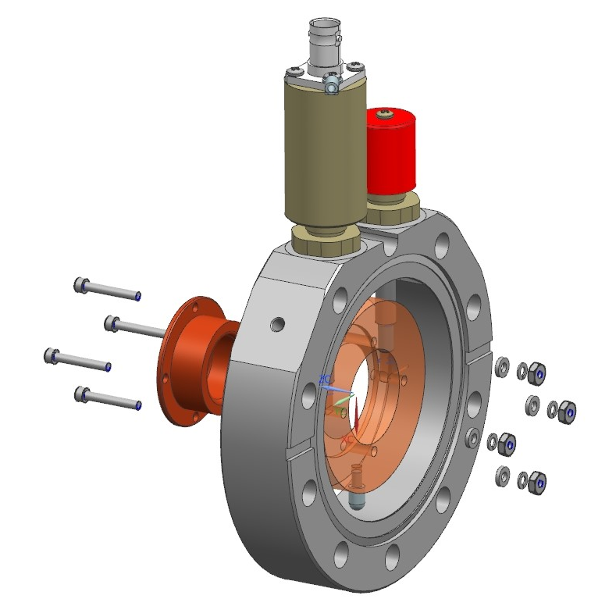
IOTA Proton Injector Beamline
Physical components still needed:
325 MHz LLRF System
Euclid Techlabs
BPM Assemblies (5x) and associated electronics
Instrumentation Technologies
Electrically Isolated Diaphragm (LEBT)
Design complete (Andrea Saewert & Steve Wesseln)
4-Channel bias / current draw measurement chassis
Working on it (Andrea & Vic)
5-6 kW 325 MHz amplifier for the Buncher
John & Ding are looking into it
MEBT Wires
To be borrowed from PIP-II IT
LEBT/MEBT Allison Scanners
To be borrowed from PIP-II IT
Electrical work / cable pulls
NML Gallery Electrical Contract
NML-MEBT & ESB-MEBT cable pull / Source area Electrical

