Slide 1
DC Voltage Breakdown Studies
By: Logan Norman, Karla Silva, Ben Jones

Slide 2
Townsend Criterion/First Ionization Coefficient
Townsend’s First Ionization Coefficient
Townsend’s Breakdown Criterion
$$ⅇ^{αd}=1+\frac{1}{γ_{se}}$$
$$α=Apⅇ^{−\frac{Bp}{E}}$$
A,B = Empirical Constants based on gas properties
α represents the amount of ionization that is possible over a certain length, a common unit is cm⁻¹.
$γ_{se}$ is the secondary emission coefficient and represents the number of electrons that are excited off the electrode surface and is directly related to the work function of the metal and the surrounding gas
A. M. Howatson,An introduction to gas discharges,eng, [1st ed.]., The Commonwealth and internationallibrary. Applied electricity and electronics division ; v.8 (Pergamon Press, Oxford).

Slide 3
Paschen’s Law
$$V_{B}=\frac{Bpⅆ}{\ln\left(Apd\right)−ln\left(ln\left(1+\frac{1}{γ_{se}}\right)\right)}$$

Slide 4
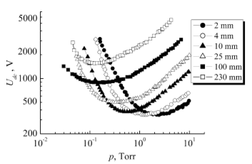
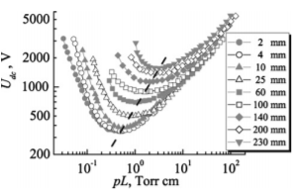
Paschen Curves
All Paschen curves are graphed against the pressure multiplied by the electrode distance (bottom)
This is because those two variables are multiplied by each other in the Paschen equation and are what usually varies, i.e. the independent variables
This creates a correlation in the minimums of the curves and aligns the curves
V. Lisovskiy, V. Koval, and V. Yegorenkov, “Dc break-down of low-pressure gas in long tubes”, Physics Let-ters A375, 1986–1989 (2011).

Slide 5
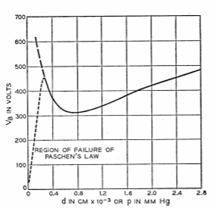
Failure of Paschen’s Law
From its creation Paschen’s law was only valid in a certain range
The law fails at higher pressures of gas as well as at very small electrode distance
Some have surmised this is due to the ionization of the gas which in turn modifies the electric field
W. S. Boyle and P. Kisliuk, “Departure from paschen’s law of breakdown in gases”, Phys. Rev.97, 255–259(1955).

Slide 6
Streamer Breakdown
J. E. Cooley,Fundamentals of undervoltage breakdown through the townsend mechanism(Princeton Univer-sity, 2008).

Slide 7
Streamer Breakdown
J. E. Cooley,Fundamentals of undervoltage breakdown through the townsend mechanism(Princeton Univer-sity, 2008).

Slide 8
Streamer Breakdown
J. E. Cooley,Fundamentals of undervoltage breakdown through the townsend mechanism(Princeton Univer-sity, 2008).

Slide 9
Meek-Raether Criterion
The meek-rather criterion states that a streamer is most likely to form when the “avalanche gain” reaches around 10^8
$$ⅇ^{αd}=1+\frac{1}{γ_{se}}$$
$$ⅇ^{αd}={10}^{8}$$
Meek-Raether
Breakdown Criterion
Townsend
Breakdown Criterion
J. M. Meek and J. D. Craggs,Electrical breakdown ofgases(1978).

Slide 10
Higher Pressure Experimentation
Papers and the theory do show that the breakdown generally follows the Paschen law at lower pd values
At intermediate pd values experimental curves generally follow the meek criterion
There is not many papers that cite the validity of the laws up and into the high-pressure region
We have characterized the high-pressure region and shown that Paschen’s Law is indeed inaccurate in this region

Slide 11
The Electrodes

Slide 12
Current Results in Argon
To the right is breakdown data that was all performed with Argon gas
The data ranges from mbar pressures to 10 bar
The electrode separation distances are .1 mm, 1 mm, 5 mm, 1 cm
The values obtained cover a large range of pd values utilizing the same setup, as intended

Slide 13
Theoretical Comparisons
The Paschen law is shown in blue on the graph to the right using accepted values for the A,B, and $γ_{se}$
The meek criterion is also shown in orange as well, with the separation between the two being constant at higher pressures
The data clearly follows a separate slope at higher pressures indicating an extension to the existing criterions/laws is necessary

Slide 14
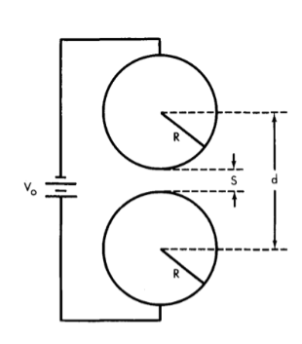
Enhancement factor
Calculated the field enhancement factor due to the spherical electrode geometry
This enhancement of the field is due to the spherical geometries we have used
Since we only used 1 cm maximum separation distance it only accounts for a maximum of 6% uncertainty in the electric field

Slide 15
Results in CO₂ and Argon
To the right is breakdown data that was all performed with Argon gas, pure CO₂, and a mixture of 10% CO₂ /90% Argon
The data ranges from mbar pressures to 10 bar
The electrode separation distances are 1 mm and 1 cm
This log scale is useful to see the trends the lines follow and is used as a standard in breakdown measurements

Slide 16
Linear Graph
To the right is the same graph as the previous slide but on a linear scale instead
The breakdown of pure CO₂ is about 5 times higher than Argon in most of the measurements and about 2-2.5 times the breakdown of the Argon- CO₂
It seems that the trend in breakdown of pure CO₂ will continue to diverge however, from the breakdown of Argon and the Argon-CO₂ mixture

Slide 17
Extrapolated Values
We were able to take Argon data all the way up to 1 cm at 10 bar, so we used this data to extrapolate the values of the other gases
We used the differences from the last slide while assuming they stay as linear as they had in the lower measurements
This puts the breakdown of pure CO2 at 1 cm gap distance and 10 bar around 210,000 Volts with some uncertainty of course

Slide 18
Summary
Paschen’s Law evaluated from Townsend Breakdown Criterion
Valid for a certain range only, lower pressures
It is suggested that Meek-Raether criterion for breakdown is the dominant mechanism at higher pressures
Further study has gone into the high-pressure region and more is still needed to understand the transition region and possibly other mechanisms taking place at high pressures
The CO2 studies show that pure CO2 is five times larger than Argon and 2.5 times larger than the Argon-CO2 mixture

Slide 19
The End
Thank you for listening,
Any Questions?

Slide 20
References
1 J. E. Cooley,Fundamentals of undervoltage breakdownthrough the townsend mechanism(Princeton Univer-sity, 2008).
2 V. Lisovskiy, S. Yakovin, and V. Yegorenkov, “Low-pressure gas breakdown in uniform dc electric field”,Journal of Physics D: Applied Physics33, 2722 (2000).
3 A. McDonald, K. Woodruff, B. Al Atoum, D.Gonz ́alez-Dıaz, B. Jones, C. Adams, V. ́Alvarez, L.Arazi, I. Arnquist, C. Azevedo, et al., “Electron driftand longitudinal diffusion in high pressure xenon-helium gas mixtures”, Journal of Instrumentation14,P08009 (2019).
4 W. S. Boyle and P. Kisliuk, “Departure from paschen’s law of breakdown in gases”, Phys. Rev.97, 255–259(1955).
5 H. S. Uhm, E. H. Choi, and G. Cho, “Breakdown prop-erties of high-pressure electrical discharge”, Physics ofPlasmas7, 2744–2746 (2000).
6 V. Lisovskii and S. Yakovin, “A modified paschen law for the initiation of a dc glow discharge in inert gases”,Technical Physics45, 727–731 (2000).
7 V. Lisovskiy, V. Koval, and V. Yegorenkov, “Dc break-down of low-pressure gas in long tubes”, Physics Let-ters A375, 1986–1989 (2011).
8 M. E. Abdel-kader, W. H. Gaber, F. A. Ebrahim, and M. A. Abd Al-Halim, “Characterization of the electri-cal breakdown for dc discharge in ar-he gas mixture”,Vacuum169, 108922 (2019).
9 V. Lisovskiy, V. Derevianko, and V. Yegorenkov, “Dcbreakdown in low-pressure cf4”, Journal of Physics D:Applied Physics48, 475201 (2015).
10 P. Osmokrovic, M. Vujisic, K. Stankovic, A. Vasic,and B. Loncar, “Mechanism of electrical breakdownof gases for pressures from 10- 9 to 1 bar and inter-electrode gaps from 0.1 to 0.5 mm”, Plasma SourcesScience and Technology16, 643 (2007).
11 A. M. Howatson,An introduction to gas discharges,eng, [1st ed.]., The Commonwealth and internationallibrary. Applied electricity and electronics division ; v.8 (Pergamon Press, Oxford).

Slide 21
One Interesting Find
$$V_{B}=\frac{Bp^{k}ⅆ}{\ln\left(Apd\right)−ln\left(\ln\left(1+\frac{1}{γ_{se}}\right)\right)}$$
One of the papers we came across included this “quenching factor” k, to denote a secondary gas introduced to quench the breakdown, and it produces curves that line up with the data
P. Fonte, V. Peskov, and F. Sauli, “Feedback andbreakdown in parallel-plate chambers”, Nuclear In-struments and Methods in Physics Research SectionA: Accelerators, Spectrometers, Detectors and Associ-ated Equipment305, 91–110 (1991).

