Slide 1
Optical Link and Component Testing
Alan G. Prosser
Fermilab
Feb. 11, 2021

Slide 2
Project: To investigate the feasibility of implementing 10 Gbps optical links at LiAr Temperatures
Approach: Perform testing of COTS components at LiN temperatures to start.
Following earlier work by Southern Methodist University, we are beginning with
edge-emitting lasers (EELs) (which showed more promise in the tests carried out
about 10 years ago)
SMU is performing tests of VCSELs to see if recent devices perform better than did
those tested 10 years ago.
Agenda:
1. Give an overview of the testing setup to be utilized
2. Give some brief information on the kinds of information to be obtained from these tests
3. Illustrate some of the technology that has been developed/evaluated over the years
4. Outline some emerging technology that may be of interest (optical modulators)
Safety Approvals for Testing at Feynman Computing Center are being pursued (D. Christian, A. Prosser)

Slide 3
Basic Link Functional Verification
λ = 1310 nm
Single Mode
Optical
Fibers
Cold
Volume
In this configuration, the
bit error rate performance of
the uplink including the
Device Under Test (DUT)
within the cold volume
can be measured.
LC
Connectors
Reference Rx Device
Rx
Tx
Tx
Rx
COTS SFP+
Evaluation
Board
COTS SFP+
Evaluation
Board
SFP+ Transceiver
3.3 V DC
SFP+ Transceiver
This approach more faithfully
represents an upstream link
SMA
Connectors
Tx
Coax
cables
Rx
Tx
Rx
SMA
Connectors
Coax
cables
+
-
Tx
Rx
Pattern
Generator
(PRBS)
Error
Checker
BERTScope
Bit Error Rate
Tester

Slide 4
Complete Tx Characterization
Single Mode
Optical
Fibers
FC
Connector
λ = 1310 nm
Digital Signal
Analyzer
Cold
Volume
In this configuration, measure-
ments of the DUT Tx optical
signal can be obtained including:
1. OMA
2. Extinction Ratio
3. Eye Height
4. Rise and Fall Times
5. Deterministic Jitter
6. Total Jitter
Clock Reference
and Pattern
Synchronization
LC
Connectors
Tx
Rx
3.3 V DC
SFP+ Transceiver
SMA
Connectors
Tx
Rx
SMA
Connectors
+
-
Coax
cables
Tx
Rx
Pattern
Generator
(PRBS)
Error
Checker
BERTScope
Bit Error Rate
Tester
COTS SFP+
Evaluation
Board

Slide 5
Complete Rx Characterization
λ = 1310 nm
Single Mode
Optical
Fibers
Cold
Volume
In this configuration,
measurements of the DUT
Rx channel eye in the
cold can be made including:
Rise and fall times
Eye amplitude
Deterministic and total
jitter
LC
Connectors
Reference Tx Device
Tx
Rx
Tx
Rx
COTS SFP+
Evaluation
Board
SFP+ Transceiver
3.3 V DC
SFP+ Transceiver
SMA
Connectors
Rx
Tx
Tx
Rx
SMA
Connectors
Coax
cables
COTS SFP+
Evaluation
Board
+
-
BERTScope
Bit Error Rate Tester
Tx
Pattern
Generator
(PRBS)
Clock Reference
and Pattern
Synchronization
Digital Signal
Analyzer
Coax
cables

Slide 6
Rx Sensitivity
λ = 1310 nm
Single Mode
Optical
Fibers
FC
Connectors
JDSU Variable Optical
Attenuator (VOA)
Cold
Volume
In this configuration, the
bit error rate performance as
a function of the Optical
Modulation Amplitude
delivered to the DUT Rx port
(varied by introducing
optical impairment through
the VOA) will permit a measure-
ment of the DUT
Receiver Sensitivity in the
cold.
LC
Connectors
Tx
Rx
Tx
Rx
COTS SFP+
Evaluation
Board
SFP+ Transceiver
3.3 V DC
SFP+ Transceiver
SMA
Connectors
Rx
Tx
Tx
Rx
SMA
Connectors
Coax
cables
Coax
cables
COTS SFP+
Evaluation
Board
+
-
Rx
Tx
Pattern
Generator
(PRBS)
Error
Checker
BERTScope
Bit Error Rate
Tester

Slide 7
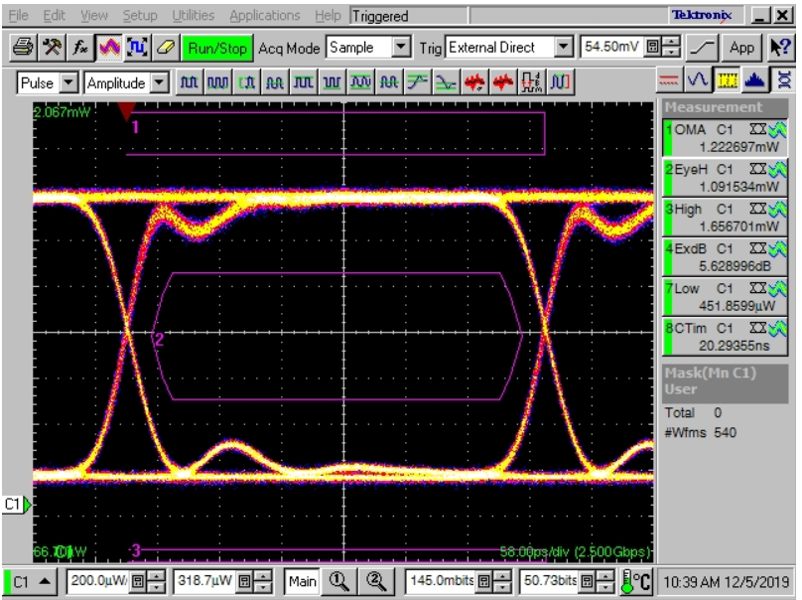
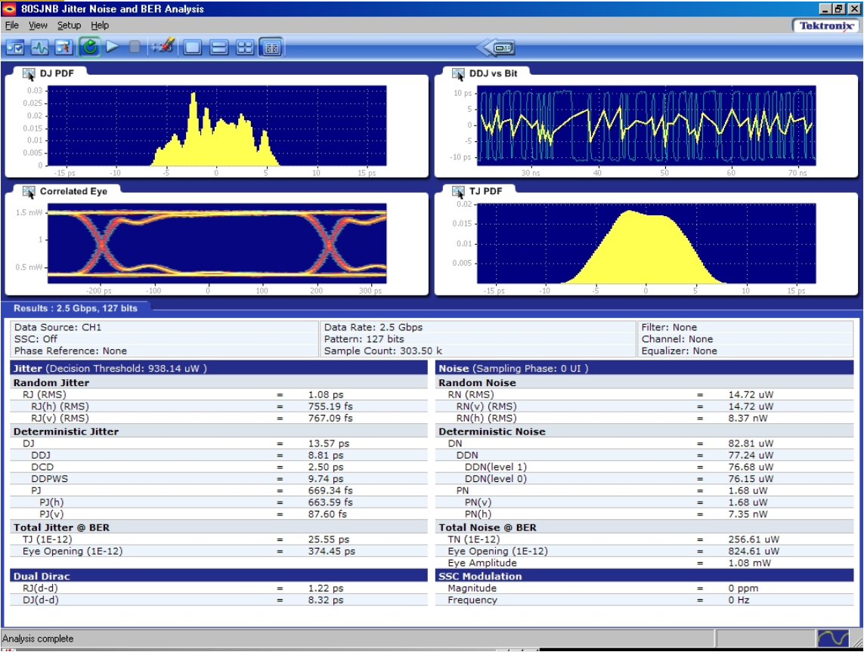
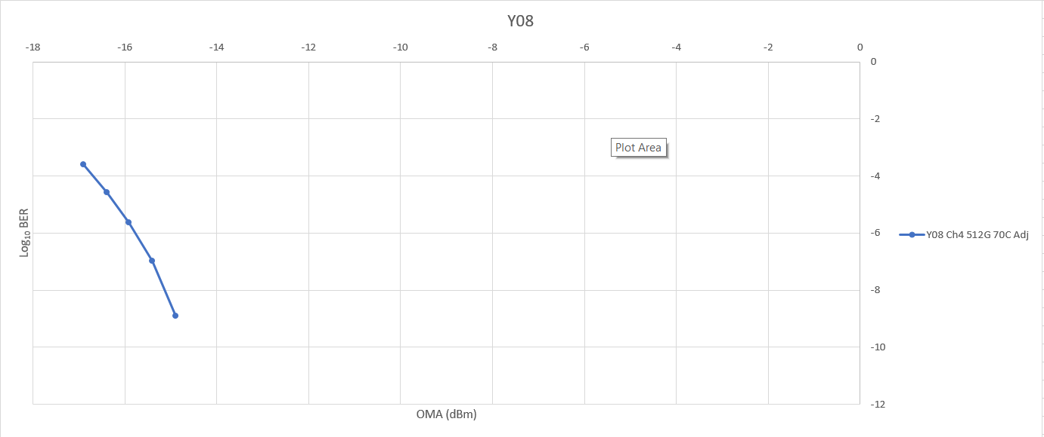
Eye Pattern Measurements (Optical and Electrical)
Jitter Composition Measurements (Optical and Electrical)
Rx Sensitivity
Measurements

Slide 8
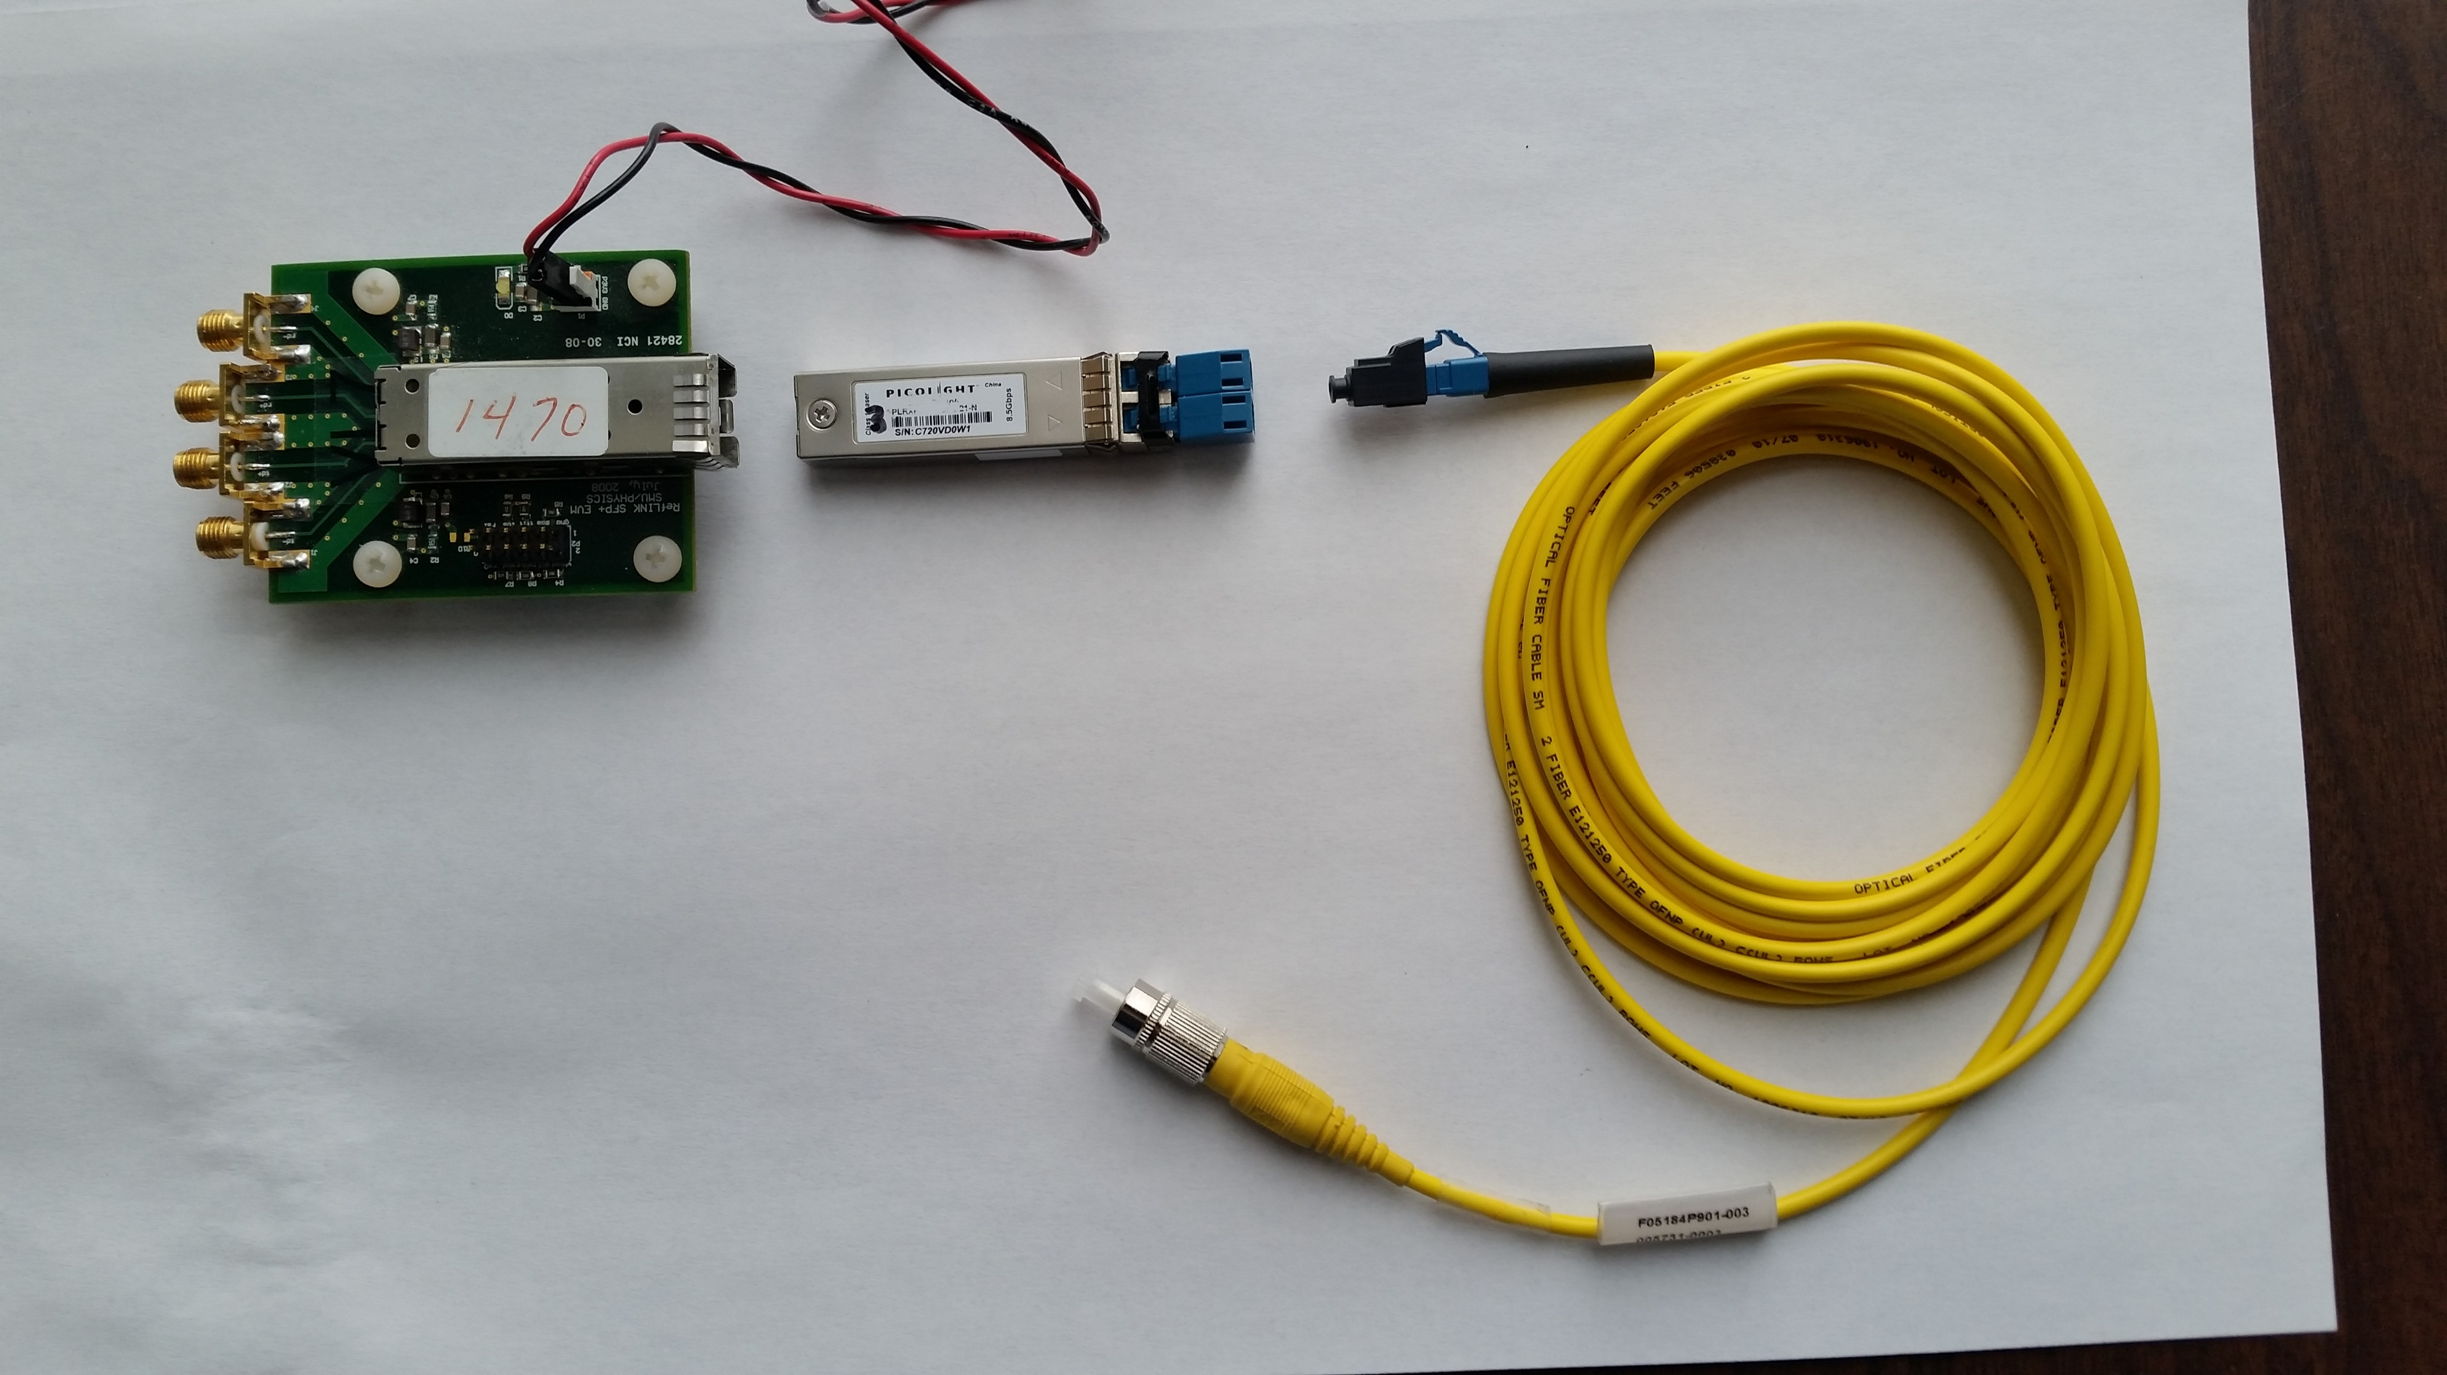
Hardware For First Tests at DUNE
LC Connector
SFP+ Module
Fiber Patch Cord
SFP+ Evaluation Board
1 Tx (transmitter)
1 Rx (receiver)
2 fibers with LC Connectors
10 Gbps capable
Multimode and Single Mode Variants
FC Connector

Slide 9
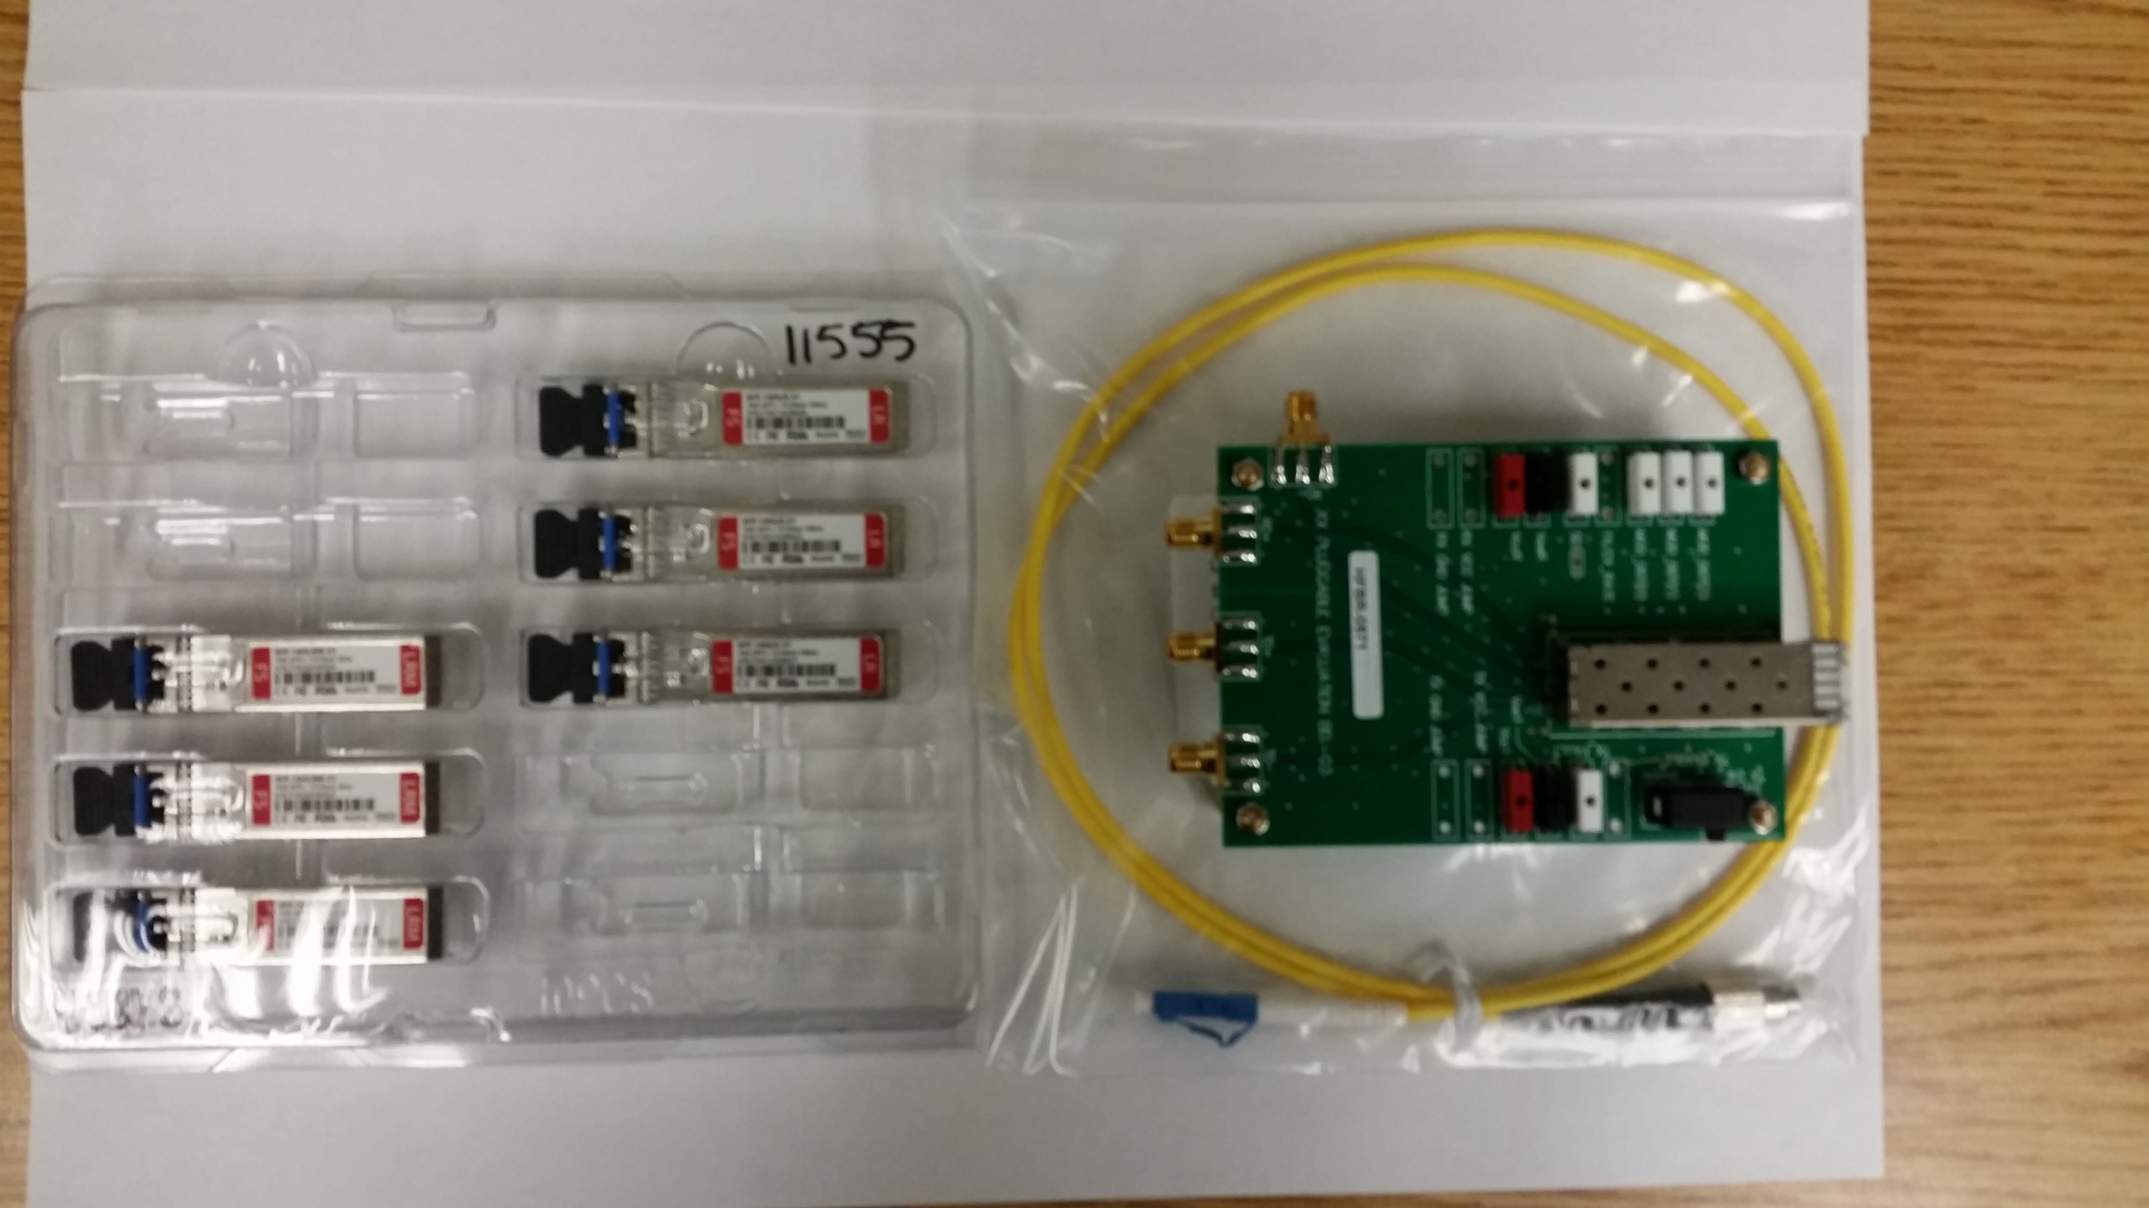
Hardware For First Tests at DUNE

Slide 10
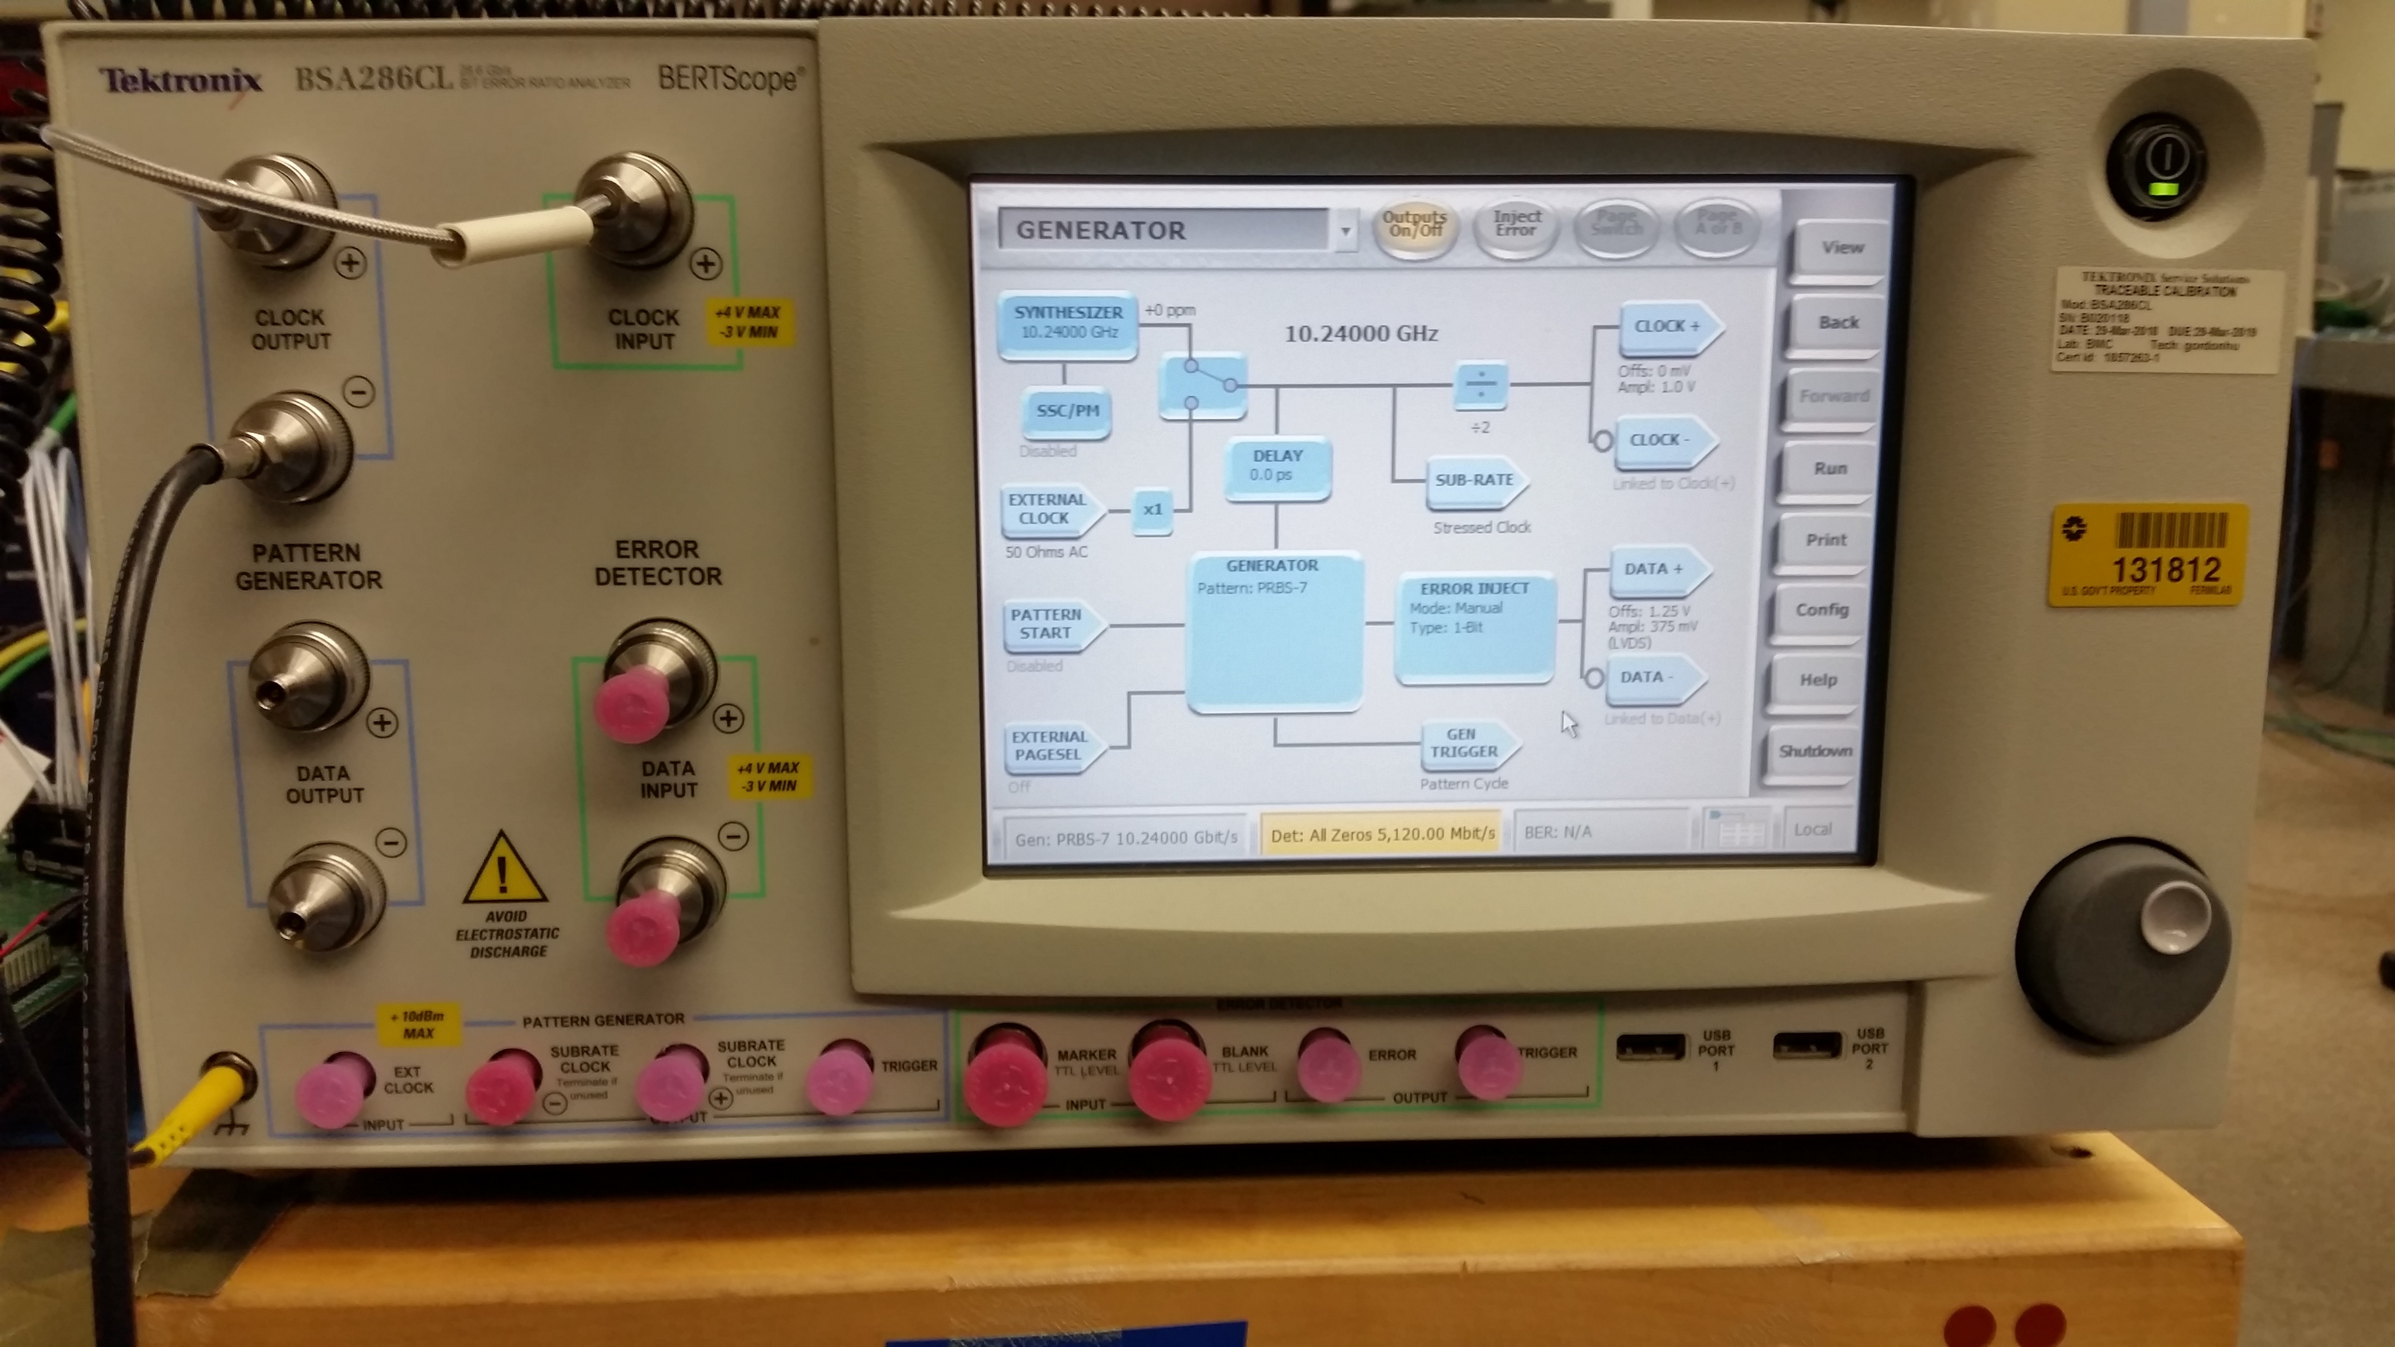
Test Equipment For First Tests at DUNE
Alan will perform checkout of the system and components starting today or tomorrow.

Slide 11
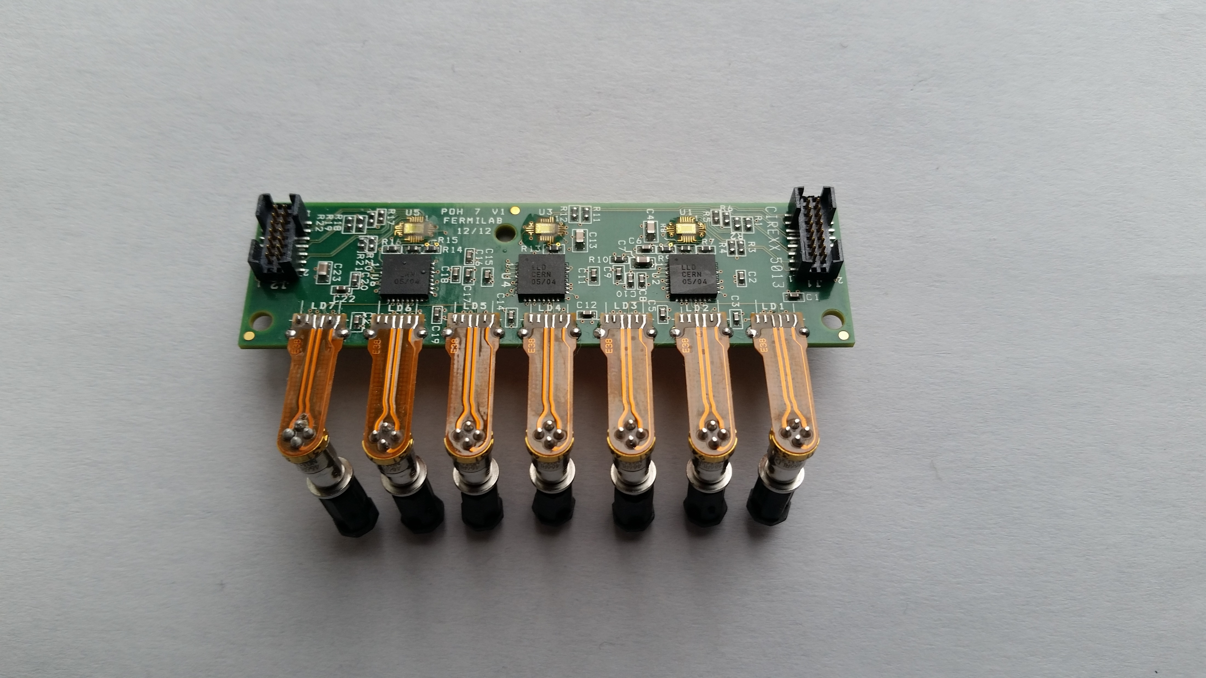
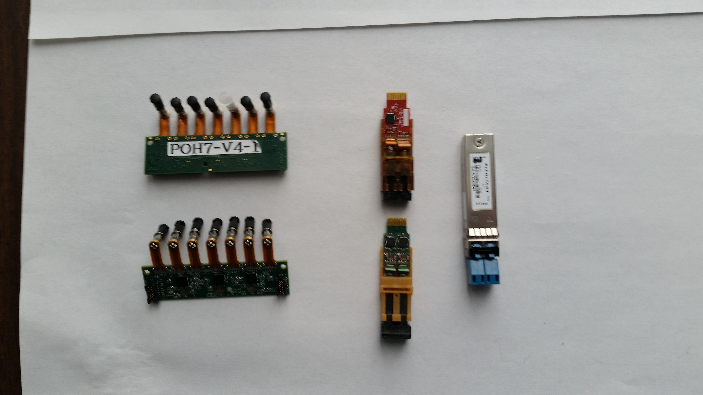
Some Single Channel Technology
Mitsubishi 1310 nm
Transmitter Optical SubAssembly (TOSA)
(COTS)
CERN VTRx
Rad Hard TRx
CERN/PSI/ETH/FNAL
Pixel OptoHybrid (POH 7Ch Tx)
CMS Phase 1 FPix
COTS SFP+
Digital Level Translator (DLT)
(Custom)
Multi-Channel
Laser Driver
(Custom)
CERN VTTx
Rad Hard
Twin
Transmitter

Slide 12
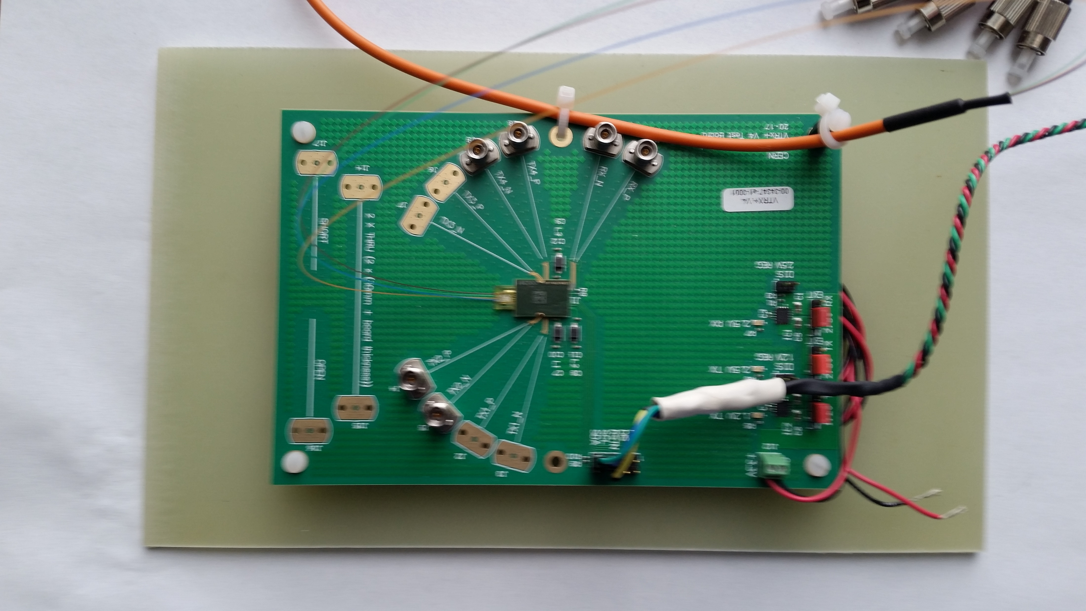
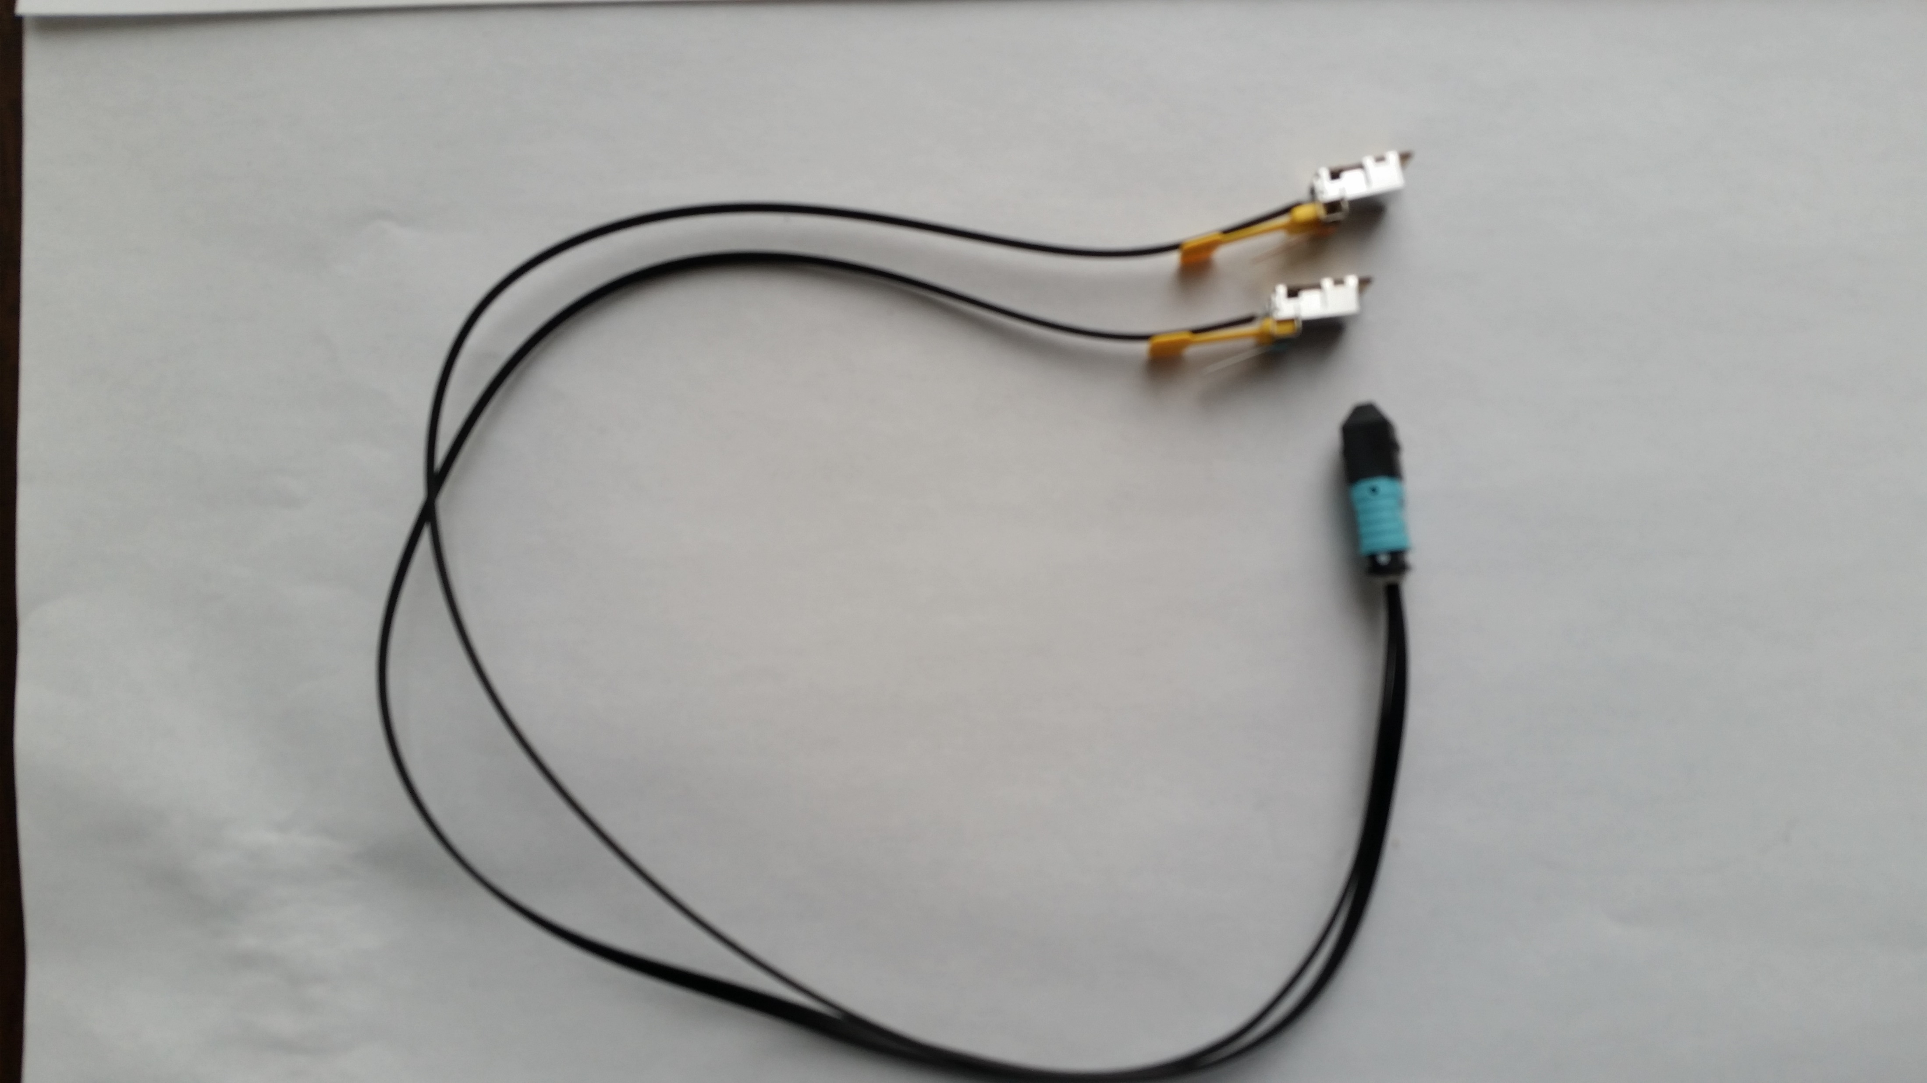
HL-LHC Components (Versatile Link Plus Project)
Back End Element (COTS*)
SAMTEC FireFly Tx/Rx Pair…
… with Y cable (terminates
in a single 24 fiber MTP connector)
Front End Element
(custom)
10.24 Gbps upstream
2.56 Gbps downstream
Early VTRx+ Prototype (Front End Element)
(This example has 2 transmitters, 1 receiver)
Devices and evaluation card from CERN
NOTE: This effort even involves the development
of custom optical packaging
14 Gbps

Slide 13
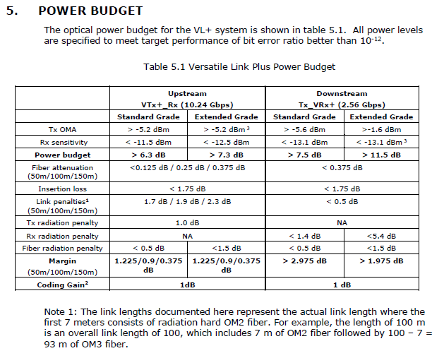
Reminder: An Optical Link is Very Much a System Concept

Slide 14
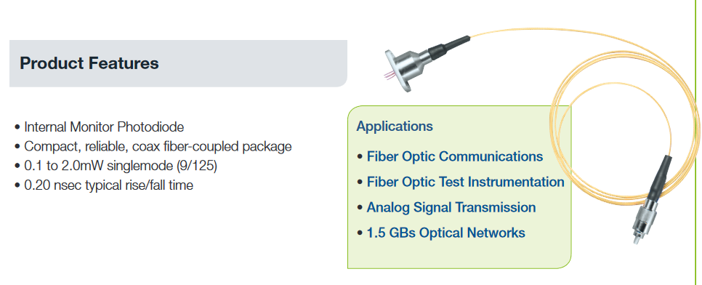
Analog Optical Data Communication
Yesterday, we heard from DarkSide on their plans to pursue an analog solution
The approach is founded on the desire to preserve the signal to noise ratio of the measured signals.
The link uses:
1. 1310 nm LED (wavelength is not a source of noise in LiAr)
2. 200 micron core diameter optical fiber (the numerical aperature in LiAr could be an issue for 9
micron core single mode fibers)
3. Photodiode and Transimpedance Amplifier on the outside
We are looking into components that might be useful for similar testing here at FNAL:

Slide 15
Some Evolving Technology
Direct Modulated Laser Diode systems are reaching the limits of performance
Indirect Modulated devices are in use already (Lithium Niobate Mach-Zehnder Modulators)
Newer devices are being investigated to combine the high-speed, low-power promise of indirect
modulation with Wavelength Division Multiplexing (WDM) for compact high throughput links
with enhanced utilization of fiber resources. These developments are part of the emerging
technology known as Silicon Photonics.

Slide 16
Some Evolving Technology – Example
Ring Resonator Modulators
This approach has
attracted interest
from members of the
community operating
in cryogenic environ-
ments.
No lasers on the
front end (low power)
Not without issues:
1. Thermal
dependence
2. Polarization
sensitivity
Multiple wavelengths
1 fiber (CW)

