Slide 1
DUNE Vertical Drift Photon Detector System
Baseline Module Sketch and Timeline
18 March 2021
Ryan Rivera

Slide 2
Baseline PDS Sketch
Datapath
Control
Distribution Boxes
Power
Assembly
PoF 1.0V, 2.5V, 3.3V
@ 5W
Sync Broadcast
(Clock/Trigger)
JTAG Broadcast
PoF 3.3V @ 10 mA
PoF 48V
ADC-0
xARAPUCA + SiPM
Amplifier Stage
ADC-1
FPGA
Control Rx
Optical Tx
Tile
ADC-2
Flash Memory
Tile Electronics Box

Slide 3
PoF Transmitter Infrastructure
For 48-60V, ..
2 cryostat feedthrough points:
8 branches of 40 tiles = 320 tiles
70mA per branch
1 branch copper line per tile
For 1V, 2.5, 3.3V,
20 cryostat feedthrough points:
80 branches of 4 tiles = 320 tiles
6 PoF fibers per tile
PoF Rack
cryostat
PPM-00350-3-4 W laser
YCH-L240 PPC
PoF 1.0V, 2.5V, 3.3V, 48-60V

Slide 4
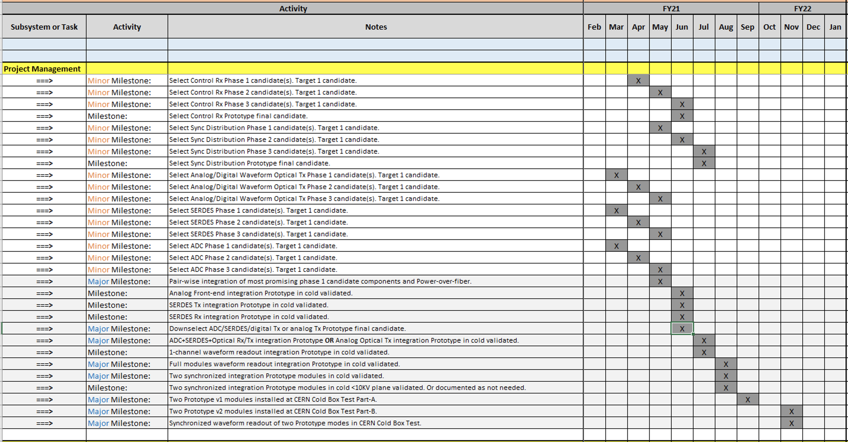
Milestone Timeline

