Slide 1
DUNE Cryogenic Optical Links
Dave Christian (FNAL)
Andy Liu (SMU)
Alan Prosser (FNAL)
Jingbo Ye (SMU)
March 17, 2021

Slide 2
Introduction
Initial testing has so far failed to produce an SFP+ module (either Tx channel or Rx channel)
that functions suitably when tested in LN2.
There is some indication that electronic issues are behind at least some of the failures.
Therefore, we propose to construct test hardware with selected components to try to
identify the sources of failures and to identify suitable components out of which a
custom CryoLink component might be produced.
FNAL will start with DFB-equipped TOSAs (modules with these performed best last week)
and laser drivers suitable for driving those TOSAs.
We are working with Southern Methodist University (Versatile Link partners) who add
valued knowledge and experience in this effort.

Slide 3
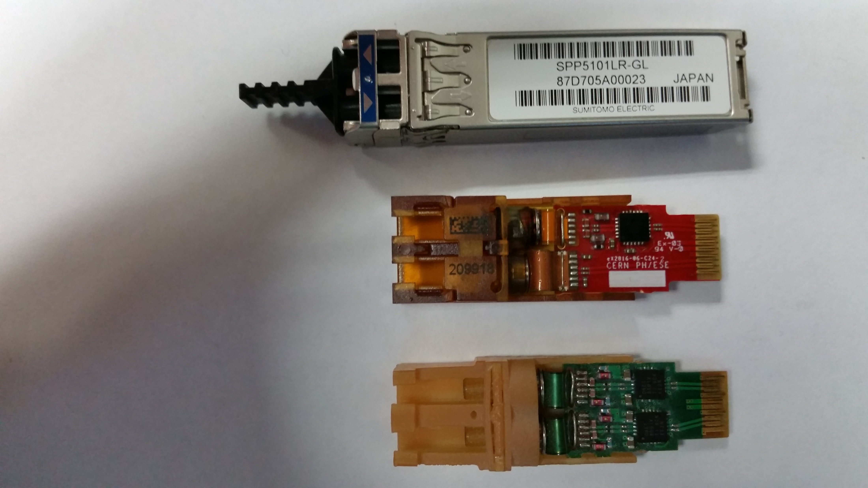
COTS SFP+
GBLD: GigaBit Laser Driver
GBTIA:
GigaBit TransImpedance
Amplifier
TOSA:
Transmitter Optical SubAssembly
ROSA: Receiver Optical SubAssembly
TOSA
Flexible Circuits
Versatile Link VTRx
Transceiver
GBLD
(Laser Driver ASIC)
Tx Connection (LC)
Rx Connection (LC)
ROSA (GBTIA Inside)
Flexible Circuits
GBLDs
Versatile Link VTTx
Twin Transmitter
TOSAs
Tx Connection (LC)
Tx Connection (LC)

Slide 4
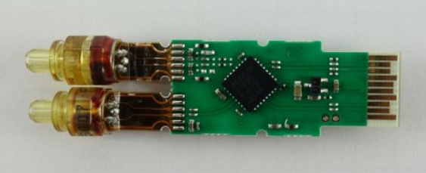
Tx Channel (side view with flexible circuit
allowed to be free)
TOSA
Latching design
may be
needed
Edge Connector Traces
Discretes
Laser Driver
Flexible Circuit
Printed Circuit Board
Solder (SMT Connection)
Strain relief for flexible circuit on each
channel?
Rx Channel (side view with flexible circuit
allowed to be free)
ROSA
Latching design
may be
needed
MicroController Unit (MCU)
Edge Connector Traces
Discretes
Limiting Amplifier
Flexible Circuit
Printed Circuit Board
Solder (SMT Connection)

Slide 5
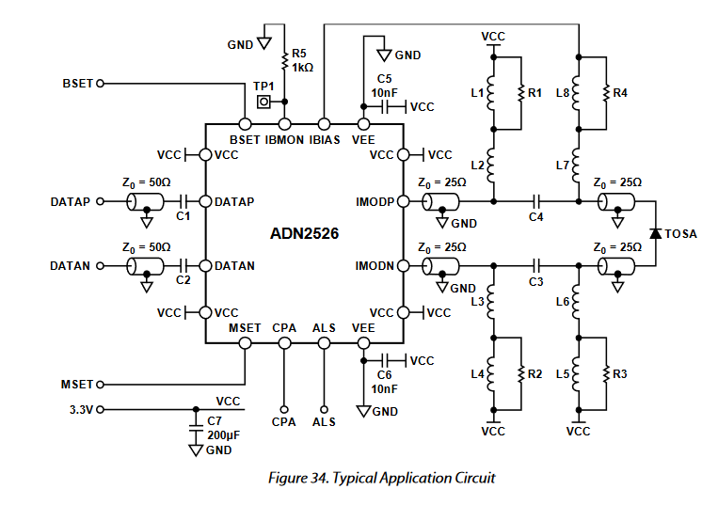
Simple Evaluation Board for Analog Devices ADN2526 Laser Diode Driver
Electrical Tests
All components will be
tested in LN2.
Power, configuration,
electrical excitation, and
electrical diagnostics
will be outside the dewar
Vibias_adj
SMA pair
SMA pair
Vimod_adj
Leave Cross Point Adjust and Automatic Laser Shutdown unconnected (50% cross point, laser enabled)

Slide 6
Simple Evaluation Board for Analog Devices ADN2526 Laser Diode Driver
Optical Tests
All components will be
tested in LN2.
Power, configuration,
electrical excitation, and
optical receiver will be
outside the dewar
Vibias_adj
TOSA Coupled to
Single Mode Fiber or
MultiMode Fiber
SMA pair
Vimod_adj
Leave Cross Point Adjust and Automatic Laser Shutdown unconnected (50% cross point, laser enabled)

Slide 7
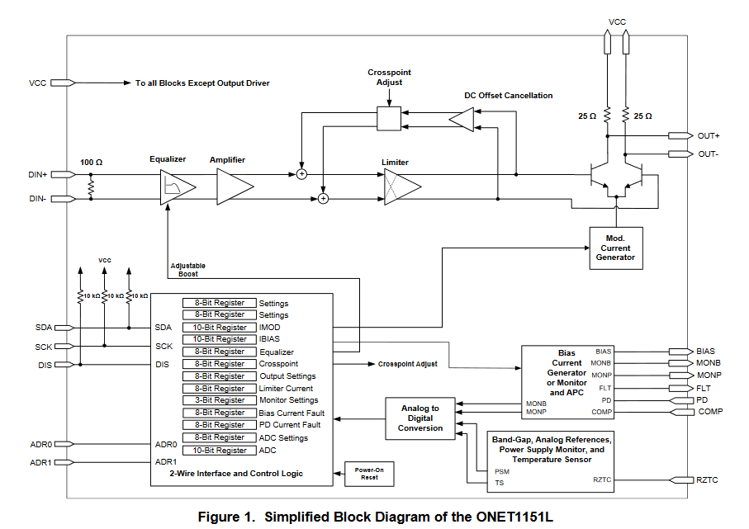
Texas Instruments ONET1151L Laser Diode Driver

Slide 8
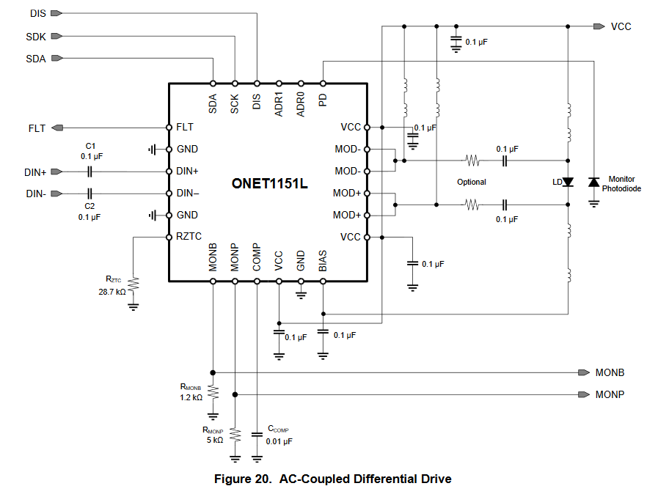
Texas Instruments ONET1151L PAB Test Circuit Proposal (Stage 1)
Optical Tests
Interface
To
I2C Dongle
Outside
Dewar
All components will be
tested in LN2.
Power, configuration (I2C
dongle), electrical excitation,
electrical monitoring, and
optical receiver will be
outside the dewar
SMA pair
TOSA Coupled to
Single Mode Fiber or
MultiMode Fiber
SMA
SMA
Leave DIS unconnected (laser enabled)

Slide 9
Texas Instruments ONET1151L PAB Test Circuit Proposal (Stage 2)
All components will be
tested in LN2.
Power, electrical excitation, and
and optical receiver will be
outside the dewar. FPGA to
configure laser driver will be in
the dewar.
Interface
To
CryoFPGA
SMA pair
TOSA Coupled to
Single Mode Fiber or
MultiMode Fiber
Interface
To
CryoFPGA

Slide 10
Summary
FNAL and SMU will jointly investigate technologies out of which suitable CryoLink (CL)
transmitter and receiver channels may be developed.
SMU will test TOSAs and ROSAs (including VCSEL-based TOSAs).
SMU has earlier experience with LOCld (custom laser driver) and Cyclone III FPGA in
LN2.
FNAL and SMU will jointly develop custom CL Tx/Rx as necessary (if COTS modules
cannot be verified in LN2).

