Slide 1
NuComp News
Lee Lueking
September 14, 2011

Slide 2
Outline
Maintenance day stuff
IF Computing Resource Summary
A look at FY12 Requests

Slide 3
Maintenance Day: Tomorrow 9/15
The following systems will be rebooted for new kernel:
GPCF024, DBWEB3 MNVNEARLINE3, MNVNEARLINE4 MBDATA01, MBDB02 MINOS-MYSQL2, MINOS-SAM02 MIPPDBSRV01, MIPPDBSRV02 NUDATA03, NUDATA04
FermiGrid expects to do a VDT upgrade on all three GP Grid gatekeepers on the Sep. 15 downtime. This is the last feature addition release of vdt 2.0.0 although there may be further patches. Expected downtime 1.5 hours. Running jobs won't be disturbed due to this work. New job submissions during the downtime will not start until after the work is completed.

Slide 4
Maintenance Day Next Week, and Next Month
Thursday 9/22, 8-10AM. Transitioning to use the new BlueArc storage space. This will affect the following areas:
/minerva/data
/mu2e/app
/minerva/app
/nusoft/app
/lbne/app
/microboone/app
/gm2/app
If these areas are used during the scheduled downtime, a stale mount may result. In some cases rebooting the affected machine(s) may be required. Jobs running on GP grid cluster are also affected and it is best to not have jobs running that employ any of these areas during this period. Condor queues will be drained Wed. night.
Next Month 10/20: IF/GPCF/MINOS/MB reboots for new kernel

Slide 5
SLF4 Demise, and SLF6 Readiness
SLF4 will no longer be supported after Feb. 2, 2012
SLF6 is close to being ready for full deployment.
(more details from Jason)

Slide 6
IFront Computing Resource Summary
Central Storage
GPCF
GP Grid Cluster

Slide 7
Central Disk (BlueArc) Allocations
 | 2009 | 2010 | 2011 (replace) | 2012 request
MiniBooNE | P80 | 30 | P25 (+13) | 0
MINOS | P90 | P30 | P30 (P30+30) | P30(+50)*
MINERvA | P10 | P20 | P40+P70* | 40
Argoneut | P20 | 0 | 0 | 0
NOvA | P4 | P26 | P30 | 100
MicroBooNE | P2 | 0 | P5 | 30
LBNE (all) | 0 | P2 | P10+P10 | 0
Mu2e | 0 | P2 | P2 | 0
g minus 2 | 0 | 0 | P10 | 0
Psatisfied
Pin-hand
* FY12 buy-ahead

Slide 8
Disk Usage Trends (1/3)
/app
/data
All
/argoneut
/gm2

Slide 9
Disk Usage Trends (2/3)
/app
/data
/lbne
/minerva
/minos

Slide 10
Disk Usage Trends (3/3)
/app
/data
/mu2e
/nova
/microboone
/miniboone

Slide 11
Experiment Assignment to Disk Pools
FY11 purchase
(175 TB)
FY11
Purchase
(+86 TB)
9/22 Minerva move
Includes app + data areas

Slide 12
GPCF Status
 | Int. Login status | Comments | Local Batch
ArgoNeuT | 1 VM |  | Jobs submitted through gpsn01 Currently 7 worker nodes: 48 x 2GB slots 18 x 4GB slots On deck: gpcf026,30,31,32.
gm2 | 1 VM
LBNE | 1 VMs
MicroBooNE | 2 VM
MINERvA | If01-if05 3 VM
MiniBooNE | (not assigned)
MINOS | Minos50-54 1VM (for testing)
Mu2e | 2 VM
NOvA | 5 VM 2 x gpcf nodes

Slide 13
Ganglia Stats
Linked from https://cdcvs.fnal.gov/redmine/projects/ifront/wiki/Monitoring_Stats
Under https://fefganglia.fnal.gov/

Slide 14
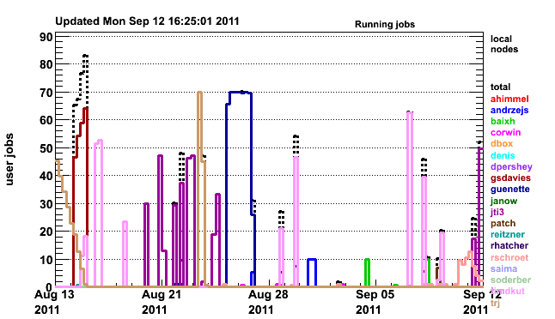
Batch Jobs gpsn01 Cluster
http://gpsn01.fnal.gov/condor_monitor/index_month_grid.html
70 total slots

Slide 15
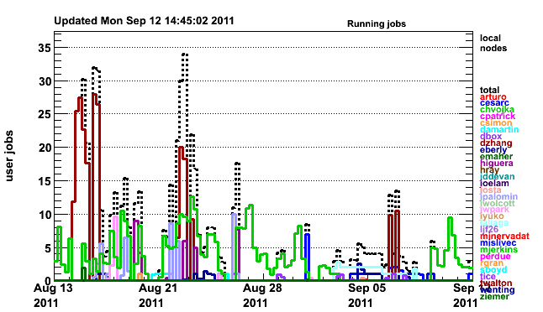
Batch Jobs on if01 Cluster
http://if01.fnal.gov:8080/condor_monitoring/index_month_local.html
30 total slots

Slide 16
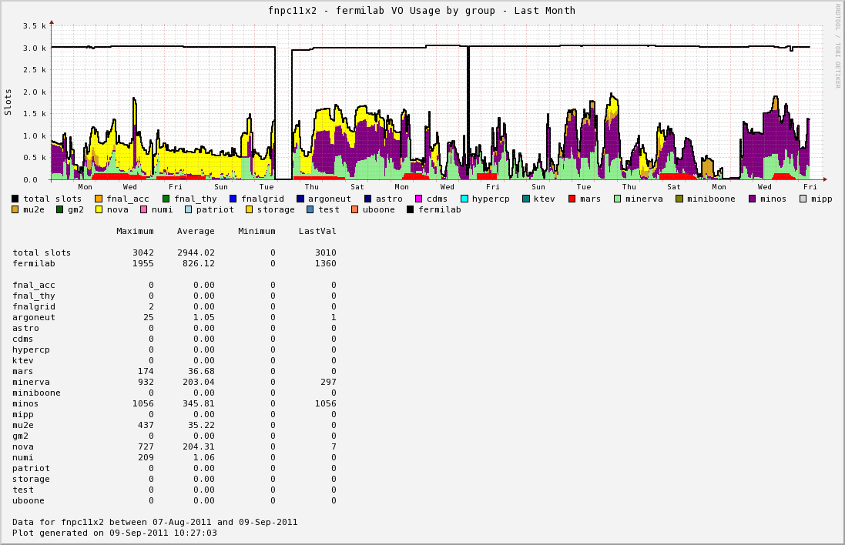
GP Grid Cluster Use; Last Month

Slide 17
FY12 Needs
The numbers
Notes and thoughts

Slide 18
A Look at the FY12 Needs Based on planning Spreadsheet
Experiment | Disk (TB) | Tape (TB) | Int. Login (4 core/VM) | Local Batch (cores) | GRID (cores) | Servers
MINOS | 0* (30) | 100 | 0 | 0 | 0 | 0* (3)
NOvA | 100 | 300 | 5 | 20 | 300 | 0
MINERvA | 40 | 50 | 5 | 20 | 200 | 0* (3)
Mu2e | 5 | 0 | 0 | 0 | 30 | 0
LBNE | 10 | 0 | 4 | 20 | 50 | 0
MicroBooNE | 23 | 50 | 0 | 20 | 0 | 0
ArgoNeuT | 0 | 0 | 0 | 0 | 0 | 0
MiniBooNE | 15 | 100 | 0 | 0 | 0 | 0
Muon g - 2 | 0* (5) | 0 | 1 | 5 | 0 | 0
(replace) | (?) |  |  | 40 | 286
TOTAL | 193 | 600 | 15 | 125 | 866 | 0
TOTAL Cost | $k | $k | $k | $k | $k | $k
* Items pre-purchased in FY11
with the requested quantity in ().

Slide 19
FY12 Needs: Notes
There was significant disk (150TB) purchased in FY11that was a “pre-buy” for FY12.
Covers MINOS needs for FY12,13.
Provides Minerva an additional 70TB “cushion”.
It appears that disk prices for FY12 may be significantly lower than FY11 ($350/TB vs. $800/TB). This may give us some flexibility:
Pre-buy portion of FY13 (FY13 total estimate is 320TB).
Provide additional storage for experiments.
Use disk archiving instead of tape.
Assumptions for Local Batch cores,
We are retiring/repurposing IF nodes,
Doubling capacity of the Local Batch
GP Grid resources released from Run II may be sufficient to meet most of our needs.

Slide 20
October NuComp

Slide 21
October NuComp
October 12 (or 19)
(We could consider a new day/time if needed.)
Topics
Condor DAGs- Submitting and running Directed Acyclic Graph jobs – Rick Snider
GPCF v 2.0 – plans for moving & reorganizing GPCF– Jason Allen
IF Beam Data – Status report on IF Beam Data Project – Igor Mandrichenko, Andrew Norman
gridFTP service – Globus Online Integrated with glideinWMS - Parag Mhashilkar, Dennis Box

Slide 22
finish

Slide 23
Short Term Plans

Slide 24
GPCF
Replace existing worker nodes (7 nodes) with “farm” type nodes. Increase number of WN’s as needed.
Increase number of VM host nodes with existing (7 worker + 4 unused) gpcf nodes.

Slide 25
Miscellaneous Servers
General-IF-DB server plan
General purpose for conditions data, ECL, etc.
Three large, 16 core, 64GB Memory, 2TB data disk
Dev: Develop and test applications
Prod: Production service
Farm Replica: Replica for scaling to farm clients.
Both MySQL and PostgresSQL instances
Independent “clusters” for each experiment
MINERvA: One event display machine, one VM server.

