Slide 1
TSIB HPT Lab Introduction and Overview
Frederique Pellemoine
TSIB HPT Lab Conceptual Design Review
01 April 2021

Slide 2
Scope of the Review
The intent of this review is to consolidate the concept of the High Power Targetry Lab with the priority on the design features that affect the construction design
Concrete walls and shielding
Safety features
Nonradioactive features and radioprotection features
Ventilation
Functionality of the lab
Layout, scopes, workflow
size of the hot cell suite

Slide 3
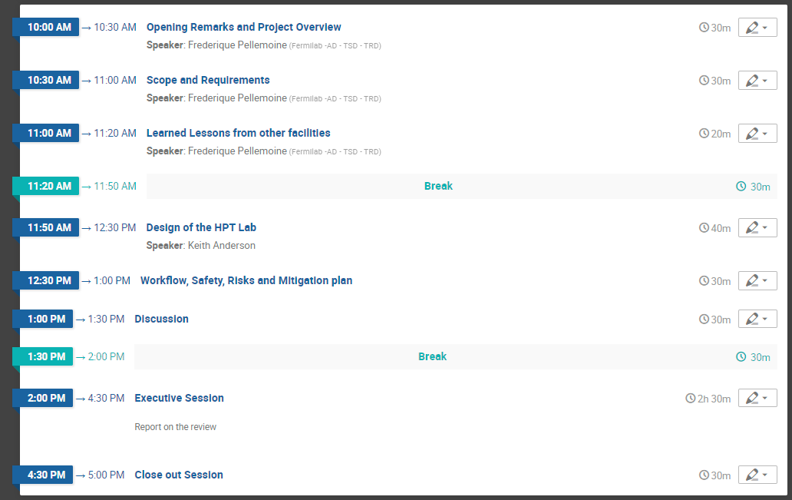
Agenda

Slide 4
Charge Questions
1/ Have the scope and requirements for the HPT Lab been adequately identified for this stage of the project?
Scope and Requirements presentation
Scope and requirements draft document
2/ Have the risks for operation of the HPT Lab been adequately identified for this stage of the project?
Workflow, Safety, Hazards and mitigation plan presentation
Workflow document
Scope and requirements document (for Hazards and mitigation plan)
3/ Does the conceptual design (and associated documents) presented satisfy the scope/requirements and adequately address the risks?
Design presentation
4/ Does the conceptual design reflect current best practices and incorporate lessons learned from other similar facilities?
Lessons Learned presentation
Charge 1
Charge 2
Charge 3
Charge 4

Slide 5
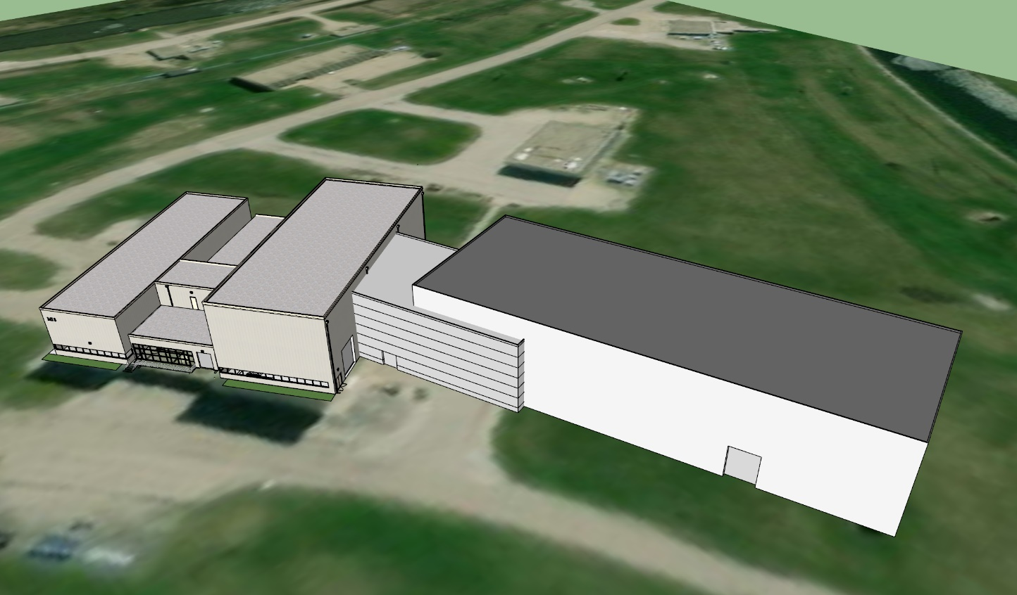
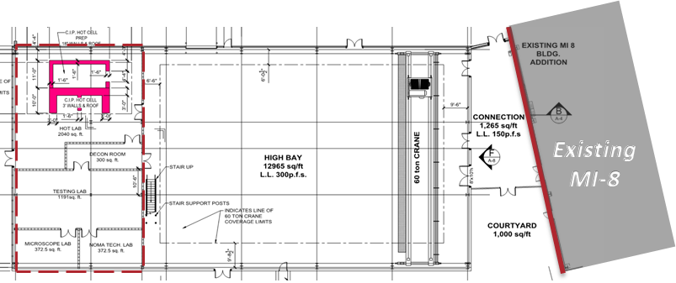
TSIB | Target Systems Integration Building
MI-8 is unable to accommodate the existing horn needs concurrent with an accelerated LBNF schedule, additional high bay space is needed to meet production capacity that are expected to double
Highbay: support area for Targetry component production and inspection
Mezzanine: LBNF Horn Component Storage and Remote Handling & Robotics Lab Area
High Power Targetry (HPT Lab)
Current MI-8 Building
New TSIB Building
HPT Lab
Mezzanine
Highbay
Conceptual Massing Study of TSIB addition to existing MI-8 Service Building, March 2020

Slide 6
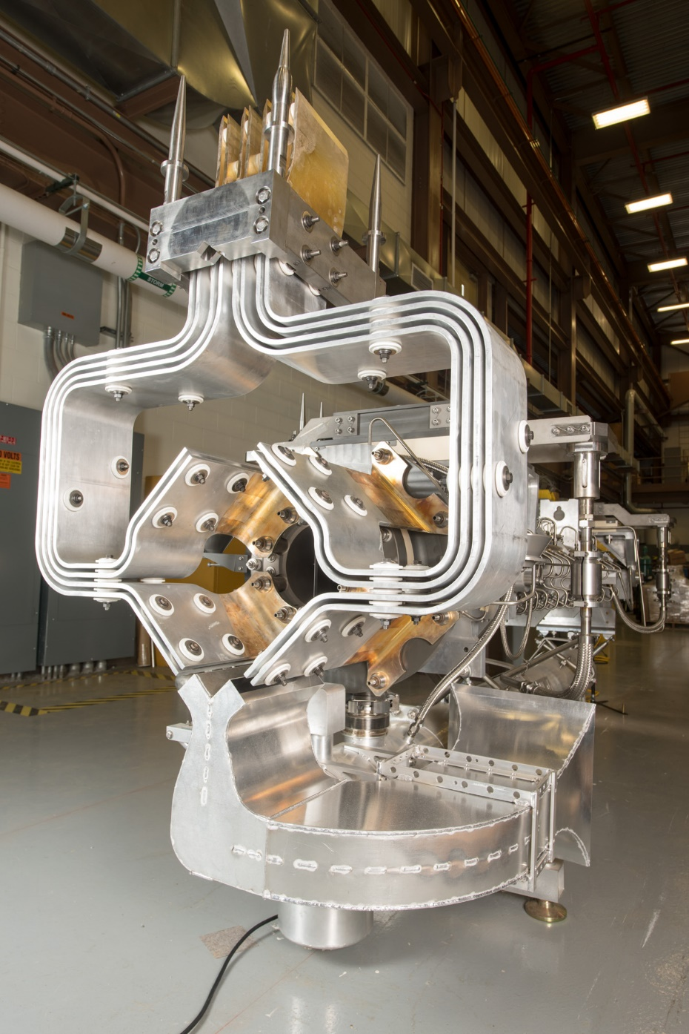
Impact of Accelerated LBNF Schedule
REMINDER: from HEP presentation in March 2020
Existing future experiment schedules require additional space / capacity by October 2025.
If LBNF schedule is accelerated, then demand for additional space & capacity will also need to be accelerated.
Current MI-8 facility is unable to accommodate the existing horn needs concurrent with an accelerated LBNF schedule.
LBNF risks losing a competitive advantage if delayed.
A. Federowicz | TSIB FSO Presentation

Slide 7
Impact of Accelerated LBNF Schedule
REMINDER: from HEP presentation in March 2020
Existing future experiment schedules require additional space / capacity by October 2025.
If LBNF schedule is accelerated, then demand for additional space & capacity will also need to be accelerated.
As of Jan 2021, the accelerated LBNF schedule is affirmed
Current MI-8 facility is unable to accommodate the existing horn needs concurrent with an accelerated LBNF schedule.
LBNF risks losing a competitive advantage if delayed.
A. Federowicz | TSIB FSO Presentation

Slide 8
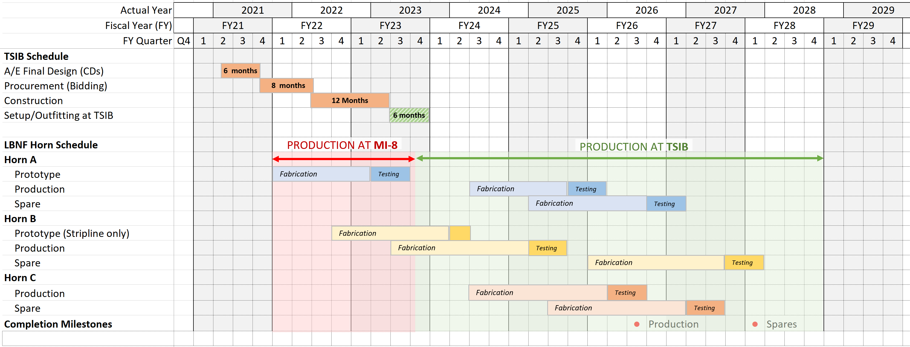
TSIB Integrated Schedule
At MI-8 and TSIB
AT RISK
AT RISK
January 2023
Beneficial Occupancy
October 2023
Deadline to start LBNF Horn production at TSIB
Assumes A/E Final Design Starts Q2 FY21 February 2021
2-month delay
*At this time, setup/outfitting activities at TSIB need to start
*At this time, MI-8 is operating at capacity, unable to produce LBNF Horn’s A, B, and C concurrently as scheduled.

Slide 9
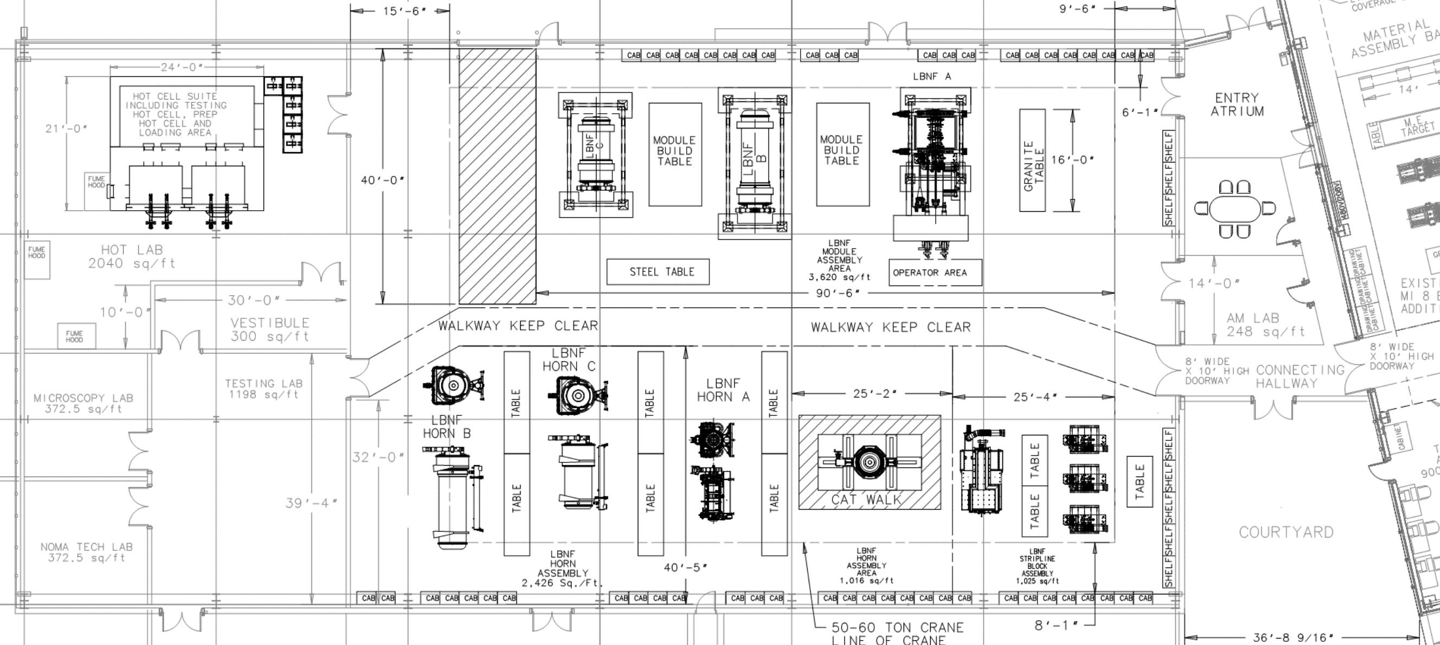
PROJECT SCOPE
Contingency Spend Down VS. Funded off Project
EXIST. MI-8
Contingency Spend Down
Funded by TSIB GPP (as risk is retired)
Steel Tables
Scaffolding
Telemanipulators
Pb-glass Windows
Small Passthroughs
Large Passthrough
Fume Hood
Not pictured:
Sampling & Storage System
Portable Jib Crane
Horn Transport Carts
Remote Vision System
Vestibule storage cabinets
Shelving rack
CONNECTOR/
ENTRANCE
HIGHBAY
HPT LAB
Module Assembly
Funded off project (LBNF and AD Operations)

Slide 10
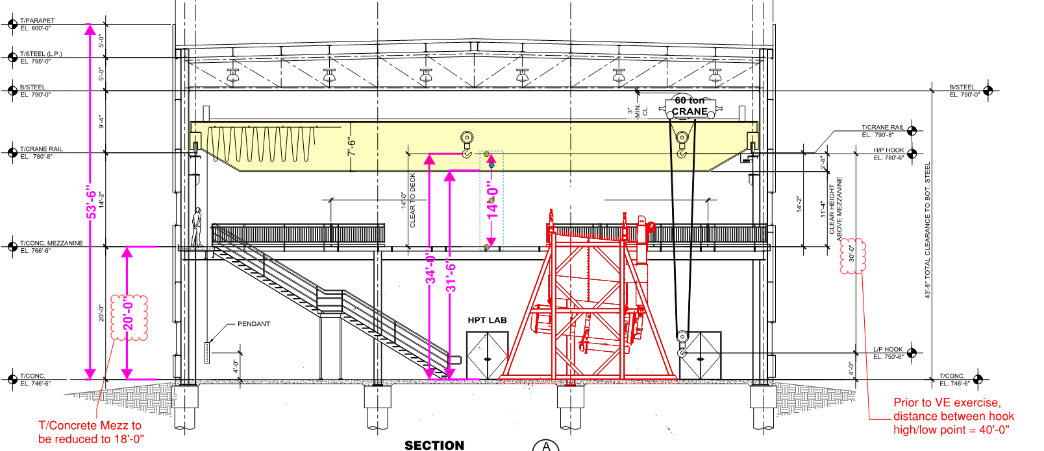
Conceptual Development
Reduced Height = 53’-6”
(10’-0” shorter than previous)
Method of horn construction changes allowing shorter building height
Outline of building section at 63’-6”

Slide 11
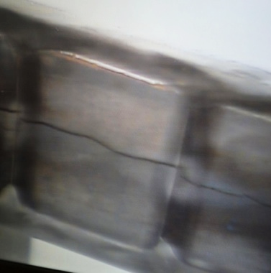
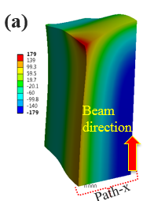
High Power Targetry (HPT) R&D is a Critical Need for HEP
Capability of High Power Targetry is critical for current and future accelerators as beam intensity and associated challenges increase.
R&D will enable high-power accelerator target facilities (e.g. LBNF/DUNE, PIP-II experiments, future HEP Program)
Recognized by HEPAP: “Realizing a multi-MW proton source to provide neutrino beam intensities at Fermilab beyond PIP-II project will require significant further R&D on targets and focusing systems, concentrated on tolerance of materials to radiation effects of intense beams.”*
RaDIATE collaboration (Radiation Damage In Accelerator Target Environments)
Fermilab founded in 2013 and acts as Program Coordinator
Fermilab’s HPT R&D Program supported by DOE OHEP General Accelerator R&D Program since 2012 (GARD)
Materials research has been the primary path of advancement
Radiation damage modification of material properties
Novel material development
Additional Challenges are:
Thermal Shock
Radiation Transport Simulation and Validation
Modeling to better predict target lifetime
Remote Handling
NuMI-MINOS target: cracked graphite fins
Stress Concentration
Accelerating Discovery," [Online]. Available: https://science.energy.gov/hep/hepap/reports/
Particle Physics Project Prioritization Panel (P5), "Building for discovery: Strategic Plan for U.S. Particle Physics in the Global Context," 2014.

Slide 12
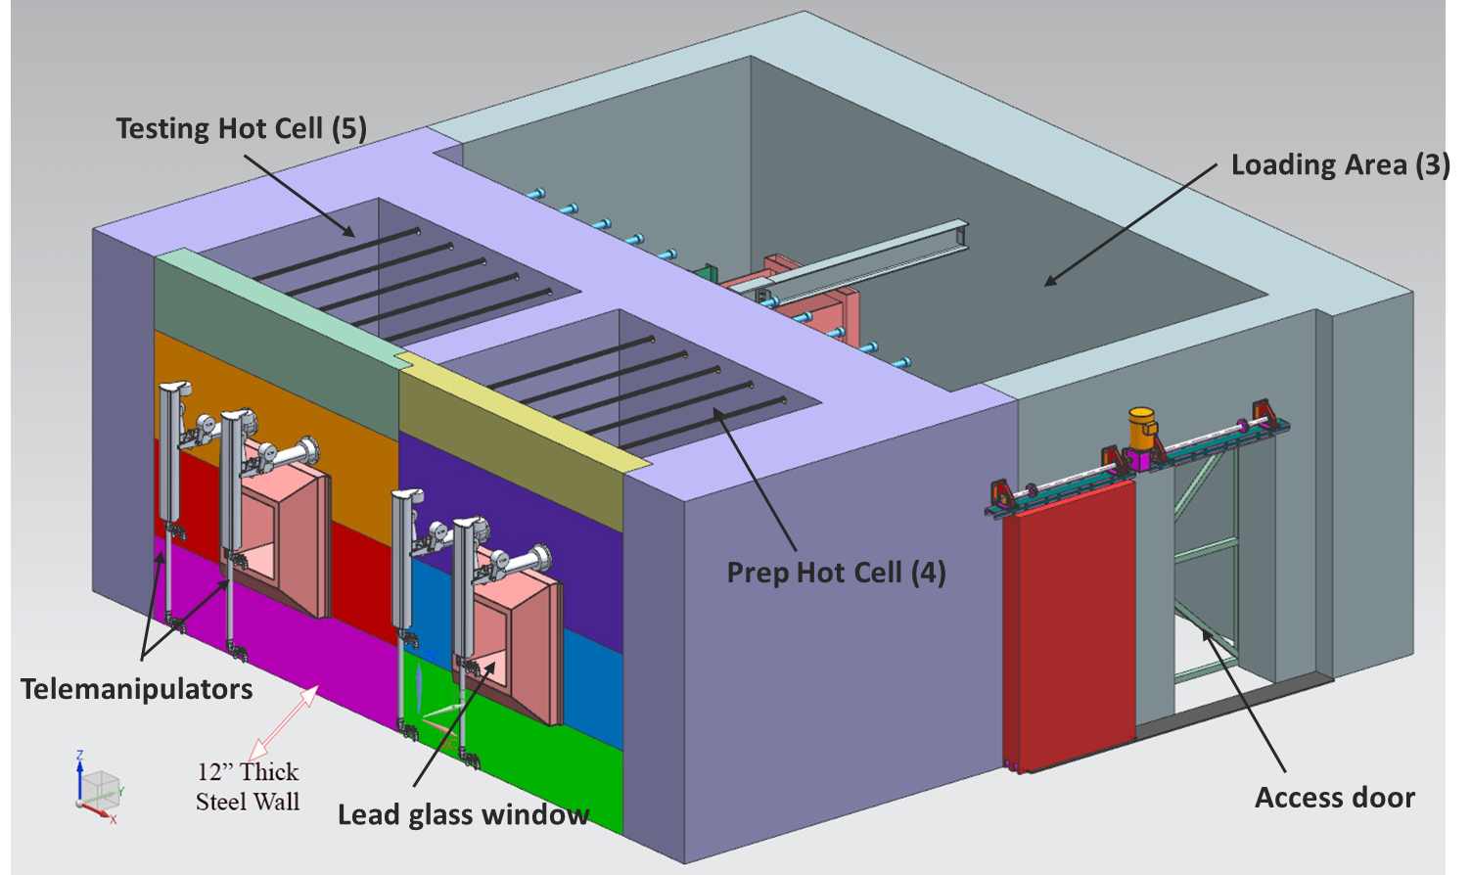
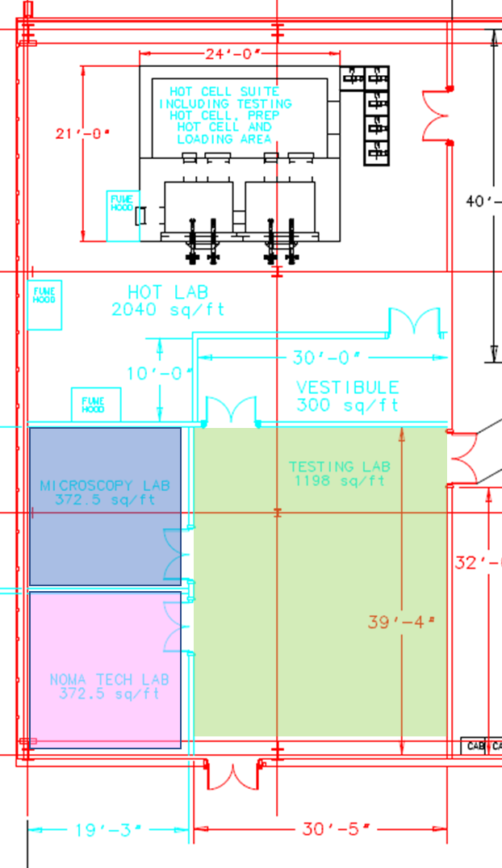
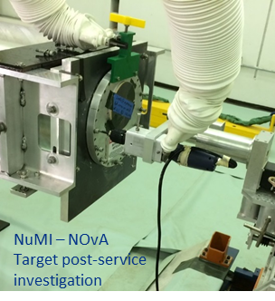
High Power Targetry (HPT) R&D is central to TSIB’s Purpose
Activated materials lab area (including hot cells)
Targetry material research on items removed from service and specimens from dedicated accelerator irradiations
Quality assurance and post-service investigations of used target station devices as part of continuous improvement within operations
In conceptual design stage
Project Plan (being finalized)
HPT R&D Group (F. Pellemoine) working with ES&H on finalizing scope of work and developing planning/design documentation
Development and operation of the HPT R&D Lab will fall within the scope of the Fermilab SAD (Safety Assessment Document) and comply with the FRCM (Fermilab Radiological Control Manual), FESHM (Fermilab Environment, Safety and Health Manual), and FEM (Fermilab Engineering Manual)
Integral part of TSIB scope since inception
P. Hurh | TSIB FSO Presentation

