Slide 1
TSIB HPT Lab Scope and Requirements
Frederique Pellemoine
TSIB HPT Lab Conceptual Design Review
01 April 2021

Slide 2
TSIB HPT Lab Scope
HPT Lab will support material science studies and post investigations for existing and future generation Fermilab Targetry development
  Materials science studies of non-active materials
    Targetry materials and materials under consideration for use as Targetry material will be studied and tested to establish baselines and evaluate their potential
  Development of novel material for use as targetry material and associated fabrication and production technologies
  Radiation damage studies of irradiated materials
    Studies and test of previously irradiated materials to determine irradiation damage effect on Targetry material
Charge 1

Slide 3
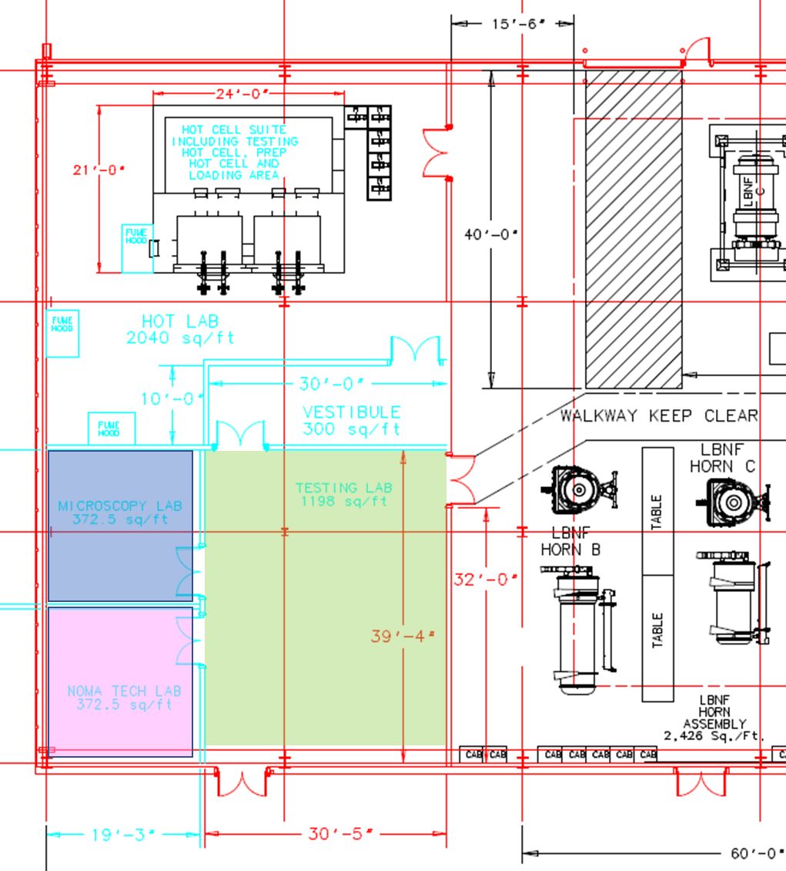
TSIB HPT Lab to support R&D Program
Hot Lab Area including Hot Cell Suite
Cold testing Lab
Microscopy Lab
Novel material and technology development area (NOMATech lab)
7
8
9
12
11

Slide 4
Cold testing area for thermo-mechanical testing on material
Scope
  The Testing Lab (11) will be used to evaluate
  mechanical and physical properties of
  non-activated material
  An area of the Testing Lab (North / East
  corner) will be equipped with a grinding/polishing
  station to prepare samples for microscopy study
Requirements
  Space for equipment and for two workstations/desks with computer
  Electrical requirements (125V/20A, 280V/20A 1 phase, 480V/60A 3 phases)
  Compressed air (2 lines)
  A polishing station with a sink (with domestic water),
  Storage cabinets for tolls, small equipment, samples, …
  Fire protection system to be determined by Fermilab ES&H/FESS life safety
  Chemical protection plan to be evaluated by Fermilab ES&H team
11
Charge 1

Slide 5
Cold testing area for thermo-mechanical testing on material
Equipment list
List of existing equipment | Dimension [WxDxH, ft] | Electrical requirements
 |  | phase | Voltage (V) | Nominal Current Draw / unit (A)
Commercial grinder/polisher | 1.3x 2.3x2.1 | 1 | 100-240 | 5
dilatometer | 8x3x4 | 1 | 208 | 16
Fermilab Fatigue Machine | 5x3x4 | 1 | 208-240 | 2
Mechanical load frame (Mecmesin 5kN existing) | 5x3x7 | 1 | 208-240 | 10
Mechanical load frame (Shimadzu) | 8x6x7 | 1 | 120 | 10
List of future potential equipment
diamond wheel saw | 1.1x1.3x1.1 | 1 | 100-240 | 1
Fatigue/tensile testing Machine Instron 8801 | 3.5x2x8.5 | 1 | 110 | 10
Furnace for load frame | To be fitted inside the load frame | 1 | 220 | 16
thermal bench test
Vibration test stand
laser flash diffusivity
profilometer
Split Hopkinson pressure bar
hardness tester
DIC system

Slide 6
Microscopy Lab
Scope
  Microstructural analysis of specimens
  (mostly Optical) but it will accommodate
  future upgrades in microscopy equipment
  (e.g. SEM/EBSD)
    During initial operations, only non-activated
    samples will be tested and a space will be
    reserved in the Hot Lab (South/East corner)
    to set up a digital microscope or other inspection
    instruments to allow examination and analysis of low activated samples.
  The Microscopy Lab will initially have a nano-indenter, a high-resolution Digital microscope
    microstructure, surface roughness, fractography, various other 3D measurements such as grain size, precipitates % age and to some extent contact less profilometry.
Requirements
  Space for equipment and for one workstation/desk with computer
  Electrical requirements (125V/20A+30A, 280V/20A 1 phase)
  Faucet and drain for SEM
  Storage cabinet for tools, and samples
9
Charge 1

Slide 7
Microscopy Lab
Equipment list
List of existing equipment | Dimension [WxDxH, ft] | Electrical requirements
 |  | phase | Voltage (V) | Nominal Current Draw / unit (A)
High resolution digital microscope (Keyence VHX-7000) | 6x3x6 | 1 | 120 | 1.5
Nano-indenter | 6x3x6 | 1 | 120 | 4
List of future potential equipment
Desktop SEM | 5x2.5 | 1 | 100-240 | 4
Differential Scanning Calorimetry | 5x2

Slide 8
Novel material and technology development area (NOMATech lab)
Scope
  Develop and manufacture various novel
  materials which have potential to be used
  as future high-power targets and beam
  intercepting devices.
    High Entropy Alloy (HEA), ceramic and
    metallic nanofiber samples
Requirements
  Space for equipment including a fume hood
  Electrical requirements (125V/20A, 280V/20A 1 phase)
  Fireproof cabinet for flammable chemicals (45 gallons capacity)
  Storage cabinet for other chemicals
  Storage cabinet for tools, and samples
  Fire protection system to be determined by Fermilab ES&H/FESS life safety
  Chemical protection plan to be evaluated by Fermilab ES&H team
12
Charge 1

Slide 9
Novel material and technology development area (NOMATech lab)
List of equipment
List of potential equipment | Dimension [WxDxH, ft] | Electrical requirements
 |  | phase | Voltage (V) | Nominal Current Draw / unit (A)
fume hood for chemical mixing | 8 x 3x5 | 1 | 120 | 6
High temperature furnace | 3x3x4 | 1 | 208-240 | 15
Nanofiber electro-spinning machine | 8x6x8 | 1 | 120 | 10

Slide 10
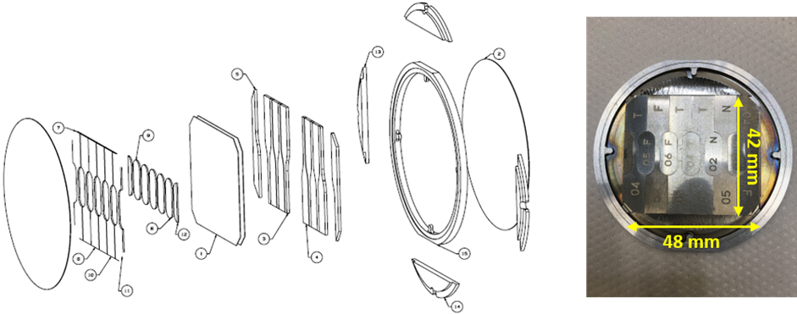
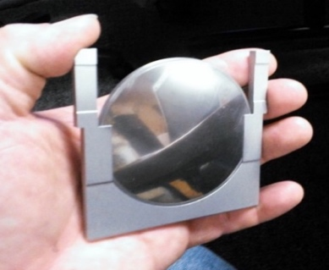
Activated Material Sources
The activated materials will come from several sources:
  The primary sources will be samples extracted from the current and future targetry components in the C0 hot cell.
    Small material samples can be extracted from horn, production target, beam windows, collimators or any other Fermilab beam intercepting devices
  The second source of activated samples will come from specimen fabricated for dedicated irradiation in support of the Fermilab HPT R&D program.
    These specimens will be small in size (order of an inch or smaller) for specific mechanical and thermal testing of activated materials (so-called R&D samples).
    These samples may be irradiated in facilities outside of Fermilab, or irradiated at Fermilab; however, Fermilab currently does not have dedicated and high-dose relevant irradiation stations on-site
Charge 1

Slide 11
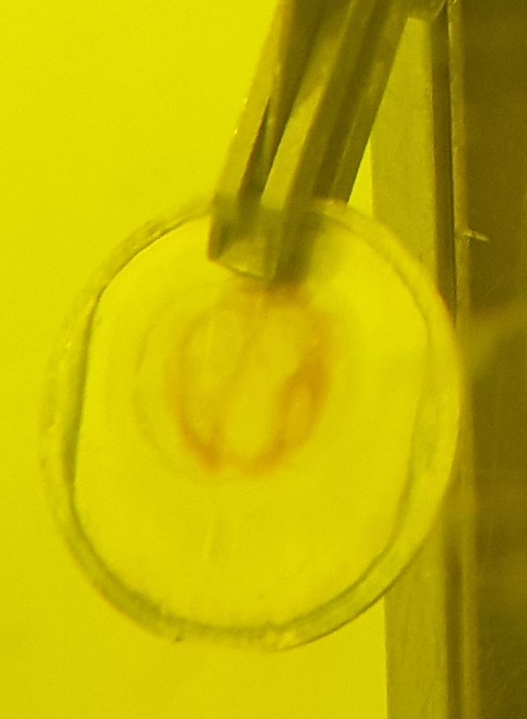
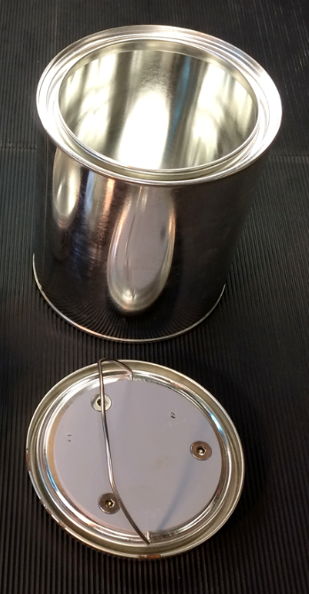
R&D Activated Material Packaging
Capsule with activated materials
Paint can / inner pot
Lead pot
Type-A container drum

Slide 12
Hot Lab Area Scope
The Hot Lab area includes a hot-cell suite and fume hood for mechanical and physical property testing of activated materials
The hot cells will be dedicated to analyze and perform Post-Irradiation Examination on small samples only
(1 mm to 100 mm scale).
Low activated samples can be tested in the fume hood or the Hot lab after being prepared in the hot cell suite and surveyed (and decontaminated, if necessary) in the fume hood
7
Charge 1

Slide 13
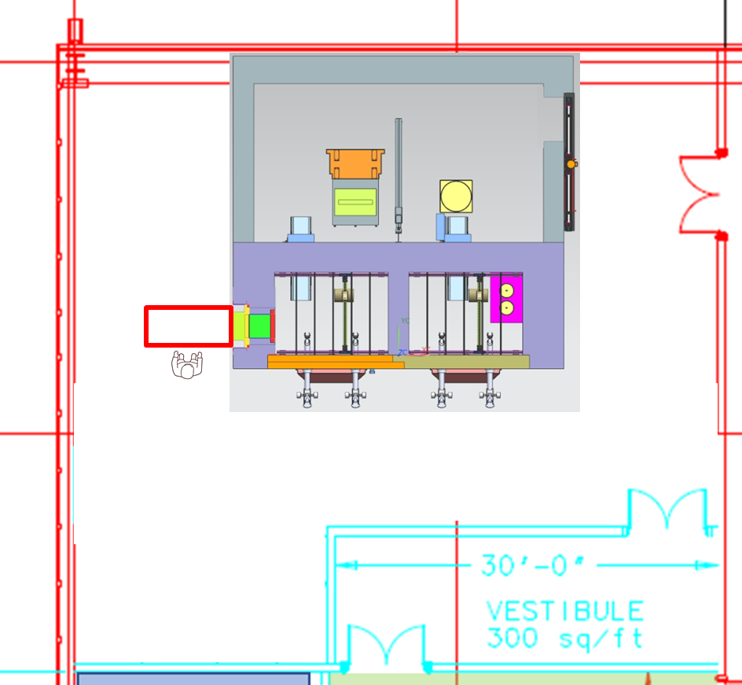
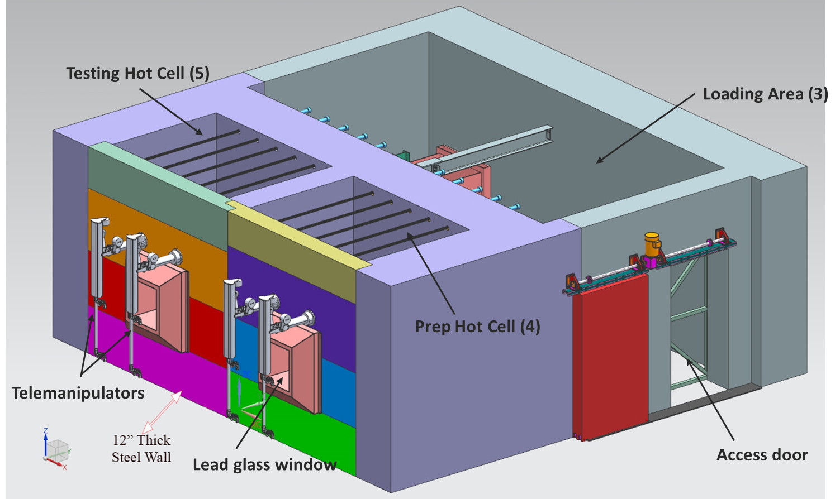
Hot Lab Area Layout
Loading/unloading Area
3
Material Access Door
2
6
5
4
Fume Hood
Prep Hot Cell
Testing Hot Cell
7
8
Vestibule
Personnel Access Door

Slide 14
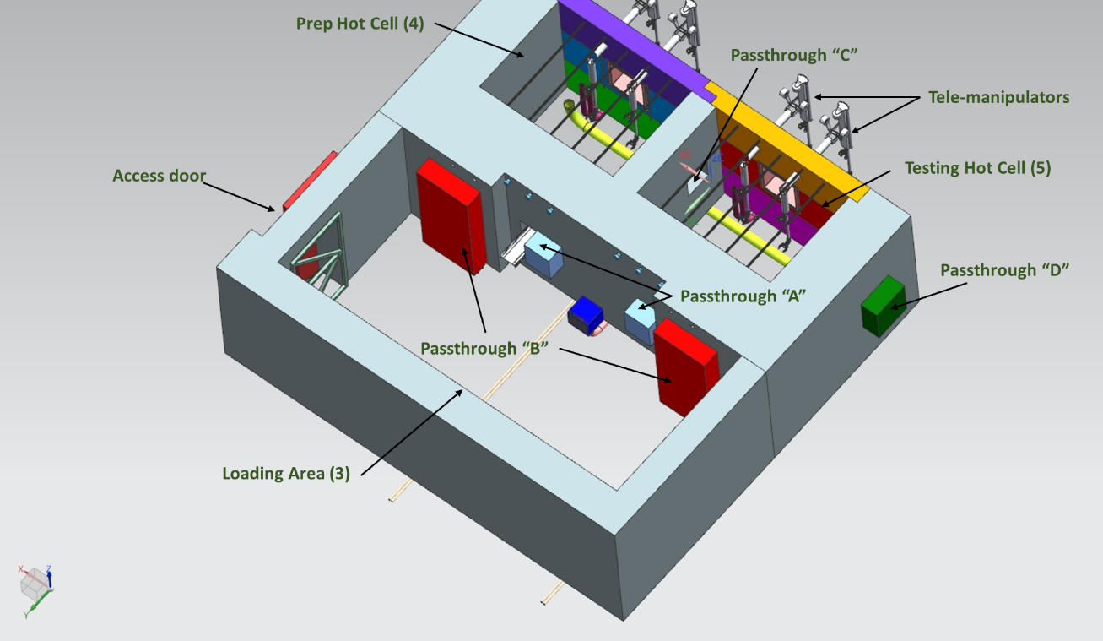
Passthrough in the Hot Cell Suite

Slide 15
Loading/unloading Area Scope
Receive the type-A container, and transfer the inner pot containing the activated material to the Prep hot cell
Install and transfer equipment in and out of hot cells
Control, decontaminate and temporarily store as needed, the testing equipment from the two hot cells to the hot lab
Prepare the large equipment on a shield plug
Extract waste from the hot cells to the appropriate disposal/storage container/cask
House the HVAC Ventilation filtration unit of the 2 hot cells for controlled maintenance of the filters
Charge 1

Slide 16
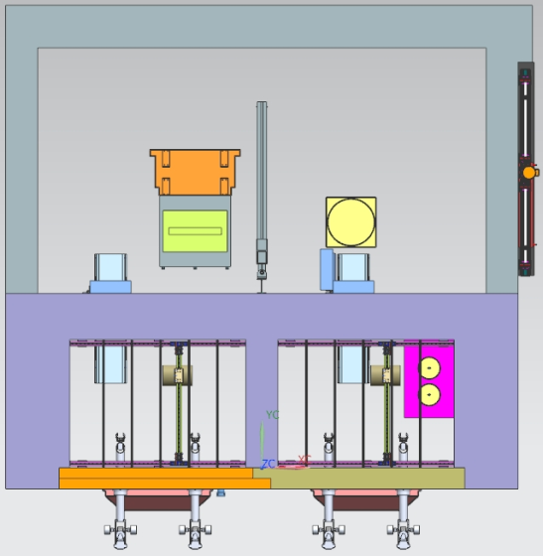
Loading/unloading Area Requirements
Have a negative pressure compared to the Hot Lab area
The access door is controlled by Radiation Physics Operations Department.
  It will only be opened, and personnel access into the Loading Area (3) permitted, during the activities described by the scope.
  The door is large enough to have pallet jack (or similar) with large equipment to access the Loading Area
  a frisker station and designated step-off are at the exit of the loading area in the Hot Lab
Passthroughs for moving equipment and
materials in and out of cells
Penetration for electrical utilities
(125V/20A, 280V/20A 1 phase)
Fire protection system to be determined by
Fermilab ES&H team/FESS life safety
Shield wall thick enough to mitigate the
exposure of workers in the Hot lab
(< 0.25 mrem/hr)
3
Charge 1

Slide 17
Loading/unloading Area Space Requirements
The loading/unloading area needs to have enough space :
  To set up the Hot Cell HVAC unit with access to the bag-in bag-out filter exchange system
  To allow access and workspace around the Type-A container during preparations for transfer activities
  To accept a lifting devices with mobile shielding panel enabling transfer of activated materials from/to the Type-A container
  To accept and maneuver a pallet truck (or
  similar) when transferring the Type-A
  container from the truck bay via the Hot Lab
  To install a permanent jib crane (1 ton load)
  To prepare a large equipment and cabling
  To be able to temporarily store equipment
  removed from the Testing Hot Cell for
  later use in the Hot Cells
3
Charge 1

Slide 18
Prep Hot Cell Scope
Paint can / inner pot with activated samples is transferred to the prep hot cell from a type-A container
The Prep Hot Cell will be primarily used to open and remove sample capsules/containers from the inner pot, to open the capsules containing the activated samples, to extract and sort the individual samples and store them as needed prior to testing
Activities may include cutting samples in small size, polishing samples for microscopy analysis and
decontamination (if necessary) of individual
sample prior to Post-Irradiation Examination
All activities in prep hot cell that need worker
operation will be done remotely using
telemanipulators
4
Charge 1

Slide 19
Prep Hot Cell Requirements
2 telemanipulators , have enough space in front of the cell to remove the arms for repair
one viewport
Pass throughs for moving equipment and materials in and out of cells and between cells
Proper ventilation to ensure a negative pressure inside the hot cells and proper filtration to contain contamination to the interior of the hot cell suite
Penetrations for HVAC system
Replaceable feed-through penetration ports for 125V/20A, 280V, 20 A, 1 phase, signal cables, utilities (fluid, compressed air)
All the switches ON/OFF, control valves (for fluids), for utilities will be controlled outside of the hot cell near the workstation (front wall) for rapid access to the worker.
In-cell lifting capability of 1000 lbs
Long term storages for lower activated samples and for
high dose samples
Walls/floor of the hot cell should be finished/sealed with
surface treatment to improve lighting and for easier
decontamination
Fire protection system to be determined by Fermilab
ES&H team/FESS life safety
Shield wall and view port thick enough to mitigate the exposure
of workers in the Hot lab (< 0.25 mrem/hr)
4
Charge 1

Slide 20
Testing Hot Cell Scope
Individual specimens (typically 1 mm to 100 mm scale) will be tested
Material tests will include mechanical tests (e.g. tensile, bend, fatigue) and physical property tests (e.g. dilatometry, thermal diffusivity, and ultrasonic)
The Testing Hot Cell will be prepared each time for a specific course of studies. Prior to the test of the sample, any needed testing instruments not already installed in the
Testing Hot Cell will be transferred into the
cell via passthrough doors
All activities in Testing hot cell that need
worker operation will be done remotely using
telemanipulators
5
Charge 1

Slide 21
Testing Hot Cell Requirements
2 telemanipulators , have enough space in front of the cell to remove the arms for repair
one viewport
Pass throughs for moving equipment and materials in and out of cells and between cells
Proper ventilation to ensure a negative pressure inside the hot cells and proper filtration to contain contamination to the interior of the hot cell suite
Penetration for HVAC system, cables and controls
Replaceable feed-through penetration ports for 125V/20A, 280V, 20 A, 1 phase, signal cables, utilities (fluid, compressed air)
All the switches ON/OFF, control valves (for fluids), for utilities will be controlled outside of the hot cell near the workstation (front wall) for rapid access to the worker
Walls/floor of the hot cell should be finished/sealed with surface treatment to improve lighting and for easier decontamination
In-cell lifting capability of 1000 lbs
Long term storages for lower activated samples
Space to accept several testing equipment (at least 2 smalls
and 1 large at the same time)
Fire protection system to be determined by Fermilab ES&H team
/ FESS life safety
Shield wall and view port thick enough to mitigate the exposure
of workers in the Hot lab (< 0.25 mrem/hr)
5
Charge 1

Slide 22
Shielding Requirements
Worst case scenario based on previous irradiation campaigns at BNL-BLIP facility
  Proton up to 200 MeV on Ti-capsule containing 56 samples during 55 days, accumulating a total of up to 4.6 x 10²¹ protons
  The maximum dose rate after 3 months of cooling down was calculated to be
  ~40 R/hr
  In future irradiations, we do not anticipate irradiating higher atomic number materials for longer irradiation time at BLIP facility
Hot cell shielding must provide sufficient shielding to reduce a 40R/hr source at 1 foot down to 0.25mrem/h
  Approximately 1ft of steel or 3 ft of concrete will provide the necessary shielding required
Lead glass thickness for the viewing windows has been calculated to be between 22” and 28” depending on density on combinations of density
 | Distance from external wall of work cell [ft]
[mrem/h] | 0 | 0.33 | 0.417 | 0.5 | 1 | 2 | 3 | 4 | 6 | 6.67
1 ft iron (source against inside wall) | 1.18 | 0.66 | 0.59 | 0.52 | 0.29 | 0.13 | 0.073 | 0.046 | 0.024 | 0.02
1 ft iron (source 1ft from inside wall) | 0.43 | 0.32 | 0.29 | 0.27 | 0.19 | 0.11 | 0.068 | 0.047 | 0.027 | 0.023
2 ft concrete (source 1 ft from inside wall) | 10.6 | 8.6 | 8.2 | 7.8 | 6 | 3.8 | 2.7 | 1.9 | 1.2 | 1
2 ft concrete (source against inside wall) | 20.1 | 14.7 | 13.7 | 12.8 | 8.9 | 5 | 3.2 | 2.2 | 1.2 | 1.1
3 ft concrete (source against inside wall) | 0.26 | 0.2 | 0.19 | 0.187 | 0.14 | 0.09 | 0.06 | 0.05 | 0.03 | 0.02
Charge 1

Slide 23
Fume Hood and Hot Lab Scope
Fume hood (6) adjacent to the Testing Hot Cell and Hot Lab (7) will be able to accept low-activated material via a passthrough
Different thermal/mechanical tests will be handled in the fume hood or the hot lab
  Specific dose rate and activity limits for samples in the fume hood and the hot lab is being determined by the Radiation Physics Operations department, taking into consideration the types of tests being performed and how
  personnel will be handling the material
  (I.e., by hands or use of tools), and how long
  samples may be handled by hand
The fume hood will serve as a point of
control for samples transferring out of the
Hot Cell Suite
6
7
Charge 1

Slide 24
Fume Hood Requirements
The fume hood needs
  To be adjacent to the testing hot cell with a direct access via the passthrough
  To be large enough to accept the few large testing equipment such as dilatometer or compact tensile test machine
  An independent ventilation to assure a negative pressure compared to the Hot Lab and maintain the required face air velocity as per ANSI/AIHA/ASSE Z9.5 and ANSI/ASHRAE 110 – Laboratory Ventilation Package (or applicable standard)
    A bag-in/bag-out system for fume hood will be determined
  Electrical requirements (125V/20A, 280V/20A 1 phase) inside the fume hood for equipment
Charge 1

Slide 25
Hot Lab Requirements
Proper ventilation to ensure a negative pressure inside the hot lab compared to the vestibule and the rest of the TSIB building
Access doors for material and for personnel need
  To be sealed (material door (2) and door between Hot Lab (7) and vestibule (8))
  Material access door to the hot lab is controlled by Radiation Physics Operations Department and will only be opened when a container is received into the hot lab (7).
  Access doors for personnel through the vestibule will be limited with a control system.
Electrical requirements (125V/20A, 280V/20A 1 phase, 480V/60A 3 phases)
Compressed air (2 lines)
Space for
  Few testing and inspection equipment
  Test bench with outlet panels
  Fireproof cabinet for flammable chemicals (~20-30 gallons)
  Storage cabinet for other chemicals/hazardous products
  Shielded storage to store the low activated material accepted for test in the hot lab and the fume hood
  Storage cabinets for tools and small equipment
  Workstations/desks with computer
An independent floor drain system separated from the general TSIB building drain and sump system as determined necessary by Fermilab Radiation Safety group.
Fire protection system to be determined by Fermilab ES&H/FESS life safety
Chemical protection plan to be evaluated by Fermilab ES&H team
Charge 1

Slide 26
Vestibule
Scope
  This room serve as an entrance to the Hot Lab and as a point of control at the exit of the Hot Lab
  Only qualified personnel will be allowed to enter the ‘vestibule’ room adjacent to access the Hot Lab
Requirement
  Access through its entrance door will be limited with a control system
  Access door between the hot lab and the vestibule needs to be sealed to maintain a negative pressure in the hot lab area
  Space for
    a frisker station and designated step-off area near the door to exit the hot lab
    at least one bench and one cabinet for booties / PPE if needed
  Electrical requirements (125V/20A, 280V/20A
  1 phase)
7
8
11
Charge 1

Slide 27
HPT Lab Requirements
Wireless network
Wire network in the different rooms with a minimum of 4 LAN plug per room, more in the largest room (Hot Lab and Testing Lab)
Room Temperature/climate control in each area
Dry walls to keep cleanness in the Labs
Floor needs to have a surface treatment (epoxy) for easy maintenance and cleaning
Windows to outside should be high level windows to allow any instrumentation installation

Slide 28
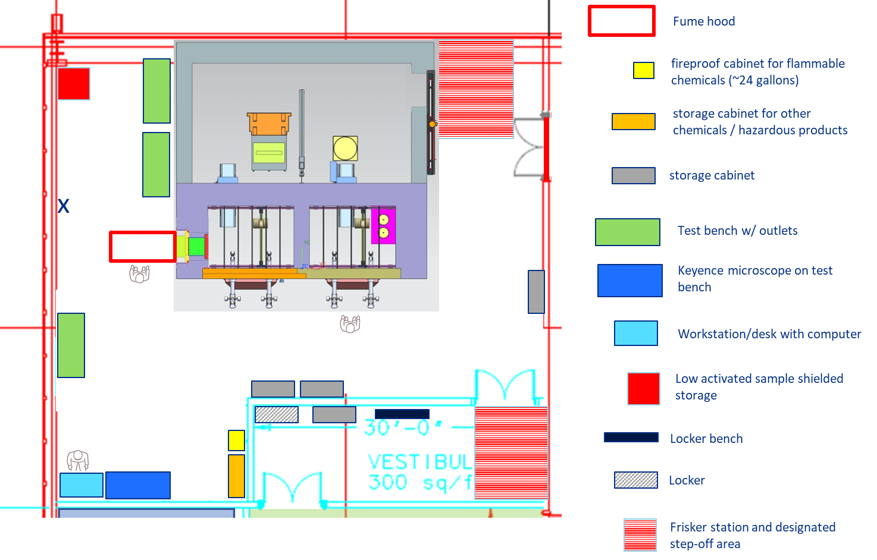
Hot Lab Layout
Charge 1

Slide 29
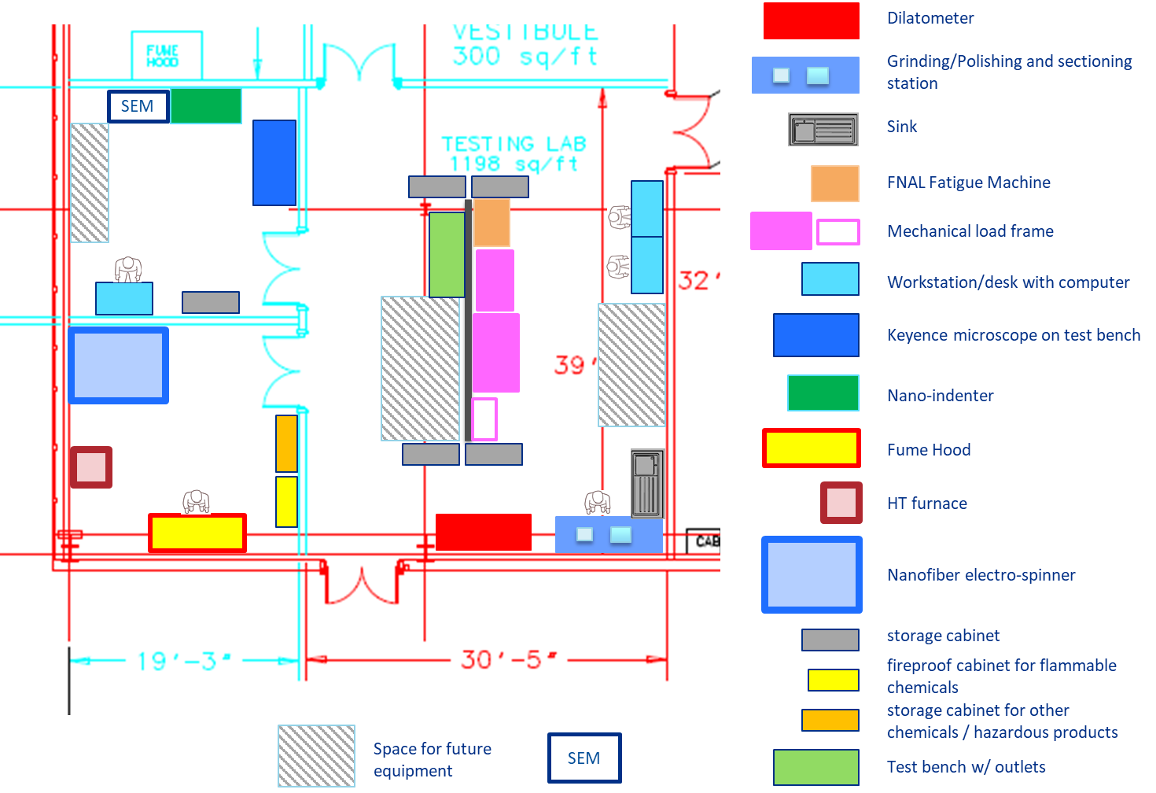
Non – Activated Material Area Layout

Slide 30
Backup Slides

Slide 31
Prep Hot Cell Requirement
2 telemanipulators and one lead glass window (thickness defined by the vendor depending on layer density used)
Several Passthrough: one small and one large to communicate with loading area, one small to communicate with Testing hot cell
Proper ventilation to ensure a negative pressure inside the hot cells.
  Since potential generation of contamination is greatest in the Prep Hot Cell, a negative air pressure, relative to the other Hot Cell Suite areas and the surrounding Hot Lab, will be maintained with the Hot Cell Suite Ventilation system.
  the ventilation system needs to keep negative pressure in the testing hot cell (4) and (5) when any passthrough is open
  Penetration for HVAC system, cables and controls
All the switches ON/OFF, control valves (for fluids), for utilities will be controlled outside of the hot cell near the workstation (front wall) for rapid access to the worker.
Fire protection system to be determined by Fermilab ES&H team/FESS life safety
In-cell lifting capability of 1000 lbs
Several storages to accept several paint cans/inner pots with lower activated samples (number of cans/pots to be defined depending on the space available below the worktable) and for high dose samples
Walls/floor of the hot cell should be finished/sealed with surface treatment (epoxy?) to improve lighting and for easier decontamination
5 replaceable feed-through penetration ports for 125V/20A, 280V, 20 A, 1 phase, signal cables, utilities (fluid, compressed air)
Charge 1

Slide 32
Testing Hot Cell Requirement
2 telemanipulators
one lead glass window (thickness defined by the vendor depending on layer density used)
Several Passthrough: one small and one large to communicate with loading area, one small to communicate with Prep hot cell and one small to communicate with the adjacent fume hood
Proper ventilation to ensure a negative pressure inside the hot cells.
  Since potential generation of contamination is greatest in the Prep Hot Cell, a negative air pressure, relative to the other Hot Cell Suite areas and the surrounding Hot Lab, will be maintained with the Hot Cell Suite Ventilation system.
  the ventilation system needs to keep negative pressure in the testing hot cell (4) and (5) when any passthrough is open
  Penetration for HVAC system, cables and controls
All the switches ON/OFF, control valves (for fluids), for utilities will be controlled outside of the hot cell near the workstation (front wall) for rapid access to the worker.
Fire protection system to be determined by Fermilab ES&H team/FESS life safety
In-cell lifting capability of 1000 lbs
Several storages to accept several paint cans/inner pots with lower activated samples (number of cans/pots to be defined depending on the space available below the worktable) and for high dose samples
Walls/floor of the hot cell should be finished/sealed with surface treatment (epoxy?) to improve lighting and for easier decontamination
5 replaceable feed-through penetration ports for 125V/20A, 280V, 20 A, 1 phase, signal cables, utilities (fluid, compressed air)
Space to accept several testing equipment (at least 2 smalls and 1 large at the same time)
Charge 1

Slide 33
Shielding Requirement
Worst case scenario based on previous irradiation campaigns at BNL-BLIP facility
  Proton up to 200 MeV on Ti-capsule containing 56 samples during 55 days, accumulating a total of up to 4.6 x 10²¹ protons
  The maximum dose rate after 3 months of cooling down was calculated to be ~40 R/hr
  In future irradiations, we do not anticipate irradiating higher atomic number materials for longer irradiation time at BLIP facility
Hot cell shielding must provide sufficient shielding to reduce a 40R/hr source at 1 foot down to 0.25mrem/h
  Assumption
    Iron ((7.87 g/cc), concrete (2.35 g/cc), Source of unspecified material
    an irradiated aluminum sample measuring 40 rad/hour @ 1 foot, which corresponds to a 3.14 Ci point-source of Na-22 and an average photon energy of about 1 MeV
1ft of steel and 3ft of concrete will provide the necessary shielding required
Lead glass thickness for the viewing windows has been calculated to be between 22” and 28” depending on density on combinations of density
 | Distance from external wall of work cell [ft]
[mrem/h] | 0 | 0.33 | 0.417 | 0.5 | 1 | 2 | 3 | 4 | 6 | 6.67
1 ft iron (source against inside wall) | 1.18 | 0.66 | 0.59 | 0.52 | 0.29 | 0.13 | 0.073 | 0.046 | 0.024 | 0.02
1 ft iron (source 1ft from inside wall) | 0.43 | 0.32 | 0.29 | 0.27 | 0.19 | 0.11 | 0.068 | 0.047 | 0.027 | 0.023
2 ft concrete (source 1 ft from inside wall) | 10.6 | 8.6 | 8.2 | 7.8 | 6 | 3.8 | 2.7 | 1.9 | 1.2 | 1
2 ft concrete (source against inside wall) | 20.1 | 14.7 | 13.7 | 12.8 | 8.9 | 5 | 3.2 | 2.2 | 1.2 | 1.1
3 ft concrete (source against inside wall) | 0.26 | 0.2 | 0.19 | 0.187 | 0.14 | 0.09 | 0.06 | 0.05 | 0.03 | 0.02
Charge 1

Slide 34
Fume hood Requirement
The fume hood needs
  to be large enough to accept the few large testing equipment such as dilatometer or compact tensile test machine
  an independent ventilation to assure a negative pressure compare to the hot lab (but pressure higher than the Hot Cell Suite) and maintain the required face air velocity as per ANSI/AIHA/ASSE Z9.5 and ANSI/ASHRAE 110 – Laboratory Ventilation Package (or applicable standard).
  to be adjacent to the testing hot cell with a direct access via the passthrough
  The exhaust (ductless or not) needs to be determined by FESS/AE.
    a bag-in/bag-out system for fume hood will be determined/developed.
  Electrical requirements (125V/20A, 280V/20A 1 phase) inside the fume hood
Charge 1

Slide 35
Hot Lab Requirement
Proper ventilation to ensure a negative pressure inside the hot lab compared to the vestibule and the rest of the TSIB building
Access doors need
  To be sealed (material door (2) and door between Hot Lab (7) and vestibule (8))
  Material access door to the hot lab is controlled by Radiation Physics Operations Department and will only be opened when a container is received into the hot lab (7).
  Access doors for personnel through the vestibule will be limited with a control system.
Electrical requirements (125V/20A, 280V/20A 1 phase, 480V/60A 3 phases)
Two compressed air lines (120 psi): one near the hot cell suite to “feed” hydraulic testing equipment installed in the Testing Hot cell via feedthrough, and one compressed air along the south wall of the Hot Lab
Fire protection system to be determined by Fermilab ES&H/FESS life safety
Chemical protection plan to be evaluated by Fermilab ES&H team.
one fireproof cabinet for flammable chemicals (~20-30 gallons)
One storage cabinet for other chemicals/hazardous products
One shielded storage to store the low activated material accepted for test in the hot lab and the fume hood
An independent floor drain system separated from the general TSIB building drain and sump system as determined necessary by Fermilab Radiation Safety group.
2 to 3 jumbo heavy-duty metal storage cabinets (48x 18 x 78”)
at least 1 test benches with outlet panels
Charge 1

