Slide 1
TSIB HPT Lab – Lessons learned
Frederique Pellemoine
TSIB HPT Lab Conceptual Design Review
01 April 2021

Slide 2



Introduction
In order to include best practices and incorporate lessons learned from other facilities we “interviewed” three different facilities with hot cells under operational
Interviewed hot cell user/operator/manager with a focus on the hot cell design and operation
  Pacific Northwest National Laboratory (PNNL)
    Robert Orton, Shielded Facilities Operations
    Dave Senor, Researcher and RaDIATE collaborator
  Argonne National Laboratory (ANL)
    Mike Billone, Program Lead, Irradiation Performace
  Oak Ridge National Laboratory (ORNL)
    Tom Muth, LAMDA Lab Manager
More interviews to come with focus on the safety aspect
In the following slides you will see check marks
  Green : Means that we already incorporated them in our design or in our future procedures to operate
  Black: Means that we are considering using their advice in our future procedures, but it is not part of the design
✓
✓

Slide 3
Introduction
It should be noted that some of the facilities “interviewed” perform work under different regulatory requirements than what will be required for the work performed in the HPT Hot Cells. The facility at Fermilab will perform work on R&D samples within capsules that are ~66x below the Hazard Category 3 limits , and ~42,400x below the Hazard Category 2 limits, and will not be subject to the nuclear safety order. It will be managed under the Accelerator Safety Order (DOE O 420.2c) and 10 CFR 835 Occupational Radiation Protection.
The following should be understood as general best practices and would be very conservative for our application.

Slide 4
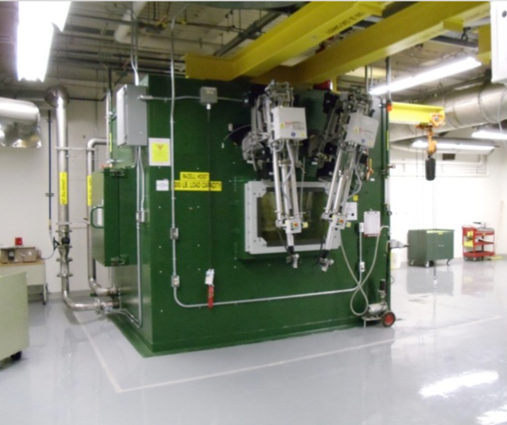
PNNL Hot Cells
In previous irradiation experiment, RaDIATE collaboration material PIE work were performed in one of these two hot cells
Hot cells are customed hot cells
MEC1
PDC1/2
Internal volume: 12’ wide x 6’ deep x 8.3’ high (with 1’ thick steel walls)
Weight: ~250,000 lbs
Two manipulator workstations (four mechanical manipulators)
In-cell lifting capability of 1000 lbs
5 replaceable feed-through penetration ports
In-cell storage below worktable
Internal volume: 6.5’ wide x 4.5’ deep x
8.3’ high (with 1’ thick steel walls)
Weight: 160,000 lbs
One manipulator workstation (two mechanical manipulators)
5 replaceable feed-through penetration ports
Allows for operation in inert environment
Work trays are removable
✓
✓
✓
✓
✓
✓
✓
Charge 4

Slide 5
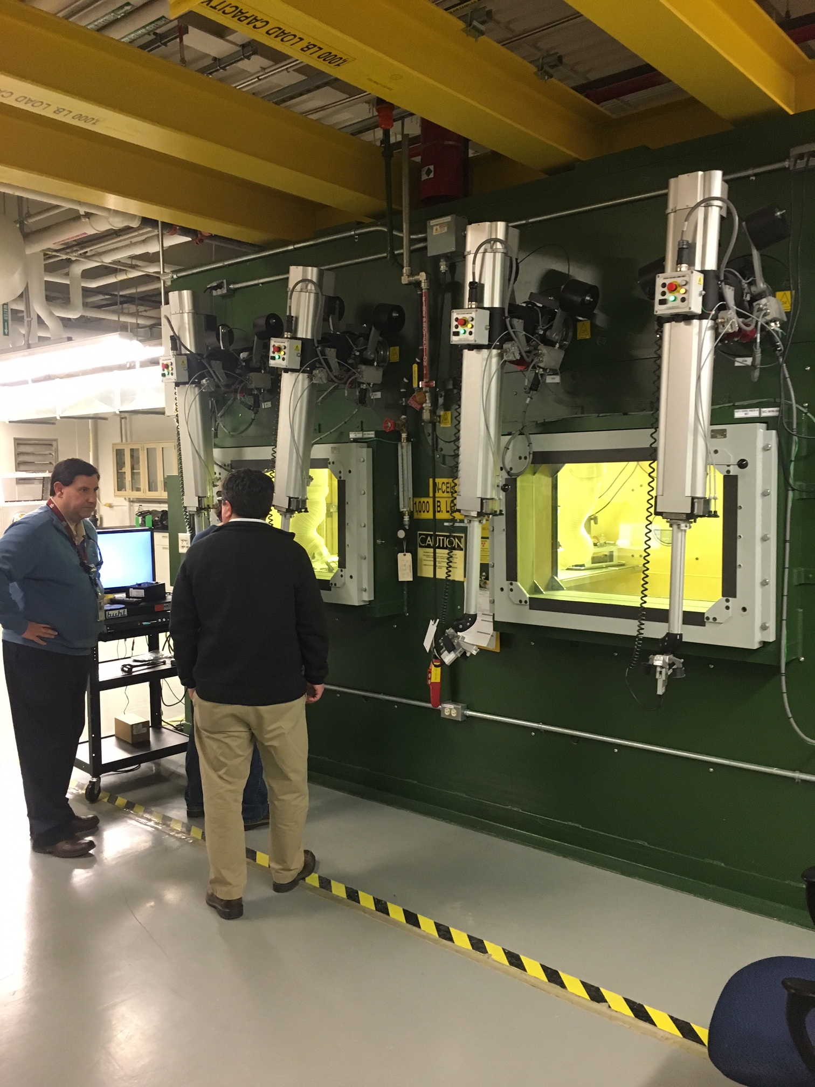
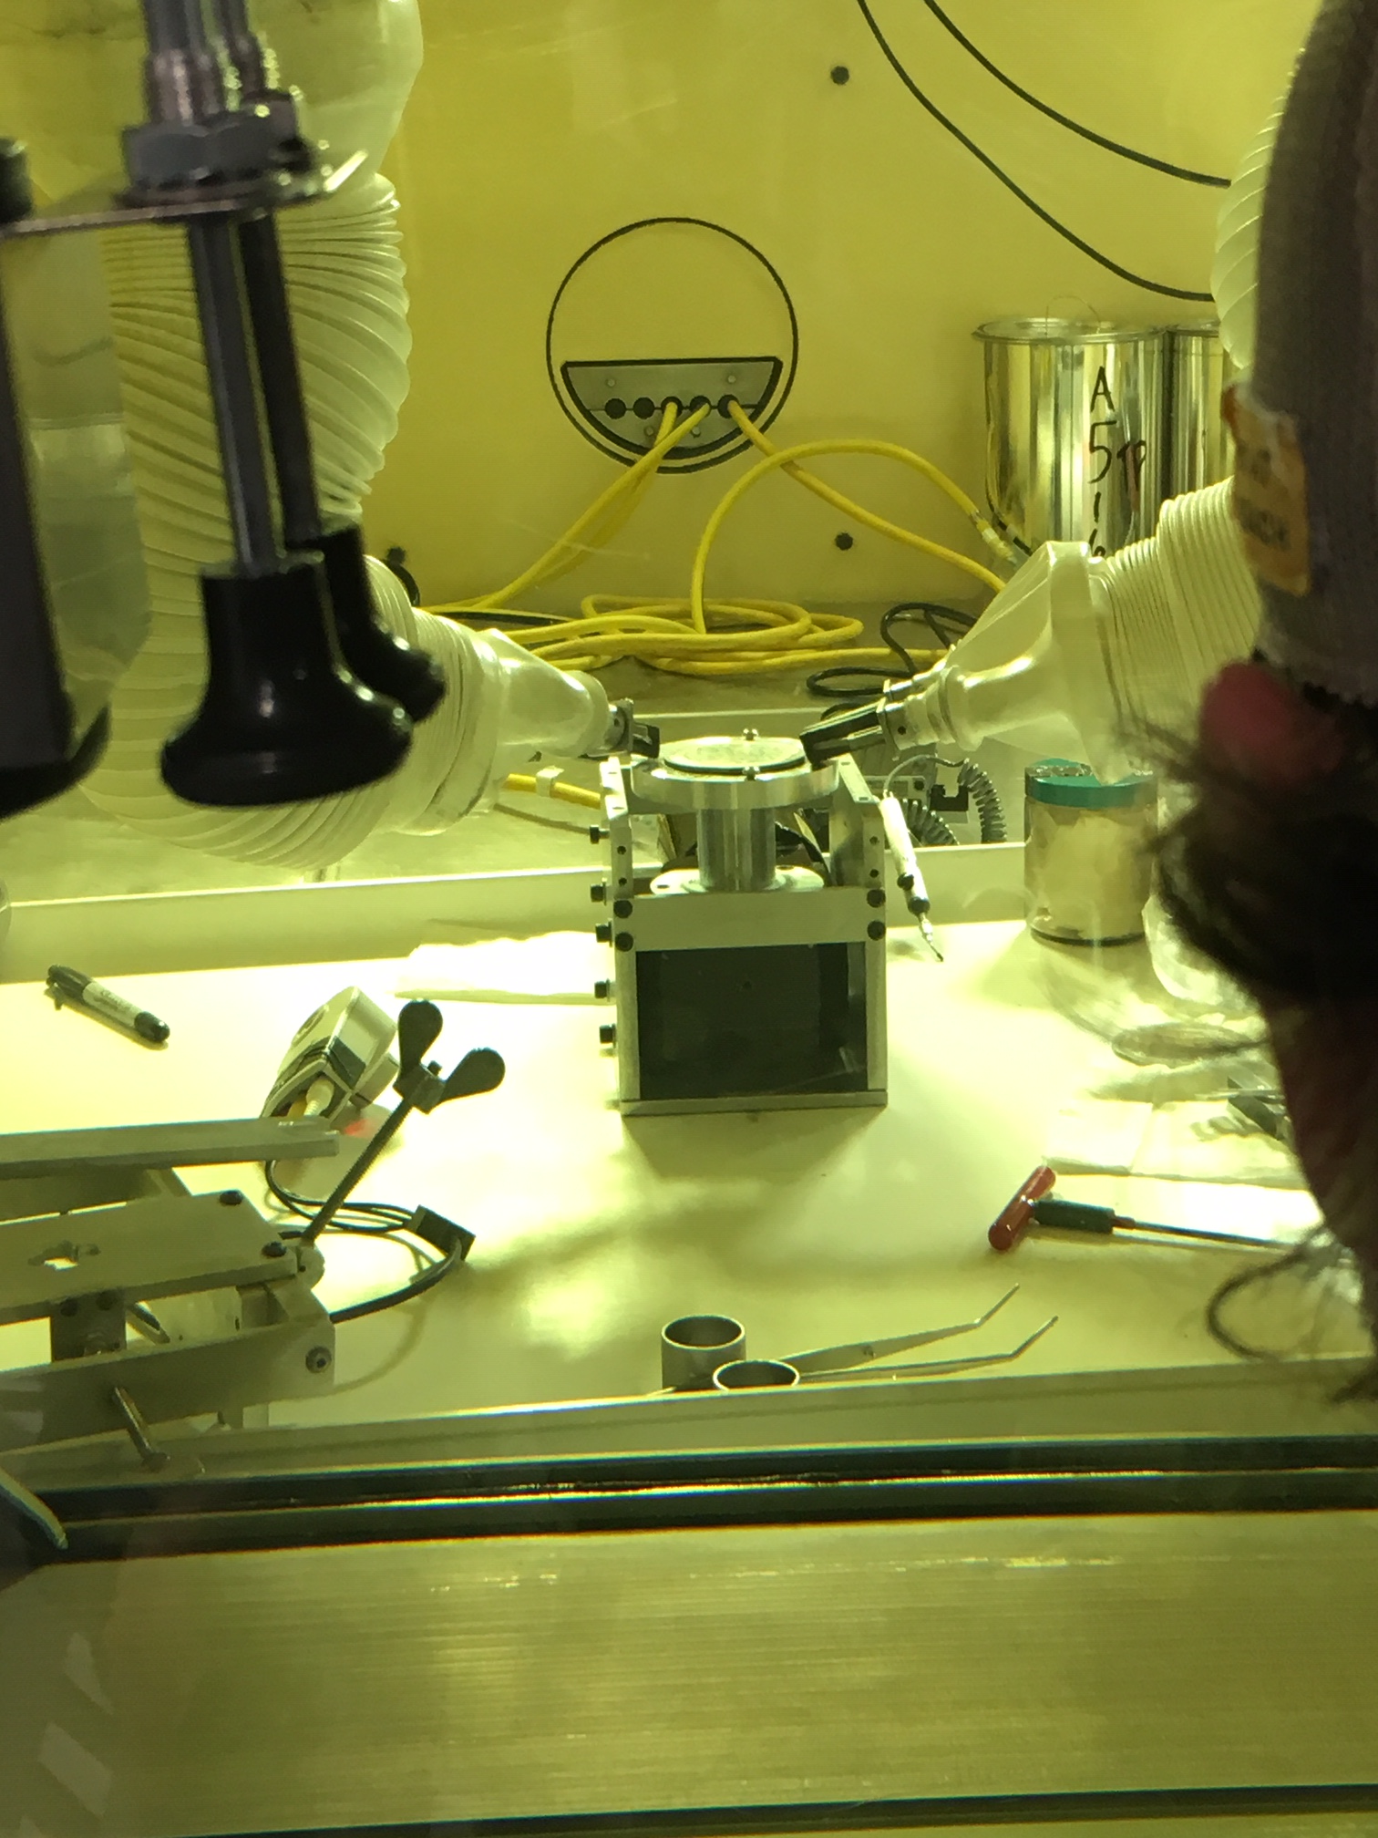
PNNL Hot Cells
✓
They are using standard equipment in hot cells but we should consider design them for remote maintenance with telemanipulator
No cooling/fluid tank inside the hot cells
  The furnace doesn’t have active cooling (Tmax ~ 500°C)
  No drainage in the hot cell but they install any equipment in a large stainless-steel tray with lip to keep contamination in.
Storage of activated materials is made by using few shielded container
No fire protection system inside the hot cells. They have extinguisher outside of the cells.
They have Mercury baker light in the hot cell which can be remotely maintained.
Epoxy on concrete for contamination mitigation and ease to clean
  Consider to have stainless steel wall if any plan to use chemical
HVAC uses bag-in/bag-out system with high efficiency filters
The designed a capsule opener
✓
✓
✓
Capsule opener
✓
✓
✓
✓
Charge 4

Slide 6
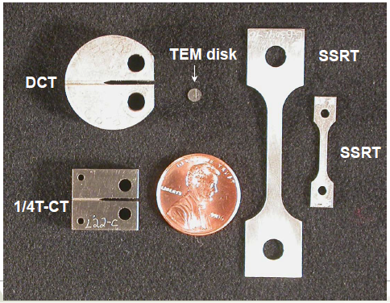
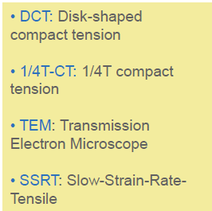
ANL - Radioactive Materials Characterization in the Irradiated Materials Laboratory (IML)
ANL Facilities for Testing Nuclear Fuel Cladding and Reactor Materials
  Operation mode not relevant with the TSIB HPT Lab, nevertheless the use of hot cell and how they operate provides us good lessons learned
Preparation of samples (polishing) at low dose for SEM characterization in fume hood and if high dose in glovebox
✓
Charge 4

Slide 7
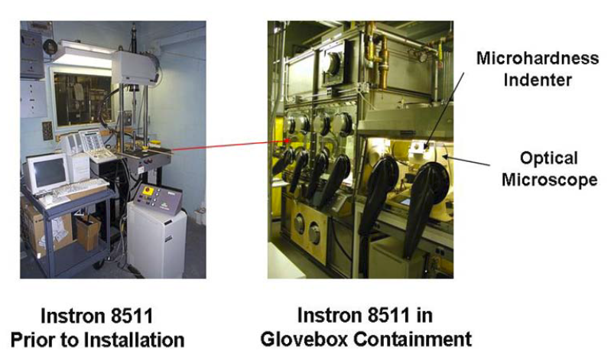
ANL – Testing Equipment
Large equipment (tensile test machine) installed in dedicated glovebox
Charge 4

Slide 8
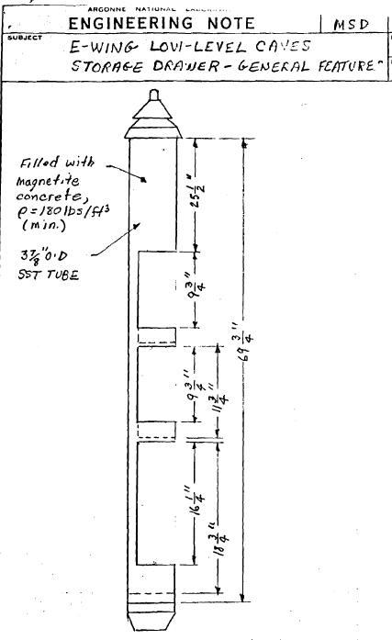
ANL - IML Cells 1 and 2 ─ Irradiated Nuclear Materials
✓
Each hot cell are dedicated to specific purpose
Hot cell (inside 6’ wide x 5’ deep x
9’8” height) with 6’ wide door in front of the hot cell
3’ of regular concrete for the walls.
2’ of magnetite concrete for the viewing wall
Plexiglass door inside the hot cell as barrier ventilation door to limit airborne while large door opened
ZrBr zinc-bromide shield windows that aged badly with time ⇨ use lead-glass window
Large window (30”Hx50”Wx30” thick)
5 shielded storage wells installed at the
back hot cell allow entrance of worker for
a short period of time
One pair of telemanipulator + a special
crane of ~ 150 lb capacity for lifting the
storage shield plugs
✓
✓
✓
✓
✓
✓
✓
Charge 4

Slide 9
ANL
✓
Have well qualified worker to operate the hot cell and the telemanipulator. Anticipate a long period of training
Have constant monitoring of the negative pressure
Have also a smoke test during commissioning of the fume hood and the hot cell
Have smooth surface for every equipment and tray to avoid contamination accumulation and to facilitate the cleaning / decontamination process
✓
✓
✓
Charge 4

Slide 10
ORNL– LAMDA Laboratory
Low Activation Materials Development and Analysis Laboratory (LAMDA)
  Multipurpose laboratory for low activated material analysis without the need for remote manipulation – NO Hot Cells
  Samples < 100 mR/hr at 1ft
    This mode of operation allows for more precise and delicate sample handling than in traditional hot cells
The LAMDA laboratory typically utilizes small, compact samples to allow characterization and test equipment to study materials phenomenon not possible at a hot cell facility
  Mechanical testing, physical properties and microstructural characterization
Charge 4

Slide 11
ORNL
Dose rate based on isotope production calculation
  Always have initial screening before hands-on activity on the samples
  Perform gamma spectroscopy in the fume hood to verify the sample activity. Survey at LAMDA lab is done by using a portable Falcon ® γ spectrometer
Always keep the hot cell cleaned. Remove regularly any unused samples and dispose any waste as soon as possible
Store all samples if possible, outside of the hot cell
For volatile gas emission they advice to use adsorber type filter (charcoal)
✓
✓
✓
✓
Charge 4

