Slide 1
TSIB HOT CELL SUITE– DESIGN
Keith Anderson
TSIB HPT Lab Conceptual Design Review
01 April 2021

Slide 2
Outline
Parameters
Material Selection
Functional Layout
Pass Throughs
Equipment Selection
Internal Storage

Slide 3
PARAMETERS
Hot cell suite must fit within the footprint designated for the hot lab.
Hot cell shielding must provide sufficient shielding to reduce a 40R/h source at 1 foot down to 0.25mrem/h
Ability to manipulate equipment and samples for testing
Long term storage for radioactive samples
Pass throughs for moving equipment and materials in and out of cells and between cells.
Contain contamination to the interior of hot cell suite.
Provide systems to ensure dose to worker is as low as reasonably achievable.

Slide 4
SHIELDING CONSIDERATIONS
Though any material can be used for radiation shielding, if it is thick enough, the usual materials are concrete, lead and steel.
Due to the hazardous nature of lead, it has not been considered for this project
Concrete and steel have been chosen as the primary shielding materials
Most of the walls and the ceiling will be made from concrete.
Concrete is less than 1/10th the cost of steel for the same amount of shielding.
The main working wall will be 12” steel plate.
Puts worker closer to the work being performed.
Easier mounting for Tele-Manipulators and Lead glass windows

Slide 5
SHIELDING CONSIDERATIONS (cont.)
Calculations have determined that 12” of steel and 36” of concrete will provide the necessary shielding required.
Lead glass thickness for the viewing windows has been calculated to be between 22” and 28” depending on density on combinations of density.
Steel has been chosen for pass through door shielding.

Slide 6
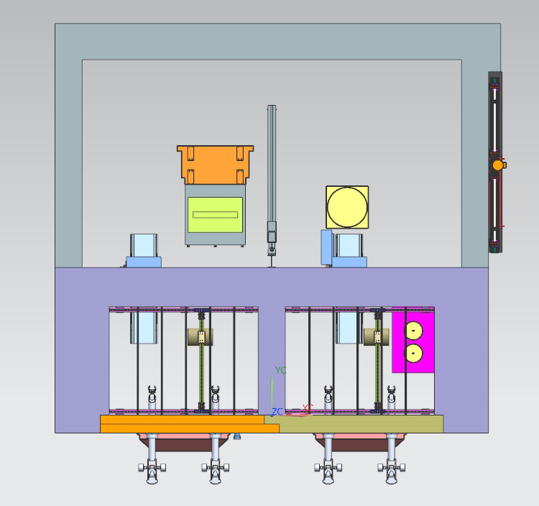
FUNCTIONAL LAYOUT
After several iterations, the layout pictured has been determined to be the most efficient use of space.
Hot cells side by side for easy transfer of materials
Shielded loading room on back of hot cells to provide for movement of materials and equipment in and out of hot cells.
The loading room provides a buffer zone to prevent the spread of contamination.

Slide 7
HOT CELL SUITE SIZE
Each hot cell has an internal footprint of 8’ W x 6’ D x 12’ H
Placing these side by side and including a shield wall of 1.5’ of concrete between them and exterior concrete walls of 3’ gives a total width of 23.5’ (3” was added to the interior of each cell to make a uniform width of 24’)
With a front wall thickness of 12” of steel and a back wall thickness of 26” of concrete the depth of the hot cells is 9’-2”
The loading room has an internal footprint of 20’ W X 11’ D x 12’ H
Adding 2’ thick concrete walls gives a total footprint of the loading room of 24’ W X 13’ D (fourth wall is a shared wall with hot cells)
Combining the hot cells with the loading room gives a total footprint of 24’ W X 22’-2” D
Adding 3’ concrete shield on the ceiling to protect the mezzanine give a total height of 15’

Slide 8
PASS THROUGHS AND SHIELD PLUGS
All pass throughs and shield plugs have been designed to meet or exceed the shielding provided by the walls in which they reside.
To eliminate shine through gaps in the shielding, a stepped design has been implemented and the overlap of shielding has been set at 10 times the gap width.
Each small pass through will be equipped with a double door air lock that will only allow one door to be opened at a time to eliminate airflow from one space to another.
The large removable shield plugs will only be sealed on the exterior side. (Prior to opening these, a decontamination procedure will be implemented.)

Slide 9
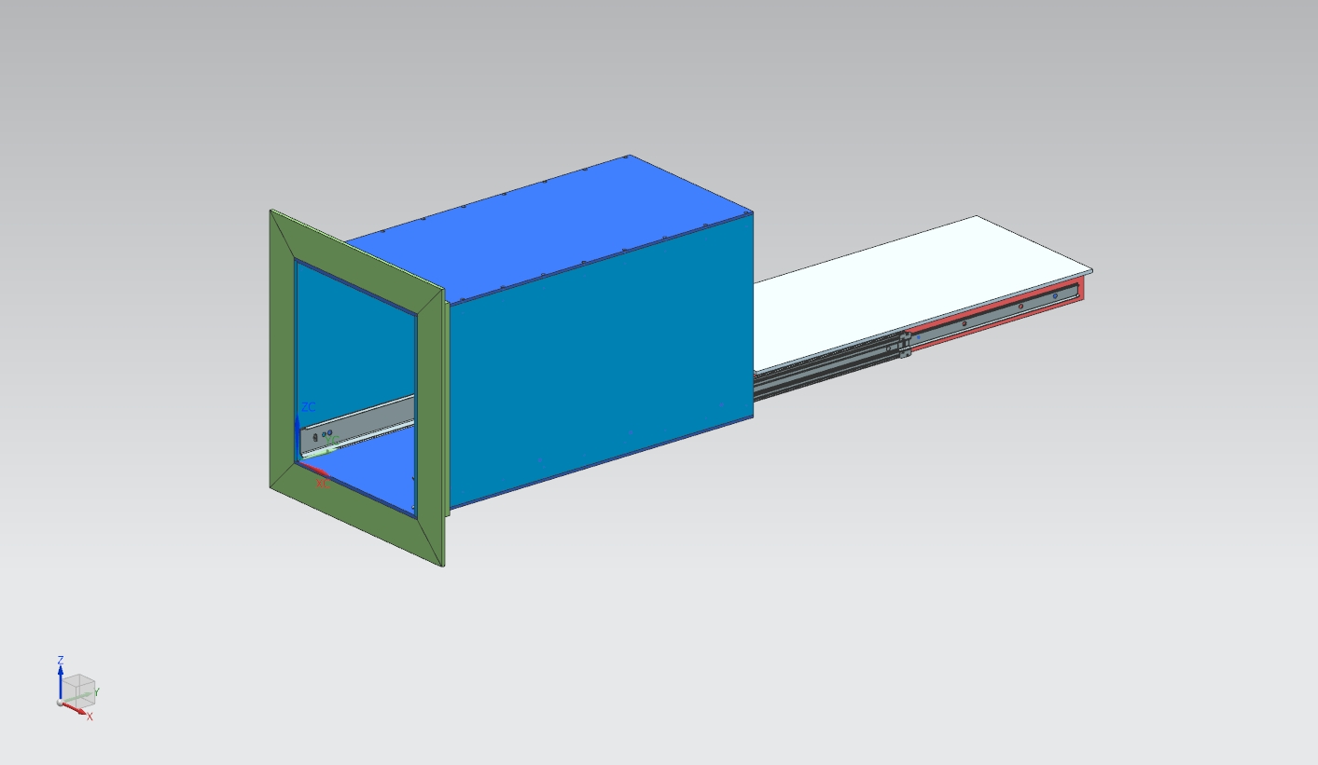
PASS THROUGHS AND SHIELD PLUGS (Cont.)
The small pass throughs have been designed with pass through drawers that can extend out in both directions. This assists maintaining distance and shielding requirements while transferring materials in and out of the cells.

Slide 10
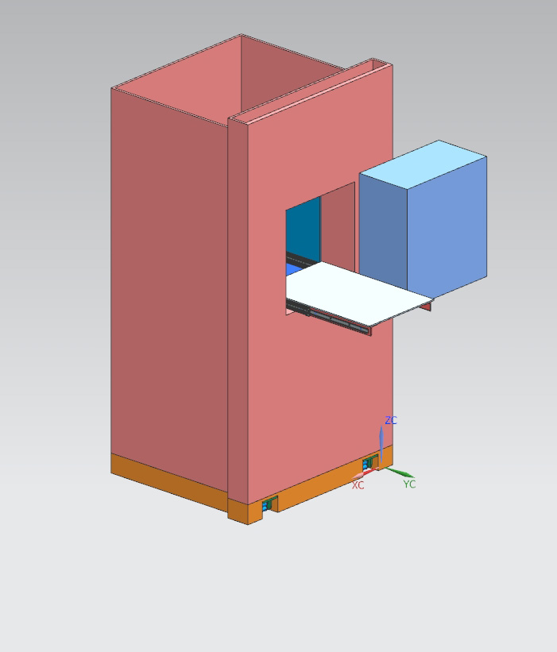
PASS THROUGHS AND SHIELD PLUGS (Cont.)
The small pass through for the prep hot cell has been incorporated int the shield plug to reduce costs and conserve space.
The shield plug is designed using steel and concrete for cost and shielding requirements.

Slide 11
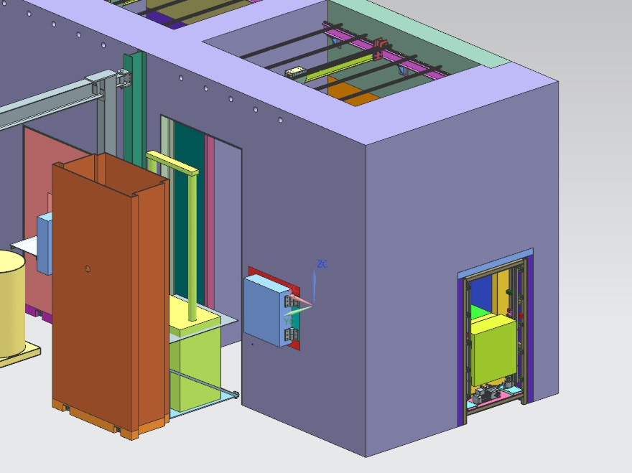
PASS THROUGHS AND SHIELD PLUGS (Cont.)
The test cell has three penetrations to the outside.
A small pass through on the rear wall for transferring specimens and small equipment.
A large plug door that has a machine carrying base for installing large machines into the test cell.
A medium sized pass through on the side for transferring materials and equipment into the fume hood

Slide 12
PASS THROUGHS AND SHIELD PLUGS (Cont.)
The small pass throughs currently are designed to be manual hinged for simplicity. (Both sliding and powered operation is being considered}
Current plan for opening and closing the large plug doors is to use hydraulics. Since this will happen in frequently the plan would be to have one system that gets installed as needed.
The side passthrough for the test cell is designed as a powered unit that raises and lowers to cover the opening.
The Large opening on the side of the loading room will have a large sliding shield door and a swinging interior door for air control.

Slide 13
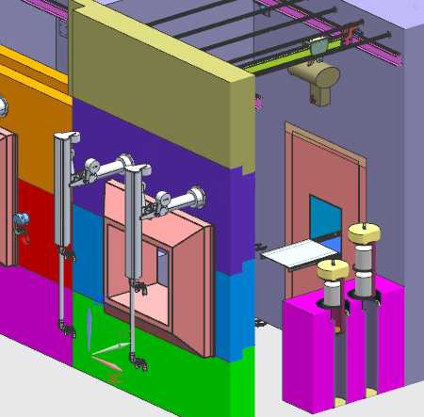
TELE-MANIPULATORS
Model G and Model F manipulators from CRL have been considered for use. We still have to weigh the pros and cons
Current plan is for Model G manipulators from CRL
Lower cost and lighter duty.
Less fatigue on operator.
Draw back is lower load capacity.

Slide 14
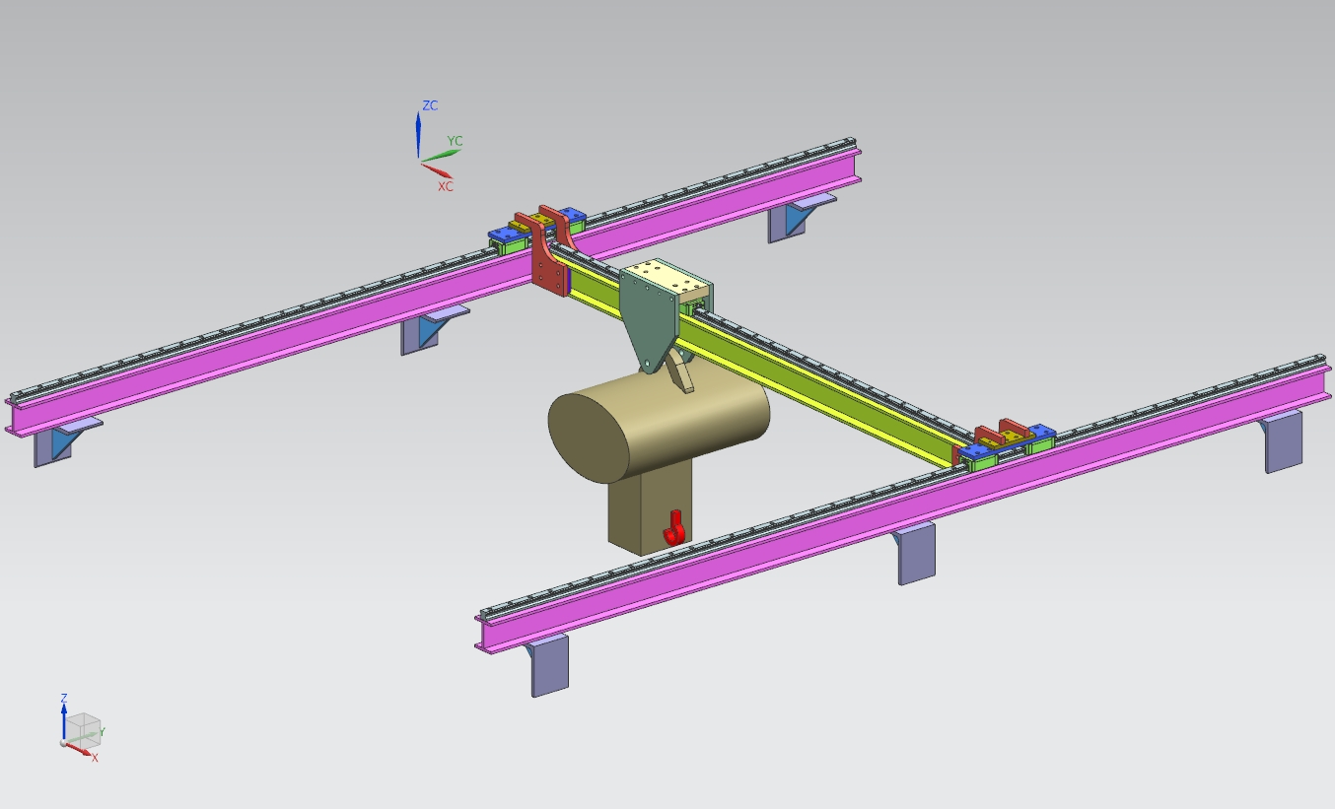
LIFTS INSIDE HOT CELL
A gantry style lift is in development for inside each hot cell
500-to-1000-pound capacity
X-Y translation
Needed for opening internal storage and moving equipment around

Slide 15
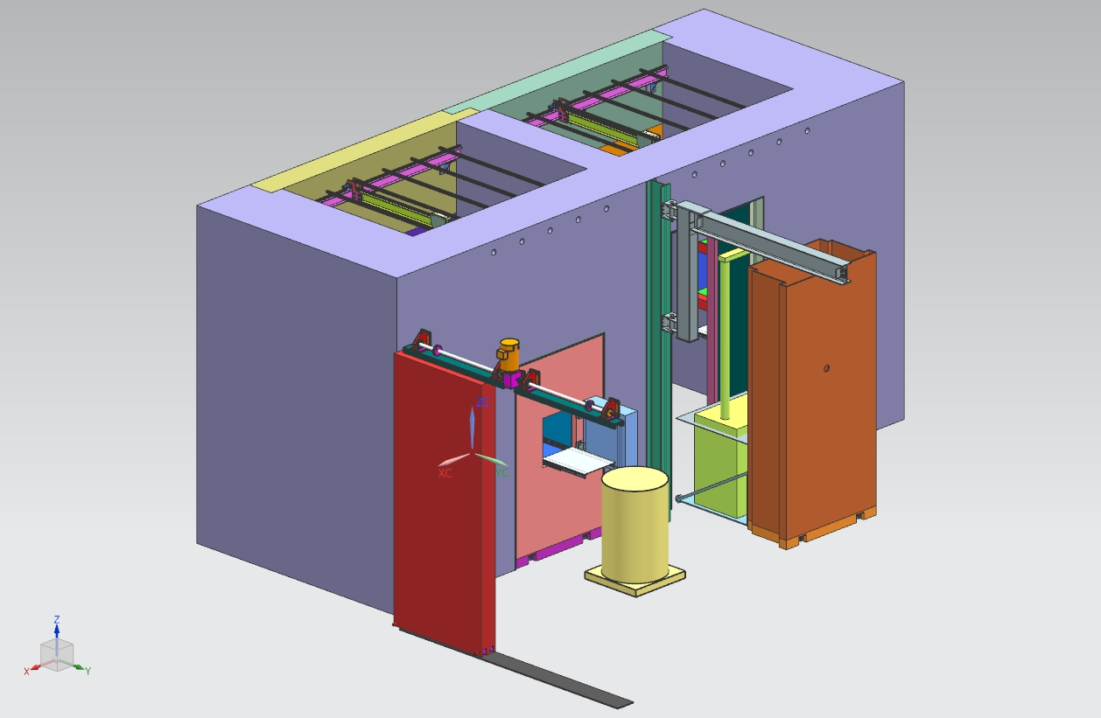
LIFT IN LOADING ROOM
A beam mounted jib crane is proposed for the loading room.
1 Ton capacity
Used to open shipping containers and to move large equipment.

Slide 16
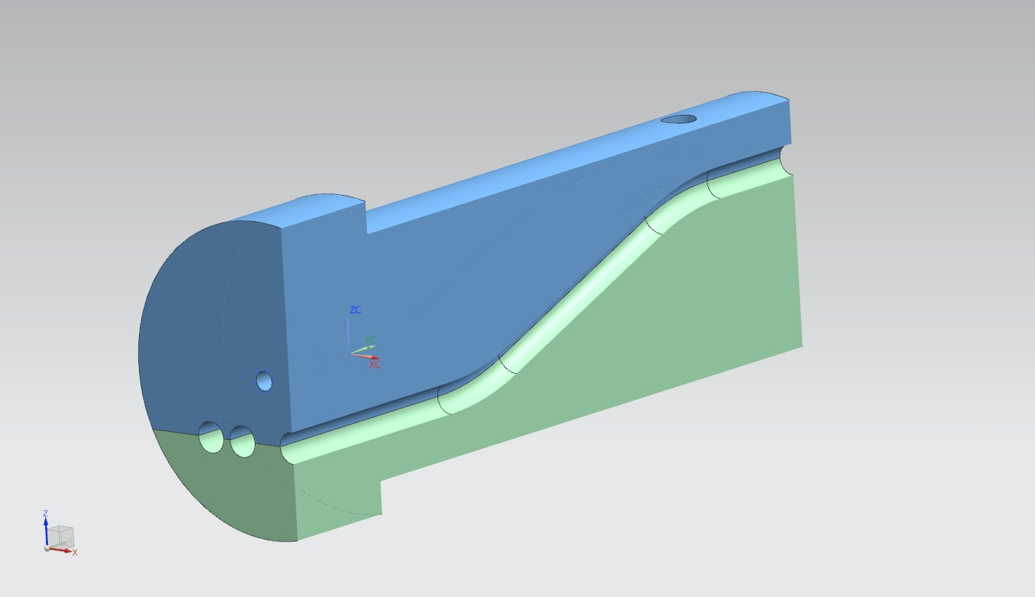
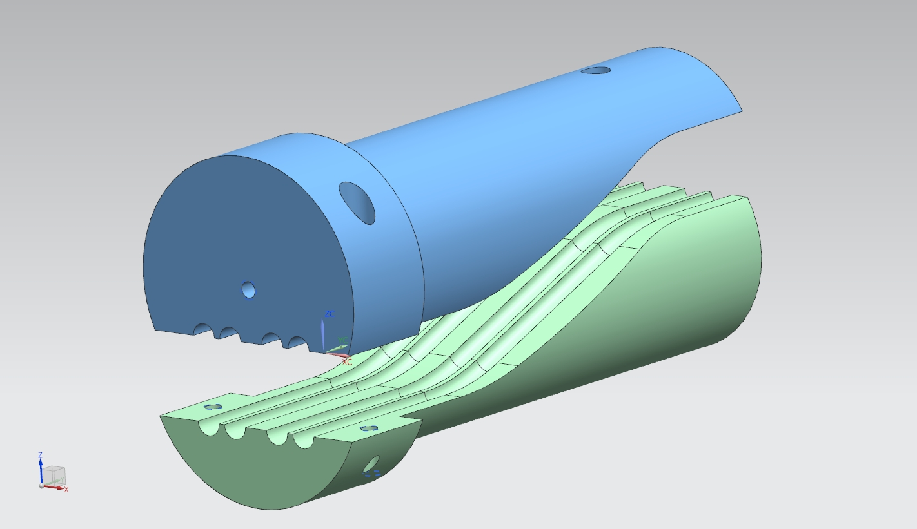
INSTRUMENTATION PENETRATIONS
Conceptual plan for instrumentation feed throughs in steel wall.
Stepped plug for overlapping joints.
Mating clamshell design
Either multiple designs for different cables or hoses
Or inserts that can be swapped of for different configurations

