Slide 1

2011 Fall Project X Collaboration Meeting
SCREAMm Results for Longitudinal Dynamics
in Pulsed Linac
G.Cancelo, Yu.Eidelman, S.Nagaitsev, N. Solyak, W. Schappert, Yu. Pischalnikov
25-27 October 2011 Fermi National Accelerator Laboratory

Slide 2
The code SCREAMm is a modified version of the old code SCREAM – SuperConducting RElativistic particle Accelerator siMulation.
Main new features:
More realistic expression for the vector-sum;
Friendly GUI;
More realistic appoach to take into account the Lorentz force detuning (LFD).

Slide 3
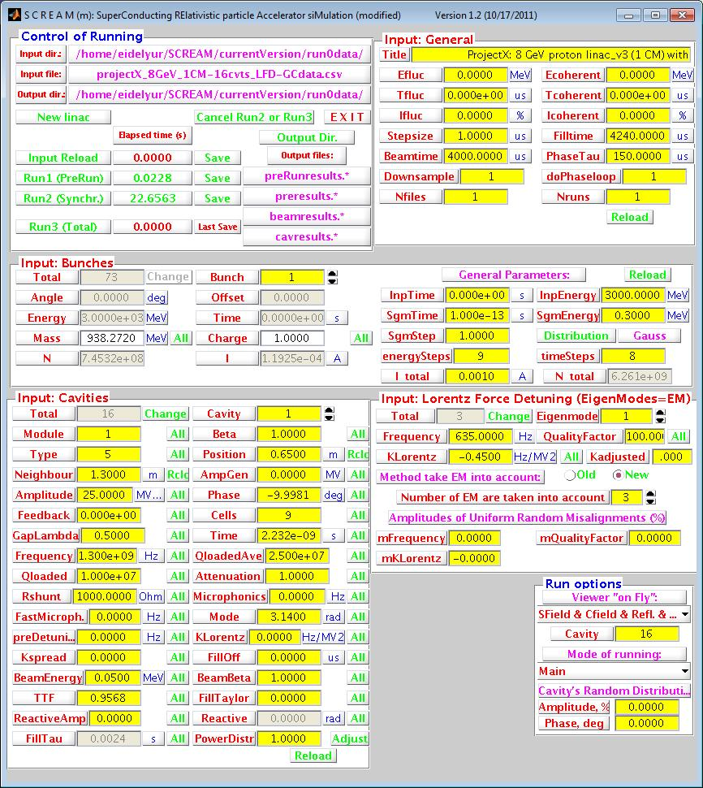
Main Window of GUI for code SCREAMm

Slide 4
Model-1 to simulate effect due to LFD
LFD equation:
Simplest model:

Slide 5
Solution
of LFD
Equation

Slide 6
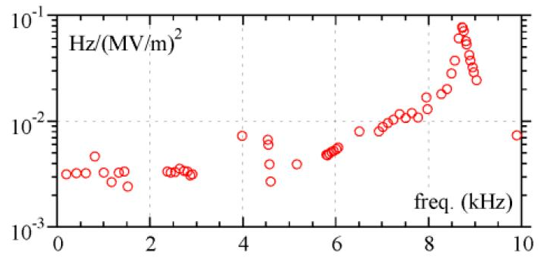
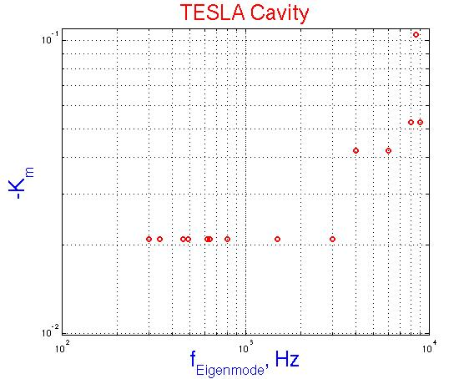
Dynamical Lorentz coefficient
M. Luong et all. EPAC2002-THPD0011
Data were used
For simulation:

Slide 7
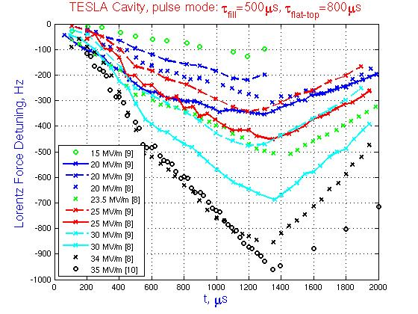
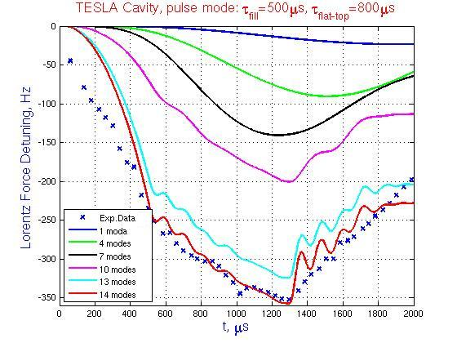
Set of Experimental Data
of the LFD Measurements
Simulation of the LFD
taking into account the different number of the eigenmodes

Slide 8
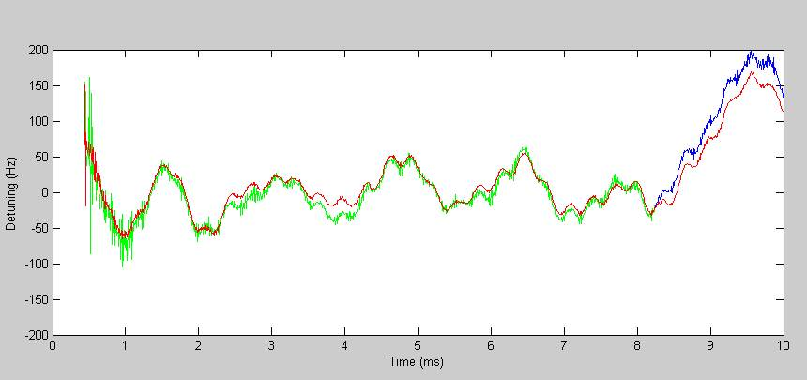
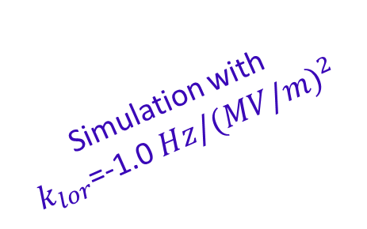
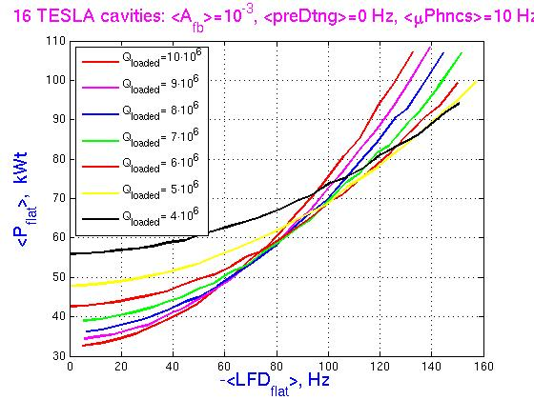
Detuning TESLA Cavity – First Experimental Data
(W. Schappert and Yu. Pischalnikov)
Model-2 to Simulate Effect due to LFD
for Long Pulse
Spectrum:
Simulation with
$k_{lor}$=-1.0 $Hz/{(MV/m)}^{2}$
UNACCEPTABLE level
of the Energy Gain !

Slide 9
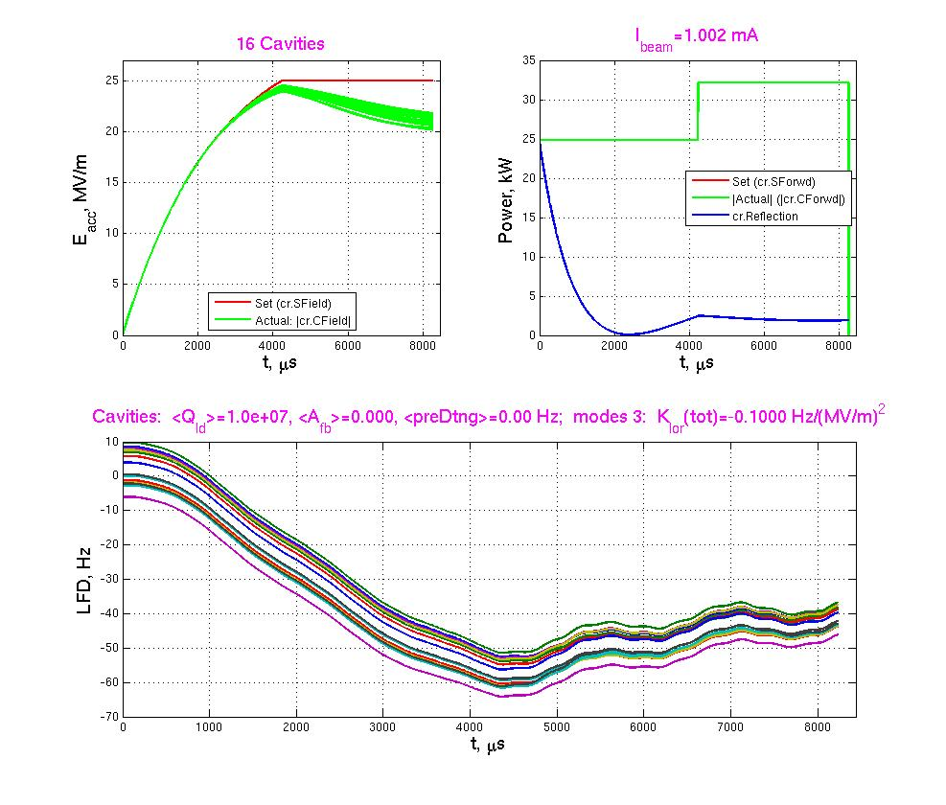
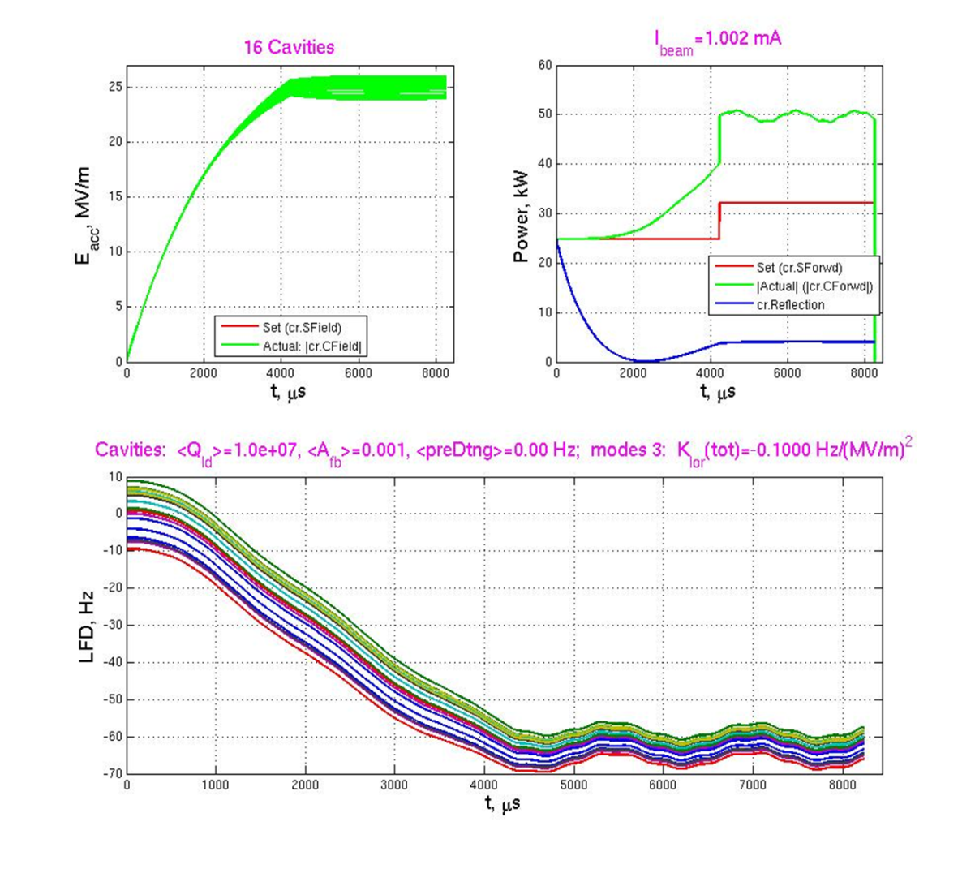
No preDetuning, No Feedback
Low Energy Gain
Spread of
Energy Gain
Power overhead
+ Feedback

Slide 10
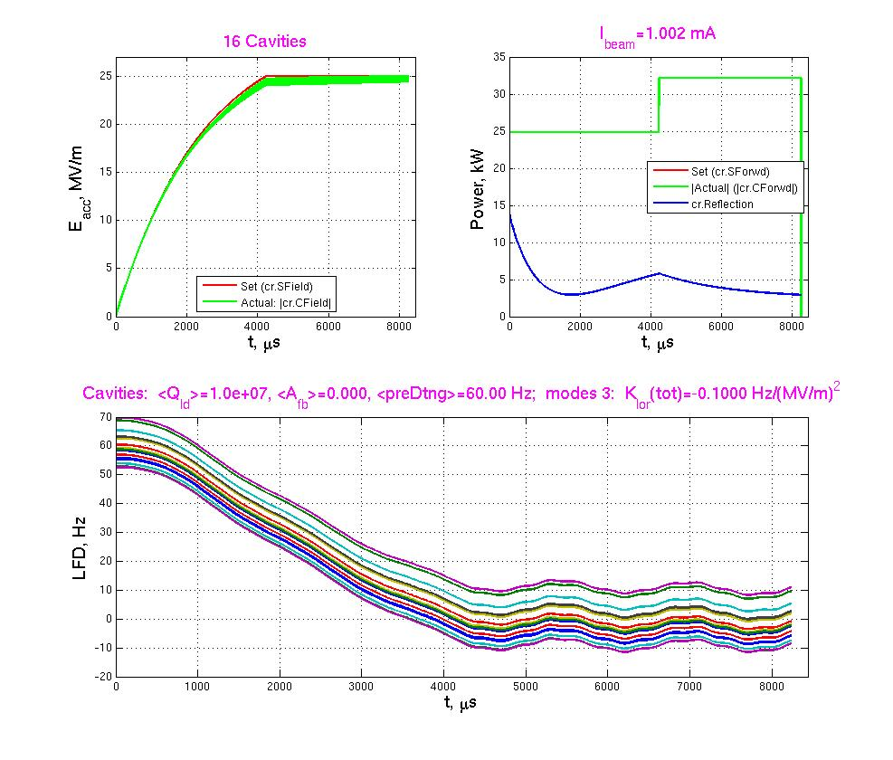
No preDetuning, No Feedback
Low Energy Gain
Spread of
Energy Gain
+ preDetuning 60Hz

Slide 11
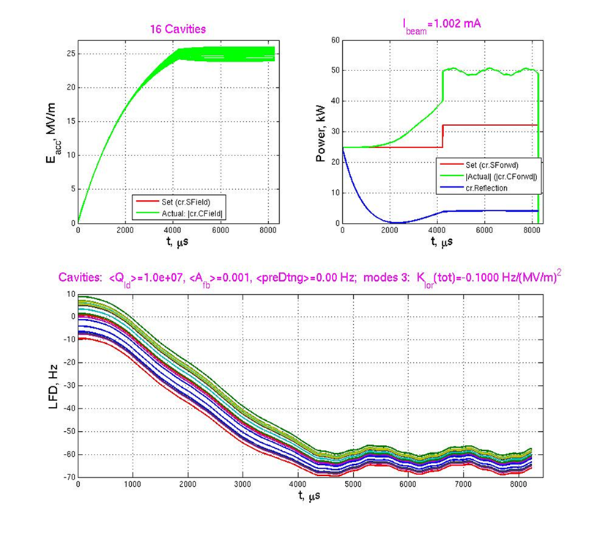
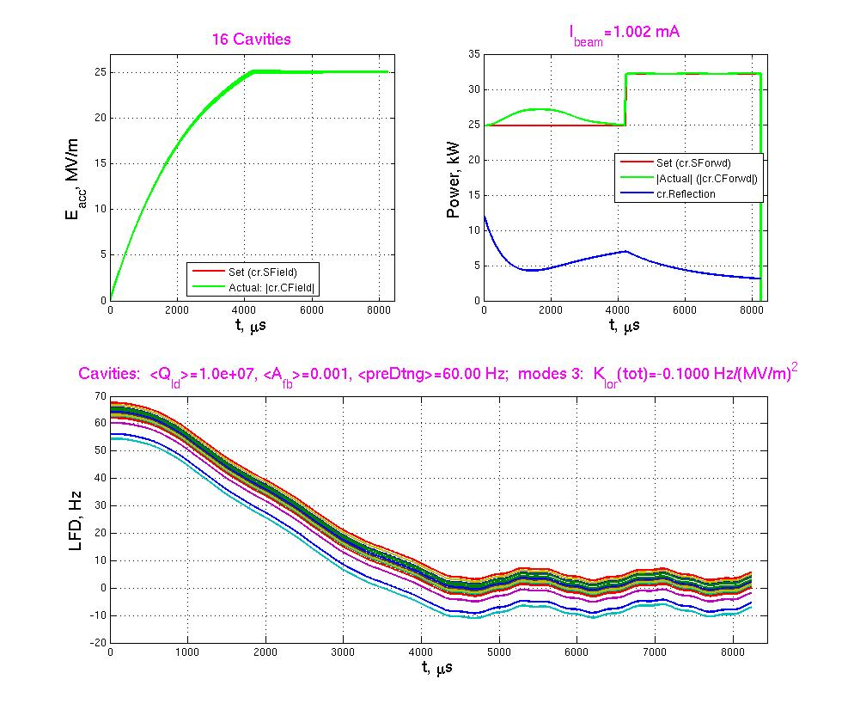
No preDetuning + Feedback
Spread of Energy Gain
Power overhead
Reasonably !
+ preDetuning 60 Hz

Slide 12
Power vs LFD
Conclusion: good agreement with G. Cancelo’s result

Slide 13
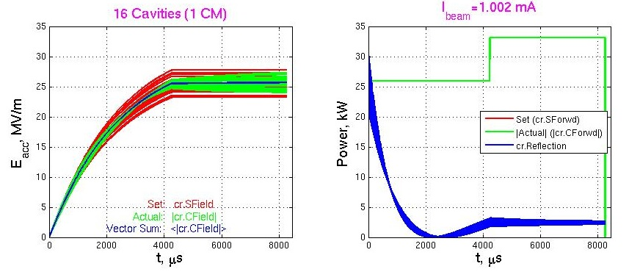
Gradient Spread Error ( )
– nominal gradient, cavity quality factor, and power (same for all cavities);
– gradient, cavity quality factor, and power for cavity number k
Distribution for cavity quality factor and power:

Slide 14
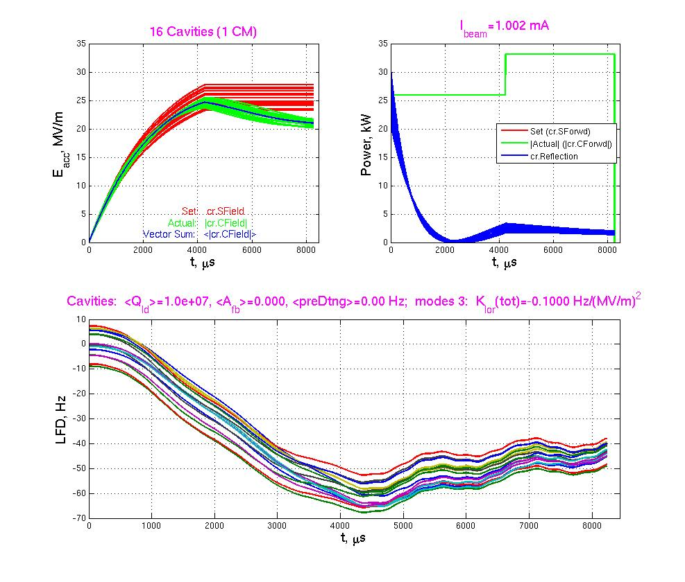

Slide 15
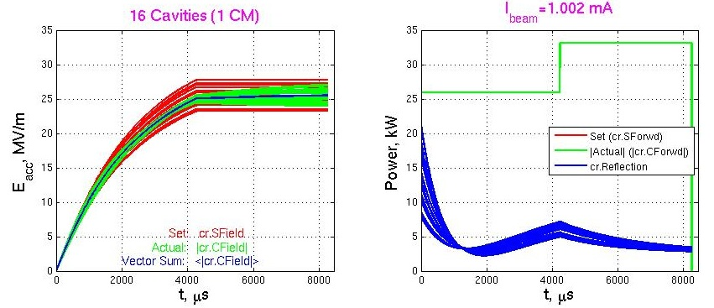
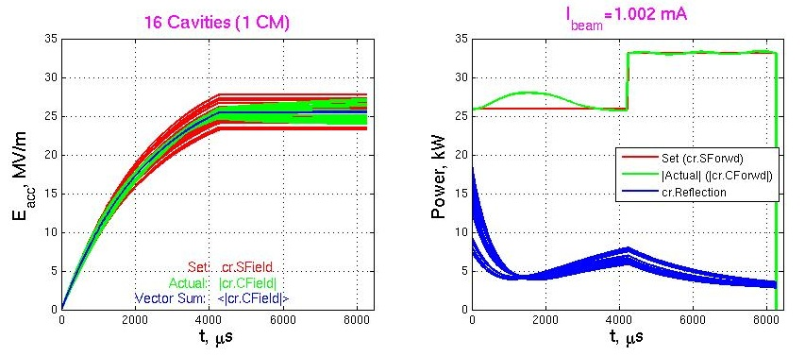

Slide 16
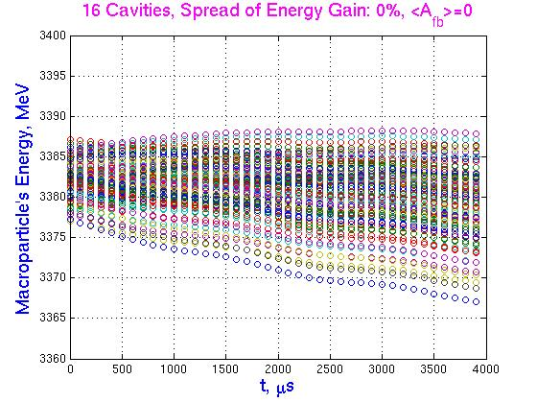
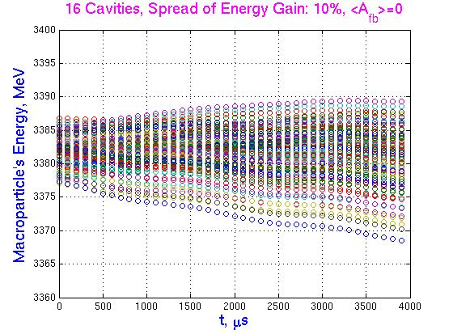
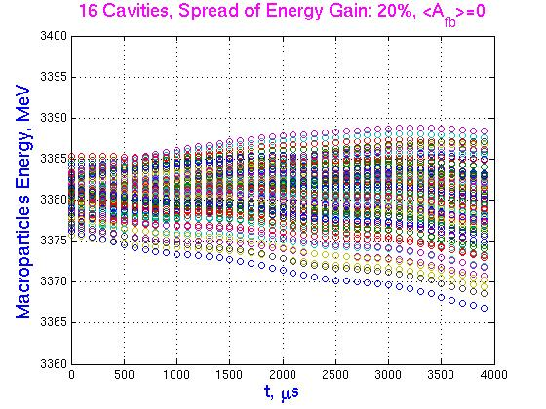
Time Dependence of Energy
at the End of 1st RF Station (2 CM)

Slide 17
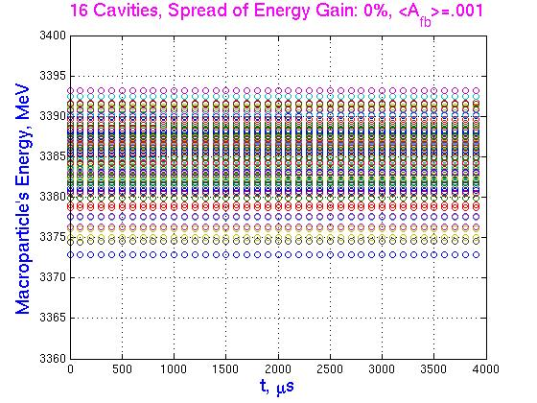
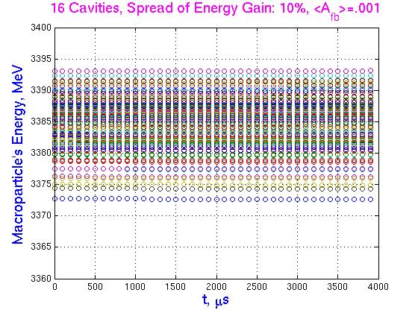
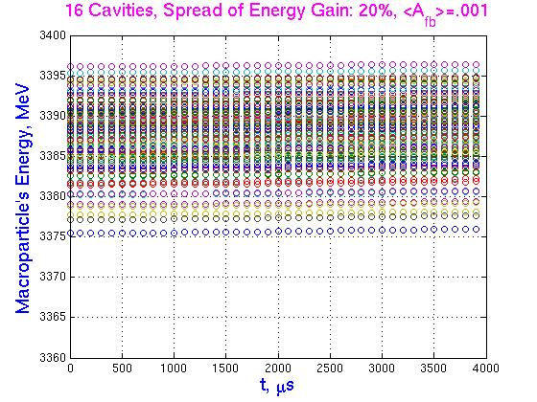
Time Dependence of Energy
at the End of 1st RF Station (2 CM)

Slide 18
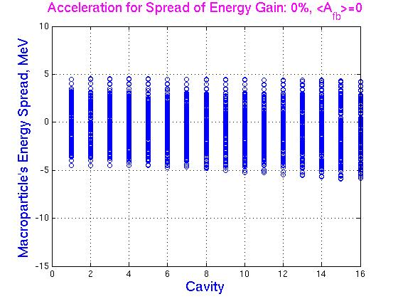
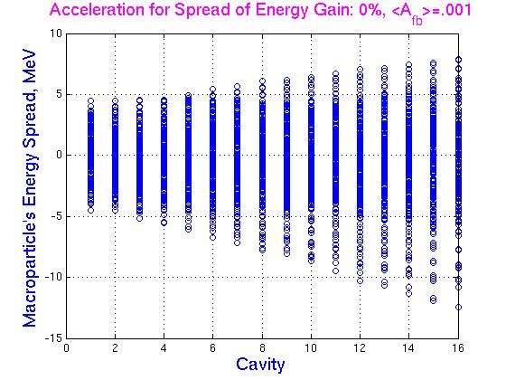
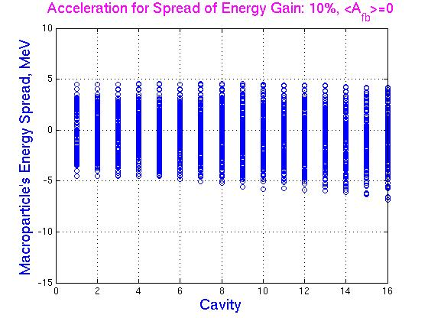
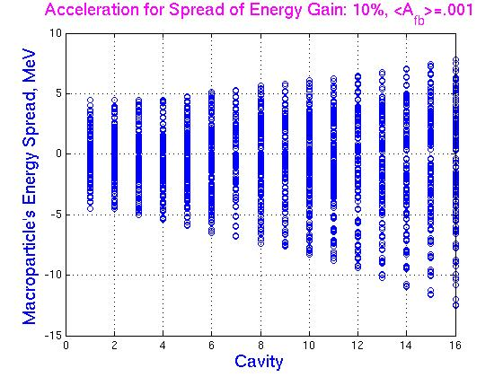
Energy Spread of the Macropartcles (16 Cavities)

Slide 19
Plans and next steps:
Realistic LFD model based on experimental data (W.S. & Yu.P.);
Investigation of total linac (208 cavities);
Taking into account energy and time jitter, fast microphonics.
Thanks for attention.

