Slide 1
Status and Plans for the IPM and Electron Beam Profiler
R. Thurman-Keup and J. Zagel
Project X Collaboration Meeting
October 26, 2011

Slide 2
Existing MI IPM’s
Existing Electrostatic (Ions) units at Q102 (Horizontal) and Q103 (Vertical) good for only 8 GeV measurements. Both will be decommissioned and removed.
Vertical will be replaced with new Magnetic Unit to collect electrons @ Q103. Existing Mark-2 at Q104 (Horizontal) has been commissioned and is in use.

Slide 3
Recycler IPM’s
New magnetic unit is in the design stage for installation during the NOVA shutdown.
Vertical at 103, Horizontal at 104
New magnet design required to accommodate tight spacing between ceiling and beam pipe center. Both will be 1KG magnetic field in data collection region. Single correction magnet either upstream or downstream.

Slide 4
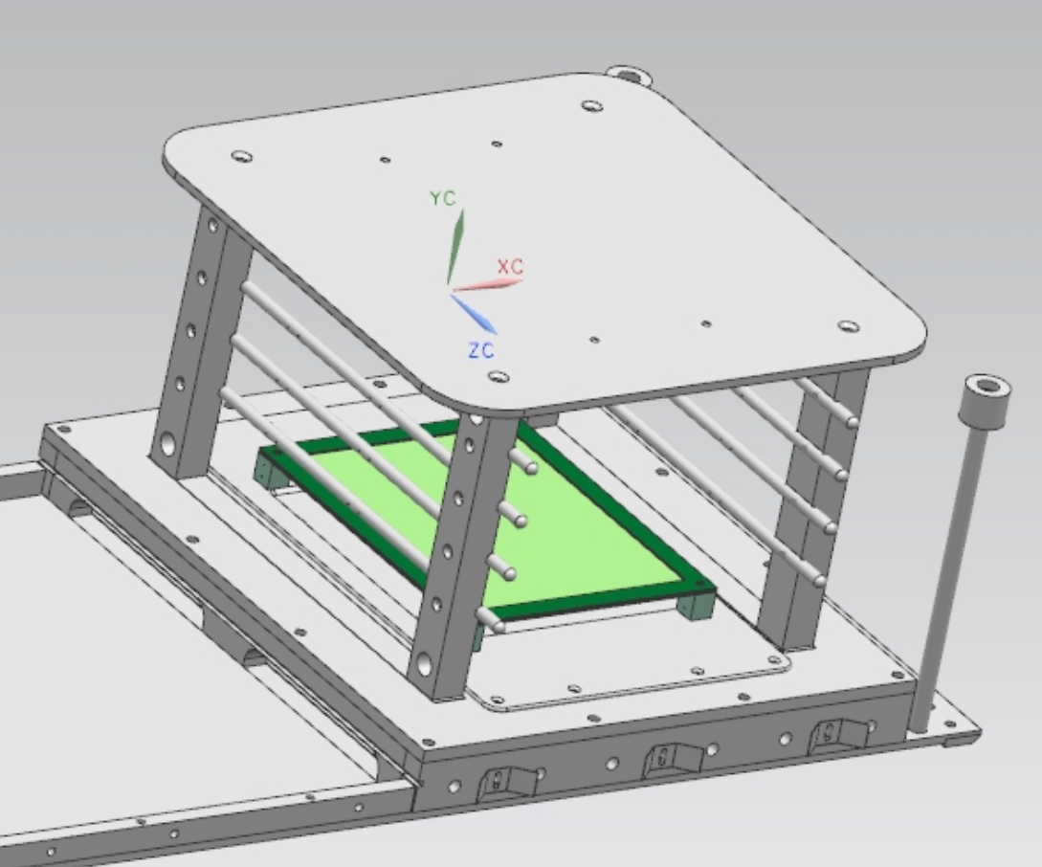
IPM Improvements
Addition of a new control grid to gate a portion of the beam of interest. About 1 booster batch up to a full revolution.
Will potentially save Micro Channel Plate lifetime.
Goal to have MCP’s last ~ 1 year.
Grid switched to give a skewed E-field driving unwanted electrons away from data collection area.
Model by T. McLaughlan – Valparaiso University

Slide 5
Electron Beam Profile Scanner
High beam power in MI/RR implies the need for non-invasive instrumentation
  Electron beam deflection technique is one choice (working implementation at SNS)
Electron beam is deflected by electric
and magnetic fields of the protons
Deflection
Angle
Electron beam
Proton beam out of page
Deflection vs. Angle provides information about the proton beam transverse profile

Slide 6
Electron Beam Profile Scanner
Various techniques for measuring deflection
  Fast scan through peak of bunch
    Requires fast deflector (< 1 ns sweep time)
    Camera to image sweep
  Slow scan, akin to flying wires (most likely solution in short time frame of Nova)
    Position the beam and record the maximum deflection as the beam passes by
      Camera readout (possibly need intensified version to see the peak deflection)
      Strip readout
        Conductive strips provide deflection position
        If designed carefully, can extract longitudinal bunch shape as well ( Need ~ 1 GHz bandwidth )
Collaborating with Wim Blokland at SNS who is doing simulations of the various techniques

Slide 7
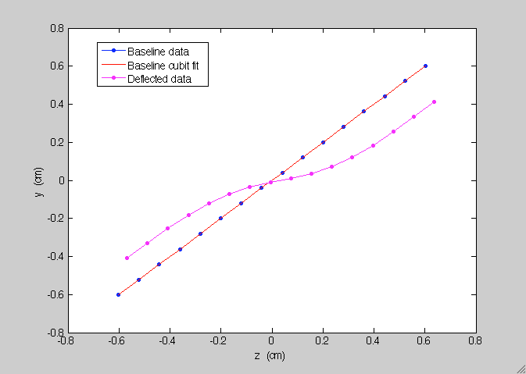
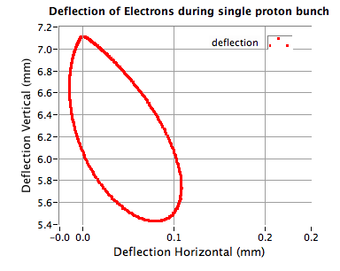
Electron Beam Profile Scanner
Fast Scan
Stationary Beam
From Wim Blokland

Slide 8
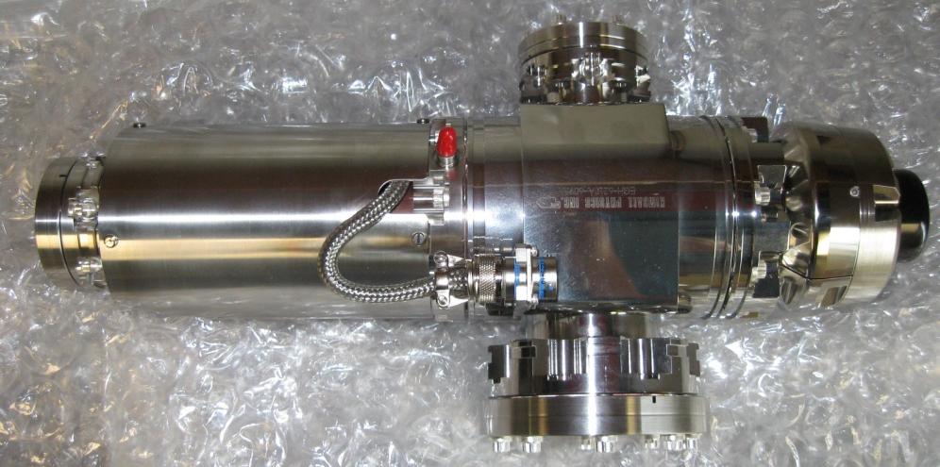
Electron Beam Profile Scanner
Commercial source: Kimball Physics electron gun
  Model EGH-6210
  Typically designed for electron microscopes
  LaB₆ cathode, up to 60 KeV, 6 mA gateable, <100μm spot size
Issues
  Comes with Short cables to supply 60 kV to avoid stored energy in cables
  Need long cables to make it into tunnel
    Fermi-built cables with resistive protection??? It’s DC…

Slide 9
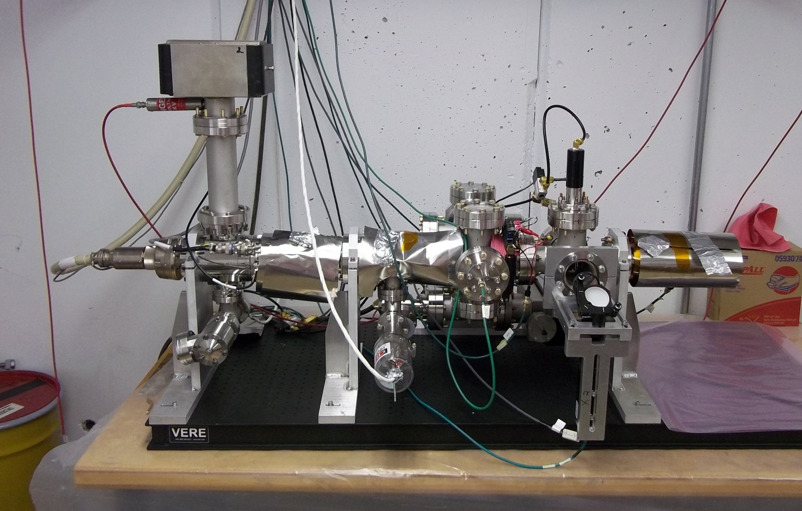
Electron Beam Profile Scanner
NWA Test Setup
OTR Screen and
CCD camera
Wires to simulate
Proton beam
Electron Gun

Slide 10
e Beam: Spot Size Measurements
Gun has internal solenoid
  Scanned beam through waist
  at screen X1
Scanned beam sizes from Ce:YAG screens (1 μA beam)
Scanned beam sizes from OTR screens
(1 mA beam)

Slide 11
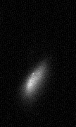
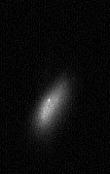
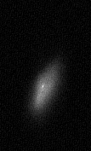
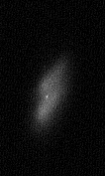
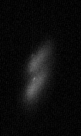
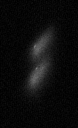
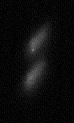
e Beam: Deflection Experiment
Wire to simulate proton beam
e Beam pulsed for 40 μs
Wire pulsed for 20 μs
Half the time the beam is deflected
0V
50V
100V
150V
200V
250V
300V

Slide 12
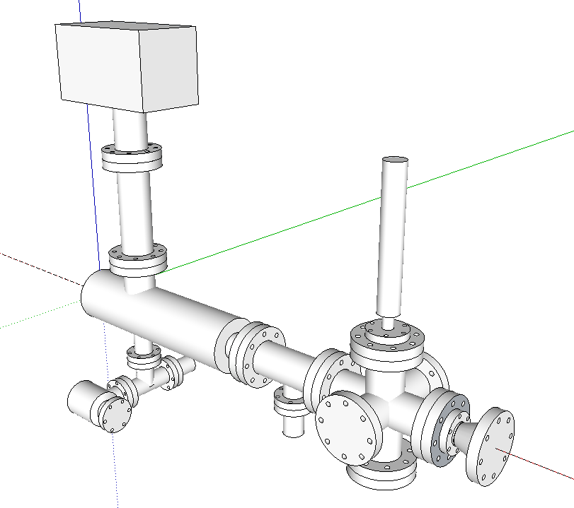
Electron Beam Profile Scanner
Pneumatic Insertion
e Beam Imaging Screen
e Gun Cables
Proton Beam
Electrostatic
Deflection
36 inches
Electron Gun
Incl. focusing
solenoid, and
steering/focusing
magnets
Detection element
Rad Hard Camera
for e Beam imaging

Slide 13
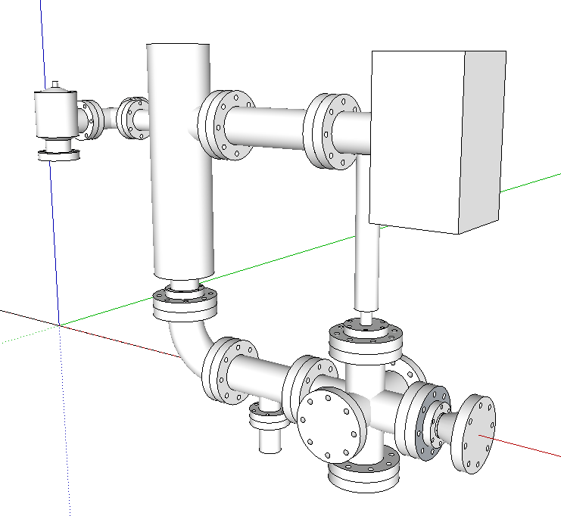
Electron Beam Profile Scanner
Proton Beam
90 deg bend
magnet here
20 inches

Slide 14
Electron Beam Profile Scanner
May need magnetic shielding
  SNS has iron pipe surrounding mu metal
  Depends on location of device
Would like to try to install something next year
  Have 1 gun ($70K; only measure one plane)
  Need a rad hard camera ($8K)
  Detection elements (??? Could be $20K or more)
  Various vacuum stuff ($20K??)
  Computer readout stuff (???)

