Slide 1
Project X Pulsed Linac (3-8 GeV)
Goals, Deliverables in FY12
N.Solyak (on behalf of PrX team)
Fermilab
Project X Collaboration Meeting, FNAL, Oct.25-27, 2011

Slide 2
Plan of talk
Layout, general parameters
Components: cavity, magnet, CM, HLRF
HLRF
LLRF and long-pulse operation issues
Lattice and beam dynamics studies.
Plan FY12.
Conclusion

Slide 3
Concepts of SC CW 3GeV and Pulsed 3-8 GeV Linac
H⁻gun
RFQ
MEBT
HWR
SSR1
SSR2
β=0.6
β=0.9
ILC
RT
CW
Pulsed
RT (~15m)
325 MHz
2.5-160 MeV
650 MHz 0.16-3 GeV
1.3 GHz 3-8 GeV
Section | Freq, MHz | Energy(MeV) | Cav/mag/CM | Type
HWR (β_{G}=0.11) | 162.5 | 2.1-10 | 9 /6/1 | SSR, solenoid
SSR1 (β_{G}=0.22) | 325 | 10-32 | 16 /10/ 2 | SSR, solenoid
SSR2 (β_{G}=0.47) | 325 | 32-160 | 36 /20/ 4 | SSR, solenoid
LB 650 (β_{G}=0.61) | 650 | 160-520 | 42 /14/ 7 | 5-cell elliptical, doublet
HB 650 (β_{G}=0.9) | 650 | 520-3000 | 152 / 19/ 19 | 5-cell elliptical, doublet
ILC 1.3 (β_{G}=1.0) | 1300 | 3000-8000 | 224 / 28/ 28 | 9-cell elliptical, quad

Slide 4
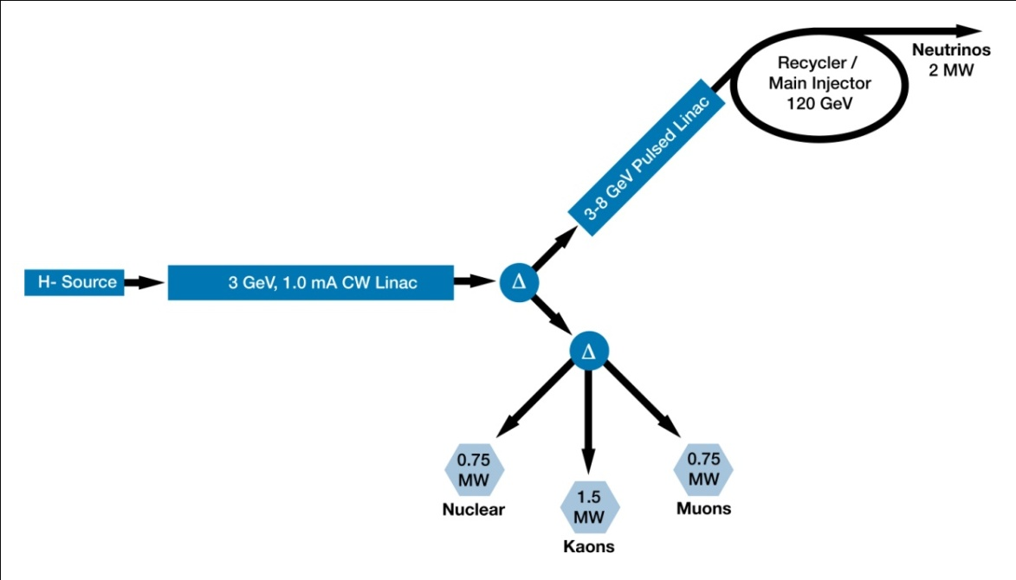
Reference design: accelerator scope
Warm cw front end 162.5 MHz, 5 mA (H- ion source, RFQ, MEBT, chopper)
3-GeV cw SCRF linac (162.5,325, 650 MHz), 1-mA average beam current
Transverse beam splitter for 3-GeV experiments
3-8 GeV: pulsed linac (5% duty cycle), 1.3 GHz
Recycler and MI upgrades
Various beam transport lines
Pulsed dipole
5% duty cycle
Pulsed 1.3 GHz linac baseline configuration (established Nov. 2010)
  25 MV/m gradient
  1 mA (2mA) beam current in 4.3 ms pulses
  1 Klystron per 8 (16) cavities (1 or 2 CM’s)
  8.3 ms, 10 Hz

Slide 5
Concept of beam chopping
Linac beam current has a periodic time structure (at 10 Hz) with two major components.
Example for injection at 10Hz (with 1 mA):
Beam to Recycler

Slide 6
Chopping for injection
RF frequency at injection into the Recycler : ~50 MHz
Chopper needs to provide a kicker gap (~200 ns per 11 µs) and needs to remove bunches that fall into “wrong” phase of ring rf voltage.
  50% of bunches are removed ( ion source at 2 mA)
  80% of bunches are removed ( ion source at 5 mA)
162.5 MHz bunches to be removed
Recycler RF

Slide 7
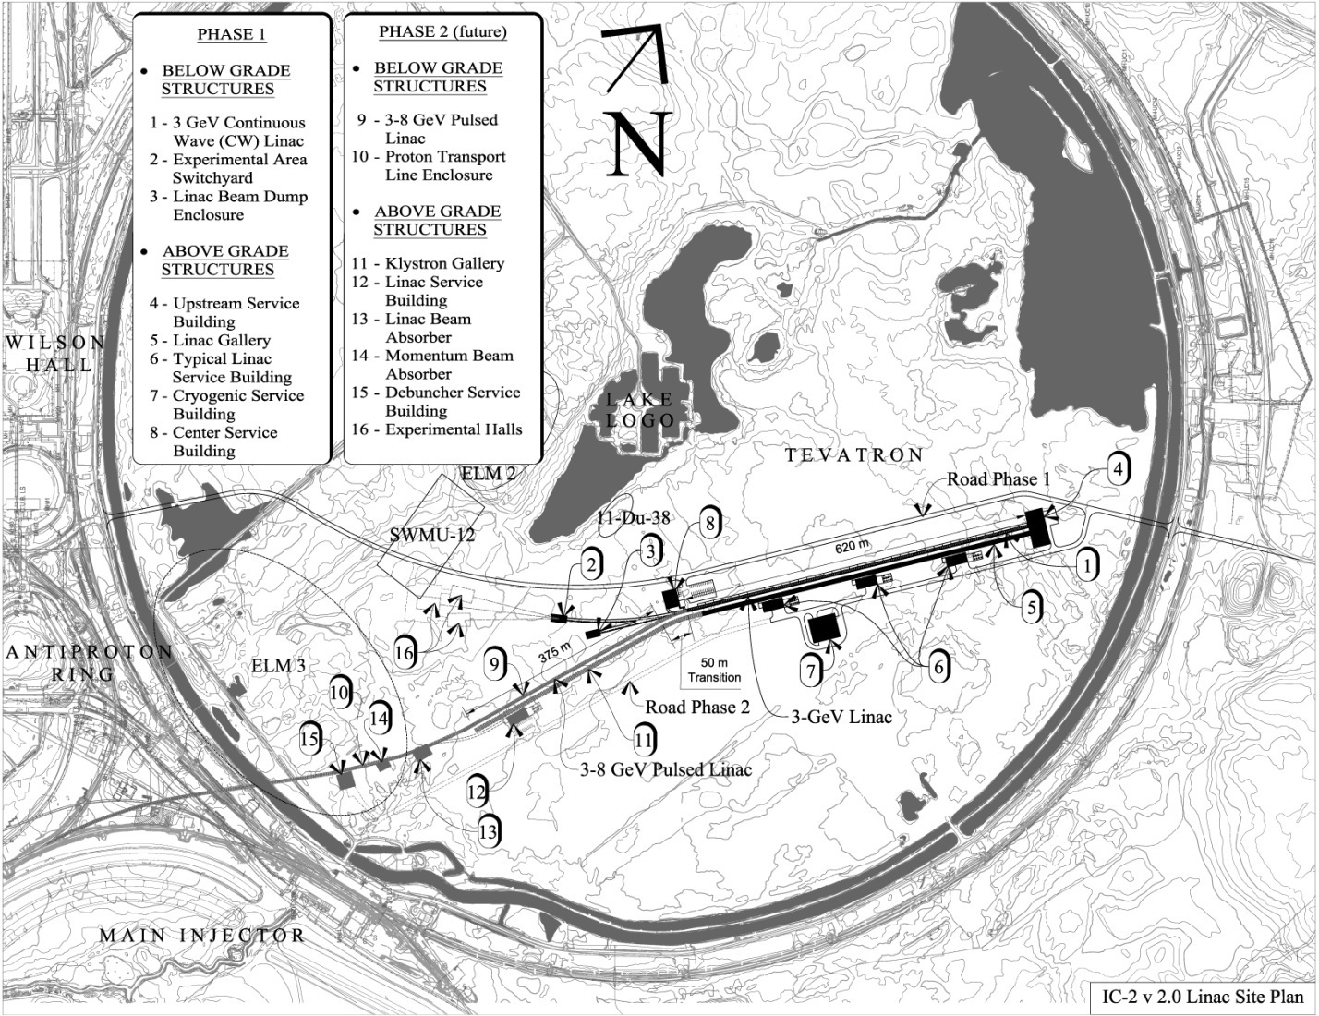
IC-2 siting (with pulsed 3-8 GeV linac)
Switchyard
CW Linac
Pulsed 3-8 GeV Linac is based on ILC / XFEL technology
Pulsed Linac
Transport line to Recycler

Slide 8

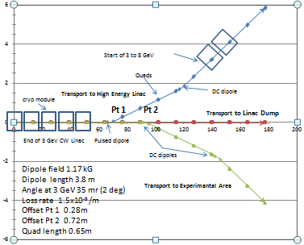
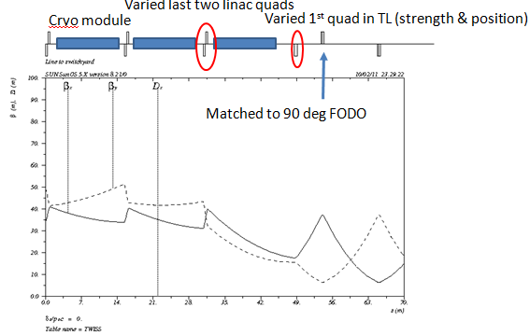
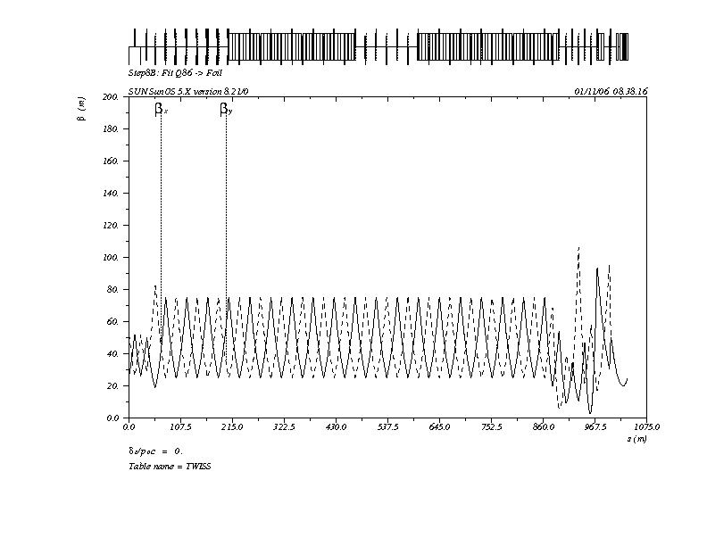
Transport Lines
3 GeV Switchyard
3 GeV Matching from HE650
(need upgrade)
debuncher
A
B
C
D
E
F
G
Momentum collimation foil
foil
8 GeV transport line from Proton Driver design showing basic layout
D.Johnson talk

Slide 9
Basic Parameters of the Pulsed Linac
Cryomodule: ILC type with SC quad in center of CM (8cav/CM)
Focusing : FODO Lattice, each Quad has x/y correctors and BPM
Cavity:
  Average Gradient 25 MV/m; max spread ±10%
  Q₀=1∙10¹⁰; Q_{load}=1 ∙ 10⁷ (Note: Q_{load} for a matched cavity at 25MV, I_{b}=1mA is 2.5∙10⁷ => BW_{1/2} =26Hz, too small to deal with LFD and microphonics)
  Filling time = 4 ms, flat-top = 4.3 ms
RF source:
  Pulse length = 8.3 ms; Rep. rate = 10 Hz
  0.4 (0.8) MW klystron per 1(2) CM’s (5o kW/cav with ~60% overhead)
  Other options: Individual pulsed solid state source per cavity (?) ~50 kW
H⁻ beam:
  - Current = 1 (2) mA; (10 mA peak @ 162.5 MHz)
  - Energy 3GeV; emittance~ 0.25 mm*mrad; σ_{E}/E=0.5MeV(init), < 10 MeV (exit)
  - Synhronous phase -10°

Slide 10
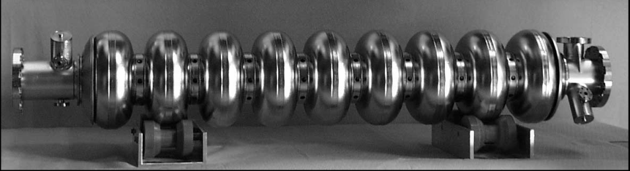
ILC type 1.3 GHz cavity
Freq. | GHz | 1.3
β_geom |  | 1
Length | mm | 1038
R/Q | Ω | 1036
G-factor | Ω | 270
Gradient | MV/m | 25
E_surf | MV/m | 50
H_surf | mT | 106
Q₀ @ 2K | 10¹⁰ | 1.2
*Q₀=1∙10¹⁰ @2K
~106 mT
*Conservative assumption for Q₀ (as XFEL)

Slide 11
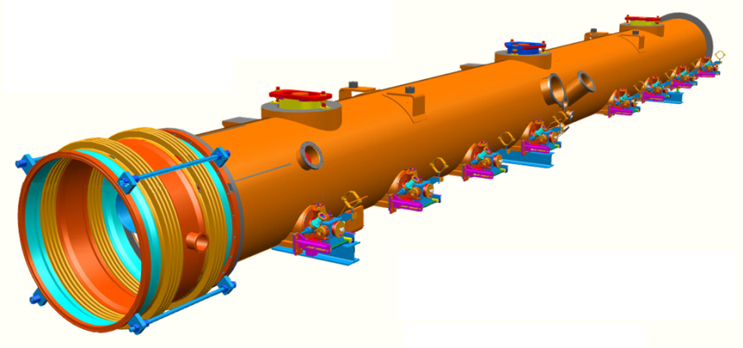
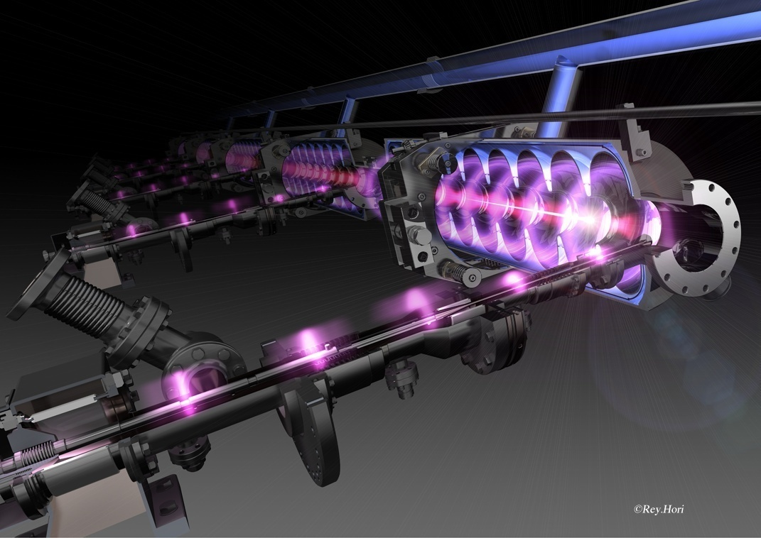
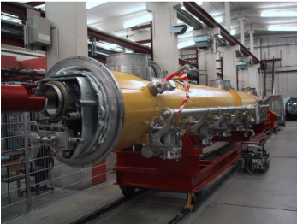
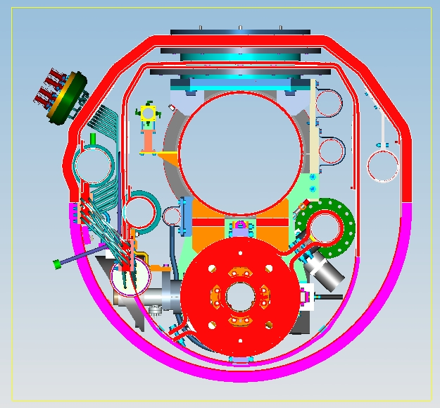
ILC type-IV (1.3 GHz) cryomodule
Possible new design for the main coupler, cheaper (S.Kazakov)
ILC Type-4 cryostat modified (?) for PrX

Slide 12
SC Splittable quadrupole with conduction cooling (V.Kashikhin)
Features:
Assemble outside of clean room (no cavity contamination)
Conduction cooling, no helium vessel.
Prototype built and tested, demonstrated requirement parameters
Ready for PrX, but can be simplified since looser reqs.
Need X/Y correctors.
Task Force in FY12 to develop EM design of splittable magnet for PrX Pulsed Linac
ILC specifications
Parameter | ILC | PrX
Integrated gradient, T | 36 | 3
Aperture, mm | 78 | 78
Effective length, mm | 666 | 600
Peak gradient, T/m | 54 | 4
Peak current, A | 100 | 100
Field non-linearity @ 5 mm radius, % | 0.05 | 0.1
Quad strength adjustment for BBA, % | -20 | ?
Magnetic center stability at BBA, um | 5 | 50
Liquid Helium temperature, K | 2 | 2
Quantity required | 560 | 30
* ILC center motion stability (ΔB/B~20%) 1µm

Slide 13
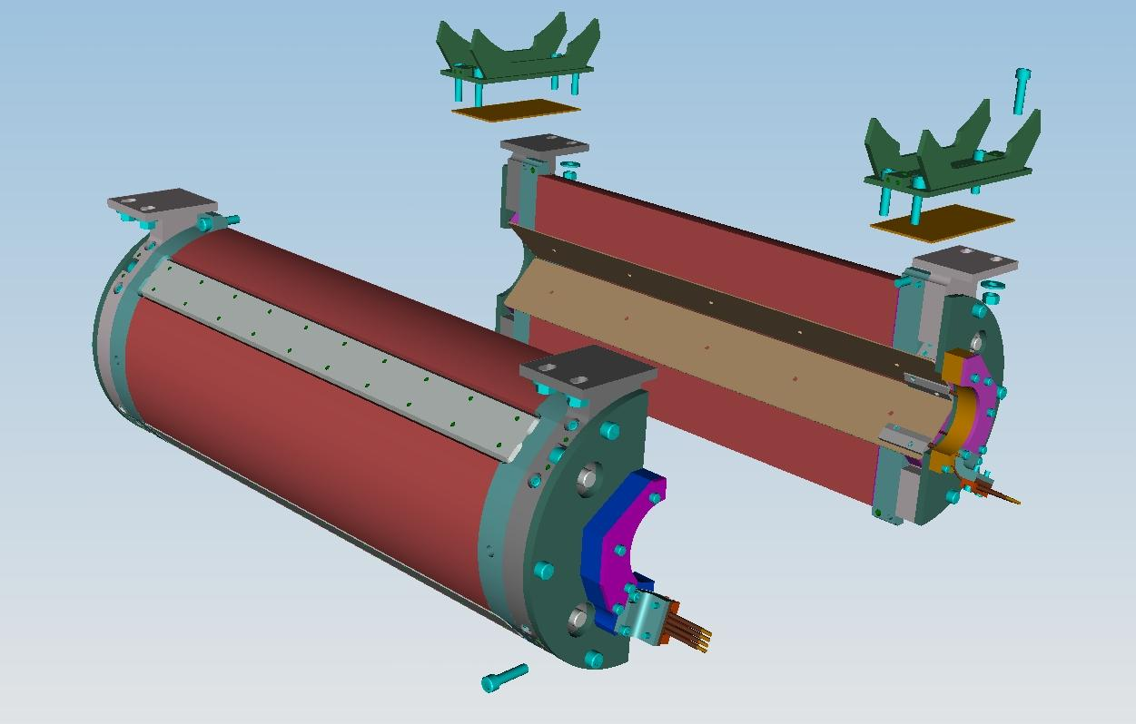
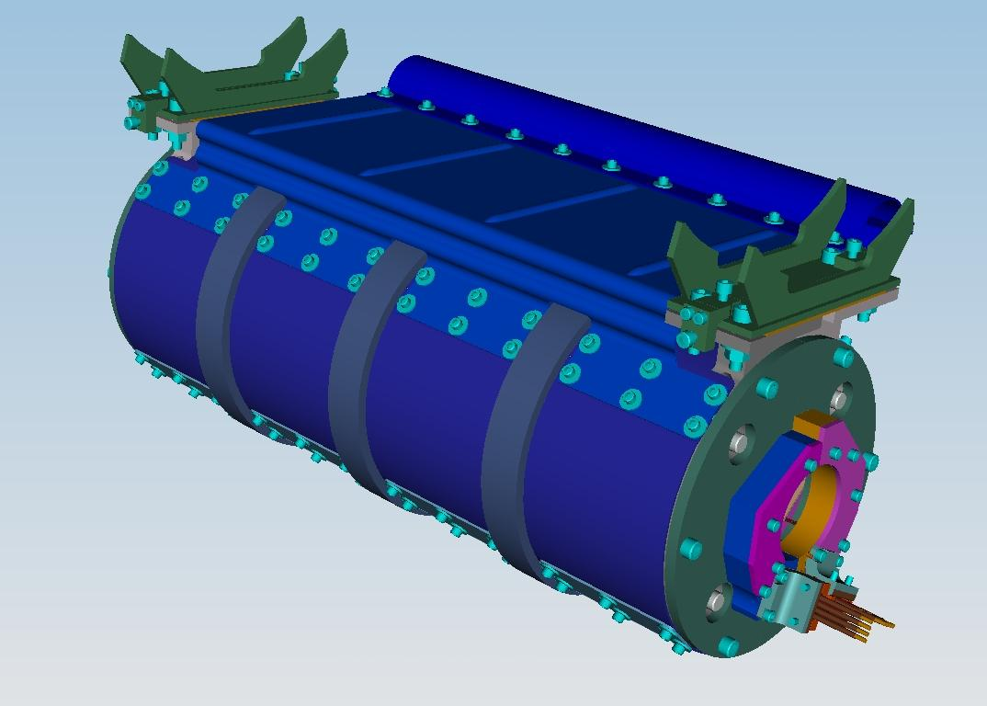
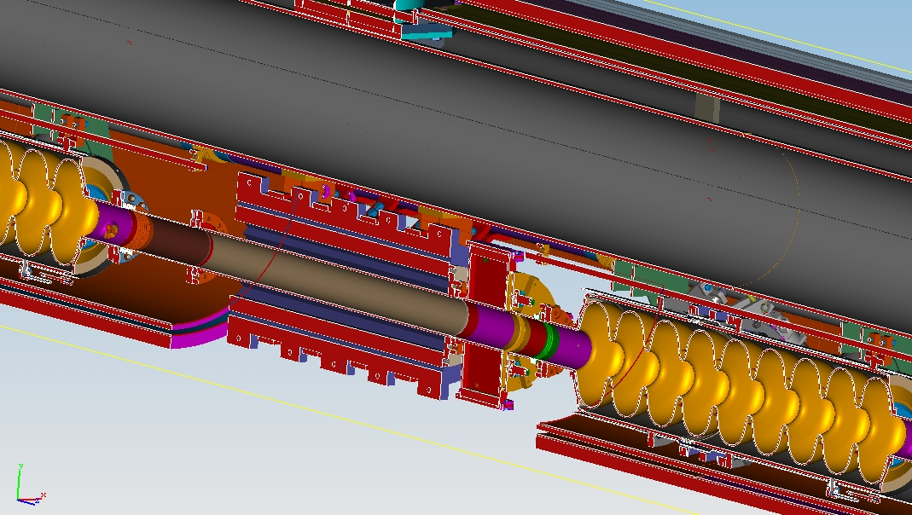
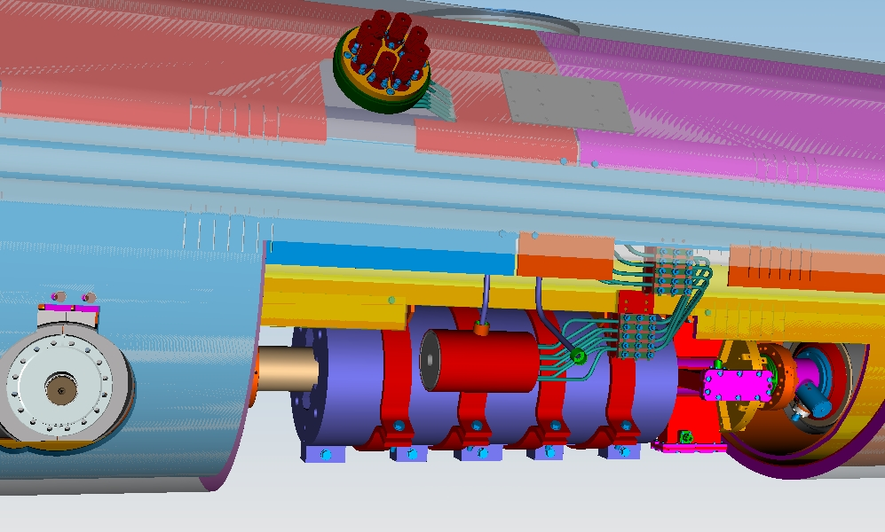
Quadrupole in Cryomodule

Slide 14
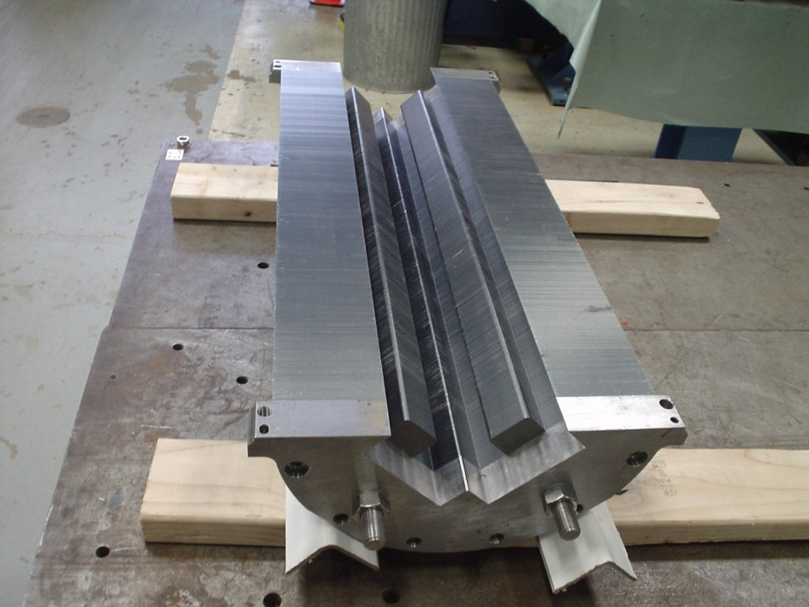
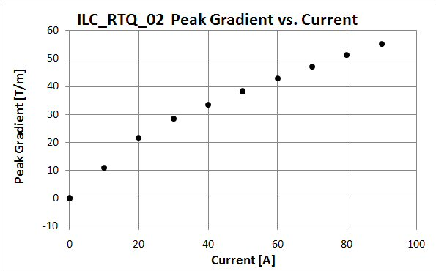
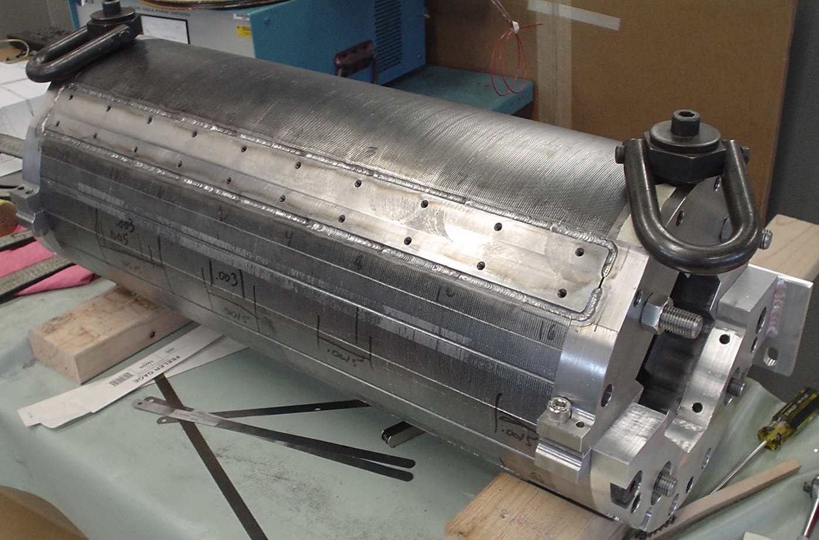
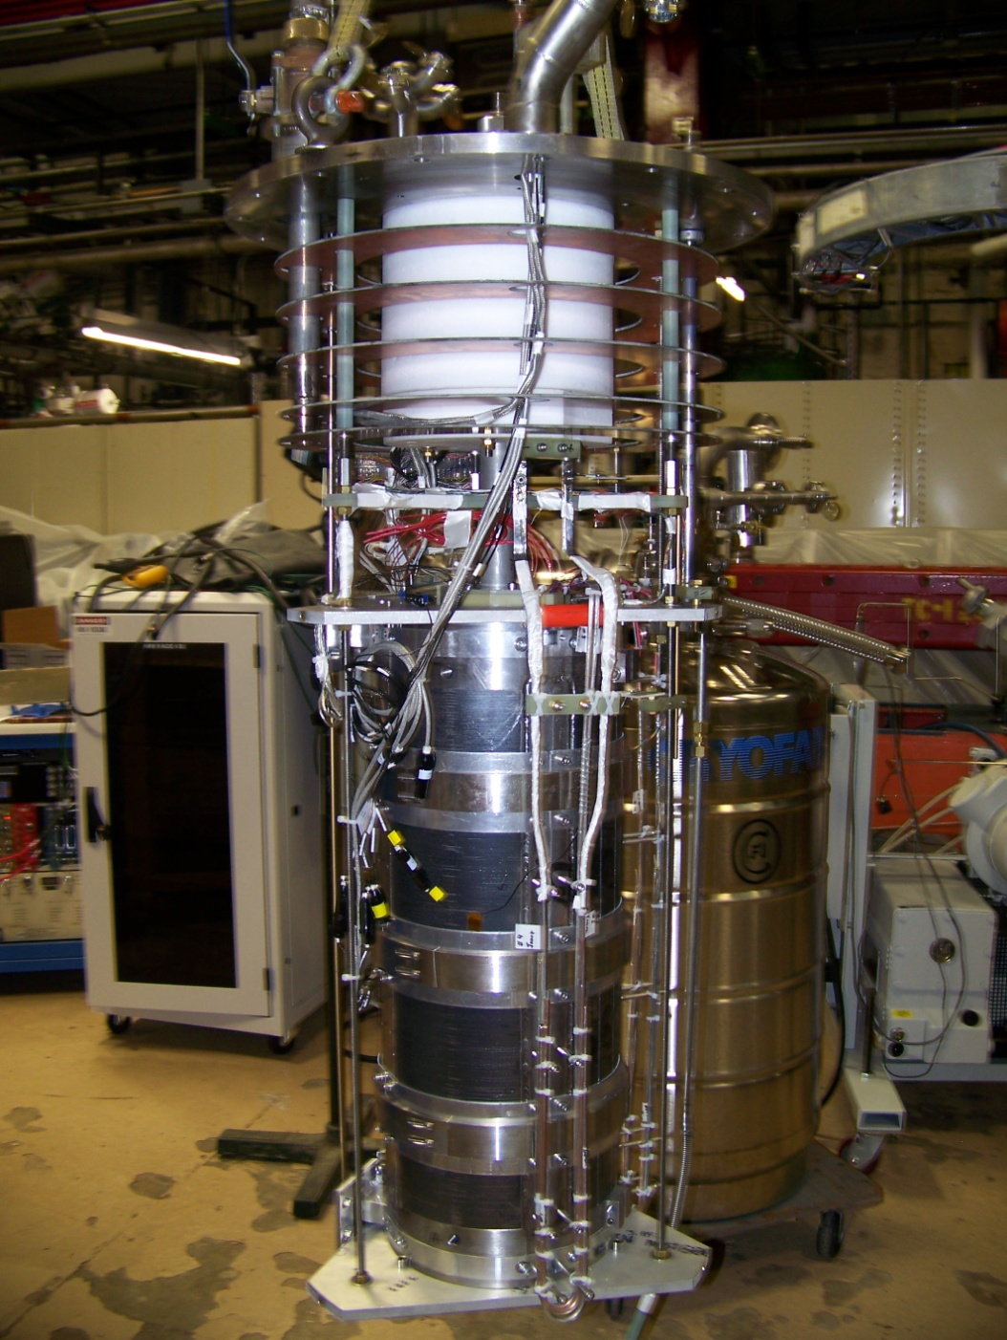
Quadrupole Gradient vs. Current
At 90 A current the quadrupole reached the specified peak gradient 54 T/m.

Slide 15
1.3 GHz Pulsed Linac RF Parameters
J.Reid

Slide 16
1.3 GHz Pulsed Linac RF Summary

Slide 17
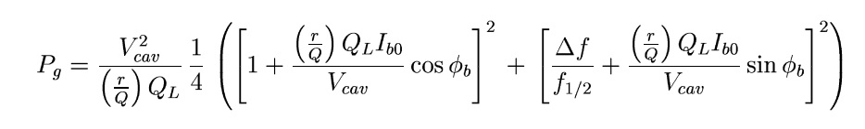
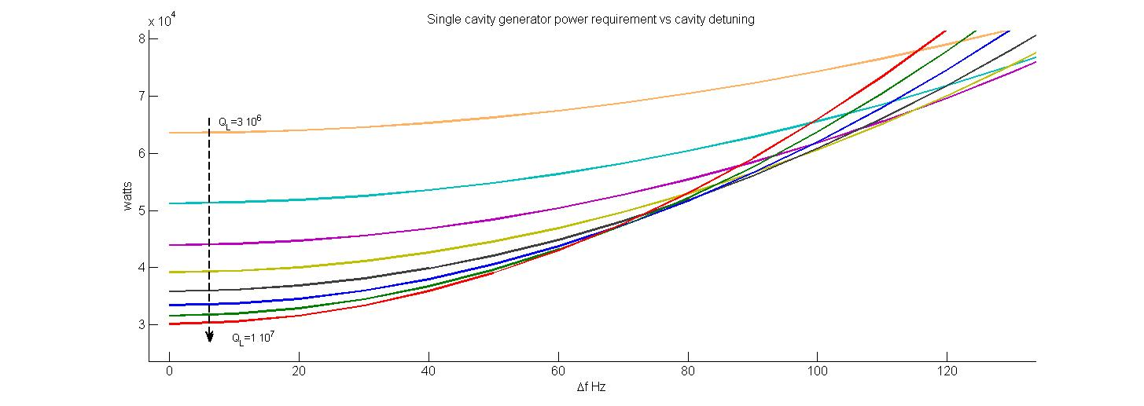
Power vs. LFD and microphonics
For 65 Hz detuning the power requirements for Q_{load} 6∙10⁶ to 1∙10⁷ are very similar
Specs for RF Power overhead ~60% (nominal ~25 kW/cavity, 1 mA)

Slide 18
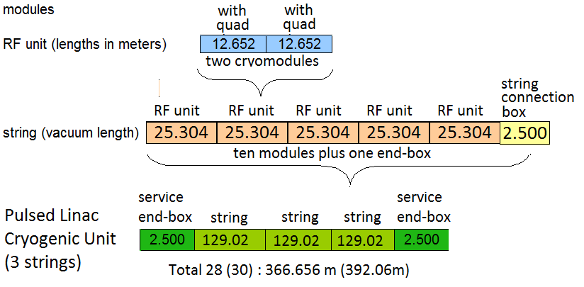
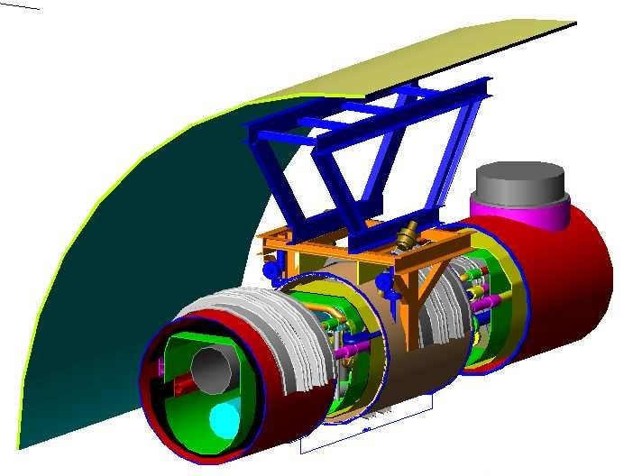
Linac cryogenic segmentation
Cryo-units lenth:
XFEL: 6*strings = 6*12 CMs Pr X: 3*strings = 3*10 CMs
Heat load/CM @2K (Scale from XFEL)
< 9W -static, < 50W -dynamic
String Connection Boxes
contain all cryogenic instrumentation
Bernd Petersen DESY MKS

Slide 19
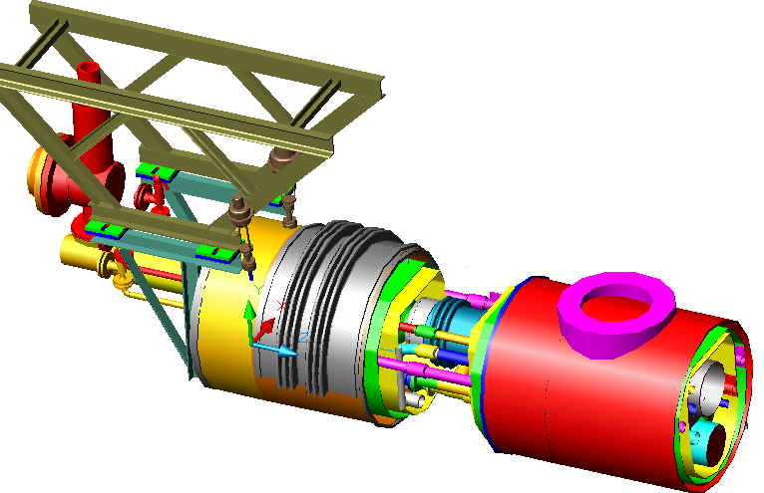
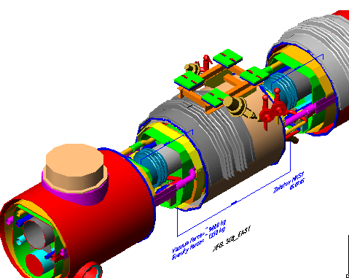
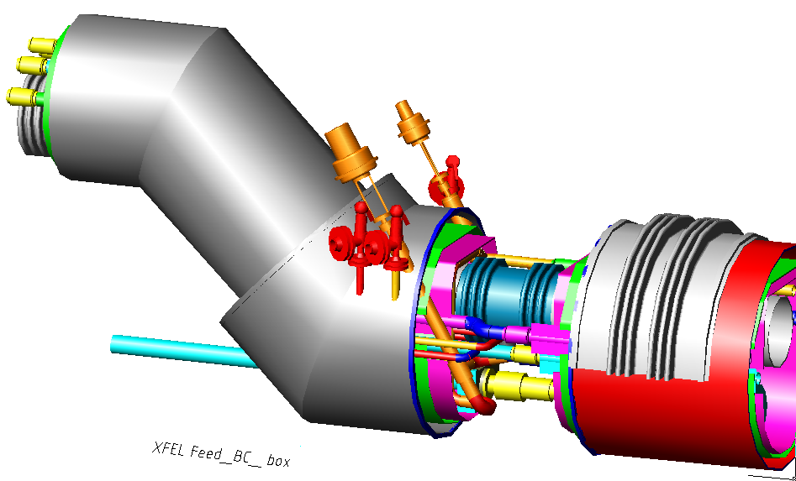
Linac cryogenic components (XFEL design)
‚regular‘ string connection box
End-BOX
Cool-down/warm-up
JT
Feed-Box
Bunch Compressor Bypass Transferline
(only 1-phase helium)

Slide 20
3-8 GeV pulsed LINAC: some outstanding issues
Only VS is regulated (flat), individual cavity gradients tilt (A & φ)
  Non constant beam energy gain along bunch train.
  Potential emittance grow, final energy spread and beam loss due to tilts in amplitudes and phases.
  How do we fix cavity tilts?
LFD: peak to peak detuning, in particular for long pulses.
  Impact of fill time in LFD.
  Active compensation or stiffer mechanical systems?
Gradient spread.
  Reduce gradient spread or minimize impact.
  Find optimum Q_{load} and power distribution for a given gradient spread.
Bringing up the LINAC
  How much gradient overhead is needed to go from I_{beam}=0 to I_{beam}=max?

Slide 21
Summary of preliminary studies for pulsed linac
Beam losses are smaller than for CW linac
  Intra-beam stripping is well below 0.1 W/m
  Magnetic stripping is small for reasonable beam displacement (<20mm)
LLRF control
  TraceWin static simulated for scheme with 1 klystron per 2 CM
    With VS control at the level below~0.5 % and 0.5 deg (individual cavity error ~10% and 10 deg) allow keep energy jitter at 8 GeV below 10 MeV. (needed for injection)
  Dynamics simulations with LFD/microphonics and Acc. gradient spread underway (see presentations: G.Cancello, B.Chase, Y.Eidelman)

Slide 22
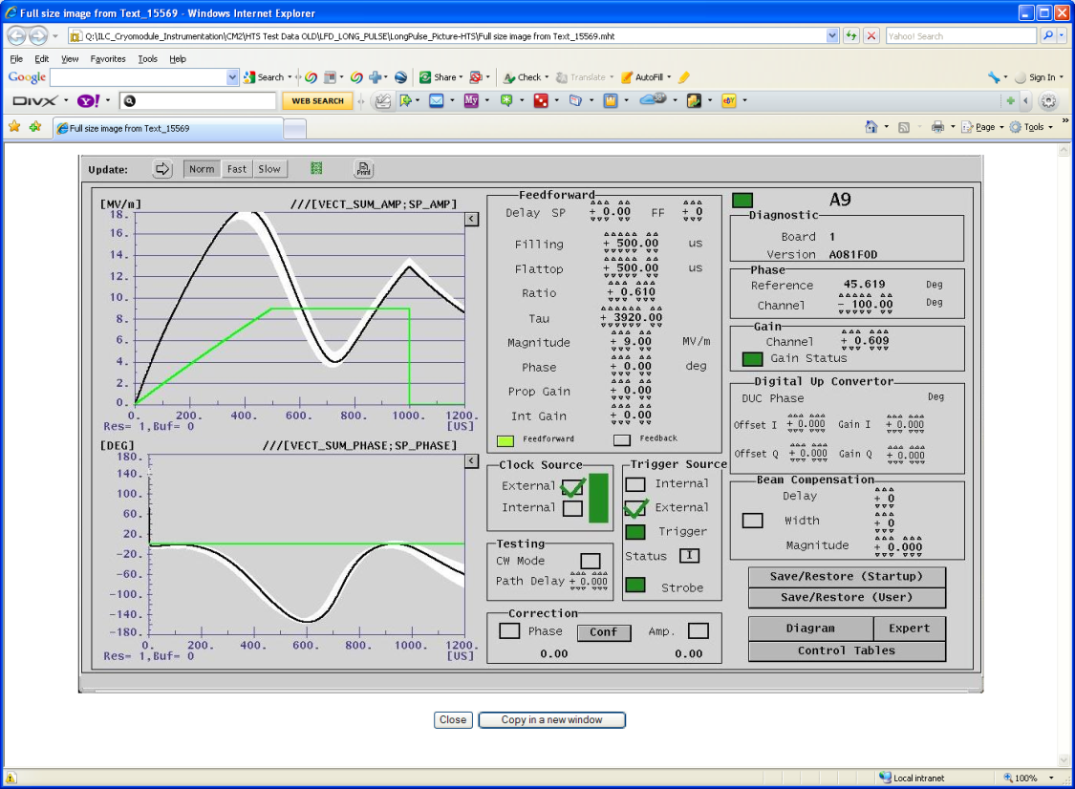
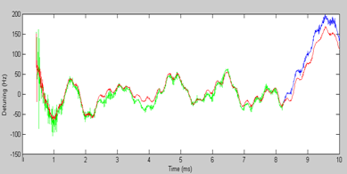
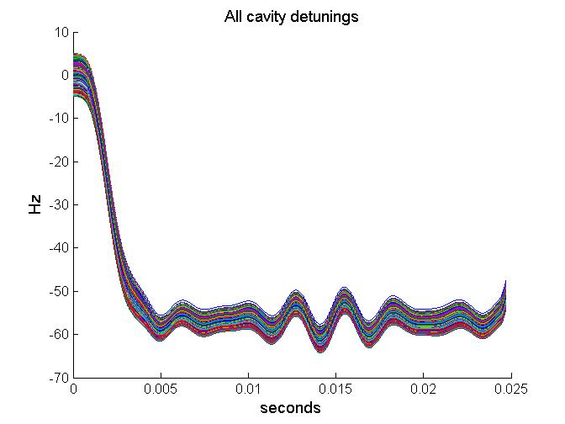
First 8ms pulse Test for Project X
Long Pulse test in Fermilab HTS for proposed Project X parameters
  - 4ms fill, 4.3 ms flattop, 24 MV/m
Successfully reduced LFD from several kHz to better than 50 Hz
  Very limited time available
  Some stability problems observed
Compensation would not possible using ‘Standard’ half-sine pulse
Plans for testing 2 cavities in long pulse regime at NML cryomodule #1 (Nov-Dec.2011)
LFD model used in modeling of longitudinal dynamics are different from measurements (max ~60 Hz, but smaller detuning in flat-top). Need improved model

Slide 23
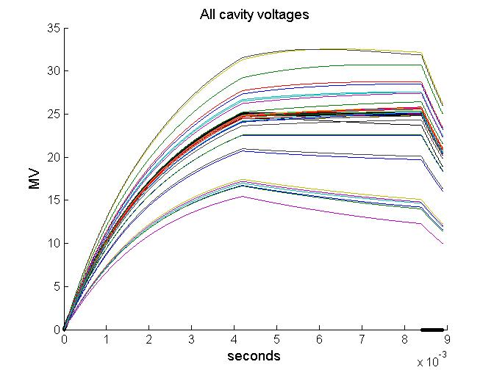
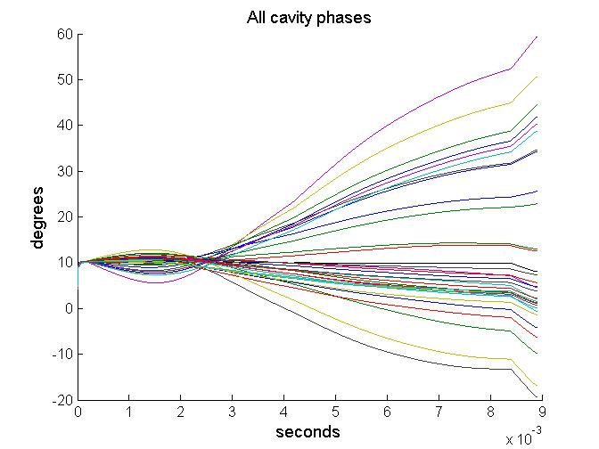
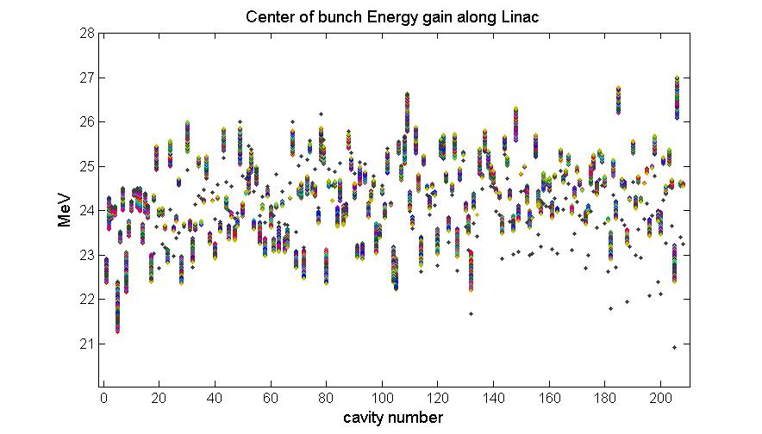
Some result of dynamic simulations with LLRF stabilization:
20% gradient spread, LFD, u-phonics, beam and coupler errors
1st RF station is DESY-FLASH ACC6-7
All other 12 RF stations have 2 low gradient cavities at 18MV and 14 cavities at 26MV.
Simulation assumptions:
    LFD: ~ 60 Hz at 25 MV.
    µ-phonics: ±5Hz uniformly distributed.
    Beam errors:
    Coupler error: 10% uniformly distributed.
Head of the bunch train
Tail of the bunch train
G.Cancelo

Slide 24
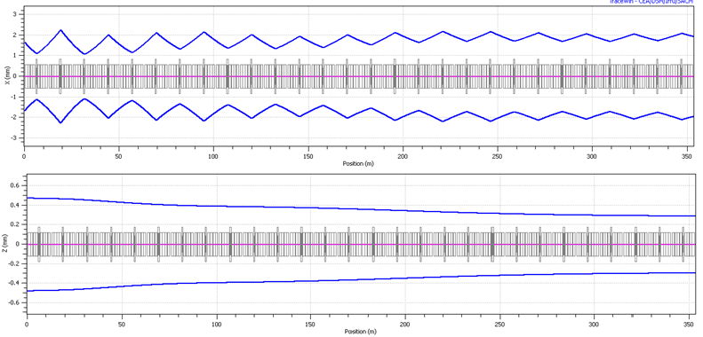
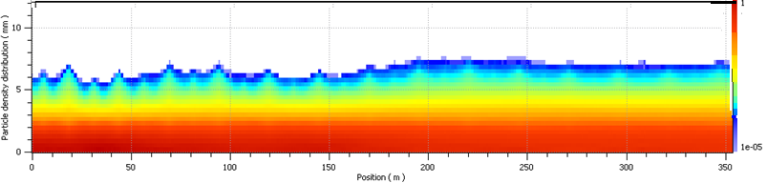
Lattice: Envelopes and Tracking

Slide 25
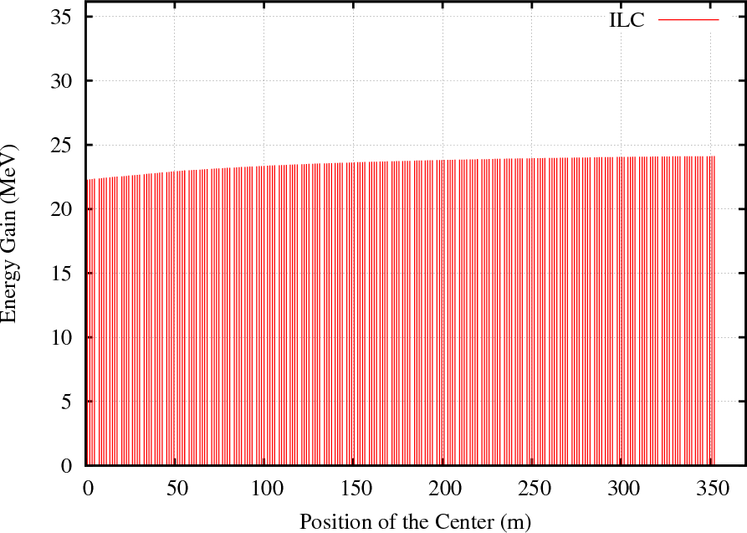
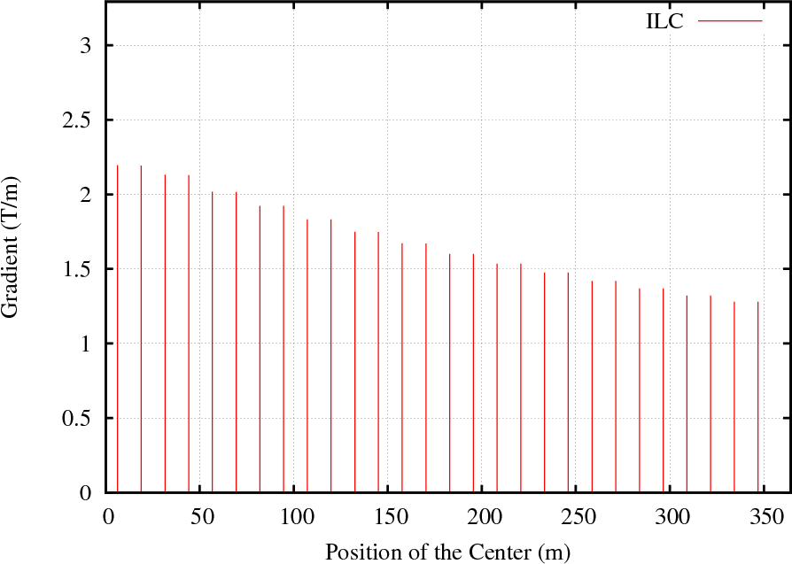
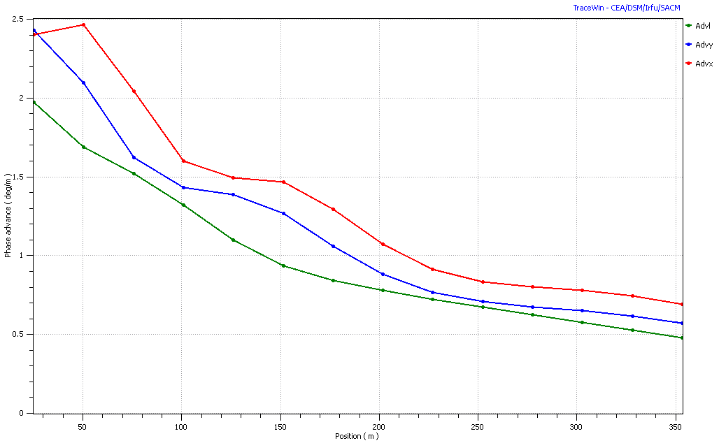
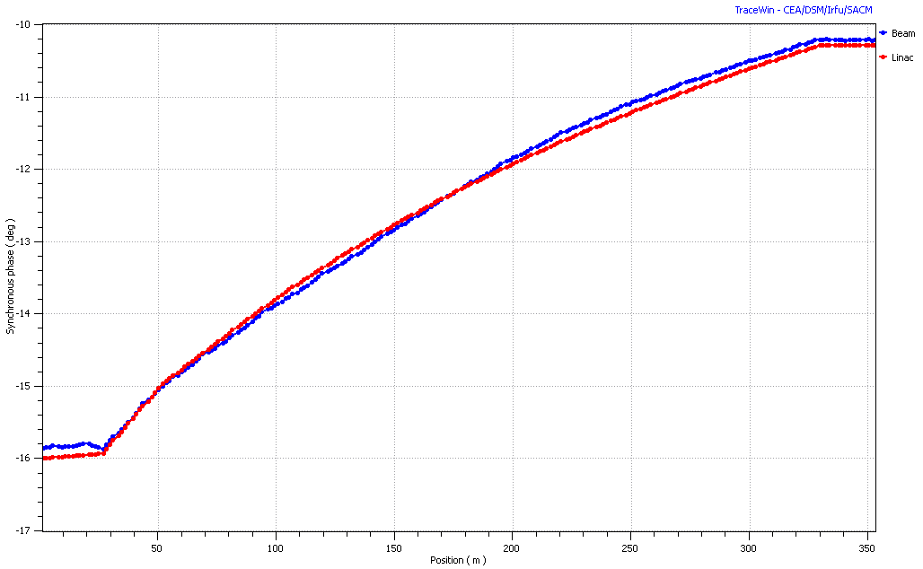
Cavity Energy Gain
Quadrupole Gradient
E_{acc} = 25 MV/m: L=1.038m
Phase Advance
Synchronous Phase

Slide 26
FY12 R&D plan for Pulsed Linac
Complete lattice design and specifications for beam alignments and RF tolerances (N.Solyak)
  Beam dynamics, losses, system specifications
  Failure analysis
  Long-pulse operation stability requirements
  Concept Design of the beam collimation system and Radiation issues, Specs
  Develop specs for linac components
  Review modified ILC like CM design (cavity, coupler,magnets,cryo) as a baseline for pulse linac
Design of the transport lines to and from pulsed linac, functional specs (D.Johnson)
Develop conceptual design of the HLRF system (modulators, klystrons, PDS, controls) – J.Reid
  Define baseline configuration and alternatives based on requirements and cost analysis
  Write specifications and cost estimations for HLRF system
LLRF performances study and develop specifications for long pulse operation regime (B.Chase)
  Develop LLRF control system for cavity, operating in long-pulse regime, based on multiple tests of ILC like cavities in HTS and NML cryomodule
  Develop models and software for long-pulse operations with LLRF controls
  Develop specifications and costing of LLRF system.
Complete conceptual and EM design of splittable SC magnet (V.Kashikhin)
Conceptual design of the cryogenic systems and specifications (A.Klebaner)
Create specifications for beam diagnostics in Linac and transport lines (M.Wendt)

Slide 27
Resources in FY12
 | M&S | FTE | Task force
N. Solyak | 10 | 0.5 | Management, specs
J-P carneiro |  | 0.4 | Beam dynamics, losses, system specifications
G. Cancelo Y. Eidelman |  | 0.5 0.5 | LLRF requirements, specification and performances
I. Tropin |  | 0.25 | Beam collimation and losses
F.Ostiguy, B. Shteynas |  | 0.25 | Beam Collimation studies
A. Saini |  | 0.15 | Failure analysis
B. Chase, W. Shappert, Y. Pischalnikov | 10 | 0.25 | LLRF, LFD, Microphonics long-pulse tests
J.Reid | 10 | 0.5 | HLRF: specs, design, alternatives, cost
D. Johnson | 10 | 0.5 | Beam delivery: Linac to R&MI Transport lines design
M. Wendt | 10 | 0.3 | BPM: design & tests, RT diagnostics, alignment control
V. Kashikhin |  | 0.15 | concept of magnet design
M. Champion |  |  | Cavity, Coupler & cryomodule design
J. Leibfritz |  |  | CM tests at NML
A. Klebaner |  |  | Cryogenic: Conceptual design and specifications
J. Patrick |  |  | Pulse Linac controls
FTE, Total |  | 4.25 | Systems

Slide 28

Project X Technical Meeting Tuesday,
July 6, 2010
Thank you
for your attention
HOMs in 650 MHz section
of the Project-X linac.
V. Yakovlev, N. Solyak, A. Vostrikov,
A. Saini, T. Khabiboulline, I. Gonin and A. Lunin

Slide 29
Back – up Slides

Slide 30
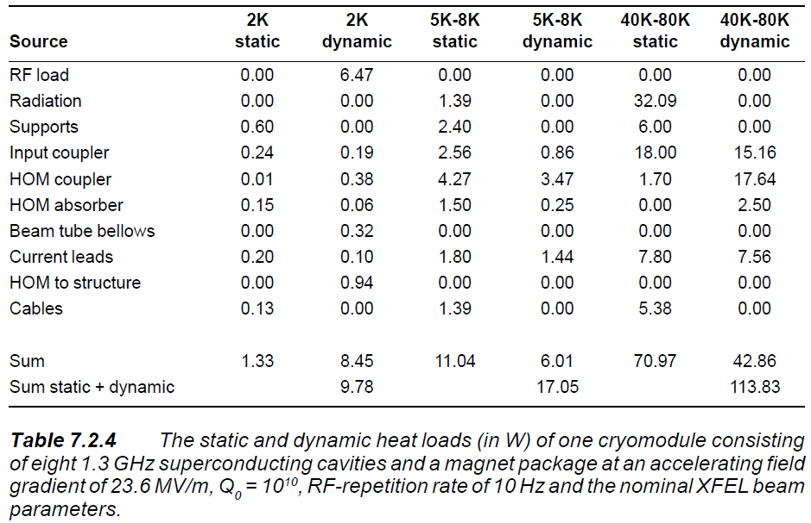
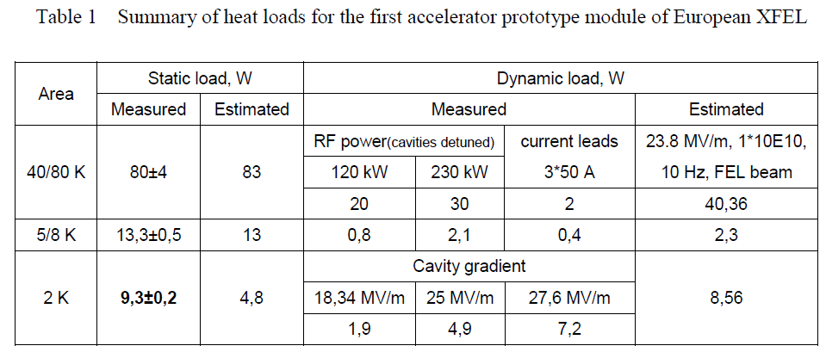
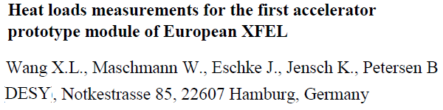
XFEL heat load specifications for XFEL Cryomodule

Slide 31
DESY
FLASH
Acc. Gradient spread in FLASH/DESY
ACC6 (MV)
29.77
30.81
28.63
28.18
17.84
18.36
22.45
22.23 Avg=24.8
ACC7
26.56
26.56
27.47
27.47
32.05
32.05
23.81
23.81 Avg=27.5
ACC6 & 7 reach 25MV/m on average with 20% & 10% spread respectively.
Fix RF distribution.
  And equal power distribution:
    Operate all cavities below the lowest quenching limit of all cavities in the RF station. Loose 20% gradient.
  Proportional power distribution:
    Cavities operated at different gradients to achieve desired VS.
    Flattop tilts. They get worse for longer flattops.
Fix couplers
  Can be optimized for a single beam loading condition.
  Tilts for all other beam loading conditions.
Cavity tilts.
  Cavity tilts and cryomodule misalignment generate orbit errors.
Beam OFF, beam ON.
  Tilt slopes are a function of gradient distribution in the RF station
State of the art for cavity spread around 25 MV is ~10%

