Slide 1
LLRF Requirements, Status and Plans
Brian Chase
For the ProjX
LLRF Collaboration

Slide 2
RF Control Requirements
 | Inject RR | Inject MI | Comments
Cavities per RF Station | 16 | 16 | Discussion on 8 vs 16
Pulse width | 8.3ms | 30ms | Same difficulty
Rep rate | 10 Hz | ~1 Hz
Beam current | 1mA | 1mA
Gradient | 25 MV/m | 25 MV/m
Loaded Qs | 1E7 | 1E7 | Simulations -> lower Qls
Regulation (RF Station VS) | 0.5 deg. 0.5% | 0.5 deg. 0.5% | Early simulation efforts
Individual cavities within an RF station | 10 deg 10% | 10 deg 10% | Early simulation efforts Complex issues…
Tolerance to piezo failure | Not tolerant | Not tolerant | Detune cavity
Gradient spread of cavities within RF group | 10% | 10% | Not yet achieved – see simulations

Slide 3
Main Points
LLRF can do a great job of controlling the Vector sum
Regulation errors 10⁻⁴
VS calibration beambased predicted errors 5x10⁻³
Noise in measurements, R/Q value, Microphonics
Gradient spreads cause cavity tilts
Piezo resonance control must work
Resonance control errors drive power overhead requirements

Slide 4
HINS with Ferrite Vector Modulators: Individual Cavity Feedback Control

Slide 5
HINS Six Cavity Test Ferrite Vector Modulators and phase shifters

Slide 6
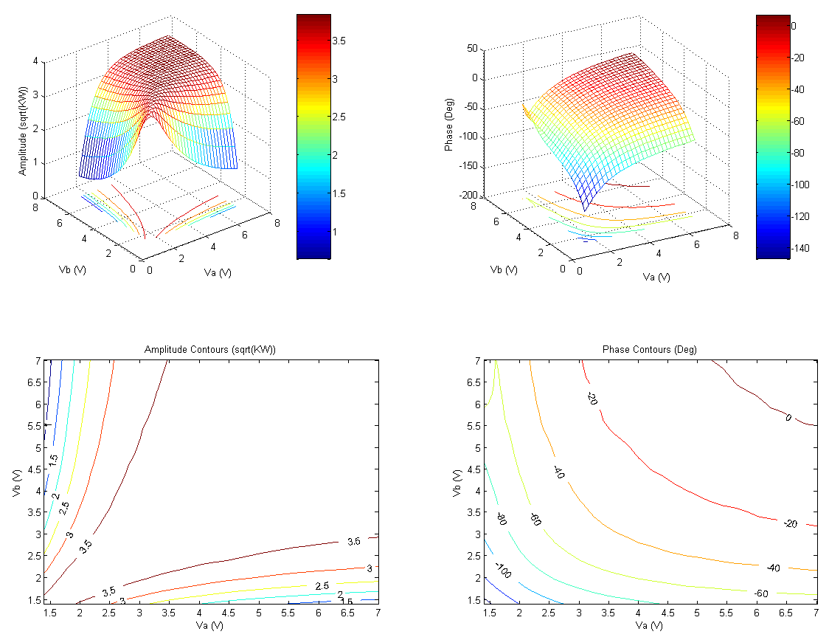
HINS Six Cavity Test Cavity-3 Source Scan Data
Vitali Tupikov’s talk

Slide 7
SRF Beam Test Facility LLRF System Level Block Diagram

Slide 8
NML CM1 LLRF Racks
Receivers and Up-converter
VXI CPU & 3 MFCs
- Probe, Fwd, Ref
Master Oscillator
Power Supplies

Slide 9
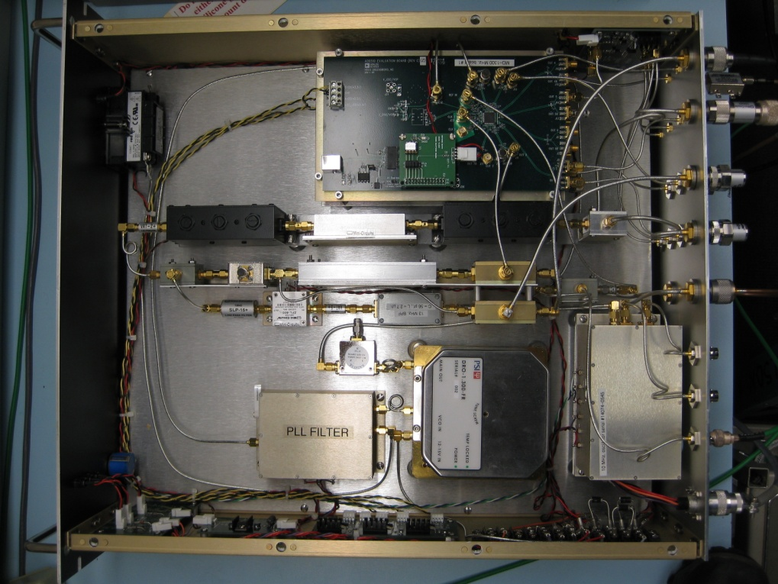
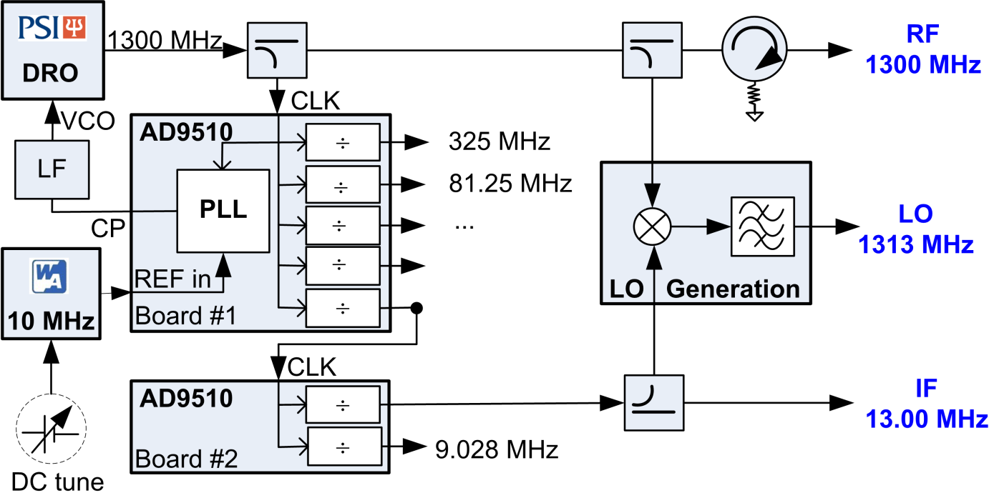
Master Oscillator
RMS jitter 46.1 fs (0.0216 deg)
integrated from 100 Hz to 100 kHz
RF, LO, IF
Programmable outputs
Timing reference
1.3 GHz
<140 fs integrated jitter (1Hz–10MHz)

Slide 10
MFC - 32 Chanel Controller
Technologies of interest:
-Multi-channel ADCs
-Low Voltage Differential Signaling (LVDS) high speed serial connections
-Differential IF signal paths
-8 channel coax connectors
-Shielded enclosure
-Low cost per channel
8 Ch ADCs
DSP
AD 9010 Clk
FPGA
8 Ch ADCs

Slide 11
Controller Firmware
Adjustable notch filter at 8pi/9 (F,Q)
Fixed notch filter at 7pi/9
PI controller
Control System Schematic

Slide 12
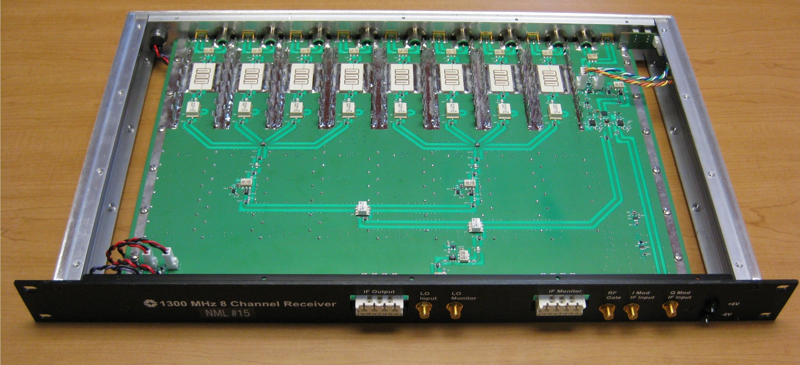
1.3 GHz 8 Channel Receiver / Transmitter
8 Channels of 1.3 GHz to 13 MHz down converters
1 transmitter with 13 MHz IQ modulation and 1.3 GHz output
Minimum 76 dB of channel to channel isolation
RF to IF conversion loss of 4 dB
IF output noise floor of -153 dBm/sqrt(Hz)
RF input 1 dB compression of 12.5 dBm
Type-N RF input connectors, Harting 8 coax IF output connector
Phase temperature stability of 0.06 degrees/ degree C
Amplitude Temperature stability of 0.008 dB / degree C

Slide 13
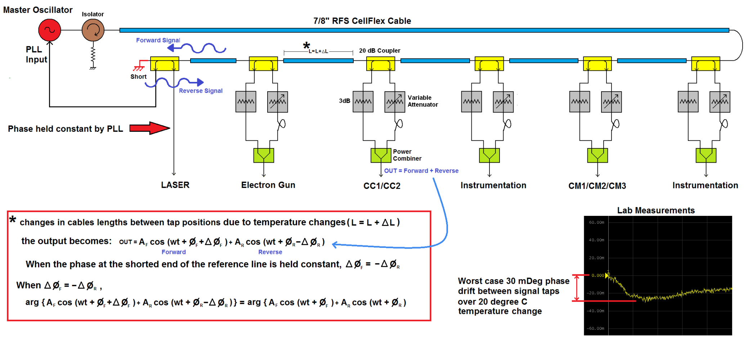
1.3 GHz Phase Averaging Reference Line for Fermilab SRF Beam Test Facility
Ed Cullerton’s talk Tuesday
Notes:
Lab measurements done with a scaled version of the reference line. (long 7/8” inch RFS cable replaced with short 0.141 cable with similar temperature characteristics)

Slide 14
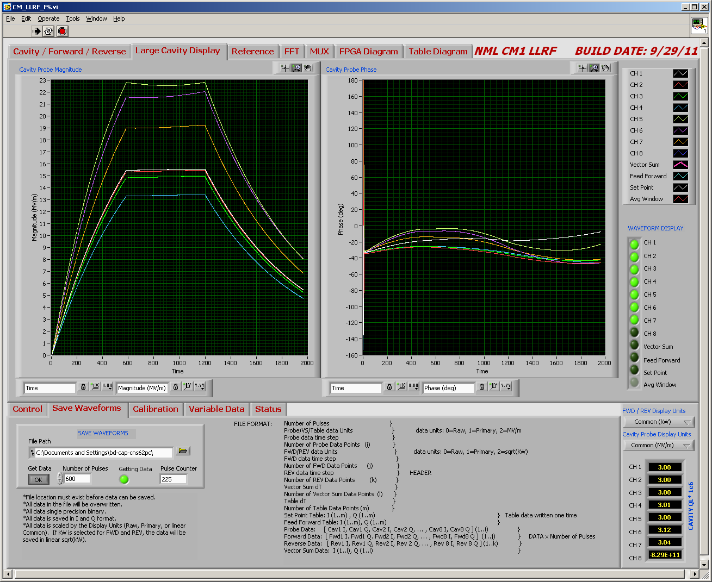
CM1 Feedback and Piezo control Off
Notes:
No feedback

Slide 15
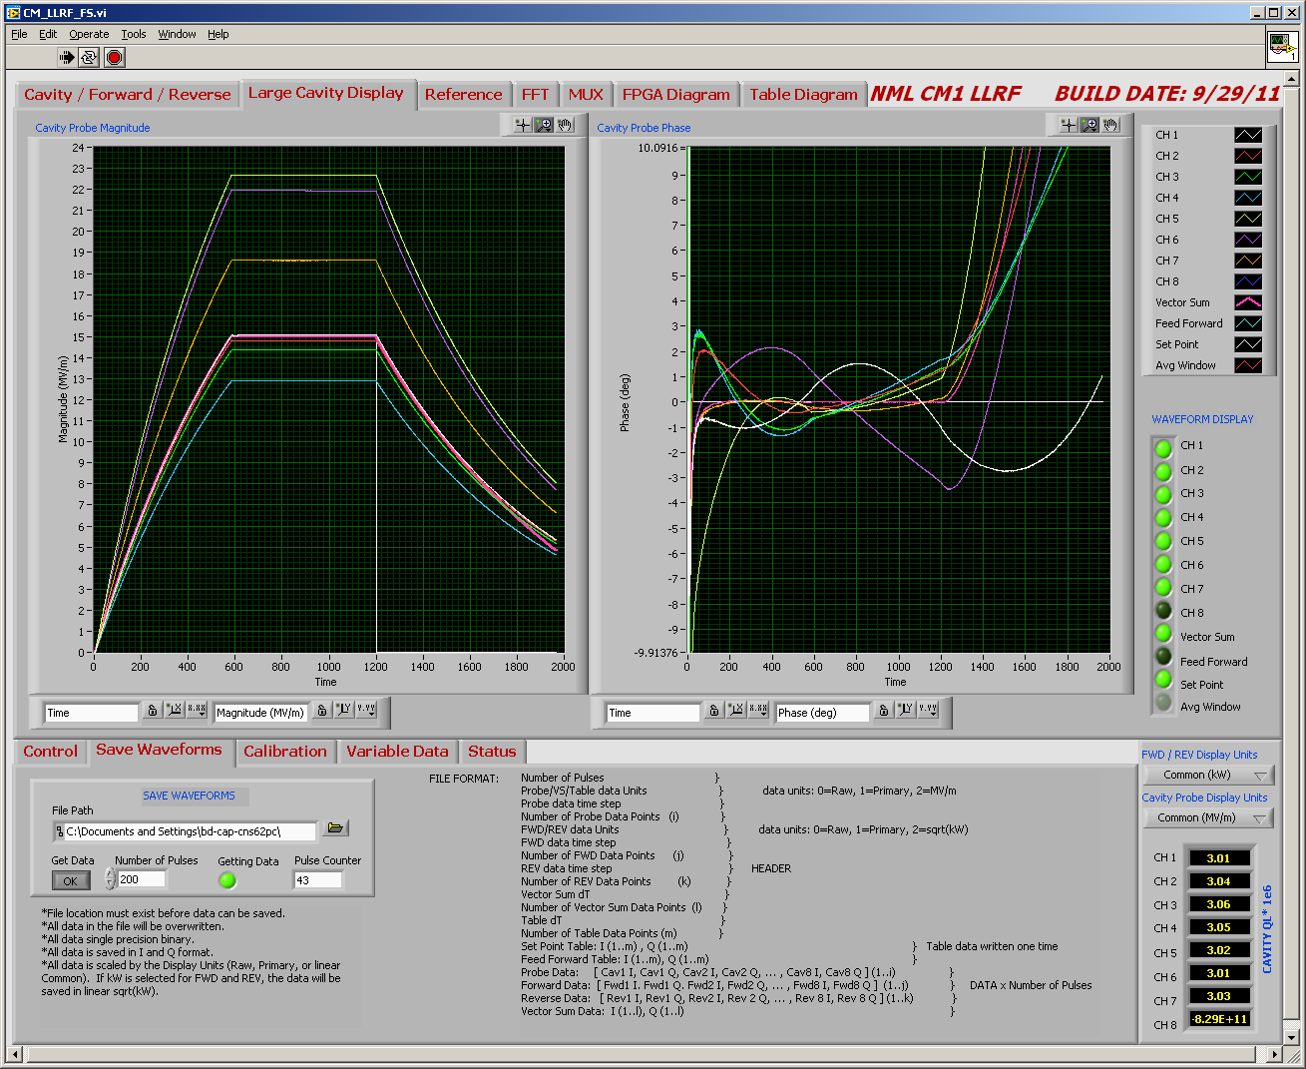
Preliminary Results Feedback and Active Detuning Compensation On
Notes:
Piezo and feedback operating together. Cav 1 is not under piezo control after phase shifter control

Slide 16
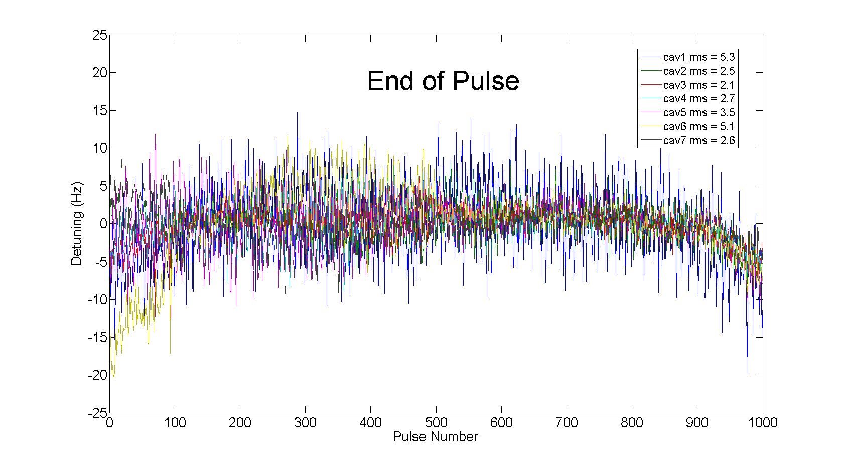
Mircrophonic detuning for 7 cavities
1000 second period, 1 Hz rep rate
Cavity 1 does not have active detuning compensation (control case)
Cavity Detuning
Feedback and Piezzo Control On

Slide 17
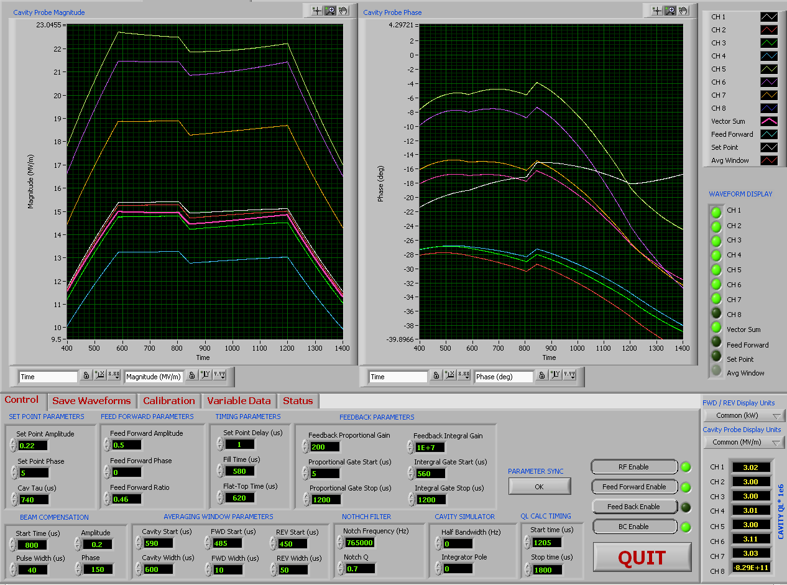
Disturbance Response
40% drop in RF voltage @150 degree phase angle
40 μsec pulse width
No feedback
Notes:
Disturbance .2 150 degrees

Slide 18
Disturbance with only Vector Sum Shown
Gradient drops 0.5 MV/m and shifts 1.5 degrees during 40μs
Notes:
Closeup of disturbance

Slide 19
Disturbance Response with Feedback On
Calibrated Proportional gain = 200, Integral gain = 1e7
0.06 MV/m, 0.13 deg peak
Notes:
Compensated fb 200, 1e7

Slide 20
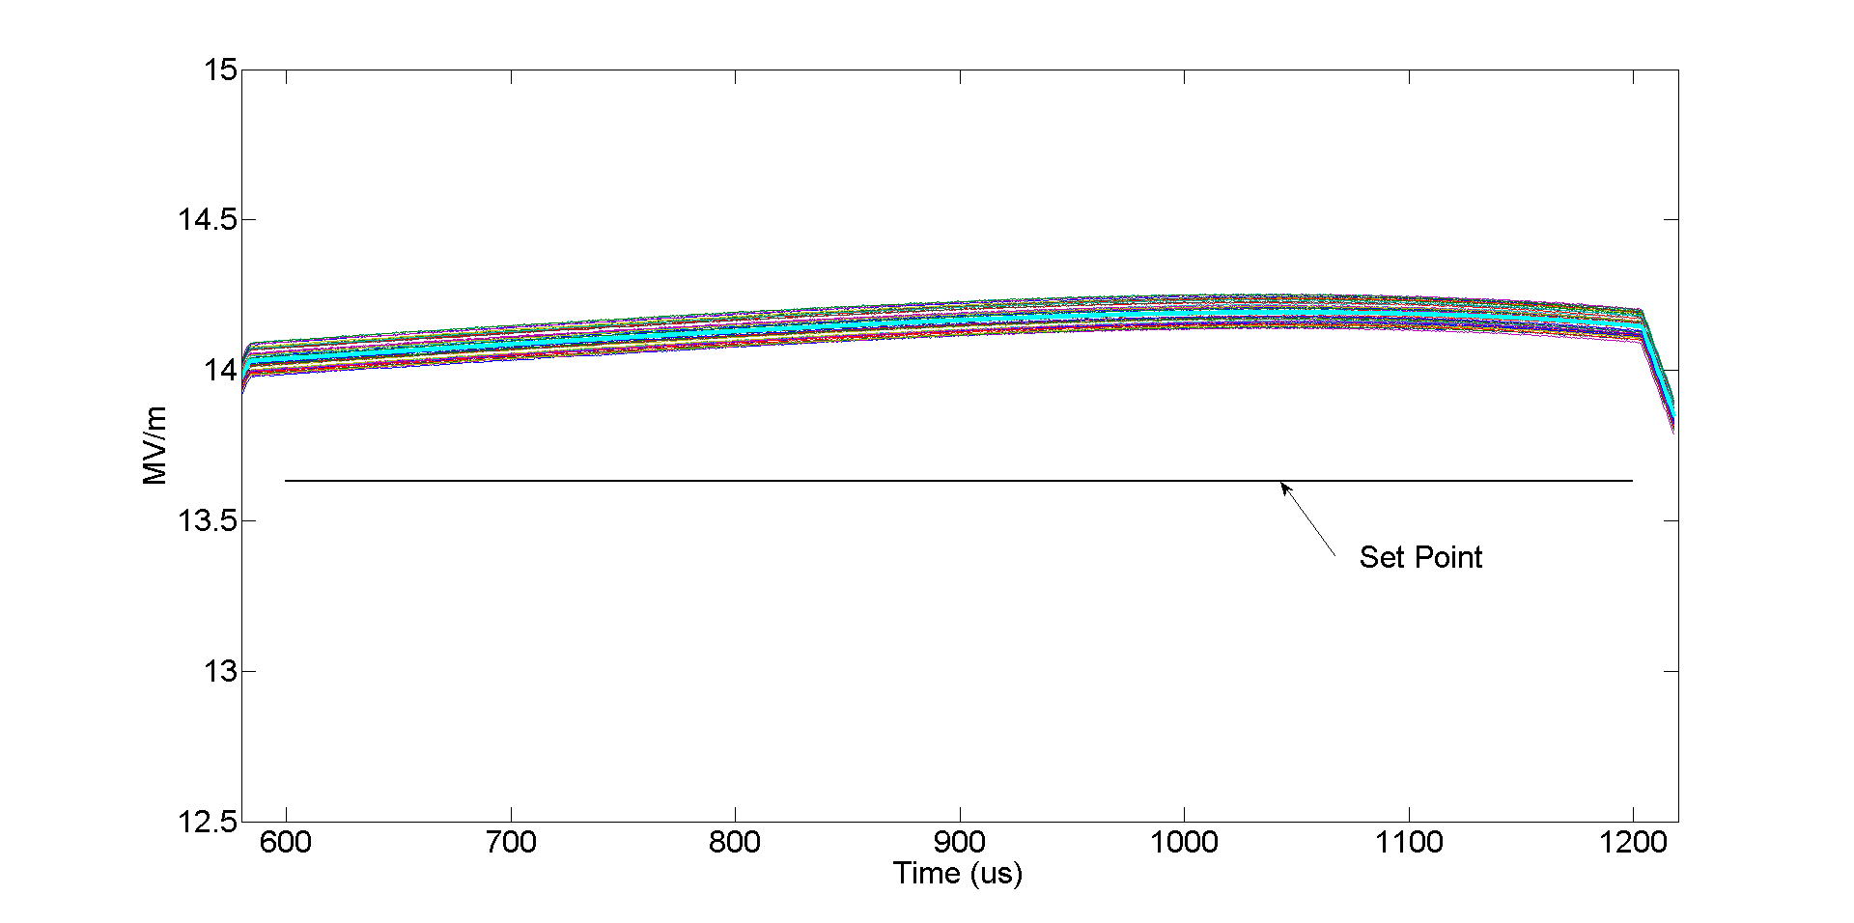
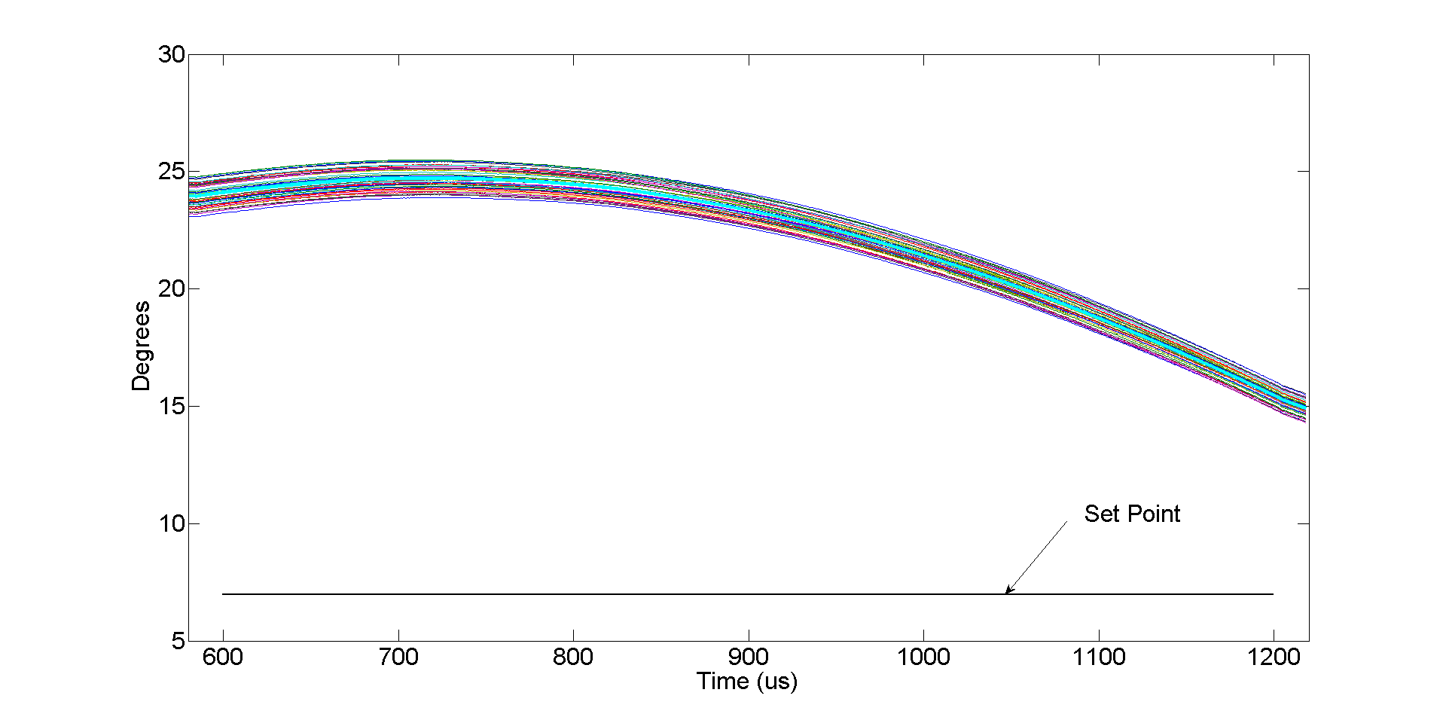
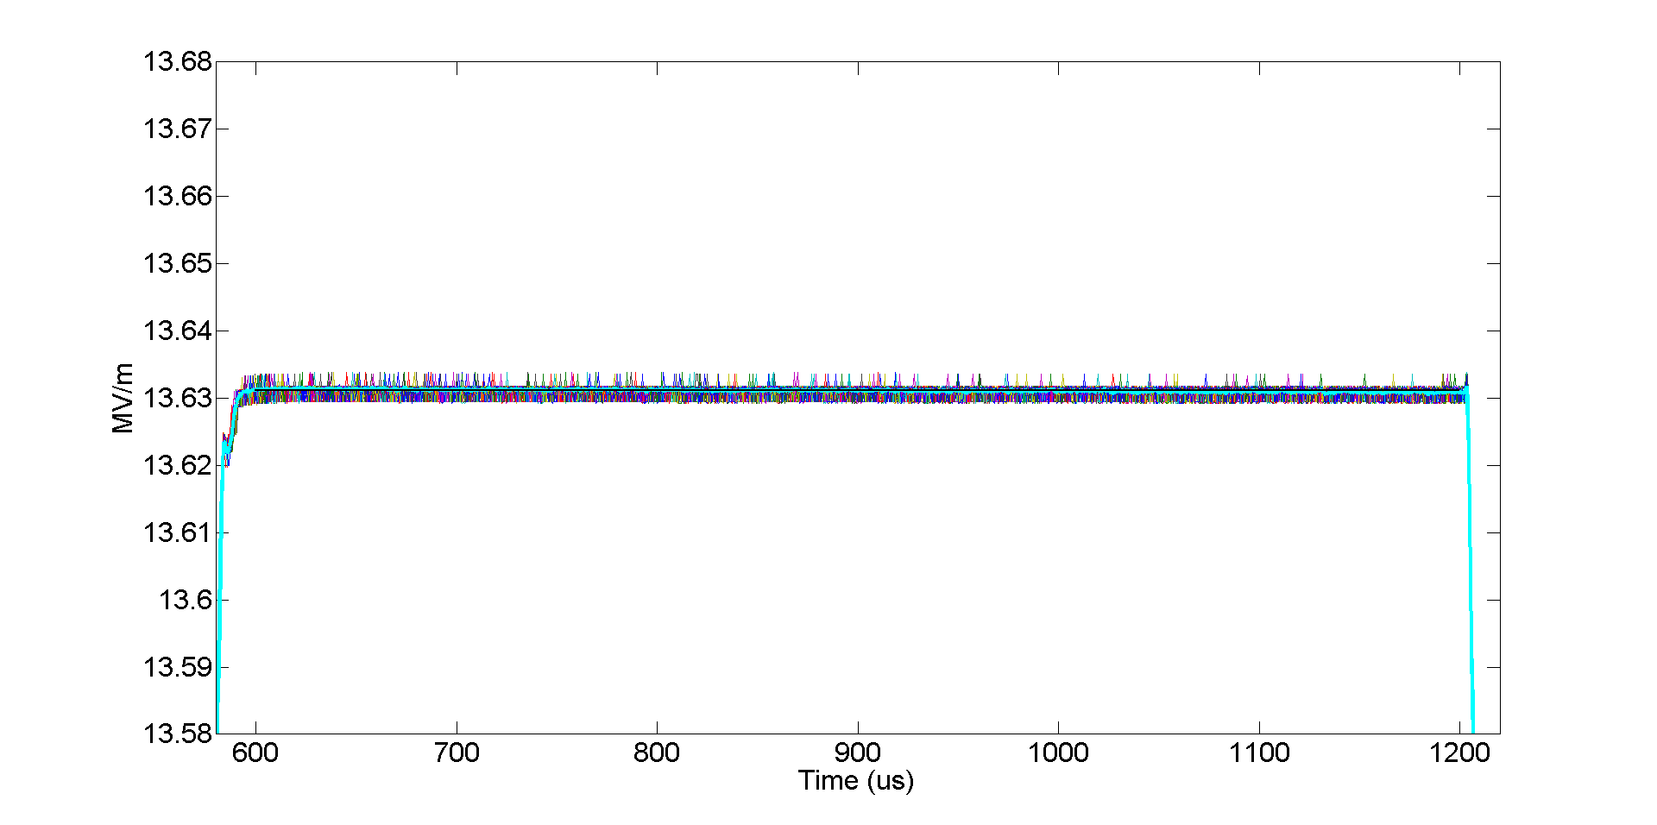
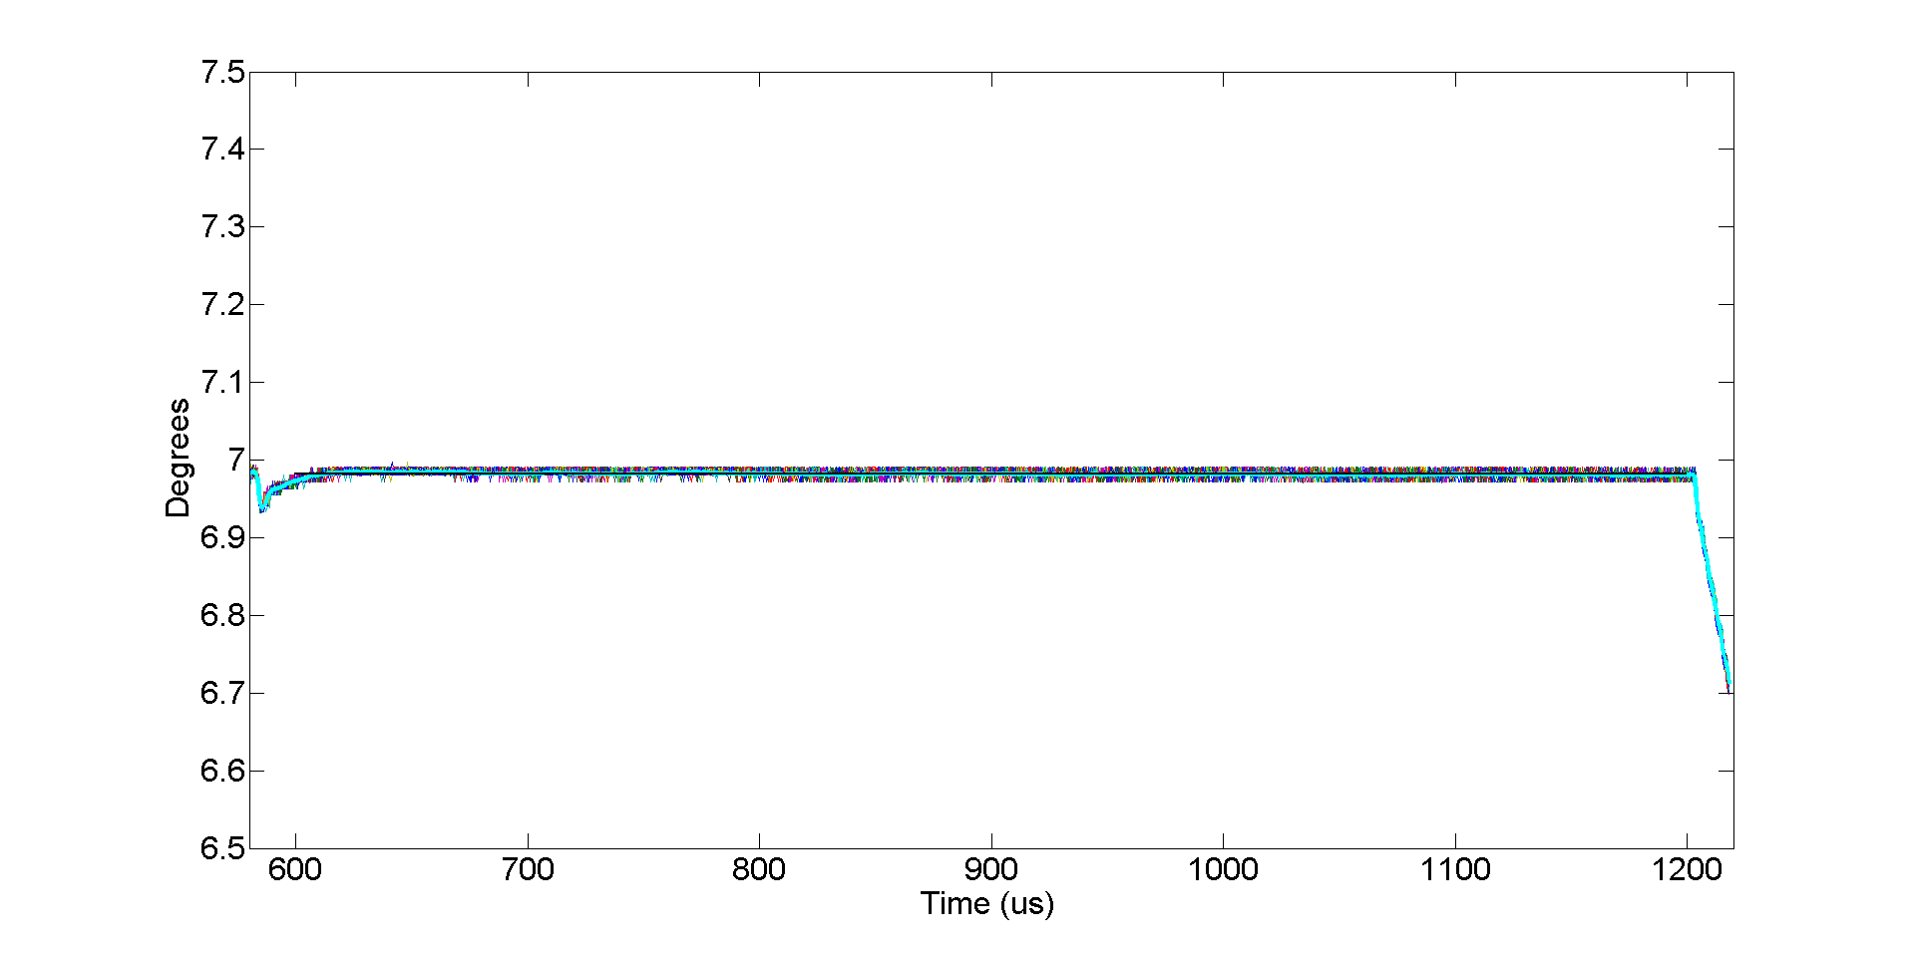
50 pulse overlay -Cryomodule 1 with seven cavities in vector sum
Vector Sum Magnitude
Vector Sum Phase
Feedback
OFF
With
Feedback
P = 100
I = 7.5e6
Vector Sum Magnitude
Vector Sum Phase
Vector Sum Magnitude
Vector Sum Phase
Vector Sum Magnitude
Vector Sum Phase
Without
Feedback
Without
Feedback
Without
Feedback
With
Feedback
P = 100
I = 7.5e6
With
Feedback
P = 100
I = 7.5e6
With
Feedback
P = 100
I = 7.5e6

Slide 21
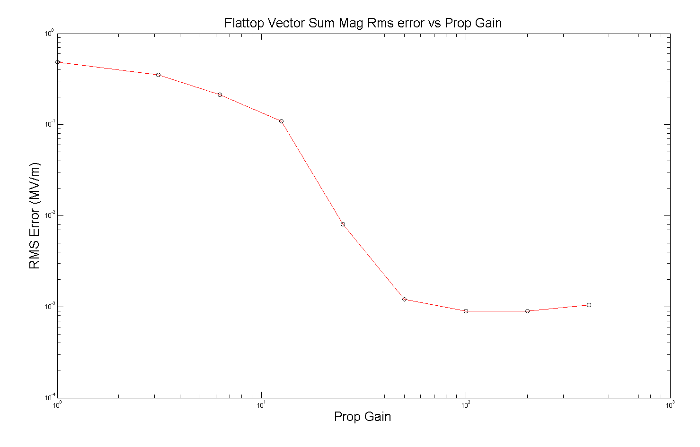
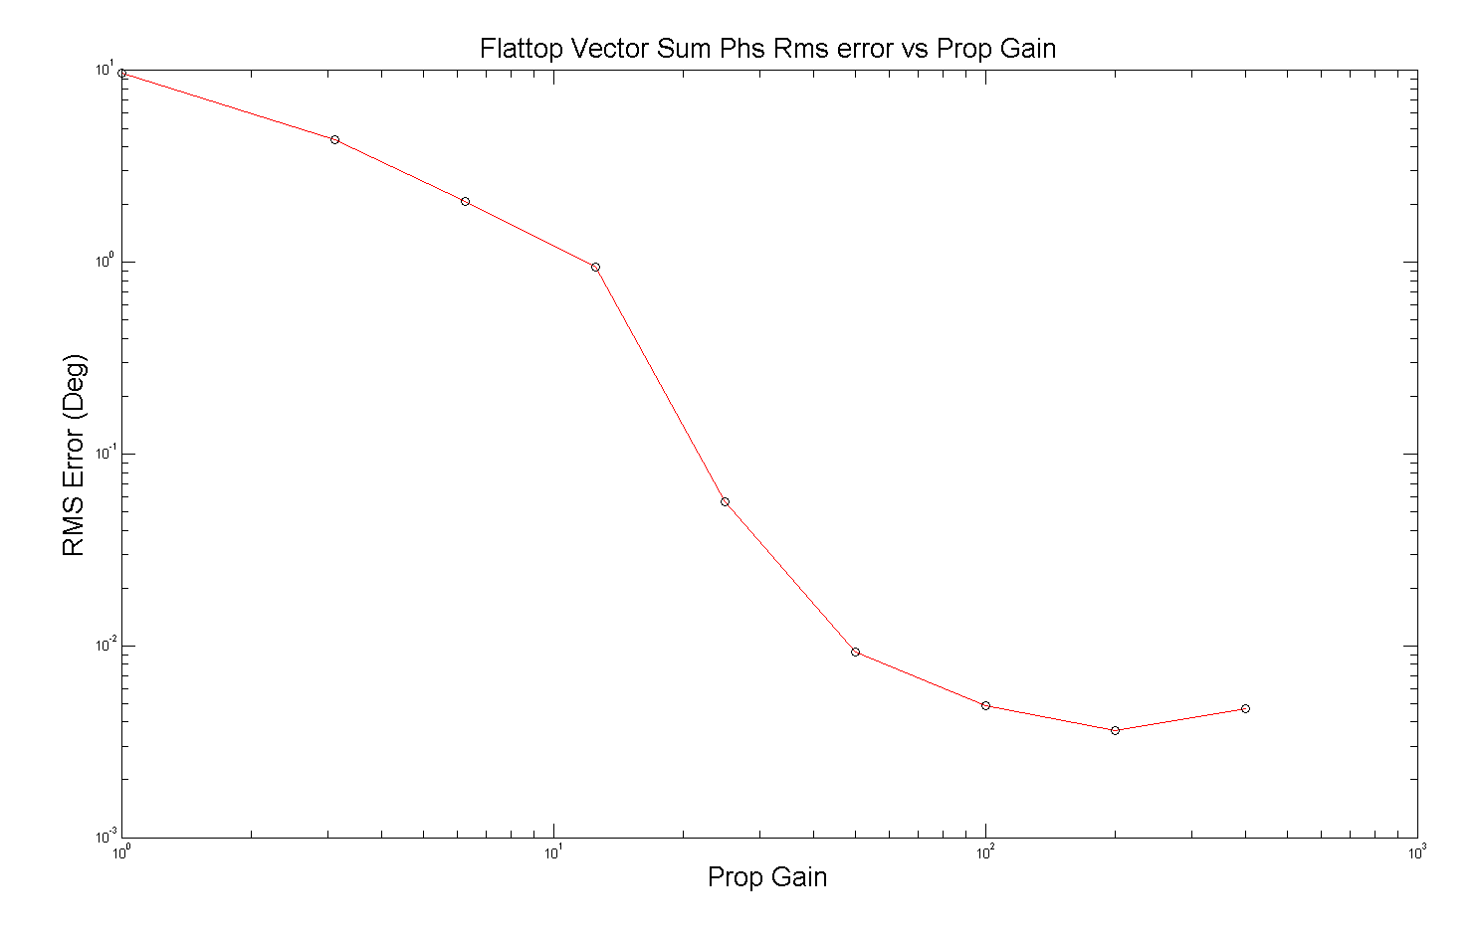
Flattop Vector Sum RMS Error vs Gain
(Igain = Pgain x 7.5e4)
Internal measured loop error
Receiver noise is below this level
RMS error at low gain is dominated by static errors and cavity tilts
0.007% RMS
0.004 deg RMS

Slide 22
Future Plans
SRF Test Facility
Replace CM1 with CM2 (January quarter 2012)
Commission gun (May 2012)
Commission CC1 (Sept 2012)
Beam (2013)
Support Project X test accelerator
LLRF performances study and develop specifications for long pulse operation regime
Develop LLRF control system for cavity, operating in long-pulse regime, based on multiple tests of ILC like cavities in HTS and NML cryomodule
Develop models and software for long-pulse operations with LLRF controls
Develop specifications and costing of LLRF system.

