Slide 1
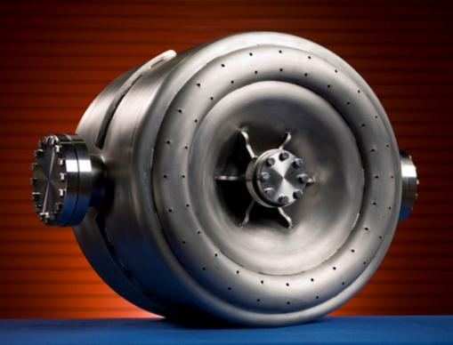
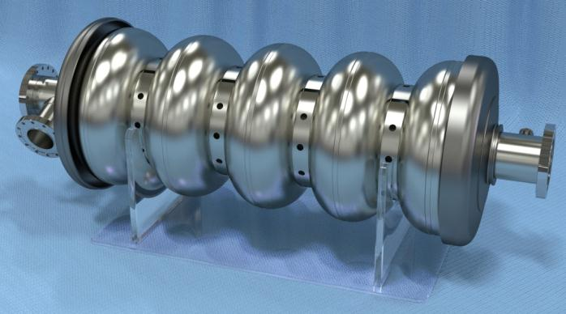
Cavity Processing for Project X “What needs to be done?” Project X Collaboration Meeting Oct. 25-27, 2011
Allan Rowe
Fermilab
TD/SRFDD

Slide 2
Cavity Types, Quantities, Prod. Rate
Section | Freq, MHz | Energy(MeV) | Installed Cav/mag/CM | Cavities/year (90% yield/5% spare)
HWR (β_{G}=0.11) | 162.5 | 2.1-10 | 9 /6/1 | 11 (1 year prod.)
SSR1 (β_{G}=0.22) | 325 | 10-32 | 16 /10/ 2 | 9 (2 year prod.)
SSR2 (β_{G}=0.47) | 325 | 32-160 | 36 /20/ 4 | 14 (3 year prod.)
LB 650 (β_{G}=0.61) | 650 | 160-520 | 42 /14/ 7 | 16 (3 year prod.)
HB 650 (β_{G}=0.9) | 650 | 520-3000 | 152 / 19/ 19 | 59 (3 year prod.)
ILC 1.3 (β_{G}=1.0) | 1300 | 3000-8000 | 224 / 28/ 28 | 87 (3 year prod.)
What is needed for a THREE year production schedule?

Slide 3
SSR Cavity Processing Recipe
1. Inspection – RF & Optical | Evacuate
2. Bulk BCP | 10. Vertical Test
HPR | 11. Helium Vessel Dressing
4. 600C 10 hrs (still evaluating Q) | HPR
5. RF Tuning | Assemble
6. Light BCP | Evacuate
HPR | 15. Horizontal Test
Assemble | 16. Ready for String
Not enough statistics to support Q requirements yet. Need more Lab-based processing results. Heat treatment likely only variable.

Slide 4
Elliptical Cavity Processing Recipe
1. Inspection – RF & Optical | Evacuate
2. Bulk EP (or CBP + light EP) | 11. 120C Vacuum Bake 48 hrs
HPR | 12. Vertical Test
4. 800 C Bake 2 hrs | Dress
5. RF Tuning | HPR
6. Light EP | Assemble
HPR | HPR
Assemble | Evacuate
HPR | 18. Horizontal Test
Q is process driver. 650MHz may need variants in recipe to maximize Q. CBP may yield higher average Q.
BCP needs to be evaluated as possible 650 MHz baseline process.

Slide 5
How many procedures?
Half-wave/SSR BCP: ~150
650 MHz CBP (if baseline): ~225
650 MHz BCP (if baseline): ~500
650 MHz EP (with CBP or EP baseline): ~500
1.3 GHz CBP (if baseline): ~ 260
1.3 GHz EP (with CBP or EP baseline): ~600
HPR Cycles: ~3000
H2 Bake Cycles: ~560 ( 260 small, 300 large)
120C Bake Cycles: ~580 (or fewer-no SSR/650)
Vertical Test Preps: ~600
Horizontal Test Preps: ~250?

Slide 6
Minimum Production Infrastructure (no spares)
BCP Capacity: 1-4.5/week = 1 to 2 BCP tools
650 MHz CBP Machines: 1.5/week = 1 machine
650 MHz EP Tools: 3.5/week = 2 tools
1.3 GHz CBP Machines: 2/week = 1 machine
1.3 GHz EP Tools: 4.2/week = 2 tools
HPR Cycles: 21/week = 6-7 tools
H2 Bake Ovens: 4/week = 1 small, 1 large
120C Bake Ovens: 4/week = 2 ovens
Assembly areas: 6/week = 3 assembly areas

Slide 7
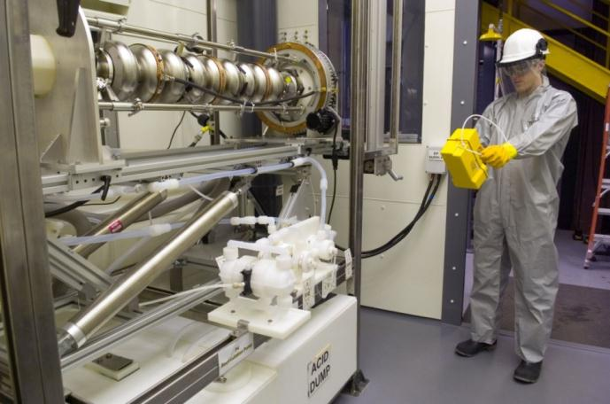
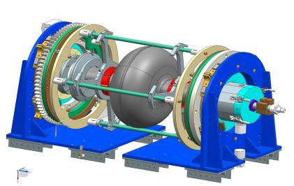
What do we have?
1.3 GHz EP Tool at ANL.
Used for Project X & ILC R&D.
QWR/650 MHz EP Tool
Total of 3-cycles/week between tools.
*S. Gerbick, R. Murphy, et. Al (ANL)

Slide 8
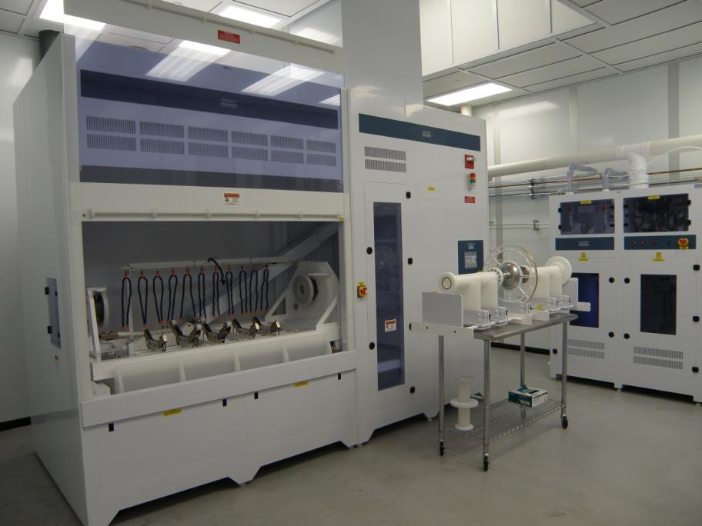
Industrial EP Tool for 650 MHz/1.3 GHz
ARRA funded, FNAL owned, AES operated - 3 cycles/week

Slide 9
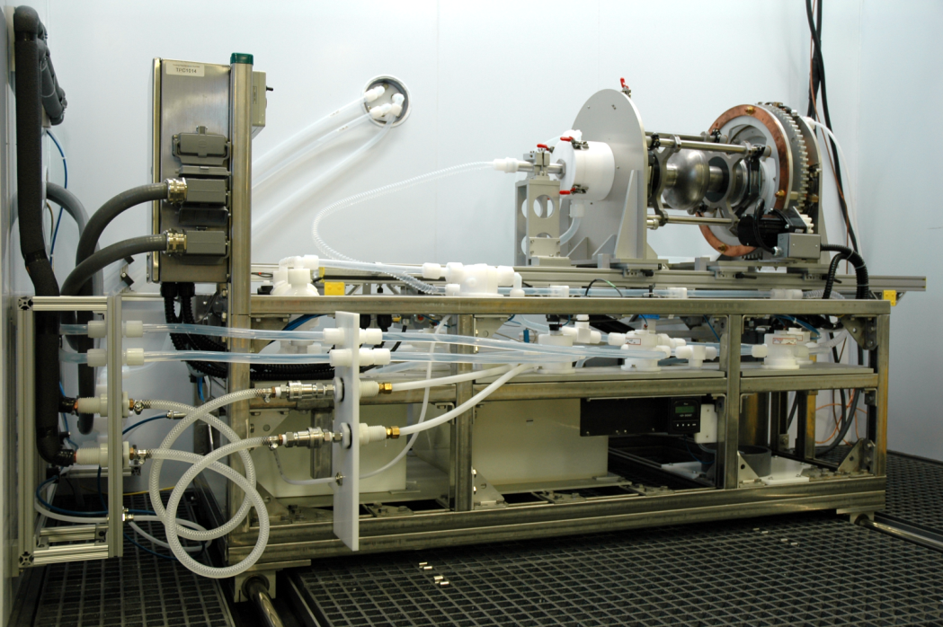
IB4 CPL R&D EP Tool (1.3 GHz only)
Upgradable EP tool may accommodate 1.3 GHz 9-cell—2 R&D cycles/week

Slide 10
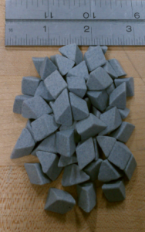
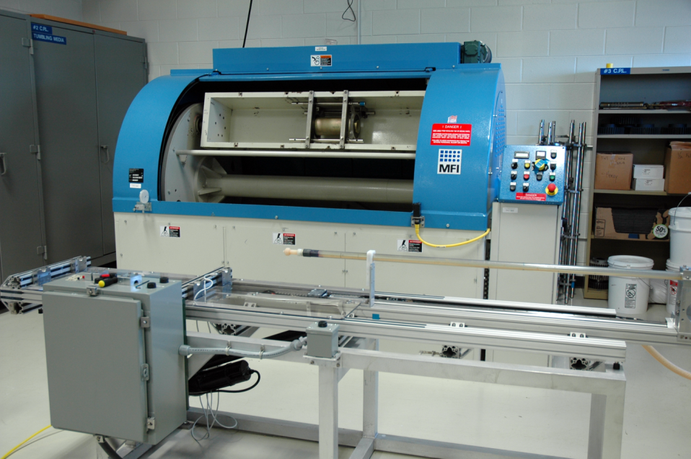
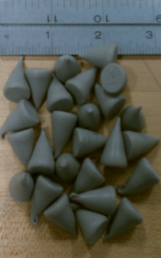
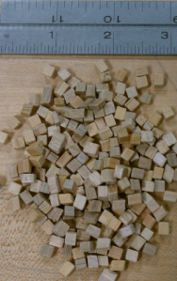
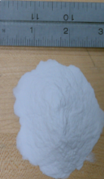
IB4 CPL CBP Machine
Tumbles 2 cavities/run, 2 complete cycles/week
C. Cooper Recipe Media

Slide 11
SCSPF High Pressure Rinse Tools
HPR of 1.3 GHz, and upgradable to 650 MHz.
HPR of 325 MHz under development.
*O. Pronitchev
FNAL HPR Tool with 1.3 GHz 9-cell
ANL HPR Tool—SSR2 shown

Slide 12
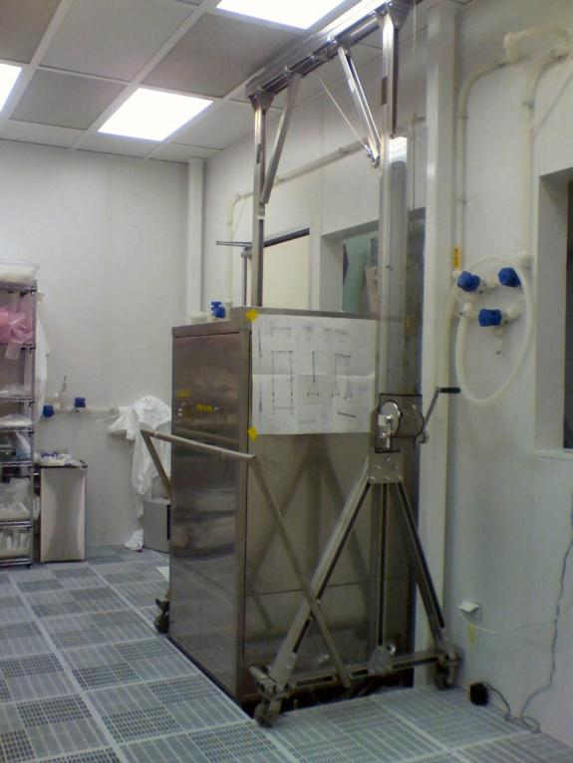
SCSPF Capabilities: Ultrasonic Cleaner
Designed for 1.3 GHz use, but will work for 650 MHz, SSR0 & SSR1. SSR2 is too large in diameter to fit within 22” x 24” US tank opening.
*O. Pronitchev
SCSPF Anteroom US tank

Slide 13
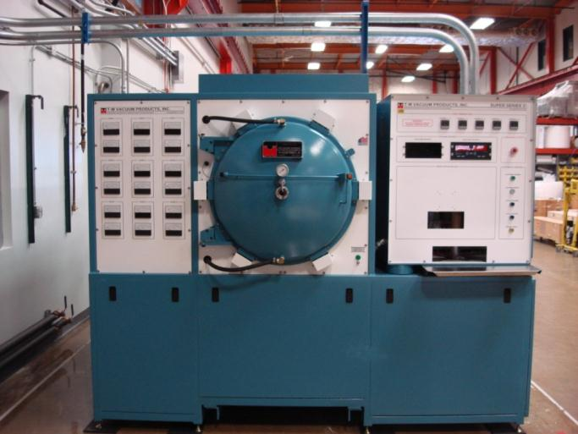
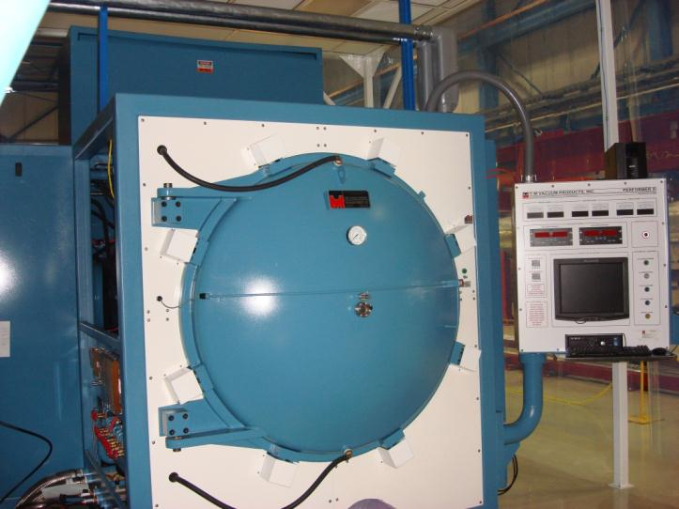
FNAL Vacuum Ovens – Hydrogen Removal
Temp = 800C or 600C
Hold = 2 hrs or 10 hrs
Pressure < 1e-06 Torr
99% drop in H2 RGA peak
IB4 Vacuum Oven—1.3 GHz
Manufacturer:
T- M Vacuum Products Inc.
*Source: M. Wong
MP9 Vacuum Oven – 650 MHz, SSRs

Slide 14
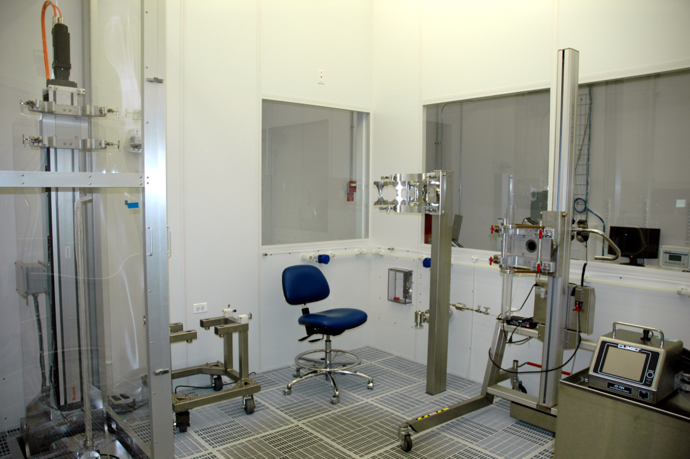
IB4 CPL Cleanroom/HPR
1.3 GHz HPR Tool, Assembly Rail, Cavity Carts— upgradable to 650 MHz

Slide 15
What do we need to meet minimum infrastructure requirements?
2-120C bake ovens (coming soon)
1-EP Tool for 650 MHz/1.3 GHz.
1-Lab-based BCP tool for 325/650 MHz
1-Industrial BCP tool for 325 MHz/650 MHz
2-3 Large US tanks sized for 650 MHz dressed
1-650 MHz CBP Machine
4-HPR Tools and cleanroom areas
1-dedicated 325 MHz Assembly/HPR Area at ANL
1-325 MHz dedicated BCP setup at ANL (not G150)

Slide 16
Processing Models to Evaluate
Model 1:
Maximize industrial involvement to limit Lab-based processing work and required in-house infrastructure and staff.
Model 2:
Out-source only high-risk work (chemistry) to industry and complete the rest of the processing sequence in-house.
Model 3:
Balanced model that keeps high-skill effort in-house, but increases industrial involvement where it makes the most impact on budget and schedule.

Slide 17
Very Near Term Goals: 0-6 Months
BCP and VT first and second new SSR cavities.
Procure, install, and commission two 120C ovens.
Configure ANL CR for 325 MHz HPR and clean assembly.
EP and VT 650 MHz 1-cell cavity.
Complete 650MHz and 325 MHz cavity handling infrastructure.
Begin fully processing cavities in FNAL CPL facility.

Slide 18
Near Term Goals: 6-12 months
Develop final SSR Processing Recipe at ANL
Industrialize bulk BCP and first HPR of SSR processing
Develop 650 MHz EP performance baseline at ANL
Modify ANL EP tools to accommodate BCP capability for 650MHz/SSR
Complete 650 MHz cleanroom tooling
Develop 650 MHz HPR parameters

Slide 19
Longer Term Goals -12-18 months
Define production recipes for all cavity types that reliably yield sufficient Qs.
Develop infrastructure plan that includes substantial industrial involvement.
Start infrastructure design and development effort to ensure facility operation prior to production start.

Slide 20
Conclusions
Substantial infrastructure exists or is in the procurement stage currently.
Recipes for high Qs are still in flux and need to be confirmed with statistics.
Staffing for development and production efforts will need to be increased prior to production start.
New cleanroom/processing space at ANL for 325 MHz cavities is critical unless FNAL will build its own complete processing/assembly facility.

