Slide 1
Project X Meeting - Fall 2011
SPL Activities
E. Ciapala
On behalf of the CERN SPL team:
O. Brunner, O. Capatina, S. Calatroni, R. Garoby, F. Gerigk, W. Hofle, A. Lombardi, E. Montesinos, V. Parma, W. Weingarten
With acknowledgements & thanks to members of the collaborating institutes – see slides

Slide 2
SPL Activities - Outline
Description of the SPL and project scope
  Cavities – design & fabrication
  Cryostat, He tank
  Tuners, couplers, HOMCs
  Power systems and pulsed modulators
  Low Level RF
  CERN SCRF infrastructure upgrade
Planning and ongoing work
Summary
Upcoming events & meetings…
  SPL documentation in EDMS [ https://edms.cern.ch/nav/SLHC-000008 ]
  SPL meetings in Indico [ http://indico.cern.ch/categoryDisplay.py?categId=1893 ]

Slide 3
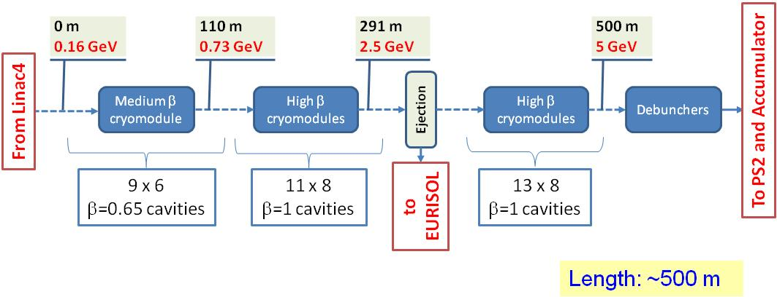
High Power SPL (HP-SPL)
    High Intensity Higher Energy SC-linac (160 MeV ® 5 GeV) with ejection at intermediate energy. 4 MW beam power.
    Compared to LP-SPL: (Which was foreseen in the injectors upgrade plan)
      5 additional β = 1 cryomodules to reach 5 GeV (π production for ν Factory)
      New klystron modulators, upgraded infrastructure (cooling & electricity, etc.)
246 Cavities

Slide 4
Present Project Scope
In 2010, program launched for study of a high intensity proton driver in the context of possible future neutrino facilities at CERN, based on the LP/HP-SPL.
Included in CERN MTP, with resources.
Comprises:
Continuation of design work on HP-SPL, excluding integration & site specifics.
Includes prototyping of critical components: cavities, RF ancillaries and cryomodule
Construction and test of four-cavity RF cryo-module
Upgrade of clean room and assembly facilities
Preparation of a power test stand
Plan to power test the cryomodule in 2014
Updated CERN yellow report on SPL to be completed by end 2011

Slide 5
SPL Study Organization
Study leader: R. Garoby
 | Coordinator | External partners
RF hardware (low level & high power) (WG1) | E. Ciapala | ESS, Cockcroft Institute + (FNAL, SNS, JLAB, ANL)
Cavities (structures & auxiliary equipment) (WG2) | W. Weingarten | CEA-Saclay, CNRS-Orsay, Uni Rostock, Stony Brook, DESY + (JLAB, SNS)
Cryo module (cryostat & cryogenics) (WG3) | V. Parma | CEA-Saclay, CNRS-Orsay, Stony Brook + (FNAL)
Beam dynamics (beam parameters) (WG4) | A. Lombardi | CEA-Saclay, ESS + (FNAL)
Architecture (layout & geometry, extraction, transfer) | F. Gerigk
Surface treatment and vacuum | S. Calatroni
Mechanical design and construction | O. Capatina
Working Groups
SPL Collaboration
R.G.

Slide 6
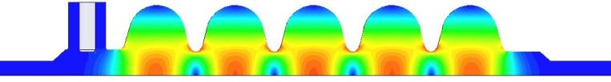
RF design of the β=1 cavity (Saclay)
J. Plouin, SACLAY, Joint ESS/SPL Meeting - SACLAY 2011
REFERENCE PARAMETERS (CDR, 2006)
RF frequency | 704.4MHz
Cavity β | 1
Accelerating gradient (E_{acc}) | 25 MV/m
Average pulse current (I_{beam}) | 40 mA
Synchronous phase (ϕ_{s}) | -15 °
Peak RF power | 1 MW
RF PARAMETERS OF THE CAVITY
Number of gaps (Ngap) | 5
Frequency [MHz] | 704.4
Beta | 1
Bpk/Eacc [mT/(MV/m)] | 4.20
Epk/Eacc | 1.99
G [Ohm] | 270
Cell to cell coupling | 1.92 %
r/Q [Ohms] | 566
Beam diameter aperture [mm] | 129.2
L_{acc} = Ngap.β.λ/2 [m] | 1.0647
Maximum energy gain @ Bpk = 100 mT | 25 MeV
Operating Temperature (O.T.) | 2 K
R_{BCS} @ O.T. (theoretical) | 3.2 nΩ
Q₀ @ O.T. for R_{BCS} | 8.4*10¹⁰
Design Goals
Optimization of r/Q, Epk, Bpk
Achievement of the external coupling
Resistance to Lorentz detuning (stiffeners)
  Reduction of K_{L} with stiffening rings down to |K_{L}|= 1 Hz/(MV/m)²
  Fast tuning system in pulsed mode (tests & operation)
704.4 fundamental mode (pi-mode)
6

Slide 7
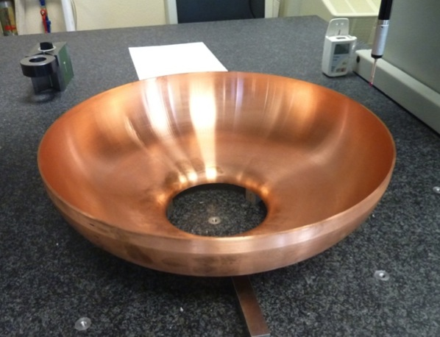
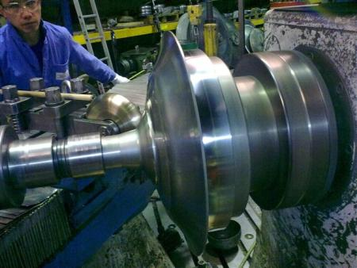
Status of β=1 cavities at CERN
Four cavities will be built
Tooling made
20 copper model half cells made, now being measured
Niobium for the four cavities (+ spare) delivered to CERN
Invitation to tender for three cavities sent out to three firms, offers being studied
CERN will manufacture the remaining cavity (TBC)
Cavity assembly at CERN, using new e-b welding machine, suitable for high quality niobium
Planned completion four cavities by end of 2012
Spinning and e-b welding

Slide 8
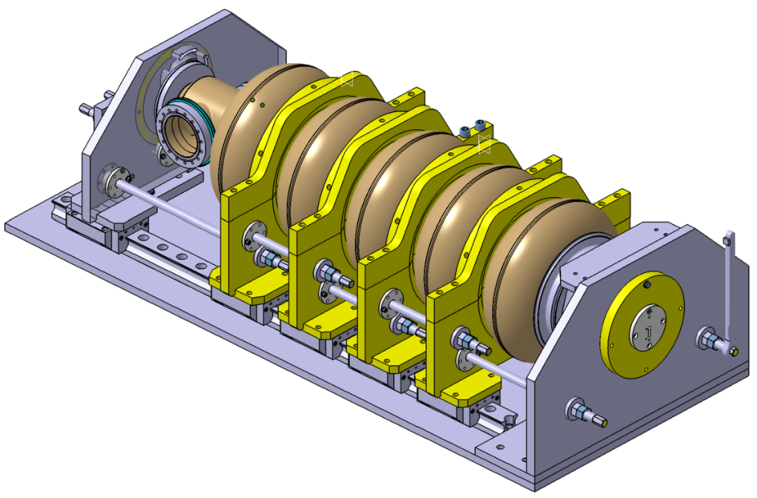
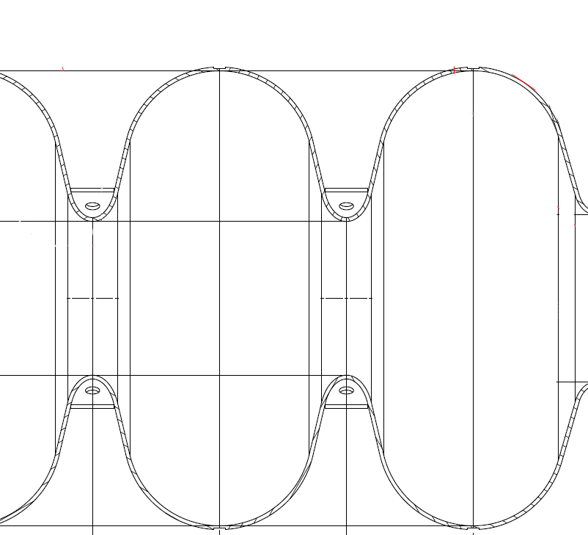
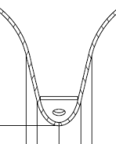
Cavity tuning set-up
J. Plouin et. al. ESS/SPL Meeting July 2011.
Development of a new tuning set-up for obtaining the field flatness after reception of the cavity.
Tuning jigs to be built both at CEA and CERN
Drilling on rings
Cell by cell tuning with plates fixed on the stiffening rings of the cavity

Slide 9
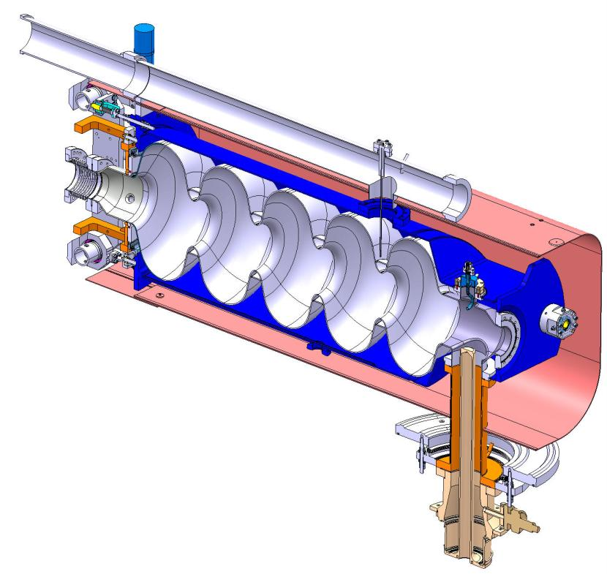
Cryostat, He Tank and Ancillaries
Helium Tank
Bulk Niobium 5-cells Cavity
HOM Coupler
Tuner
Magnetic Shielding
Power Coupler
Schematic sectional view of the five-cell cavity inside its helium tank, with tuner magnetic shielding, power coupler and HOM coupler

Slide 10
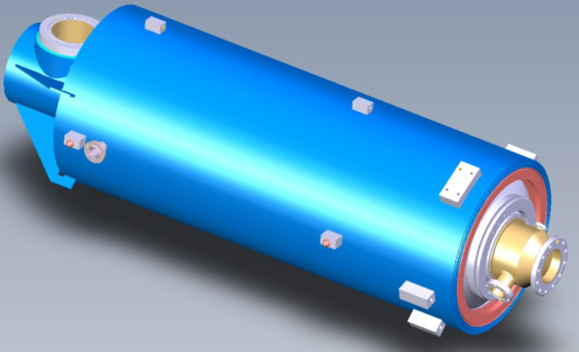
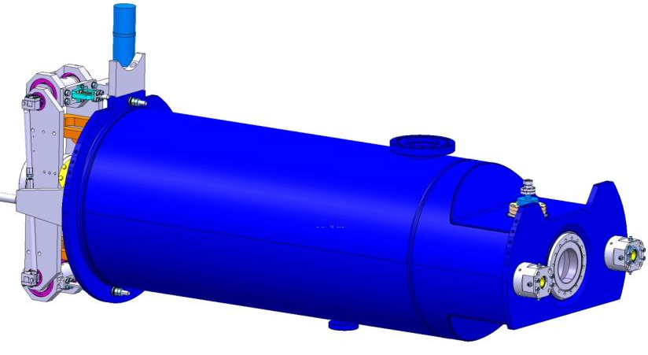
He tank design : CEA/CERN
The ‘short SPL cryomodule’ is under-study by CERN+IPNO
CEA designing fully equipped cavity (with He tank, tuning system, coupler interfaces…) which fits on horizontal cryostat CryHolab
At CEA : design for tests in CRYHOLAB
(J. Plouin et al.)
At CERN: integration of 4 cavities string in SPL short cryomodule
Will finally use stainless steel for He tank to ease design of interfaces to other components

Slide 11
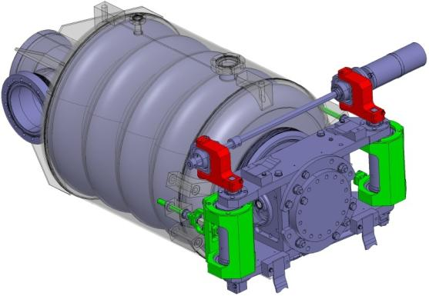
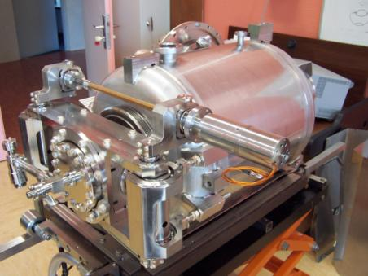
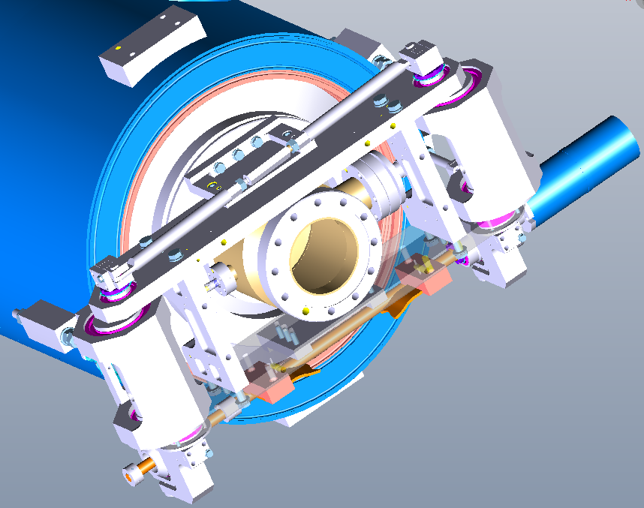
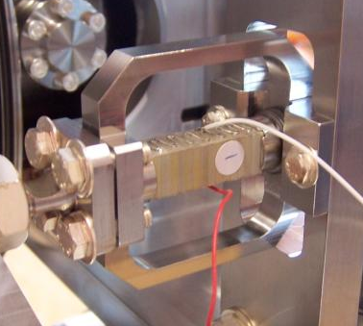
Saclay piezo tuner for 700MHz cavities
G. Devanz, CEA-Saclay, SPL 3rd coll. meeting
Slow tuner with symmetric action
Excentric/lever arm proven Saclay design
Planetary gear box (3 stages)
Single NOLIAC 30mm piezo actuator
Stiffness measured on the tuner pneumatic jack = 35 kN/mm
Initially developed for the beta=0.5 5-cell cavity
Piezo Support
11

Slide 12

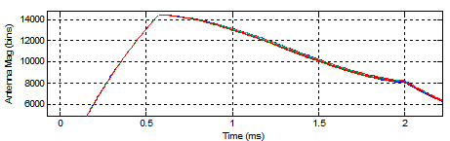
Field flatness with & without piezo
no piezo
+/- 0.7 %
field flatness
In amplitude
achieved
by using
piezos !
piezo excited
use of piezo minimizes additional RF power needed to further improve the field flatness to the design target of +/- 0.5 %

Slide 13
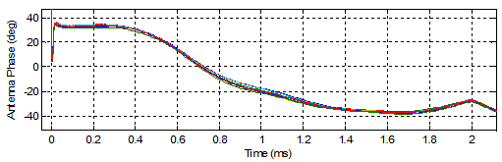
Phase flatness with & without piezo
+/- 8 degrees flatness
In phase, achieved
by only using
piezo ! Needs
RF feedback
to achieve
design goal
of +/- 0.5 degrees
no piezo
piezo excited

Slide 14
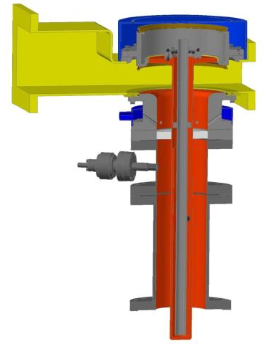
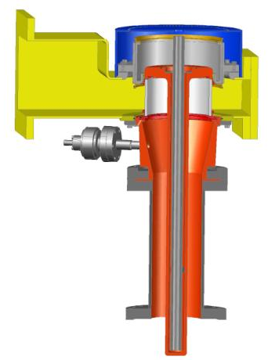
Power Couplers
Single RF window
Fixed coupling
Double walled tube on outer line
Mounted vertically, below the cavity
Double walled tube partially supporting the cavity
Type 2
Type 1
Type 1 - Air-cooled cylindrical ceramic window
Type 2 - Coaxial ceramic window.
Due to the tight planning, and risk of difficulties with either type, the decision was taken to build 4 of each.

Slide 15
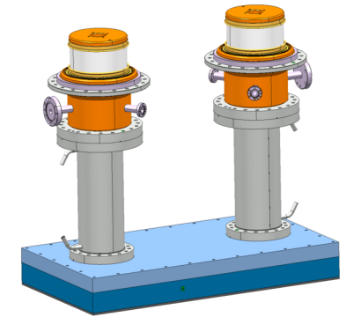
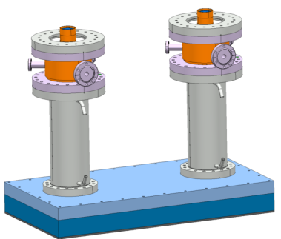
Coupler testing and processing
Assembly at DESY using their XFEL high quality clean room facilities and procedures.
Then RF tests at CEA
RF Processing done using a “clean room line” assembly consisting of:
  A test cavity
  A pair of couplers
  Two double walled tubes
X 2
X 2

Slide 16
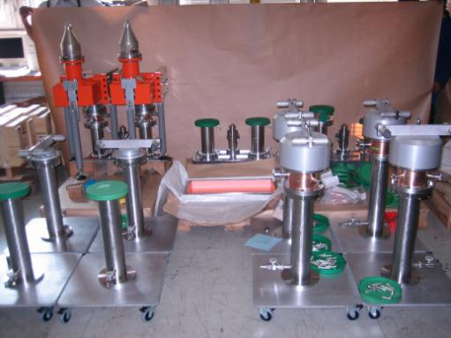
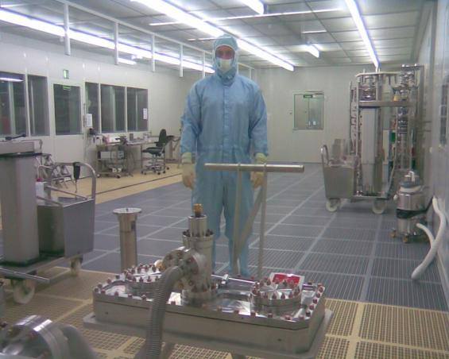
Coupler assembly at DESY
All parts & components for four assemblies were prepared
All parts vacuum tested at CERN
All material sent to DESY for clean room assembly
A first test line assembled in the DESY clean room, using DESY-XFEL process cquality procedures
Vacuum tight.

Slide 17
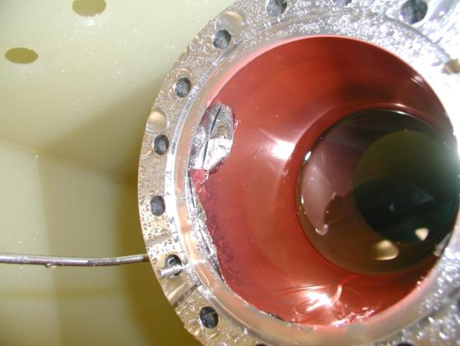
Couplers: Assembly & test
BUT difficulties with the Double Walled Tube (DWT) – peeling of sputtered Cu coating.
Possible explanation: machining of the DWT
Removed all copper on all DTs & clean them down to stainless steel (electro-polishing).
Four DWTs, NOT copper plated returned to allow completion of two assemblies. Completed and returned to CERN
Successful vacuum leak tested the two assemblies,
CEA tests will now be done, without Cu plating (Additional heating not an issue for warm tests – can water cool)

Slide 18
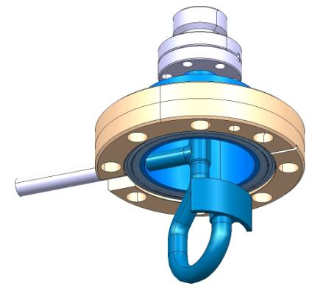
HOM Couplers – Design studies
HOM Couplers needed if we have to cope with a variety of chopping schemes.
(Cavity has a mode at 2111.64, MHz very near 3fo)
Possibility to cool with super-fluid liquid helium retained. Therefore the HOM coupler ports are directed up.
HOM coupler port on the power coupler side extremity (right side) is directed upwards opposite the power coupler port.
A second HOM coupler port on the opposite extremity of the power coupler, rotated by 60° from vertical.
Futher design work is however needed…
Short cryomodule will have HOM ports
Preliminary design of HOM coupler for β = 1 SPL cavity.

Slide 19
RF Power requirements along HP-SPL
Need additional power margins:
for Feedbacks (TBC)
7% Waveguide losses
Modulator droop, (?), coupling variations
1000 kW nominal (max β=1) on cavity => ~ >1.2-1.3 MW from klystron
Have a wide range of powers along the linac
Cavity #
Cavity #

Slide 20
RF Power Sources
Work done on choice of power sources
Klystrons:
  One klystron per two cavities ?
  One klystron per cavity ?
IOTs:
  One IOT per cavity
  Multiple IOTs combined per cavity
Solid State Amplifiers (SSA)
  Optimal & modular config. for Low β, too big for high power sections
Magnetrons
Studied by A. Dexter CI, with JLAB
SPL = 704 MHz
Erk Jensen

Slide 21
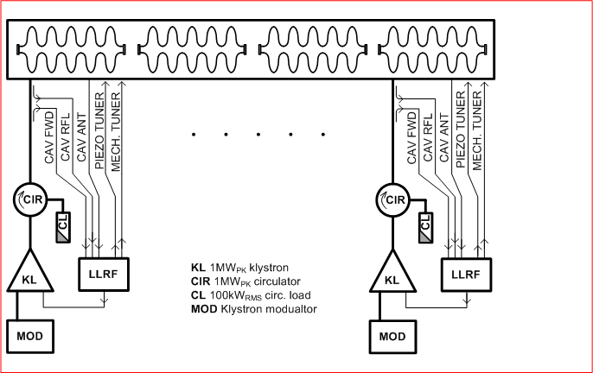
RF distribution schemes
Option 2) 1 klystron/cavity
Equipment | Qty | Cost/item. | Total
 |  | k Euro | kEuro
Klystron 1.2MW | 4 | 400 | 1600
1 MWp Circulator | 4 | 100 | 400
Circulator load 100kW | 4 | 20 | 80
Hybrid | 0 | 20 | 0
Hybrid load 100kW | 0 | 20 | 0
Phase shifter (mechanical) | 0 | 20 | 0
Vector Modulator 1MWp | 0 | 100 | 0
Klystron Modulator 1.5 MW | 4 | 200 | 800
Total (per 4 cavity unit) |  |  | 2880
Advantages:
Simplest RF hardware set
Full Direct RF control of each cavity. Simple non-interdependent RF loop controls
No additional power overhead or extra cooling
Good operability, best fault tolerance
Disadvantages:
240 power sources…
FOOTPRINT

Slide 22
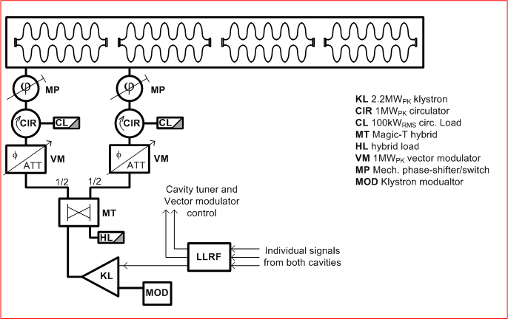
RF distribution schemes
Option 3) 1 klystron/2 cavities
Equipment | Qty | Cost/item. | Total
 |  | k Euro | kEuro
Klystron 2.4MW | 2 | 500 | 1000
1 MWp Circulator | 4 | 100 | 400
Circulator load 100kW | 4 | 20 | 80
Hybrid | 2 | 20 | 40
Hybrid load 100kW | 2 | 20 | 40
Phase shifter (mechanical) | 2 | 20 | 40
Vector Modulator 1MWp | 2 | 100 | 200
Klystron Modulator 3 MW pk | 2 | 360 | 720
Total (per 4 cavity unit) |  |  | 2520
Advantages:
120 power sources instead of 240
Disadvantages:
Still need the full hardware set, with associated cost, development effort…
Additional power overhead with its extra cooling requirement

Slide 23
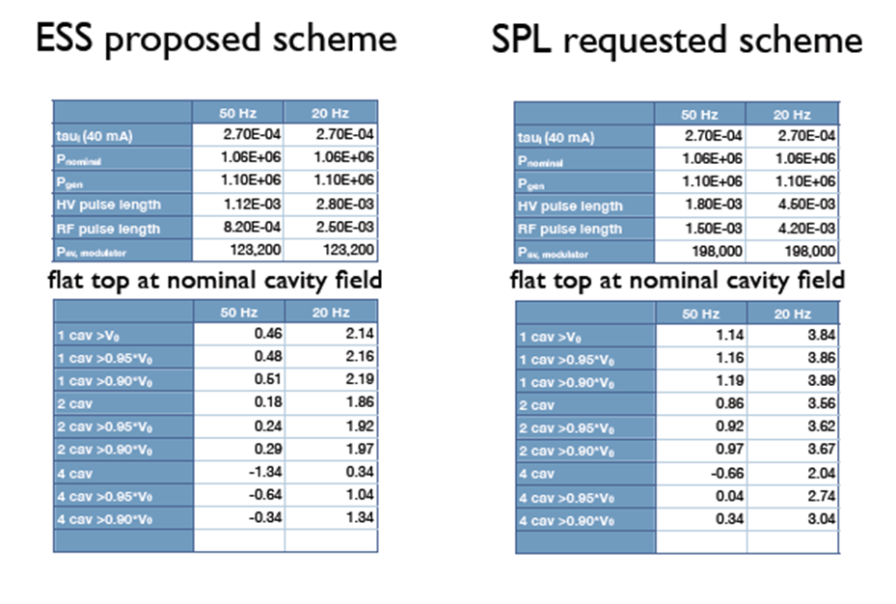
Klystron Modulators for ESS and CERN
K. Rathsmann (ESS) - Fifth SPL Collaboration Meeting - November 2010.
ESS Modulator for SM18
Pulse repetition rate: 20 Hz
Pulse length: 2.8 ms
Modulator Peak Power: 2.88 MW
Modulator average power: 200 kW
Higher rep rate possible with shorter pulse length
Klystron:
Pulse length: 2.5 ms
Peak power: 1.5 MW
ESS do tender for 1-3 systems – 2 Suppliers ?
50 Hz as option for SPL
ESS tendering is finished , offers just received.
order in 2011, for delivery October 2012

Slide 24
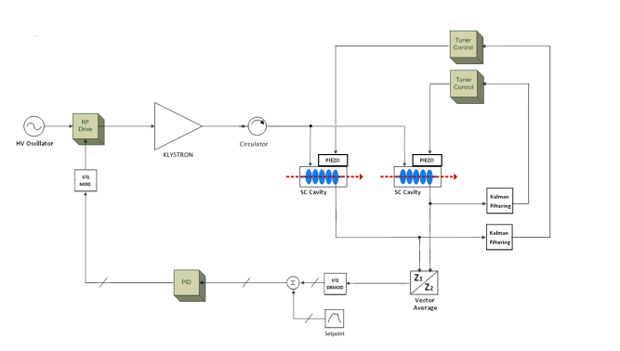
Tuner control and RF feedback simulations
Matlab & Simulink modeling
Various effects studied, for dual cavity configuration:
Cavity Voltage Amplitude and Phase
Forward and Reflected Power
Additional Power for Feedback Transients and Control
Effect of Lorentz Detuning on Feedback Power
Effect of Source Current Fluctuations
Mismatched Low-Power Case
Effects of Beam Relativistic Beta Factor on Cavity Voltage with beam-loading
Mathias Hernandez-Flanez

Slide 25
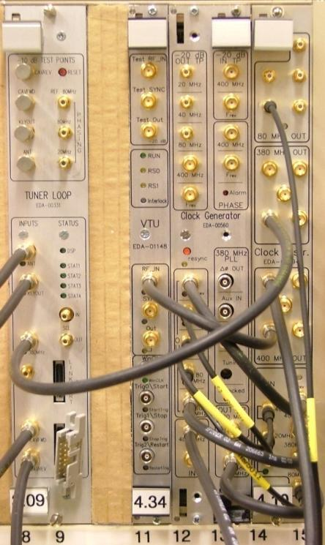
LLRF Hardware for tuner characterization
CERN modified LHC hardware used in cavity tuning tests at Saclay
four channels analog down conversion to IF
f_{RF} = 704.4 MHz
f_{LO} = (39/40) f_{RF} = 686.79 MHz
f_{IF} = f_{RF} -f_{LO} = 17.61 MHz
digital IQ demodulation with
sampling at 4xf_{IF} = 70.44 MHz
rate of (I,Q) samples: 17.61 MS/s
actual bandwidth lower and
depending on desired precision
Next steps → evolution to full LLRF system with RF feedback

Slide 26
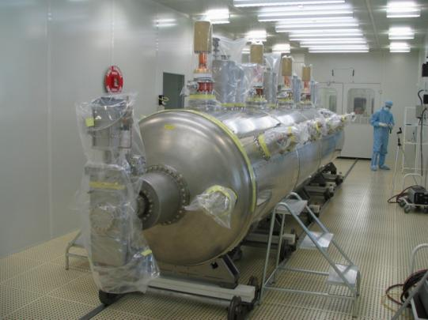
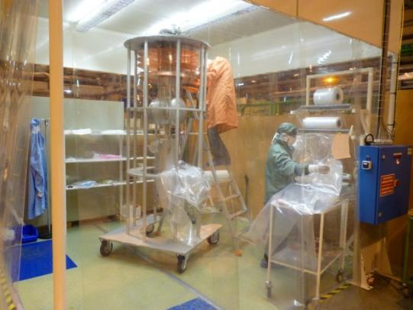
Cavity assembly and testing at CERN
    CERN SCRF Installations date from 1990s and LEP, with minor refurbishing for LHC cavities
    Major upgrade of facilities needed to handle modern high gradient cavities, in progress:
    New preparation, rinsing equipment, UP water
    New clean room
    Improved cryo, with 2K operation
    Modern diagnostics equipment

Slide 27
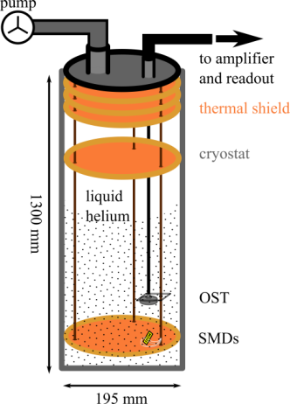
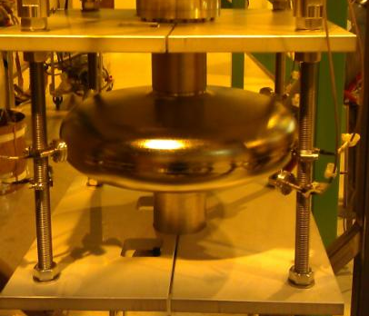
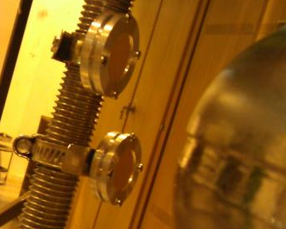
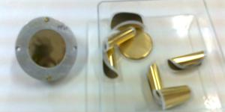
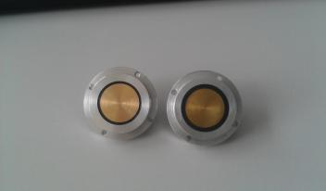
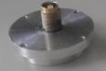

Second sound diagnostics at CERN
Similar tests also at Saclay
Second sound study
SPL test cavity
4.5 ± 0.5 cm
OST manufacturing at CERN, thanks to Cornell support.
Membrane sputtering
CERN (LEMO) vs Cornell (SMA)
Kitty Liao Oct 2011
27

Slide 28
SPL Activities
Description of the SPL and project scope
Cavities – design & fabrication
Cryomodule , He tank
Tuners, couplers, HOMCs
Power systems and pulsed modulators
Low Level RF
CERN SCRF infrastructure upgrade
Planning and ongoing work
Summary
Upcoming events & meetings…

Slide 29
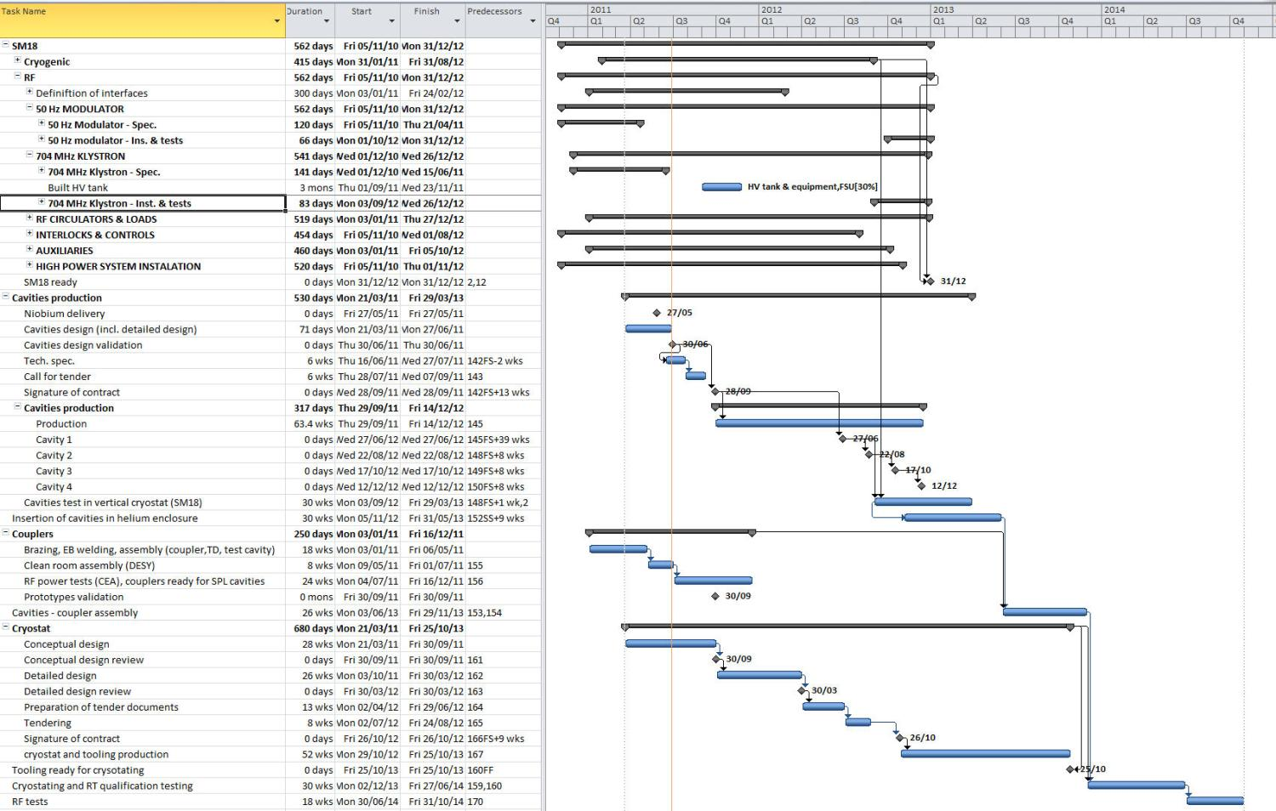
Planning of SPL R&D
Modulator from industry (ESS) Q3 2012
2011
2012
2013
2014
Install & test klystron End Q4 2012
Cavity fabrication end 2012 Delayed by Nb procurement.
Vertical tests by end Q1 2013
Couplers assembled and processed by end 2013
Cryostat with cavities by end 2013
RF tests mid 2014

Slide 30
Ongoing SPL work in SM18
Preparation of HP RF
1.5 MW 704 MHz klystron in final stages of being ordered
Modulator installation preparation ongoing, including 400 V distribution line
RF power distribution system layout done, waveguides ordered.
One circulator and 3 Magic Tees, loads to be ordered by EoY
(allowing simultaneous powering of up to 4 cavities)
Interlocks & controls in preparation
First vertical test of an SPL cavity
Using a low β single cell from SACLAY
Cavity cooled down
He leak discovered
Tests under way to test & commission the measurement system
Will repair leak and continue..

Slide 31
Summary (1)
Design of all major components is complete, excluding the cryomodule
Cryomodule review upcoming, design work to complete on He tanks and magnetic shielding.
Beginning of cryomodule construction (IN2P3) planned for end 2012
Cavity fabrication on schedule, test infrastructure being commissioned
Specification & construction of He tanks – ongoing (CEA)
Tuner design (SACLAY) validated in exhaustive tests, SACLAY will provide all 4 tuners – French in-kind contribution

Slide 32
Summary (2)
RF High power equipment & klystron procurement on schedule
Specification & order of klystron modulator from industry being managed by ESS
Power couplers: Review done March 2011. Issue with DWT to resolve but well in hand
HOM Couplers – work still needed but not needed for initial cryomodule test
Upgrade of cryogenics and overall infrastructure in SM18 expected to be ready on time.
Test of single cell sc cavity now starting…
The studies have progressed well and we are well into preparing the hardware.
The project is ambitious, but is advancing well.

Slide 33
Some Upcoming Events
SPL / ESS Specific:
  SPL Cryomodule Review : 4th Nov. 2011 CERN.
  7th ESS-SPL Collaboration meeting : 8-9 December, 2011 CERN.
  ESS RF Workshop 12-16 December, Uppsala.
Other Meetings at CERN
  LHC Crab cavity Workshop LHC CC11: 14-15 November
  LHC Collaboration Meeting: 16-18 November.
Thank you for your attention.

Slide 34
SPL Activities
Spare Slides

Slide 35
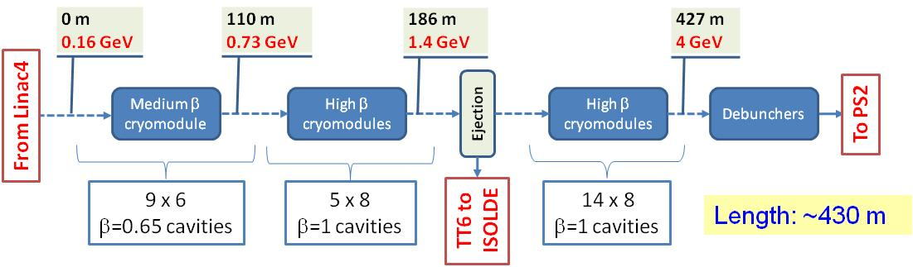
Low Power SPL LP-SPL
    LP-SPL: SC-linac (160 MeV ® 4 GeV) with ejection at intermediate energy
    Part of the upgrade of the CERN injectors, with PS2
    Designed to be upgradable to High Power for future facilities such as a neutrino factory => HP-SPL
Original Injectors Upgrade Scenario using LP-SPL
206 Cavities

Slide 36
HP-SPL basic characteristics
Beam characteristics of the main options
 | Option 1 | Option 2
Energy (GeV) | 5 | 5
Beam power (MW) | 4 MW | 4 MW
Rep. frequency (Hz) | 50 | 50
Protons/pulse (x 10¹⁴) | 1.0 | 1.0
Av. Pulse current (mA) | 20 | 40
Beam pulse duration (ms) | 0.8 | 0.4
2 × beam current ⇒ 2 × nb. of klystrons etc .

Slide 37
Resume - SPL R&D until 2016
H⁻ source R & D (part of SLHC-PP)
Continued within the Linac4 project
Study of the optimum high power RF architecture for a high power SPL (part of SLHC-PP)
Terminated
Design, construction and test of superconducting RF cavities (704 MHz – 5 cells) in a cryomodule
Continued within EuCARD (CEA and CNRS) (2 cavities) + French in-kind + CERN resources (4 cavities)
Development of high power RF coupler, HOM damper and adaptation of tuner
Continued with French in-kind contribution + CERN resources + Uni Rostock
Upgrade of the SM18 test place [2 K cooling + pulsed RF source at 704 MHz (1.5 MW @ 50 Hz )]
Continued with ESS support (modulator) + CERN resources
Pulsed high power RF tests of contiguous cavities in a common cryostat
Continued with ESS participation + CRISP support + CERN resources
(Design, construction and test a high power klystron modulator: to resume in 2014)
(Design, construction and test of a prototype cryomodule equipped with 8 β=1 cavities: delayed)
Pending definition of CERN strategy following recommendations of the “European Strategy Group for Particle Physics” at the end of 2012.

Slide 38
Cavity Parameters β= 0.65
Type of accelerating structure | β=0.65 | 5-cell standing wave
Accelerating mode |  | TM₀₁₀, π-mode
Fundamental frequency ƒ_{RF} | [MHz] | 704.0
Nominal gradient E_{acc} | [MV/m] | 19
Quality factor Q₀ at nominal gradient |  | 10¹⁰
Active length L | [m] | 0.692
Cell-to-cell coupling k_{cc} | [%] | 1.45
Iris diameter (inner cells) | [mm] | 96
Iris diameter (outer cells adjacent to power coupler/tuner) | [mm] | 140/130
R/Q | [Ω] | 275
E_{peak}/E_{acc} |  | 2.63
B_{peak}/E_{acc} | [mT/MV/m] | 5.12
Geometry factor | [Ω] | 197
Δƒ/ΔL | [kHz/mm] | 164
Lorentz-force detuning constant K_{Lor} | [Hz/(MV/m)²] | -1.6
Q_{ext} of input coupler (I_{B} = 20 mA and φ =15°) |  | 1.2 × 10⁶
Cavity bandwidth f/Q_{ext} | [Hz] FWHM | 590
Fill time | [μs] | 270

Slide 39
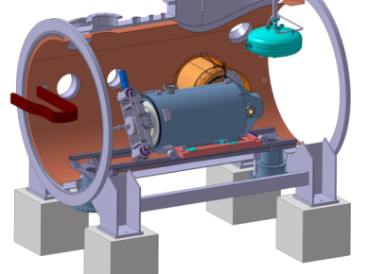
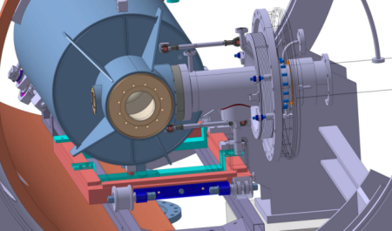
B=0.65 cavities and test cryostat
J. G.Olry et al., IPN Orsay, Joint ESS/SPL Meeting - SACLAY 2011
PLANNING
--> end of June ’11: call for tender preparation
29th Aug’11: deadline for receiving the offers
Mid-Sept ’11: choice of the manufacturer
Beginning of Oct’11: start of the fabrication
July ’12: cavity delivery w/o helium vessel → field flatness
Sept’12: helium vessel welding
Oct’12: cavity delivery
Nov ’12: cavity preparation (BCP + HPR) & assembly in clean room
Dec ’12 (for Christmas?): test in vertical cryostat
In 2013: cavity installation & test in CRYHOLAB

Slide 40
Cavity Parameters β= 1
Type of accelerating structure | β=1 | 5-cell standing wave
Accelerating mode |  | TM₀₁₀, π-mode
Fundamental frequency ƒ_{RF} | [MHz] | 704.4
Nominal gradient E_{acc} | [MV/m] | 25
Required field flatness ΔV/V | [%] | < ±2.5
Quality factor Q₀ at nominal gradient |  | 10¹⁰
Active length L | [m] | 1.065
Cell-to-cell coupling k_{cc} | [%] | 1.92
Iris diameter (inner cells) | [mm] | 130
Iris diameter (outer cells adjacent to power coupler/tuner) | [mm] | 129.2/140
R/Q | [Ω] | 566
E_{peak}/E_{acc} |  | 2.0
B_{peak}/E_{acc} | [mT/MV/m] | 4.2
Geometry factor | [Ω] | 270
Required tuning range | [kHz] | ± 300
Δƒ/ΔL | [kHz/mm] | 164
Lorentz-force detuning constant K_{Lor} | [Hz/(MV/m)²] | 1
Q_{ext} of input coupler (I_{B} = 20 mA and φ =15°) |  | 1.2 × 10⁶
Cavity bandwidth f/Q_{ext} | [Hz] FWHM | 590
Fill time | [μs] | 270
Number of HOM couplers |  | 2, if needed

Slide 41
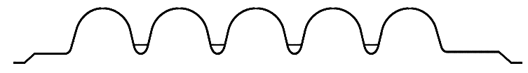
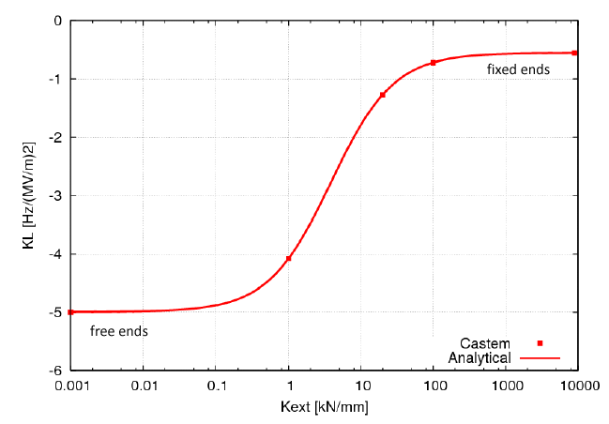
Mechanical parameters of the cavity
G. Devanz/J. Plouin 3rd SPL Meeting CERN 2009.
with tank and tuner
free ends
fixed ends
 | SPL | HIPPI
Nominal wall thickness [mm] | 3 | 4
Cavity stiffness Kcav [kN/mm] | 3.84 | 2.25
Tuning sensitivity Δf/Δz [kHz/mm] | 164 | 295
K_{L} with fixed ends [Hz/(MV/m)²] | -0.55 | -2.7
K_{L} with free ends [Hz/(MV/m)²] | -5 | -20.3
Pressure sensitivity K_{P} [Hz/mbar] (fixed ends) | 1.2
The cavity will be equipped with a Saclay 4 tuner. The stiffness of the HIPPI - Saclay 4 tuner has been measured : K_{ext} 35 kN/mm
The SPL cavity equipped with this tuner would present a detuning coefficient
|K_{L}| = 1 Hz/(MV/m)² ≈ |K_{L}| estimated for Tesla
41

Slide 42
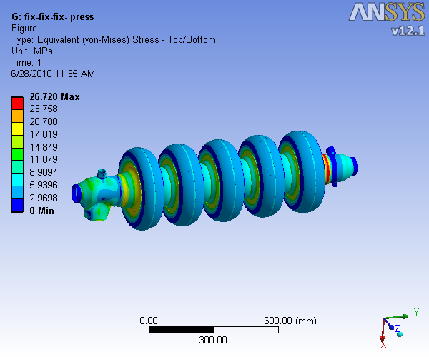
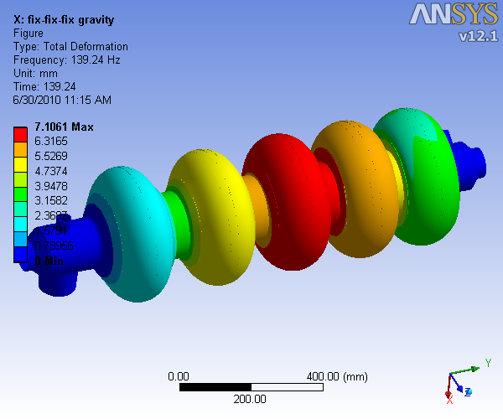
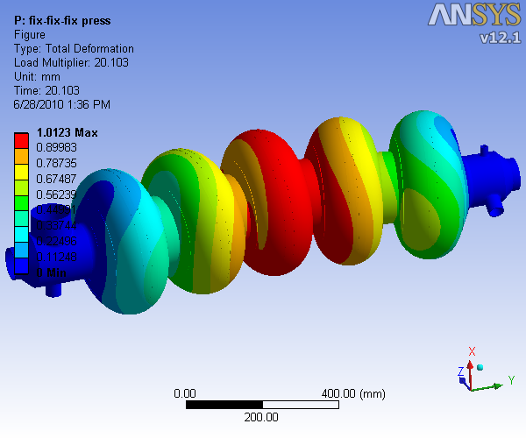
Mechanical properties of cavities
Further design studies completed at CERN:
Maximum external pressure of 2 bars – fix-fix boundary condition (1)
Sensitivity to pressure fluctuation => one order of magnitude lower than the frequency bandwidth
Deformation for tuning
Natural vibration - First longit. mode at ~140 Hz (2)
Buckling (3)
=> Cavity thickness 3mm.
(1)
(2)
(3)

Slide 43
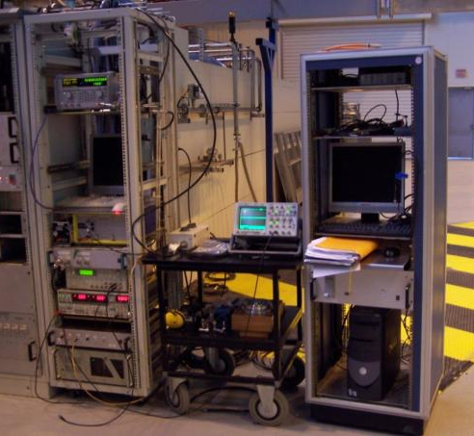
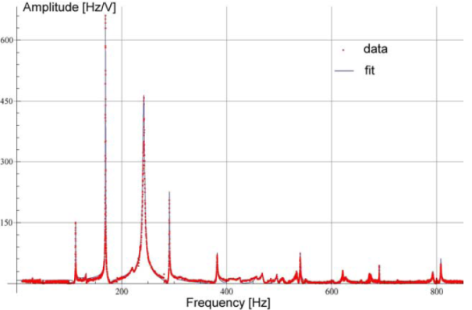
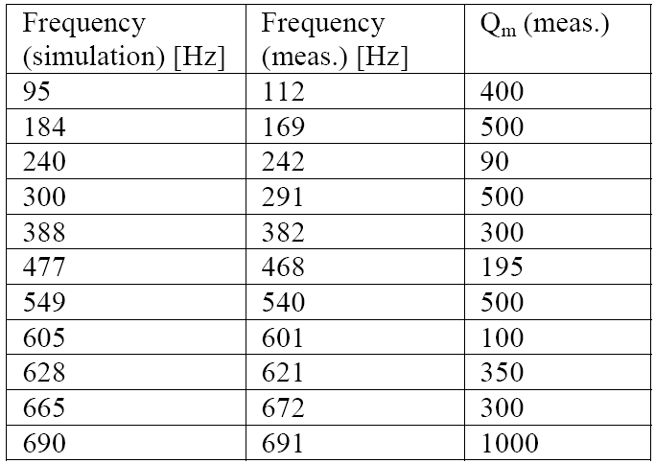
Transfer function measurements
G. Devanz, CEA-Saclay, SPL 3rd coll. meeting
43

Slide 44
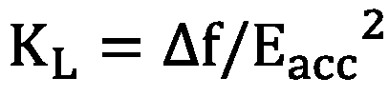

Mechanical stiffening of the cavity
Cavity aimed to work in the pulsed mode  sensitivity to Lorentz detuning is critical
Lorentz detuning coefficient :
➲ Insertion of stiffening rings to reduce |K_{L}|
Mechanical model of the cavity (CASTEM)
The cones are an element of flexibility in the structure  they increase |K_{L}|
around the optimum
Optimal position for Rring = 91 mm

Slide 45
Cavity HOMs : list
#freq r/Q beta_opt Qo Rs_nOhm
692.459406 15.495341 0.55 5.87048e+10 4.58
695.691165 40.295848 0.63 5.85048e+10 4.60
699.762722 86.977902 0.71 5.82537e+10 4.62
703.121236 173.038043 0.81 5.80475e+10 4.64
704.420268 565.499512 1.00 5.8134e+10 4.65
1293.187800 3.150182 0.66 4.06538e+10 9.75
1303.568690 7.969888 0.72 4.01921e+10 9.86
1317.445320 17.344152 0.79 3.95608e+10 10.02
1329.742220 59.154893 1.00 3.9004e+10 10.16
1335.734260 107.744313 0.98 3.8525e+10 10.23
1450.724780 0.831396 0.92 5.06898e+10 11.62
1460.366080 1.999197 0.89 5.03429e+10 11.74
1474.206000 2.839266 0.85 5.03023e+10 11.92
1488.535980 2.701775 0.80 5.09436e+10 12.10
1499.066360 2.342662 0.73 5.20134e+10 12.24
Operating frequency mode (π) : f₀ = 704.4 MHz
J. Plouin et al., 3rd SPL Meeting CERN 2009
No monopole HOM at 2f₀
1843.272060 0.209069 0.95 3.35164e+10 17.22
1858.324840 0.596186 0.91 3.26306e+10 17.47
1881.326440 1.603429 0.98 3.28434e+10 17.84
1911.484360 1.329645 0.94 3.31308e+10 18.33
1948.248770 1.819111 1.00 3.35394e+10 18.95
2000.236410 2.451434 0.98 3.13642e+10 19.84
2039.865120 1.377179 0.78 3.70143e+10 20.53
2072.798390 3.019703 0.83 3.349e+10 21.12
2086.249930 5.689452 0.88 3.00335e+10 21.36
2089.642160 19.164504 1.00 2.90251e+10 21.42
2111.640680 10.636820 1.00 2.94648e+10 21.82
2119.767790 8.476595 1.00 2.65214e+10 21.97
2138.944200 1.075819 0.95 2.94674e+10 22.33
2175.157760 1.744804 0.91 3.24669e+10 23.00
2219.889020 4.482180 0.97 3.46431e+10 23.86
2262.192880 7.529522 1.00 3.6688e+10 24.68
2290.061390 0.330347 0.85 4.00758e+10 25.23
Mode at 2111.64 MHz very near 3f₀
Cut-off frequencies for the mode TM010
Ø 80 mm : 2865 MHz
Ø 130 mm : 1763 MHz
Ø 140 mm : 1637 MHz
2464.607050 0.764947 0.95 2.5928e+10 28.82
2485.980300 1.514541 1.00 2.63647e+10 29.28
2512.576190 1.303253 0.96 2.84428e+10 29.86
2538.171130 8.505168 1.00 3.13472e+10 30.42
2559.022710 6.760250 0.99 3.40374e+10 30.88
2565.011240 2.855068 0.95 3.43392e+10 31.01
2639.339900 0.070686 0.90 2.41594e+10 32.69
2645.191100 0.071469 1.00 2.48068e+10 32.82
2650.937090 0.150348 1.00 2.47399e+10 32.96
2657.099030 0.275372 1.00 2.44513e+10 33.10
2721.471070 1.230228 0.96 2.23449e+10 34.60
2765.009700 0.249521 0.83 2.99369e+10 35.63
2781.989510 0.411752 0.87 2.61634e+10 36.04
2799.460470 0.229298 0.90 2.30615e+10 36.46
2809.660150 6.941103 1.00 2.09609e+10 36.71
List of monopole HOM calculated with Superfish between 0 and 3000 kHz
Axisymetric calculations
45

Slide 46
HOM Coupler design issues
A larger coupling port increases the transmission in the low frequency regime, but has little effect on a parasitic notch near 2.1 GHz.
This notch only appears on the HOM coupler opposite the power coupler, indicating that it depends on the geometry of the beam tube.
The parasitic notch frequency is close to three times the fundamental mode frequency and could therefore be harmful.
From the determination of the Qext values one concludes that around 2.1 GHz the damping is insufficient by far
However, power coupler may contribute to HOM damping
Futher design work needed…
Will not fit HOMCs to first cryomodule
Simulated transmission for the SPL cavity
Simulated Qext vs frequency for two HOMCs and power coupler port shorted

Slide 47
SPL Power Coupler – Design
RF Specs
f₀ | 704.4 MHz
High Power SPL | 1000 kW pulsed Max. foreseen RF pulse length: 2.0 ms 50 Hz (20 ms) 100 kW average
Cavity design gradient | 19-25 MV/m
Q_{ext} of input coupler | 1.2 x 10⁶ ⁻ HPSPL setting
Input line Ø | 100 / 43.5 mm = 50 Ω (from the cavity design)
Waveguides | WR 1150
Technical Choices
Single RF window
Fixed coupling
Double Walled Tube on outer line
Clean room mounted together with the double walled tube horizontal in one operation
Mounted vertically below the cavity, with double walled tube partially supporting the cavity
With HV DC bias
Air cooled

Slide 48
RF Power Sources - Comparisons
Comparison of Klystrons & IOTs
Parameter | Remark
Power | IOTs reaching klystrons - 600kW feasible..(TBC)
Efficiency | IOT 75% Klystron 55-60% (70% limit)
HV | IOTs lower ~ 40kV (oil-free ?)
Size | IOTs shorter
Cost | IOTs 30% lower
Lifetme | IOT Not known for high power, low power as klystrons
Drive | Klystron gain 35db, IOT 20dB – needs more drive
Characteristic | Klystron gain reduces at high drive, IOT saturates
Magnetrons
Efficiency high, but can we get the power we need?
Phase locking needed, in development by CI
Response in a feedback loop? Bandwidth, group delay..
Cost, HV requirements, size ? Studied by A. Dexter CI, with JLAB

Slide 49
RF distribution schemes
Option 1) 1 klystron/4 cavities
Initially Preferred Layout for LP SPL – klystron economy
  Linear distribution, using less space consuming “planar” hybrids with individually adjusted coupling.
  Vector modulators for fast phase/amplitude field control
  Mech. phase shifters for cavity phasing or isolation
D. Valuch

Slide 50
Layout with two cavities per klystron
X
X
piezo tuner indispensible to avoid vector modulator.
Vector
modulator
Vector
modulator
Klystron
Feedback
Vector
SUM
Simulation program developed for LLRF simulations, user interface for 1, 2 and 4 cavities per klystron, M. Hernandez Flano

Slide 51




Amplitude and Phase variation for Dual Cavity Case (Without Piezo Feed-Forward)
K=-0.5
K=-1

Slide 52


Phase variation for Dual Cavity Case
(With Piezo Feed-Forward)
Cavity 1 (K=-1 )
Cavity 2 (K=-0.5 )

Slide 53


Transit Time Factor variation
β=1 cavities, open loop simulation
Beamloading
Values obtained from SUPERFISH simulations by Marcel Schuh (CERN)
Weaker beam loading will result in a higher flat-top equilibrium and less phase detuning of the cavity for the same generator power.
Beta value taken from beam energy at beginning of SPL β=1 section.
Beamloading

Slide 54
CERN SM18 SCRF test stand activities
    Ongoing work:
        LHC spare cavities, cryomodules & power couplers
        HIE Isolde cavities, cryomodules (later)
        CTF3 pets structures
        SPL cavities and cryomodules
        Nb studies λ/4 resonator (To cryo Lab)
        Linac 4 structure tests (short-term)
      Future
        Crab Cavity assembly & test
        Prototypes LHeC, LHC 800 MHz??

Slide 55

Upgrade of SM18 Facilities
    Assembly area & clean rooms (J. Chambrillon)
      Upgrade of clean rooms, installation of access rooms (personal + material)
      Installation of high pressure rinsing equipment & ultra pure water supply
      Improved cleanliness, more working space..
      Preliminary design shown, still being studied
Ionized air shower
Outer working place
Class 100
Class 10
Personnel access, with air shower Class 1 000
Air supplier
Control room
HPWR system
Cleaning & rinsing room Class 100
UPW production
Baldaquin 2
Storage area Class 100
Baldaquin 1
Class 100

