Slide 1
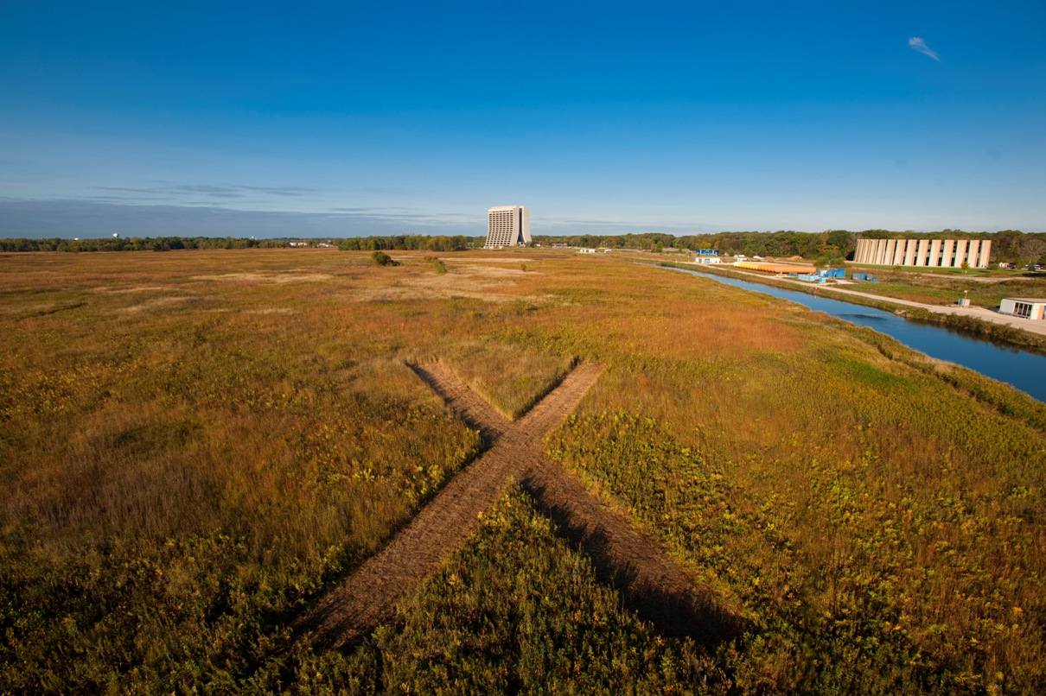
WG1 summary
Sergei Nagaitsev, Robert Kephart, Valeri Lebedev, Peter Ostroumov, Derun Li
October 27, 2011

Slide 2
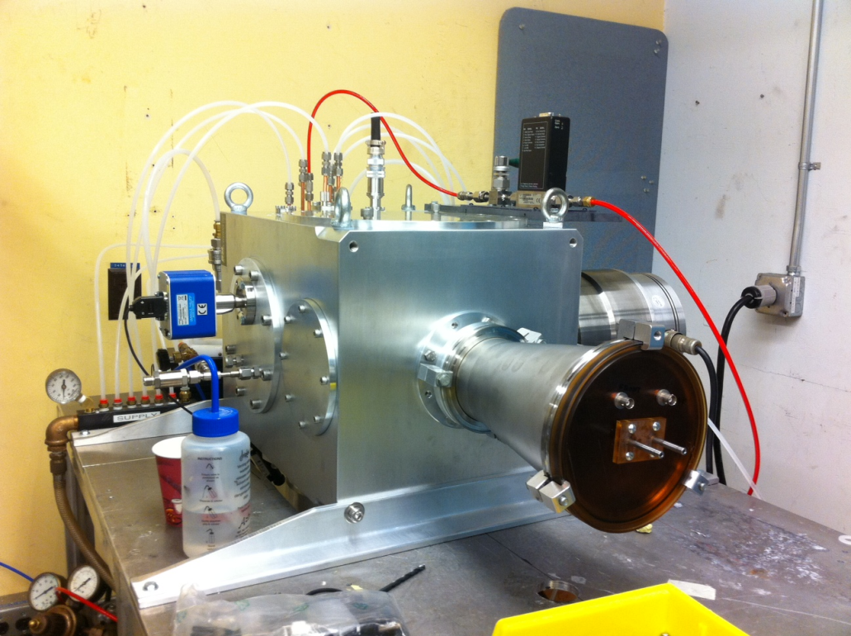
Ion source
Commercial source procured and installed at LBNL
Tests underway at LBNL
  Demonstrated 10 mA operation
  Will measure emittances, stability
Established Ion source requirements
for Project X/PXIE
  5mA nominal, 10 mA max, 30 kV
  measured norm rms emitt < 0.2 mm-mrad

Slide 3
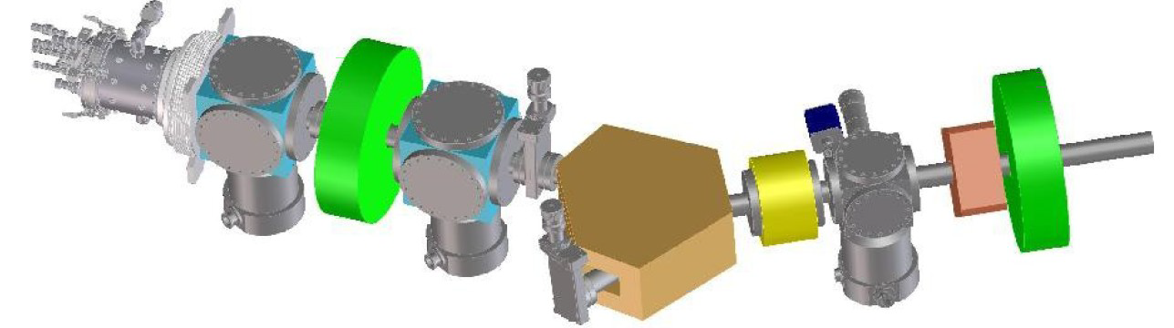
LEBT
Project X LEBT concept exists since Apr 2011 meeting: 2 sources with a Y dipole magnet
Neutralized beam transport
Refined requirements for the LEBT chopper
  < 100 ns rise/fall time
  Needed for commissioning – start with a pulsed beam, then increase duty factor
  May support 1 MHz pulsing
Planning for LBNL and PXIE tests is underway
PXIE LEBT

Slide 4
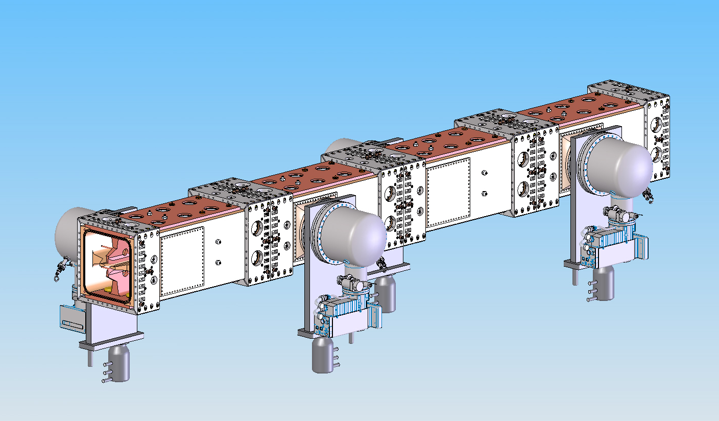
RFQ
Ion type: H-
Beam current: 5 mA (nominal); 1 – 10 mA
Transverse emittance (norm, rms): < 0.25 mm-mrad
Longitudinal emittance (rms): 0.8 keV-nsec
Input energy: 30 keV
Output energy (kinetic): 2.1 MeV
Duty factor: 100% (CW)
Frequency: 162.5 MHz

Slide 5
RFQ
Excellent progress on engineering and design
  well-defined deliverables (fabrication drawings and tests by end of FY12)
Starting to establish fabrication, installation and commissioning plans
It is possible to have the RFQ installed at Fermilab in May, 2014.

Slide 6
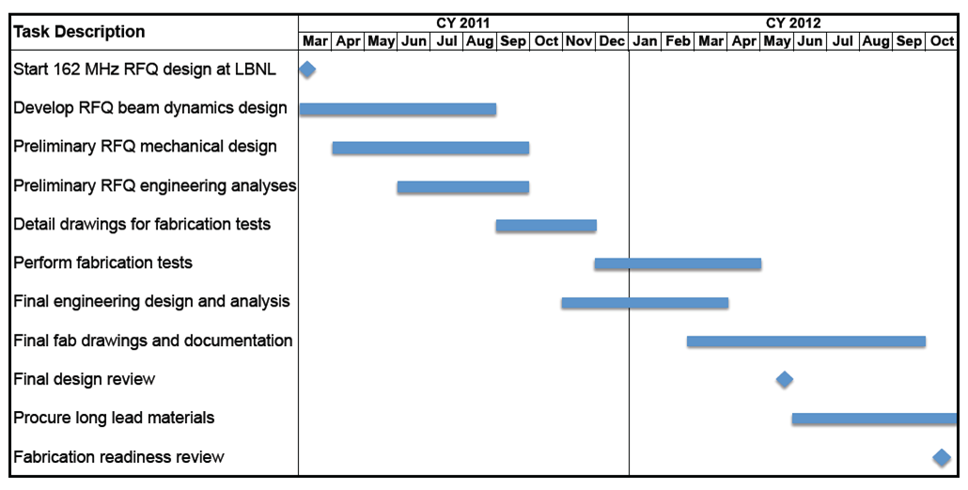
RFQ Design Schedule
RFQ fabrication expected to take ~1.5 years

Slide 7
MEBT
Functions of MEBT
  Form the bunch structure required for CW Linac
  Match optical functions between RFQ and SRF
  Include tools to measure the properties of the beam coming out of RFQ and sent to SRF
  Protect SRF from accidents
Technically driven schedule
  Jan 2012 – MEBT design layout is complete
  May 2013 - all MEBT components are designed
  May 2014- MEBT installed

Slide 8
MEBT critical components
Chopper kicker
  Three versions of a TW kickers are in a stage of conceptual design at Fermilab
  All are making excellent progress
Chopper driver
  At this stage, this is a critical-path item
  Fast switch
    Voltage and average power for switching are the issues
  Linear amplifier
    Phase distortion
    AC- coupled, low frequency cut-off can not be too low
    A pre-distortion is being considered
Beam absorber
  Several versions of the absorber have been simulated for 12.5 kW
  We consider manufacturing a small absorber prototype and testing it with an electron beam

Slide 9
MEBT summary
Functional specifications of PXIE MEBT have been finalized
The optical scheme of MEBT has been chosen
  Modular design with periodic transverse and longitudinal focusing
Conceptual design of most elements has started
A significant increase of engineering efforts is required to stay on schedule

Slide 10
Development of the PXIE cryomodule with 162.5 MHz HWRs
EM Design of the HWR is nearly complete
Mechanical design and engineering analysis has just started and will use well-developed procedures and techniques
Fabrication steps of HWRs will be similar to those used for QWRs and HWRs at ANL
Cavity sub-systems, slow tuner, fast tuner and RF coupler will be nearly the same as were developed and used for the ANL-ATLAS projects
RF surface processing technique recently developed for the 72 MHZ QWR will be applied for 162 MHz HWRs
Cryomodule assembly, alignment is similar to the new ATLAS cryomodule

Slide 11
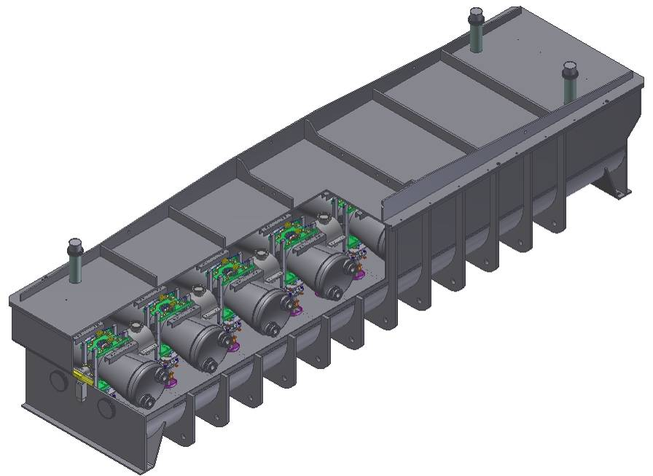
162.5 MHz Cryomodule Concept
9 HWRs and 6 SC solenoids
Vacuum vessel design will comply with DOE vacuum vessel consensus guidelines.
Cryogenic Loads
Load to 70 K | 250 W
Load to 5 K | <20 W
Load to 2 K | <20 W
5.9 m (<5.7 m) x 1.6 m (<1.6 m) x 1.5 m (FNAL Initial Spec)
With the beam height = 1.3 m the top of the lid will be at 2.0 m (<2.00 m) from the floor
11

Slide 12
Overall design and fabrication philosophy of SC cavities at ANL
Incorporate into the cavity design the following features and sub-systems
  RF coupler
  Slow tuner
  Fast tuner
  RF surface processing
  Facilitate integration into the cryomodule
    Cavity alignment
Fabrication is being done under close supervision of ANL experts
  EBW by an ANL engineer
  Wire EDM set up by an ANL engineer
  Helium vessel work - under ANL engineer guidance
RF surface processing, assembly, testing
  ANL experts

Slide 13
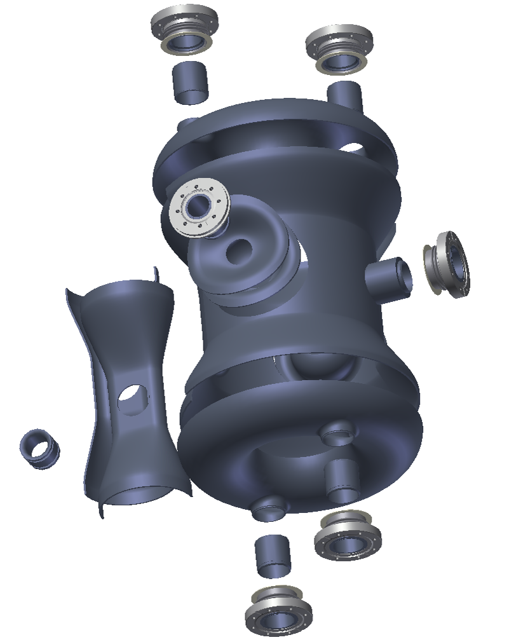
Mechanical Design of the HWR
Start with an RF volume from MWS
Build the niobium cavity around the MWS model
Build an integral 304 stainless steel helium jacket around the niobium cavity
This model is used for:
  Fabrication
  Base Mechanical Model
Design to:
  Minimize microphonics, e.g., zero df/dP
  Maximize slow tuner range
  Maximize fast tuner range
13

Slide 14
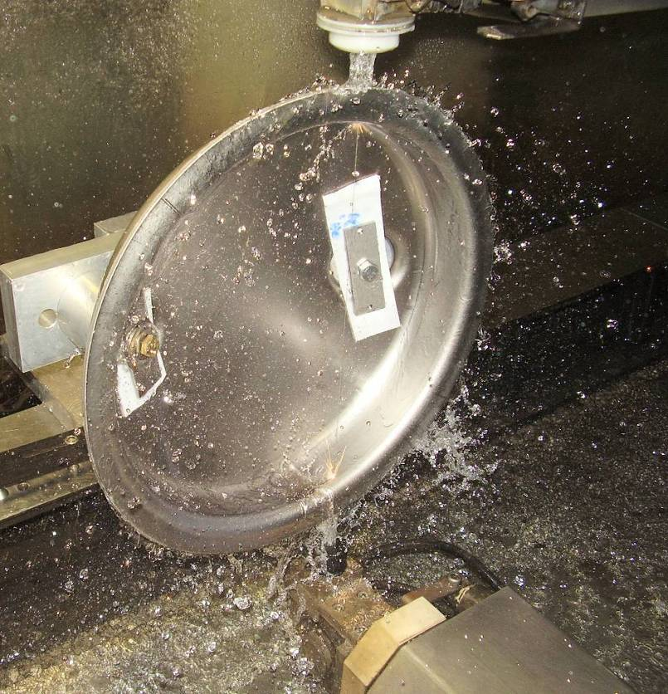
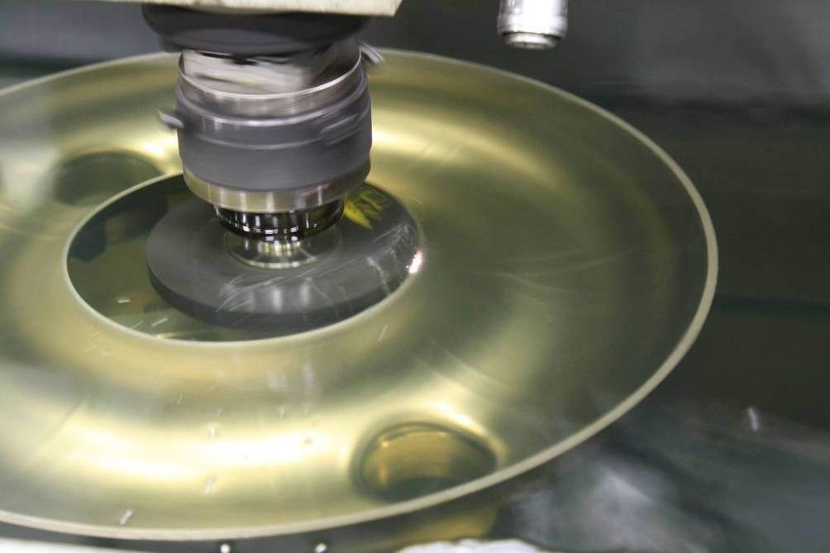
Cavity Fabrication by Wire EDM
Essentially no possibility for inclusions
Recast layer only 5 microns thick
  Oxide of brass and niobium
  Completely removed with a 5 minute BCP; not removed easily by EP
Cavity Bottom Dome
Sinker EDM of the Toroid center
conductor mating surface

Slide 15
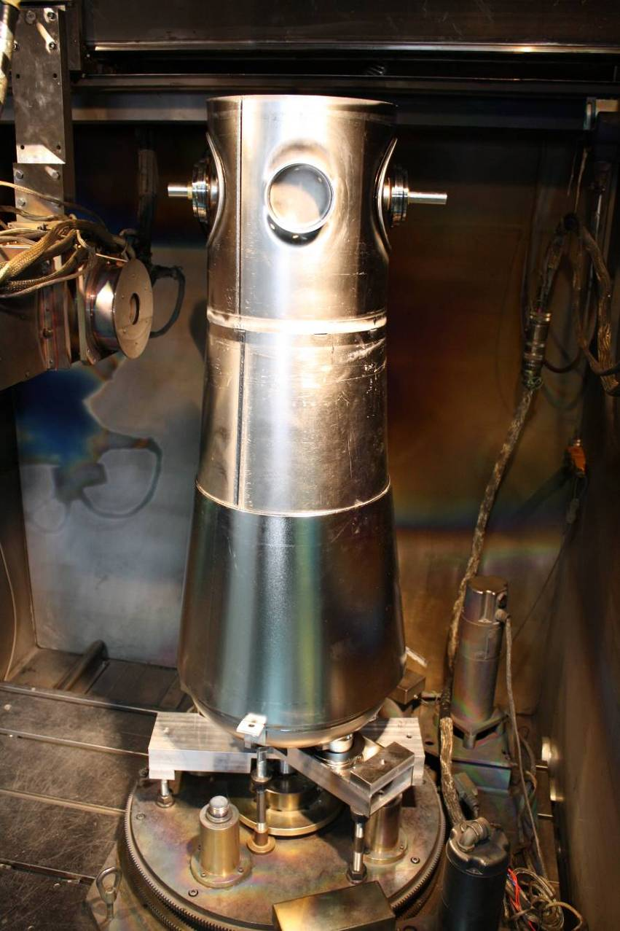
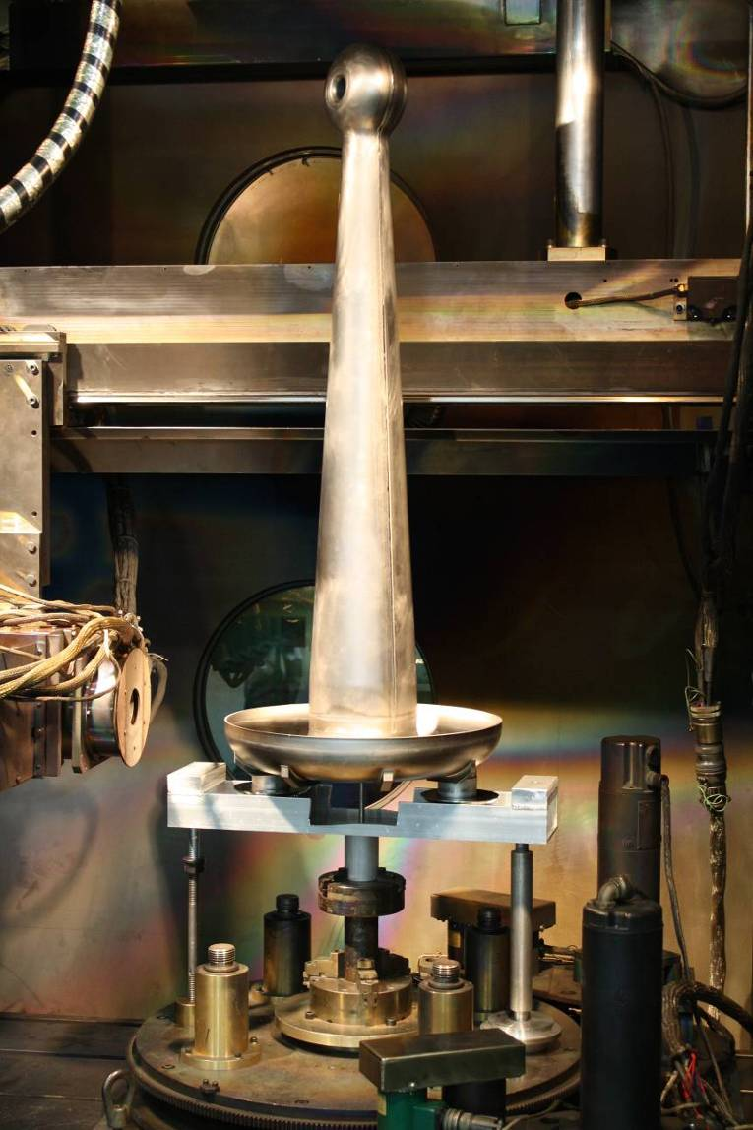
Electron Beam Welding

Slide 16
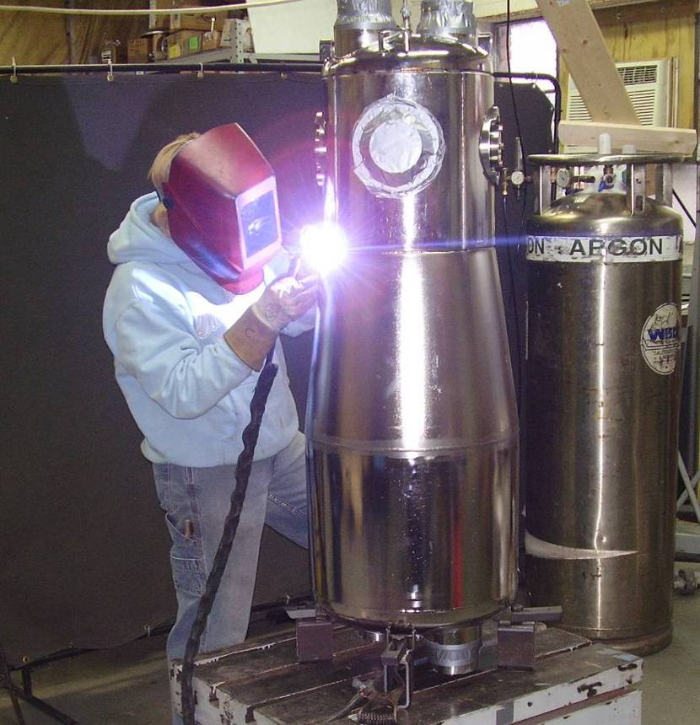
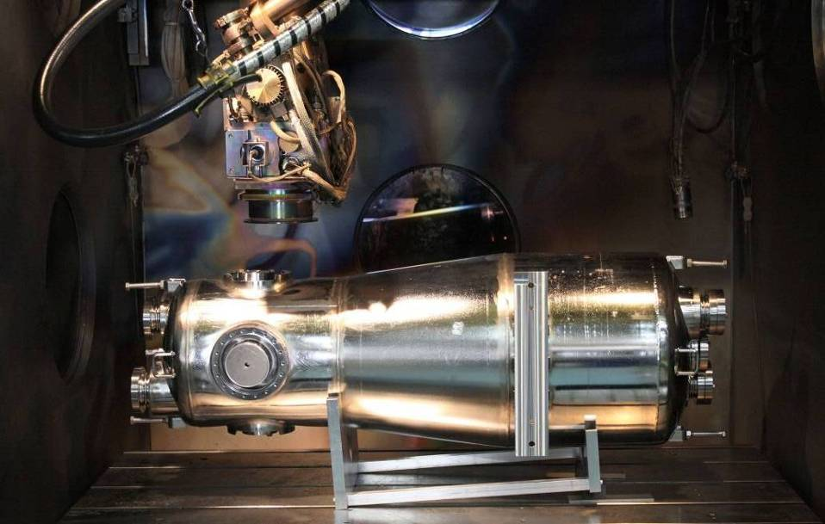
Stainless Steel LHe Vessel, TIG welding
Final Step: connect beam ports
to the SS helium vessel using
Electron Beam Welding

Slide 17
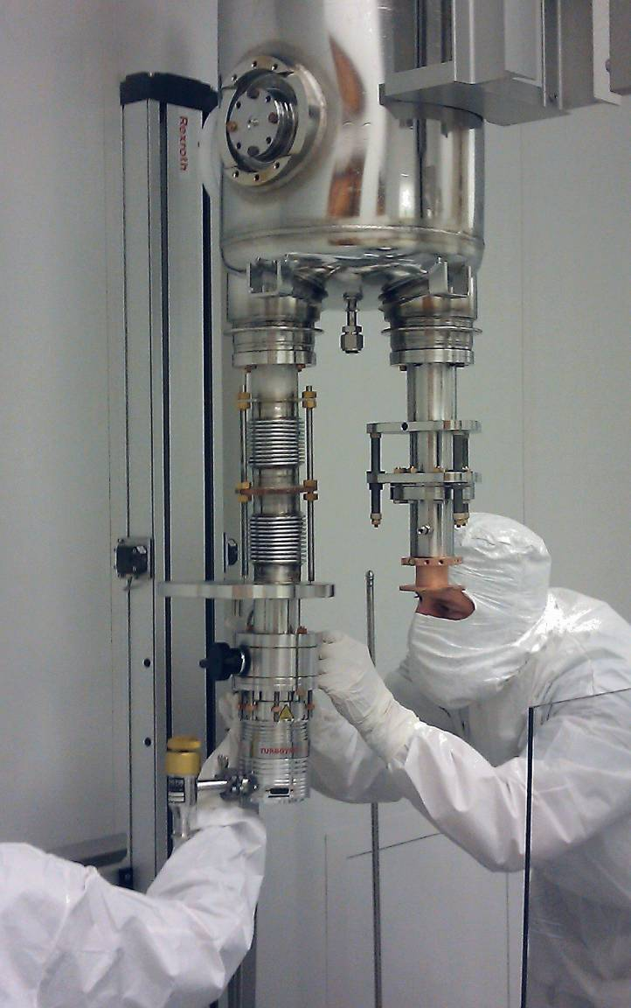
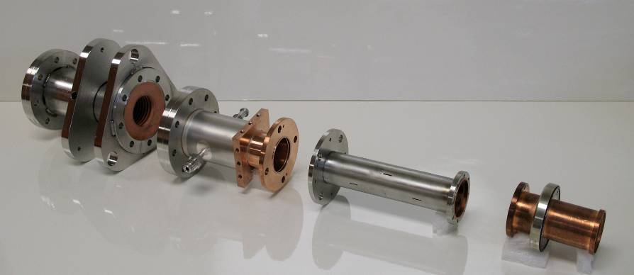
RF coupler, built and tested at 4 kW CW RF power, so far at 72 MHz
Coupler parts
Coupler

Slide 18
Fast piezoelectric tuner has been tested with 170 MHz HWR
Installed and tested with
170 MHz HWR PZT parts

Slide 19
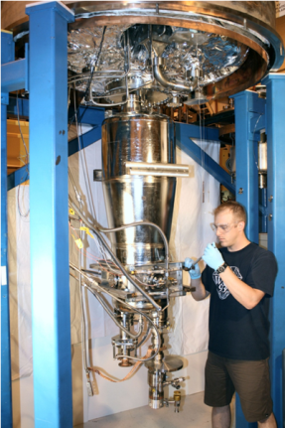
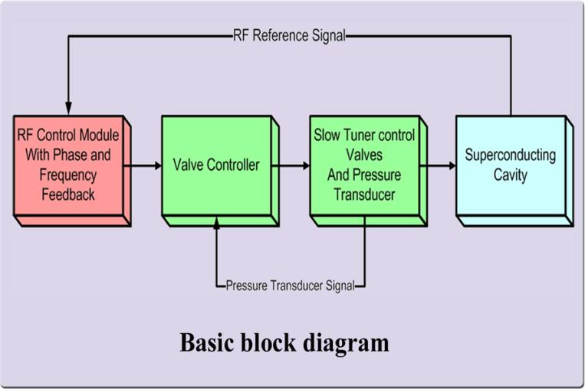
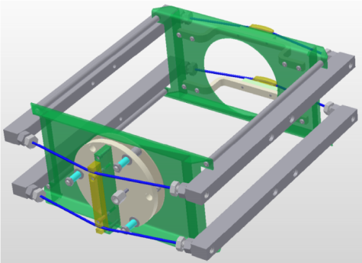
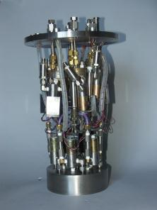
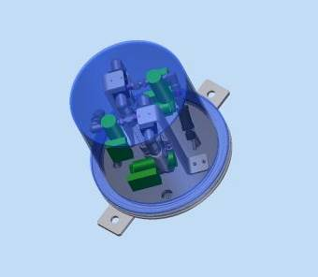
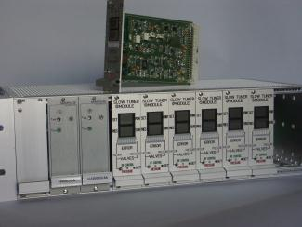
ANL Pneumatic Slow Tuner Block Diagram and Components
In operation at ATLAS for several decades
G.P.Zinkann
97 MHz cavity unit
109 MHz cavity unit
19

Slide 20
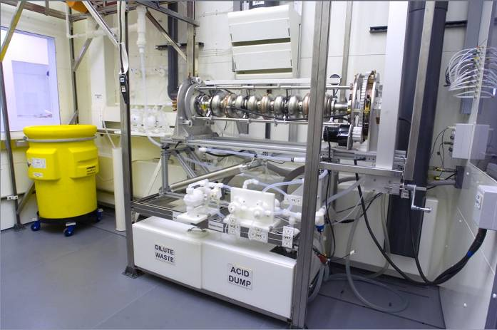
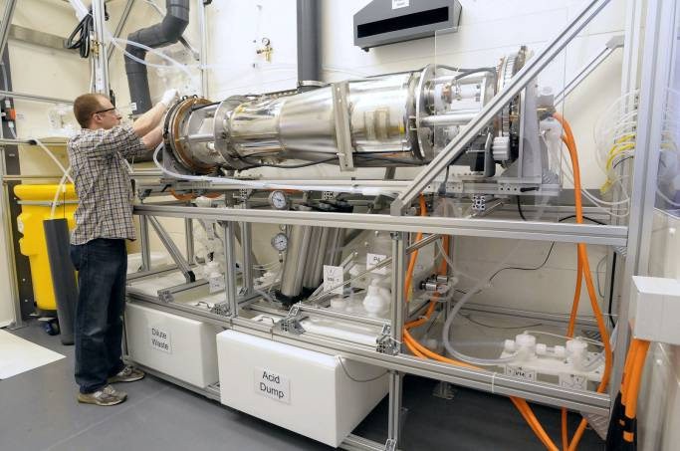
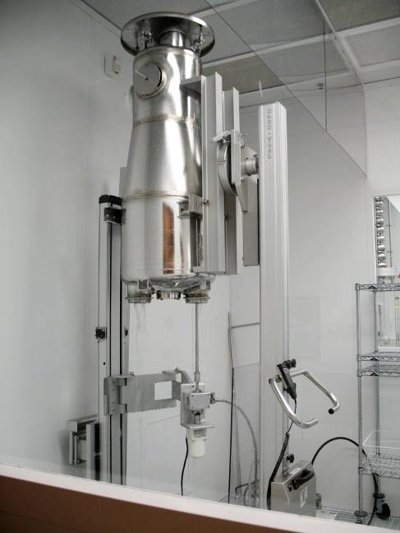
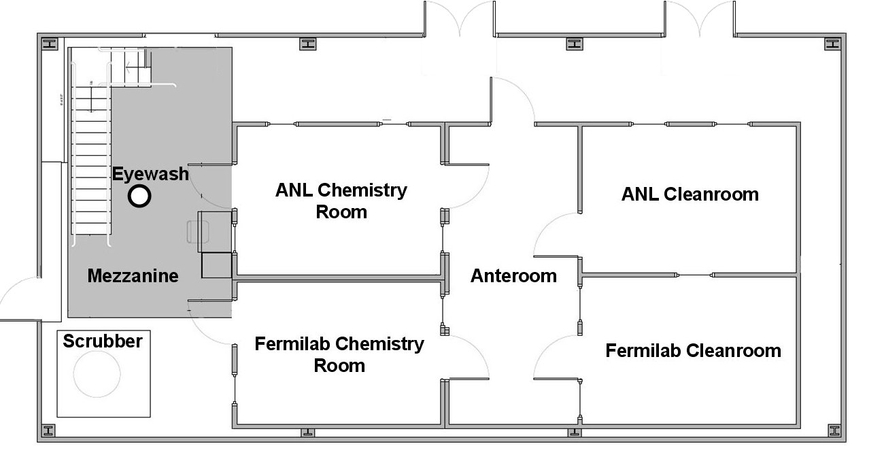
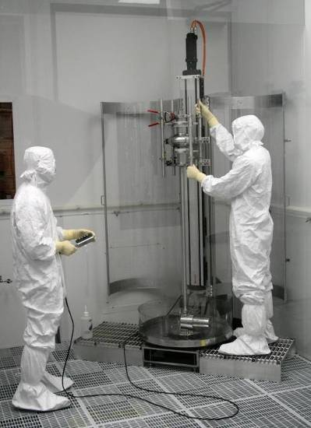
Joint ANL/FNAL 2000 ft² Cavity Processing Facility at Argonne
1.3 GHz Cavity
Electropolishing
QWR/HWR Cavity
Electropolishing
QWR/HWR Cavity Rinsing
Chemistry
Room 1
Chemistry
Room 2
1.3 GHz Cavity Rinsing

Slide 22
SSR1 Cavity EM and Mechanical Design,
L. Ristori
SSR1 cavities have been designed for HINS
  Their EM parameters are acceptable for Project X and PXIE
10 cavities are ordered: first two are received
Helium vessel was designed for high current and cannot be used
New helium vessel with reduced df/dP has been designed

Slide 23
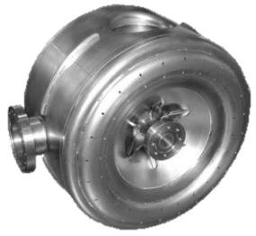
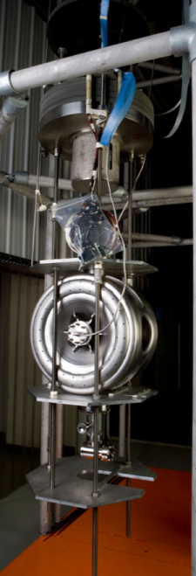
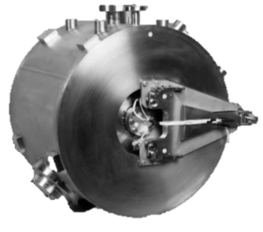
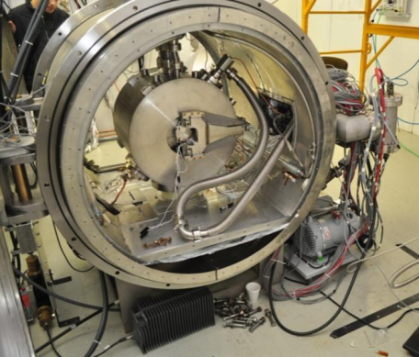
SSR1 overview
Single Spoke Resonators have been developed at Fermilab in the last few years
2 bare prototypes tested in VTS and 1 jacketed prototype tested in HTS
We are receiving an order of 10 resonators from US vendors, 8 needed for the PXIE cryomodule
1st prototype
By Zanon (Italy)
Main Parameters
Frequency | 325 MHz
β_{G} | 0.215
Aperture | 30 mm
Cavity diameter | 492 mm
Bandwidth | ~ 90 Hz
Gain/Cavity, nominal | 2 MeV
Max Surface Magnetic Field, nominal | 60 mT
Max Surface Electric Field, nominal | 39 mV/m
Power/Coupler, nominal | 4 kW (1 mA)
He temp, pressure | 1.8-2.1 K, 20 torr
Q₀ at E_{acc} | > 1.1x10¹⁰
df/dP (jacketed) | <25 Hz/mbar
1st prototype
Jacketed at FNAL
VTS
Spoke Cavity Test Cryostat

Slide 24
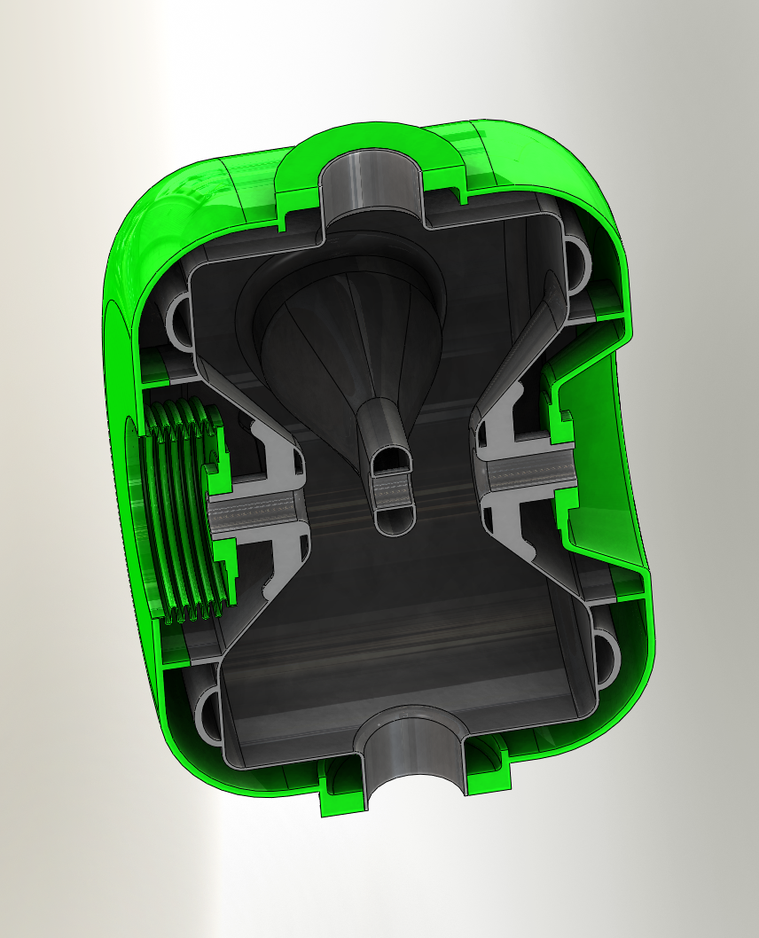
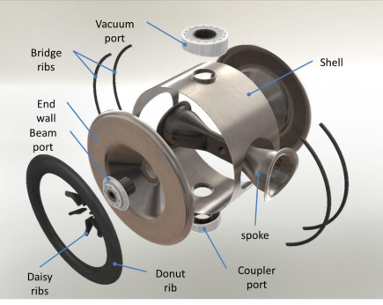
SSR1 Mechanical design
Requirements:
Pressure rating 2 bar
Pressure sensitivity df/dP < 25 Hz/mbar
Tuning range ±130 kHz without yield
Facts:
Cavity material: 3.1 mm
Helium Vessel made of 316L
Transitions are Cu-Brazed (ANL)
Flanges are Conflat (3-3/8” & 6”)
All stiffeners are made of RRR40 Nb
Tuning
forces

Slide 25
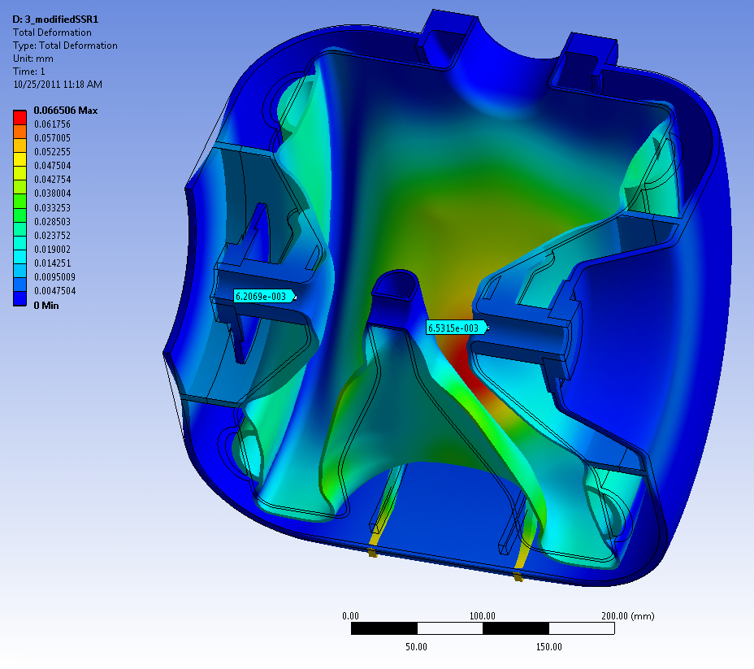
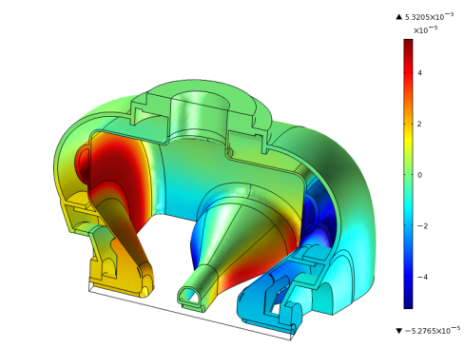
Pressure sensitivity - analyses
Comparison between analysis tools
High E
Comsol multiphysics
df/dp ~ 4.9 Hz/Torr
Ansys multiphysics
df/dp ~ -1 Hz/Torr
Ansys mechanical (explained in next slide)
df/dp ~ 2.6 Hz/Torr
High B
Figure shows deformations (enhanced x500) for a cavity under vacuum and Helium at 1 atm
Beam pipes deform only ~ 6 μm inward
df/dP < 10 Hz/torr
Deformations in high E and B regions balance out resulting in a small frequency shift

Slide 26
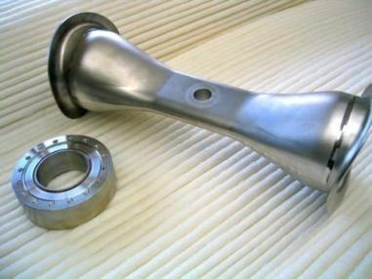
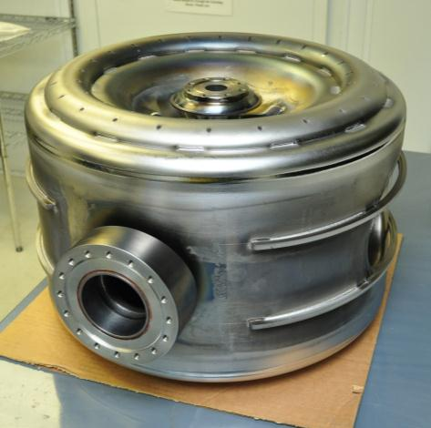
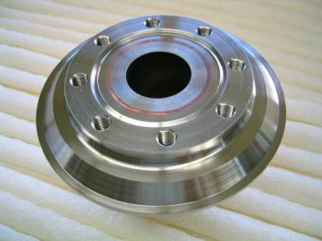
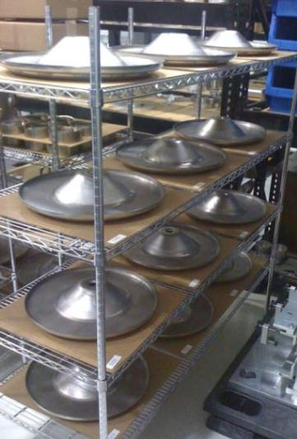
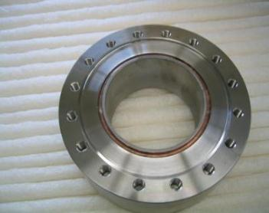
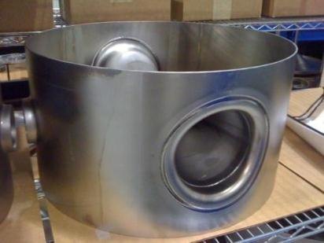
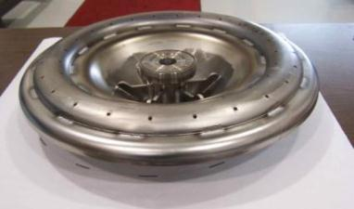
SSR1 Fabrication (Niowave-Roark, USA)
10 resonators ordered, 2 received. Balance expected by end of 2011.
Cu
Nb
SST
Spoke with collars
Beam Pipe port
ANL development
Power Coupler
port
Completed resonator

Slide 27
Plan for the 10 resonators
Bulk BCP at ANL (1st already in process)
Hydrogen degassing at FNAL (10h at 600 C)
Light BCP at ANL
Vertical tests at FNAL (1st expected in January 2012)
Jacketing operations to start in March 2012
Jacketed tests in cryostat to start in June 2012

Slide 28
SSR1 Cryomodule Design Issues
Tom Nicol
October 26, 2011

Slide 29
Functional specifications are close to be finalized
Major cryomodule components and instrumentation are determined
Interfaces are discussed and will be determined soon
Heat loads are estimated
Alternative cryomodule versions are considered
Requirements to sizes and interfaces for cavities couplers, tuners, solenoids and their leads are under discussion

Slide 30
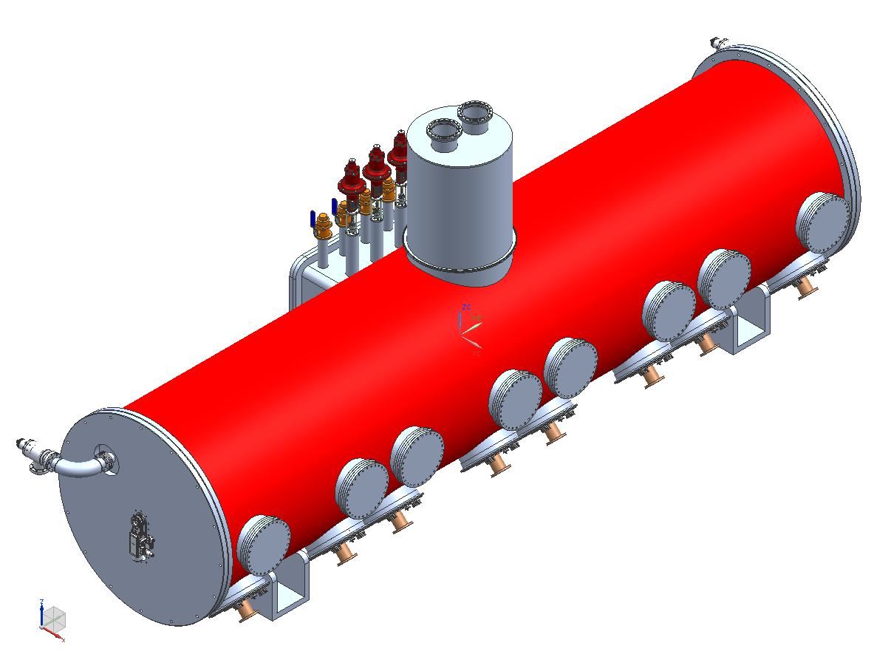
Cryomodule conceptual design
Bayonets and control valves
Relief and pumping lines
Cavity vacuum
pumpout
Access ports
Input couplers
Beamline valve

Slide 31
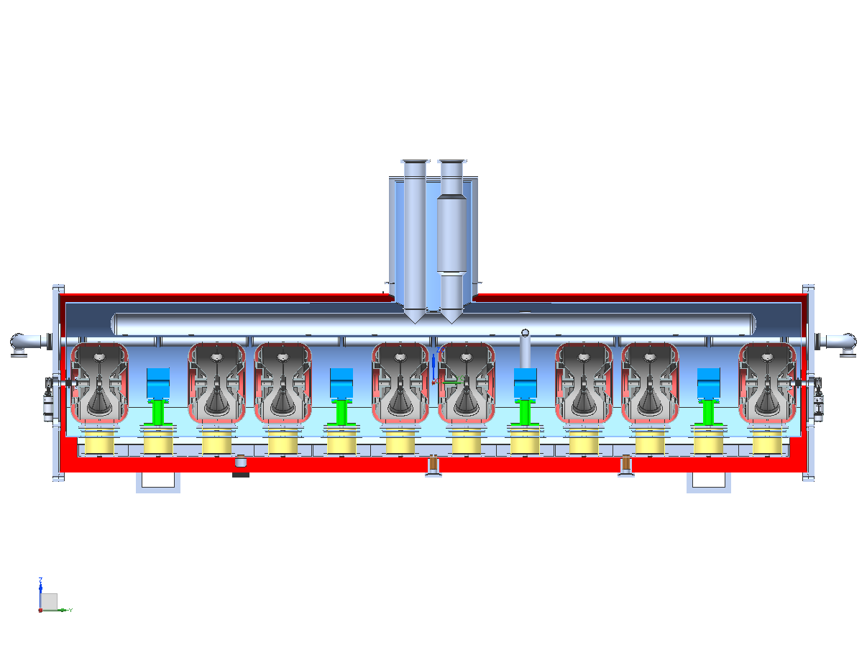
Cryomodule conceptual design
~5.3 m

Slide 32
Schedule
Eventual goal – beam through PXIE in late 2016.
More near term goal – first cryomodule complete by early 2014.
Cryomodule conceptual design – 6 months, starting now.
Detail design – 6 months after that.
Parts procurement – 9 months.
String assembly – 1 month.
Cryomodule assembly – 2 months.
So far this seems consistent with an early 2014 cryomodule finish.

Slide 33
Status and plans
Functional requirements specification is complete at least in draft form.
Conceptual design is in process.
People are working on details of all the major pieces, e.g. cryomodule structures, dressed cavities, tuners, solenoids, couplers, current leads, etc.
An order for 10 cavities is in process and bare cavities are beginning to arrive.
Vertical test facilities exist and are capable of testing ~2 cavities/month.
The existing horizontal test facility is being upgraded to 2 K operation.

Slide 34
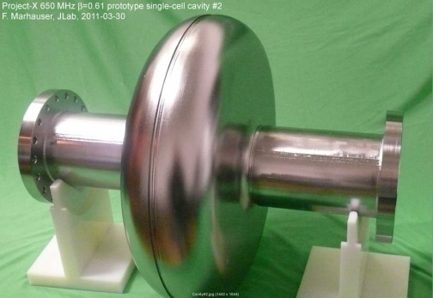
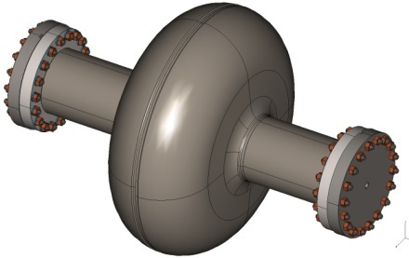
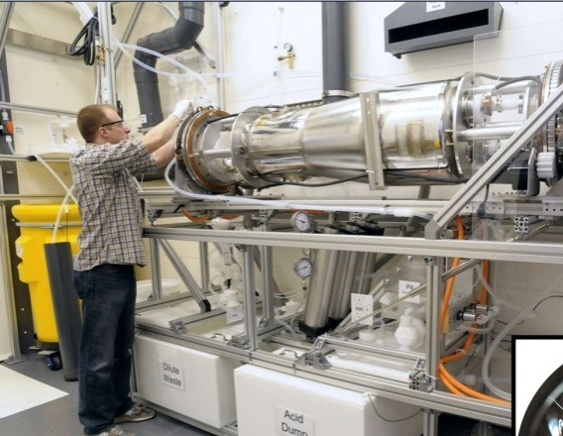
650 MHz Cavity Prototypes and Readiness for Processing & Testing
Single-cell designs complete: for β = 0.6 & 0.9 cavities
Prototypes fabricated:
  Single-cell β = 0.6: 2 prototypes@JLab, 6 ordered industry
  Single-cell β = 0.9: 5 cavities ordered from industry; due Nov 11
  Prototypes at both β are also being fabricated in India
  Two 5-cell β = 0.9 cavities ordered from industry
Infrastructure modifications: for 650 MHz in process
    FNAL: Vertical Test Stand: Electronics, amplifier, tooling
    FNAL: Cavity handling & HPR tooling, etc.
    FNAL: Optical inspection system modifications
    ANL: New electro-polishing tool
    Industry: EP/BCP capability in US industry
    JLAB: new cryo infrastructure (FNAL ARRA funds)

Slide 35
Excellent Results from JLAB single cell tests

Slide 36
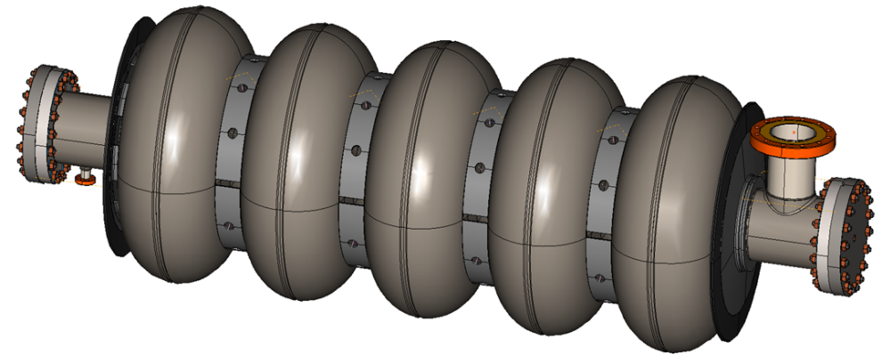
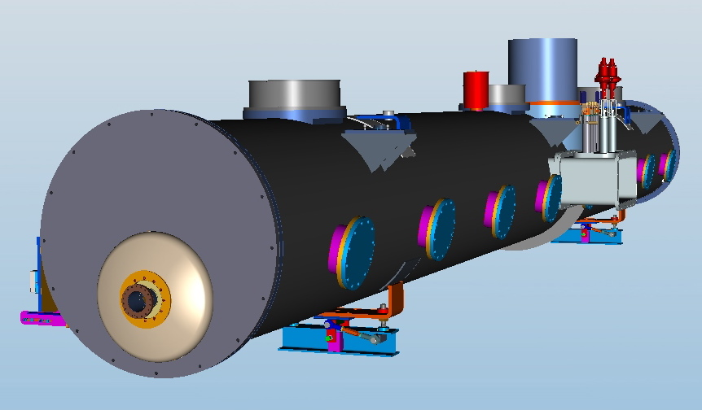
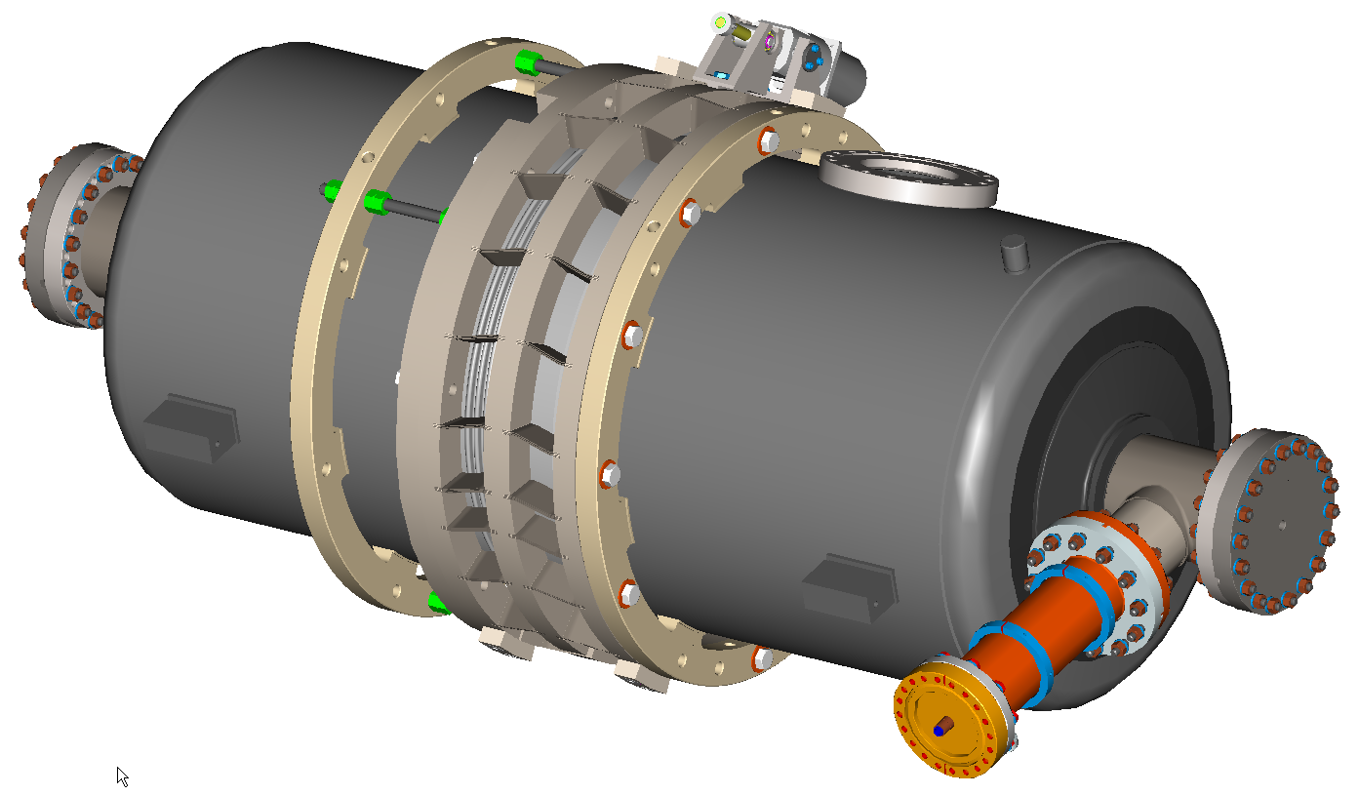
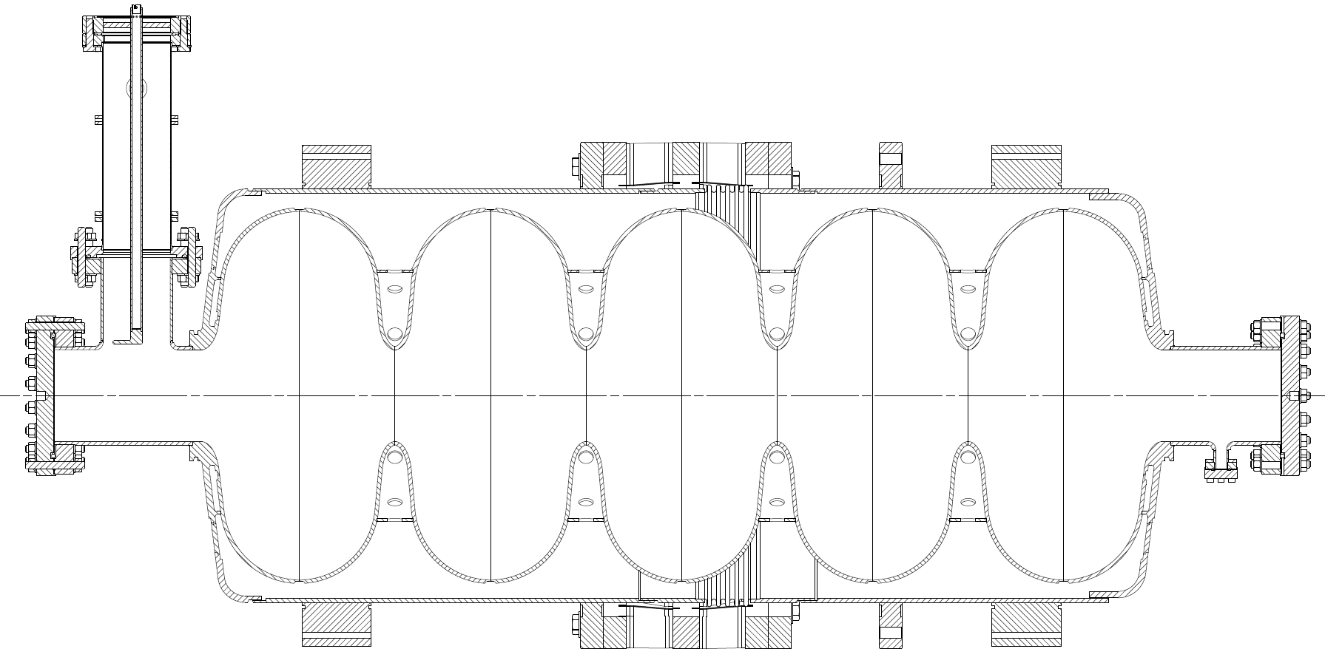
650 MHz Five-Cell Cavity and CW CM Design Status
Cavity drawing package and specification done
CW CM conceptual design advanced
  stand-alone 8-cavity cryomodule
  Overall length: ~12 m, 48 “ O.D.
5-cell β= 0.9
Stiffening rings located to minimize dF/dP while maintaining tunability
Collab with India
Concept utilizing blade tuner
M Champion

Slide 37
Session 5 WG 1
R. Stanek “PXIE Front End Layout and Associated Facilities”
  Working on a credible schedule and updated cost estimate
  Follow more defined engineering process (FRS, TRS, risk analysis, design reviews…)
  Need to gather latest design information (incl. 3D models) into one location
  PXIE facility layout is in progress
R. Pasquinelli “PXIE RF Systems”
  Good opportunity to "recycle" Tevatron RF hardware for RFQ driver at 162.5 MHz
  Commercial amplifiers planned for remaining 20 PXIE cavities
  Commercial amplifier efficiencies are 40-50%, R&D will attempt to improve on this for eventual Project X construction
  Commercial amplifier price per watt $13-$15 for both 162.5 MHz and 325MHz
A. Klebaner “PXIE Cryogenics”
  New superfluid cryoplant is centerpiece of PXIE cryogenic operations
  Need ability to measure heat load of individual cryomodules in PXIE
  Decisions need to be made on required 2K pressure stability and intermediate shield temperatures (within available range)
  Strategy for operating PXIE and cryomodule test stands needs to be developed

Slide 38
Session 5 WG 1 (cont’d)
V. Scarpine “PXIE Instrumentation”
  Need to write requirements document for instrumentation (operations vs. commissioning)
  Assume full LEBT characterization at LBNL, what instrumentation will be supplied?
  Is sufficient space allocated for instrumentation in MEBT?
  Need to develop laser profiling technology
M. Wendt “PXIE Cold BPM”
  Can HWR and SSR1 have the same cold BPM?
  Cold BPM has a couple design options, each one has some negatives
  FNAL and ANL will work together to explore solutions
W. Schappert “Microphonics Suppression in CW Linac”
  Active control scheme successful in controlling microphonics
  Need to design for increased stiffness in cavities (also helps df/dp)
  Large projects could use Microphonics Czar (FRIB using vibration consultants)
  Care required at every level (civil, cryo, elec, mech) for trouble-free multi-cavity operation over extended time

Slide 39
Items Requiring Follow up
Preliminary 3-D models of the HWR and SSR1 cryomodules exist, we should combine these in a single model to explore issues related to the interface, collimators, instrumentation, and lattice spacing
Need to agree on the location and type of BPM’s for the HWR and SSR1 CM’s.
Whenever feasible our goal should be standardization.
Don’t be fooled by apparent low M&S cost of a component or instrument, often it is labor or software that drives the cost of systems. The way to keep costs down is to avoid the proliferation of new “systems”.

Slide 40
Items Requiring Follow up
Pneumatic tuners with direct contact piezo control of microphonics have been used at ANL for many years with high reliability, in contrast tuner motors located in the cryomodule vacuum have a checkered history WRT reliability. ➔ We should take a critical look at pneumatic tuners for SSR1 and perhaps 650 MHz cavities
Even if we keep tuner motors, we should examine carefully if the blade tuner with series piezo’s is the right choice vs other options for 650 MHz.
Is it a requirement that the slow tuners must be able operate with beam in the linac ?

Slide 41
Items Requiring Follow up
People are starting to consider how cavity and magnet alignment information will be carried to survey points on the outside of cryomodules… that’s great… but…
Need to formally adopt and document the Project X overall alignment system (e.g. Define the coordinate system, define the type of survey points on components (e.g. track ball), define any stay clear or sight lines, define at least roughly the number and location of monuments to located on PX tunnel walls, etc)
This overall system then should set the requirements for the design of alignment systems for the PXIE enclosure and components

Slide 42
Items Requiring Follow up
It seems sensible that HWR and SSR1 cryomodules have solenoids and current leads etc of common design. We should work towards this end.
In some cases it seemed that some specifications that were “flexible” were being treated as non-negotiable… we should make clear what is vs isn’t negotiable
Should try to sign off various draft Functional Requirements documents and then design teams should develop the associated Technical Requirements documents before we start cutting metal for PXIE

