Slide 1
Main Injector Single Bunch Tune Measurements
Duncan Scott
Main Injector Department

Slide 2
Introduction
How will the Main Injector respond to higher intensity beams?
Currently slip stacking gives ~ 10¹¹ particles per bunch
Project X has 3 10¹¹ particles per bunch
What experiments can we do now to compare with simulations?
Can we generate beams with > 10¹¹ particles?

Slide 3
Space Charge Tune Shift
As intensity increases There are coherent and incoherent space charge tune shifts to consider
Incoherent shifts difficult to measure, $e\text{xpect}:$
These tune shifts induce blow-up and shorten lifetimes
Therefore we can measure lifetime vs bunch charge for 1, or a few, (5) bunches
$${ΔQ}_{incoh}∝\frac{Bunch Intensity}{Bunch Length}$$

Slide 4
Exp. 1: Using beam from booster
Studied beam for 2.5 seconds @ 8 GeV in the MI
Nominal tune Q_{h}=26.47 Q_{v}=25.43
Chrom, -7
Fix Q_{h(v)} change Q_{v(h)}
Measure:
Transmission (beam in / beam out )
Tune (using bpms)
Beamsize / Emittance (wirescanner)
Injection dp/p

Slide 5
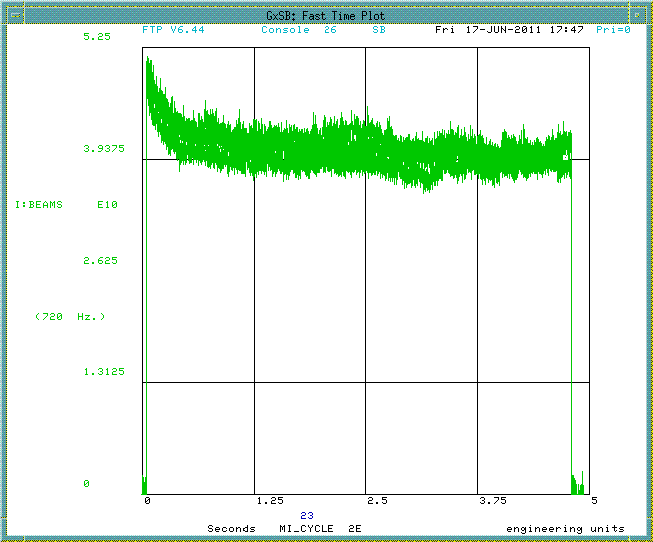
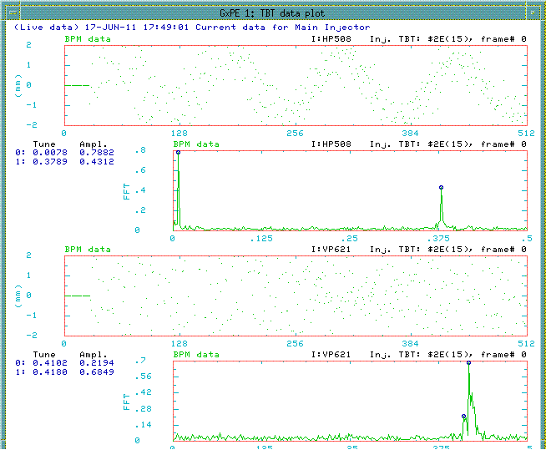
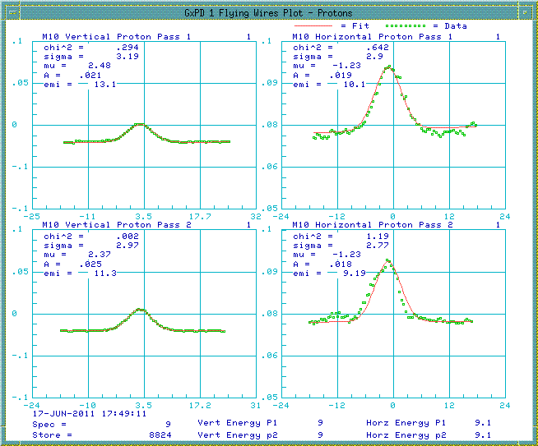
Example Experiment 1 Data
As well as using existing console programmes we can analyse Wall Current Monitor data

Slide 6
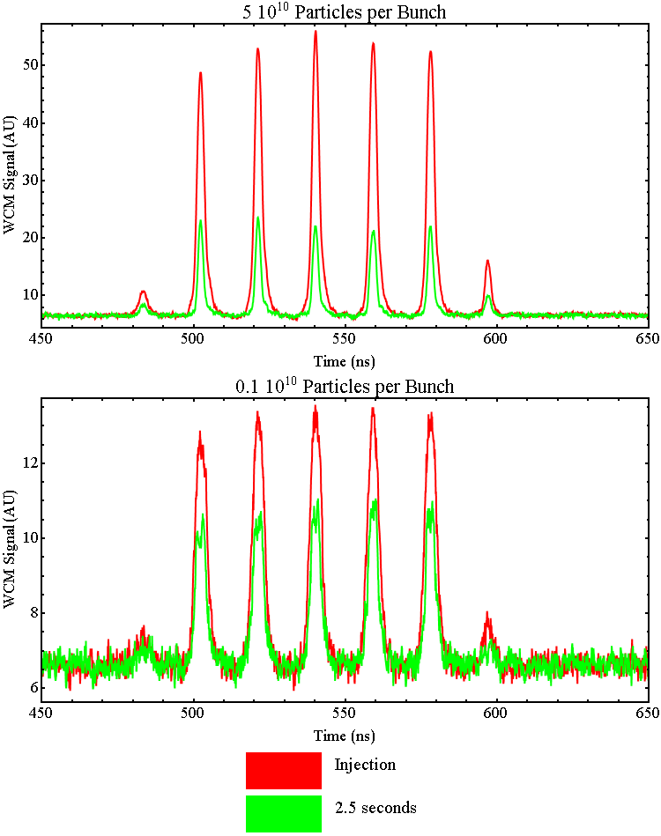
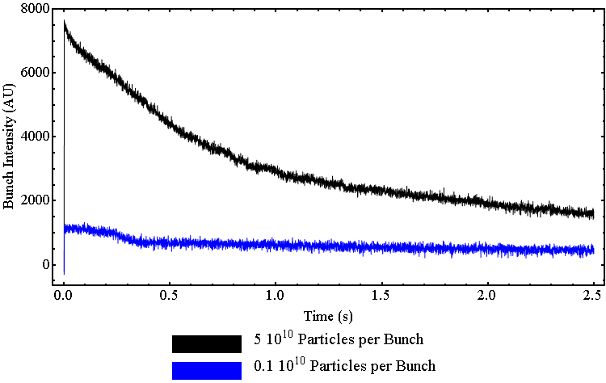
WCM Data
WCM data shows loss of intensity in bunches
Each bunch loses similar intensity
Signal can be integrated to give bunch intensity loss with time
Can also measure bunch length

Slide 7
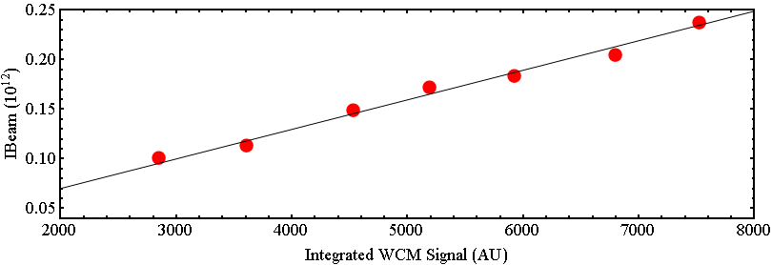
Relate WCM signal to beam intensity
Integrate WCM signal and compare to IBEAM to get bunch intensities

Slide 8
Transmission vs Tune

Slide 9
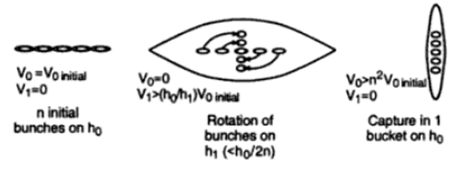
Higher Intensity Bunches: Coalescing
Coalescing Can give higher intensity bunches
Initial bunches in 53 MHz RF
Rotate bunches in 2.5 MHz RF
Recapture in 53 MHz RF

Slide 10
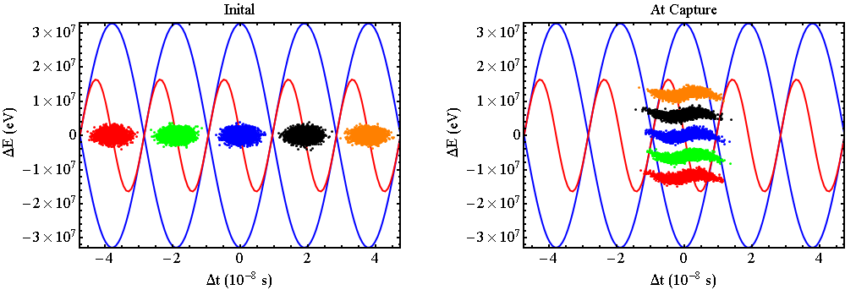
Energy Spread at Rotation Determines Coalescing Efficiency

Slide 11
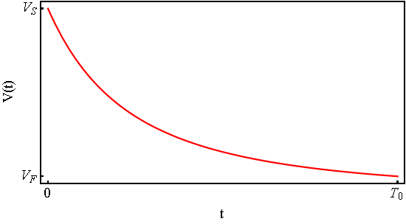
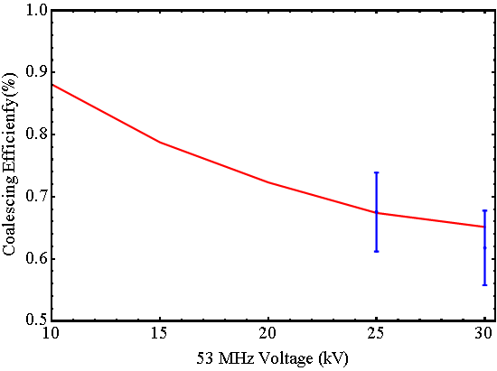
Increase Coalescing Efficiency
Adiabatically Reduce 53 MHz RF voltage to damp the beam energy spread
With current RF can get to 25 kV
~70% efficient for 5 initial bunches
Simulation
Experiment

Slide 12
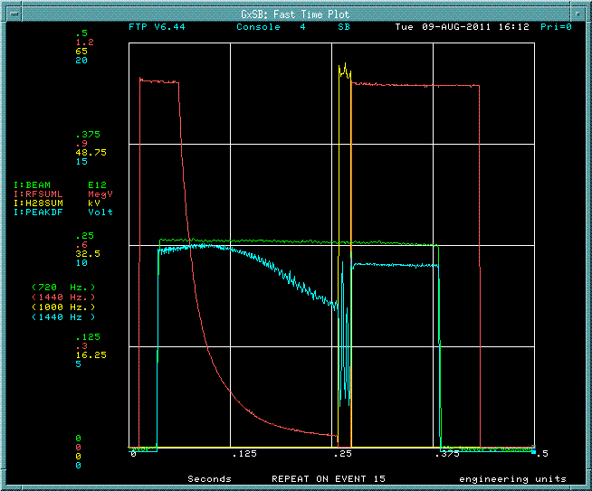
Coalescing With Existing RF
With current RF, there must be 0.75 turns in 2.5 MHz bucket
Minimum time between RF commands too long for 0.25 rotations
53 MHz off
2.5 MHz On
2.5 MHz Off
53 MHz On
Reduce
53 MHz RF

Slide 13
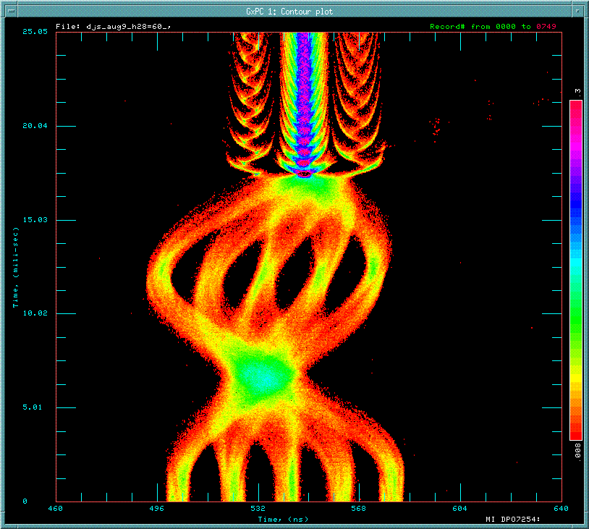
Coalescing With Existing RF
Example WCM data for 0.75 rotations of 5 bunches then recapture
Time
(turns)
Position in ring

Slide 14
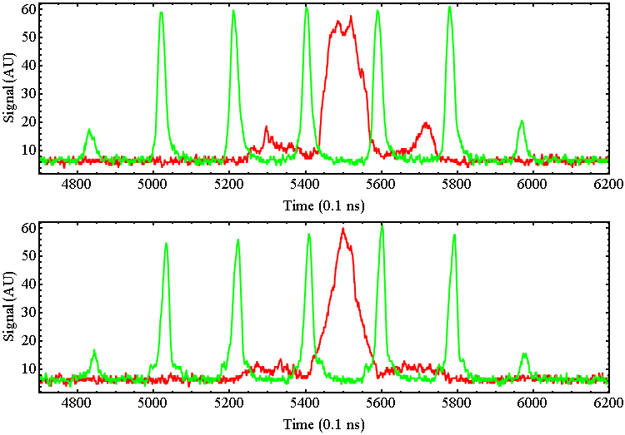
Bunch Length Increase
After coalescing the bucket is almost full
Therefore bunch length has increased
Example WCM signals
No Coalescing
With Coalescing

Slide 15
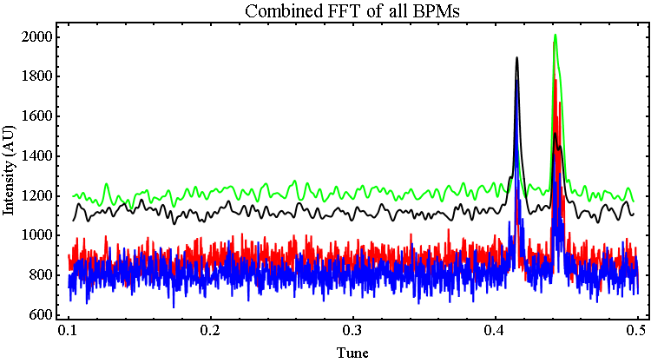
Tune Measurement
When 53 MHz RF is snapped on change tune, Ping beam and take TBT BPM Reading
TBT BPM data for approx. 100 vertical and 100 horizontal BPMS
Small signal but by combining FFT of all BPMs tune can be measured
No horizontal pinger so small skew quad time bump used to increase coupling for measurement
Then measure transmission from WCM data

Slide 16
Transmission vs Tune

Slide 17
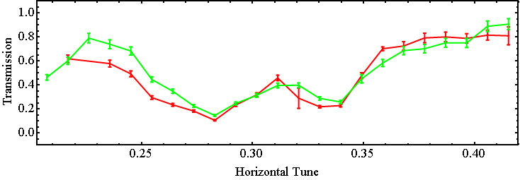
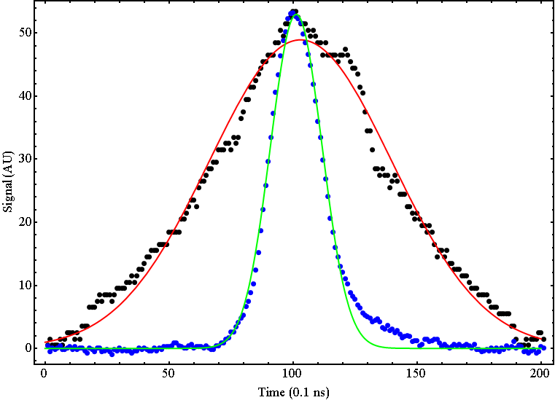
Example Comparison
172 10⁹ Coalesced
54 10⁹ Uncoalesced
Similar transmission with factor of 3.2 increase in intensity
However Bunch length increased by factor 3.4
$$σ_{z}=3.7$$
$$σ_{z}=1.1$$
$${C.F. ΔQ}_{incoh}∝\frac{Bunch Intensity}{Bunch Length}$$

Slide 18
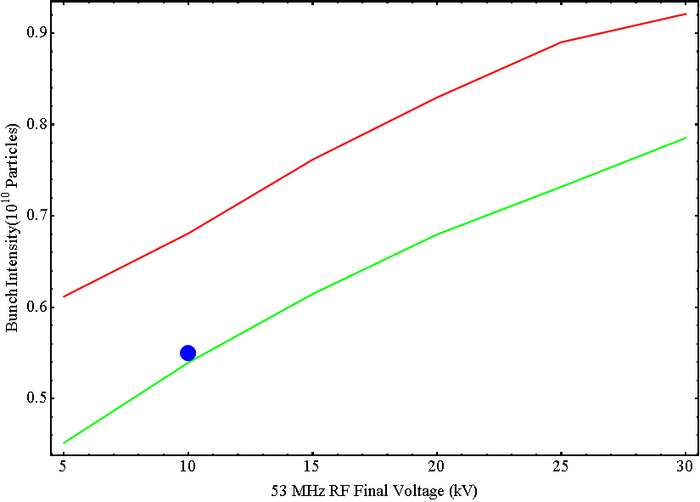
Increasing Beam Intensity
Reducing the 53 MHz voltage below 25 kV should increase efficiency and bunch intensity
Could try coalescing 7 bunches?
53 MHz voltage and initial bunch intensity required to give 3 10¹⁰ particles
11 Booster Turns
5 bunch coalescing
7 bunch coalescing

Slide 19
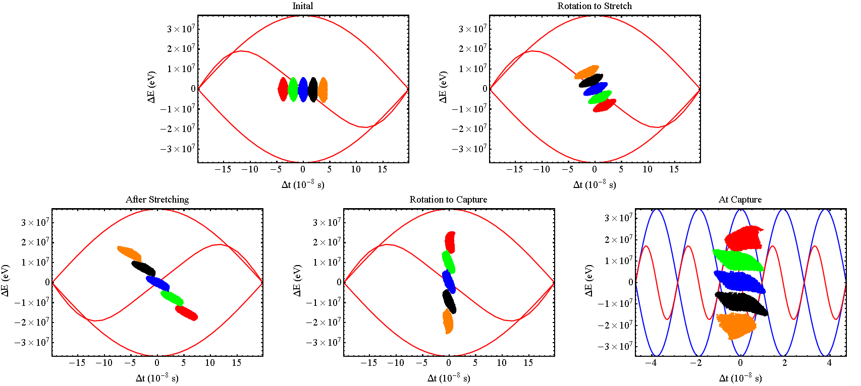
Increasing Beam Intensity
Bunch Stretching at unstable fixed point
Requires shorter time between RF commands

Slide 20
Summary & Further Work
One way for the MI to prepare for Project X is to look at space charge tune shifts for single (few) bunches
Initial Experiments have been carried out
Measure transmission vs tune for different bunch intensities and bunch lengths
Coalescing currently gives ~1.7 10¹¹ particles
Clear differences seen -> Space charge tune shifts
Further Study
Compare with simulations
By improving RF coalescing may be able to get 3 10¹¹ particles
What is $\frac{Bunch Intensity}{Bunch Length}$ for Project X and can we recreate it?
Other ideas…

