Slide 1
Lorentz Force Detuning Compensation for Pulsed Linac:
First Results and Short Term Plan
Yuriy Pischalnikov Warren Schappert
Project X Collaboration Meeting, Oct.25-27, FNAL

Slide 2
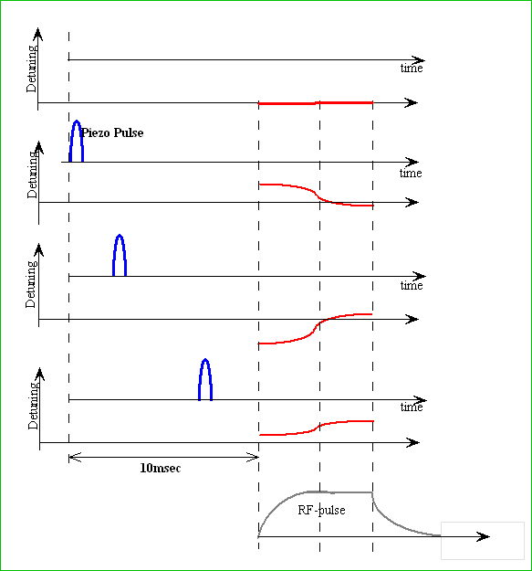
Adaptive Least Square LFD Algorithm
has been developed at Fermilab as a part of SRF Resonance Control R&D program
(Developed by Warren Schappert.)
The response of the cavity frequency to the piezo impulse (TF) can be easily measured when cavity operated in CW-mode.
Since it is often not convenient to connect a pulsed cavity to CW source we developed alternative technique to measure this response (TF) when cavity operated in RF-pulse mode.
“1”
“10”
Piezo/cavity excited be sequence of small (several volts) narrow (1-2ms) pulses at various delay.
The forward, probe and reflected RF waveform recorded at each delay and used to calculate detuning.
[Response Matrix]
“34”
Details of Adaptive LS LFD Algorithm at :
“W. Schappert, Y.Pischalnikov, “Adaptive Lorentz Force Detuning Compensation”. Fermilab Preprint –TM-2476-TD.

Slide 3
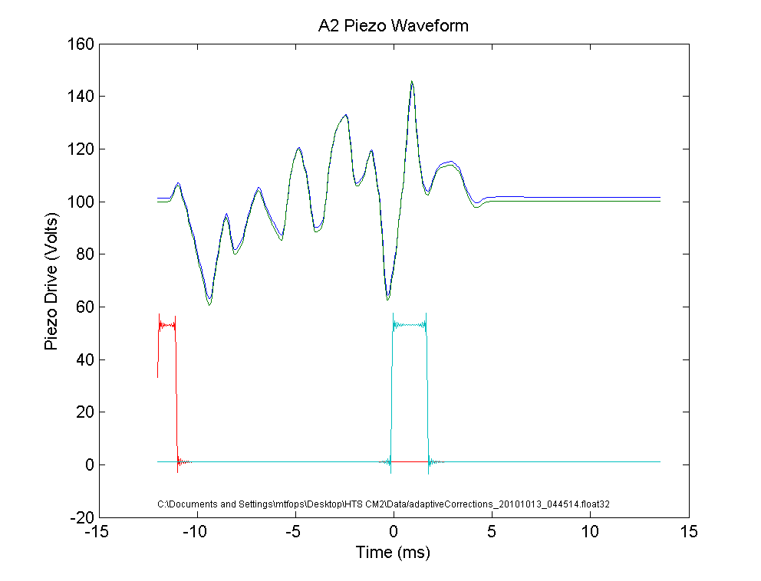
Adaptive LS LFD Algorithm
Response Matrix
Piezo Pulse # (or delay)
“1”
“10”
“34”
100Hz
As operating conditions vary, the RF waveforms can be used to measure any residual detuning. The response matrix can then be used to calculate the incremental waveform required to cancel that residual detuning.
Time during RF pulse
0
DETUNING
Optimal Compensation Pulse
for 1.3GHz 9cell cavity equipped
with KEK tuner
-100Hz
Invert the response matrix and determine combination of pulses needed to cancel out the LFD using LS
Any part of RF pulse could selected for Compensation:
“Fill+FlatTop” only “FlatTop”

Slide 4
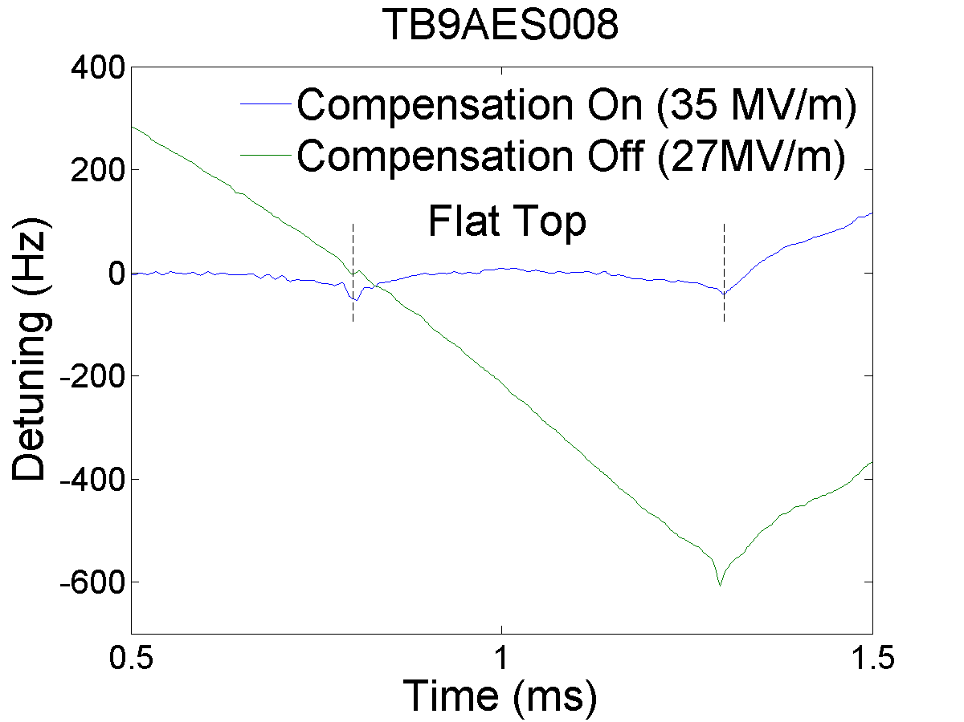
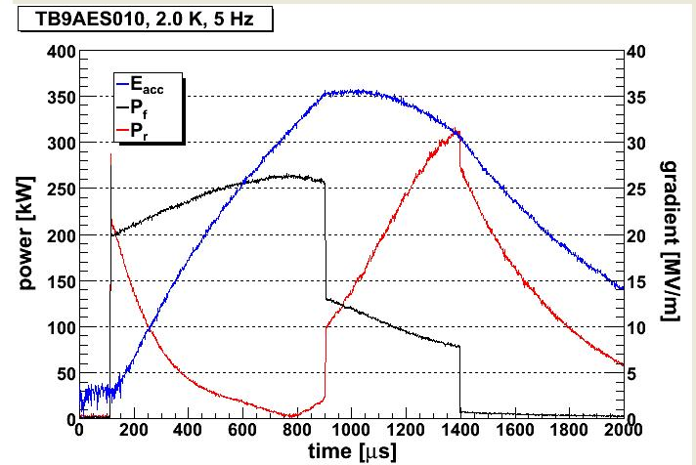
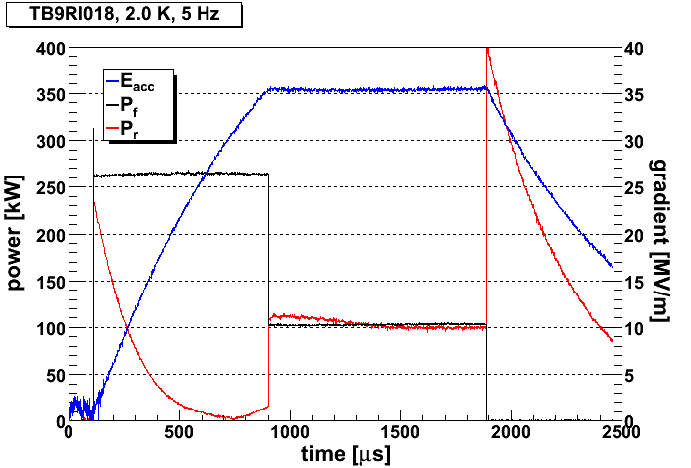
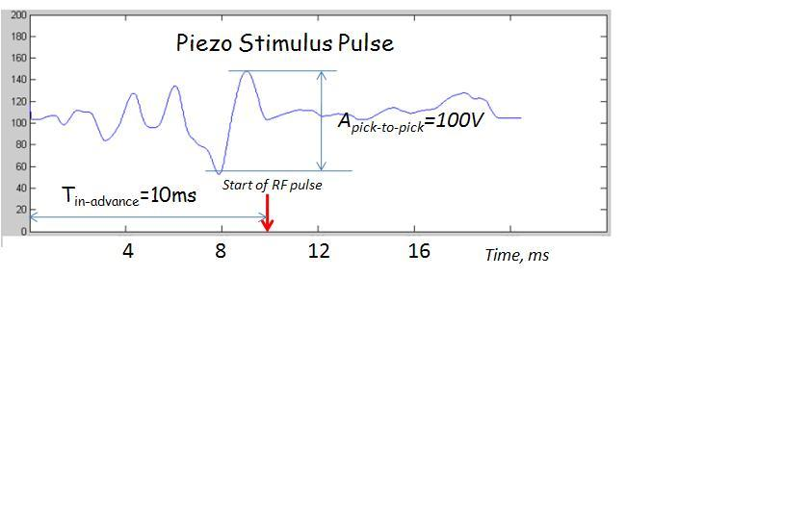
HTS at MDB FNAL
LFD during 1,3ms RF-pulse (Fill+FlatTop) was ~2300Hz
LS LFD compensation -- to less than 20Hz during 1,3ms pulse
Eacc=35MV/m
Open loop operation
Piezo OFF
Piezo ON
Piezo OFF
Piezo ON

Slide 5
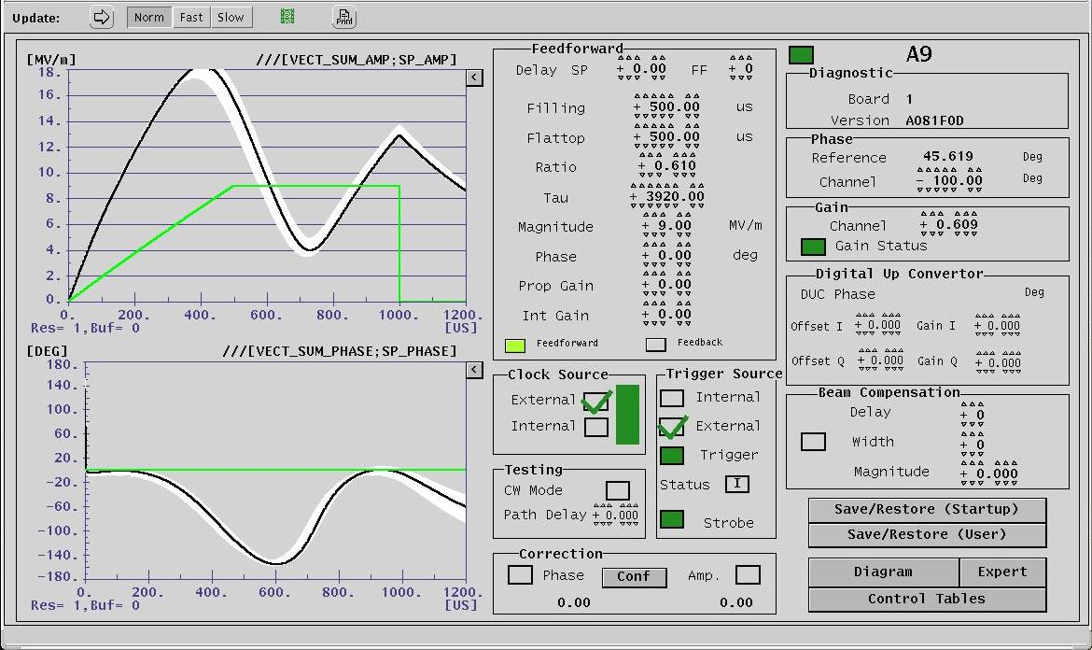
Eacc=15MV/m PIEZO OFF
RF pulse 4ms-Fill & 4 ms Flat-top
Blade Tuner at HTS
Open loop
4ms
160 DEG

Slide 6
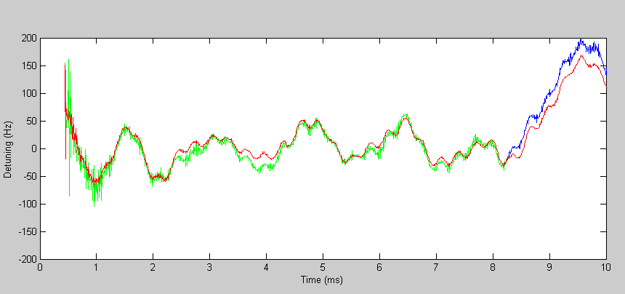
LFD Compensation Eacc=22.8MV/m
RF pulse 4ms-Fill & 4 ms Flat-top
Blade Tuner at HTS
Open loop
Fill=4ms
FlatTop=4ms
Piezo Stimulus Pulse
Apiezo p-to-p=100V
10ms
8ms-RFpulse
Start of RF pulse

Slide 7
HTS test with long (8ms) pulse --- Blade Tuner
  2 piezo
  ΔF=3000Hz (at 200V on piezo)
      For 23MV/m ~50% of piezo stroke required….
Plan is to use CM1 cavities #5 & #6 test with SACLAY I/DESY tuner - 1 piezo
  ΔF=700Hz (at 200V on piezo)

Slide 8
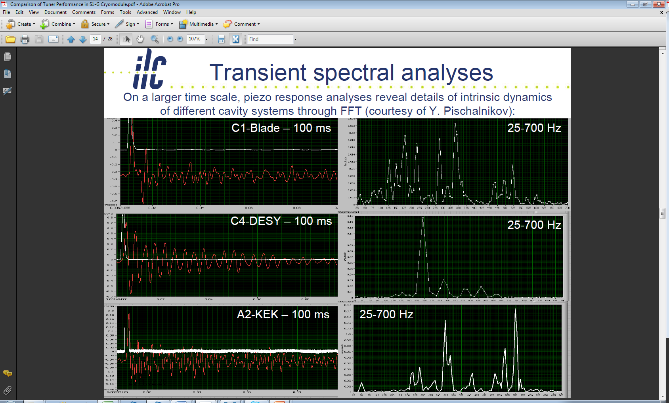
Transient spectral analysis
Response of cavity /tuner system on short piezo stimulus pulse

Slide 9
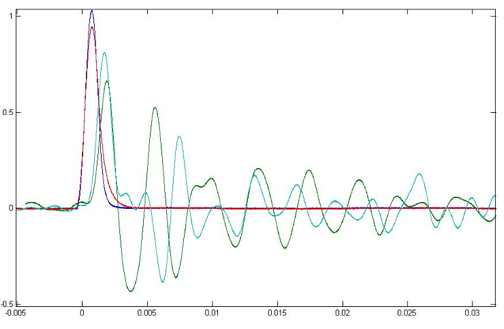
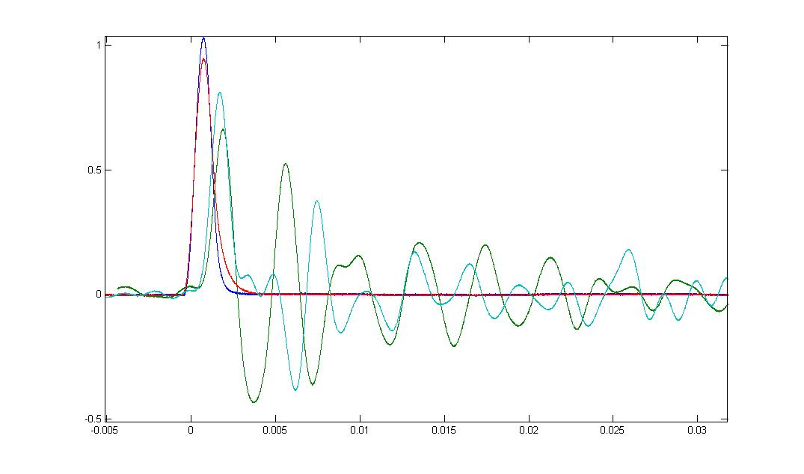

Slide 10
Summary
First “proof-of-principle” LFDC test with 8ms RF pulse (at 22MV/m) was successful.
FNAL’s adaptive LS LFD compensation algorithm is “key” for success…
  At S1-Global LS LFD algorithm successfully used for compensation of the different type of tuner with different transfer function
CM#1 (cavity #5&#6) is not the best starting point for LFDC test with “long pulse”
  DF=700Hz (instead of 3000Hz for Blade Tuner)
  Saclay I/DESY tuner transfer function – “good mechanical oscillator”

