Slide 1
PXIE Facility and Layout
Rich Stanek
Session 5 / WG1
October 26th, 2011

Slide 2
Background
Project X will form the backbone of Fermilab operation in the future
Risks for Project X include generating beam parameters in the front end, chopping, and controlling halo, emittance growth, beam losses…
Mitigate these risks by building first 30 MeV of the Project X design
Idea for PXIE is just a few months old
Decided on a really good acronym
Project X Injector Experiment
Designs are in progress but still have many details to work out
Need to start looking at integration issues
Want to form some level of consistency across the various components

Slide 3
PXIE Location
Decision to site PXIE at the CryoModule Test Facility (CMTF) building driven by
Availability of space and cryogenics (new superfluid cryogenic plant)
Looked at several options, this was the best choice
NML, CMTF and PXIE form an integrated complex of facilities targeting future accelerator R&D
NML ➔ ~1 GeV pulsed e⁻ linac for ILC RF Unit tests and AARD activities
CMTF ➔ two CM test stands (multi-frequency) serviced by 200w @1.8K superfluid cryogenic system and ~220 L/hr. helium liquefier, RF power test area, clean room, tech area…
PXIE ➔ ~30 MeV CW H⁻ linac for Project X R&D

Slide 4
Schedule/Cost Estimate
Have some very high level goals (proposed by Project Scientists)
First beam through PXIE October 2015
This has generated a series of additional intermediate milestones for component design and construction
Need to validate all of these dates
Working on a “bottoms up” schedule
Take into account: scope of work, personnel availability, commitments to other projects, other priorities, and funding
Must have a credible schedule to set proper expectations
Cost estimate starting point is the current Project X estimate
Modify by
Changes in the assumptions
Current technical design, facilities and resources
Need to have this cost estimate in order to accurately plan

Slide 5
Engineering Processes
Fermilab has recently established a more defined engineering process guided by our Engineering Manual
Graded approach based on engineering judgment and risk assessment
Documentation of requirements, risks, analysis, approvals…
Functional Requirements Specification (FRS)
Technical Requirements Specification (TRS)
Formal Design Reviews
Quantification of Risk
Procedures
More complete engineering and QC documentation
Central repository for engineering information (including 3D CAD models)
EDMS (Teamcenter)
Collaborators on PXIE will have access to Teamcenter data base
Unfortunately not available until March/April 2012 timeframe
Forces us to look at interim solutions
Currently using Doc DB, website links, file servers…

Slide 6
PXIE Facility Planning
What we are building is a general purpose Accelerator Test Area
First tenant will be PXIE
Working on the details of overall facility construction
Size of concrete pad
Layout of tunnel walls and support equipment area
Building exterior
Requirement for crane coverage
Power requirements
Cryogenic loads and performance specifications
Required radiation shielding
How to deal with penetrations, labyrinths…
Dump requirements

Slide 7
Accelerator Test Area Initial Concepts
Looked at variety of options for connecting Test Area to CMTF building
Minimize cost (use existing shield blocks) but provide reasonable space in order to test components
Factor in initial cost and ease of modification/maintenance

Slide 8
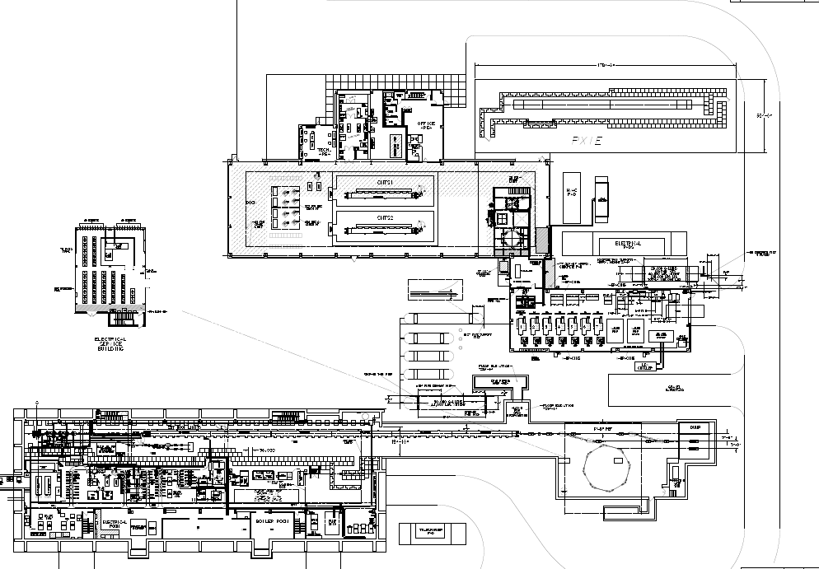
NML, CMTF and PXIE
High bay area:
NML ~ 15,000 sq. ft.
CMTF ~ 14,000 sq. ft.
PXIE ~ 8,900 sq. ft.

Slide 9
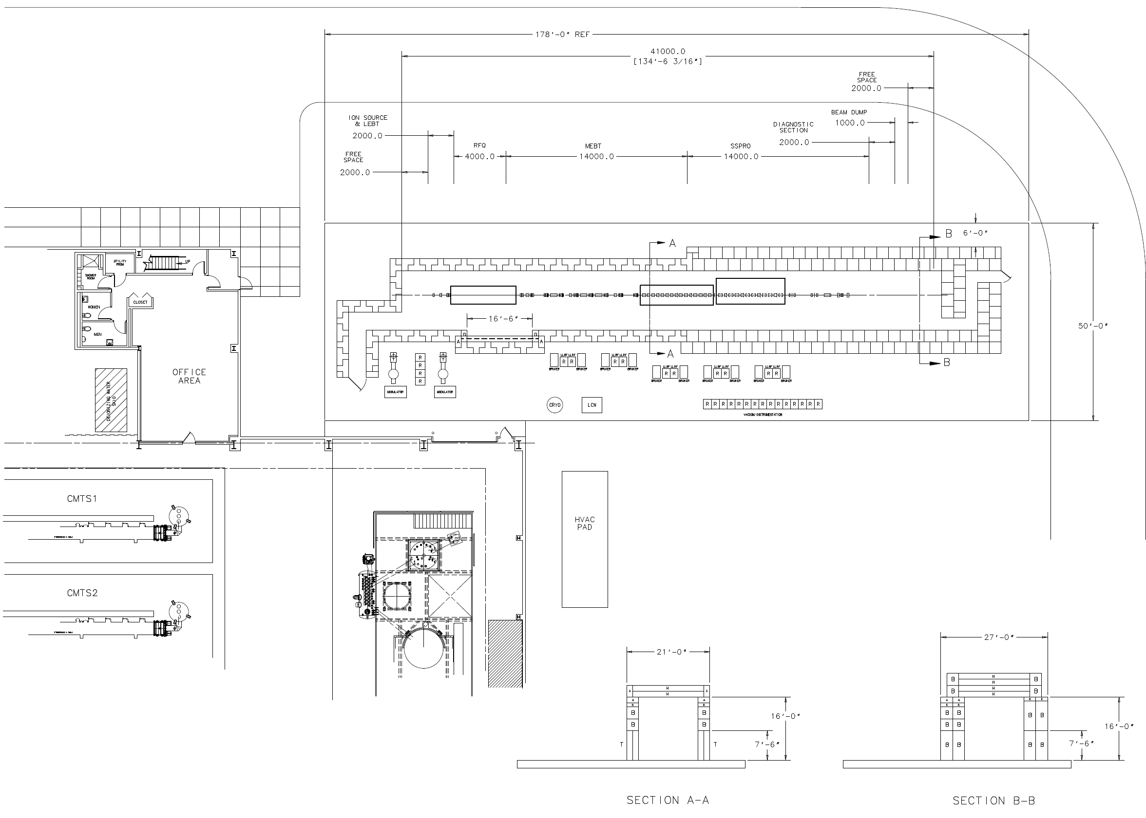
Accelerator Test Area (PXIE)

Slide 10
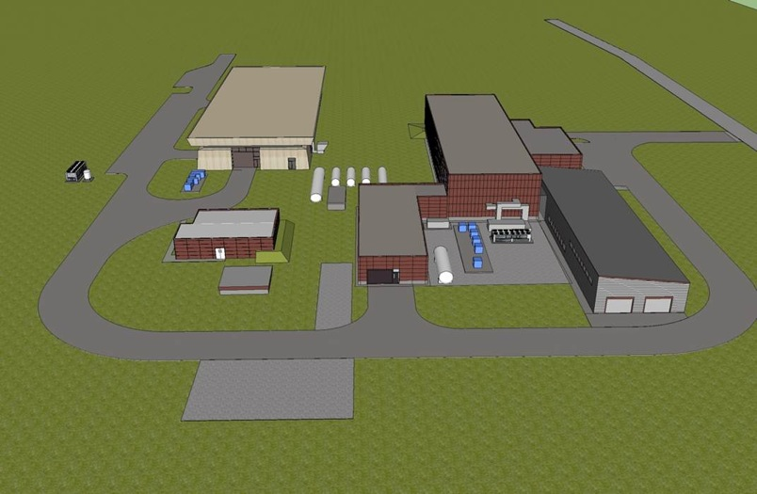
SRF Accelerator Test Area Complex Layout
Jerry Leibfritz working with FESS on building layout

Slide 11
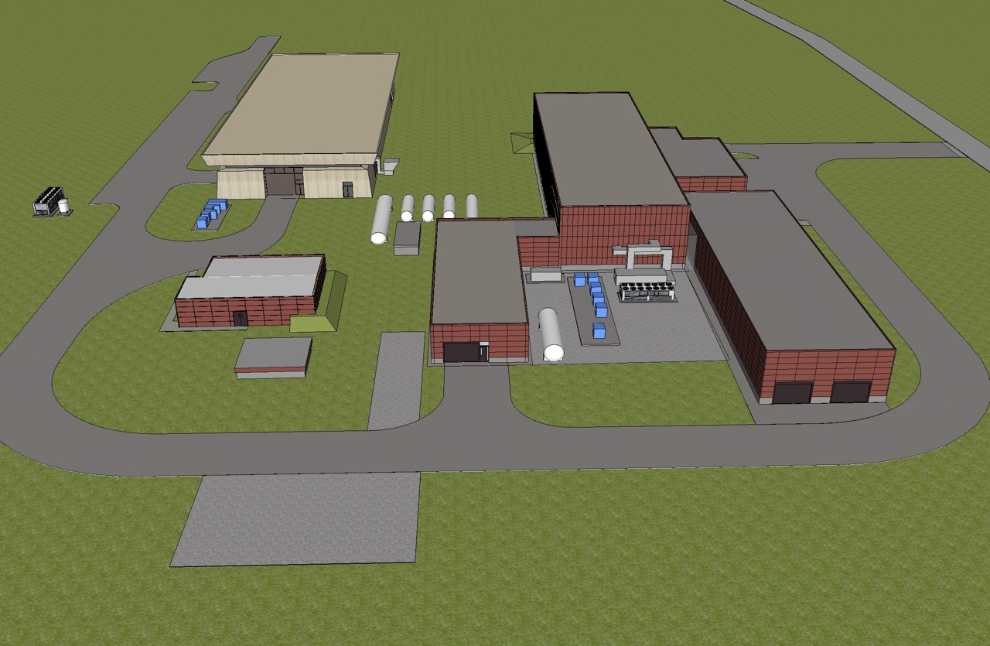
SRF Accelerator Test Area Complex Layout (2)

Slide 12
Component Layout
Jim Kerby working on detailed component layout using latest optics
Will be an iterative process
Gathering information on size of components and interface dimensions
Question of how close PXIE design should be to Project X
Should it be one for one to test critical components?
Do we need to test installation procedures and alignment schemes?

Slide 13
Key Parameters/Issues
Physical Layout
Concrete pad 178’ (L) x 50’ (W) ➔ close to maximum size for that area
Tunnel internal cross section 15’ (W) x 16’ (H) ➔ compatible to Project X
Beam height = 4.265’ (1.3 m)
Cryogenics (A. Klebaner)
Capacity vs. load at operating temperature needs to be examined
Need to understand stability requirements vs. operation modes
Turn on off test stands and PXIE is staged so real data will be available
AC Power
Should have enough wall plug power but if not, option to add transformer
RF Power (R. Pasquinelli)
Substantial space required for power sources, racks, waveguides, coax…
Controls
Global controls will utilize standard FNAL control system (ACNET)
LLRF control is an area that needs additional communication
Instrumentation (V. Scarpine, M. Wendt)
One of the key R&D features that will be explored is validating instrumentation
Including chopper extinction measurements

Slide 14
PXIE and SRF Program
PXIE’s SRF components (HWR and SSR1) are fully consistent with and integrated into FNAL’s overall SRF Program
SSR1 has been ongoing (Roark/Niowave)
Recent switch from SSR0 to HWR means ANL has a larger role
SRF organizations and responsibilities are already well established
FRS drafts exist and TRS documents are being written
Infrastructure will be modified to accommodate new frequency
Priorities will be adjusted to reflect relative critical nature of work
Non-SRF work for the rest of PXIE will be integrated with Project X RD&D Program
Clearly PXIE is a high priority in that it demonstrates several key beam components/parameters and reduces risk for Project X

Slide 15
Summary
Just beginning the process of facility planning
Beamline layout ➔ in progress
Civil construction planning ➔ in progress
Component specifications ➔ being developed
Design work ➔ in progress
Source & RFQ ➔ LBNL
HWR ➔ ANL
SSR1 ➔ FNAL/India
Magnets ➔ FNAL
RF Sources ➔ FNAL/SLAC/India
Cryogenics ➔ FNAL
Instrumentation ➔ FNAL/SLAC/SNS/India
Working on “bottoms up” schedule and cost estimate
PXIE will serve as a valuable R&D tool for Project X

