Slide 1
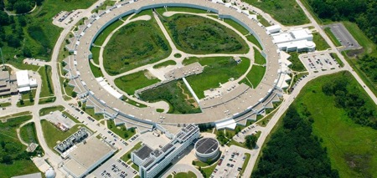
Welcome and introduction to the AWA upgrades workshop
erhtjhtyhy
John byrd
Director, Accelerator Systems Division
Director, Argonne Accelerator Institute
Advanced Photon Source
jbyrd@anl.gov
AWA Upgrades Workshop
25 March, 2021

Slide 2
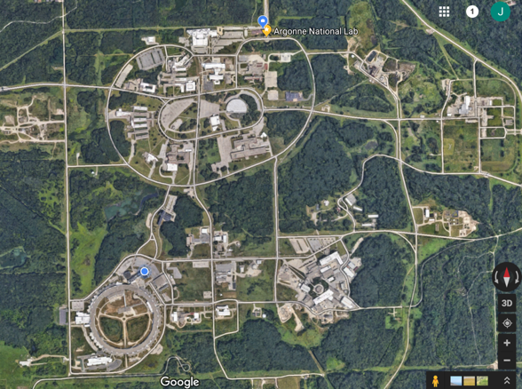
Welcome to Argonne!
The definition of a “green field site.”

Slide 3
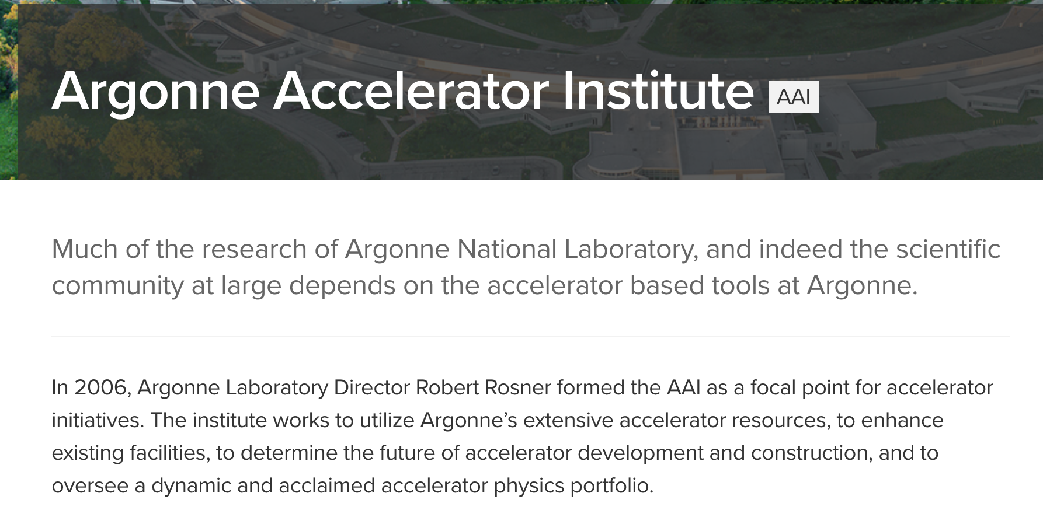
Nice web site with lots of pictures and ideas…..
Reality: The AAI is a largely virtual organization with little direct lab funding ($125k/yr)
We’re trying to change this because we see lots of opportunities, especially given the broad range of Argonne capabilities in accelerator science and technology, beam test facilities, and experience in accelerator modeling, building, commissioning and operation.

Slide 4
DOE is helping motivate a substantial role for the AAI
However, some strings are attached…
Comments from SC / HEP on 2020 Argonne Lab Plan…
  The synergy between AWA and other Argonne accelerator efforts remains superficial and disappointing. The Argonne Accelerator Institute is held up as one potential guiding center for all ANL accelerator efforts, but has provided no visible value to HEP. The promise of strong linkage to BES described at the Accelerator R&D Review has yet to materialize….
DOE provided a specific Program Execution Management Plan (PEMP) goal to push AAI forward
  HEP: Provide a short document by June 30, 2021 outlining the concrete efforts the lab has undertaken or will undertake to establish stronger synergy between the Argonne Wakefield Accelerator and other Argonne accelerator efforts. The document should highlight relevant connections between various SC programmatic interests and how the integrated ANL accelerator R&D approach will better serve these interests, including the relation of nearer-term, specific technology R&D goals to the broader lab vision.

Slide 5
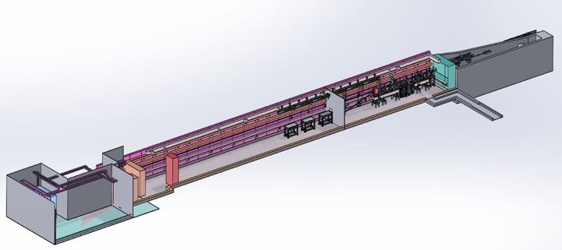
LEA: Linac Extension Area
booster
Chicane
RG2
RG1
PCG
L5 L4
L2
LEA
wall
375 ~ 500 MeV
LINAC
150 MeV
6 MeV
PAR
17m
53m
An existing radiation enclosure of ~ 53 m long;
The LEA beamline will utilize the first ~ 17 meter of the tunnel;
The end of the tunnel will serve as a S-band RF test stand.

Slide 6
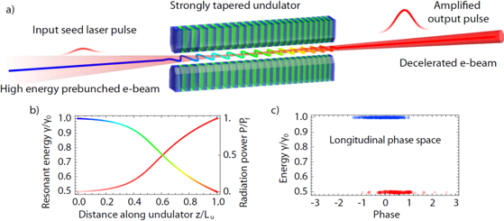
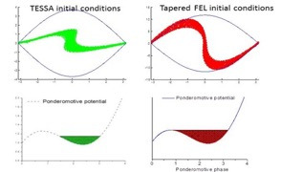
Proposed LEA Experiment: Tapering Enhanced Stimulated Superradiant Amplification (P. Musumeci, UCLA)
Modern SASE FELs only extract a small fraction (0.1%) of the electron beam energy.
How can we get higher x-ray pulse energy from FELs?
We can extract a large fraction of the energy from an electron beam provided:
  A high current, microbunched input e-beam
  An intense input seed
  Gradient matching to exploit the growing radiation field.
IFEL deceleration
Duris et al. NJP (2015)
Notes:
After the success of this experiment we started thinking what happens if we do the experiment in reverse. Obviously the dynamics here is time-invariant so if we flip all th eparticle directions it will bepossible to reverse the interaction. That is inject a high energy beam and decelerate it down to half of its energy. Where did the energy go? Since there are no medium, no boundaries, the energy can only go back into the laser, so we would be able to extract half of the energy in the e-beam and give it to the radiation. This is what started us formulating the TESSA concept. The main ingredients are a high current microbunched beam, a high intensity seed and a properly tapered undulator.
Many times I have been asked what is the difference between a inverse inverse free electron laser and a free electorn laser. Of course the equations are the same. The best way to understand it is in the initial conditions.

Slide 7
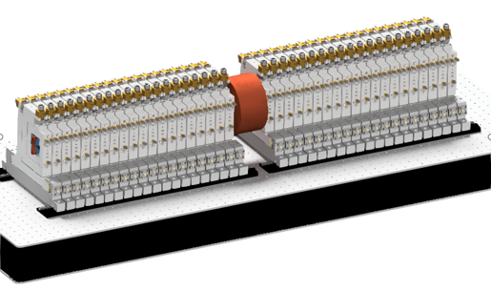
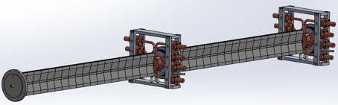
Sasha’s dream: A compact accelerator structure for next generation linacs
Two accelerator sections shown with and without quadrupoles
180 GHz collinear wakefield accelerator. A quadrupole ”wiggler” provides focusing for drive beam.
Prototype tests have already started. A DOE proposal has been submitted by NIU to further testing.

Slide 8

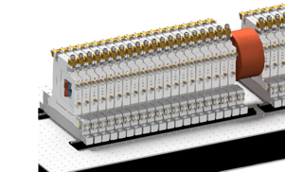


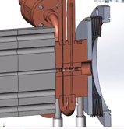
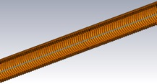
Components in Accelerator Module
Accelerator Module
Vacuum chamber surrounded by focusing quadrupole magnets.
Bellows
Vacuum chamber
0.22 m
Transition Section
Corrugated waveguide embedded in water cooled copper block.
0.5 m
Corrugated Waveguide
Water in and out channels.
Extracts excess beam radiation and measures beam position.
Bellows attaches to next accelerator module.
Assists with the increases of beam energy by ~ 50 MeV.

Slide 9
Summary
Welcome to everyone, especially my dear friends from Berkeley Lab. I hope we can bring you in as partners for several other activities here.
Thanks to my APS colleagues for making time for this workshop given the many other demands.
Argonne has a bright accelerator future. Please come and help us!

