Slide 1
Argonne Wakefield Accelerator
AWA: upgrades fy21-23
AWA-II: >fy25
erhtjhtyhy
John power for the AWA group
Argonne Wakefield Accelerator
An HEP-GARD Test Facility
Argonne National Laboratory
March 25, 2021
AWA Upgrades Mini-Workshop

Slide 2
Introduction to awa
The AWA’s mission:
R&D for future accelerators

Slide 3
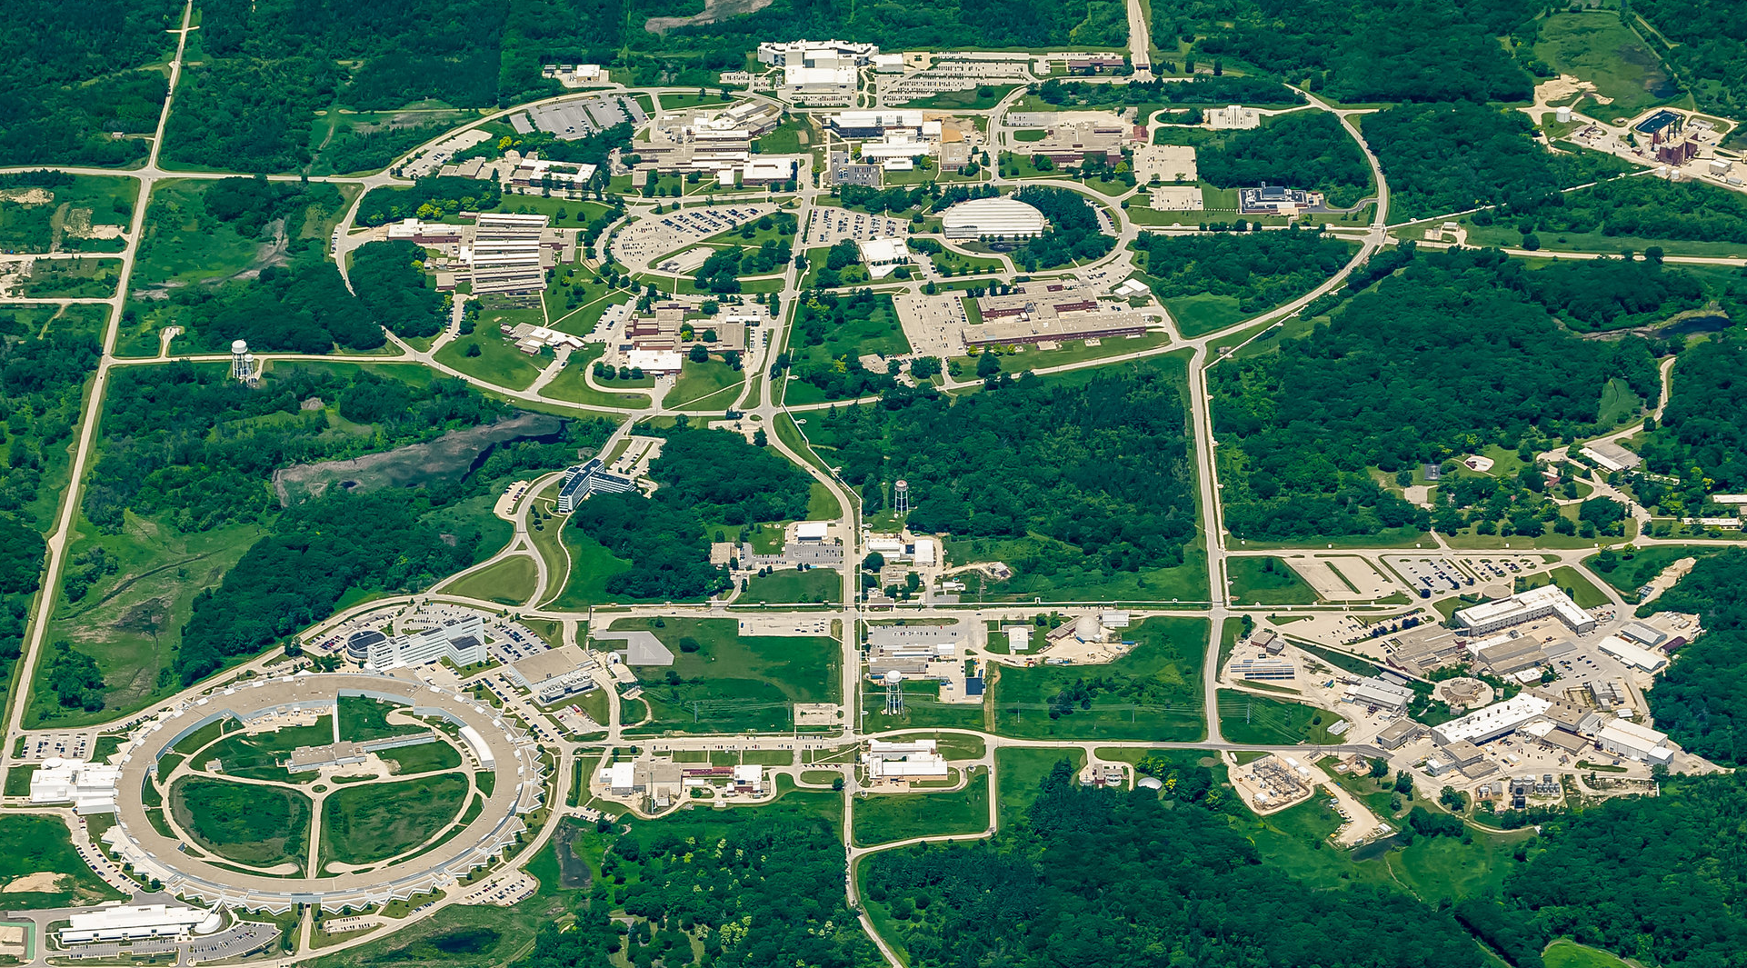
Argonne wakefield accelerator (AWA)
Campus: 15 minutes west of Chicago
ATLAS: NP national user facility
200 AREA
300 AREA
400 AREA
AWA Group
APS: BES national user facility
AWA Facility
Notes:
Accelerators at Argonne

Slide 4
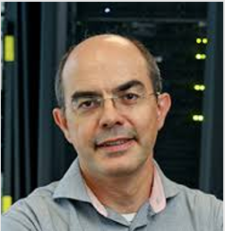
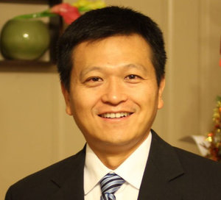
The awa group
Beam
Physics Lead
Advanced Accelerator Concepts Lead
STRONG UNIVERSITY
CONNECTION
Group Leader
STRONG INDUSTRY
CONNECTION
Philippe Piot
NIU/APS/AWA
Chunguang Jing
Euclid/AWA
John Power
Advanced Accelerator Concepts
Advanced Accelerator Concepts
Making things work
Controls & RF Systems
Mech. & Civil Engineering
Beam
Physics
Electron Sources
Wanming Liu
Scott Doran
Gwanghui Ha
Eric Wisniewski
Xueying Lu
NIU/APS/AWA
Jiahang Shao
Charles Whiteford
Guest Scientist
Joint Appointment

Slide 5
The AWA Upgrades groups
EPICS
Guobao Shen (APS)
Andrew Johnson (APS)
Wanming Liu (AWA)
LLRF
Daniele Filippetto (LBL)
Carlos Serrano (LBL)
Derun Li (LBL)
Larry Doolittle (LBL)
Vamsi Vytla (LBL)
Yawei Yang (APS)
Wanming Liu (AWA)
KLYSTRON
Ali Nassari (APS)
Alex Cours (APS)
David Meyer (APS)
Wanming Liu (AWA)
AWA
DOE-HEP
LK Len
AAI
John Byrd
AWA
John Power
Wanming Liu
Philippe Piot
AAI & DOE

Slide 6
the Argonne Wakefield Accelerator Facility
3x 1300 MHz RF photocathode guns
WITNESS
DRIVE
- 15 MeV photoinjector linac
- Produces bright beam acceleration
- Supports low-energy experiments
- 65-MeV Drive photoinjector (Cs₂Te) linac
- World’s highest-charge (e.g. 100 nC) photoinjector
- High brightness low-Q beams
65
ACT
- 1-5 MeV RF gun
- dedicated Argonne Cathode Test stand (photocathode and field emission research)
- physics of breakdown & diagnostics tests
Notes:
Independent Drive and Witness Beamlines

Slide 7
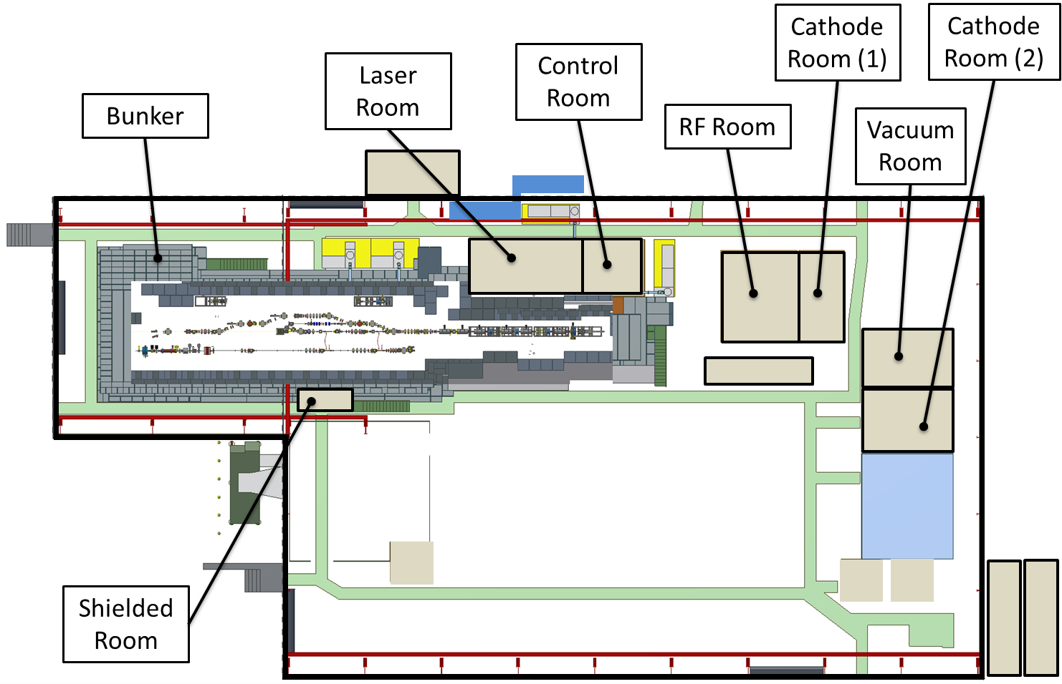
Argonne wakefield accelerator facility
BLDG 366
39 m
127 ft

Slide 8
the Argonne Wakefield Accelerator test Facility
WHY upgrade????
Research areas
Help AWA become the premier Structure Wakefield Accelerator (SWFA) Test Facility in the world -- a key to future accelerators
Beam-driven wakefield acceleration
Structure Wakefield Acceleration (SWFA)
Collinear Wakefield Acceleration (CWA)
Two-Beam Acceleration (TBA)
Plasma Wakefield Acceleration (PWFA)
Accelerator and Beam Physics
6D phase space manipulation
Electron cooling
Novel diagnostics (Single-shot, AI/ML Virtual, etc.)
RF Acceleration Technology
100’s MV/m NCRF short-pulse structures
100’s MW NCRF short-pulse power source
Electron sources
Photo and field emission. High brightness beams.
Machine Learning
ML for machine control, virtual diagnostics and physics
AWA & COLLABORATORS

Slide 9
Awa upgrade plans

Slide 10
AWA UPGRADE PLANS
Upgrade path
AWA-I: upgrade of beam quality and capabilities
Beam stability.
LLRF synchronization system (w/ LBL & APS)
Klystron A & P system (w/ APS RF Group)
EPICS control system.
Enable Machine Learning for improved machine control, virtual diagnostics and physics (w/ APS Controls group)
Beam Brightness. Emittance improvement by RF symmetrized gun (in-house) & RF symmetrized cavities (LBL)
Extended Bunch shaping. (SLM based Laser shaping, TDC shaping, EEX Multileaf Collimator, etc.)
AWA-II: High energy version of AWA
65 MeV → 150 MeV
Tighter focus for acceleration research
Allows SWFA to enter GeV & GV/m regime
High beam density for improved PWFA
Increase the size the experimental switchyard
AWA
current
FY21-23
45 ft
klystron
Control, laser, vacuum, rf, office, cathode
AWA-II
>FY25
+45 feet

Slide 11
extras

Slide 12
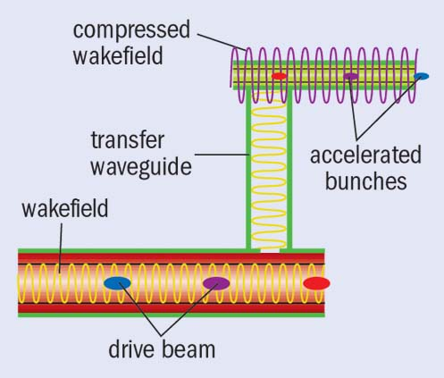
the Argonne Wakefield Accelerator Facility
Structure Wakefield Acceleration
SWFA 15-year roadmap
2020-2025 |  |  |  |  | 2025-2030 |  |  |  |  | 2030-2035
 |  | Main beam shaping R&D
 | Advanced structure R&D
 | High charge drive beam R&D
 | 100’s MeV demonstrator
 |  |  |  |  |  | 1 GeV w/ main bunch train demonstrator
High efficiency klystron (Synergy efforts from CLIC/SLAC)
 |  |  |  |  |  |  |  |  |  | 1 GeV high-efficiency module
 |  |  |  |  |  |  |  |  |  |  |  |  | AFLC CDR
 |  | CWA energy doubler
High charge drive beam shaping R&D
 |  |  |  |  |  | XFEL CDR
Roadmap of beyond 3 TeV collider and other near-term applications
Two Beam Acceleration
Linear
Collider
Collinear Wakefield Acceleration
XFEL
drive beam
main beam
FY21-23 (Upgrades)
The AWA’s mission is to support the DOEHEP GARD program for future accelerators

