Slide 1
AWA Improvement
Modulators and Klystrons
Alex Cours, 3/25/2021

Slide 2
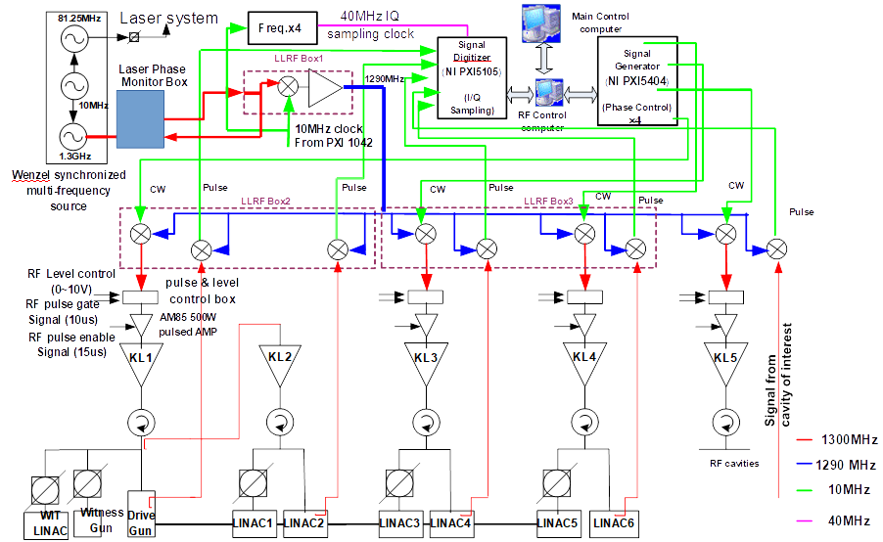
AWA RF System current configuration

Slide 3
Our Goals
To try to find the main sources of instability within the modulators and klystrons.
To offer immediate measures helping reduce deviation of the klystron output RF power.
To offer long-term measures.
Alex Cours, 3/25/2021

Slide 4
Possible Sources of RF Instability
Associated with the Mods and Klys
The charging power supplies voltage instability.
Flatness of the modulator pulse in combination with rf timing jitter.
Klystron gun emission variation.
Klystron filament power variation.
Drive power amplitude and phase instability.
Many others (not considered here).
Note: the drive power to K2 is provided by K1.
Alex Cours, 3/25/2021

Slide 5
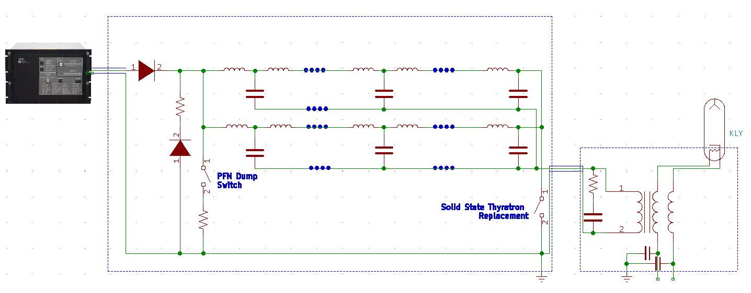
AWA Modulators
The AWA modulators are identical to the APS linac ones,
The charging power supplies are the same: TDK-Lambda 40-kV units.

Slide 6
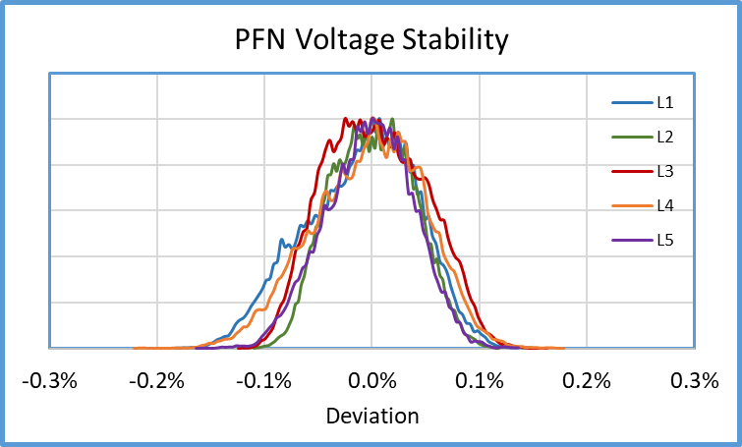
Charging PS (and PFN) Voltage Stability at the APS
The PFN voltage long- and short-term stability remains at the same level during entire life of the power supply.

Slide 7
What do we know about the klystrons
K1: Thales 1993 (!)
K2: Litton 1962 (?!!)
K3: Thales, 2010
K4: Thales, 2010
K5: Thales, 2018
K1 provides drive power to klystron K2
Alex Cours, 3/25/2021

Slide 8
Short-term (1 minute) Cathode Current Stability
Alex Cours, 3/25/2021

Slide 9
The Difference between new and old Klystrons
These plots represent the longer-term (~ 1 hour) behavior of the cathode currents in the young and relatively old klystrons, while the PFN voltages in both modulators were stable.
The obvious difference was caused by cathode emission instability in the older tube.
Alex Cours, 3/25/2021

Slide 10
Cathode Current Instability vs. Klystron Age
Instability of cathode current associated with the gun emission deviation grows with aging of the klystron.
In very old klystrons, cathode current may be 10 and more times less stable than PFN voltage.
Alex Cours, 3/25/2021

Slide 11
Resulting instability of the klystron output RF
As we can see, the resulting instability of rf power is much higher in some of the klystrons.
Certainly, contribution of the drive power variation may be significant, but the older klystrons are important sources of rf instability.
Alex Cours, 3/25/2021

Slide 12
Resulting instability of the klystron output RF
The fact that one old klystron (K1, 28 years old) is the drive power source for another VERY OLD klystron (K2, 59 years old!) makes us suspect that this tandem is one of the main sources of all AWA energy instabilities.
We do not know the actual “filament ON” life of both klystrons, but there is a reason to believe that the guns were in use during significant amount of time.
Alex Cours, 3/25/2021

Slide 13
Short Summary
It was found that:
The AWA modulators are very similar to the APS ones and hardly are sources of significant instability.
The tandem of K1 and K2 klystrons is very old and likely is to blame for the main portion of the rf power deviation.
Information about klystron filament hours and amplitude stability of the AWA modulators and klystrons is not available, so the entire discussion is based mainly on the APS linac studies.
Alex Cours, 3/25/2021

Slide 14
Conclusion and Suggestions
The following plan seems suitable for the immediate implementation:
Make sure all klystrons run in saturated mode. This will lower effect of any drive power instability.
Try to determine “filament ON” hours at least for K3, K4, and K5 klystrons. Keep tracking of this parameter in future.
As accurate as possible, measure stability of the main amplitudes (DC and RF) in order to find the worst of them (note: cathode voltage instability causes klystron output rf phase variation). Measure short- and long-term stability. Also, look at timing jitters.
Slight increasing of filament power may lower the gun emission deviation.
Using the Sola voltage stabilizers in the filament circuits will reduce effect of the line voltage variation.
Alex Cours, 3/25/2021

Slide 15
Conclusion and Suggestions (cont.)
The following plan seems suitable for the longer time:
Try to replace K1 and K2 klystrons with much newer tubes.
Reconfigure the RF system in order to avoid using one klystron as a source of drive power for another one.
Alex Cours, 3/25/2021

