Slide 1
News
Julie and Brendan

Slide 2
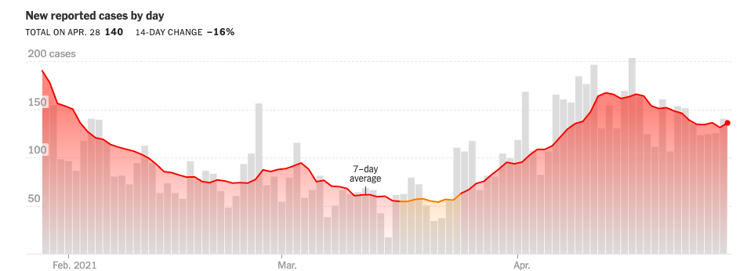
Covid
Kane County
Covid is still here
This has affected many of us and some of us have lost people very close to us
Please continue to follow the guidelines and be extra mindful of the mental health of our colleagues and collaborators
Many are going through many other stressful things besides Covid
None of the lab’s policies have changed since the last meeting. But they have clarified that we do not expect to have a separate set of rules for people who have been vaccinated
If you are attending virtual meetings not hosted by Fermilab, fill in a TA
Please take vacation. We all need a break.

Slide 3
Charge codes
Most of our time is on research or ops codes but everyone should be charging correctly for time not on research or ops
40PD.00.01: training or all hands meetings
40PD.00.02: Department management tasks
40PD.00.03: Any lab committees you are working on
40PD.00.04: Any PPD committees you are working on
40PD.00.05: Internal reviews (except for PPD reviews)
40PD.00.06: External committees or reviews
40PD.00.18: EDI work
40PD.01.01.06: Outreach
If you haven’t been charging here, let me know and we can do a historical edit. 1 hour is no big deal but 1-2 hours per week or a several day review adds up.
(I will ask PPD to reduce the number of codes next year as this is getting ridiculous)
We are overrunning a little on research and underrunning on these codes and its likely due to people not charging to these codes when they should be charging to them
If we overrun on research, we won’t be able to hire a postdoc next year.
Taking vacation also helps. If you take an afternoon off, put it down as vacation. Better yet, take a week off.

Slide 4
Mu2e Applications Physicist position
Please help us spread the word about this position
We already received the feedback that we did not include enough info in the ad and a lot of people have questions
Please direct people with questions to me

