Slide 1
IOTA Proton Injector Activities
Dean (Chip) Edstrom
03/26/2021

Slide 2
Summary of Activities
HLRF Build-out
Placement of HLRF Components (DONE!)
325 MHz Klystron / Modulator / Charging Supply / Transformer
Meeting with Fluids / RF / Drafting
Electrical Fixed-Price-Contract
Water Fixed-Price-Contract
HLRF Distribution
Low-Energy Beam Transport
Looking for the stub… Leak check before assembly.
EID design progress
Medium Energy Beam Transport
Updated Wiki
Beamsheet Complete
Cable List Updated

Slide 3
HLRF Build-out
Placement of HLRF Components (DONE!)
325 MHz Klystron / Modulator / Charging Supply / Transformer
Meeting with Fluids / RF / Drafting
Electrical Fixed-Price-Contract
Kermit & Dave Featherston
Contract in purchasing.
Water Fixed-Price-Contract
Yurick Czajkowski
Price estimate from last year’s budget exercise… No FPC yet.
HLRF Distribution
Ding Sun & John Reid
Off-the-shelf parts

Slide 4
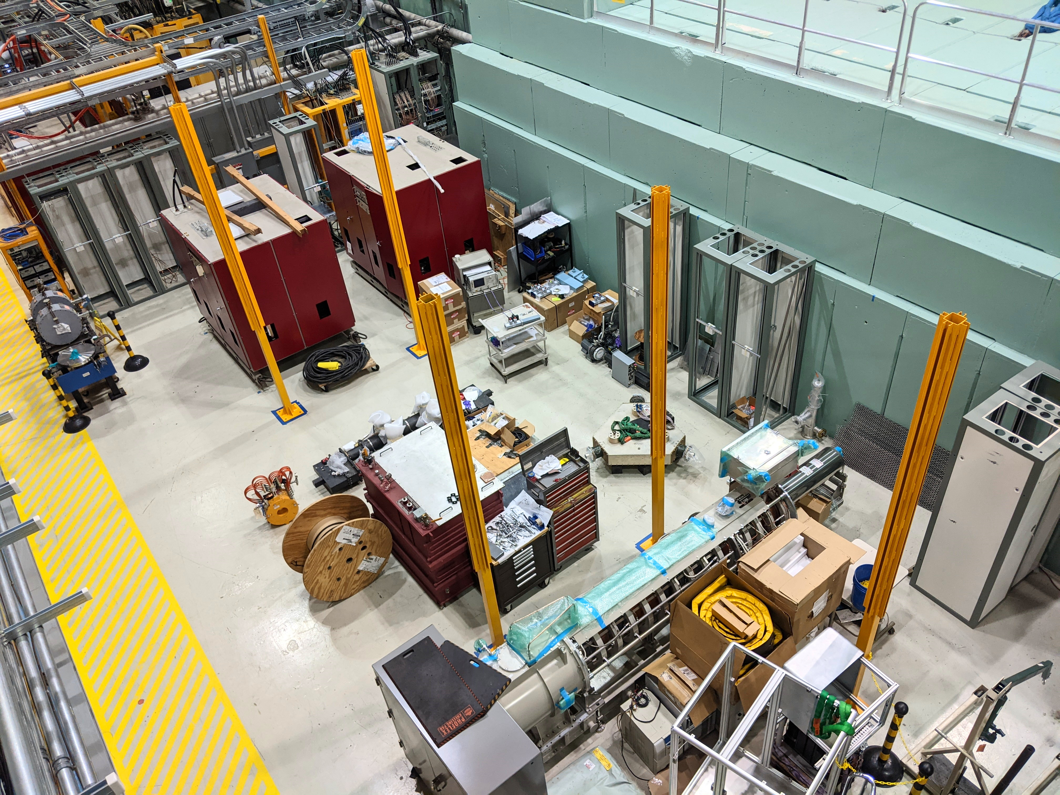
The 325 MHz HLRF Area Now

Slide 5
HLRF Distribution (Courtesy: Ding Sun)

Slide 6
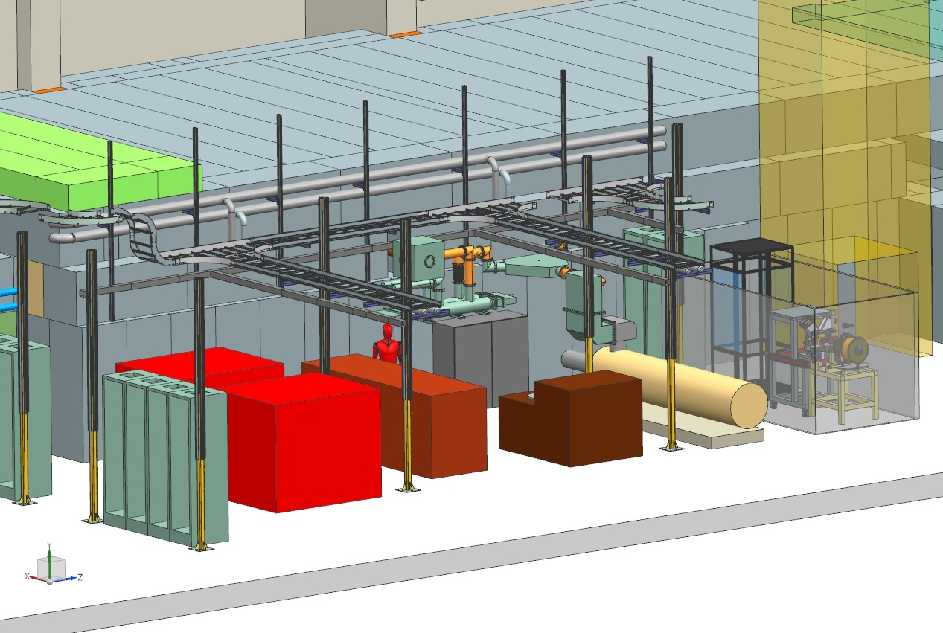
Electrical / Water FPC (Courtesy Steve Wesseln)

Slide 7
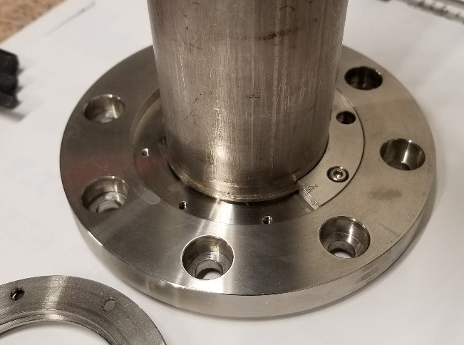
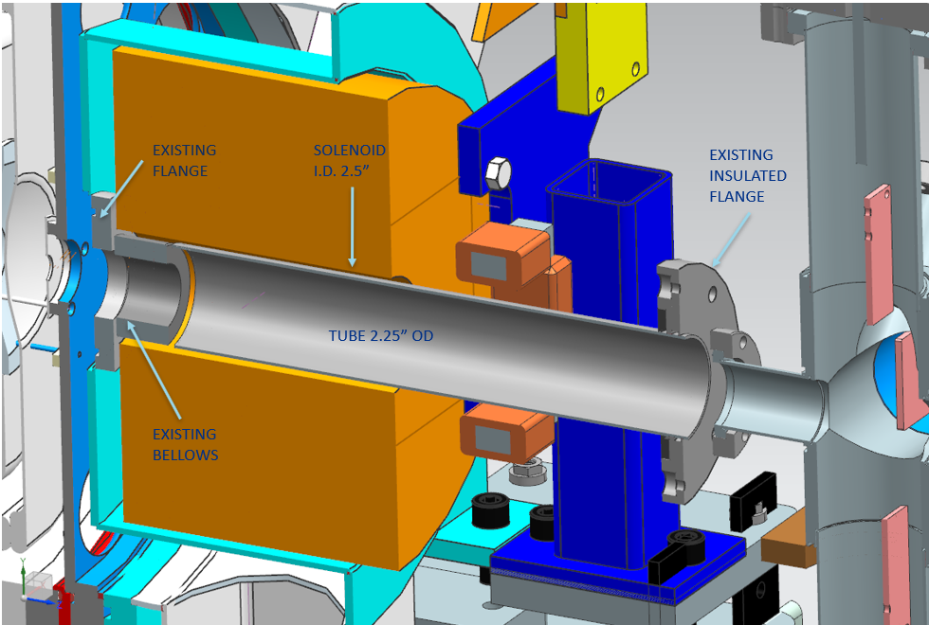
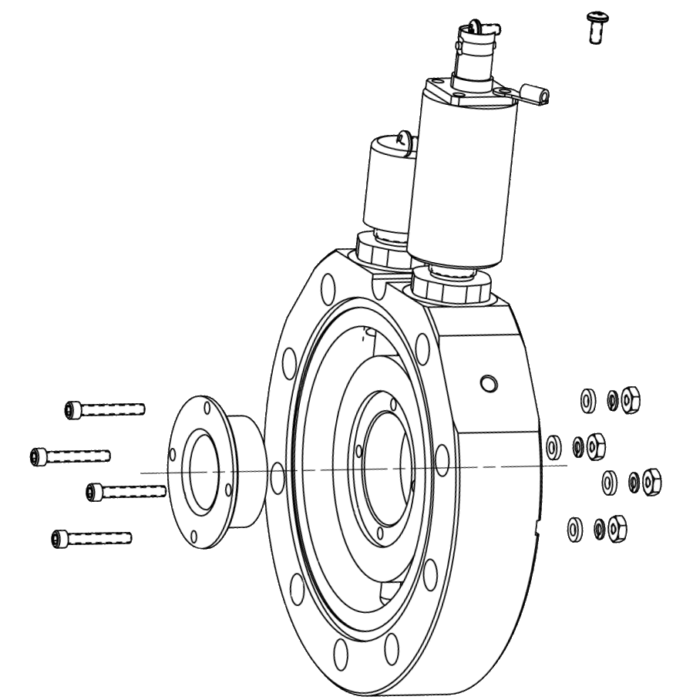
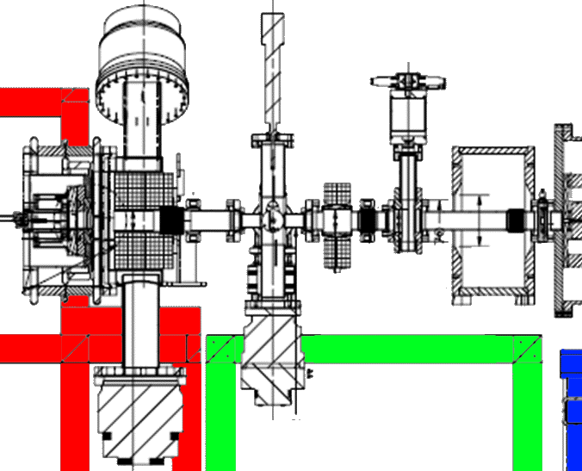
LEBT
LEBT Upstream Stub at NWA
Odd ‘split-flange’ design
Needs a leak check
Adapter to be fabricated
Electrically Isolated Diapragm
Based on PIP-II design
13 mm initial aperture

Slide 8
MEBT
Updated Wiki
https://cdcvs.fnal.gov/redmine/projects/iota-proton-injector/wiki/MEBT
Includes updated beamsheet from Sasha R.
Priority #3 after HLRF area & LEBT
HLRF Area needed for FPCs
LEBT needed for Test Cage & Source Commissioning

Slide 9
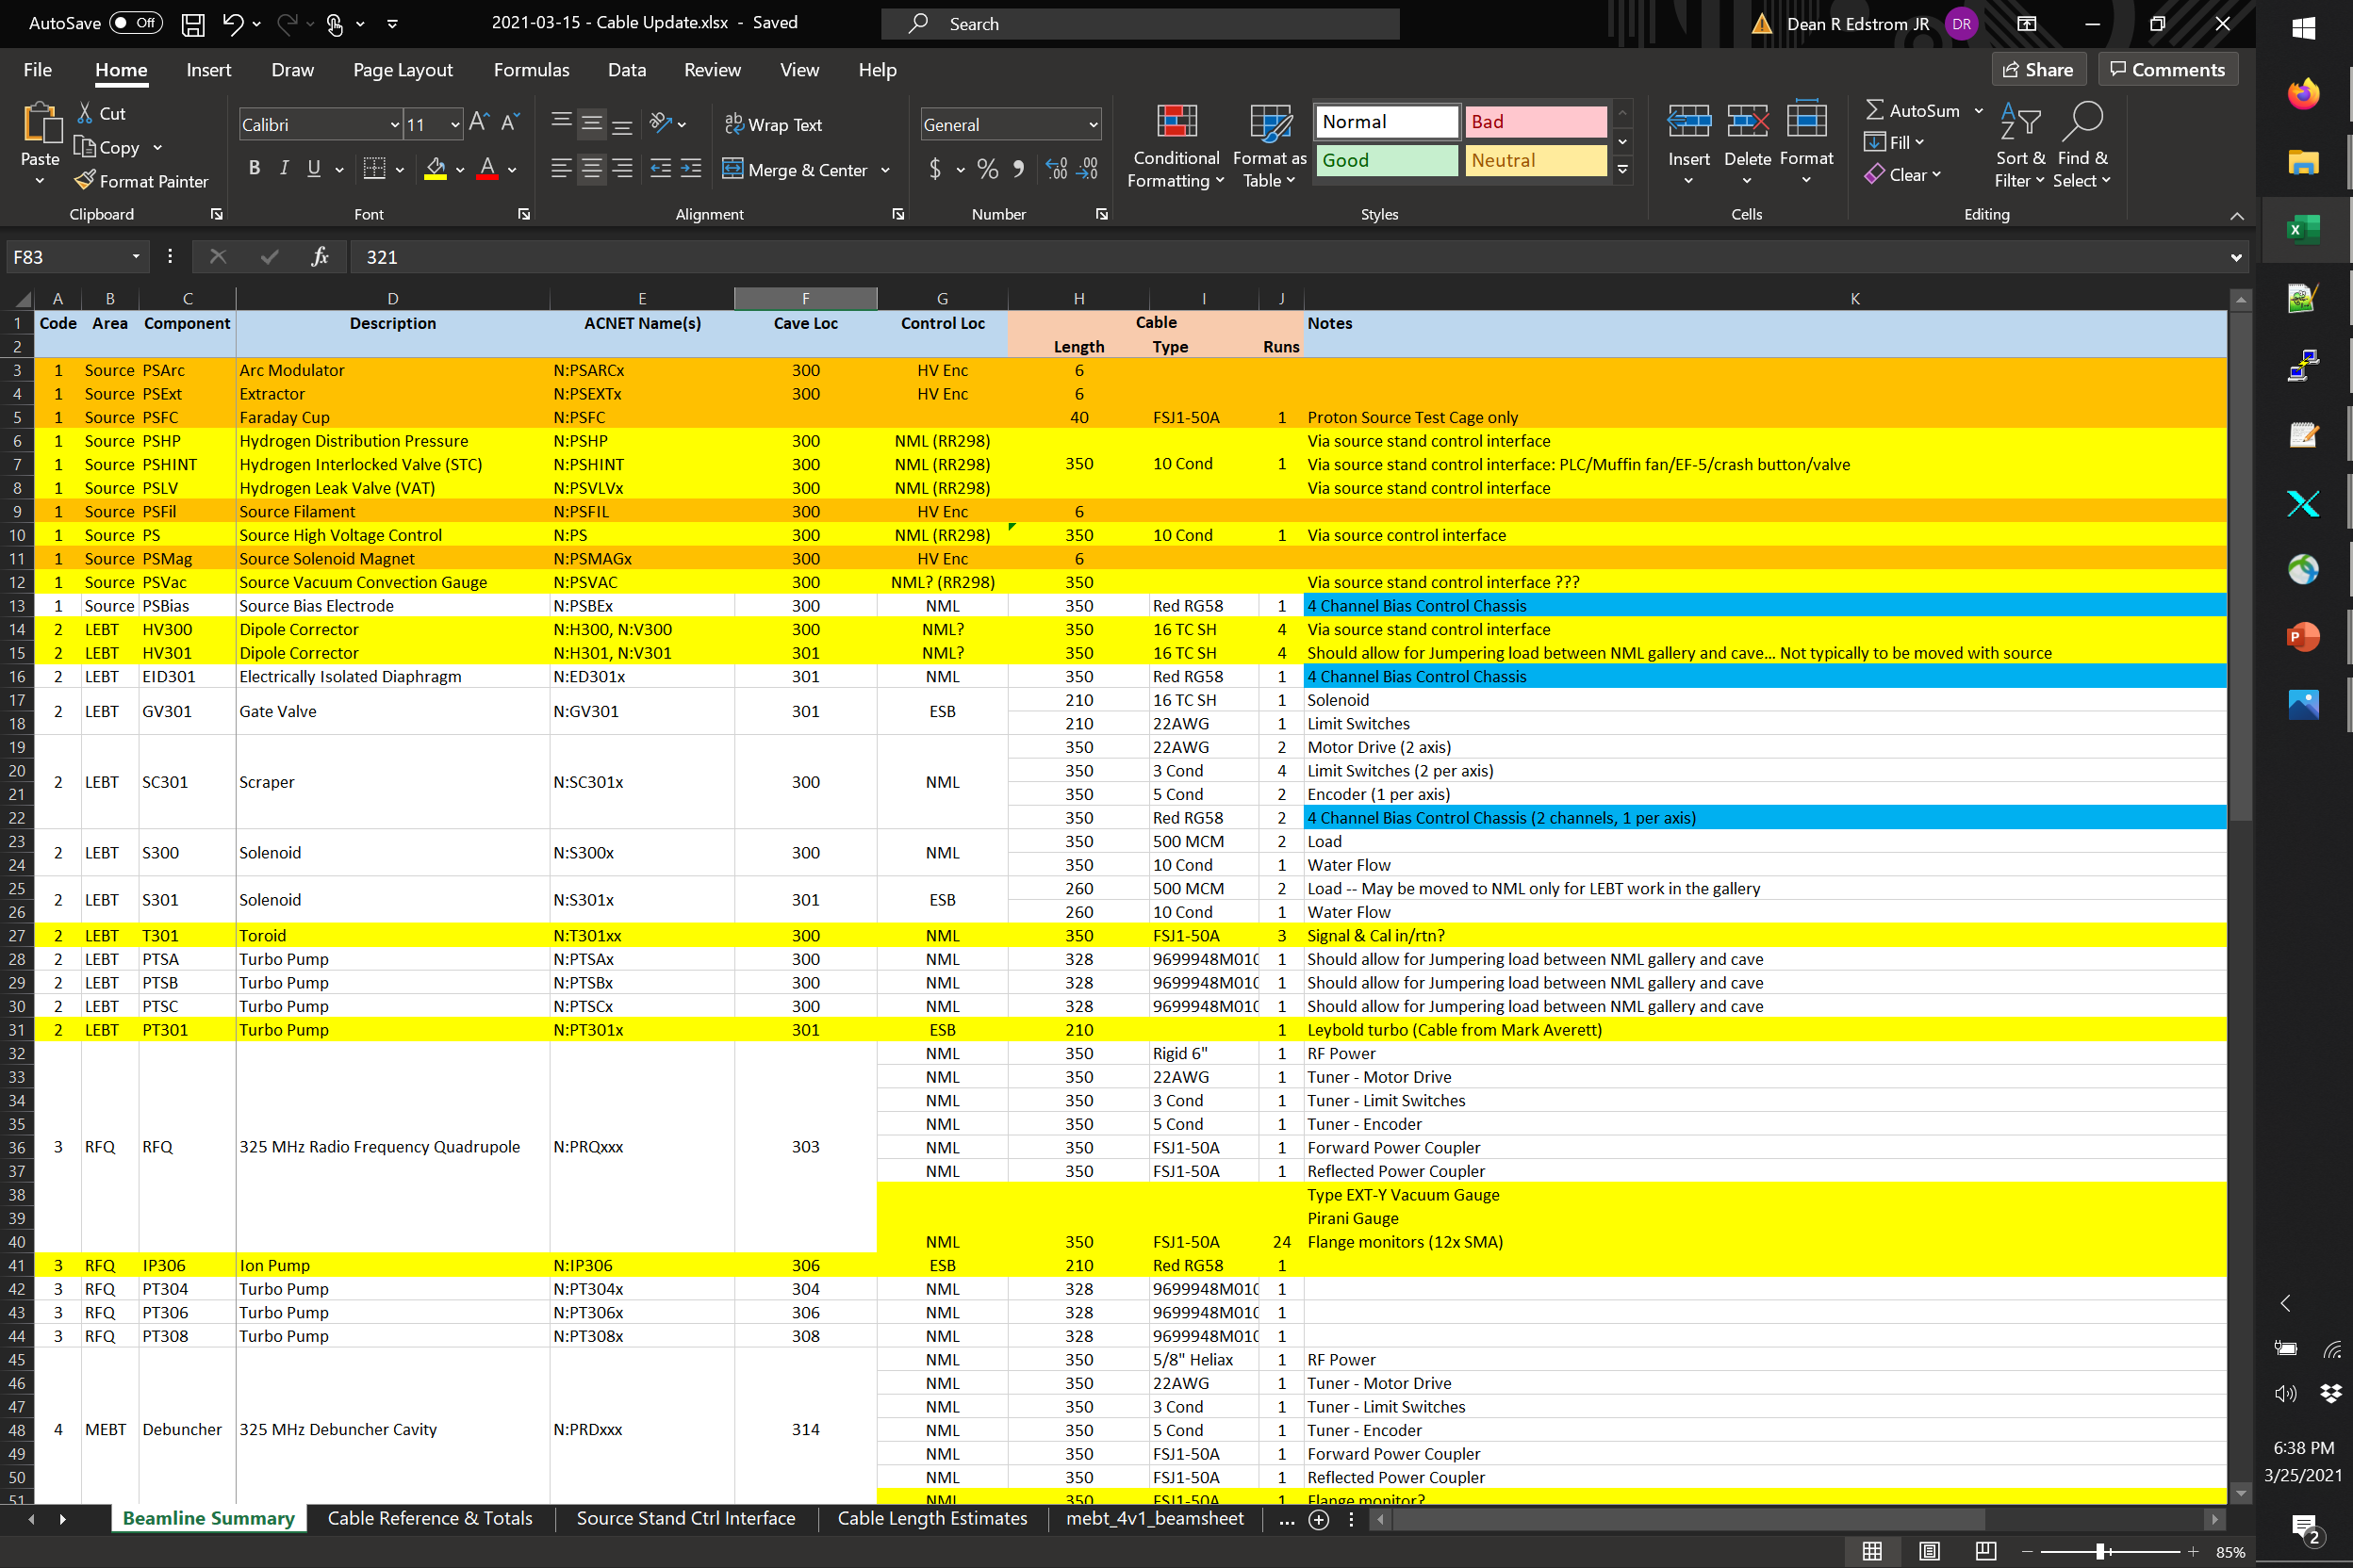
Cable List
Intended to include all beamline elements & timing
Broken into 5 primary areas:
Source (HV Enclosure / Ground Racks)
Low-Energy Beam Transport
RFQ
Medium-Energy Beam Transport
Timing (ESB to NML)
Also updated on the Wiki
Need to update est. lengths

