Slide 1
Planned Mu2e Target Test at AP0
Dave Pushka
Potential Fermilab Muon Campus & Storage Ring Experiments
26 May 2021

Slide 2
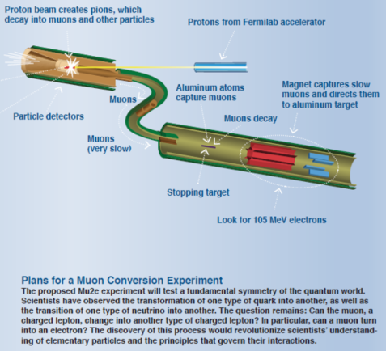
Background:
Mu2e has a Radiative Cooled target:
8 GeV Protons from Delivery Ring
Eight 43 msec long spills during 380 ms. Then, 1020 msec of no beam.
Operate for 1 year (2 x 10⁷ seconds ~ 5555 hrs ~ 33 weeks)
Goal is to make pions which decay to muons, and the muons transported to and absorbed in a stopping target.
Beam Power is 7.3 kW for the design intensity running
About 700 Watts absorbed in the target.

Slide 3
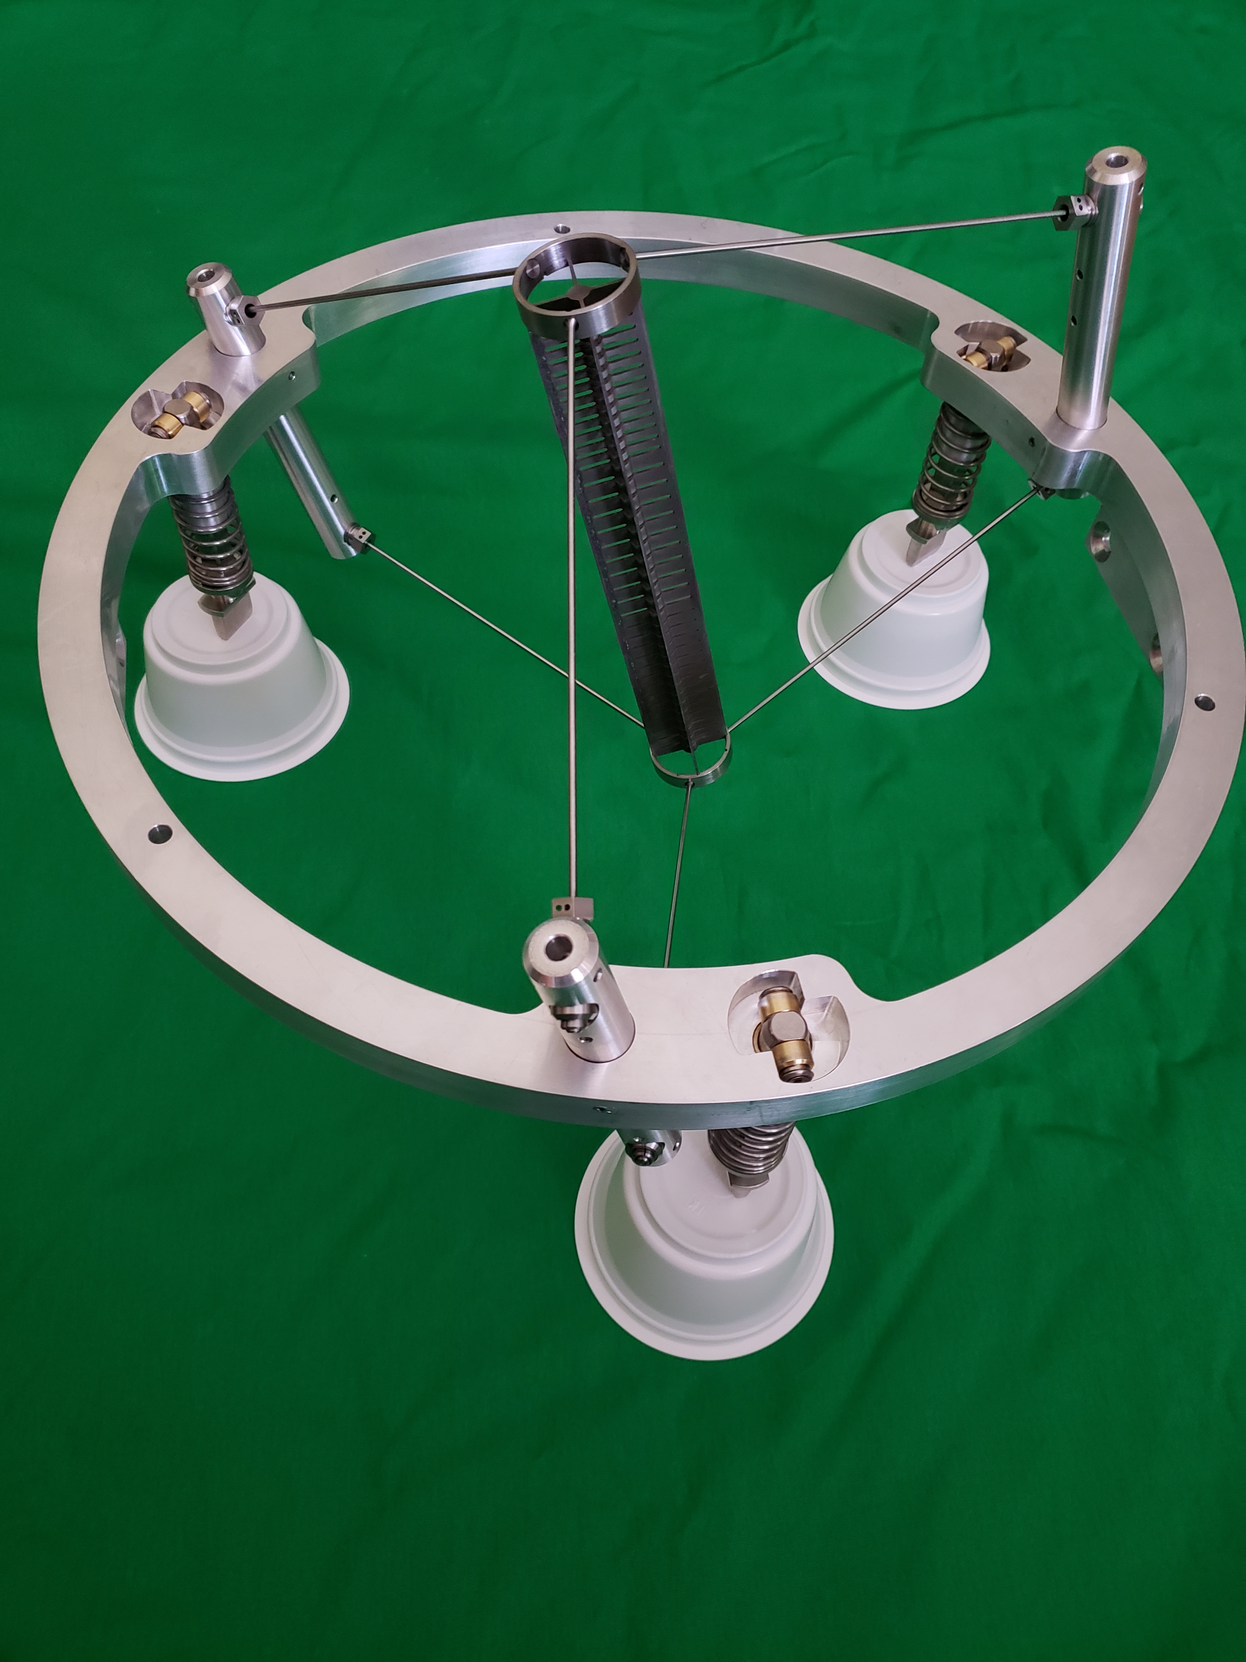
Scope and Motivation
Target is Unique and Multiple Failure Modes Exist:
Differential Thermal Stress could cause cracks
Low stresses at elevated temperature could lead to Creep
Residue Oxygen or Water vapor in the vacuum can lead to tungsten oxidation at elevated temperature.
Mu2e is a $200M+ experiment which depends on this target successfully lasting 1 year.
Does it really make sense to put a unique, un-tested target in the experiment?

Slide 4
Why AP0?
Protons at 8 GeV, same as in Mu2e
Spot size and delivery different than Mu2e
  Mu2e Resonant Extraction
  AP0 Not resonant (Actually, a more severe thermal shock)
  Spot sizes (beam sigma) differ slightly
The complication:
  Testing the Mu2e target means removing the g-2 target and ceasing beam delivery to g-2.
  Ideally performed when g-2 is otherwise unable to take beam.
  Involves significant effort in the AP0 target hall, best to occur at the end of an operating period.

Slide 5
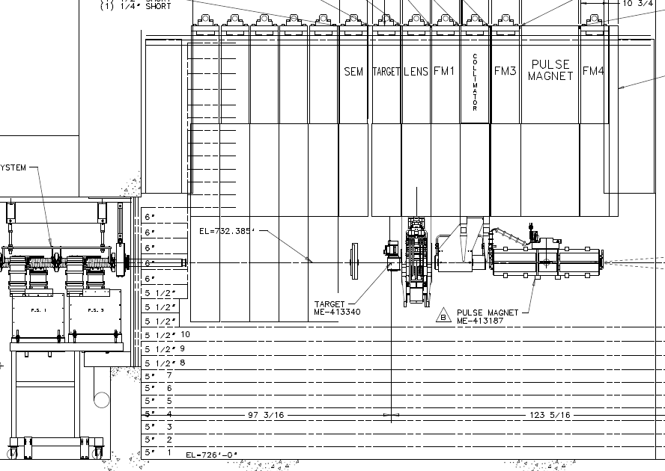
Test Target Taking Position of g-2 target in AP0:
Existing Target and Shielding Module Removed.
Test target and Module inserted in place of target used for g-2
Instrumentation and vacuum utilities connected to top of module.

Slide 6
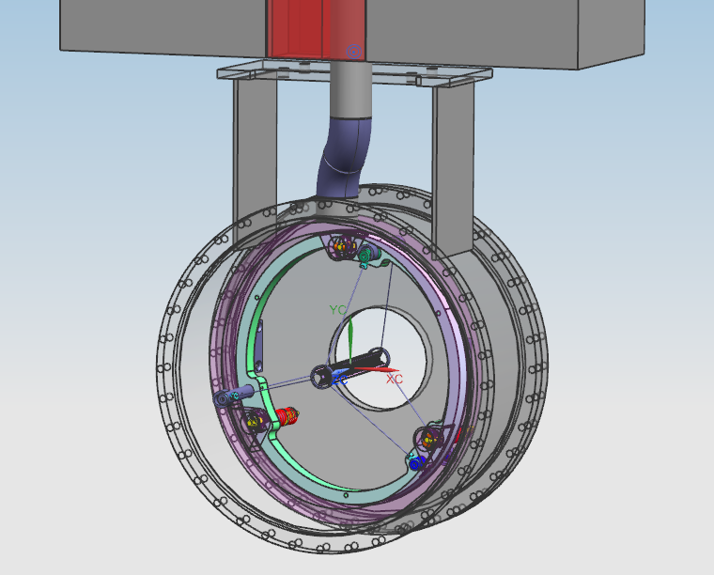
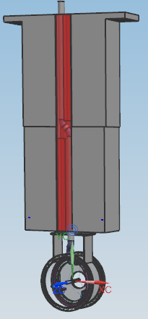
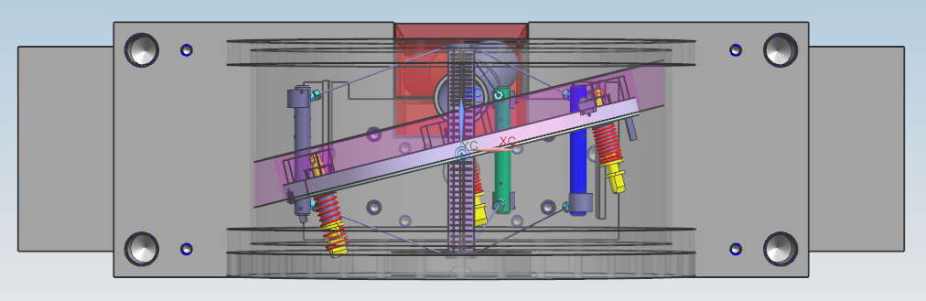
Mu2e Target Test Vessel and Target Assembly:
Identical target and bicycle ring and spoke supports to the one planned for use in Mu2e.
Bicycle ring mounted 14 degrees to square to align target with the beam:

Slide 7
Resulting Hand Calculated Stresses for Acceptable Creep:
Creep depends on:
Stress,
Temperature
and Time.
Test Duration likely
Unable to match 1 year operation to fully compare creep.
An oven test would be a more economical method to probe creep
ф2 mm Spoke
Tensile Stress
~ 1.2 MPa at 945 C
Target Bending Stress
~1 MPa at 1130 C

Slide 8
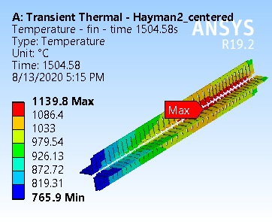
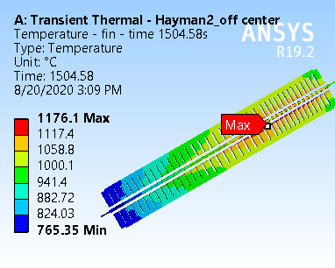
FEA Predicted Target Fin Temperatures for centered and off axis beam
Above are excerpts for an analysis report by Ingrid Fang (PPD) using Edep date from Kevin Lynch (CUNY, York College)
Comparing centered beam and 2 mm off-set beam
(1504.58 seconds is where the transient analysis has reached a steady state condition)

Slide 9
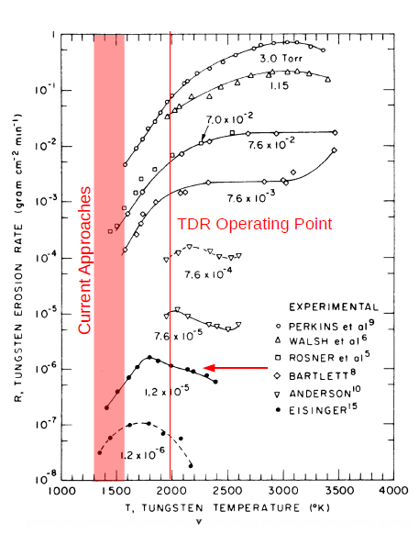
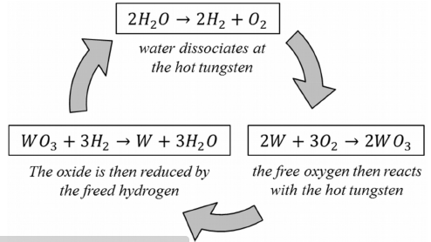
Target Failure Modes Continued, Oxidation:
Oxidation driven by residual Oxygen and Water Vapor in the vacuum.
Depends on the concentrations of O2 and H2O and on the temperature. Negligible if the temperature is sufficiently low.
Oxygen Cycle:
Water Catalyst:

Slide 10
Target Failure Modes Continued, Oxidation:
The two photographs show before and after oxidation tests performed by RAL with an air leak to a vacuum.
Better Vacuum lowers residual Oxygen and water vapor, reducing the material loss.
Vacuum Calculations indicate 1x10⁻⁵ torr around target.
Better vacuum limited by conductance of high vacuum line.

Slide 11
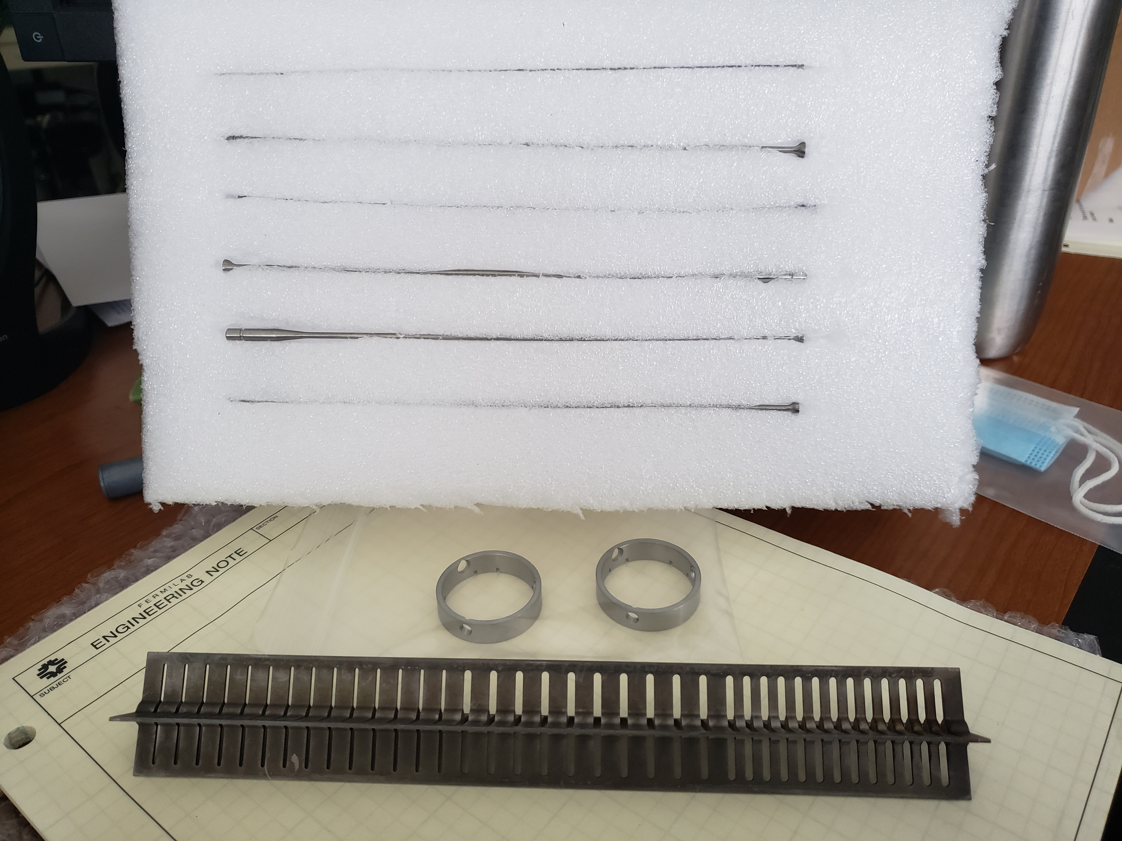
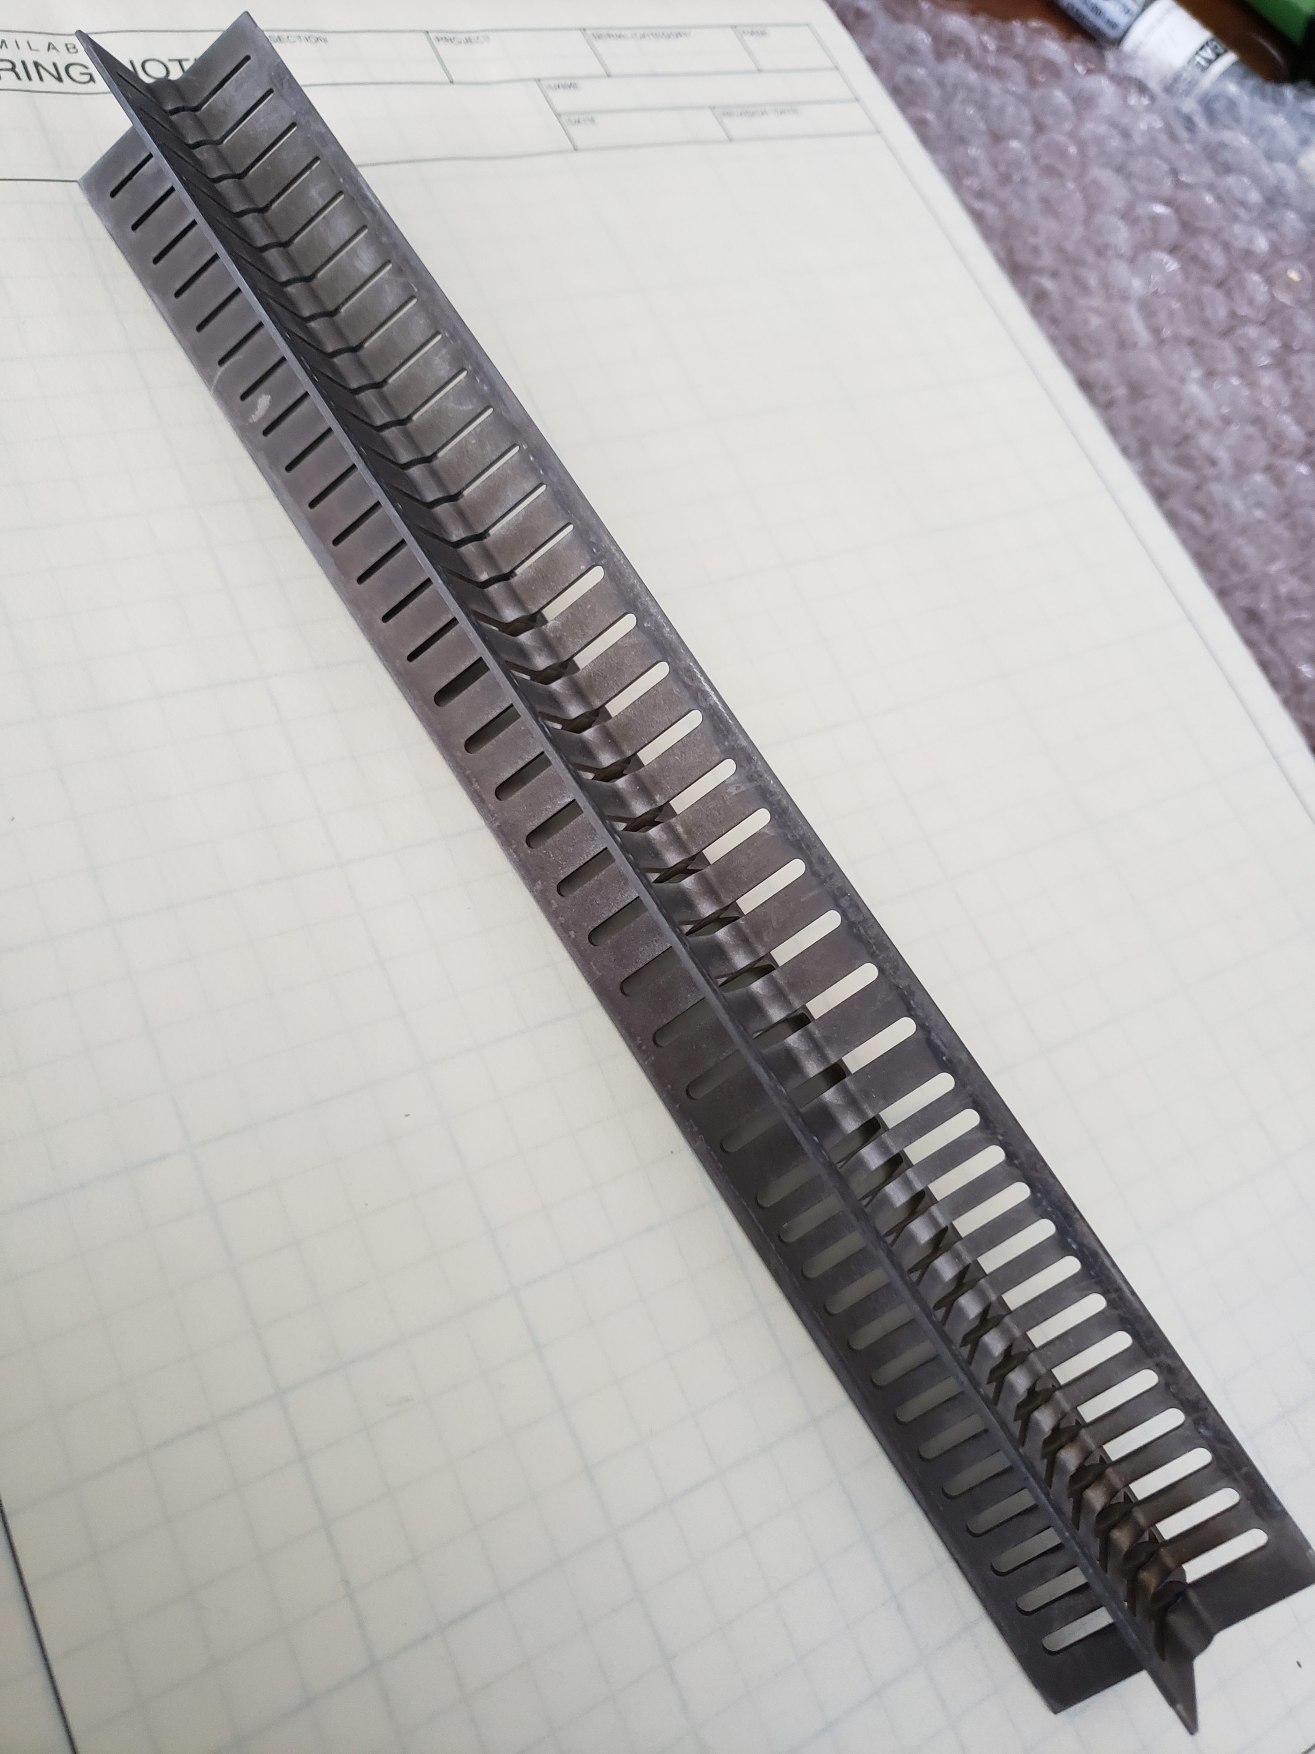
Un-mounted target images showing thin sections:
Spokes are 2 mm diameter
Fins are 1 mm thick
Core is 6.3 mm diameter
Tungsten loss due to Oxidation can severely affect target.

Slide 12
Testing Plan:
Expose to beam, Measure Target Temperature & Stress:
  Operate at a full, steady state temperature (min ~ 30 minutes)
  Compare measured temperature to FEA temperature predictions:
    Informs us on our emissivity validity
    Heats target from the inside out (puts extremities in tension)
      An oven test is the opposite
    Accounts for actual beam center spot variation.
  Measure stress in surfaces on target fin, spokes, ring, & core
    Compare measured stress to FEA Stress prediction
Rinse and repeat as necessary. (Take target thru multiple thermal cycles).

Slide 13
Testing Plan:
During beam tests
  Record vacuum levels in the target chamber
  Ideally measure residual gas composition
Post beam exposure, inspect for tungsten surfaces deterioration due to oxidation & examine for evidence of Creep distortion.
  Perform in a hot cell at C0
  Requires the development of tooling to expose target
  Mostly visual examination, with some measurements.
Extrapolate damage to target in Mu2e from test target data

Slide 14
Target Testing Challenges & Status:
Build a target to test: DONE
Build a bicycle ring to mount the target in: DONE
Find a place to test a target with a Mu2e like beam: AP0
Build a vacuum vessel to house the test target: In Progress
Find a AP0 module to support the test vessel: DONE
  Thank-you Jim Morgan and the AD / Muon Department folks!
Identify appropriate instrumentation to measure target temperature, stress: Not currently filled
  James Popp (CUNY, York College) providing some input
  FNAL / AD / TSD asked for help, help TBD
Post exposure examination plans not developed.
  Some preliminary discussion in FNAL / AD / TSD held.
  No Firm Plan(s) developed.

Slide 15
Team of Participants:
CUNY, York College:
  James Popp: Instrumentation
  Kevin Lynch: G4 beamline Modeling
Fermilab:
  Jerry Annala (Muon): Mgmt
  Peggy Crayton (MSD, Drafting): Vessel & Window drawings.
  Yun He (TSD): Mgmt
  Tom Kobilarcik (External Beams): Mgmt
  Alyssa Miller (External Beams): Minutes, coordination
  James Morgan (Muon): AP0 Expert & Beam Expert
  Dave Pushka (TSD): Design, vessel, windows, target
  Steve Werkema (Muon): Mu2e Project Mgmt

Slide 16
Potential Schedule:
May take several more months to procure vessel, perhaps complete Fall 2021
Several months to procure window. Fall 2021
Post 2021 shut down (assuming technician availability), mount vessel to module, add shielding.
Mount target and ring to vessel
Install instrumentation & instrumentation feed thru (s)
Install windows on vessel
Helium Leak check target and vessel assembly in AP0
Await for next g-2 hiatus for opportunity to put target module in AP0 target chase.

