Slide 1
PIP-II
E. Pozdeyev, PIP-II Project Scientist
Potential Fermilab Muon Campus & Storage Ring Experiments
26-May-2021

Slide 2
Outline
PIP-II design overview
PIP-II design status and major milestones
Performance in PIP-II era
Future upgrades
Summary

Slide 3
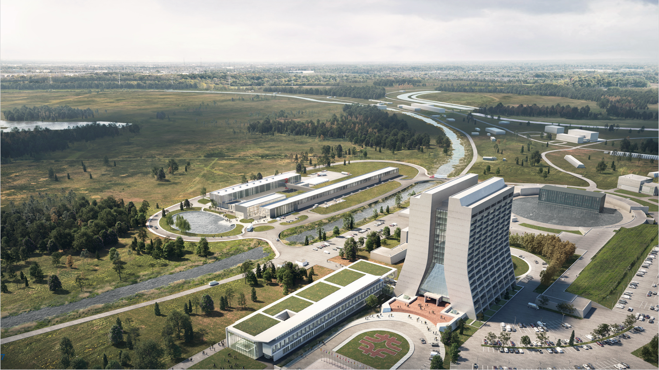
MI, RR
Booster
400 MeV Copper Linac

Slide 4






MI, RR
Transfer Line
PIP-II
Booster
800 MeV SRF Linac

Slide 5
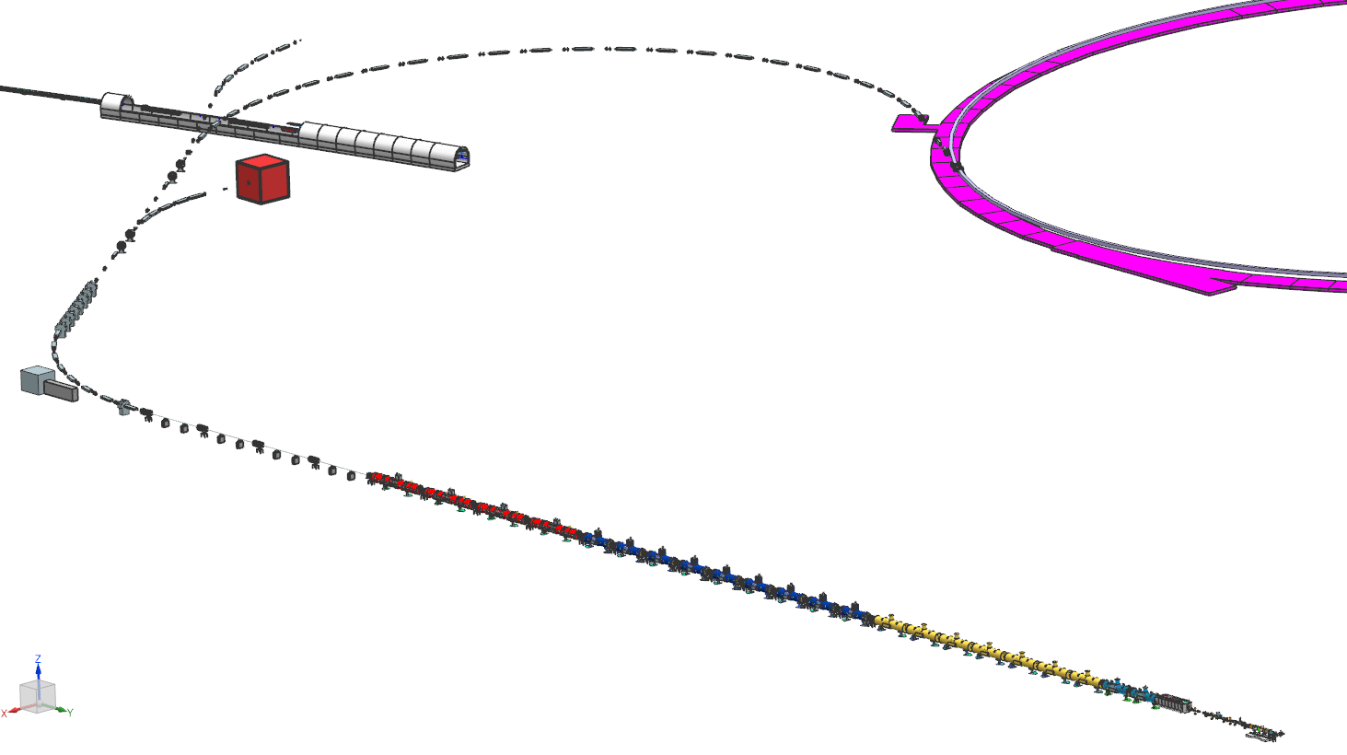

Project Scope
800 MeV H− CW-compatible linac
  CW warm Front End
  SRF section
    CW SRF (Cryomodules of 5 types)
    Cryoplant compatible with CW ops
  Space for two cryomodules (1 GeV) and a beam separator
Linac-to-Booster transfer line
  Beam line compatible with 1 GeV
  25 kW beam absorber
  Switching magnet to Absorber
  Space for switching magnet and beam line to Mu2e-II
Complex Accelerator Upgrades
Conventional Facilities
Space for Mu2e-II
Beam line
Beam Transfer Line
Main Ring
Tunnel
FNAL Booster
25 kW Dump
Space reserved for two CMs (1 GeV)
and beam separator
Dump
800 MeV SRF Linac
5 types of SRF cryomodules
CW RF Operations
Front End
H- Ion
Source (x2)

Slide 6
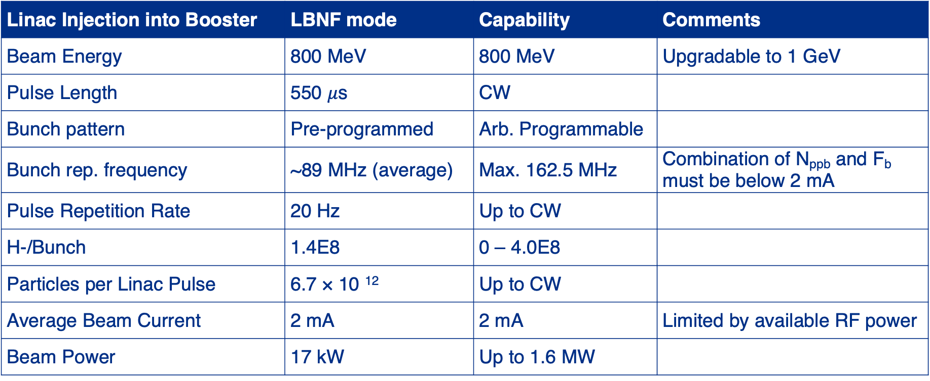
PIP-II Linac Performance
Linac Injection into Booster | LBNF mode | Capability | Comments
Beam Energy | 800 MeV | 800 MeV | Upgradable to 1 GeV
Pulse Length | 550 $μ$s | CW
Bunch pattern | Pre-programmed | Arb. Programmable
Bunch rep. frequency | ~89 MHz (average) | Max. 162.5 MHz | Combination of N_{ppb} and F_{b} must be below 2 mA
Pulse Repetition Rate | 20 Hz | Up to CW
H-/Bunch | 1.4E8 | 0 – 4.0E8
Particles per Linac Pulse | 6.7 × 10 ¹² | Up to CW
Average Beam Current | 2 mA | 2 mA | Limited by available RF power
Beam Power | 17 kW | Up to 1.6 MW

Slide 7
PIP-II Linac Performance
Linac Injection into Booster | LBNF mode | Capability | Comments
Beam Energy | 800 MeV | 800 MeV | Upgradable to 1 GeV
Pulse Length | 550 $μ$s | CW
Bunch pattern | Pre-programmed | Arb. Programmable
Bunch rep. frequency | ~89 MHz (average) | Max. 162.5 MHz | Combination of N_{ppb} and F_{b} must be below 2 mA
Pulse Repetition Rate | 20 Hz | Up to CW
H-/Bunch | 1.4E8 | 0 – 4.0E8
Particles per Linac Pulse | 6.7 × 10 ¹² | Up to CW
Average Beam Current | 2 mA | 2 mA | Limited by available RF power
Beam Power | 17 kW | Up to 1.6 MW
1.1% of the total intensity
98% available to other users

Slide 8
PIP-II Major Milestones
Mar 2018
Approve Alternative
Selection (CD-1)
Dec 2020
Approve Scope, Cost,
Schedule (CD-2)
Oct 2026
Shutdown Complex
Operations For
Booster Connection
2018
2019
2020
2021
2022
2023
2024
2025
2026
2027
2028
Feb 2021
Approve Long-Lead
Procurements (CD-3a)
Sep 2024
Linac Tunnel
Occupancy
Jan 2027
SRF Linac
Comm. Begins
Jul 2020
Cryoplant Bldg.
Construction
Approved
Dec 2028
Project Completion
Start of Operations
(Early CD-4)
Mar 2022
Approve Technical
Construction (CD-3)
Mar 2019
Linac Complex
Ground-Breaking

Slide 9
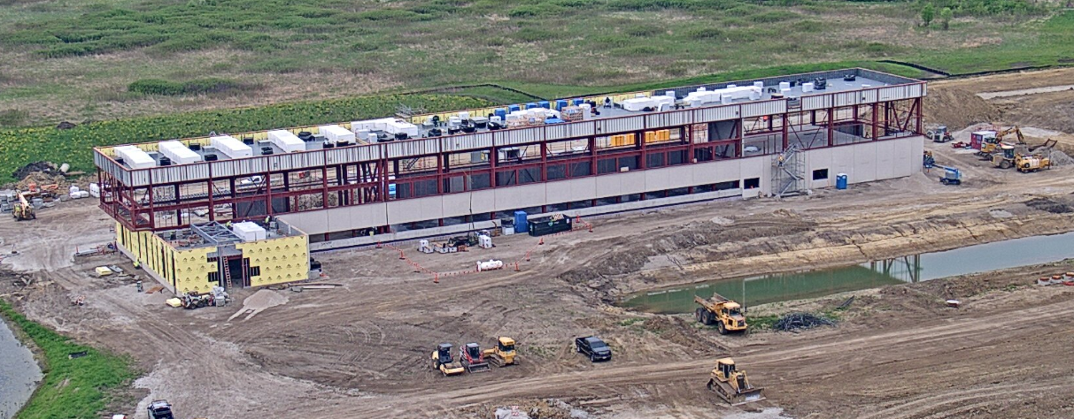
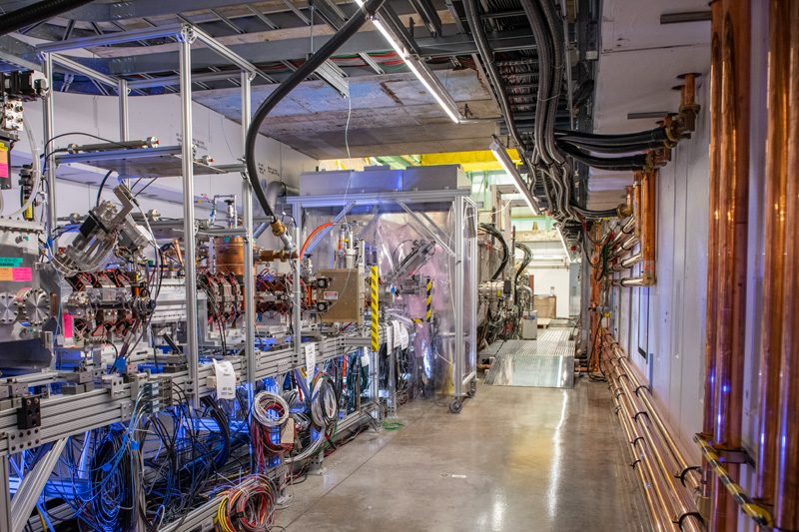
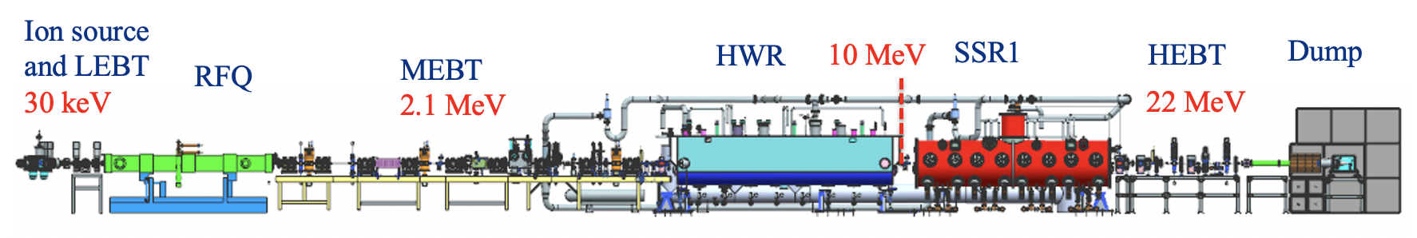

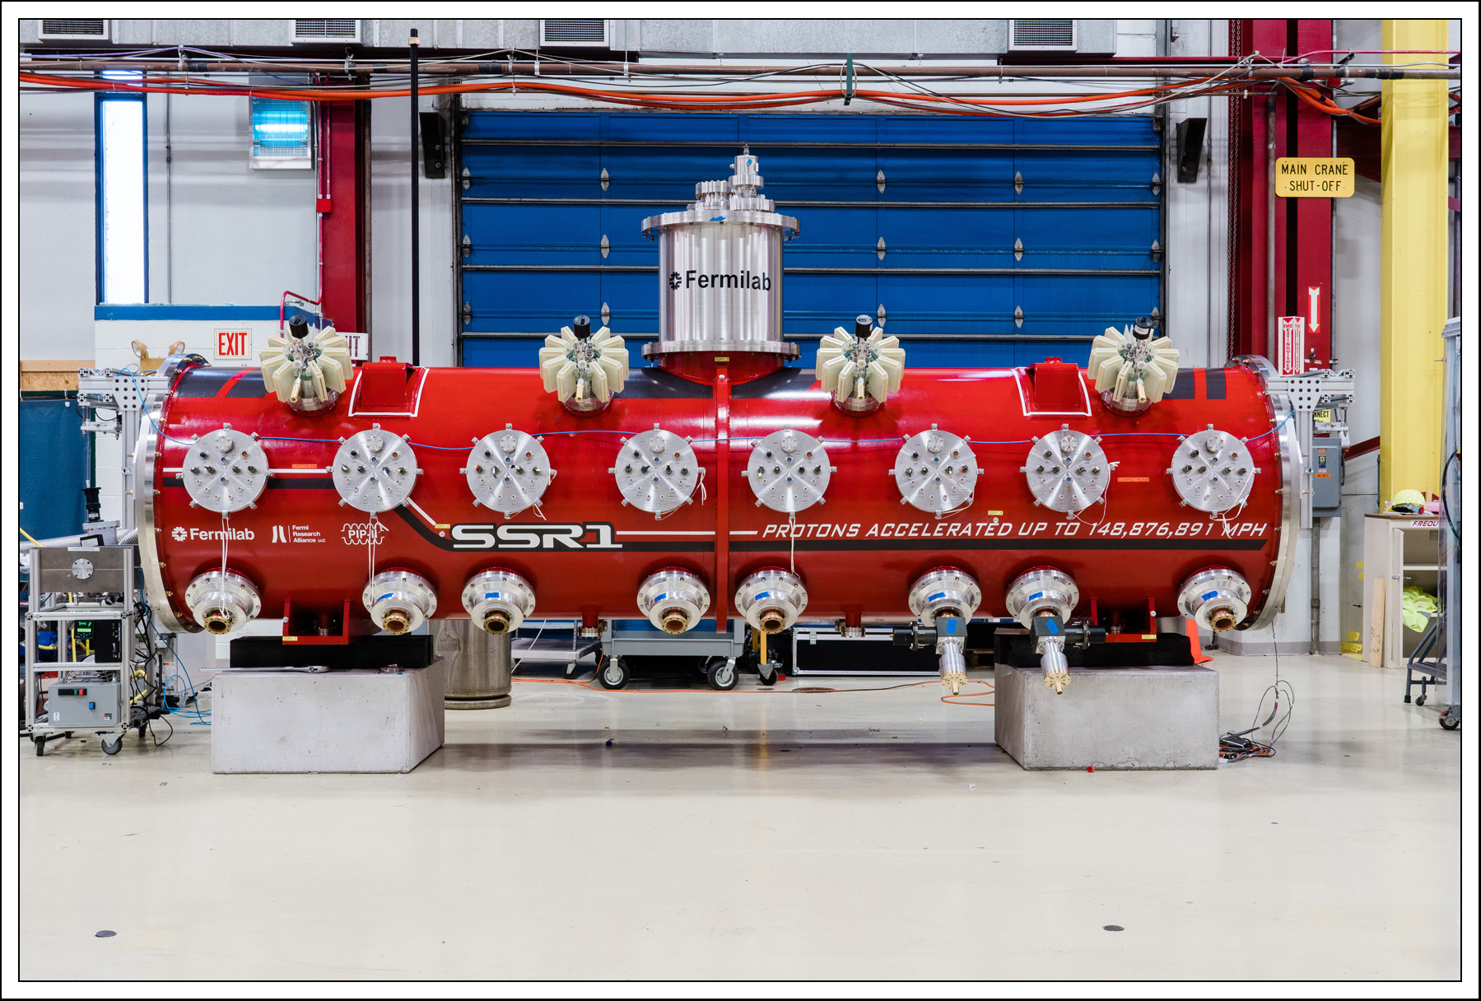
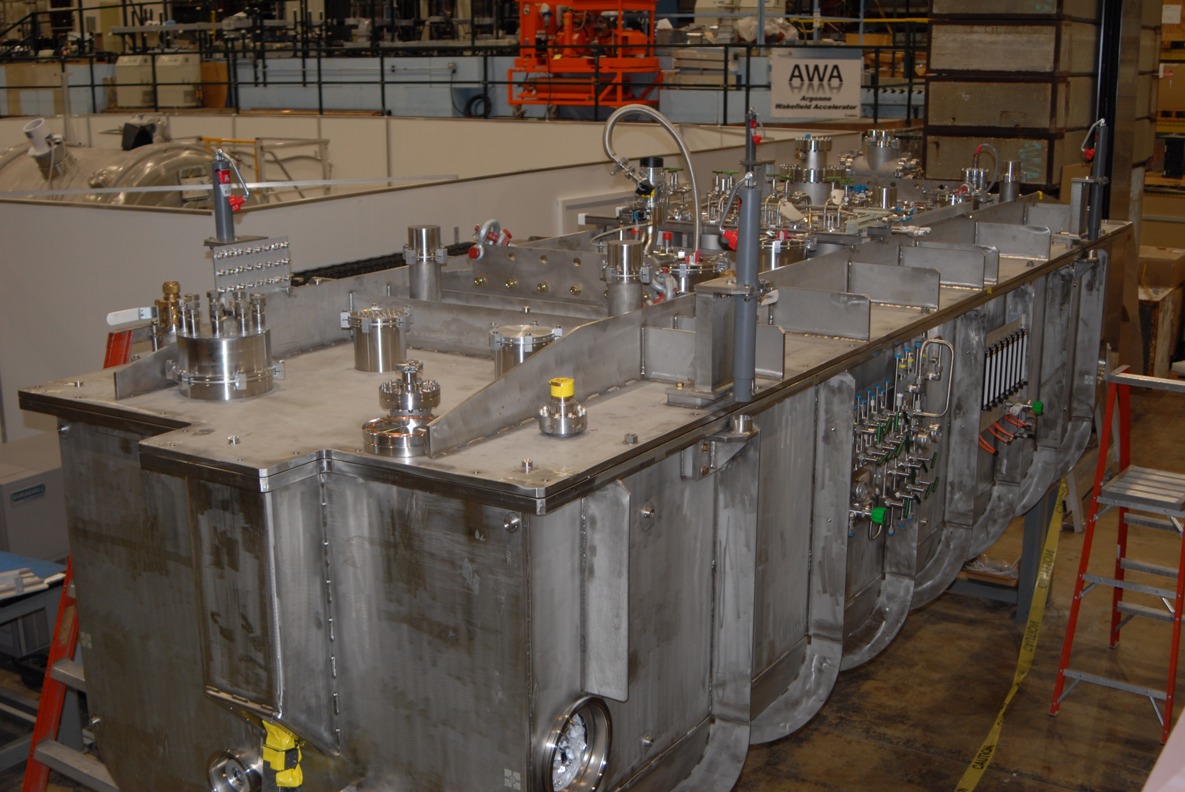
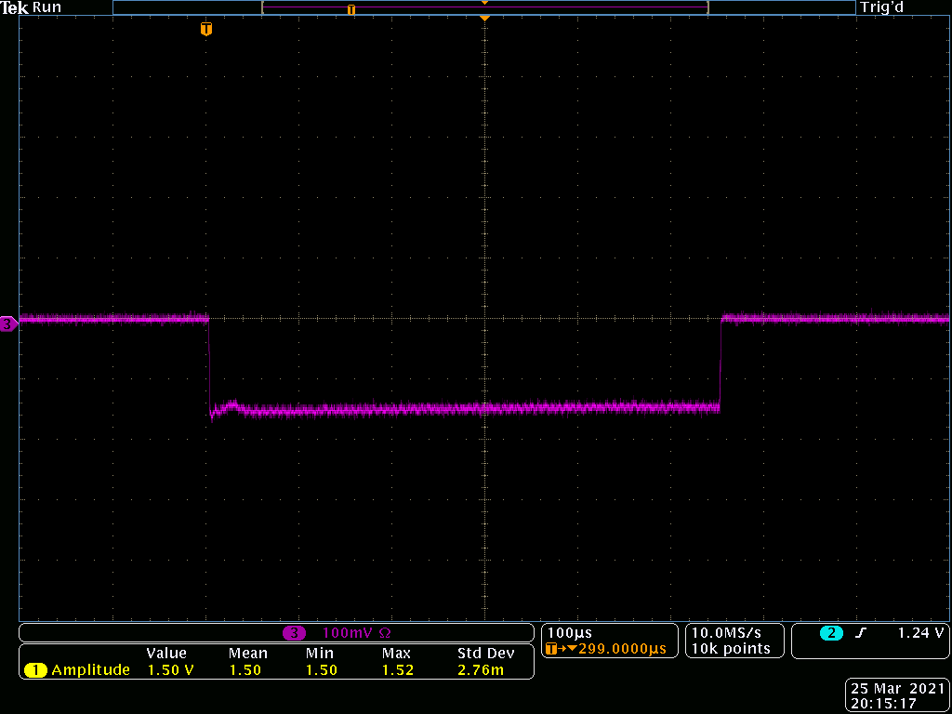
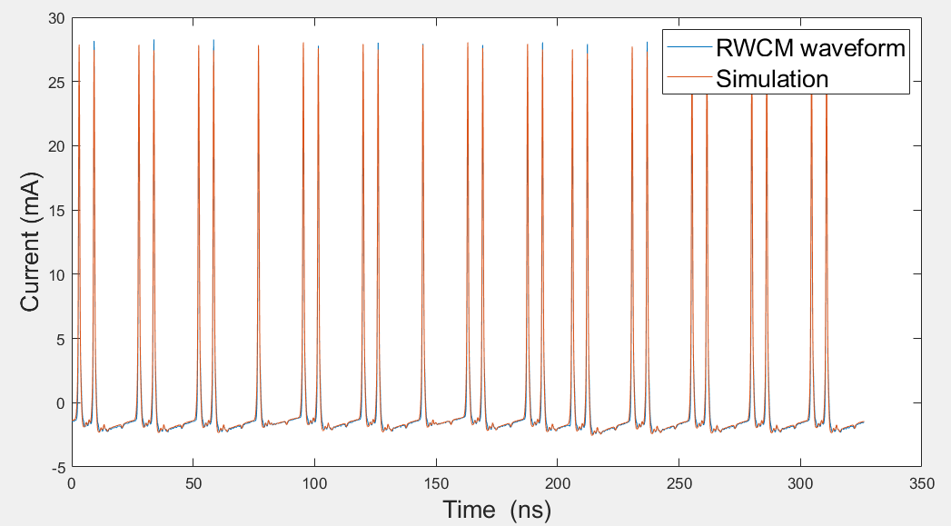
Project Major Activities
PIP2IT was successfully commissioned
LBNF Booster Beam demonstrated
(16 MeV, 2 mA, 550 us, 20 Hz, chopped)
PIP-II Cryoplant Building Construction site
HWR Cryomodule
SSR1 Prototype Cryomodule

Slide 10
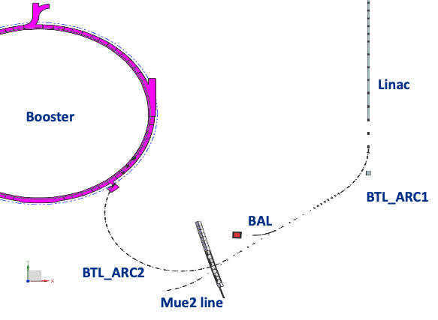
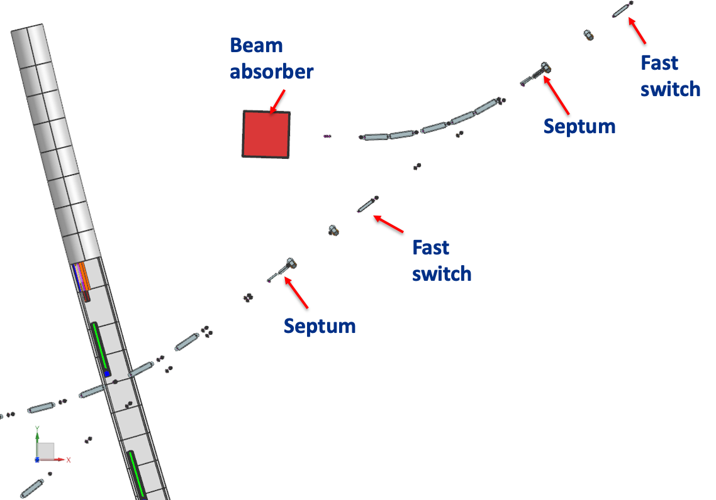
Mu2e-II Beam Line Included in CF Design, Space Reserved
Present design separates BAL and Mu2e-II lines
Booster
Mu2e-II

Slide 11
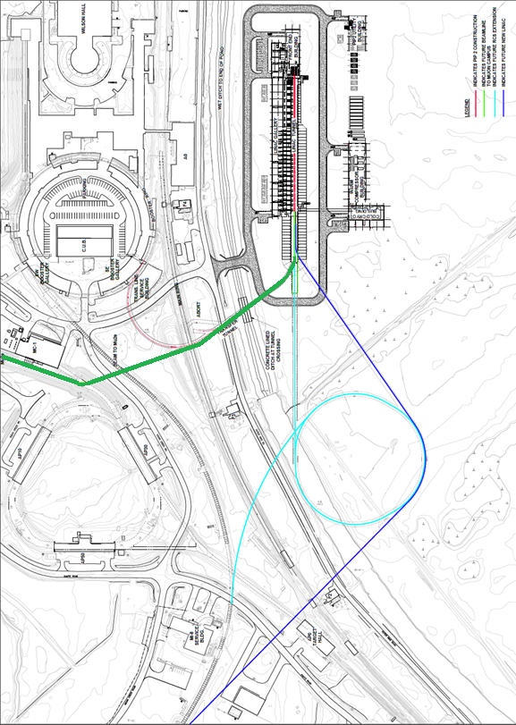
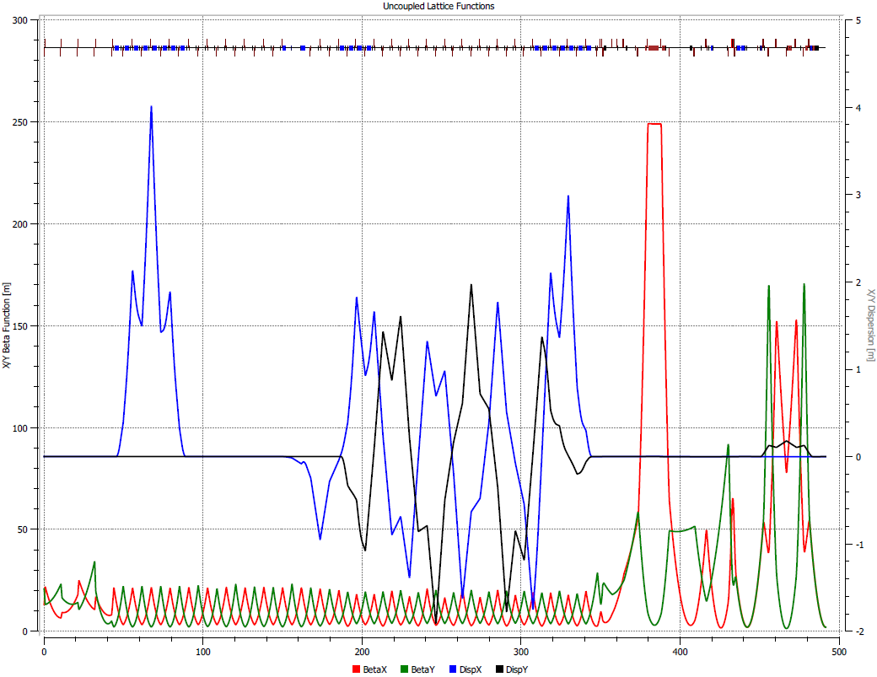
Mu2e-II Beam Line
Conceptual design studies were performed
  Design of beam line has been developed
  Small changes of BTL needs to be included in the design
PIP-II Project does not include Mu2e-II beam line, the switching magnet, SRF separator. Additional effort will be required to develop those
Optics functions of Mu2e-II beam line A. Vivoli, M. Xiao

Slide 12
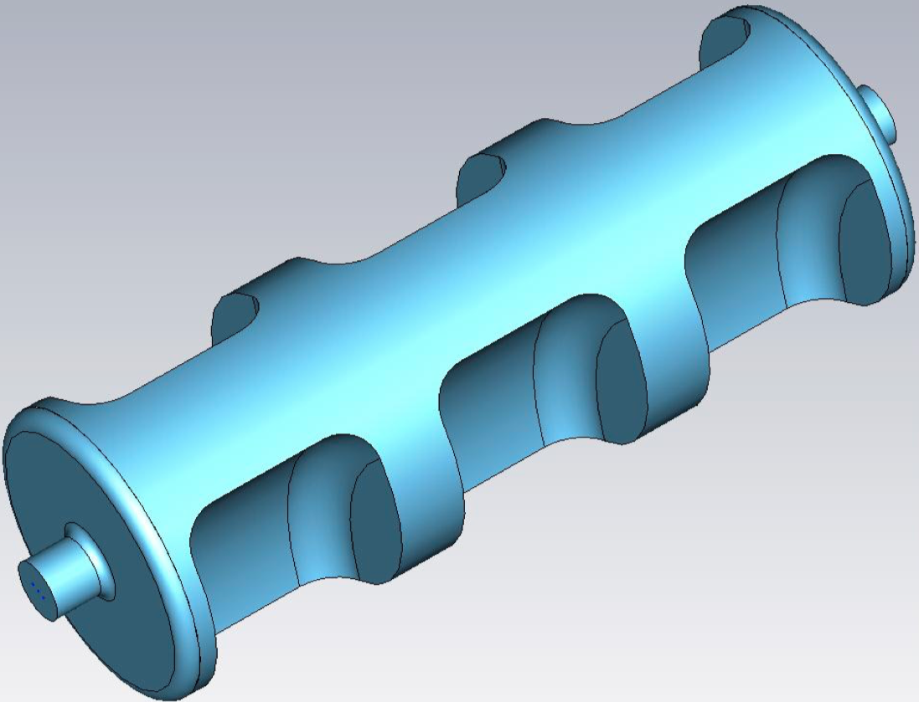
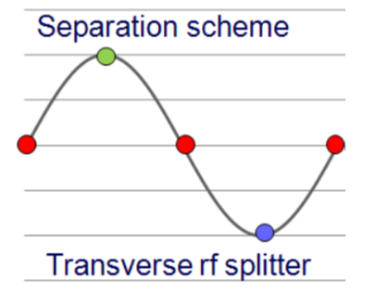
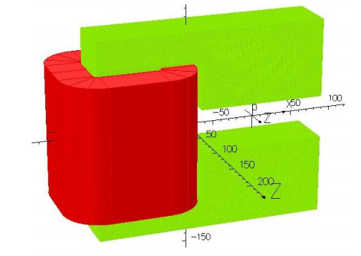
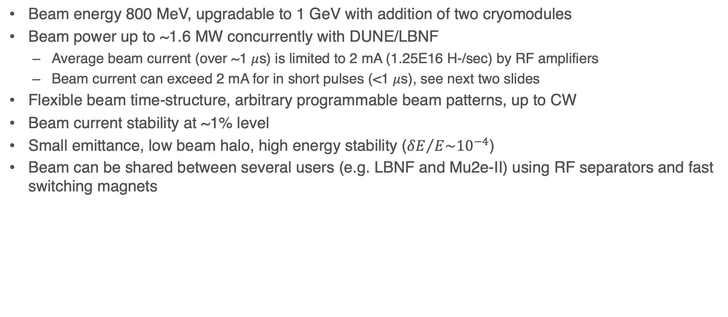

Enhanced Capabilities at 800 MeV
Beam energy 800 MeV, upgradable to 1 GeV with addition of two cryomodules
Beam power up to ~1.6 MW concurrently with DUNE/LBNF
  Average beam current (over ~1 $μ$s) is limited to 2 mA (1.25E16 H-/sec) by RF amplifiers
  Beam current can exceed 2 mA for in short pulses (<1 $μ$s), see next two slides
Flexible beam time-structure, arbitrary programmable beam patterns, up to CW
Beam current stability at ~1% level
Small emittance, low beam halo, high energy stability (${δE}/{E\sim {10}^{−4}}$)
Beam can be shared between several users (e.g. LBNF and Mu2e-II) using RF separators and fast switching magnets
RF Separator Concept
Fast Switching Magnet
Switching time ~10-20 $μs$

Slide 13
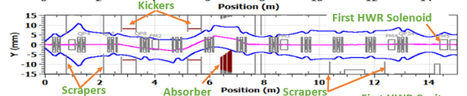
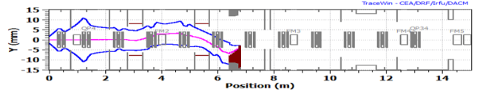
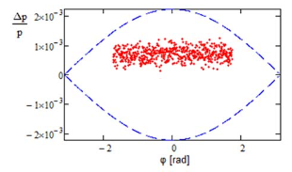
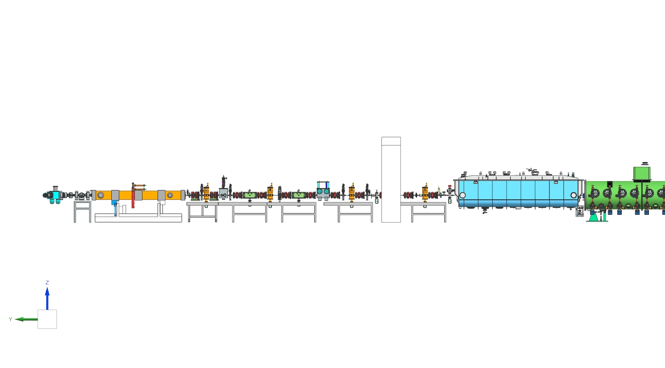
Beam Chopping Is Critical for PIP-II/LBNF Operations
MEBT chopper can remove any bunch at 162.5 MHz
Remove bunches that do not fit Booster RF buckets
  Phase window 55% of Booster separatrix, 45% removed
  Extinction rate ~1E-3
Optics and bunch charge cannot be adjusted quickly. It takes hours to retune optics
Bunch pattern can be adjusted instantaneously
After RFQ and
Collimation
I=3.7 mA,
CW 162.5 MHz
Beam chopped
down to 2 mA
(45% of bunches
removed)
<F>~89 MHz
LEBT
I=4-5 mA
DC
55%
Chopper
Kickers
Absorber
HWR
Ion source
CW RFQ
SSR1

Slide 14
Mu2e-II Operations Concurrent With LBNF
Mu2e-II Pulse Current 3.7 mA @162.5 MHz
45% of PIP-II RFQ beam will be discarded to control Booster injection losses
Average beam current in Booster pulse is 2 mA
Chopping can be turned off during Mu2e-II pulse
  Bunch rep. rate 162.5 MHz.
  Beam current 3.7 mA (> 2mA!)
Cavity voltage and stored energy will decrease because RF amplifiers cannot supply required amount of RF power
Because Mu2e-II pulses are short, the voltage droop caused by depletion of stored energy is small ~1e-5. This should work because the average current is less than 2 mA
Pulse length = 107 ns
18 bunches @162.5 MHz
Pulse Beam Current = 3.7 mA (2.3E16 p/s)
Average beam power = 190 kW

Slide 15
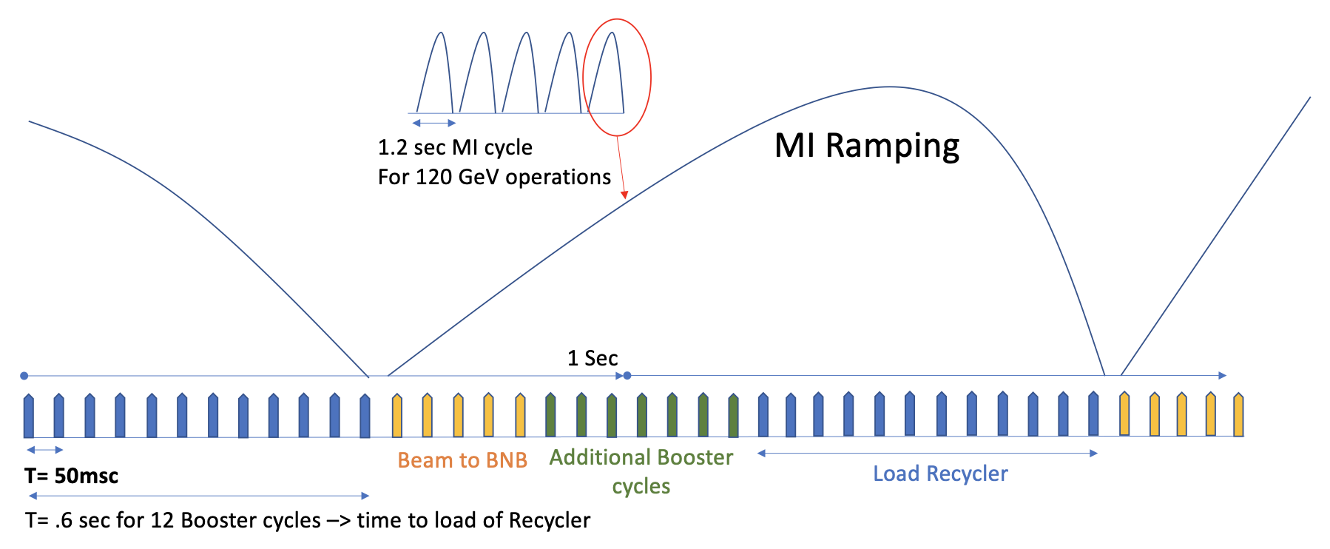
Booster Performance in PIP-II Era
Booster | Current Performance | PIP-II Era
Beam Energy | 8 GeV | 8 GeV
Particles per Pulse | 4.5 x 10¹² | 6.3 × 10¹²
Repetition Rate | 15 Hz | 20 Hz
Otherwise, Booster beam parameters will be similar
The number of available Booster transfers/fills available to other users might depend on the beam energy on the LBNF Target
For 60 GeV DUNE/LBNF Operations,
the MI cycle will roughly half long, ~0.6s.
Twice as much current is required to
maintain same beam power on the LBNF
target.
Courtesy
W. Pellico

Slide 16
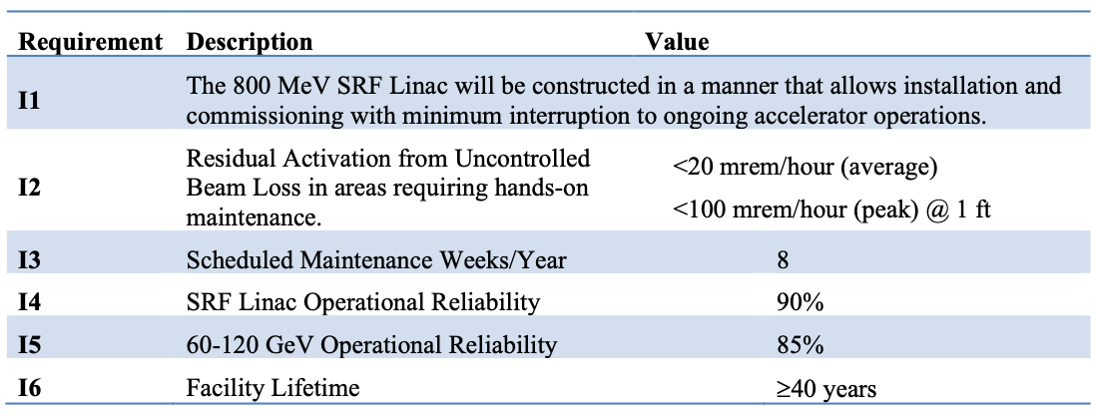
PIP-II Availability
PIP-II Global Requirements Document

Slide 17
Accelerator Systems Requiring Attention to Ensure Compatibility
Fast MEBT chopper
  200 Ohm kickers (present design) are not compatible with a high-switching rate and CW operations
  Alternative CW-compatible options are possible
    50 Ohm kicker with commercial amplifiers. Cost ~$1M-$2M.
MPS, LLRF, Instrumentation
  Data collection and processing and calibration need to be re-evaluated
Timing and synchronization
  Timing and synchronization is more complicated than for LBNF operations and need to be thought through

Slide 18
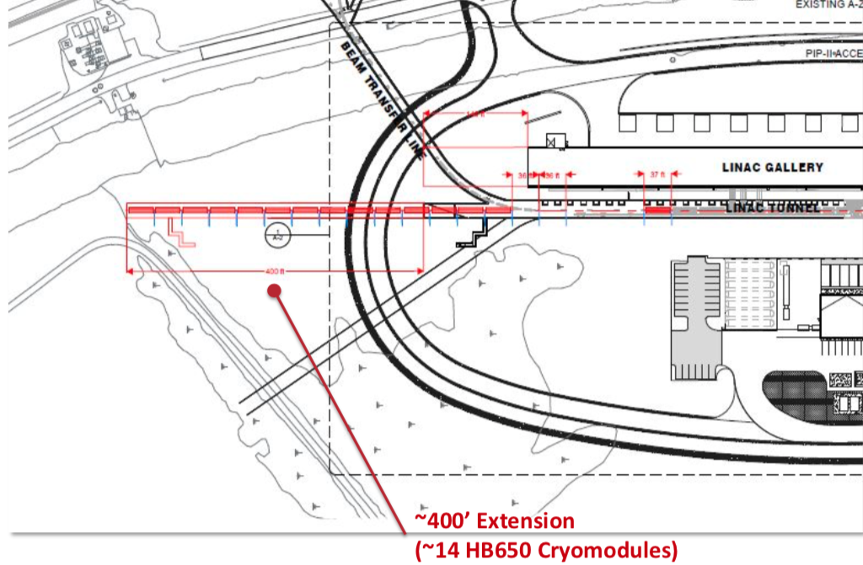
Upgrade to 2GeV, Multi-User Operations
PIP-II linac extension to 2 GeV (CW or Pulsed)
Accumulator ring to provide high-power short pulses
RCS or 8 GeV linac as power upgrade
800 MeV – 1 GeV Beam
2 – 2.5 GeV Beam to Users
2 GeV Beam to RCS
Future Upgrades
RCS
  LBNF Upgrade to 2.4 MW
2 GeV storage ring
  High power, low duty factor

Slide 19
Summary
PIP-II Linac can deliver high power (1.6 MW), high quality, high stability beam
PIP-II linac can provide high-duty factor, flexible beam patters to multiple users concurrently
PIP-II Will increase beam power delivered by the Fermilab Booster
Design of several PIP-II systems must be revised to ensure compatibility with high duty factor beam operations

Slide 20
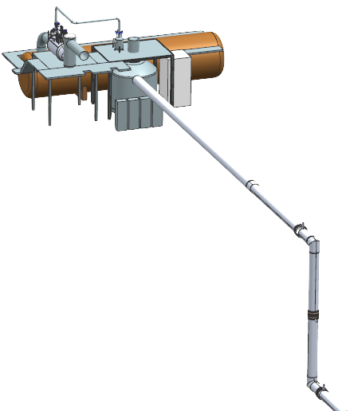
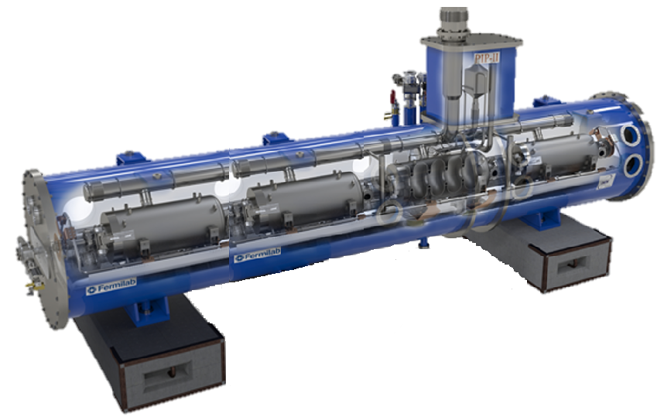
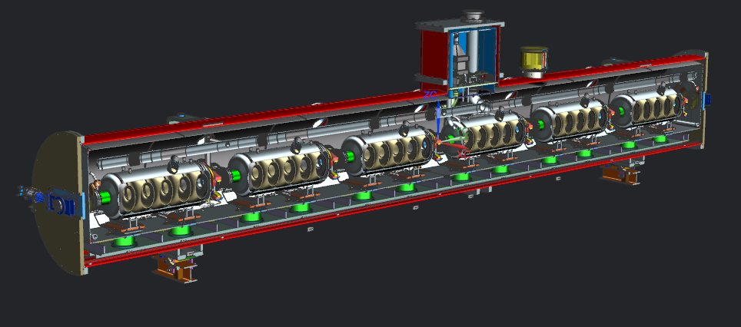
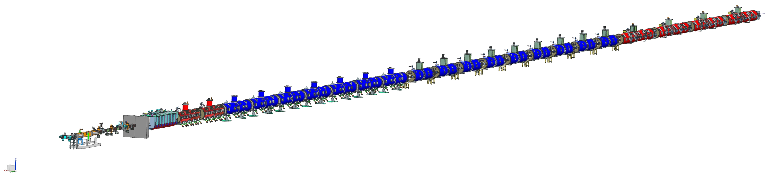
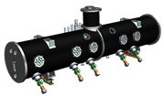
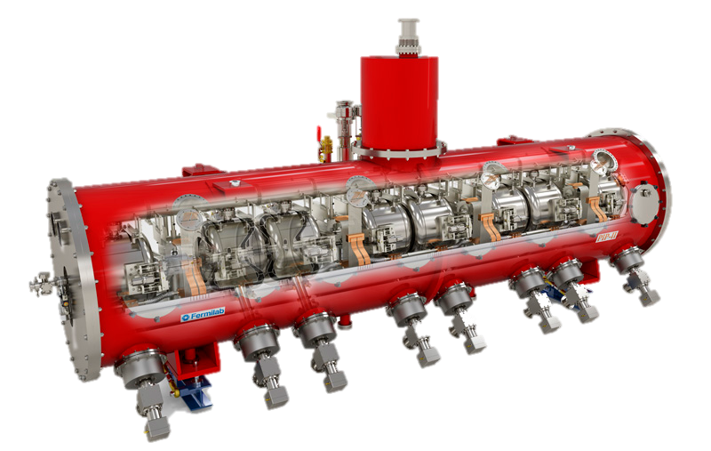
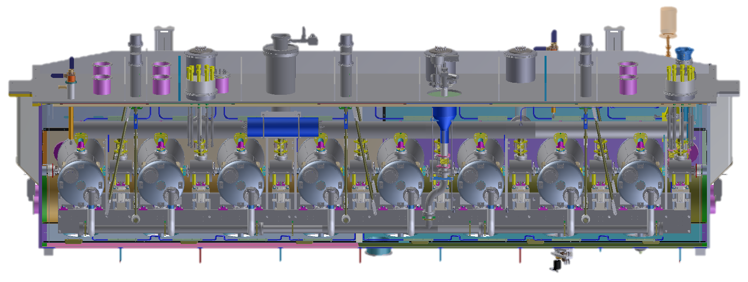
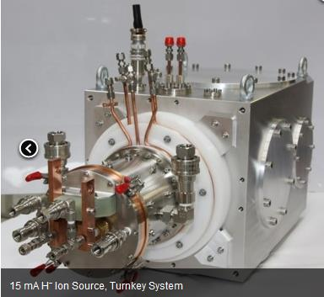
PIP-II Superconducting RF CW Linac
800 MeV H- CW RF Linac
Space reserved for 1 GeV Upgrade
Elliptical
HB650 X 4
24 Cavities
650 MHz
Single Spoke
SSR2 X 7
35 Cavities
325 MHz
Elliptical
LB650 X 9
36 Cavities
650 MHz
Single Spoke
SSR1 X 2
16 Cavities
325 MHz
CDS
HWR
8 Cavities
162.5 MHz
833 MeV
H- Ion source
516 MeV
177 MeV
Superconducting
RFQ
32 MeV
10 MeV
PIP-II linac is technically complex, state of the art superconducting RF accelerator
2.1 MeV
Room Temperature

Slide 21
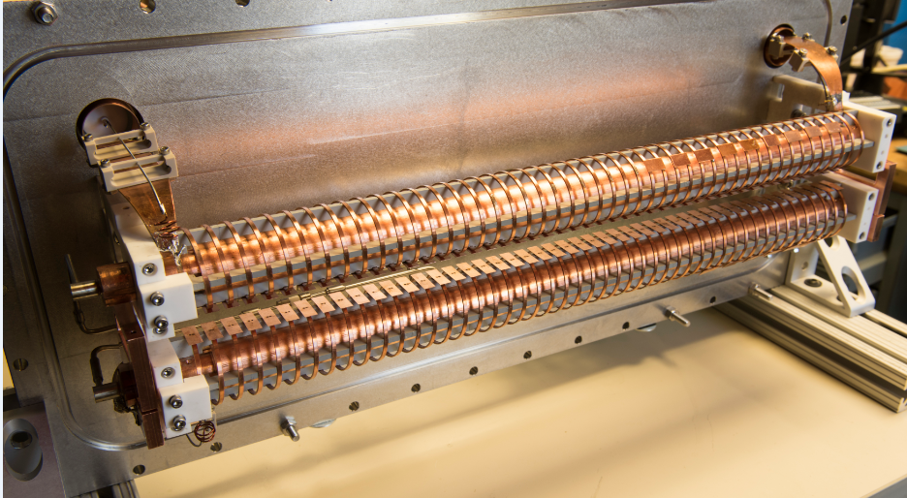
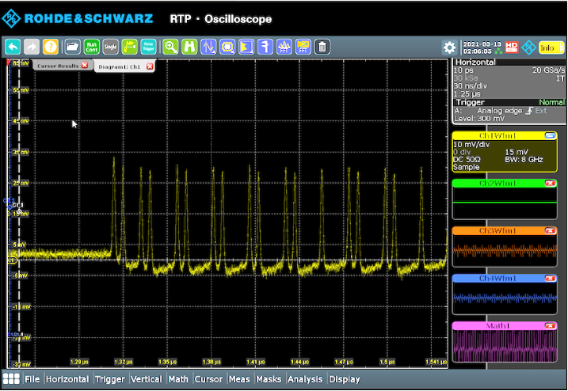
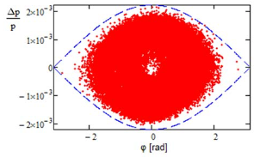
How MEBT Beam Chopper Works
Beam is deflected by two fast, traveling wave kickers to an absorber
MEBT chopper can remove any bunch at 162.5 MHz without impact on other bunches
Main goal is to remove bunches that do not fit Booster separatrix
  Phase window 55% of Booster separatrix. Bunches that do not fit the window are chopped
Bunch passes through
55%
Bunch chopped

Slide 22
Beam Current Evolution in MEBT in LBNF mode
Once FE is setup, optics and bunch charge cannot be adjusted quickly
It takes hours to retune optics
Bunch pattern can be adjusted instantaneously
After collimation
I=3.7 mA,
CW 162.5MHz
N_{ppb}=1.4E8
Beam chopped
down to 2 mA
(45% of bunches
removed)
<F>~89 MHz
SC Linac
I=2mA, limited by RF amplifiers
Chopped to <F>~89 MHz
N_{ppb}=1.4E8
LEBT
I=4-5 mA
DC
RFQ Exit
I=4-5 mA,
CW 162.5 MHz
Ion source
RFQ
Chopper
Kickers
HWR
SSR1
Absorber

Slide 23
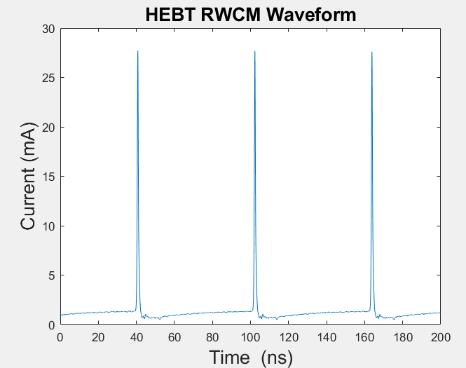
Extinction Rate
Measured bunch pattern at PIP2IT
Pattern: 1 through, 9 out
MEBT chopper design extinction rate is 1E-3
  Determined by longitudinal and transverse beam halo in MEBT
Recent PIP2IT data is being processed (see the Figure)
Early indication is extinction rate is ~1E-3
  Difficult to measure better than 1E-3
The extinction rate can be enhanced with LEBT (slow) chopper
  Switching time ~100 ns
  Need to ensure it can work with 600 kHz in CW regime

Slide 24
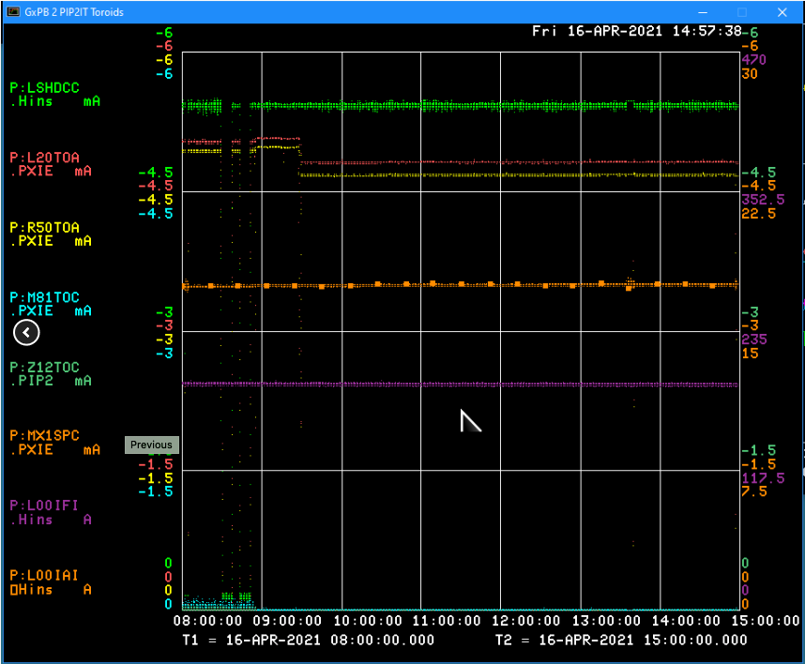
Excellent Current Stability Demonstrated at PIP2IT
Ion source current
RFQ entrance
RFQ exit

Slide 25

Options for Sharing Beam Between Multiple Users
Fast Switching
Magnet with
Several Beam Lines
400 kW
SRF Linac
RF Separator
800 kW
More users
can be added
400 kW
RF Separator Concept
Fast Switching Magnet
Switching time ~10-20 $μs$

