Slide 1
800 MeV Resonant Extraction from the Delivery Ring
John A Johnstone
Potential Muon Campus & Storage Ring Experiments
May 26th, 2021

Slide 2
Transitionless Deceleration in the Delivery Ring
Large beam losses will occur if beam is decelerated from injection @ 8 GeV (γ = 9.53) to 2 GeV (γ = 3.13) through the DR natural transition energy γ_{t} = 7.64.
Transition is avoided by using select quad triplets to boost γ_{t} above beam γ by 0.5 units throughout deceleration until γ_{t} = 7.64 and beam γ = 7.14 (5.76 GeV kinetic).
Below 5.76 GeV the DR lattice reverts to the nominal design configuration
Optical perturbations are localized within each triplet
Straight sections are unaffected thereby keeping the nominal M3 injection beamline tune valid.

Slide 3
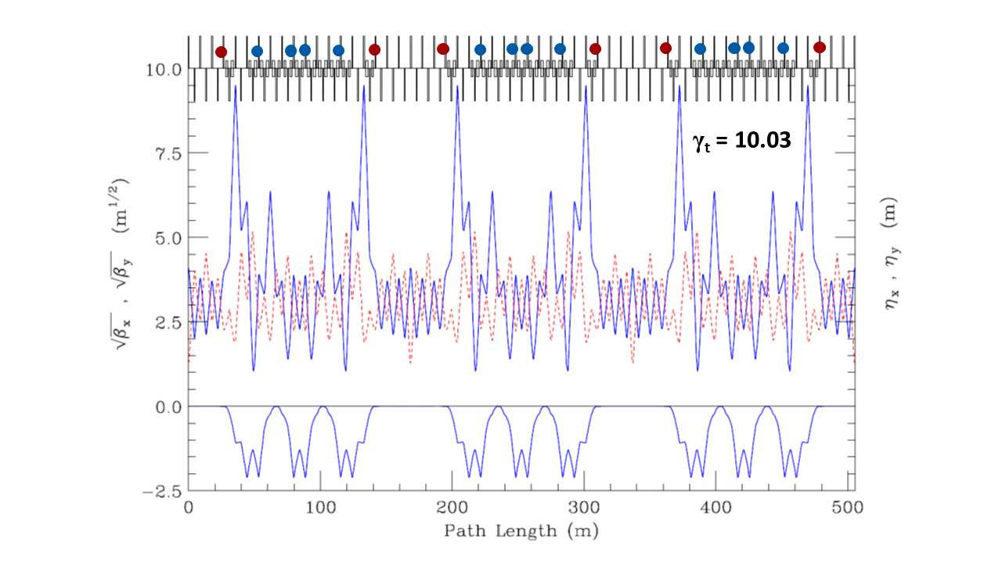
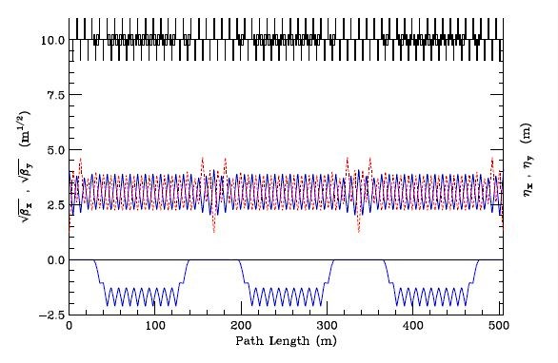
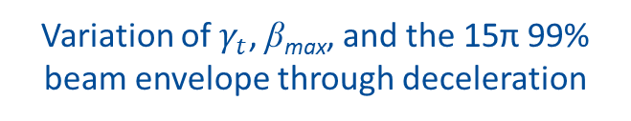
Ring Optics through Deceleration
8 GeV injection energy (top) and <5.8 GeV (bottom)
Blue & red circles indicate sites of the γ_{t} quad triplets.
γ_{t} = 7.43
Variation of $γ_{t}$, β_{max}, and the 15π 99% beam envelope through deceleration

Slide 4
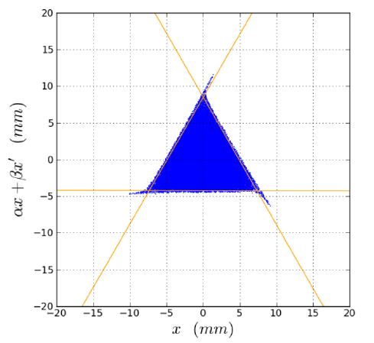

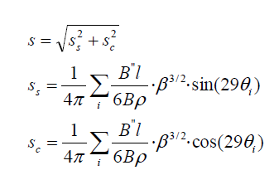


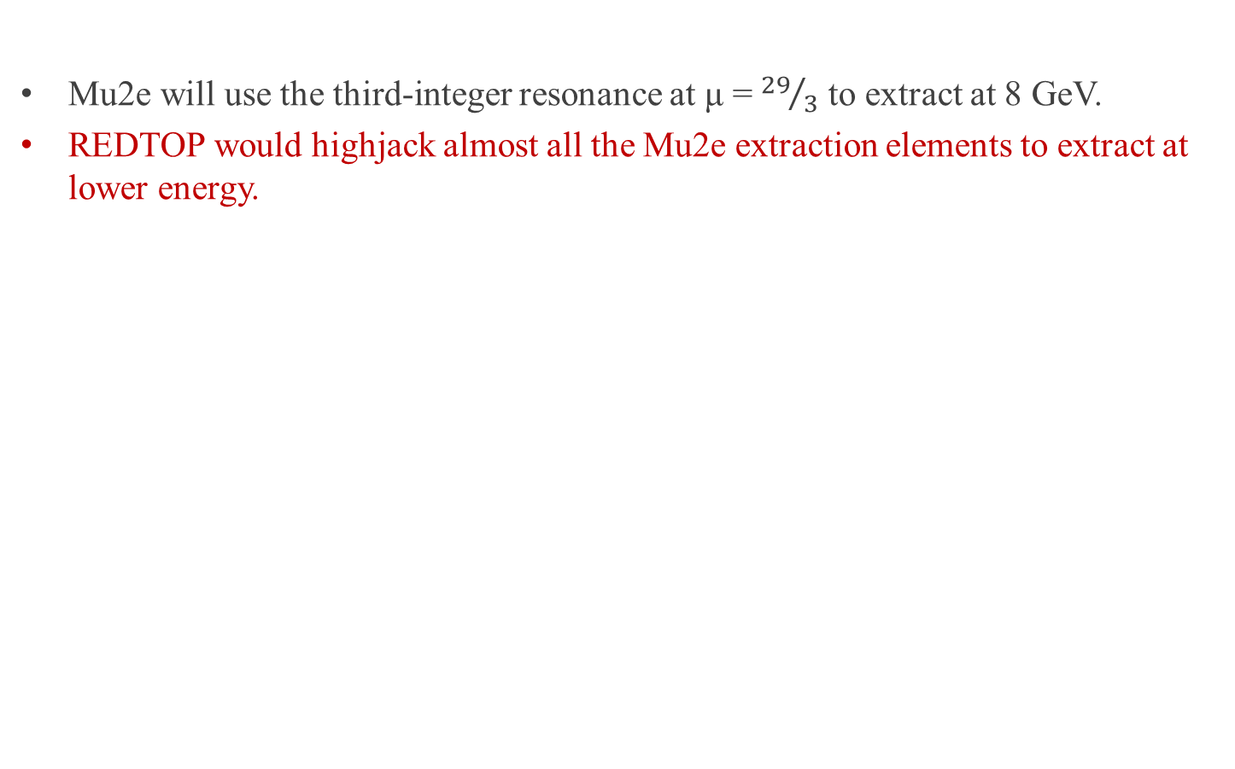

REDTOP Extraction from the DR
Mu2e will use the third-integer resonance at μ = ${29}/3$ to extract at 8 GeV.
REDTOP would highjack almost all the Mu2e extraction elements to extract at lower energy.
Sextupoles driving the resonance split the phase space into stable & unstable regions.
Match of triangle area to beam emittance gives strength:
Ramping a zeroth-harmonic quad circuit shrinks the stable are to zero.
Results given here are for an 800 MeV beam & $ε_{95}$=16π
but can be scaled to any other values

Slide 5
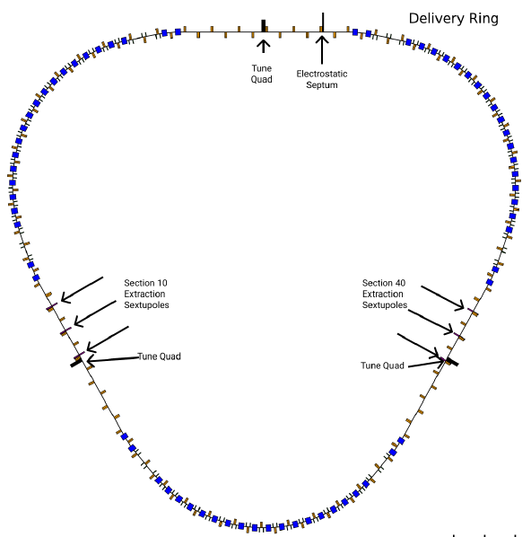
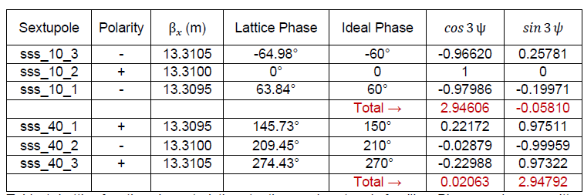
Third-Integer Extraction Circuits

Slide 6
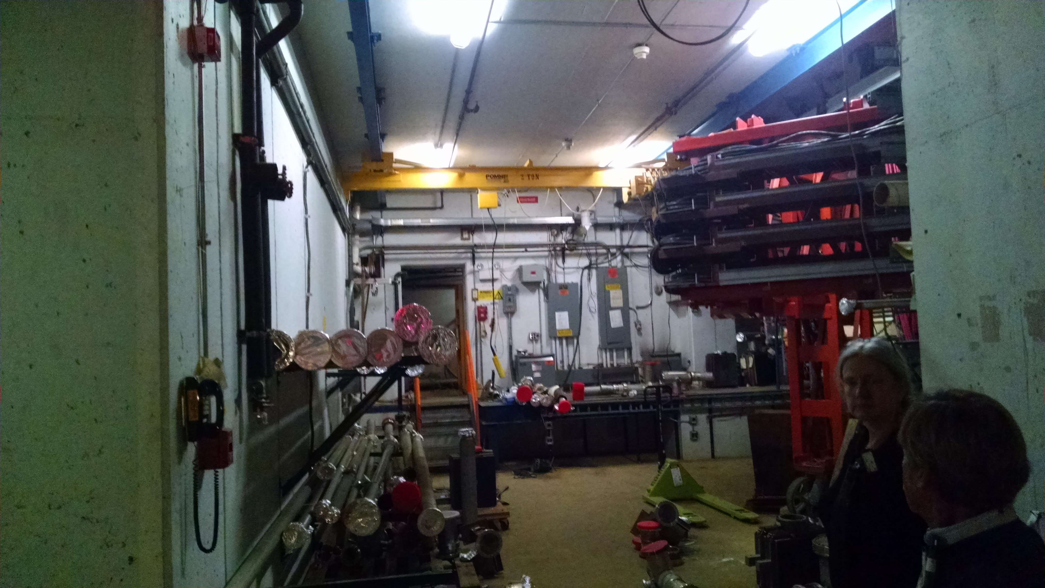
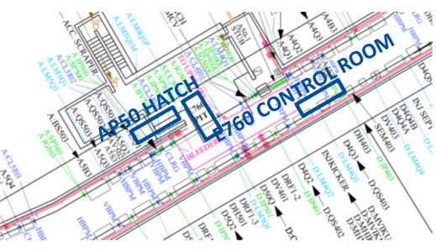
REDTOP Extraction
REDTOP space exists at AP50 E760 Pit
The 270º of betatron phase advance between the Mu2e Electrostatic Septum and REDTOP Lambertson is ideal for AP50 extraction to the inside of the ring.
An additional REDTOP ES is not needed

Slide 7
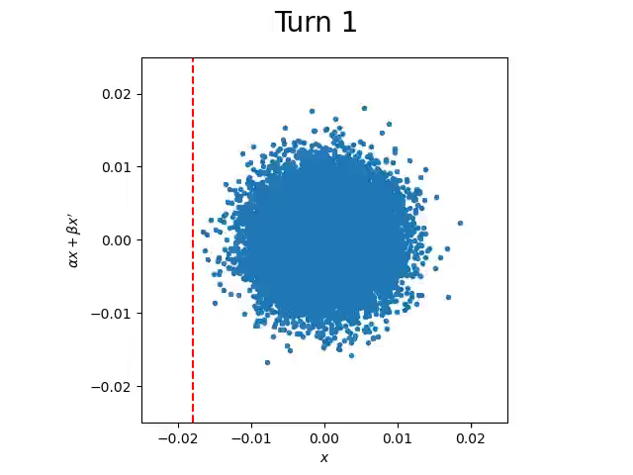
Tracking Simulation (Axel Moreen – SULI Intern 2020)
Turn 1-200: Sextupole Ramp
Turn 1000-5000: Quadrupole (Tune) Ramp
7
Axel Moreen | Simulation of Third-Integer Resonant Extraction of 800 MeV Protons in the DR
Notes:
7
7
7
7

Slide 8

Back Off Slides

